Slide 1
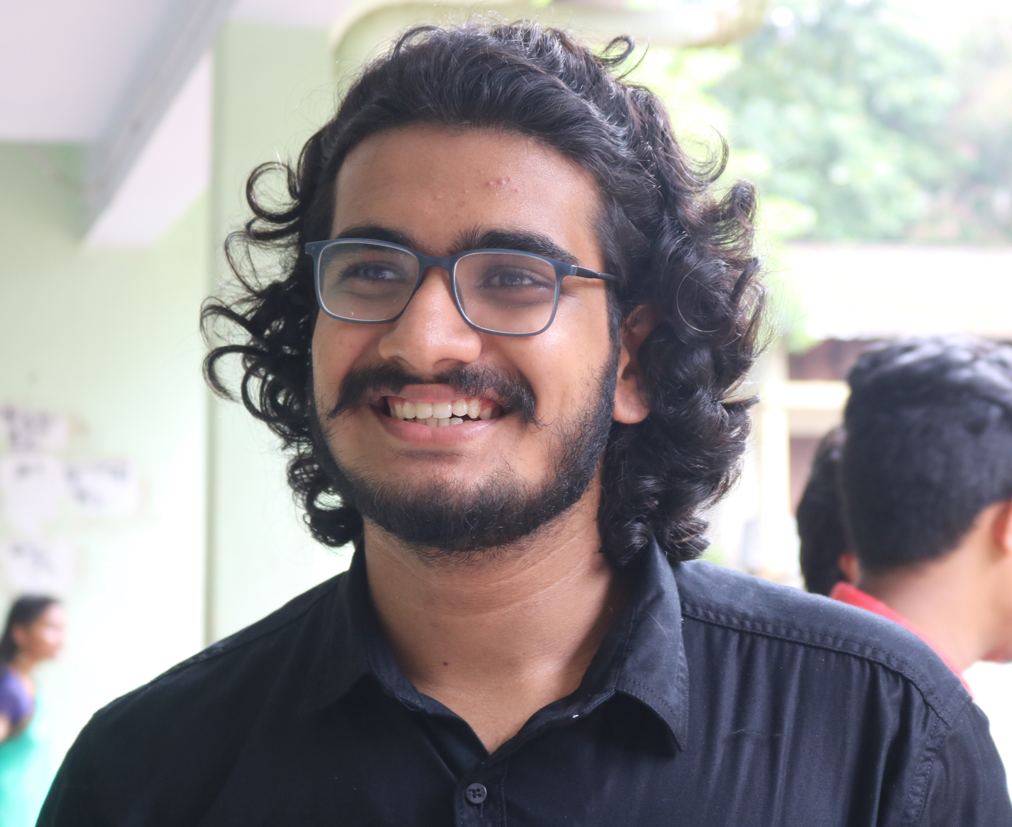
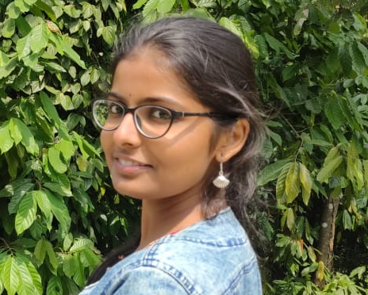
ADA LOVELACE DAY HACKATHON Sonnet Generation
JOHN P VELLANIKARAN
GAYATHRI ARVIND
TOTAL NUMBER OF TEAM MEMBERS (2)

Slide 2
CONTENTS
Introduction
Technical Preliminaries
Role Of Each Member
Solution Architecture

Slide 3
INTRODUCTION
Deep Learning is a fast upcoming field and a subset of Machine Learning.
It mimics the human learning principle – “Learn by Example”.
The massive surge in available data in the last decade along with extensive development in the platforms ands environments that allow for the use of brain-like computing systems called neural networks which can detect patterns in data similar to neural connections in our brains has made it possible to realize a wide range of applications like Self driving cars, Natural Language Processing, Visual Recognition and countless more.
Recurrent Neural Networks have helped in advancing the field of text generation to a large extent
Current state-of-the-art techniques for Natural Language Generation are LSTM and Transformers.
In this project Bidirectional LSTM's are made use of.

Slide 4
TECHNICAL PRELIMINARIES
PLATFORMS AND ENVIRONMENT
Python 3.7
Backend Engine: Tensorflow 2.x
Platform: google colab
GPU: yes, google colab GPU
API AND CODE WRAPPERS
Keras
Hyperas
HTML

Slide 5
ROLE OF MEMBERS
The best architecture was decided upon collectively as a result of extensive research into the reference materials provided and other resources.
Subsequently, Manipulation of text data, tokenisation and splitting of text data was implemented by Mr. John.
Initial architecture was then created by Ms.Gayathri.
Parameter tuning and Hyperparameter tuning was performed by both candidates simultaneously.
The results were cross-referenced and the best model solution obtained within the 5 days time provided has been uploaded in the Git-hub repository.

Slide 6
SOLUTION ARCHITECTURE
DATA CLEANSING AND MANIPULATION
The data was loaded into the environment in the form of <list> type, each sonnet an element of the list
The sonnets were further divided into sentences with length ranging from 2 to word-length of sonnet
Each word in the dataset were encoded as integers(Tokenisation)
Tokenisation was done using the Tokenizer available in keras.preprocessing api.
The sentences taken from the sonnet were converted from texts to sequence of numbers representing each word in the dataset.

Slide 7
MODELLING
Layers used:
Embedding layers to convert to vectors
LSTM layers
Final Output Dense layer
Optimizer: Adam trained with lr=0.01 and 0.001
Loss function: sparse_categorical_crossentropy
Number of epochs:500

Slide 8
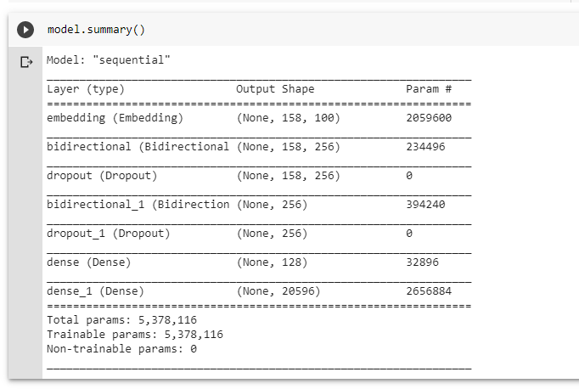
Model Summary

Slide 9
VISUALISATION
The trained weights are loaded into a separate Python File.
The user has to enter a word and it will be converted to the corresponding integer using tokeniser
The output would be 14 lines of words generated by the model.
Different set of outputs can be obtained by changing the temperature value. Thus desired output can be selected by the user.

Slide 10
CONCLUSION
The model was trained for 500 epochs and it took around 16 hours to train the model. An accuracy of about 75% was obtained. Both members of team agree that upon further tuning of parameters, the performance can be improved. Due to hardware limitations, the amount of data that can be used to improve the rhyme scheme is not practical. It is inferred from the results obtained that word-by-word training produces better results than character based training. The only limitation being the very large training time. It is a trade-off of time taken for accuracy of the model.

