Slide 1
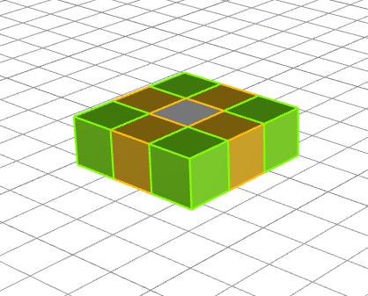
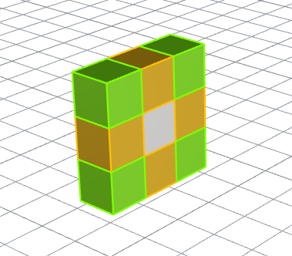
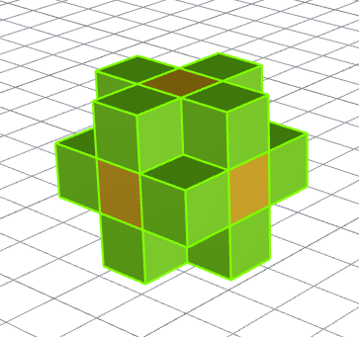
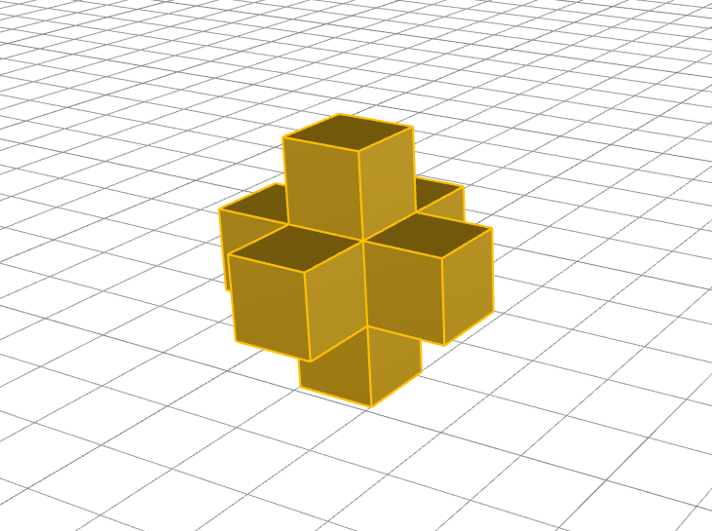
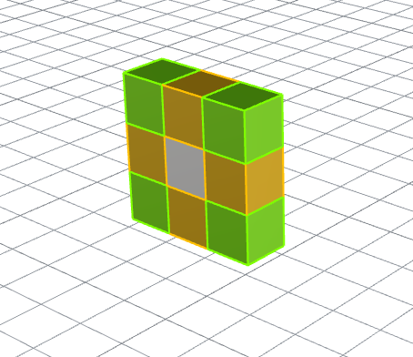
Build Octree
Build root octree
Split octree by minimum level and number of features in each node
Identify leaf node, boundary node, interior node and exterior node
Generate non-repeated vertex list
Identify boundary face & Correct internal face orientation
Output mesh
Test git
w
nw
n
sw
ne
s
e
se
t
n
s
b
t
n
w
s
e
t
w
b
e
b

Slide 2
Build Octree
Build root node
vector<double> position = getPositionRoot();
double size = getSizeRoot();
root = cOctNode(0,"0",position,size,geoFPtsList,geoFEdgesList,geoFFacesList, NULL);
Get the position (center) of geometry object
Get max edge * 1.05 as size of root node

Slide 3
Build Octree
Split octree by minimum level and number of features in each node
splitOctreeByMinLevel(root);
splitOctreeByFeaturePt(root);

Slide 4
Build Octree
3. Identify leaf node, boundary node, interior node and exterior node
setup_leafNodesList(&root);
setup_bNodesList(&root);
setup_leafNodesNbr();//n*logN
setup_nodesState(); //non-boundary node -> identify interior / exterior node

Slide 5
Build Octree
4. Generate non-repeated vertex list
setup_mshPtList();
node’s vertices coordinate set when constructed but node’s vertices indices set here
node->mshPts3DList
node->mshPtsIndxList
setup_nodeMshFaces();
node’s faces information set
node->mshFaceList face’s nid, own, low, upp, ptsList, ptIndxList

Slide 6
Build Octree
Identify boundary face & Correct internal face orientation
setup_mshFaceList();
Create connectivity, i.e. decide each output mesh face in the NodeList contains output mesh
find face’s nbr, judge if it remains, judge which larger, judge which to reverse order
identify internal faces or boundary faces
setup_nodePhyName();
setup_mshBdsList();
num_allNodes=countAllNodes(root);
num_intlNodes=countIntlNodes(root);
num_extNodes=countExtNodes(root);
num_bNodes=countBNodes(root);

Slide 7
OctNode Class
static const int NUM_BRANCHES_OCTNODE = 8;
double size; //node cube length
int level;
string nid;
vector<double> position;
vector<cOctNode> branches;
cOctNode* parent;
vector<vector<cOctNode*>> nbr;
vector<double> low, upp;
int mshVolIndx;
int state; //0-boundary node ; -1 - exterior node; 1 - internal node
vector<cTri*> geoFFacesList;
vector<cFeaturePt*> geoFPtsList;
vector<cFeatureEdge*> geoFEdgesList;
vector<int> geoFFacesIndxList;
vector<vector<double>> mshPts3DList;
vector<int> mshPtsIndxList;
vector<bool> mshPtsRepeatedList;
vector<cFace> mshFacesList
bool isLeafNode();
int numOfGeoFFaces();
int numOfGeoFPts();
int numOfGeoFEdges();
void setGeoFFacesIndxList();
void addNode(int _level, string _nid, vector<double> _position, double _size,
vector<cFeaturePt*> _geoFPtsList,
vector<cFeatureEdge*> _geoFEdgesList,
vector<cTri*> _geoFFacesList,
cOctNode* _parent);
void getLowUppVerts();//calc low and upp by position
void calMshPts3D();
void calMshFaces();
bool boxRayIntersect(cLine &ray);
bool sphereRayIntersect(cLine &ray);
void update_MshFaces_PtIndxList();
void updateMshFaces_mshVolIndx(int _mshVolIndx);
void removeExtraFeats();
bool isPtInNode(vector<double> pt);
4
upp
7
6
2
state
mshVolIndx
geoFPtsList
geoFEdgesList
geoFFacesIndxList
size
level
nid
position
parent
branches
nbr
4
5
3
0
1
mshFacesList
3
2
low
0
1
mshPts3DList;
mshPtsIndxList;
mshPtsRepeatedList
5
getLowUppVerts();
calMshPts3D();
size-> position-> (low, upp) -> mshPts3DList
calMshFaces();
update_MshFaces_PtIndxList();
updateMshFaces_mshVolIndx(int _mshVolIndx);

Slide 8
cFace Class
string nid;
int nbr; //neighbour
int own; //owner
int label;
int nPts;
vector<vector<double> > ptsList;
vector<int> ptIndxList;
vector<double> N;
vector<double> centroid;
vector<double> low;
vector<double> upp;
int mshVolIndx;
int state; //0-boundary face ; 1 - internal face
cOctNode* node;
void getN();
double getAngle(cFace *surface);
vector<double> getCentroid();
void findPhyName(vector<cTri*> _geoFFacesList);
int findGeoFaceWithMinDist(cLine _ray,vector<cTri*> _geoFFacesList);
void changeOrder();
int findFaceRelationship(cFace* f1, cFace* f2);
bool isPtInFace(vector<double> pt);

Slide 9
Octree Class
static const int MAX_OCTREE_LEVELS = 6;
static const int MIN_OCTREE_LEVELS = 5;
static const int MAX_OCTNODE_FEATS = 5;
int branchOffsets[8][3];
cOctNode root;
//octree setup depends on geomData - run geomData read STL first
//simple geom data
vector<vector<double> >& geoPts3DList=cGeomData::getInstance()->pts3DList;
vector<vector<int> >& geoTrisList=cGeomData::getInstance()->trisList;
vector<string>& geoPhyNamesList=cGeomData::getInstance()->phyNamesList;
int numOfGeoPts;
int numOfGeoTris;
int numOfGeoPhyNames;
//geom features
vector<cTri*> geoFFacesList; //geom feature faces list
vector<cFeaturePt*> geoFPtsList; //geom feature pts list
vector<cFeatureEdge*> geoFEdgesList; //geom feature edges list
vector<double> ptInGeom;
//msh data
vector<vector<double>> mshPtsList;
int mshPtIndxCount=0;
int mshVolIndxCount = 0;
//vector<cFace> mshExtFacesList;
vector<cFace*> mshIntlFacesList;
vector<cFace*> mshBFacesList;
vector<cFace*> mshAllFacesList;
vector<cBoundary> mshBdsList;
int num_mshBFaces, num_mshIntlFaces;
//vector<int> eleVolList;
vector<cOctNode*> bNodesList;
vector<cOctNode*> nonBNodesList;
vector<cOctNode*> leafNodesList;
vector<cOctNode*> tmpNodesList;
int num_allNodes, num_intlNodes, num_extNodes, num_bNodes;

Slide 10
Octree Class
void splitOctreeByMinLevel(cOctNode &node);
void splitNodeByFeaturePt(cOctNode &node);
void splitOctreeByFeaturePt(cOctNode &node);
void splitNodeById(string node_id);
void setup_leafNodesList(cOctNode* node);
void setup_leafNodesNbr();
void delExtNodes(cOctNode &node);
void addGapNodes();
void setup_mshPtList();
void addMshPtsOfNode(cOctNode* node);
bool isPtSame(vector<double>& pt1, vector<double>& pt2);
void setup_nodeMshFaces();
void setup_bNodesList(cOctNode* node);
void findBNode(cOctNode* node);
void findNodeState(cOctNode* node);
void setup_nodesState();
void setup_nbrNodesState(cOctNode* node);
void setup_mshFaceList();
void findMshIntlFaces();
void put2List(int flag,cFace* currentMshFace,cFace* listMshFace);
void setup_nodePhyName();
void setup_mshBdsList();
void saveAsGmsh(const char* _fileName);
void saveAsOFMesh();
void saveAsOFMeshPts();
void saveAsOFMeshFaces();
void saveAsOFMeshNeis();
void saveAsOFMeshOwns();
void saveAsOFMeshBds();
int countAllNodes(cOctNode &node);
int countIntlNodes(cOctNode &node);
int countExtNodes(cOctNode &node);
int countBNodes(cOctNode &node);
void outputNodeName(cOctNode &node);
void outputMshPts(cOctNode &node);
void outputMshFaces(cOctNode &node);
void defineBody(vector<double> _ptInGeom);
void buildOctree();
void setup_root();
double getSizeRoot();//get length of root cube
vector<double> getPositionRoot();//find low/upp of geom -> get root cube center position
vector<cOctNode*> getLeafNodeByPt(vector<double> pt, cOctNode& node);
void addLeafNodeByPt(vector<double> pt,cOctNode& node);
cOctNode* getNodeFromId(string nodeId);
cOctNode* findBranchById(string nodeId, cOctNode &node);
void findBranchesByLabel(int polyLabel, cOctNode &node, vector<cOctNode*> &nodeList);
vector<Intersection> findRayIntersect(cLine &ray);
set<int> getListPolysToCheck(cLine &ray);
void getPolysToCheck(cOctNode &node, cLine &ray, set<int> &intTestPolys);
void getNodesToCheck(cOctNode &node, cLine &ray, vector<pair<cOctNode*,double> > &nodeList);
vector<int> findRayIntersects(vector<cLine> &rayList);
vector<int> findRayIntersectsSorted(vector<cLine> &rayList);
vector<cOctNode*> getNodesFromLabel(int polyLabel);
vector<cOctNode*> getSortedNodesToCheck(cLine &ray);
void splitNodeByMinLevel(cOctNode &node);

Slide 11
cOctNode::calMshFaces() would setup:
vector<cFace> mshFacesList[6]
cFace.low, cFace.upp, cFace.ptsList, cFace.ptIndxList
This requires cOctree::setup_mshPtList() called first to setup:
mshPtsIndxList because cFace.ptIndxList rely on it.
Then, cOctree::setup_nodeMshFaces() can call:
calMshFaces();

Slide 12
Class OctreeApp{
MAX_OCTREE_LEVELS = 6;
MIN_OCTREE_LEVELS = 5;
MAX_OCTNODE_FEATS = 5;
cOctree octree
readSTL()
defineBody(x, y, z)
defineBody()
setupMeshSize(int, int, int)
buildOctree()
saveAsOFMesh()
}
Class cFeaturePt{
}
Class cFeatureEdge{
}
Class cFeatureFace{
}
Class cLine{
}
Class cOctNode{
Parent, children
vector<cTri*> geoFFacesList; //geom feature faces list
vector<cFeaturePt*> geoFPtsList; //geom feature pts list
vector<cFeatureEdge*> geoFEdgesList; //geom feature edges list
}
Class cOctree{
cOctNode root, depth
setup_root();
balance()
splitOctree()
}
Class cOctreeUtil{
output_geoFPtsList(vector<cFeaturePt*>& geoFPtsList, vector<vector<double> >& geoPts3DList)
output_octree(const char* _fileName, cOctree* tree)
}
Class cGeomData{
}
Class cFace{
}
Class cBoundary{
}
Main(){
App=New octreeApp()
App.readSTL()
App.defineBody(x, y, z)
App.setupMeshSize(int, int, int)
App.buildOctree()
App.saveAsOFMesh()
}
buildOctree(){
octree.setup_root();
octree.splitOctreeByMinLevel(cOctNode &node);
octree.splitOctreeByFeaturePt(cOctNode &node);
octree.setup_leafNodesList(cOctNode* node);
octree.setup_leafNodesNbr();
octree.identifyNodes(cOctNode &node);
octree.setup_mshPtsList();
octree.setup_mshFacesList(); //不删除node的面，只需设置面的状态为不输出。
//遍历时，设置面是否为内部面。先判断两相邻面的大小，大的为不输出，小的为输出。
//再判断他们所属标号大小，如果大面所属标号>小面所属标号，反转小面序列，交换小面所属标号。如果大面所属标号<小面所属标号，维持现状。
octree.setup_nodePhyName();
octree.setup_mshBdsList();
}

