Slide 1
A User Guide for the new developed program for AVA study at the post-CFD phase
Oct 2015

Slide 2
Contents
Introduction
Key functions of the program
Instructions for the program
Input the case parameters
Input the wind parameters
Input the information for Focus Areas and Test Points
Working Procedure
Testpoint-checking
Data Processing

Slide 3
Introduction
In a traditional method, when working on an AVA project, we need using loads of scripts to output or export result data from Ensight after getting the simulation cases. The results we want normally can be classified by three parts, VR testpoints, contour plots and vector plots respectively.
However, we have to modify the scripts every time for different projects as the wind directions and the testpoints are different. Editing such scripts manually is very dull, time-consuming and prone to errors.
Therefore, as for this reason, a new program for the post-CFD data processing of AVA project is developed, which can solve the aforesaid problem easily and streamline our work.
This program is designed to create scripts by Excel which can connect to Ensight perfectly and it also can load the data exported from Ensight. So by using this new method, what you need to do is just input some key parameters and several clicks and your work is done.

Slide 4


Key functions of the program
This program is developed by using Excel VBA, which can output scripts for Ensight as well as load data exported from Ensight.
This program can generate almost all the scripts you will use in Ensight, including loading cases, exporting VR testpoints, outputting contour plots and vector plots.
This program can also load VR testpoint data and calculate Combine VR, SVR and LVR
This program can extract and process the data for specific Focus Areas

Slide 5
Instructions for the program

Slide 6
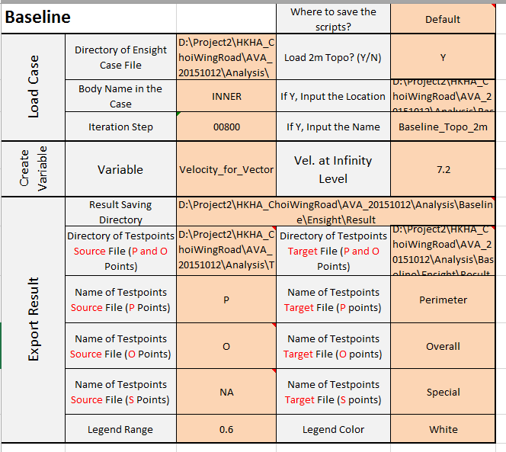
Input the case parameters
Don’t change anything in the gray cells
Input information in the orange cells
All the contents in the orange cells should be filled in this section and the following slides would explain the meanings of some of the key parameters.

Slide 7
Input the case parameters
Don’t change anything in the gray cells
Input information in the orange cells
When you enter “Default”, all the scripts created will be saved in the same directory of this Excel file. Otherwise, you can enter a location path where you want to save.
If Y, give the file location and file name then the script created will contain the commands to load a topography
In this module, it is assumed that all your testpoint files exported from Rhino, e.g. P points, O points and S points are saved in the same directory.
If there is no S points, just enter “NA” instead.
Warns: It is better that you don’t change any information of the testpoint files from Rhino and export P, O and S points separately.

Slide 8
Input the case parameters
Don’t change anything in the gray cells
Input information in the orange cells
Enter a directory where you want to save the output result from Ensight, e.g. contour plots, vector plots.
Enter a directory where you want to save the testpoint result files from Ensight, e.g. VR of P points, VR of O points and VR of S points. It is also possible if you like to change the name of the testpoint file.

Slide 9
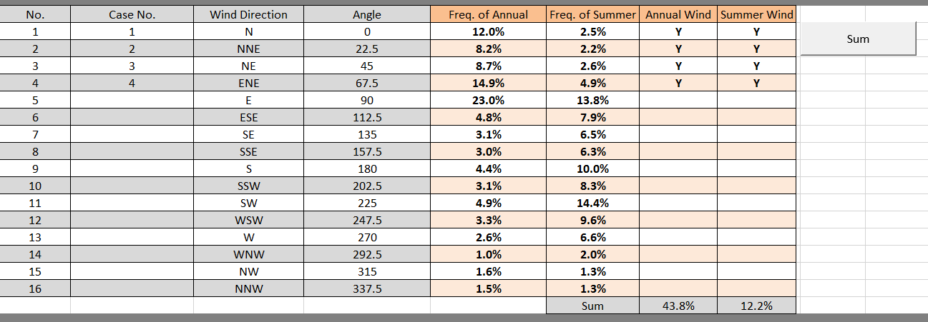
Input the wind parameters
Don’t change anything in the gray cells
Input information in the orange cells
1
2
1
Just enter “Y”, if you are studying a wind from that direction. If not, enter “N” or just leave it “empty”.
And press “Sum” when you input all winds you want to study
2

Slide 10
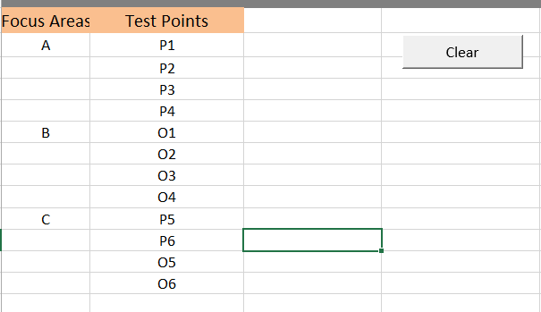
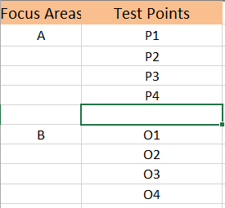
Input the information for Focus Areas and Test Points
Type the name of your focus area and its testpoint name. You are suggested to follow the format shown in this sample. There is no problem, if your testpoints are not consecutive for a specific focus area. However, Spaces between testpoints should be avoided.
Bad Example

Slide 11
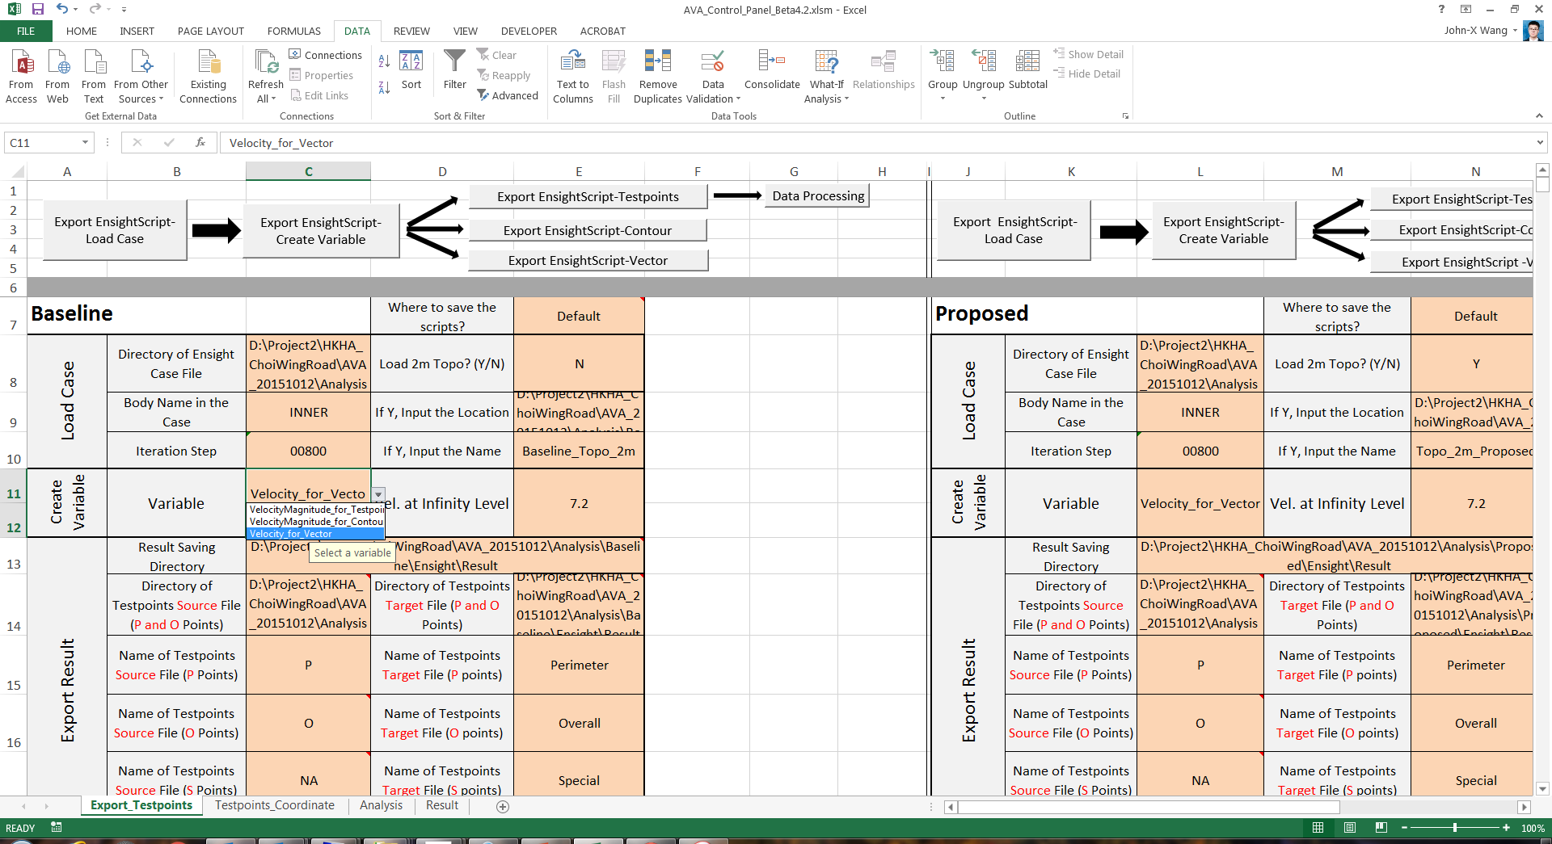

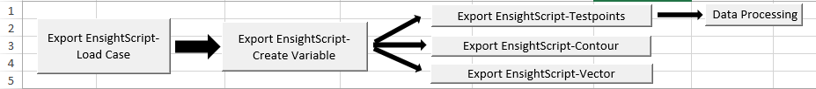


Working Procedure
Select a variable
3b
2
1
Create a script to load cases
5
6
3a
4
1
2
5
6
Before click this button, you must finish Step 3b first.
6
7
Click 3 times in total
1
2
5
6

Slide 12
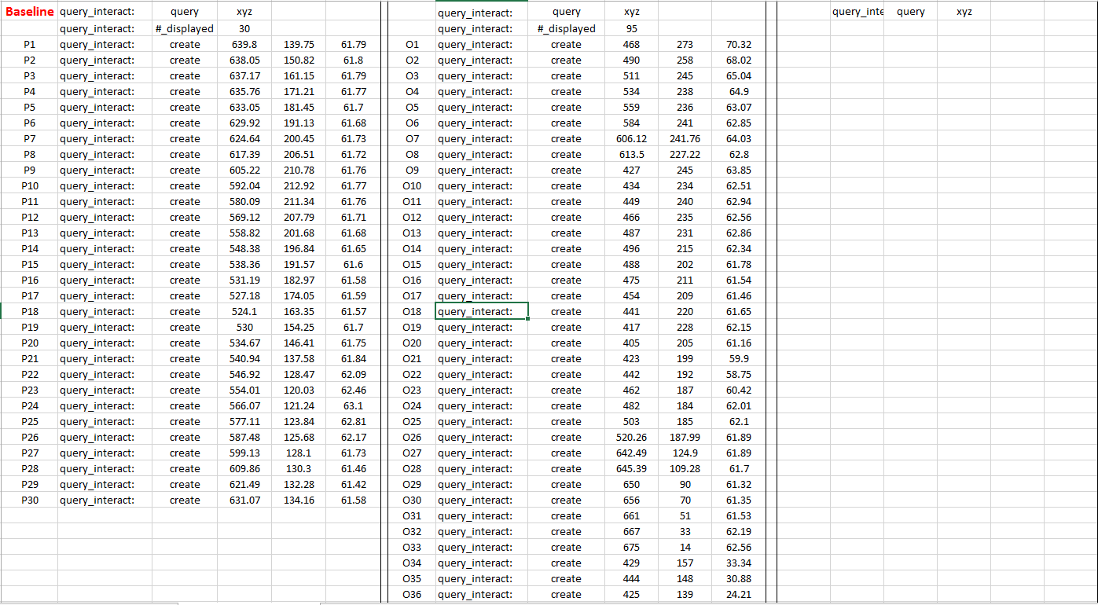
Testpoint-checking
When coming to the step 3a
Check P points
Check O points
Check S points

Slide 13
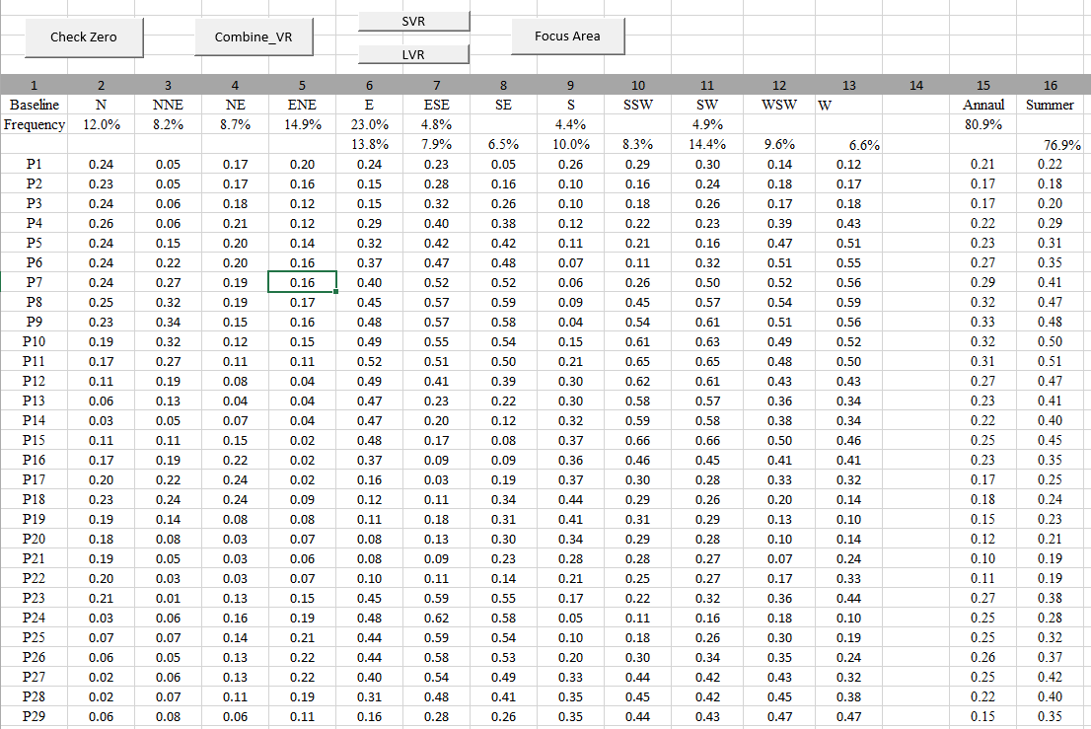
Data Processing
When coming to the step 4
1
2
3
5
4
2
Calculate the Combined VR in various wind directions
1
Highlight the data less than 0.01

Slide 14
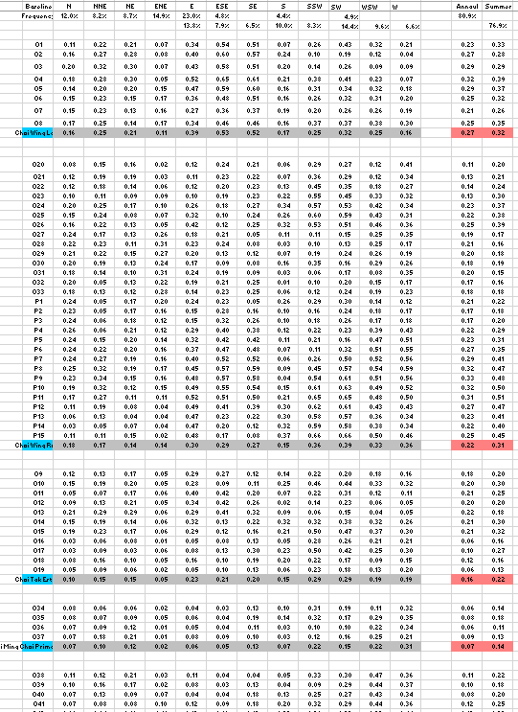
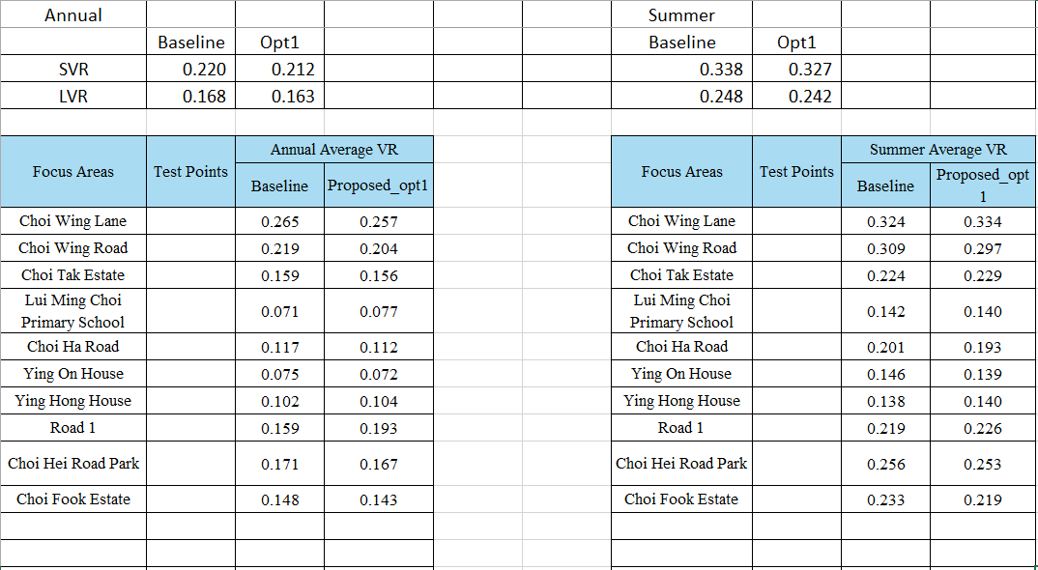
Data Processing
5
3
4
More Details for Checking
5
Summary

Slide 15
End

