Slide 1

CFD General Notation System
http://www.cgns.org
Bruce Wedan
ANSYS/ICEM CFD

Slide 2
Presentation Overview
What is CGNS ?
History of CGNS
CGNS Steering Committee
ISO-STEP Standard
HDF5 Interface
User Base
CGNS Main Features
Current Release (Version 2.3)
Extensions (Version 2.4 beta)
CGNS Tools
Detailed Node Descriptions
Example
Conclusions

Slide 3
What is CGNS ?
CFD General Notation System
  Principal target is the data normally associated with compressible viscous flow (i.e. Navier-Stokes)
  Applicable to computational field physics in general with augmentation of the data definitions and storage conventions
Objectives
  Provide a general, portable and extensible standard for the storing and retrieval of CFD analysis data
  Offer seamless communication of CFD analysis data between sites, applications and system architectures
  Eliminate the overhead costs due to file translation and multiplicity of data sets in various formats
  Provide free, open software – GNU Lesser General Public License

Slide 4
What is CGNS ?
Advanced Data Format (ADF)
  Software that performs the I/O operations
  Directed graph based on a single data structure (the ADF node)
  Defines how data is organized in the storage media.
Standard Interface Data Structures (SIDS)
  Collection of conventions and definitions that defines the intellectual content of CFD-related data.
  Independent of the physical file format
SIDS to ADF Mapping
  Defines how the SIDS is represented in ADF
CGNS Mid-Level Library (MLL)
  High level Application Programming Interface (API) which conforms closely to the SIDS
  Built on top of ADF and does not perform any direct I/O operation

Slide 5
History of CGNS
1994-1995:
  Series of meetings between Boeing and NASA addressing means of improving technology transfer from NASA to Industry: The main impediment to technology transfer is the disparity of file formats.
1995-1998:
  Development of the CGNS System (SIDS, ADF) at Boeing Seattle, under NASA Contract with participation from:
    Boeing Commercial Aircraft Group, Seattle
    NASA Ames/Langley/Lewis Research Centers
    Boeing St-Louis (former McDonnell Douglas Corporation)
    Arnold Engineering Development Center, for the NPARC Alliance
    Wright-Patterson Air Force Base
    ICEM CFD Engineering Corporation

Slide 6
History of CGNS
1997-1998:
  Development of the CGNS Mid-level Library.
  Institution of the CGNS website (http://www.cgns.org)
  first release of the CGNS software and documentation.
1999-2001:
  CGNS Steering Committee created as a subcommittee of the AIAA CFD Committee on Standards
  Version 2.0 of CGNS library released
    Added moving grids and time-dependent data
  ISO-STEP standardization process undertaken by Boeing
  CGNStalk mailing list created at NASA Glenn

Slide 7
History of CGNS
2002:
  CGNS becomes a AIAA Recommended Practice
  Version 2.1 of CGNS library released
    Added support for user-defined arrays, chemistry and links
2003:
  Source code moved under CVS at SourceForge (http://sourceforge.net/projects/cgns/)
  Version 2.2 of CGNS library released
    Added axisymmetry, rotating coordinates, connectivity and boundary condition properties
2004:
  HDF5 interface to CGNS released
  Version 2.3 (current stable version) released
    I/O times speed up by an order of magnitude

Slide 8
CGNS Steering Committee
Public forum made up of international representatives from government, industry and academia
Responsibilities
  Maintain the software, documentation and CGNS web site
  Ensure a free distribution of the software and documentation
  Promote the acceptance of the CGNS standard
Organization
  Meets at a minimum of once a year
  Represented by an elected ChairPerson
    currently Chris Rumsey of NASA Langley
  Governs by consensus
  Welcomes participation of all parties, members or not

Slide 9
CGNS Steering Committee
Membership – 20 organizations
NASA Ames | US Air Force / AEDC
NASA Langley | CD ADAPCO
NASA Glenn | Intelligent Light
Boeing Commercial | Pointwise
Boeing – Rocketdyne | Aerospatiale Matra Airbus
Boeing Integrated Defense Systems | NUMECA
Pratt & Whitney | ONERA
ICEM CFD Engineering | Stanford University
Fluent, Inc. | Utah State University
Rolls-Royce Allison | ANSYS CFX

Slide 10
ISO-STEP Standard
AP 237 – Fluid Dynamics
  Top-level standard which defines the data types and structures used throughout the field of fluid dynamics
  Need to extend ISO-STEP for binary data (currently ASCII only)
Part 110 – Computational Fluid Dynamics
  Defines the data types and structures unique to CFD
Part 52 – Mesh-based Topology
  Defines structured and unstructured grids including topology and element connectivity
Part 53 – Numerical Analysis
  Defines links to product data management structures and configuration control for numerical analysis

Slide 11
ISO-STEP Standard
Approval process
  A proposal must past 6 stages or “gates” to become a standard.
  Passage through each “gate” requires a specified number of votes from the 17 P-Member countries. There are CGNS users in each of these countries.
  Proposals are cancelled after 2 years if progress is not shown
  AP 237 is at “gate” 3 (Committee Draft)
  Parts 110, 52, and 53 are at “gate” 4 (Draft International Std)
Current status
  Standardization effort is stalled due to lack of funds.
  ISO-STEP has decided to merge AP 237 with AP 209 (finite element analysis) because there is a high degree of common content. Effort is being lead by Keith Hunten of Lockheed Martin

Slide 12
HDF5 Interface
Implementation
  Fully implemented at the ADF level – no change to MLL
Advantages
  Used in many applications
  Parallel I/O using MPI
  Faster access through linked files
Disadvantages
  File sizes are 2 to 3 times larger
  I/O times are generally 2 to 3 times slower, but may be up to a order of magnitude for a large number of nodes
Current Status
  HDF5 Task Force set up to further evaluate implementation
  Added as option to CGNS with conversion routines

Slide 13
User Base
Registered Users
  591 users from more than 25 countries
CGNStalk (as of May 2003)
  153 participants from 20 different countries and at least 63 different organizations
SourceForge (last 2 years)
  Average of 20 page views and 7.5 downloads per day
Known implementations
  13 commercial, 9 government, 5 industry, 3 academia

Slide 14
CGNS Main Features
Hierarchical data structure: quickly traversed and sorted, no need to process irrelevant data
Complete and explicit problem description
Standardized naming conventions
Unlimited internal documentation, and application specific data
Layered so that much of the data structures are optional
ADF database: universal and self describing
Based on a single data structure called an ADF node
The data may encompass several files through the use of links
Portable ANSI C software, with complete Fortran and C interfaces
Files stored in compact C binary format
Complete and architecture independent API

Slide 15
Current Release (Version 2.3)
Grid coordinates and elements
  1D, 2D and 3D support (physical and cell dimensions)
  Any number of structured and/or unstructured zones
  Cartesian, cylindrical and spherical coordinates systems
  Linear and higher-order elements (22 predefined element types)
  2D axisymmetry
Grid connectivities
  1-to-1 abutting, mismatched abutting, and overset (chimera)
  Connectivity properties (average and periodic interfaces)
Boundary conditions
  Simple or complex boundary conditions with predefined identifiers
  Any number of Dirichlet or Neumann conditions may be specified globally or locally on a boundary condition patch
  Boundary patch normals, area and wall function properties

Slide 16
Current Release (Version 2.3)
Governing flow equations
  General class of flow equations
  Gas, viscosity, thermal conductivity, thermal relaxation, chemistry, turbulence, and turbulence closure models
Solutions
  Vertex, cell, face or edge centered with rind (ghost points/cells)
  Any number of solution variables
  Predefined identifiers for solution variables
  Generic discrete data (not typically part of the solution)
Time-dependent flows
  Time-accurate or non-time-accurate
  Rotating, rigid motion or arbitrary motion grids
  Storage of base and/or zone iterative data

Slide 17
Current Release (Version 2.3)
Physical data
  Data class: dimensional, normalized, or non-dimensional
  Data conversion factors
  Dimensional units: mass, length, time, temperature and angle
  Dimensional exponents: powers of base units
Auxiliary data
  Global and/or local convergence history
  Reference state variables
  Gravity and global integral data
  Arbitrary user-defined data
  Textual data for documentation and annotations

Slide 18
Current Release (Version 2.3)
Families
  Provides a level of indirection to allow mesh to geometry associations
  Boundary conditions may be applied on families
  Links mesh surfaces to one or more CAD entities

Slide 19
Extensions (Version 2.4 beta)
Units
  Electric current, amount of a substance, and luminous intensity added to the base units
Electromagnetics
  Electric field, magnetic field and electrical conductivity models added to the governing flow equations
  Voltage, electric and magnetic field strengths, current density, electrical conductivity, Lorenz force and Joule heating added to list of solution identifiers
Families
  Rotating coordinates and complex boundary conditions added to the family specification

Slide 20
Extensions (Version 2.4 beta)
Boundary conditions
  Allow for specification of boundary condition data at a location different than that of the patch specification
User-defined data
  Allows recursive user-defined data
  Family names and point set specification added
1-to-1 connectivities
  Periodic and average interface properties added
Partial read and write
  Partial read and write for grid coordinates, elements and solution variable added

Slide 21
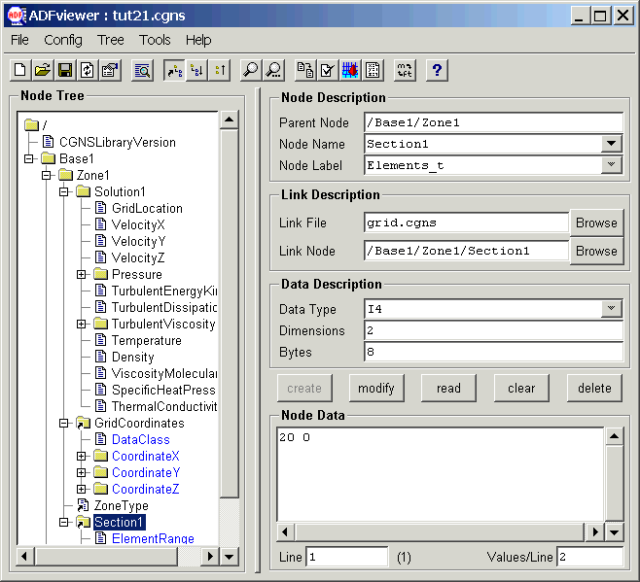
CGNS Tools
ADFviewer
  Views and/or edits ADF/CGNS files.
  May create, delete or modify nodes
  Nodes are displayed in a Windows-like collapsible tree
  Additional utilities may be accessed from the menus
  Configurable menus
  Written in Tcl/Tk

Slide 22
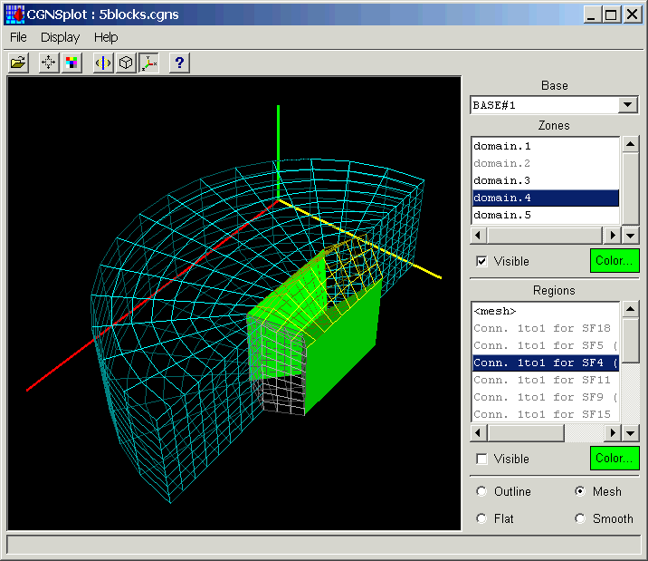
CGNS Tools
CGNSplot
  Viewer for CGNS files
  Displays zones, element sets, connectivities, and boundary conditions
  Written in Tcl/Tk with OpenGL
  Runs standalone, or may be called from ADFviewer

Slide 23
CGNS Tools
File conversion
  Convert Patran, PLOT3D and Tecplot files to CGNS
  Convert CGNS files to PLOT3D and Tecplot
CGNS file manipulation
  Data conversion utilities for modifying the solution location (vertex or cell-center), solution variables (primitive or conservative), and data class (dimensional or normalized)
  Subset extraction and interpolation
CGNS bindings
  Tcl/Tk interface to ADF and MLL
  PyCGNS: Python interface to ADF and MLL
  ADFM: in memory representation of ADF trees
  CGNS++: C++ interface to ADF and MLL

Slide 24
CGNS Tools
Other utilities
  CGNScheck: checks CGNS files for valid data and conformance to the SIDS
  ADFlist: lists ADF/CGNS file tree structure and node data
  ADF_Edit: command-line based interactive browser/editor for ADF/CGNS files
  CGNS_readhist: reads a CGNS file and writes convergence history to a formatted file.
  FTU (File Transfer Utility): converts to and from PLOT3D, and has a text-based menu allowing the manipulation of a CGNS base
  CGNS Viewer: ADF/CGNS file editor/viewer with a GUI using the GTK+ library

Slide 25
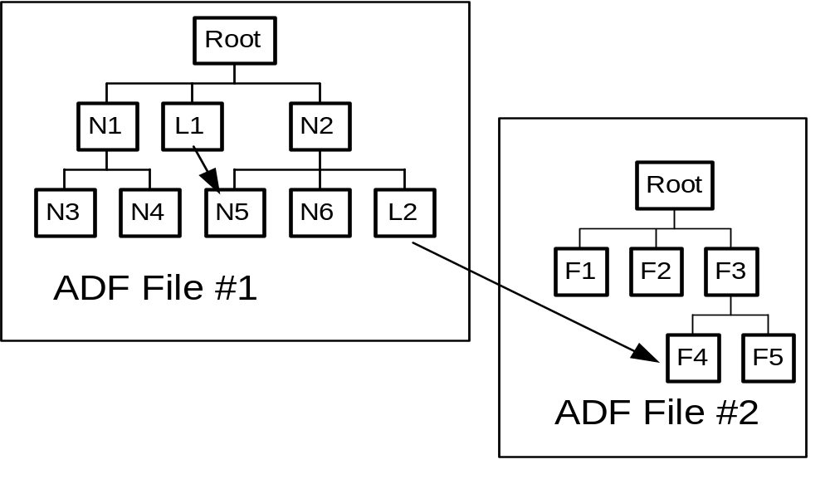
ADF Core

Slide 26
ADF Node Content
ID: A unique identifier to access a node within a file.
Name: A character field used to name the node. It must be unique for a given parent.
Label: A character field used to described the type of information contained in the node.
Data type: A character field specifying the type of data (e.g. real, complex) associated with the node.
Number of dimensions: The dimensionality of the data.
Dimensions: An integer vector containing the number of elements within each dimension.
Data: The data associated with the node.
Number of sub-nodes: The number of children directly attached to a node.
Name of sub-nodes: The list of children names.

Slide 27
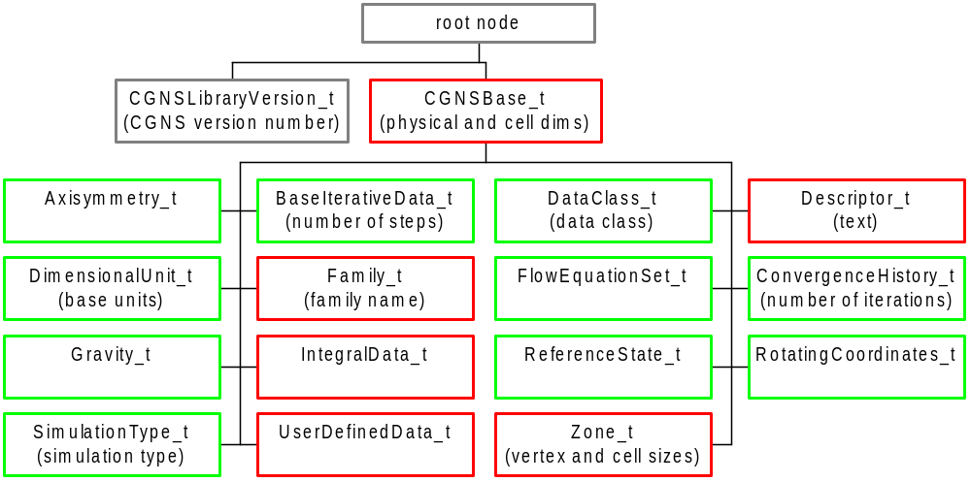
Top Level Structure

Slide 28
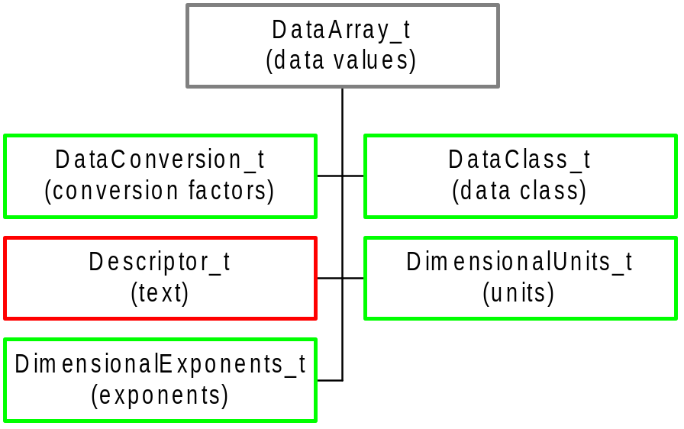
DataArray_t Node

Slide 29
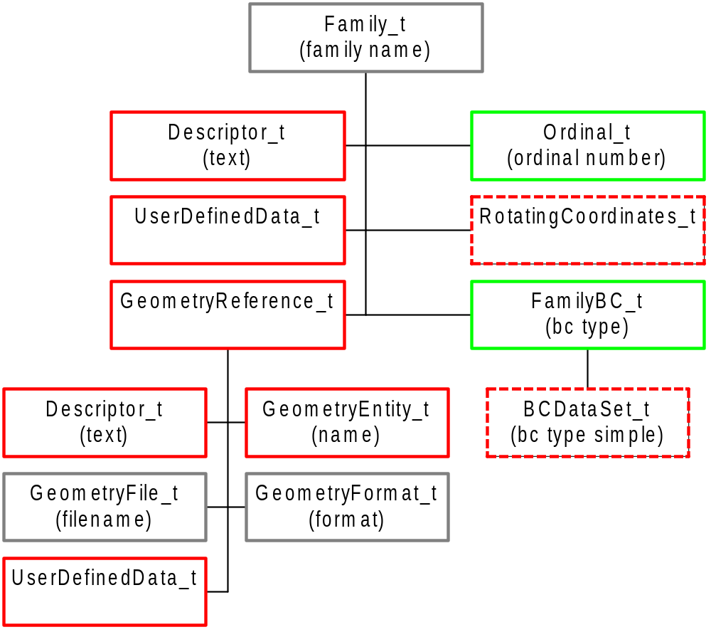
Family_t Node

Slide 30
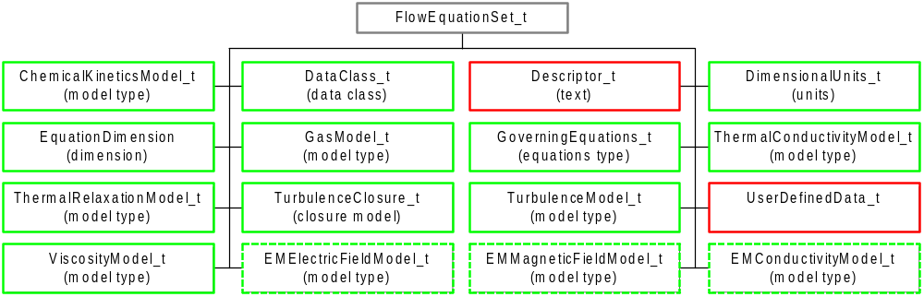
FlowEquationSet_t Node

Slide 31
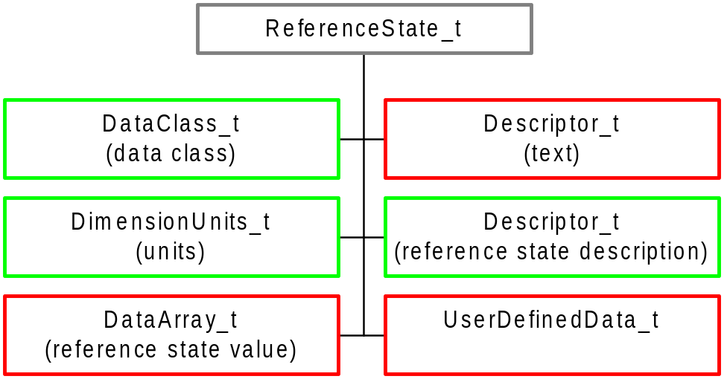
ReferenceState_t Node

Slide 32
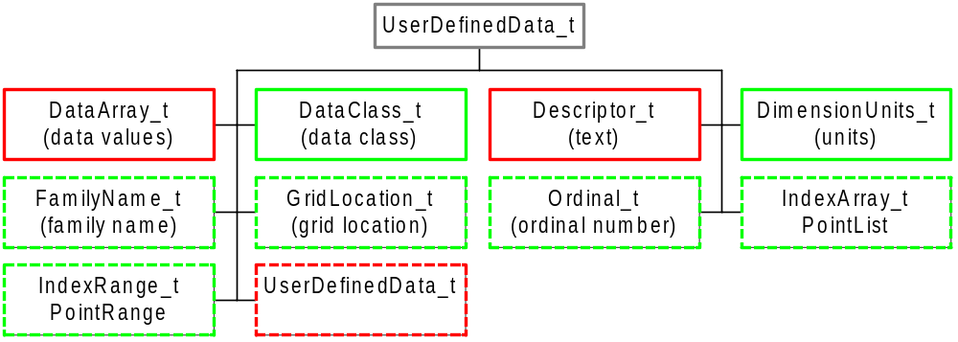
UserDefinedData_t Node

Slide 33
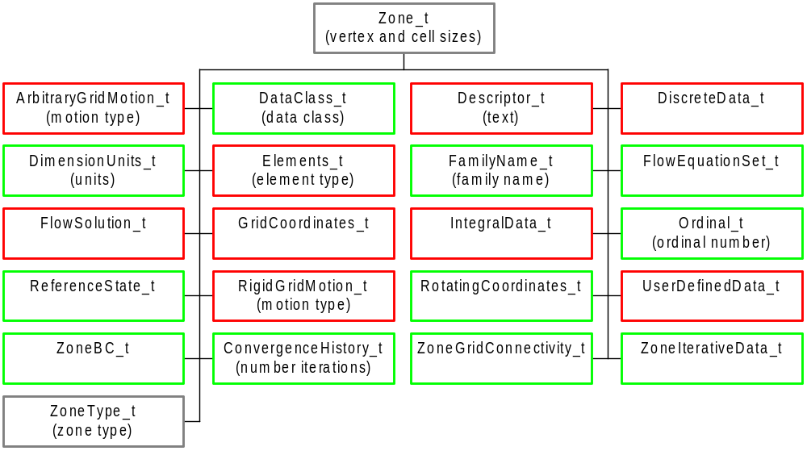
Zone_t Node

Slide 34
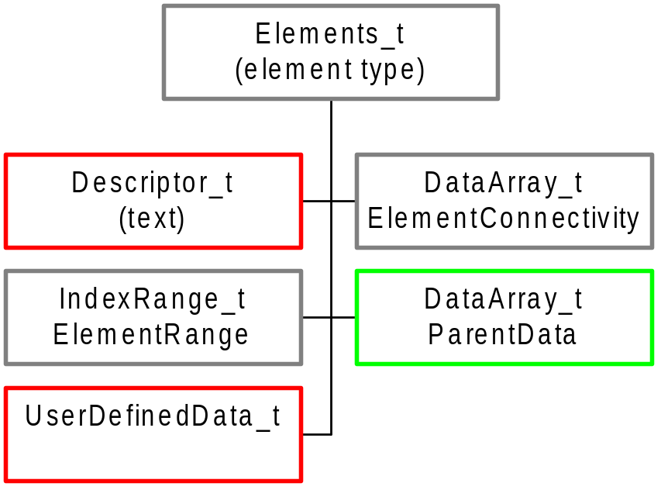
Elements_t Node

Slide 35
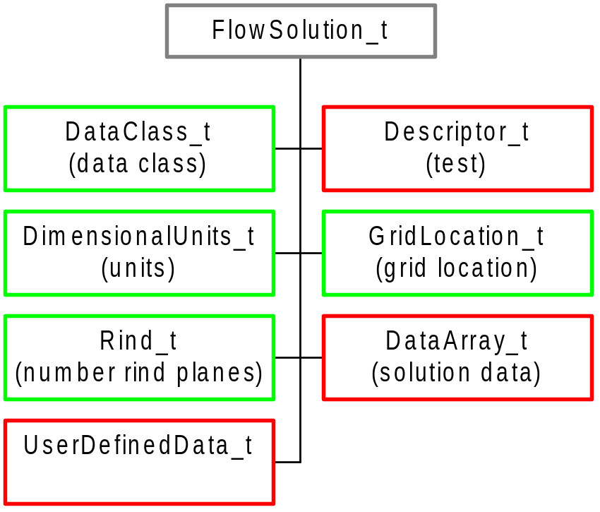
FlowSolution_t Node

Slide 36
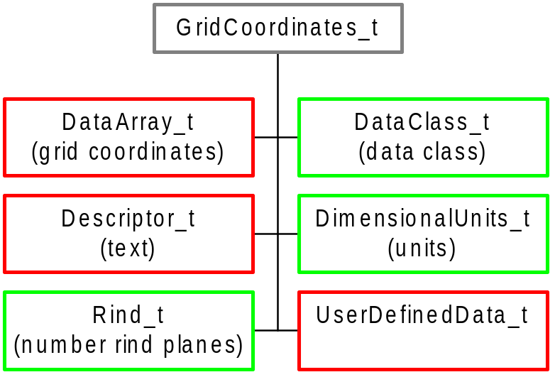
GridCoordinates_t Node

Slide 37
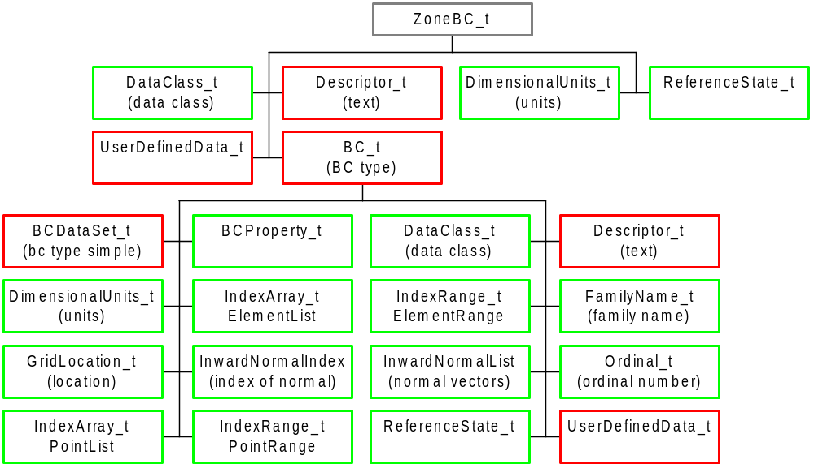
ZoneBC_t Node

Slide 38
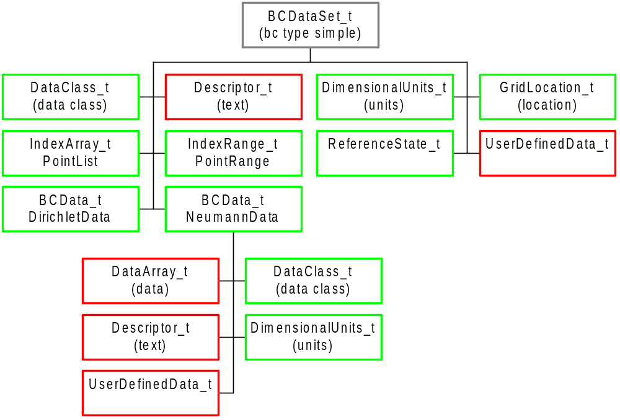
BCDataSet_t Node

Slide 39
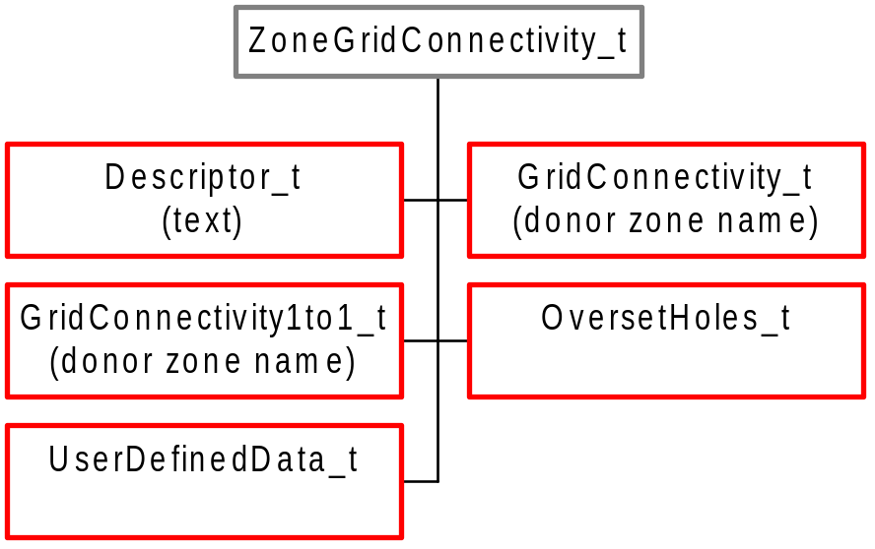
ZoneGridConnectivity_t Node

Slide 40
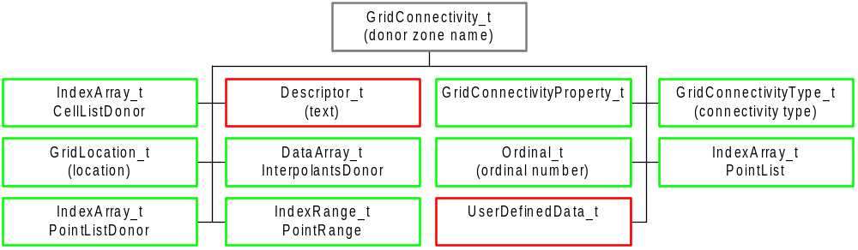
GridConnectivity_t Node

Slide 41
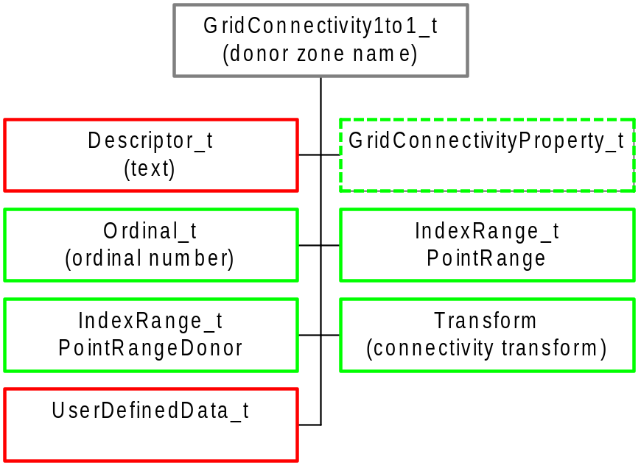
GridConnectivity1to1_t Node

Slide 42
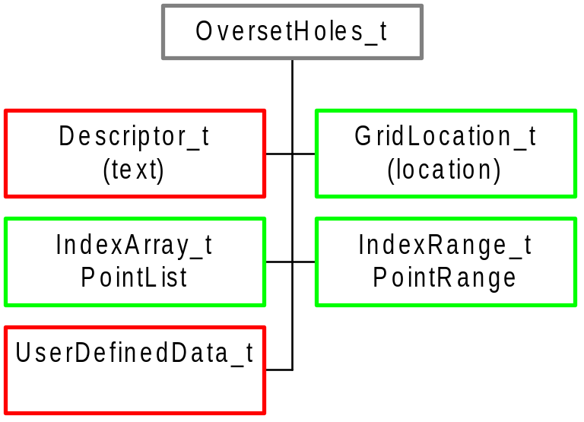
OversetHoles_t Node

Slide 43
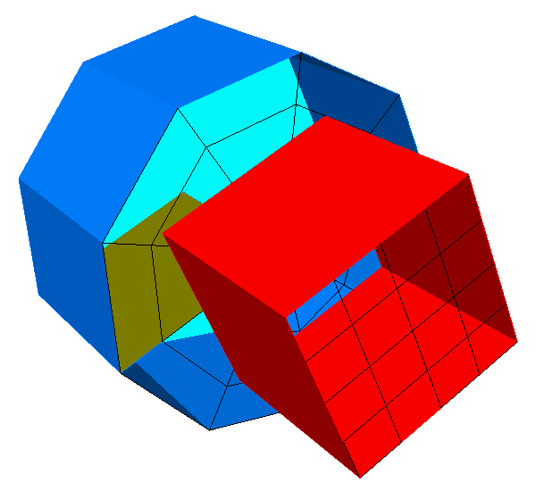
Example
Structured cylinder attached to unstructured cube

Slide 44
Example - Code
unlink("example.cgns");
cg_open("example.cgns", MODE_WRITE, &cgfile);
cg_base_write(cgfile, "Mismatched", CellDim, PhyDim, &cgbase);
cg_goto(cgfile, cgbase, "end");
cg_descriptor_write("Descriptor", "Mismatched Grid");
cg_dataclass_write(Dimensional);
cg_units_write(Kilogram, Meter, Second, Kelvin, Radian);
/*----- zone 1 is unstructured cube -----*/
cg_zone_write(cgfile, cgbase, "UnstructuredZone",
size, Unstructured, &cgzone);
/* write coordinates */
cg_coord_write(cgfile, cgbase, cgzone, RealSingle, "CoordinateX", xcoord, &cgcoord);
cg_coord_write(cgfile, cgbase, cgzone, RealSingle, "CoordinateY", ycoord, &cgcoord);
cg_coord_write(cgfile, cgbase, cgzone, RealSingle, "CoordinateZ", zcoord, &cgcoord);
/* write elements and faces */
cg_section_write(cgfile, cgbase, cgzone, "Elements", HEXA_8, 1, num_element, 0, elements, &cgsect);
cg_section_write(cgfile, cgbase, cgzone, "Faces", QUAD_4, num_element+1, num_element+num_face, 0, faces, &cgsect);
cg_parent_data_write(cgfile, cgbase, cgzone, cgsect, parent);
/* write inflow and wall BCs */
cg_boco_write(cgfile, cgbase, cgzone, "Inlet", BCInflow, ElementRange, 2, range, &cgbc);
cg_boco_write(cgfile, cgbase, cgzone, "Walls", BCWall, PointList, n, pts, &cgbc);
/*----- zone 2 is structured cylinder -----*/
cg_zone_write(cgfile, cgbase, "StructuredZone", size, Structured, &cgzone);
/* write coordinates */
cg_coord_write(cgfile, cgbase, cgzone, RealSingle, "CoordinateR", xcoord, &cgcoord);
cg_coord_write(cgfile, cgbase, cgzone, RealSingle, "CoordinateTheta", ycoord, &cgcoord);
cg_coord_write(cgfile, cgbase, cgzone, RealSingle, "CoordinateZ", zcoord, &cgcoord);
/* write outlet and wall BCs */
cg_boco_write(cgfile, cgbase, cgzone, "Outlet", BCOutflow, PointRange, 2, range, &cgbc);
cg_boco_write(cgfile, cgbase, cgzone, "Walls", BCWall, PointList, n/3, pts, &cgbc);
/* periodic 1to1 connectivity */
cg_1to1_write(cgfile, cgbase, 2, "Periodic", "StructuredZone", range, d_range, transform, &cgconn);
/*----- zone 1 -> zone 2 connectivity -----*/
cg_conn_write(cgfile, cgbase, 1, "Unstructured -> Structured", Vertex, Abutting, PointRange, 2, pts, "StructuredZone", Structured, CellListDonor, Integer, n/3, d_pts, &cgconn);
cg_goto(cgfile, cgbase, "Zone_t", 1, "ZoneGridConnectivity_t", 1, "GridConnectivity_t", cgconn, "end");
cg_array_write("InterpolantsDonor", RealSingle, 2, dims, interp);
/*----- zone 2 -> zone 1 connectivity similar -----*/
/* close file */
cg_close(cgfile);

Slide 45
Example - Node Tree
ADF MotherNode
+-CGNSLibraryVersion
+-Mismatched
+-Descriptor
+-DataClass
+-DimensionalUnits
+-UnstructuredZone
| +-ZoneType
| +-GridCoordinates
| | +-CoordinateX
| | +-CoordinateY
| | +-CoordinateZ
| +-Elements
| | +-ElementRange
| | +-ElementConnectivity
| +-Faces
| | +-ElementRange
| | +-ElementConnectivity
| | +-ParentData
| +-ZoneBC
| | +-Inlet
| | | +-ElementRange
| | +-Walls
| | +-PointList
| +-ZoneGridConnectivity
| +-Unstructured -> Structured
| +-GridConnectivityType
| +-PointRange
| +-CellListDonor
| +-InterpolantsDonor
+-StructuredZone
+-ZoneType
+-GridCoordinates
| +-CoordinateR
| +-CoordinateTheta
| +-CoordinateZ
+-ZoneGridConnectivity
| +-Periodic
| | +-Transform
| | +-PointRange
| | +-PointRangeDonor
| +-Structured -> Unstructured
| +-GridConnectivityType
| +-PointList
| +-CellListDonor
| +-InterpolantsDonor
+-ZoneBC
+-Outlet
| +-PointRange
+-Walls
+-PointList

Slide 46
Conclusions
Why should I use CGNS ?
  CGNS is a well-established, stable format with world-wide acceptance, use and support
  Provides seamless communication of data between applications, sites, and system architectures
  Supported by most commercial visualization and CFD vendors
  Extensible and flexible – easily adapted to other fields of computational physics through specification in the SIDS
  Backwards compatible with previous versions – forwards compatible within the major release number
  Allows new software development to focus on functionality and reliability rather than data I/O, storage and compatibility
Want more information ?
  http://www.cgns.org

