Slide 1
Regular Research Meeting
07/04/2021

Slide 2
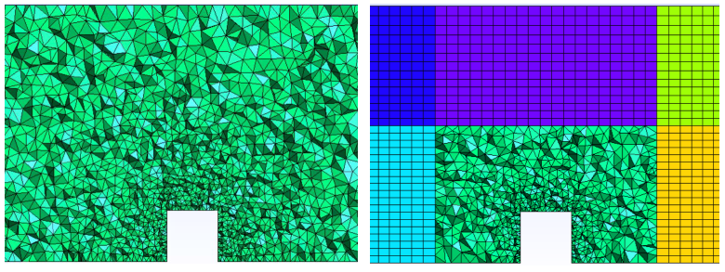
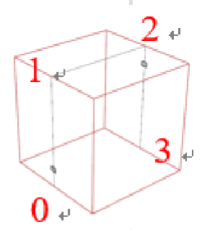
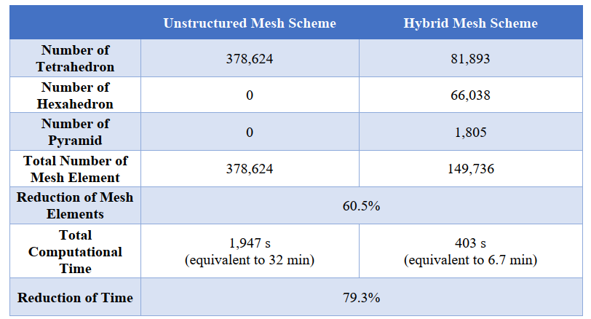
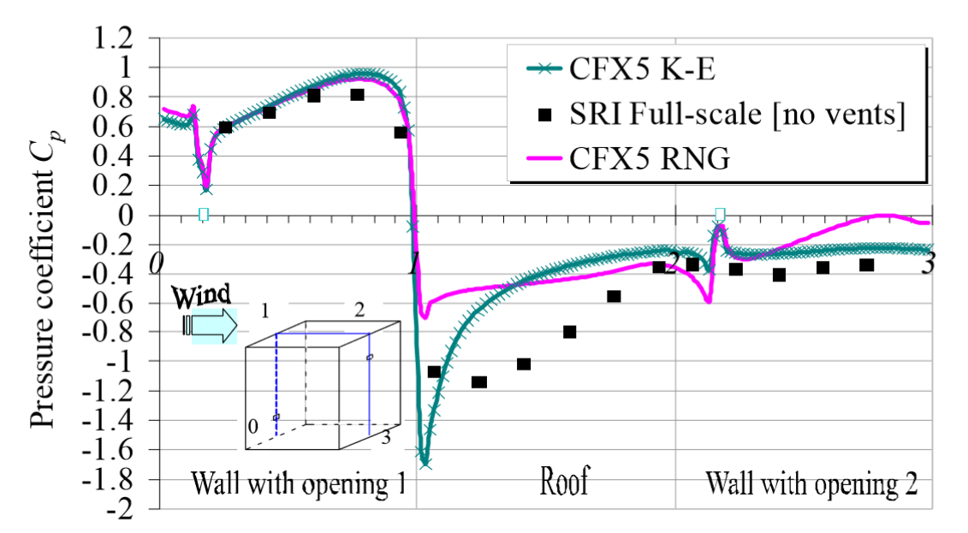

Hybrid mesh
A Solution to the problem:
Hybrid mesh – reduce the number of mesh and keep mesh quality
Outer zone – multiblock and structured grid
Inner zone – tetrahedral grid to capture building features
0 - 1
1 - 2
2 - 3
Cp

Slide 3
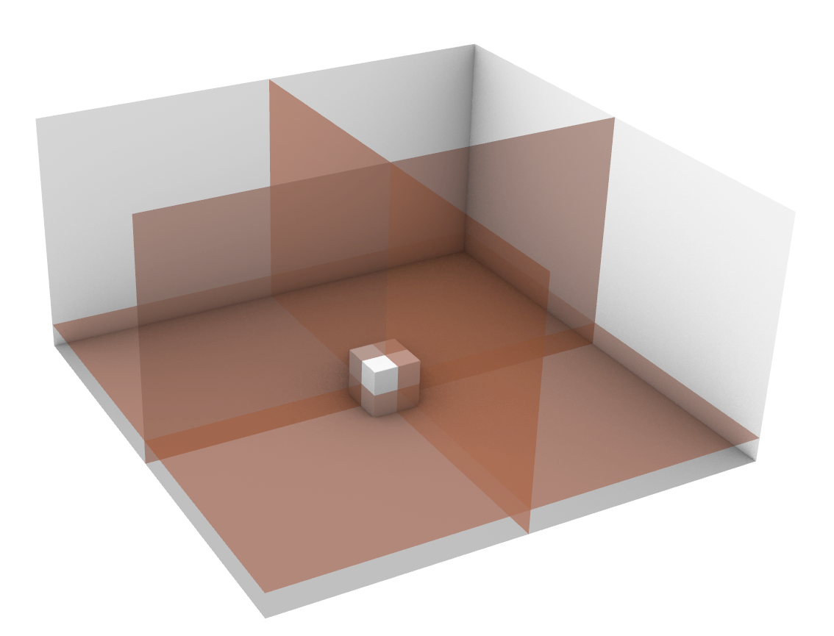
XZ Plane
YZ Plane
XY Plane

Slide 4
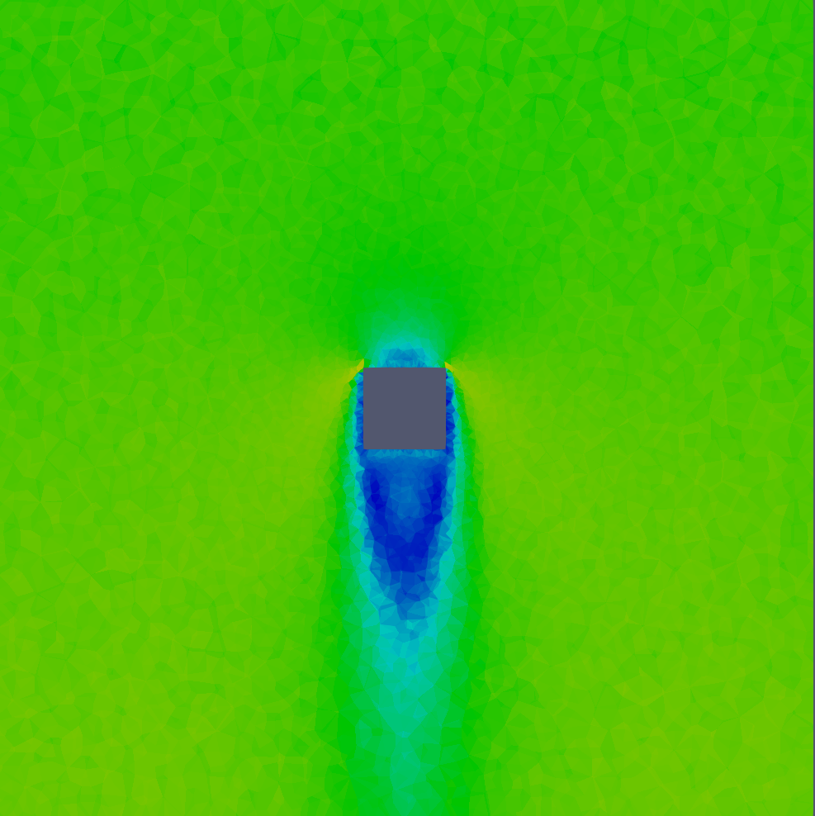
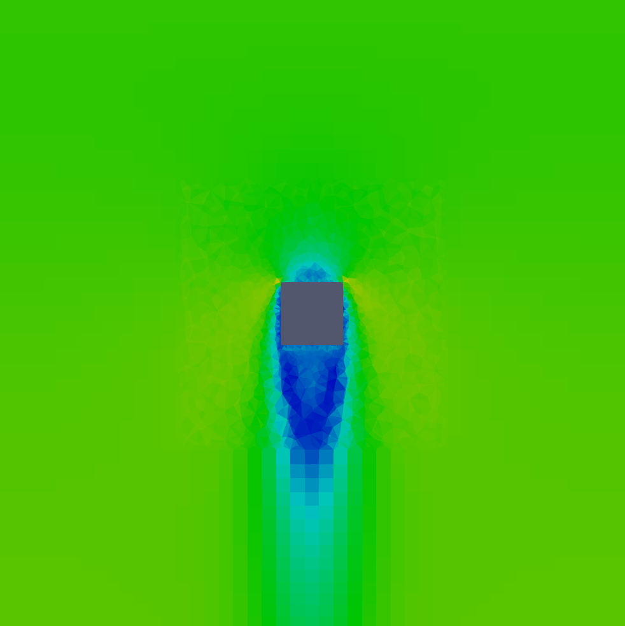
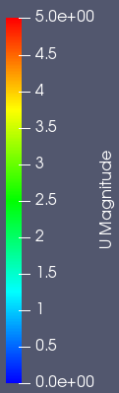
Tet Mesh
Hybrid Mesh
XY Plane
MRE | MAE | MSE
3.85% | 0.08 | 0.01

Slide 5
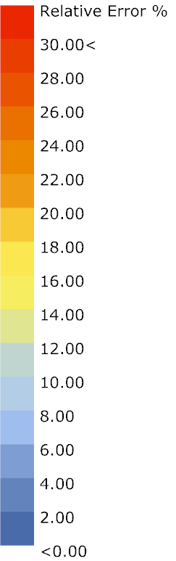
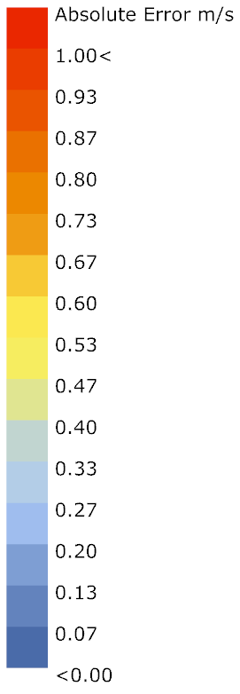
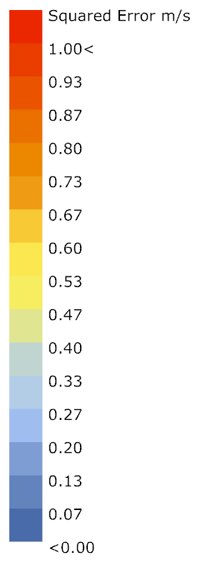
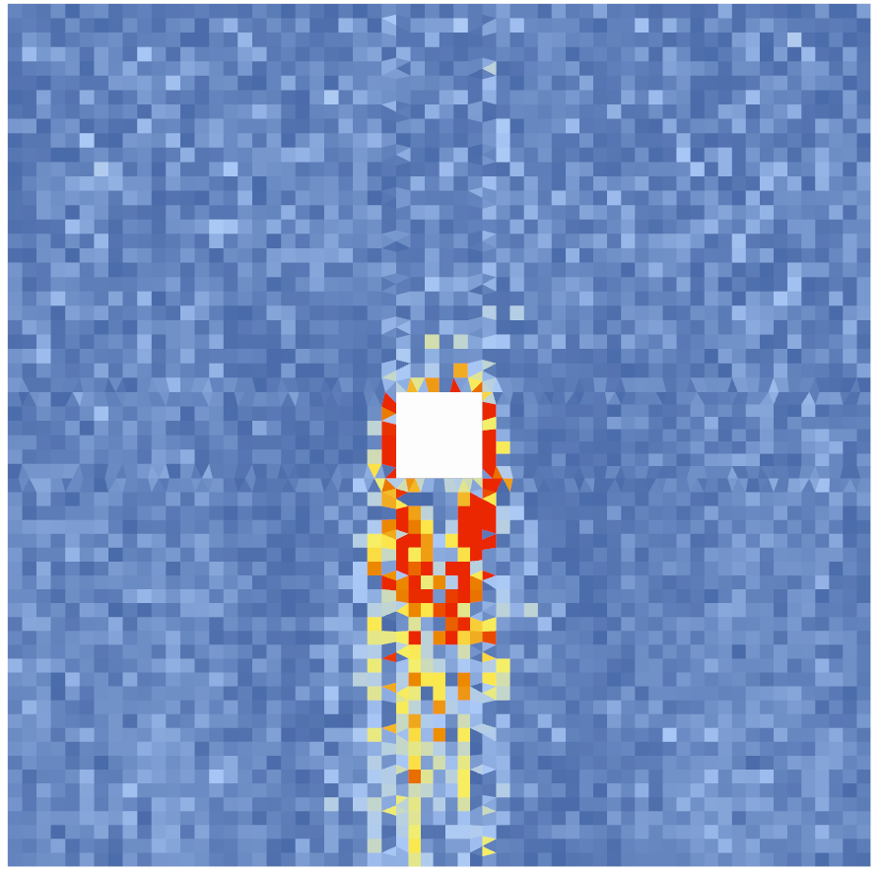
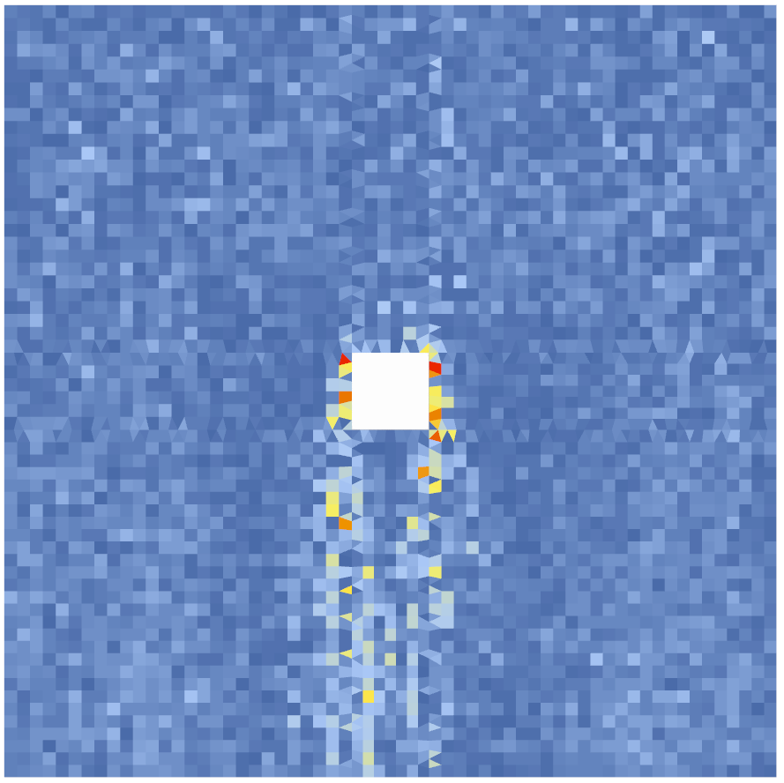
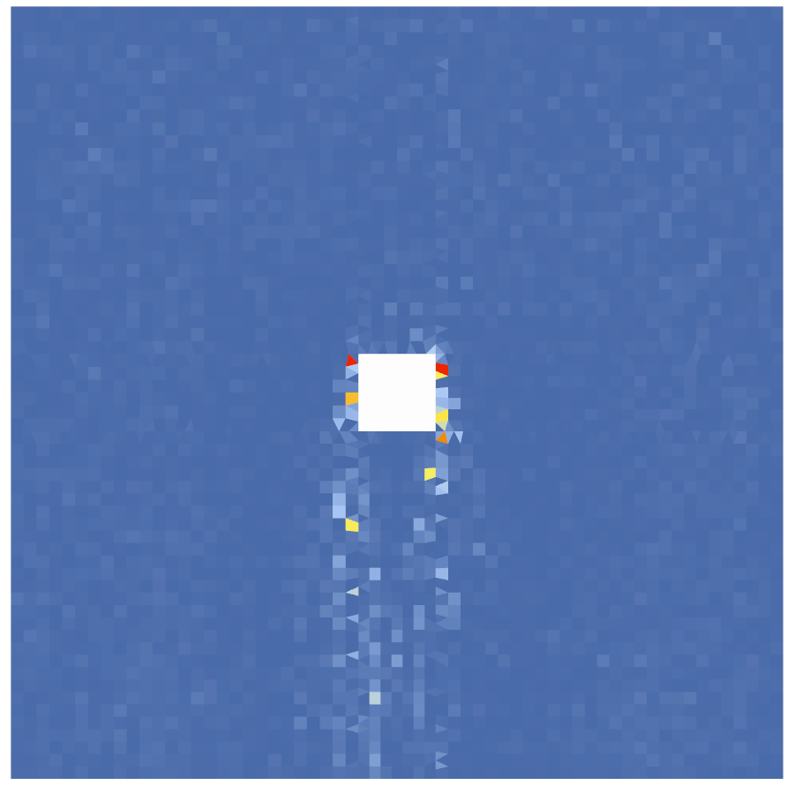
XY Plane
Relative Error Distribution
Absolute Error Distribution
Squared Error Distribution
MRE | MAE | MSE
3.85% | 0.08 | 0.01

Slide 6
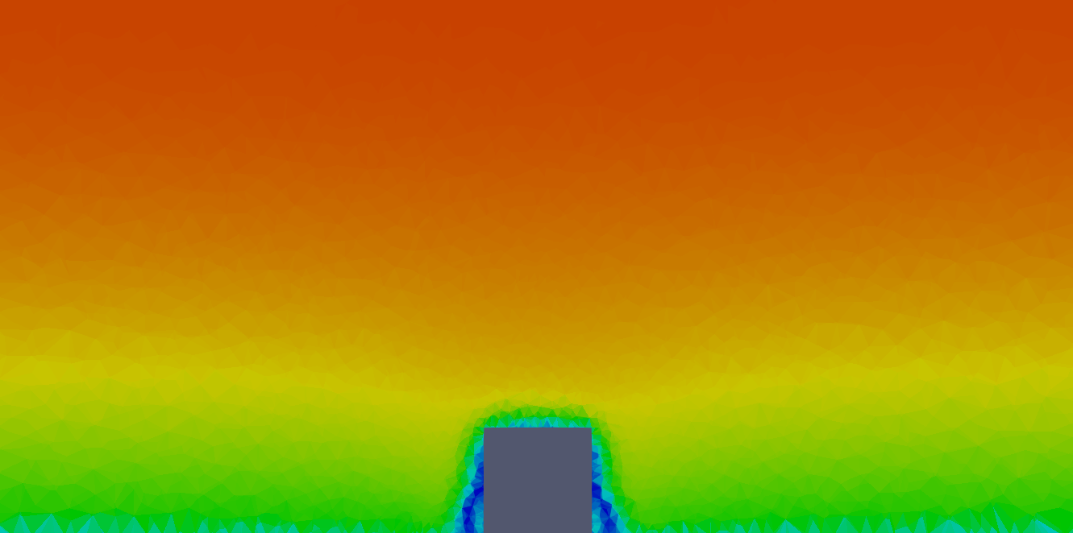
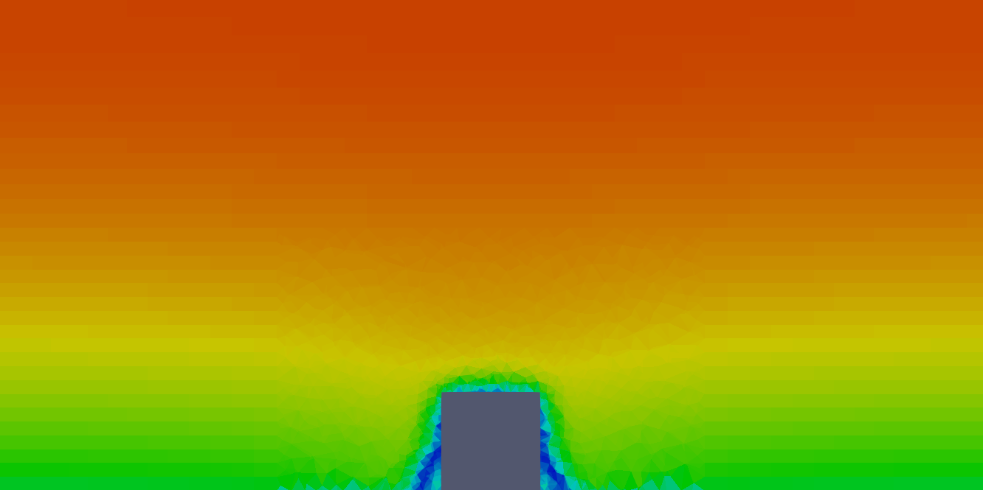
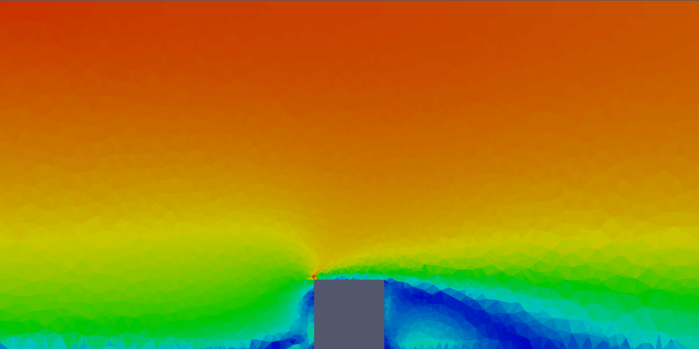
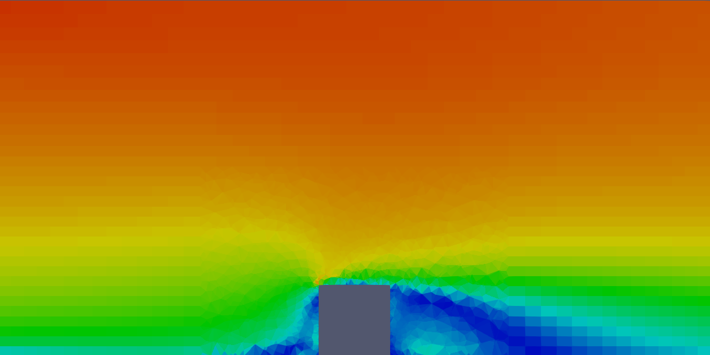
Tet Mesh
Hybrid Mesh
MRE | MAE | MSE
1.95% | 0.04 | 0.01
XZ Plane
MRE | MAE | MSE
2.76% | 0.04 | 0.01
YZ Plane

Slide 7

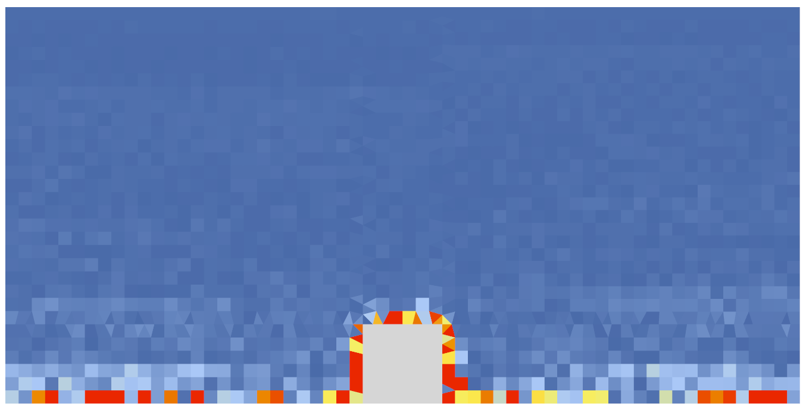

XZ Plane
Absolute Error Distribution
Relative Error Distribution
MRE | MAE | MSE
1.95% | 0.04 | 0.01
Squared Error Distribution

Slide 8

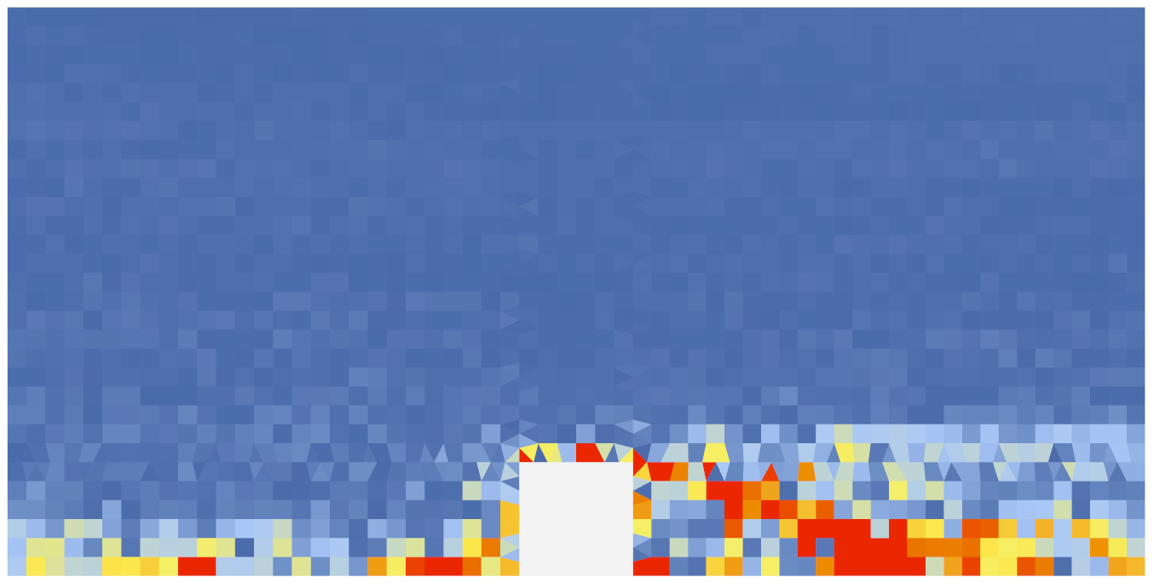

YZ Plane
Absolute Error Distribution
Relative Error Distribution
MRE | MAE | MSE
2.76% | 0.04 | 0.01
Squared Error Distribution

Slide 9
Findings
The similar flow patterns are achieve between the tetrahedral mesh scheme and hybrid mesh scheme;
Higher errors are distributed near the ground and building boundary layer;
Higher relative errors are found in the wind shadow area while the error magnitude is not significant in terms of absolute and squared errors.
Finest meshes along the ground and building boundary should be allocated to improve the accuracy;
Finer meshes should be arranged in the wind shadow area or integrate adaptive mesh strategy in this area.

