Slide 1

Portfolio Website Content

Slide 2
Home page Website Content

Slide 3
Home section
Let’s shape your business DIGITALLY today!
Start receiving online orders with no effort when you get your own website & mobile application at 0% commission.

Slide 4
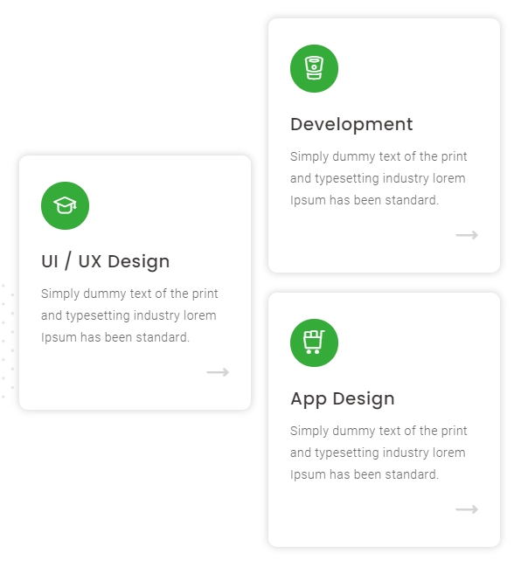
About
Websites
Give your idea a place to grow online and create a website you’re proud of.
Mobile Apps
Get high performance and scalable mobile app development services for your business.
Brand Your Platform
You’ve got multiple features to help you to get your own stage with creative decoration.

Slide 5

About
Your website is ready..
Fast, secure and always online!
+
Free Domain
Make your idea real. Claim your space online with a domain that is built into your package.
+
Grow your business
Track your performance, and create campaigns from the same dashboard.
+
Flexible Themes
Do you want a platform that feels like you? Choose your favorite layout to best display your business.
+
Customer Support
We’ve got your back and ready to help you 7 days/ week.

Slide 6
Features (instead of Services)
Our services has no limits..
See what a website can do!
+
Manage your platform
Your handy dashboard allows you to manage your stock, present your products & services and follow your statistics.
+
Dashboard for every job role
Your dashboard is tailored to your role in the business: owner, manager, operator and delivery driver.
+
Streamline your orders
Watch your order operations become one synchronized process. No more running around chasing orders.
+
Activate online payment
Your storefront is equipped with plenty of payment gateways using cash or credit card.

Slide 7
Features (instead of Services)
Our services has no limits..
See what a website can do!
+
Monitor & analyze your growth
Plan for the future with sales analytics. Your dashboard records all your online dealings, and it analyzes it too.
+
Flexible voucher system
Your vouchers are designed to leave room for brand creativity.
+
Protect your data and your customers
We provide you with the SSL certificate that protects the data going to and from your site, from personal info to credit card numbers.
+
Promote your website
Get professional tools to drive traffic to your website, boost engagement and see how visitors behave on your site.

Slide 8
portfolio
Corporate
ONline
Restaurant
Eat’s Crispy
Restaurant
Grill Valley

Slide 9
Pricing
Get more than just a website
Business & eCommerce Plans
30 Days Plan
3 Months Plan
6 Months Plan
12 Months Plan
3 Years Plan
Billed monthly
Billed quarterly
Billed semi-annually
Billed annually
Billed for one time
Then It will be for free
2000 LE/ Month
1800 LE/ Month
1700 LE/ Month
1600 LE/ Month
1600 LE/ Month
Included in plan:
Unlimited user accounts
Personalized onboarding with free setup
Delivery services integration
Discount vouchers
Custom domain name
Customer Support
Stock Management
Analytics for customer behavior and geolocation
Performance analysis and reports

Slide 10
FAQs
+
How does ONline help small business owners succeed?
We offer more than just a platform to build your website, we offer everything you need to create an effective, memorable online presence. Already have a site? We offer hosting plans that will keep it fast, secure and online.
+
Why do I need a website for my business?
Even small local businesses that only serve their hometown need a site. That's because the web is the first place people go when looking for a product or service.
+
Why choose ONline for building your website
Because it’s a fast, simple way to create a website that you and your customers will love. Simply type in your idea or industry and ONline will provide you with professionally designed, ready-to-launch templates. From there, just add your own text and images and you’re good to go.
+
How can I get my own personalized email address?
Once you have your own domain, you can purchase a Google Workspace mailbox and get a custom email address using your domain.
+
What is the process of signing up?
It’s simple: Choose your pricing plan, Send in your restaurant information, and your account manager will set up your website in 24 hours. We also offer online training sessions on how to manage your dashboard.

Slide 11
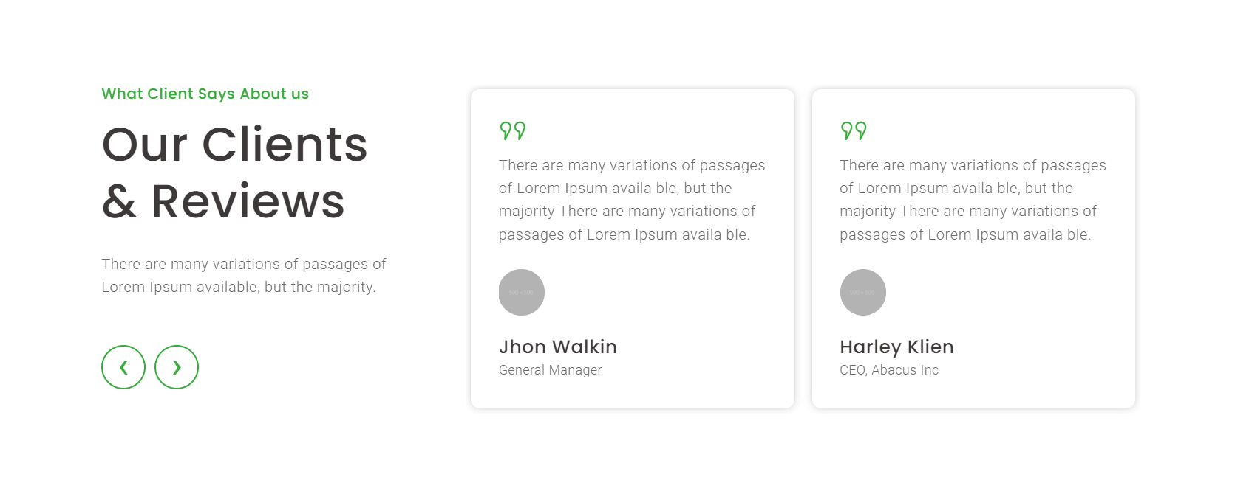
Clients review
Header
Description
Image
header
description

Slide 12
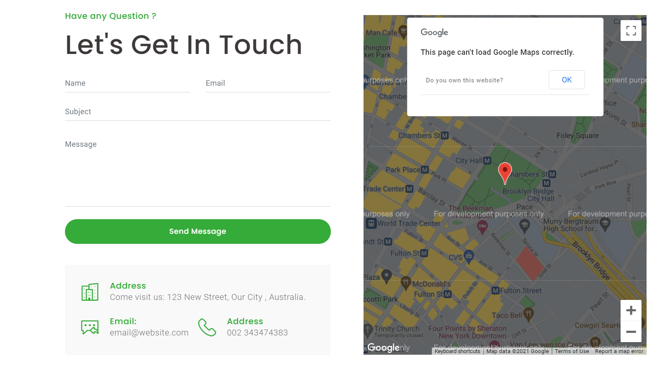
Contact us
Same of digital bond information

Slide 13


