Slide 1

Portfolio Website Content

Slide 2
Home page Website Content

Slide 3
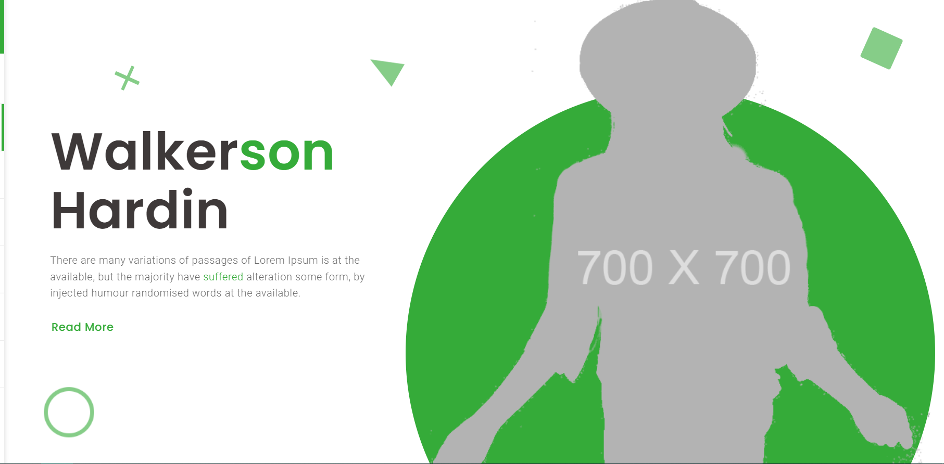
Home section
Header
paragraph
Image 800 x 800

Slide 4
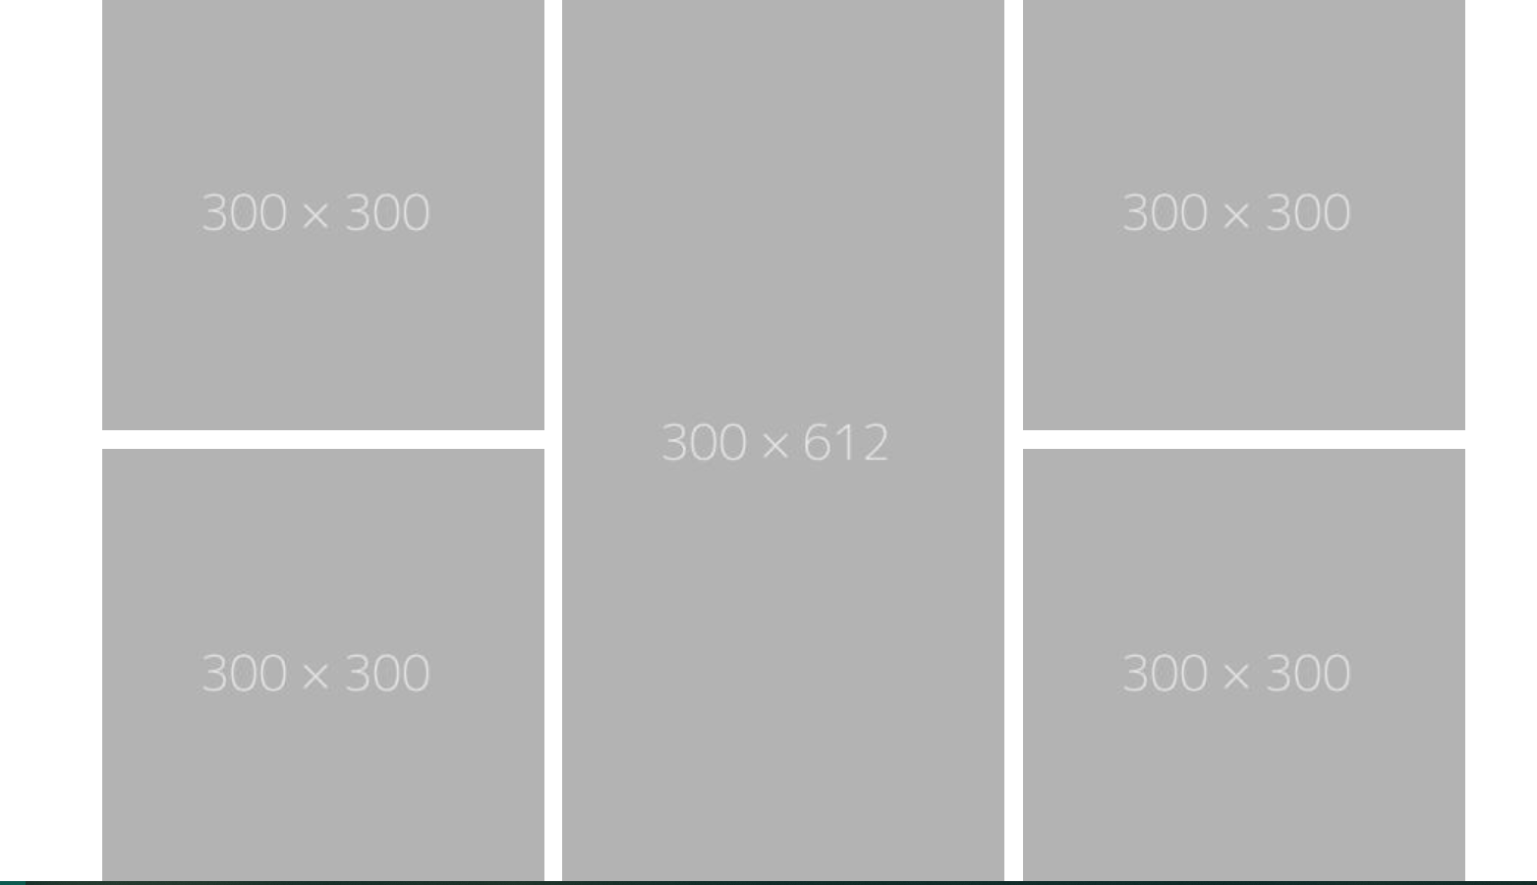
portfolio
image
description
Find whatever you love with us

Slide 5
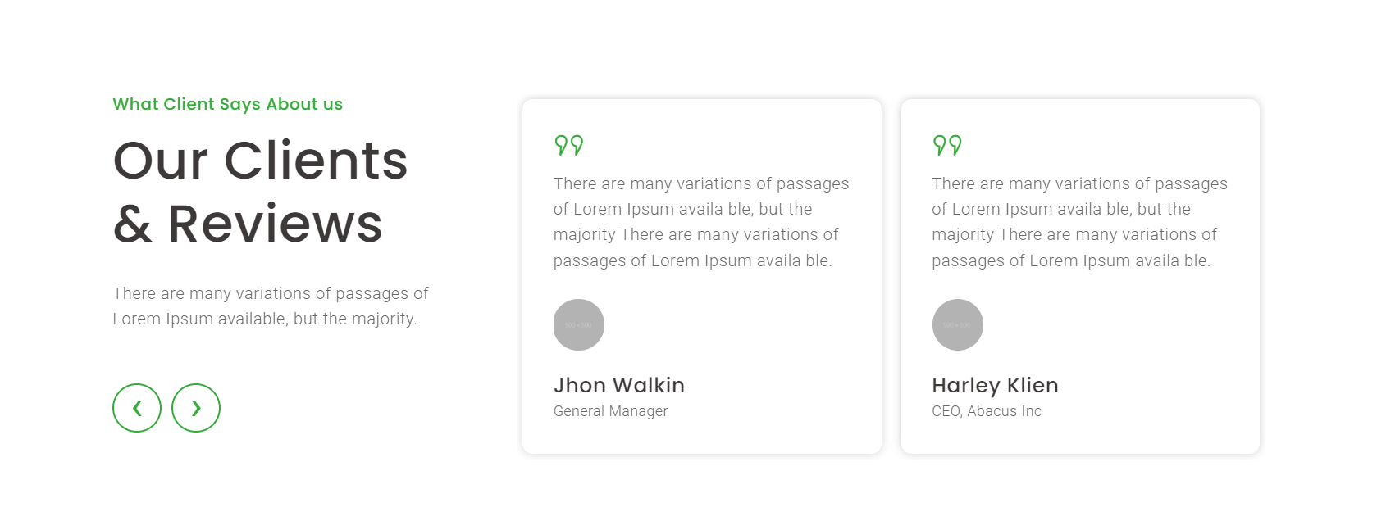
Clients review
Header
Description
Image
header
description

Slide 6
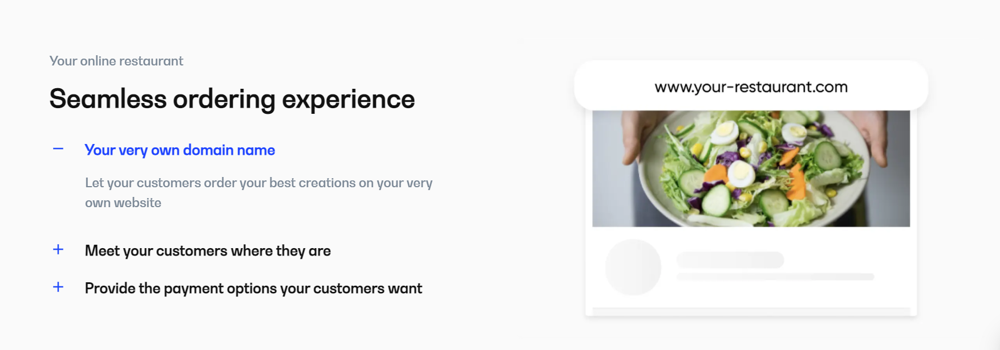
services
Header
description
Image 500 h x w 650

Slide 7
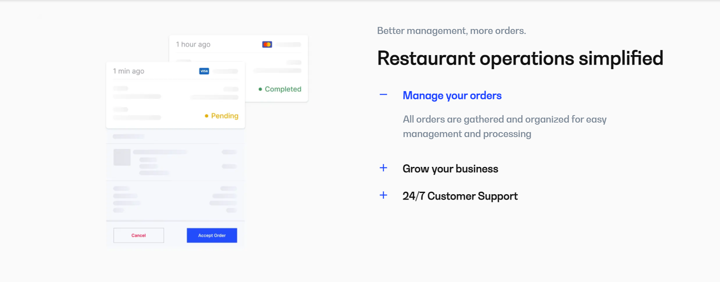
Features
Header
Image 500 h x w 650
description

Slide 8
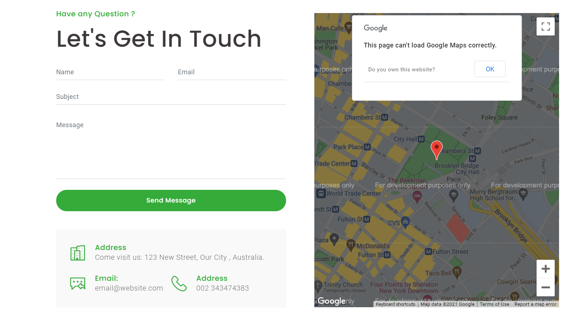
Contact us
Field you want
Map
details

Slide 9


