Slide 1

Your GPU Nodes Deserve Better: Flatcar Container Linux for AI Workloads
KubeCon + CloudNativeCon North America 2026
Jan Bronicki & Sayan Chowdhury

Slide 2
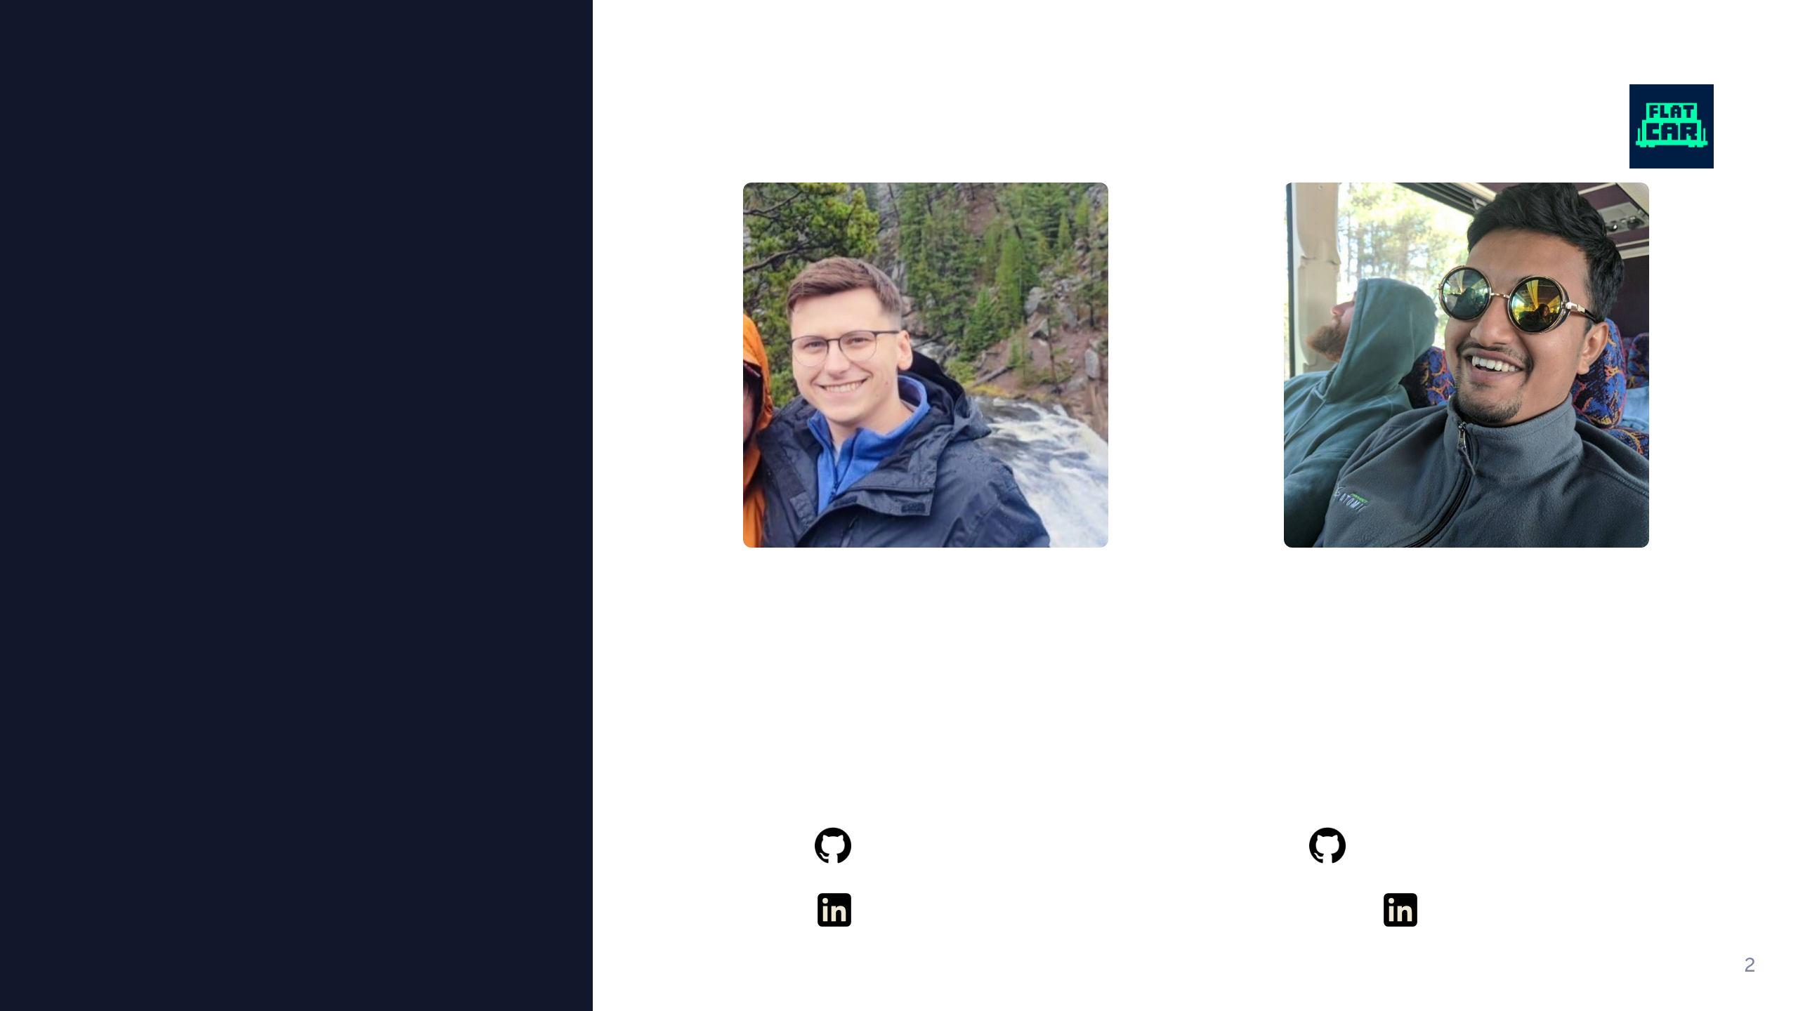
Who are we
Jan Bronicki
Sayan Chowdhury
Flatcar Maintainer
Software Engineer at Microsoft
Flatcar Maintainer
Software Engineer at Microsoft
@John15321
jan-bronicki
@sayanchowdhury
yudocaa

Slide 3

Agenda
The community behind Flatcar
Flatcar in five minutes, live in a VM
sysexts and Kubernetes, live in a VM
Release channels
The GPU node problem: NVIDIA drivers as sysexts, live on AWS
Live: an LLM, GPU metrics, and Triton on Flatcar

Slide 4

Community Stewarded
What that means, and who we are

Slide 5

Community stewarded
Fully open, fully free: Apache 2.0, public roadmap, public issue tracker
No single owner: the project and trademark belong to the CNCF and the Linux Foundation
CNCF project: neutral governance under the Cloud Native Computing Foundation
You can join: SIG meetings are public; anyone can propose changes or maintain
Flatcar is a CNCF project

Slide 6
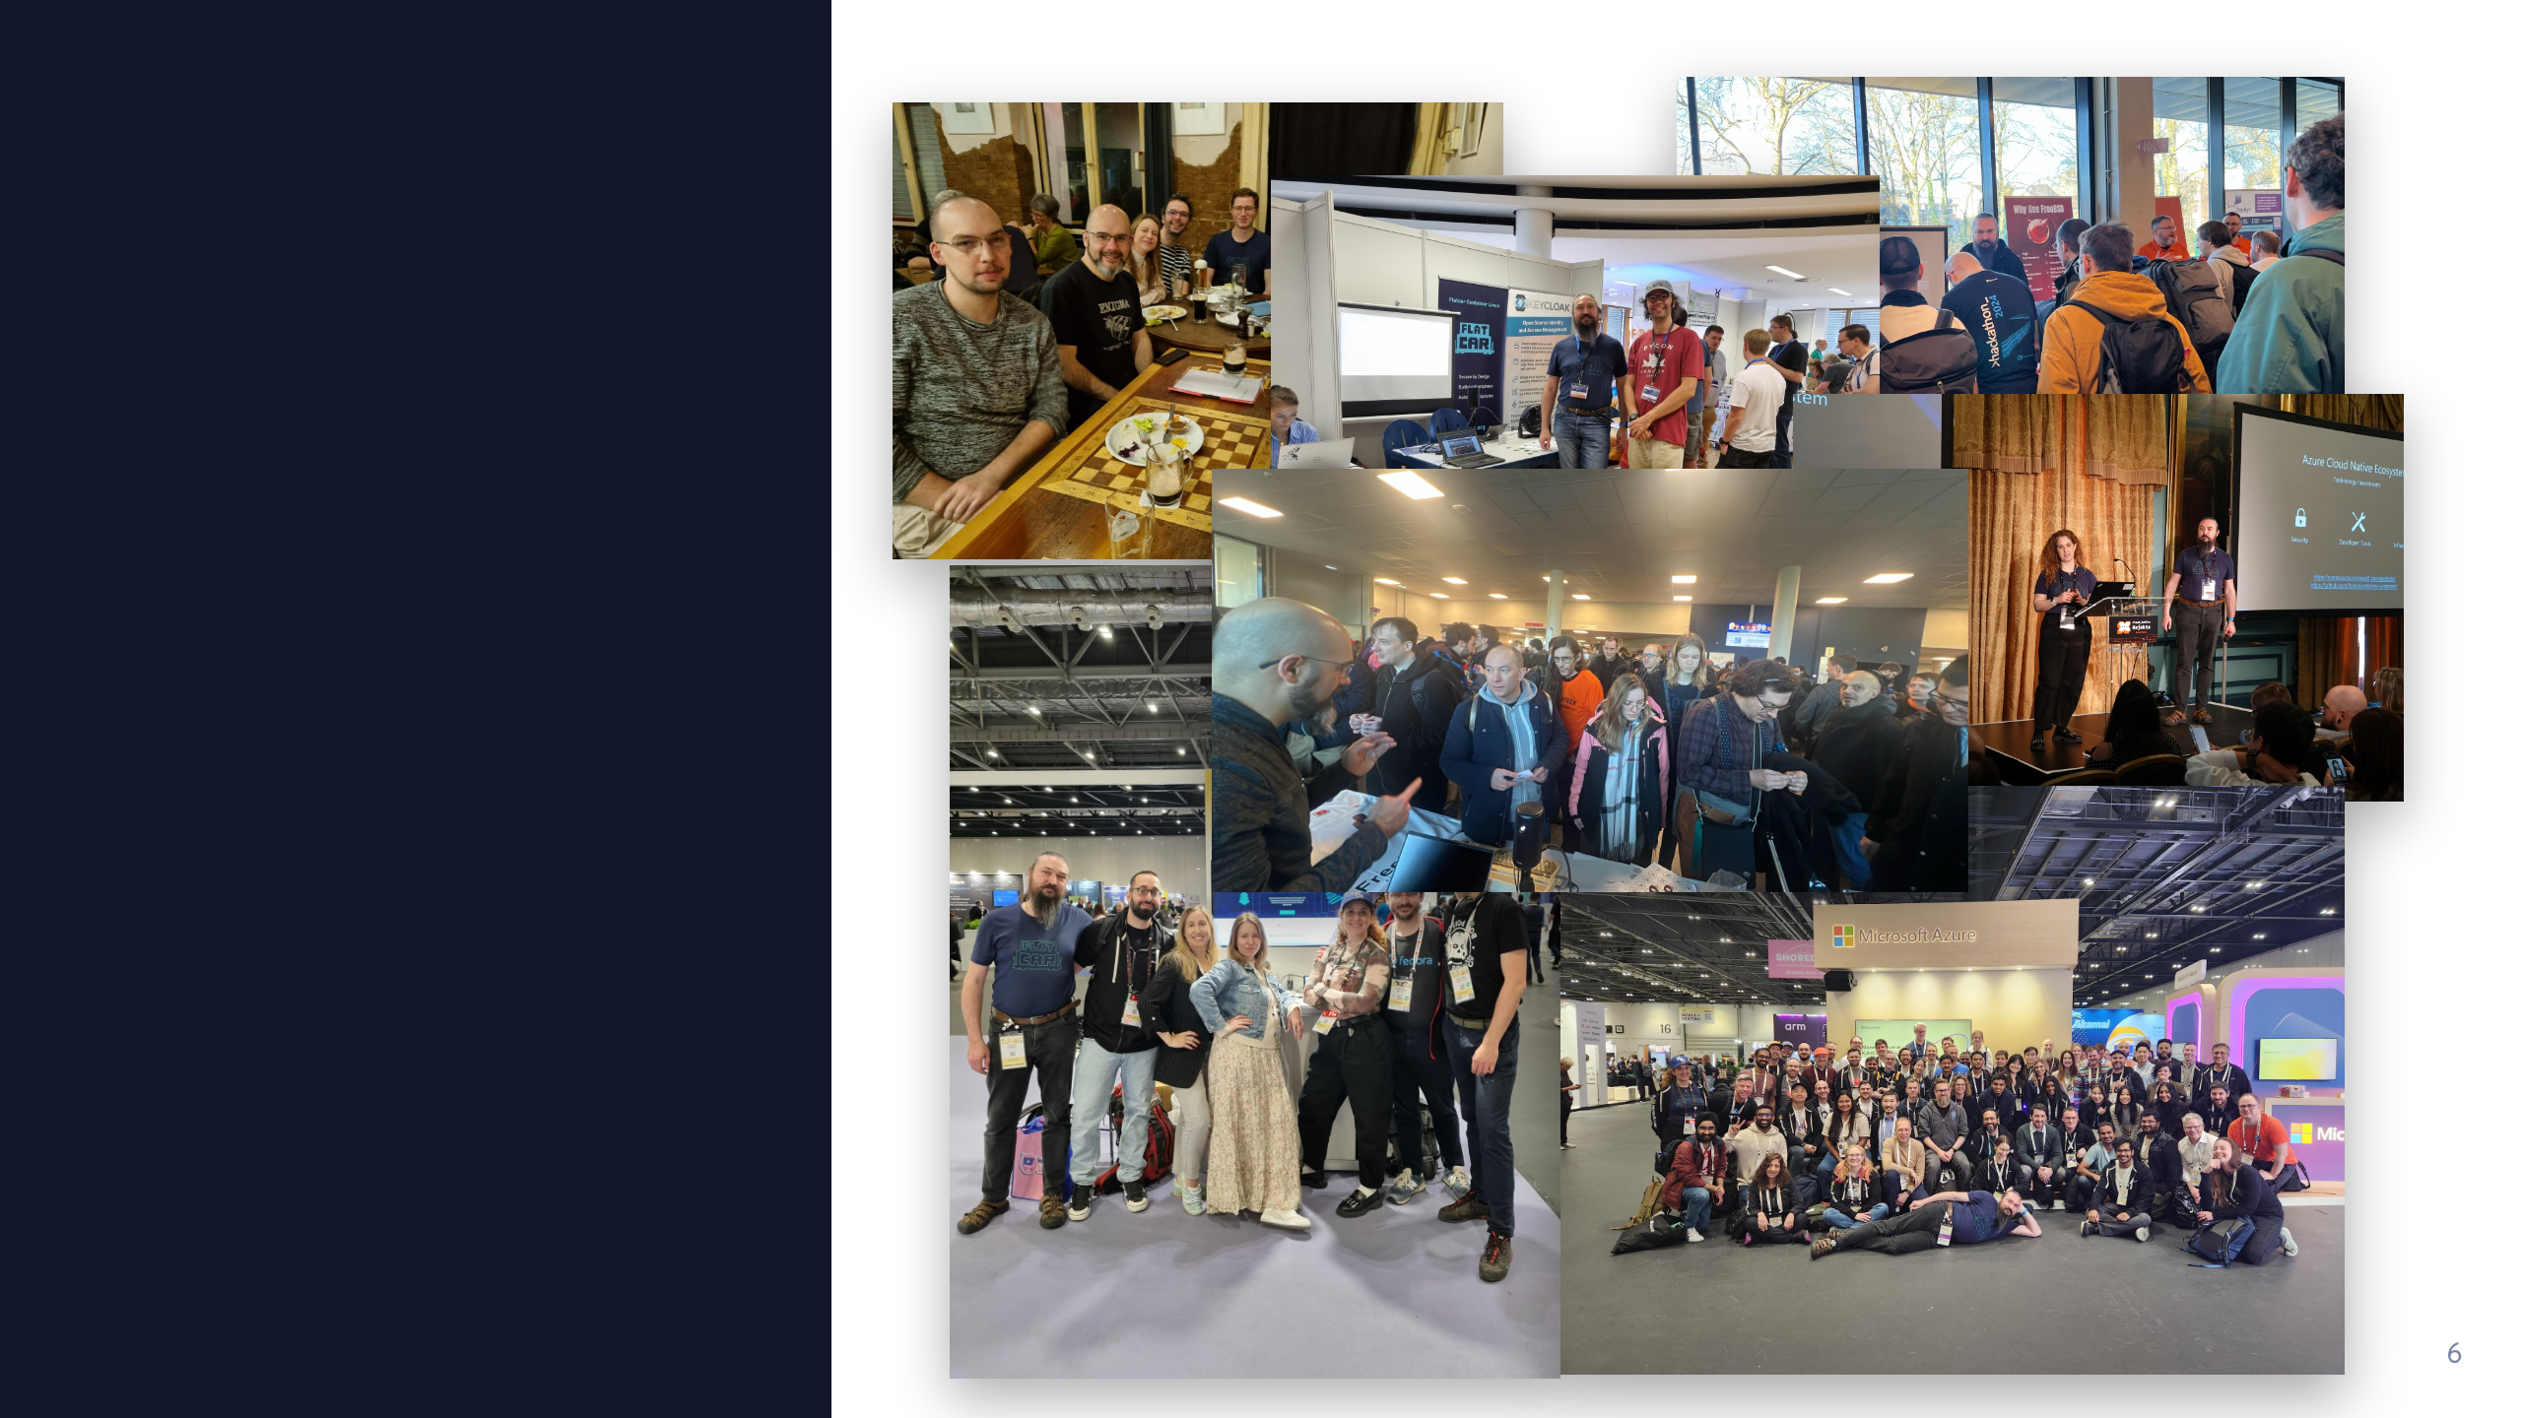
The community

Slide 7
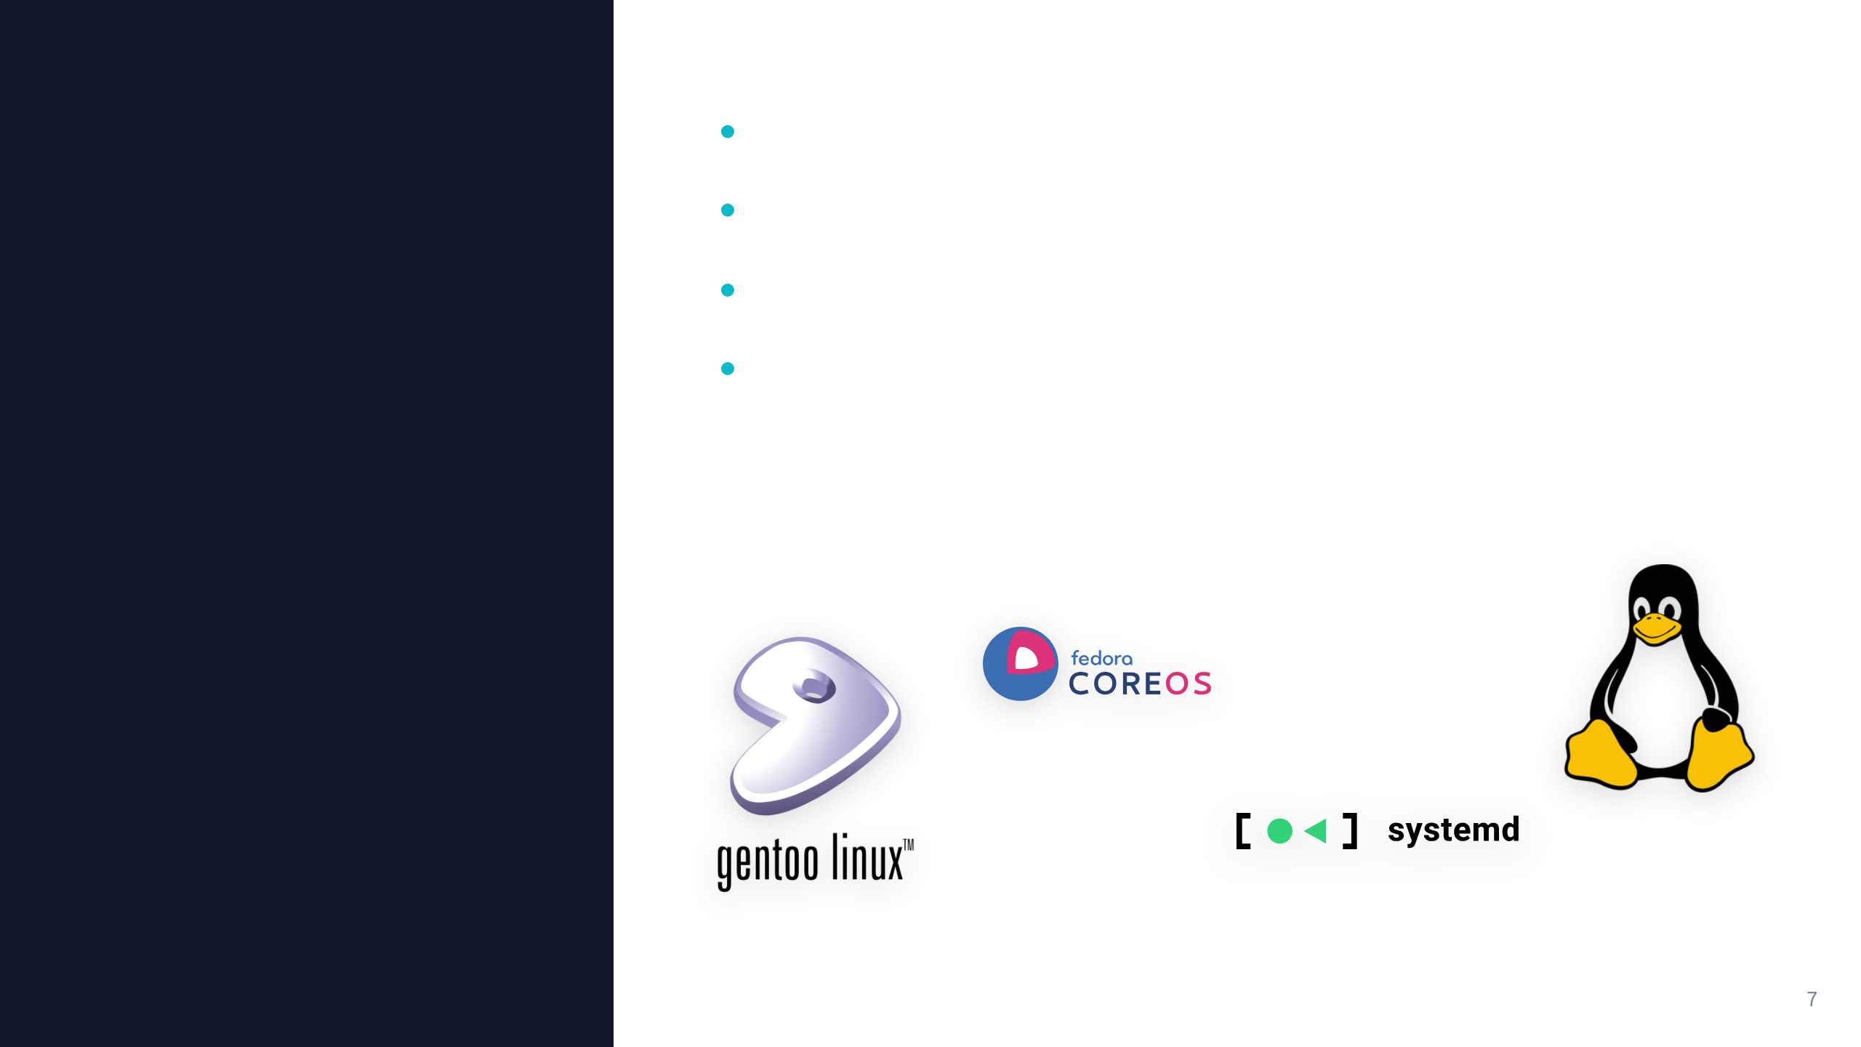
We work with
Gentoo and Fedora CoreOS
systemd, Dracut, Grub, Afterburn
Openwall oss-security non-disclosure list
Co-founders of the UAPI Group, cross-distro SIG for image-based Linux

Slide 8
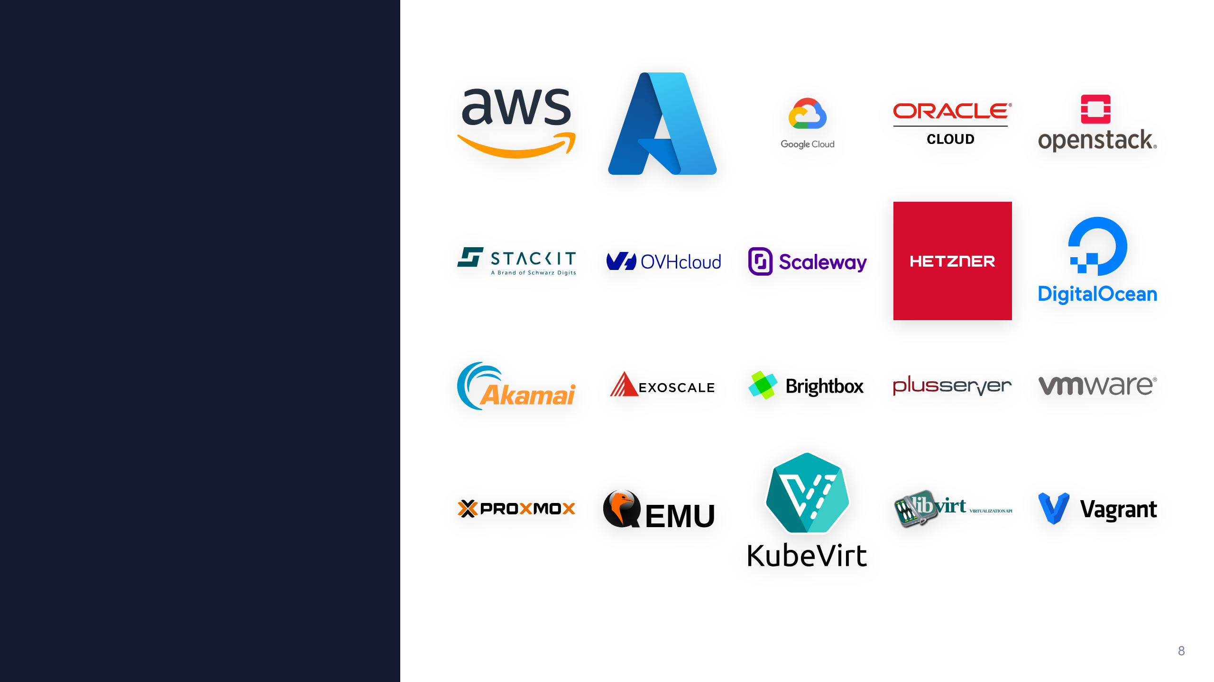
Runs everywhere

Slide 9
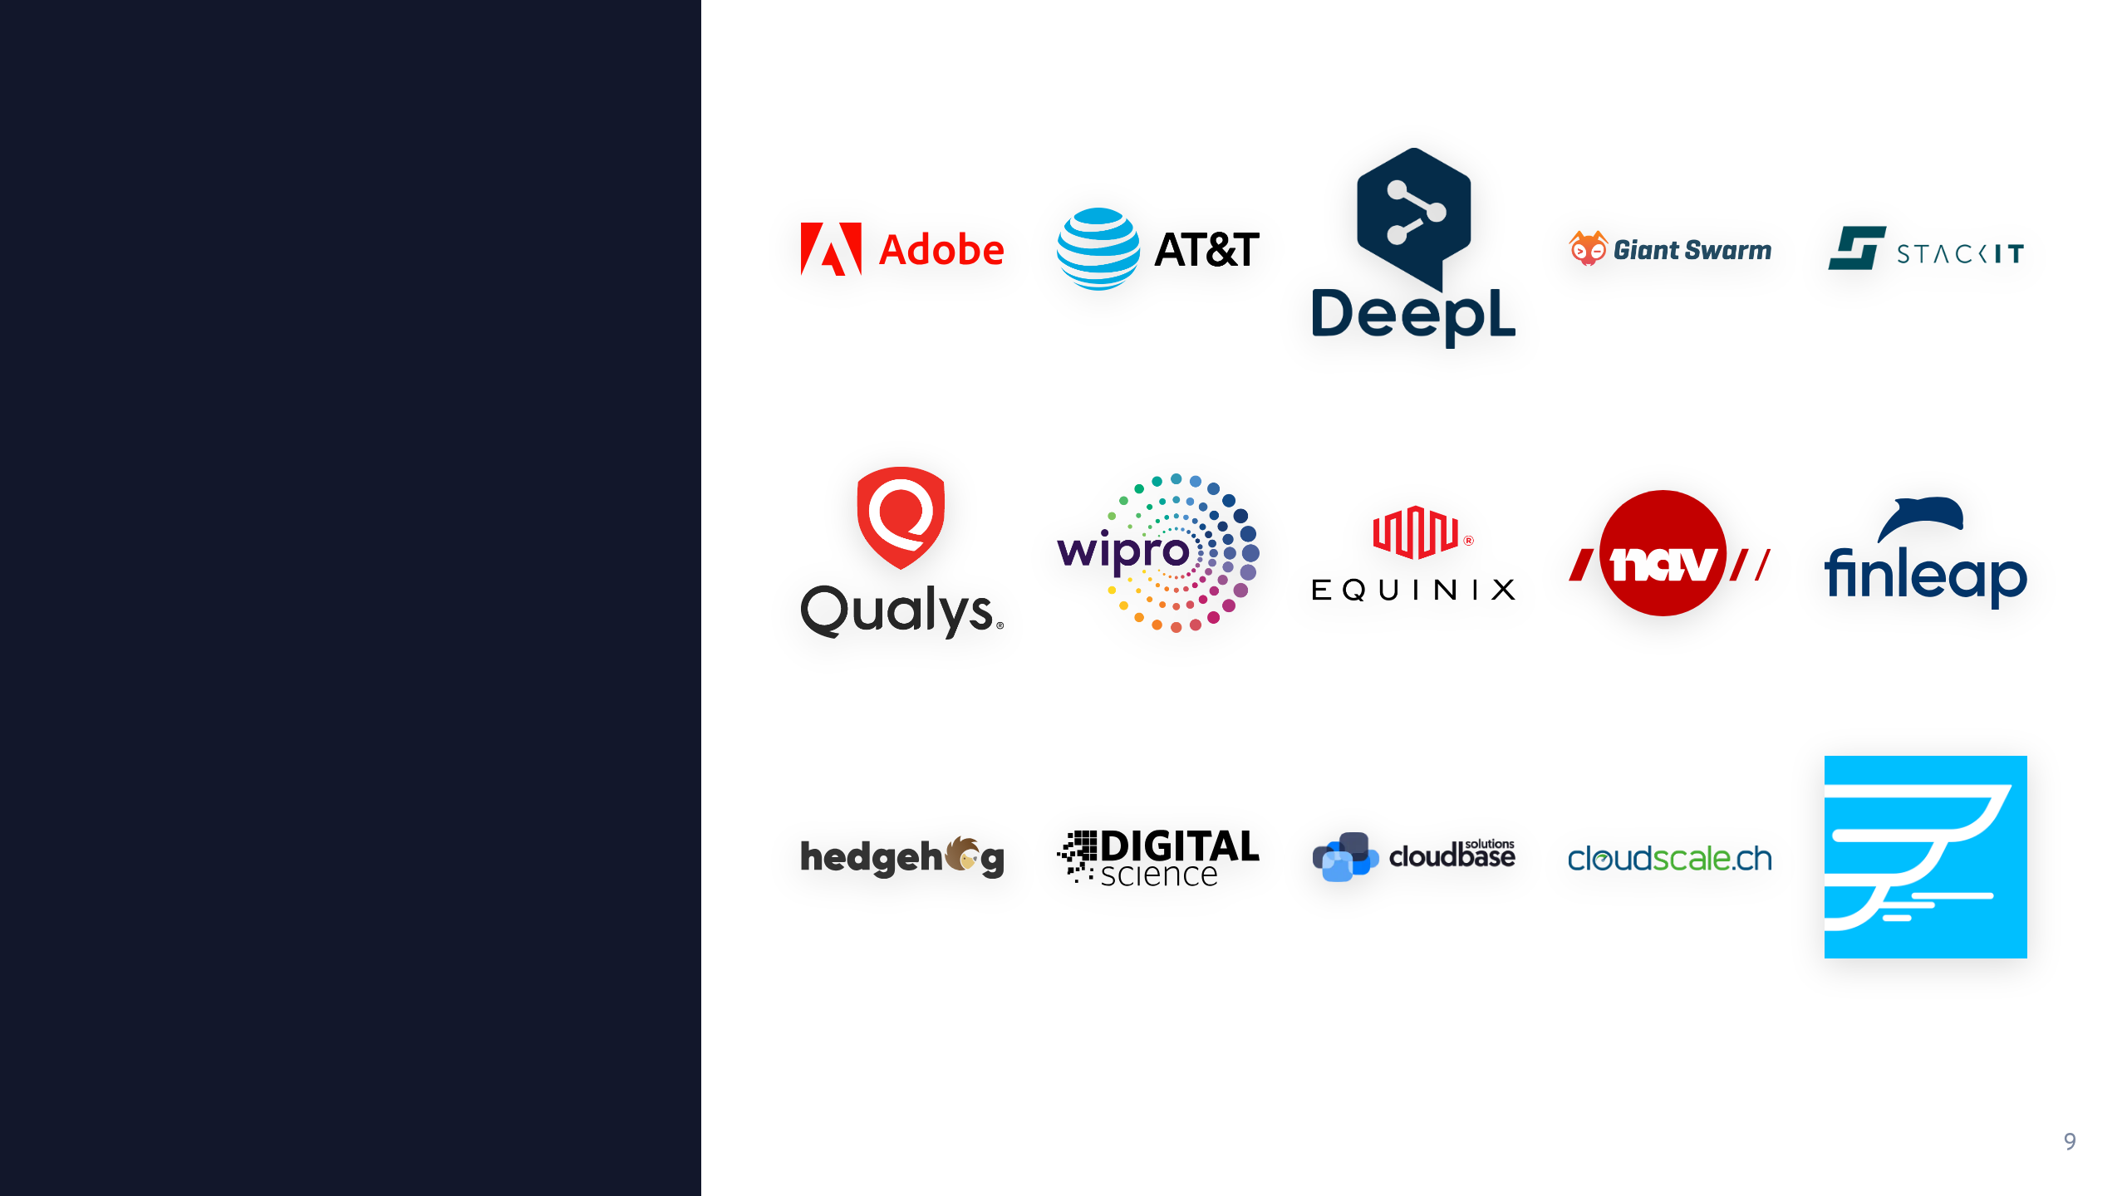
In production at

Slide 10

What Problem Do We Solve?
Why the OS is still the odd one out

Slide 11

Everything is code. Almost.
Already declarative
Still treated differently
Dockerfiles
Host OS installed interactively
Kubernetes manifests, Helm charts
Changed over time
Repaired manually when it breaks
GitOps workflows
CI/CD pipelines

Slide 12
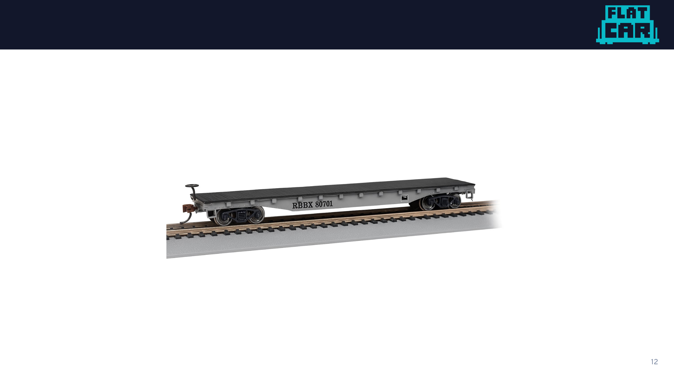
Flatcar?

Slide 13
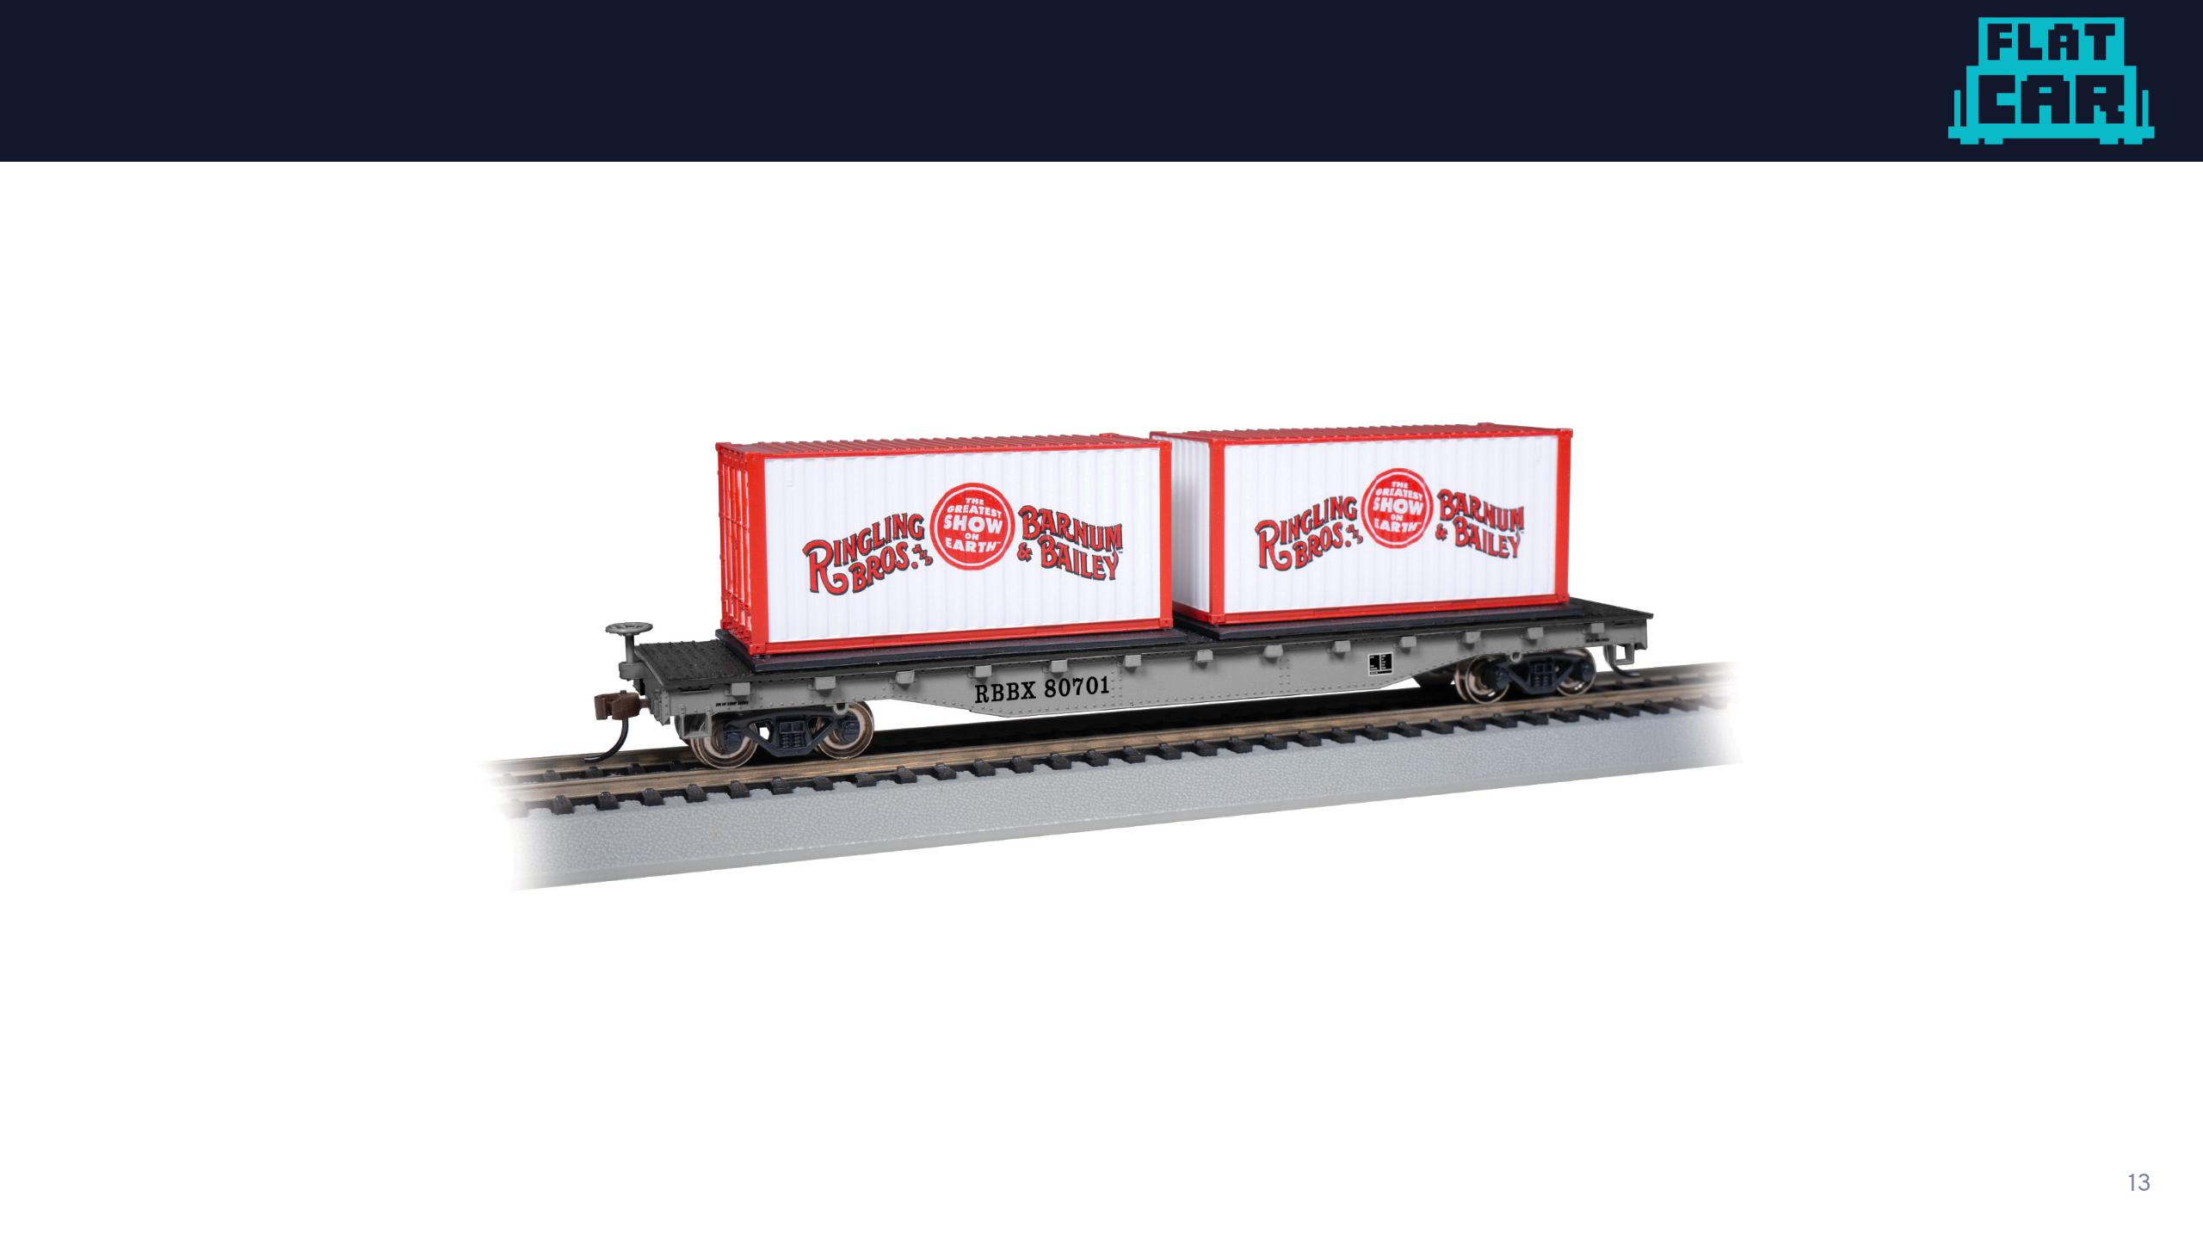
Flatcar!

Slide 14
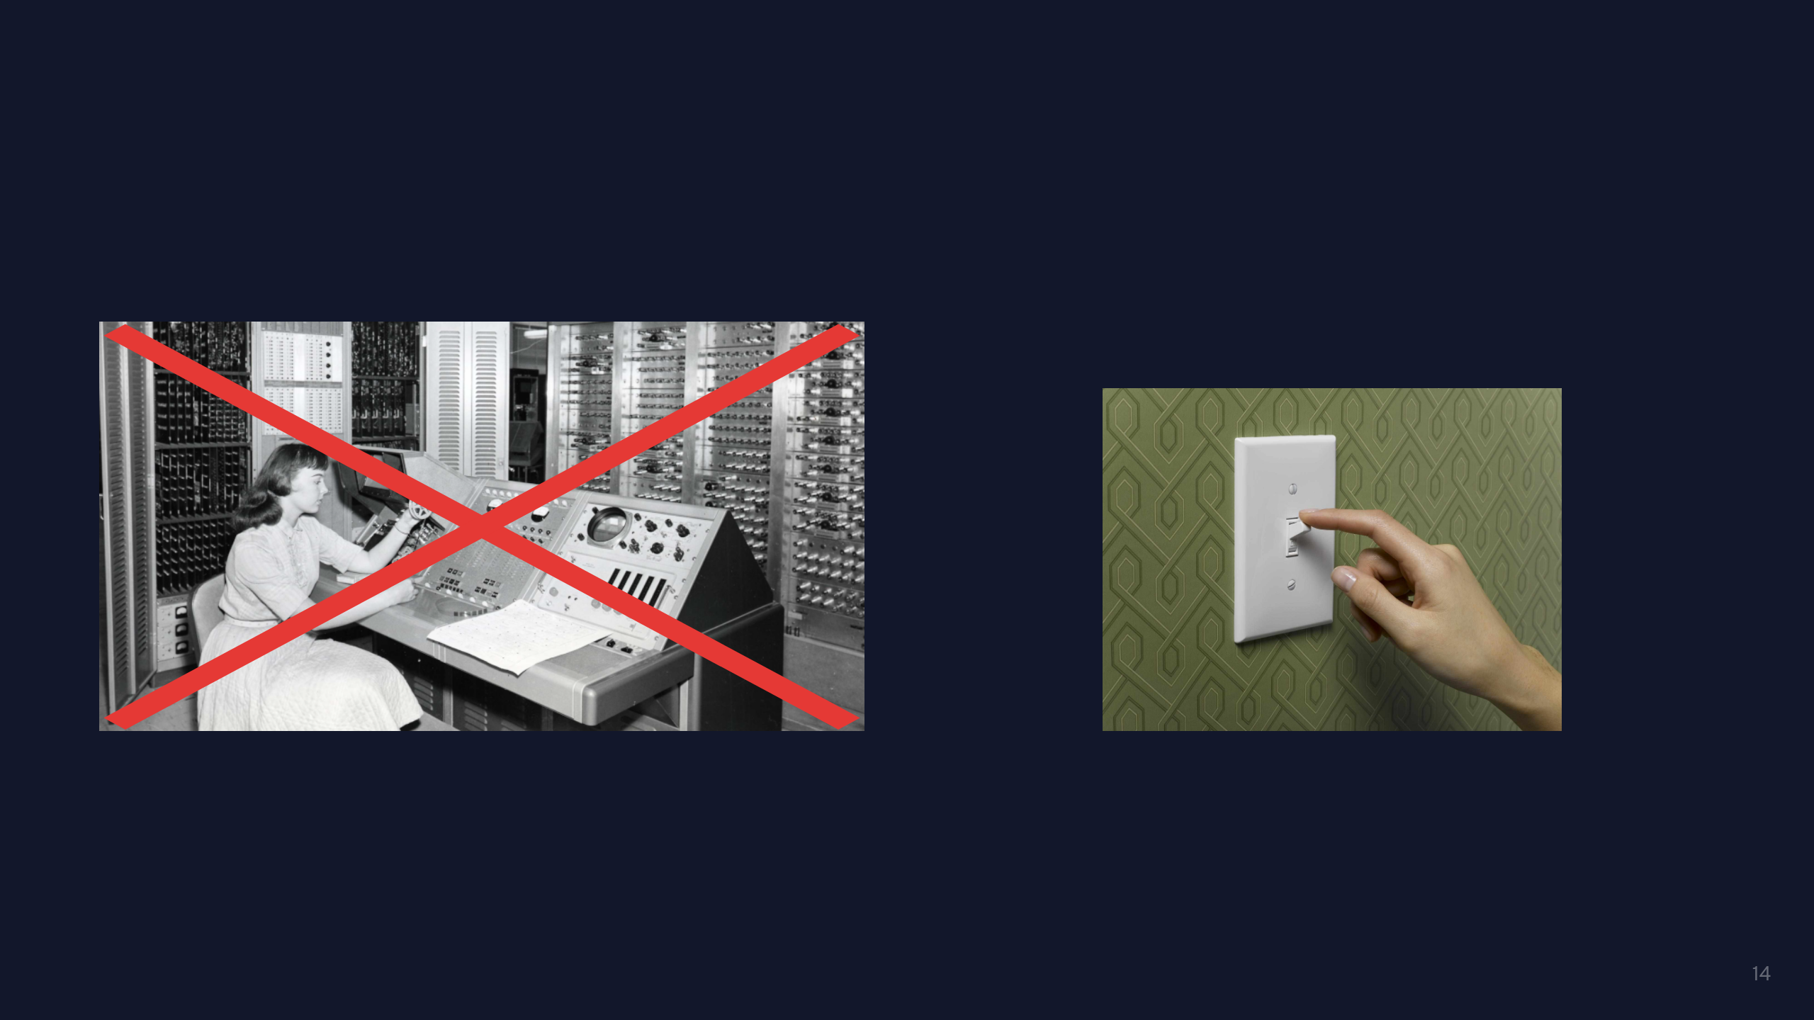
The UX we chose
General-purpose Linux
Flatcar

Slide 15

Operating Systems as Code
A versioned, declarative artifact. Provisioned, not installed.

Slide 16

Provisioned, not Installed
Traditional install
Flatcar: provisioned
Interactive choices during setup
One declarative config, applied at boot
Every machine ends up a little different
Every machine identical, reproducible
Manual updates, package churn, drift
No separation between OS and config
Whole-OS atomic updates, no drift
Same idea as containers, with the config in Git

Slide 17
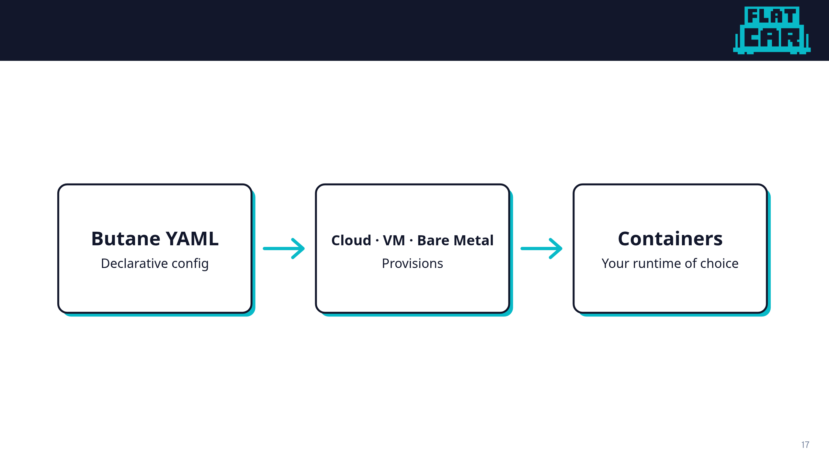
Flatcar Workflow

Slide 18
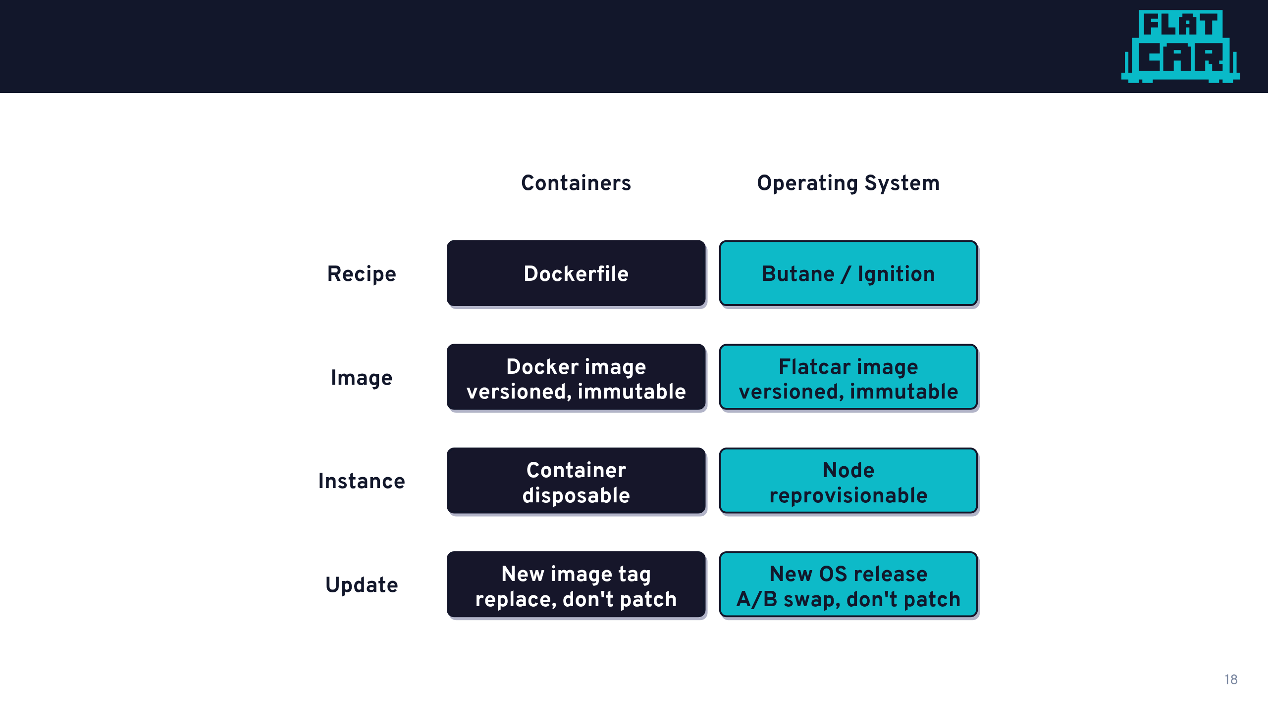
The Container Philosophy, for the OS

Slide 19

What Butane looks like
# Butane config header: declares this is a Flatcar config
variant: flatcar
version: 1.0.0
# Drop in a systemd unit. Flatcar installs and starts it at first boot
systemd:
units:
- name: nginx.service
enabled: true
contents: |
[Service]
ExecStart=/usr/bin/docker run --rm -p 80:80 nginx
[Install]
WantedBy=multi-user.target

Slide 20
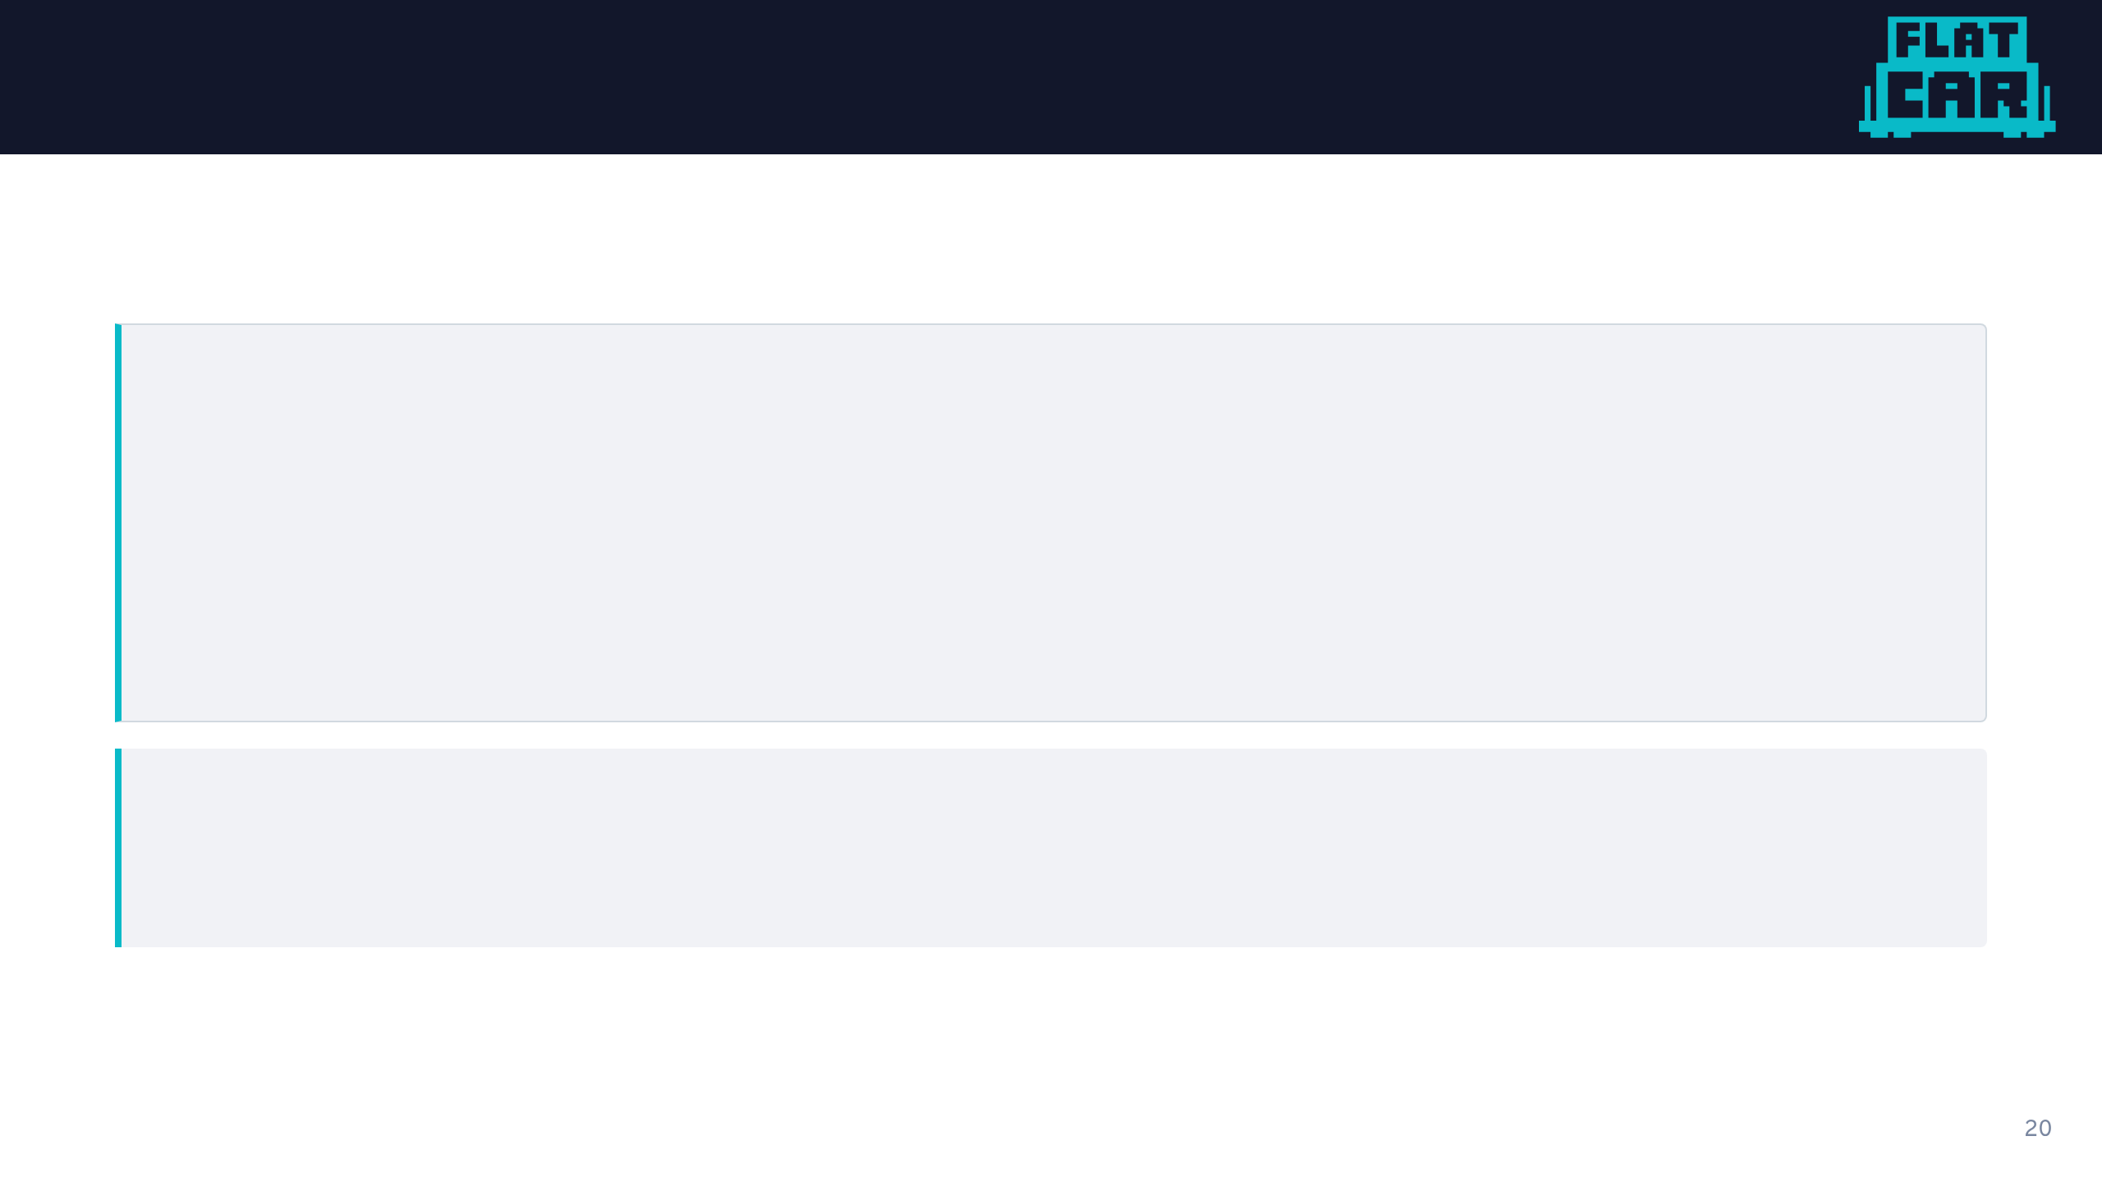
Boot it in a VM
# Transpile Butane to an ignition config (JSON)
$ butane -o config.ign config.bu
# Boot Flatcar in QEMU with the config applied
$ ./flatcar_production_qemu.sh -i config.ign
The config gets handed to Flatcar as user-data. Same channel every major cloud, hypervisor, and bare-metal provisioner uses to seed an instance.

Slide 21

It came up serving
$ systemctl is-active nginx.service
active
$ curl -sI http://localhost
HTTP/1.1 200 OK
Server: nginx/1.27.3
Content-Type: text/html
No login. No post-boot setup. The machine came up already doing its job.

Slide 22

What's Up With That Immutability Thing?
Immutable by design

Slide 23

Immutable by Design
First boot provisions from config. After that: the base OS doesn't change.
The OS is read-only and dm-verity protected.
No package updates: the entire OS updates as one unit.
Same config + same base image = identical machine every time.
sysexts for optional add-ons.

Slide 24
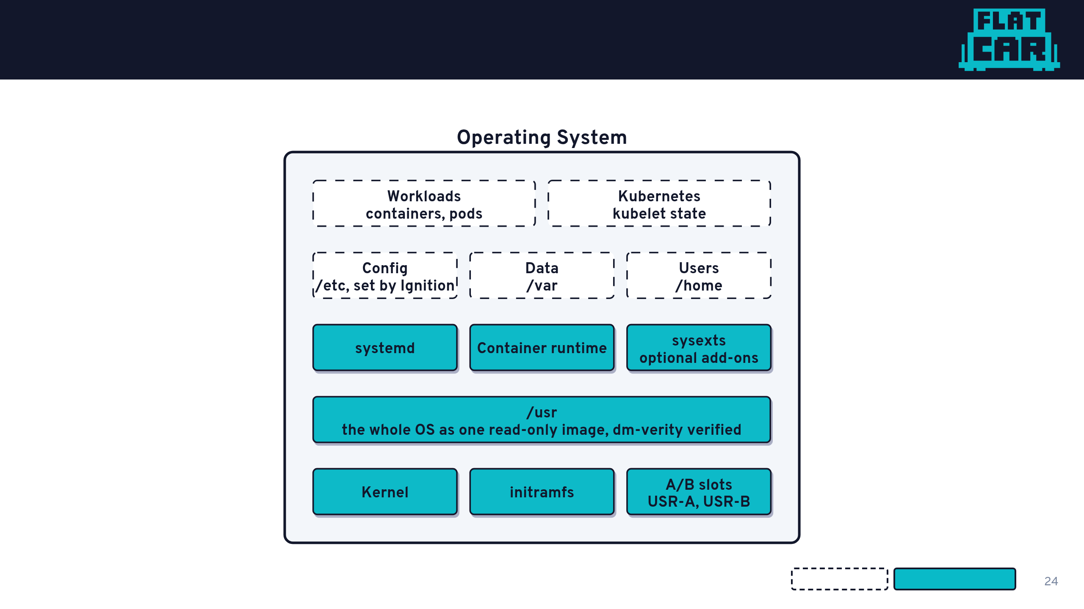
What is Immutable?
Writable: yours
Read-only: Flatcar's

Slide 25
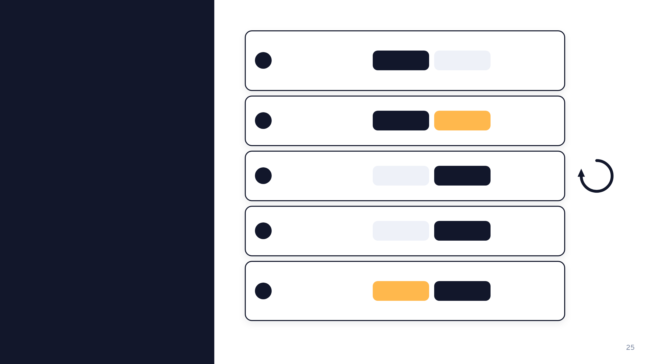
A/B Updates
Image ships both slots identical. Only true at first boot.
Fresh install
1.2.3
1.2.3
1
A
B
New image written over the passive slot. No downtime.
Update staged
1.2.3
1.2.4
2
A
B
Boot flips to B. If it fails, reboot back to A at 1.2.3.
Reboot swaps
1.2.3
1.2.4
3
A
B
B live. A untouched: it's your rollback target.
Steady running
1.2.3
1.2.4
4
A
B
1.2.5 overwrites the old 1.2.3 on A. Next reboot: A active, B rollback.
Next update
1.2.5
1.2.4
5
A
B
↺ The passive slot is never auto-synced. It's your rollback until the next update lands.

Slide 26
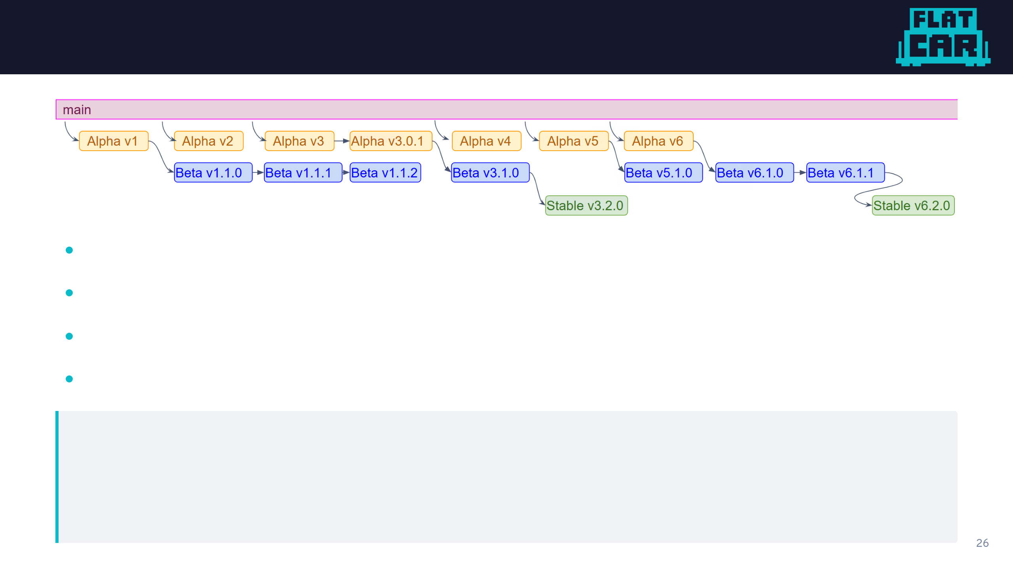
Channels
Alpha: fully tested, may have incomplete features. Developers.
Beta: production-ready. Canary alongside stable.
Stable: widespread production. Promoted from beta.
LTS: slower-moving track for environments that need it.
Every commit runs the full test suite: unit, integration, and product tests across every supported cloud. By the time a version ships, even Alpha, it's been through hundreds of runs.

Slide 27

Demos!
Let's see it running

Slide 28
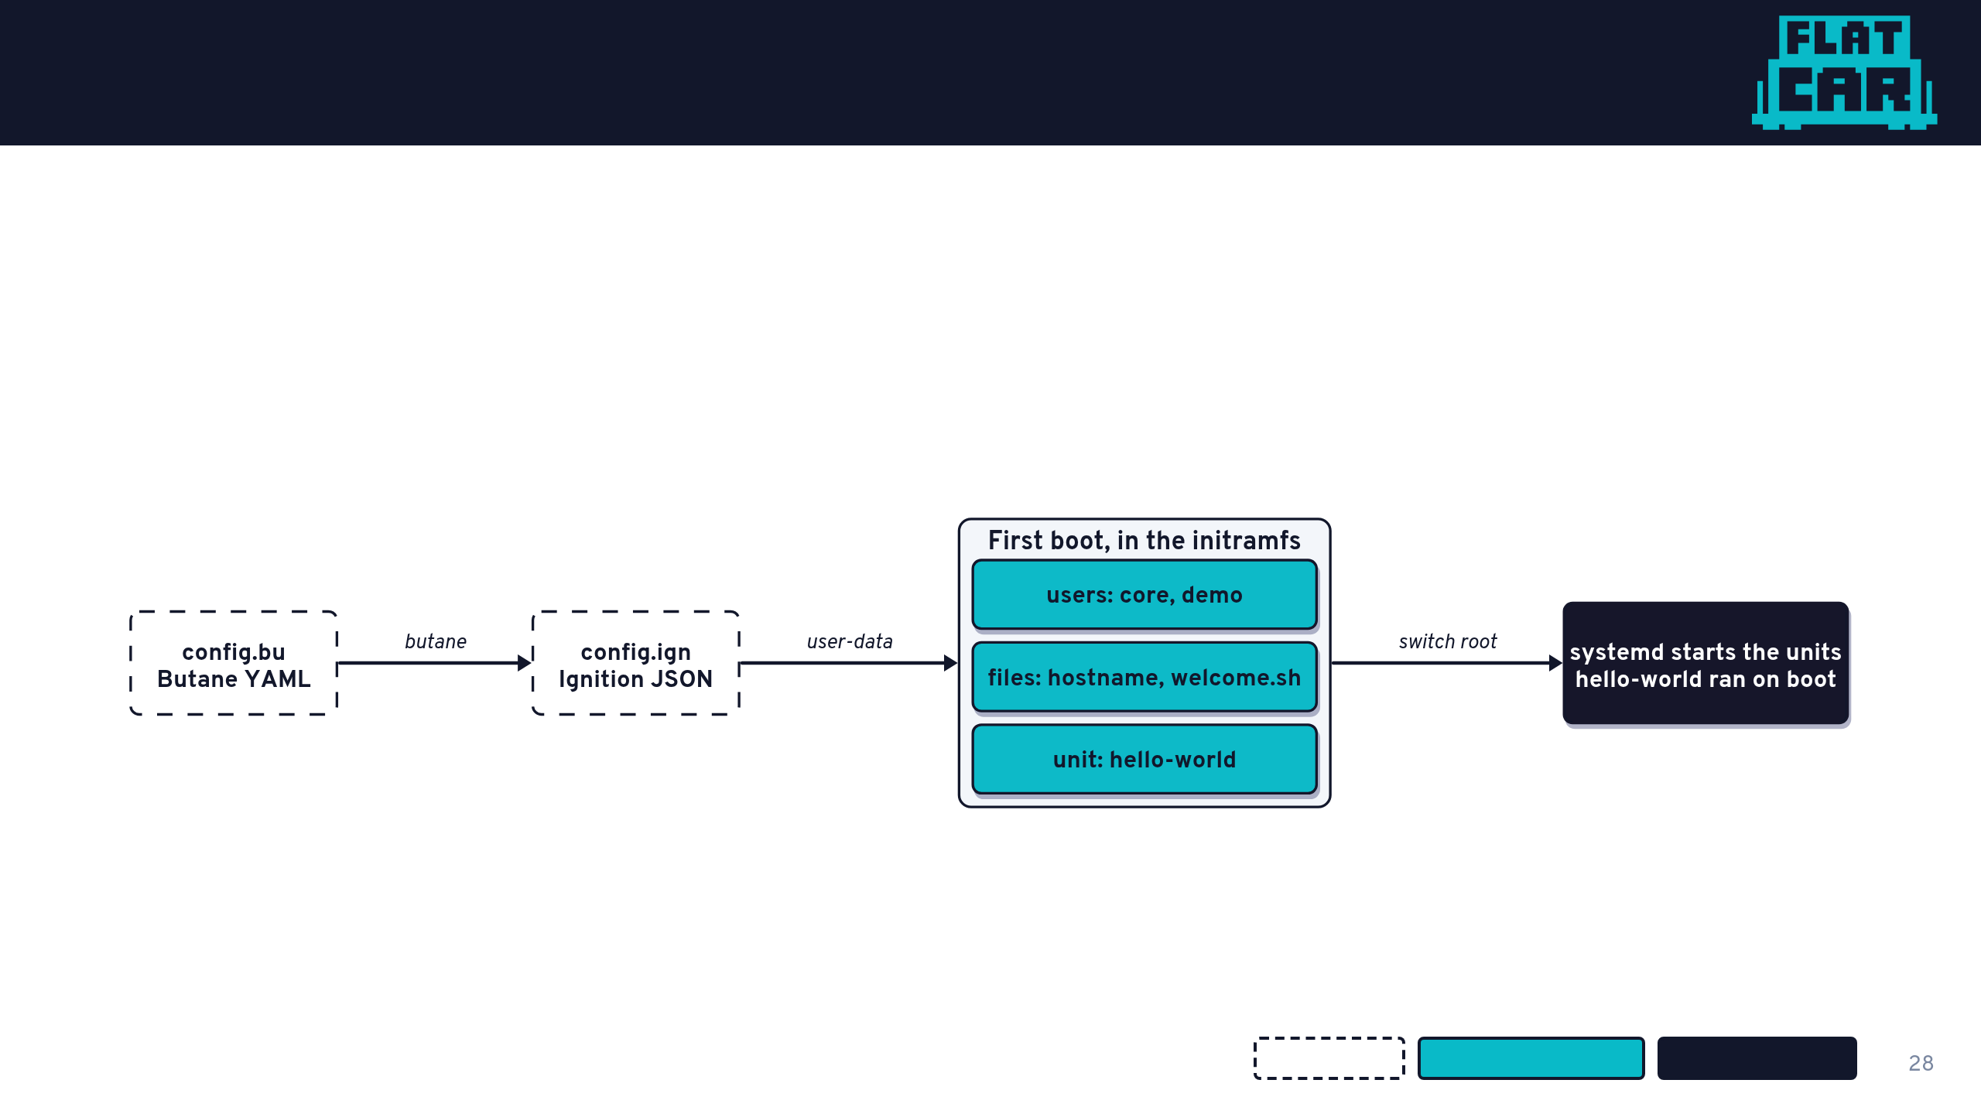
First boot does the work
Ignition runs once, in the initramfs, before the real system starts. Users, files, and units already exist when systemd comes up.
Your config
Applied by Ignition
Running system

Slide 29
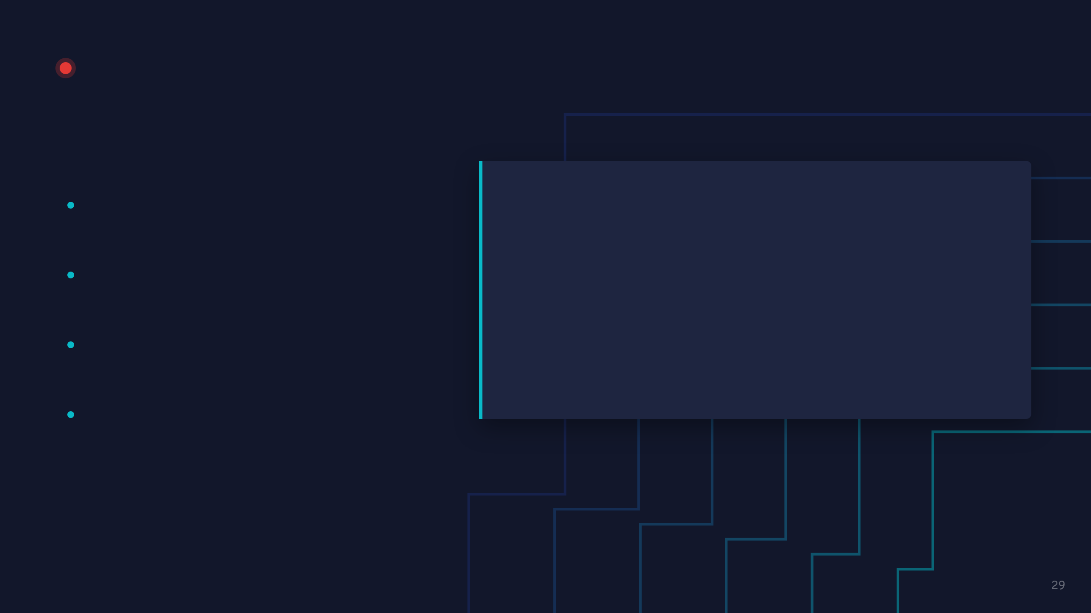
LIVE DEMO · 01
Hello world, from a config
WATCH FOR
demos/01-getting-started-on-flatcar-on-qemu
No installer: the disk image is the OS
$ ./demo-tmux.sh
# right pane, once sshd is up:
Hostname, user and script set by Ignition
$ ssh -i ssh/demo_ed25519 \
-p 2222 core@localhost
hello-world ran before anyone logged in
$ journalctl -u hello-world.service
$ /opt/bin/welcome.sh
$ sudo touch /usr/test
/usr is read-only

Slide 30
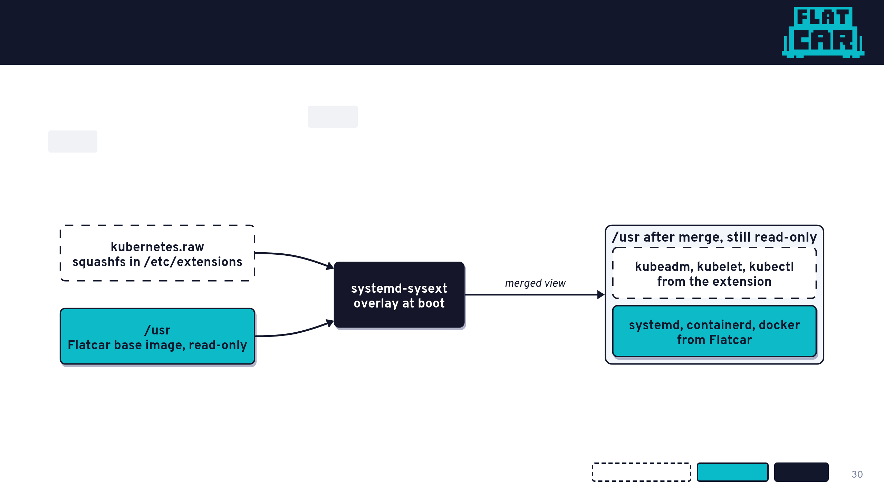
System extensions
No package manager, read-only /usr. A sysext is a squashfs image that systemd overlays onto /usr at boot. Add the file: the software appears. Remove it: gone.
Extension you add
Flatcar base
systemd

Slide 31
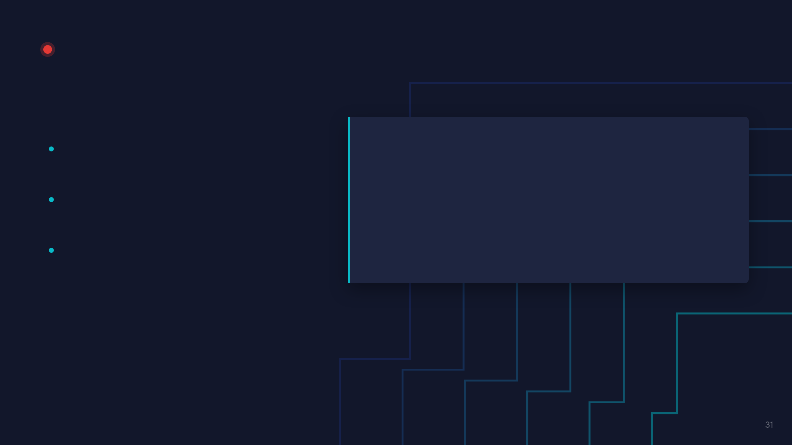
LIVE DEMO · 02
Adding Kubernetes with a sysext
WATCH FOR
demos/02-system-extensions
kubernetes listed as a merged extension
$ ./demo-tmux.sh
$ systemd-sysext status
kubeadm, kubelet, kubectl on a box with no package manager
$ which kubeadm kubelet kubectl
$ kubeadm version
/usr is still read-only
$ sudo touch /usr/bin/hello
# Read-only file system

Slide 32
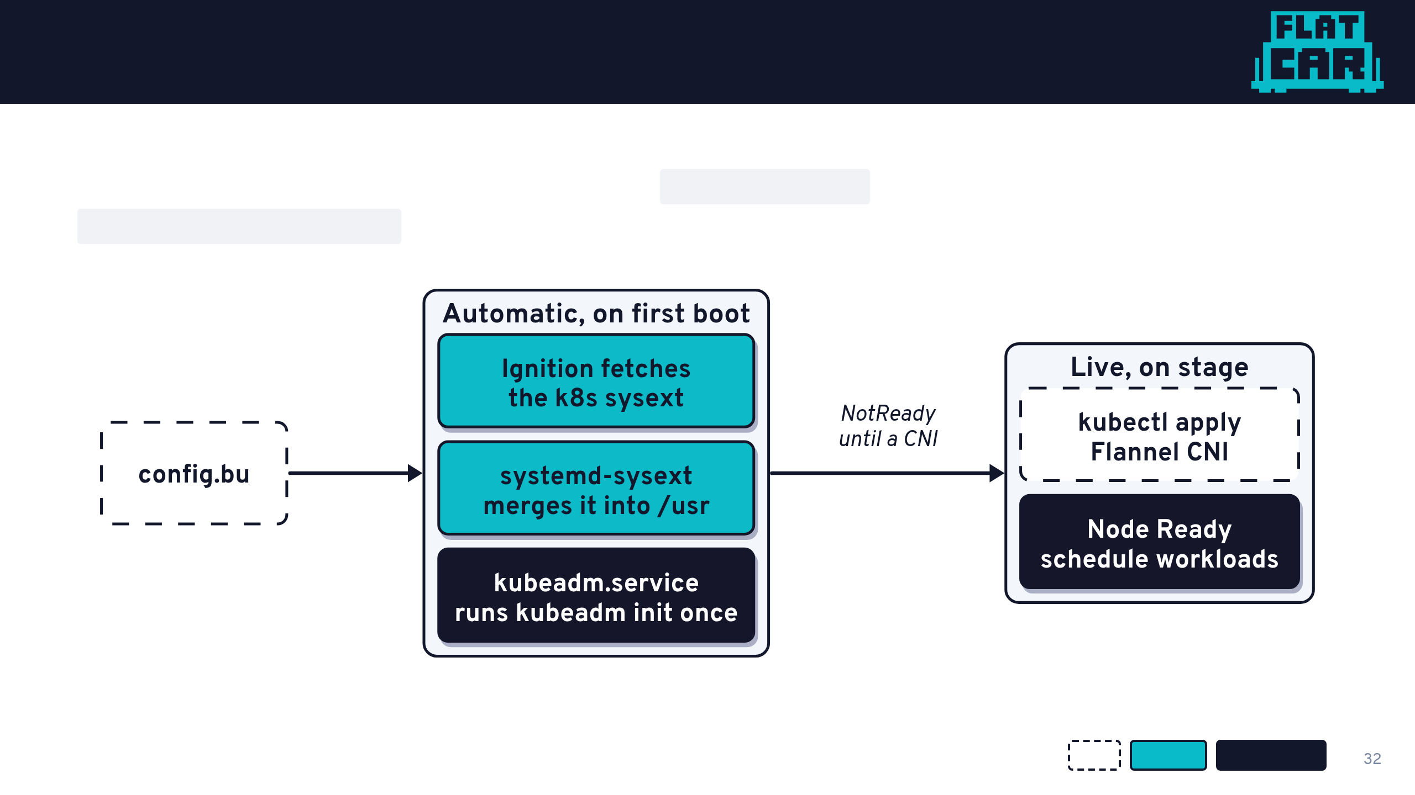
A Kubernetes node from one config
Same sysext, plus one systemd unit that runs kubeadm init on first boot. A ConditionPathExists guard makes it run exactly once: reboots resume the cluster.
You
Flatcar
Kubernetes

Slide 33
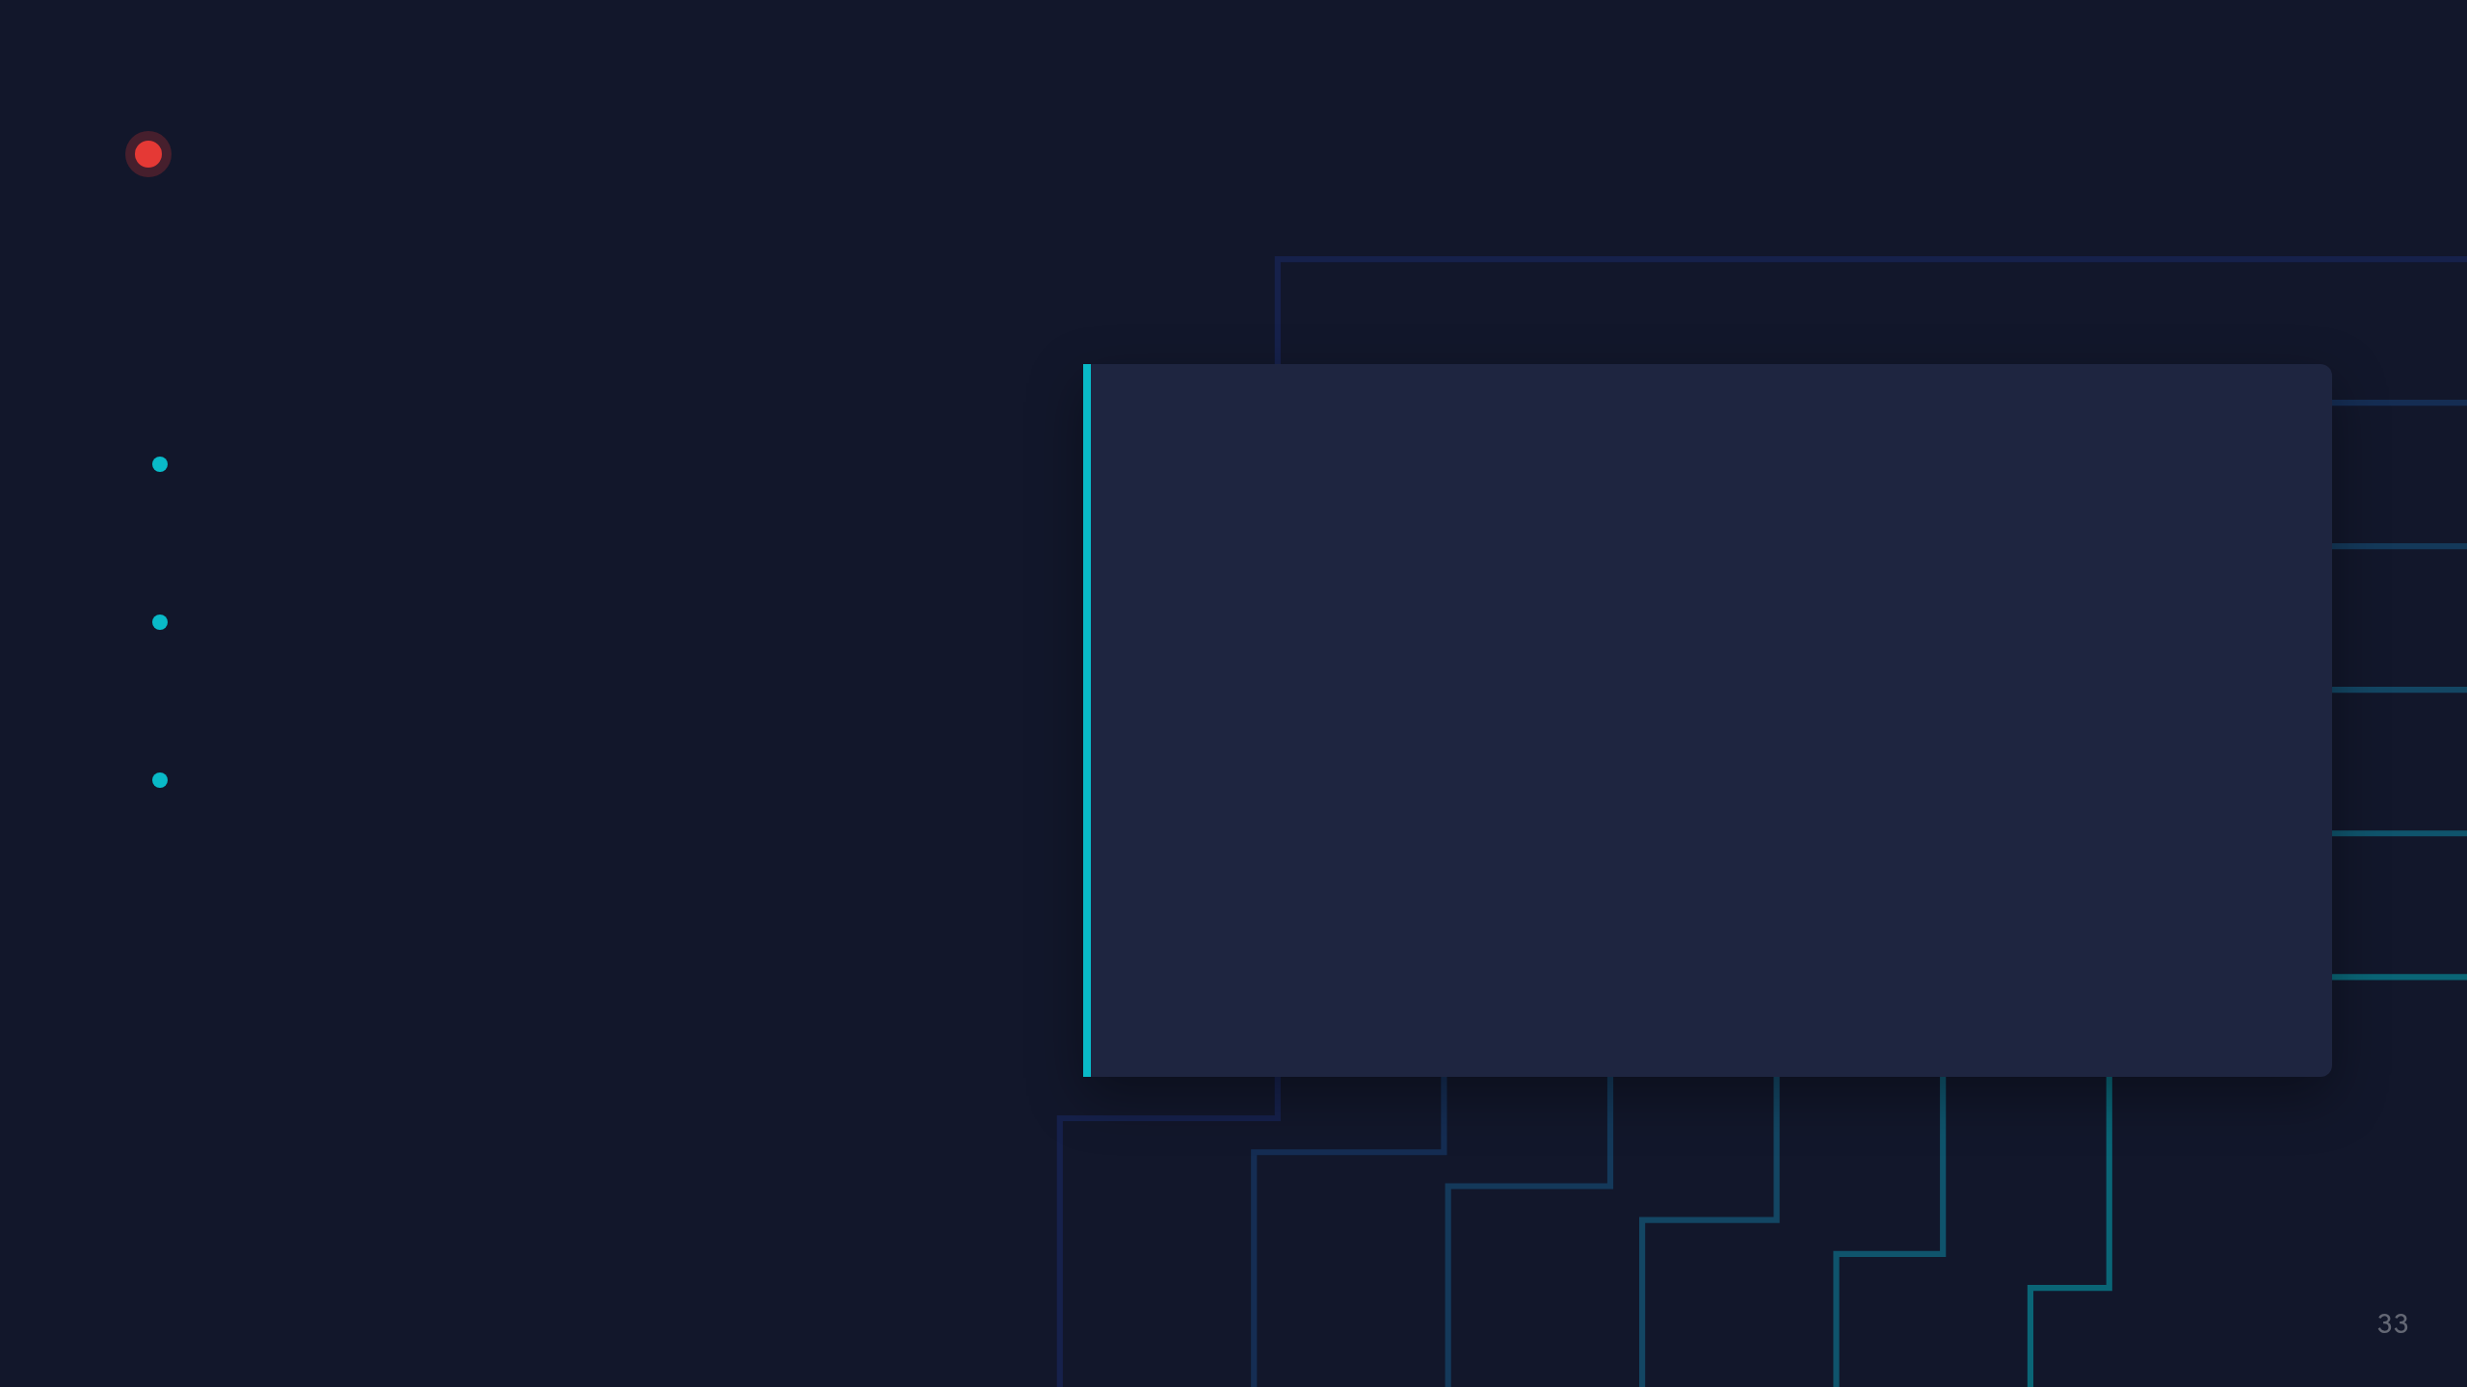
LIVE DEMO · 03
Kubernetes on Flatcar
WATCH FOR
demos/03-deploy-kubernetes-with-flatcar
kubeadm init already ran during boot
$ ./reset.sh && ./demo-tmux.sh
$ kubectl get nodes
Node goes NotReady to Ready with one apply
# NotReady: no CNI yet
$ kubectl apply -f <flannel v0.28.10>
A workload scheduled on the node
$ kubectl get nodes
$ kubectl get pods -A
$ kubectl taint node flatcar-demo \
node-role.kubernetes.io/control-plane-
$ kubectl apply -f app-demo.yaml

Slide 34

GPU Nodes, Done Right
NVIDIA drivers without giving up immutability

Slide 35

The GPU node problem
Drivers are tied to the kernel, so every OS update is a risk
Hand-patched GPU nodes drift apart
Rolling back a driver on a mutable host is painful

Slide 36

NVIDIA drivers as sysexts
Driver shipped as a systemd-sysext image, merged over read-only /usr
Pinned per kernel and Flatcar release, versioned like any artifact
Updated and rolled back with the OS, atomically, through A/B

Slide 37
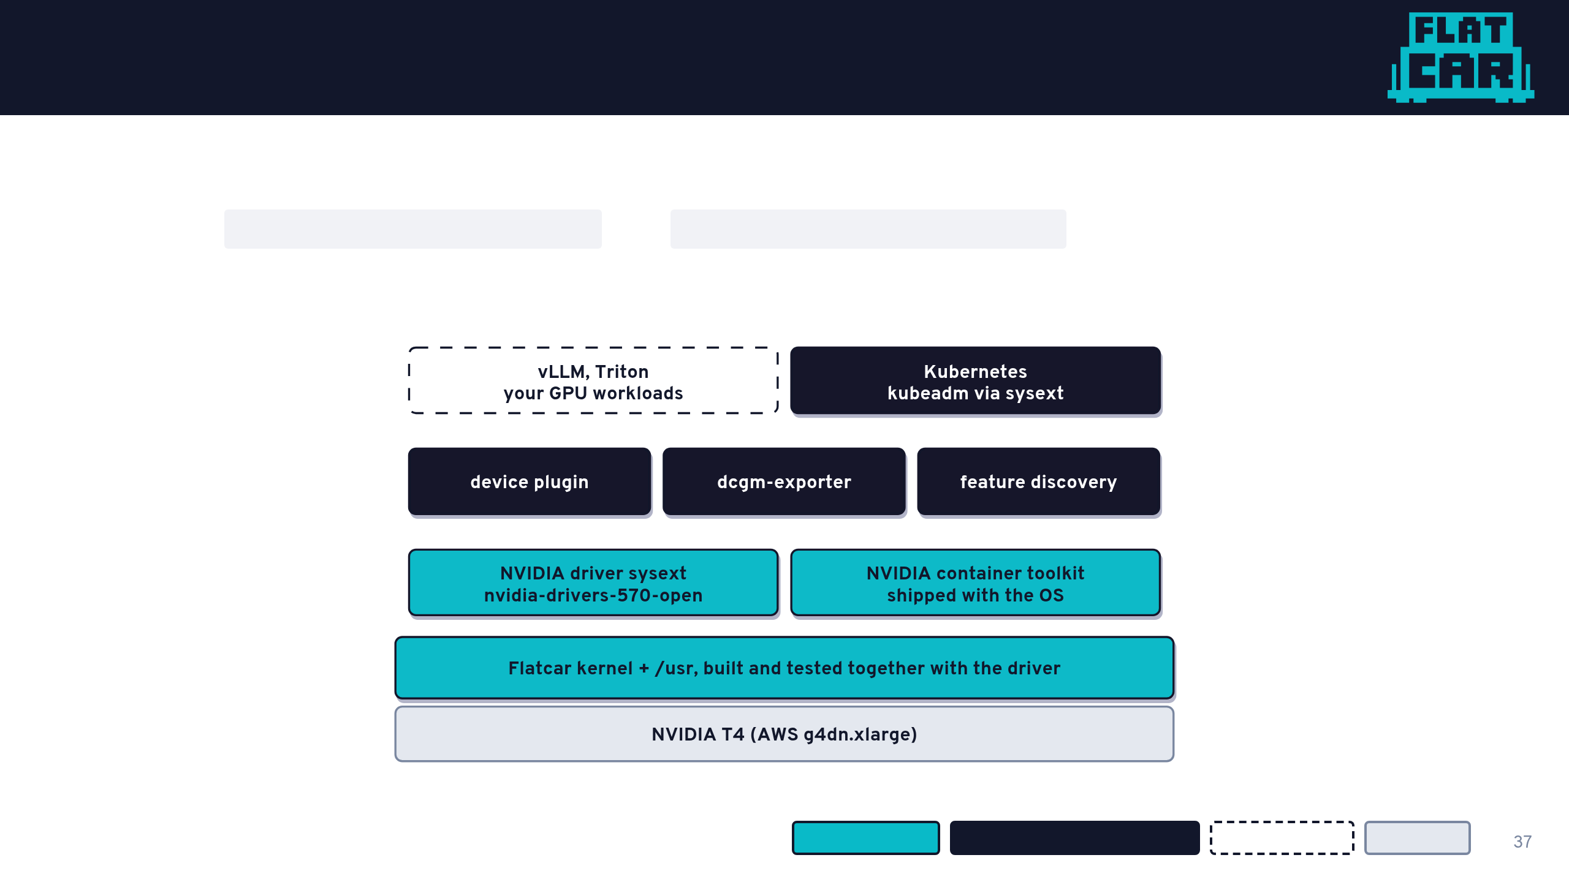
Who owns what on a GPU node
Flatcar ships the driver and the container toolkit, built against its own kernel. The GPU Operator runs with driver.enabled=false and toolkit.enabled=false: it only does the Kubernetes side.
Flatcar ships it
Kubernetes / GPU Operator
Your workload
Hardware

Slide 38

LIVE DEMO · 04
A GPU node on AWS
WATCH FOR
demos/04-nvidia-driver-on-flatcar-aws
nvidia-smi works on a fresh node: no driver install step
$ ./demo-tmux.sh
$ systemd-sysext status
The driver listed as a merged sysext
$ nvidia-smi
A pod that asks for a GPU gets one
# CNI + untaint, then (full flags: COMMANDS.md)
$ helm install gpu-operator nvidia/gpu-operator \
--set driver.enabled=false \
--set toolkit.enabled=false
$ kubectl get pods -n gpu-operator
$ kubectl run gpu-test ... -- nvidia-smi

Slide 39
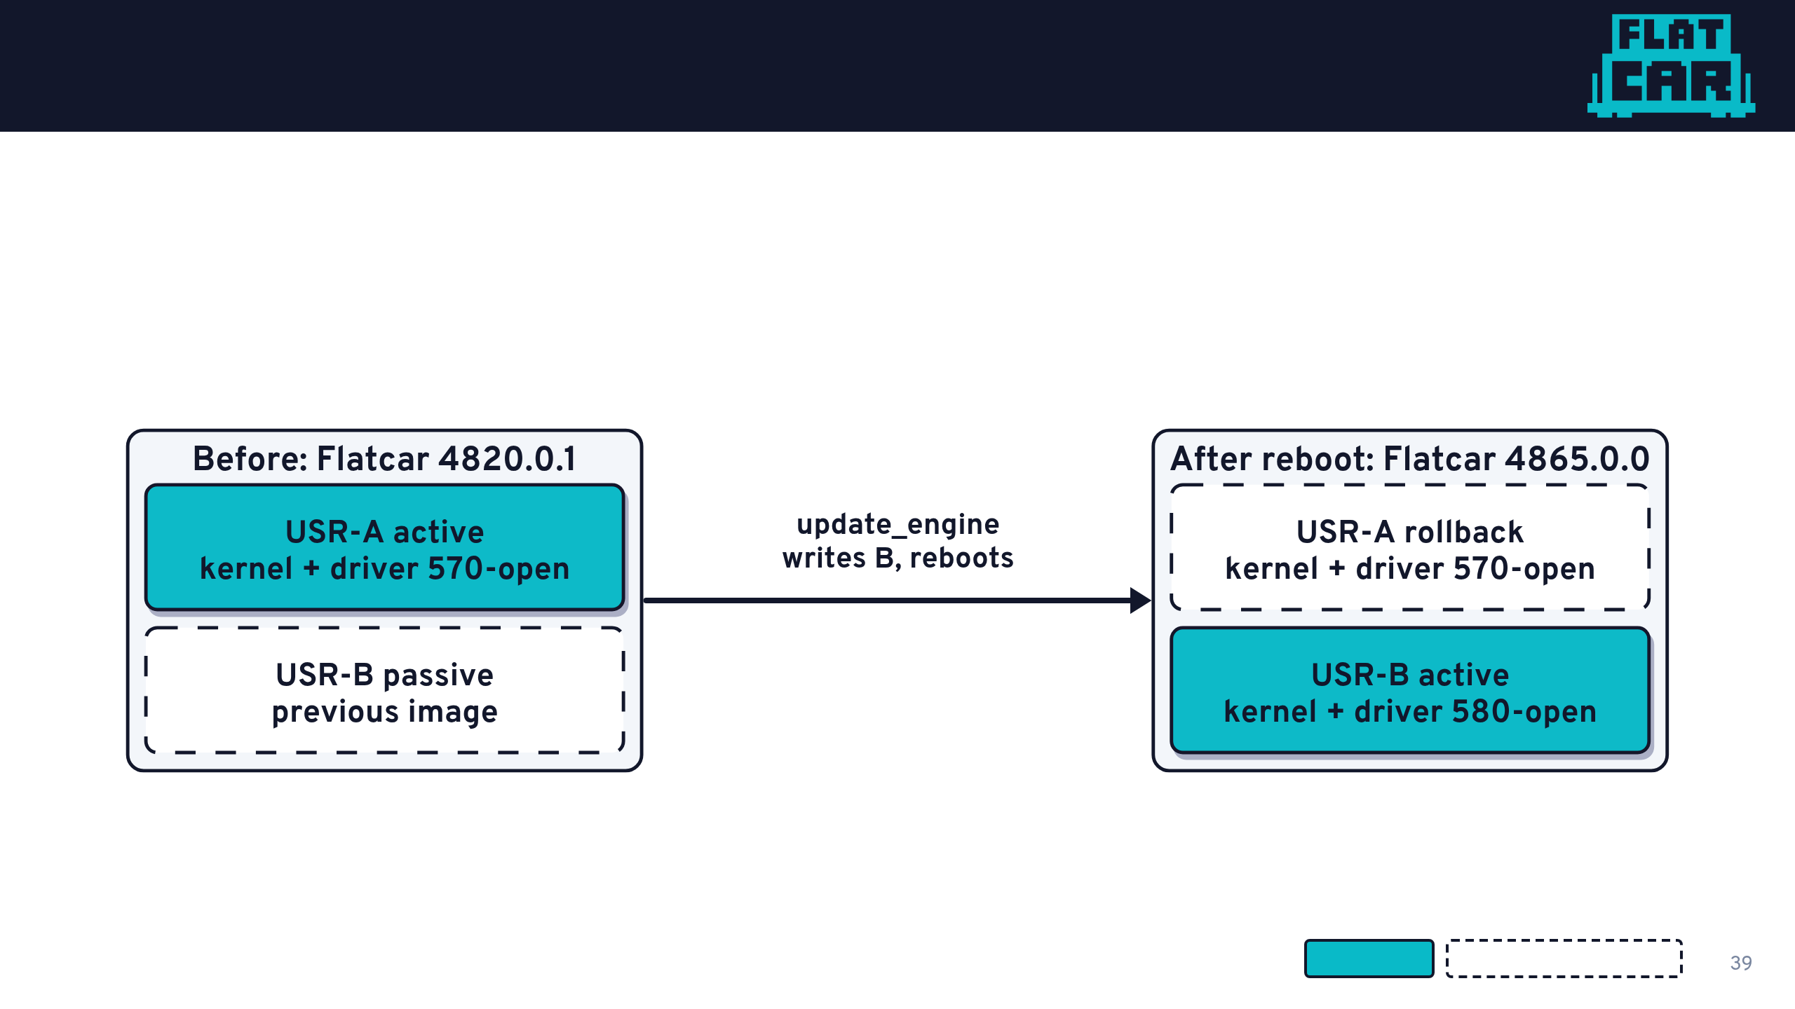
Driver upgrades ride the OS update
The driver is built with the kernel, so it is upgraded with the OS: one atomic A/B update. If the new driver misbehaves, reboot into the old slot.
Active slot
Passive / rollback slot

Slide 40
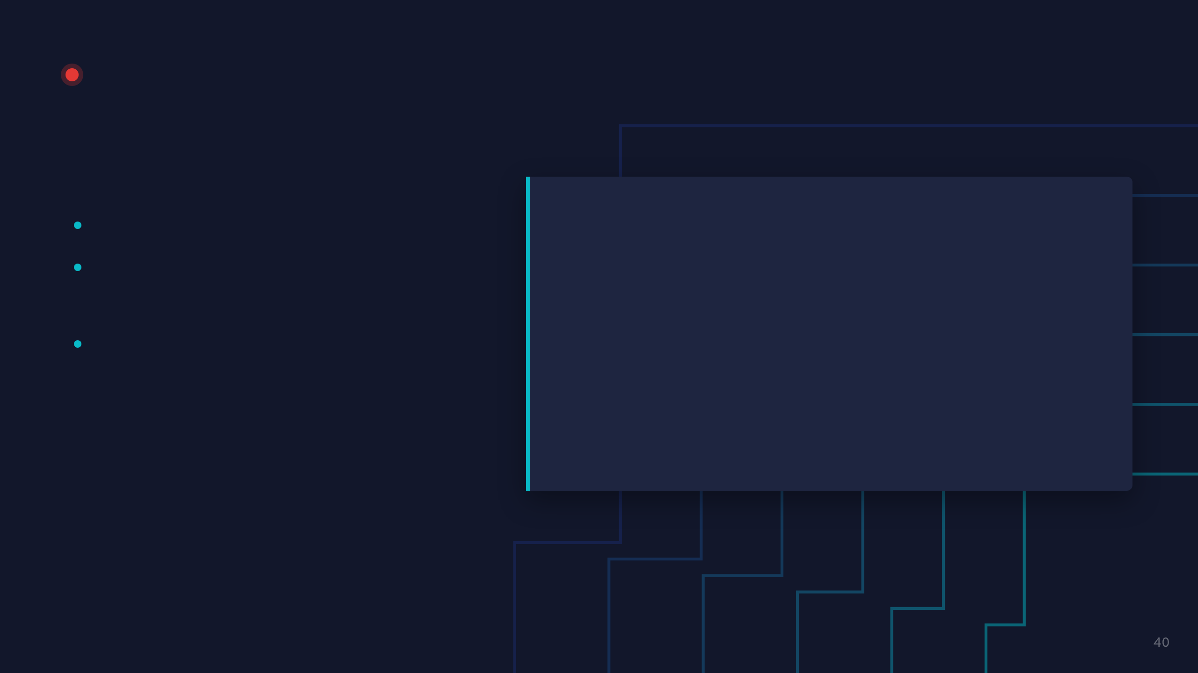
LIVE DEMO · 05
NVIDIA driver upgrade in place
WATCH FOR
demos/05-nvidia-driver-upgrade-in-place
Before: driver branch 570-open
$ ./demo-tmux.sh
One command: download, apply, reboot
$ systemd-sysext status
$ nvidia-smi
After: 580-open, config untouched
$ update_engine_client -status
$ update_engine_client -update
# reboots, SSH back in with the same key
$ systemd-sysext status
$ nvidia-smi

Slide 41
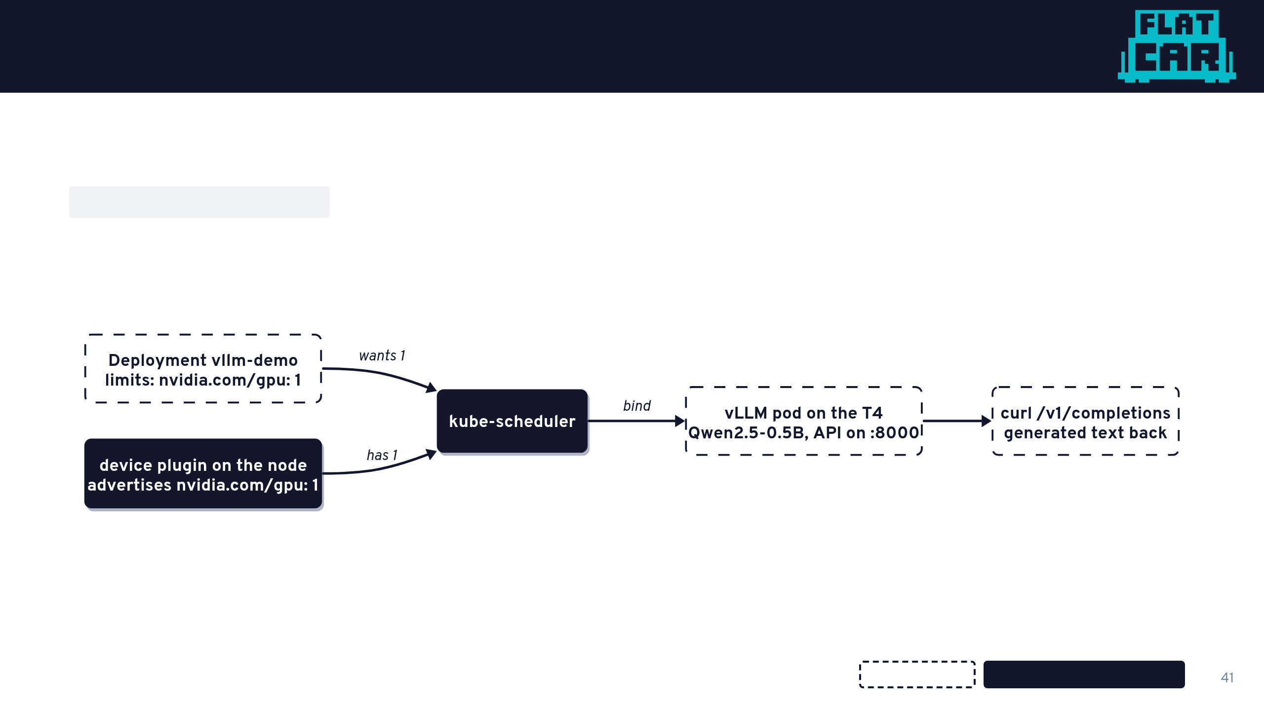
Scheduling a model onto the GPU
The device plugin advertises the GPU as a countable resource. A pod that asks for nvidia.com/gpu: 1 lands on it, and a second one waits.
Your workload
Kubernetes / GPU Operator

Slide 42
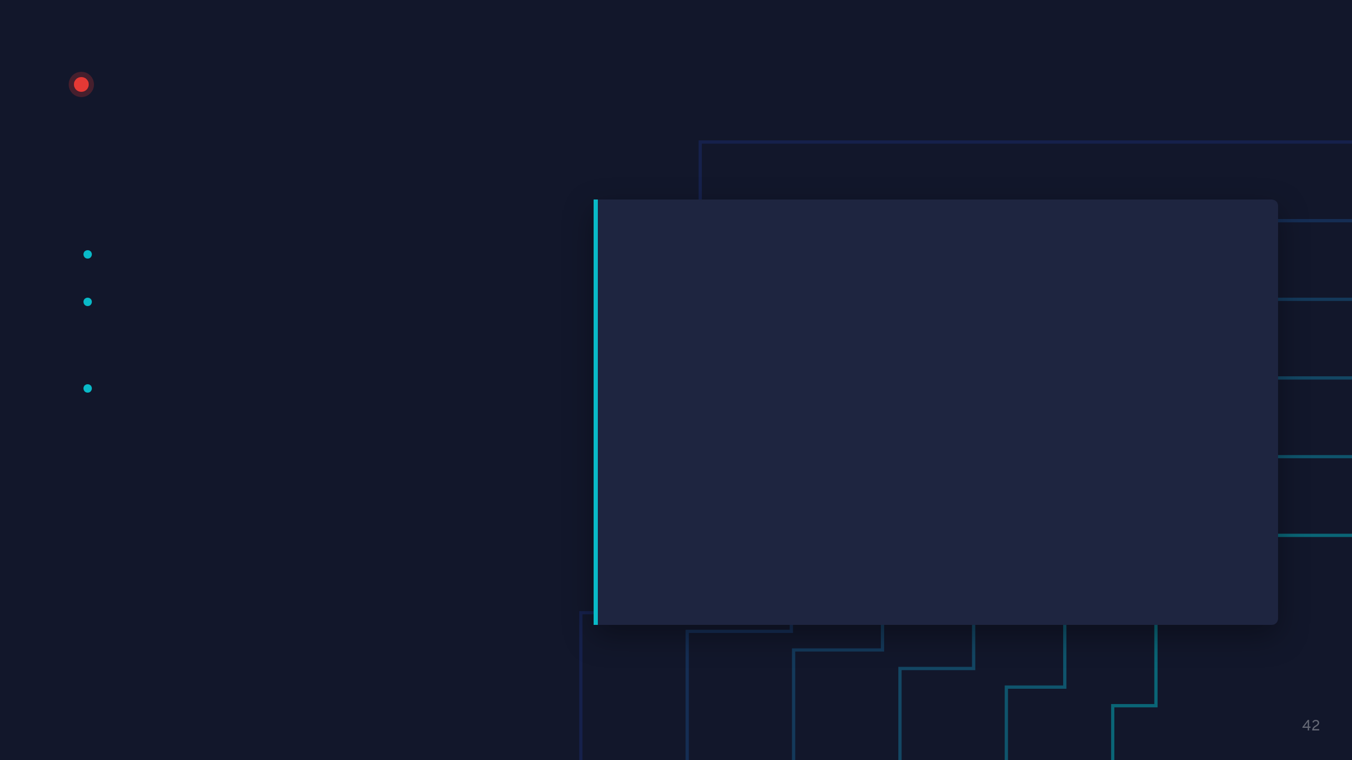
LIVE DEMO · 06
vLLM inference on Flatcar
WATCH FOR
demos/06-vllm-inference-on-flatcar
A model generating text on the T4
$ kubectl apply -f vllm-demo.yaml
An OpenAI-style API, served from our node
$ kubectl get pods -w
$ CLUSTER_IP=$(kubectl get svc vllm-demo \
A second replica stuck: Insufficient nvidia.com/gpu
-o jsonpath='{.spec.clusterIP}')
$ curl $CLUSTER_IP:8000/v1/completions \
-H "Content-Type: application/json" \
-d '{"model":"Qwen/Qwen2.5-0.5B-Instruct",
"prompt":"Flatcar Container Linux is",
"max_tokens":40}'
$ kubectl scale deploy vllm-demo --replicas=2

Slide 43
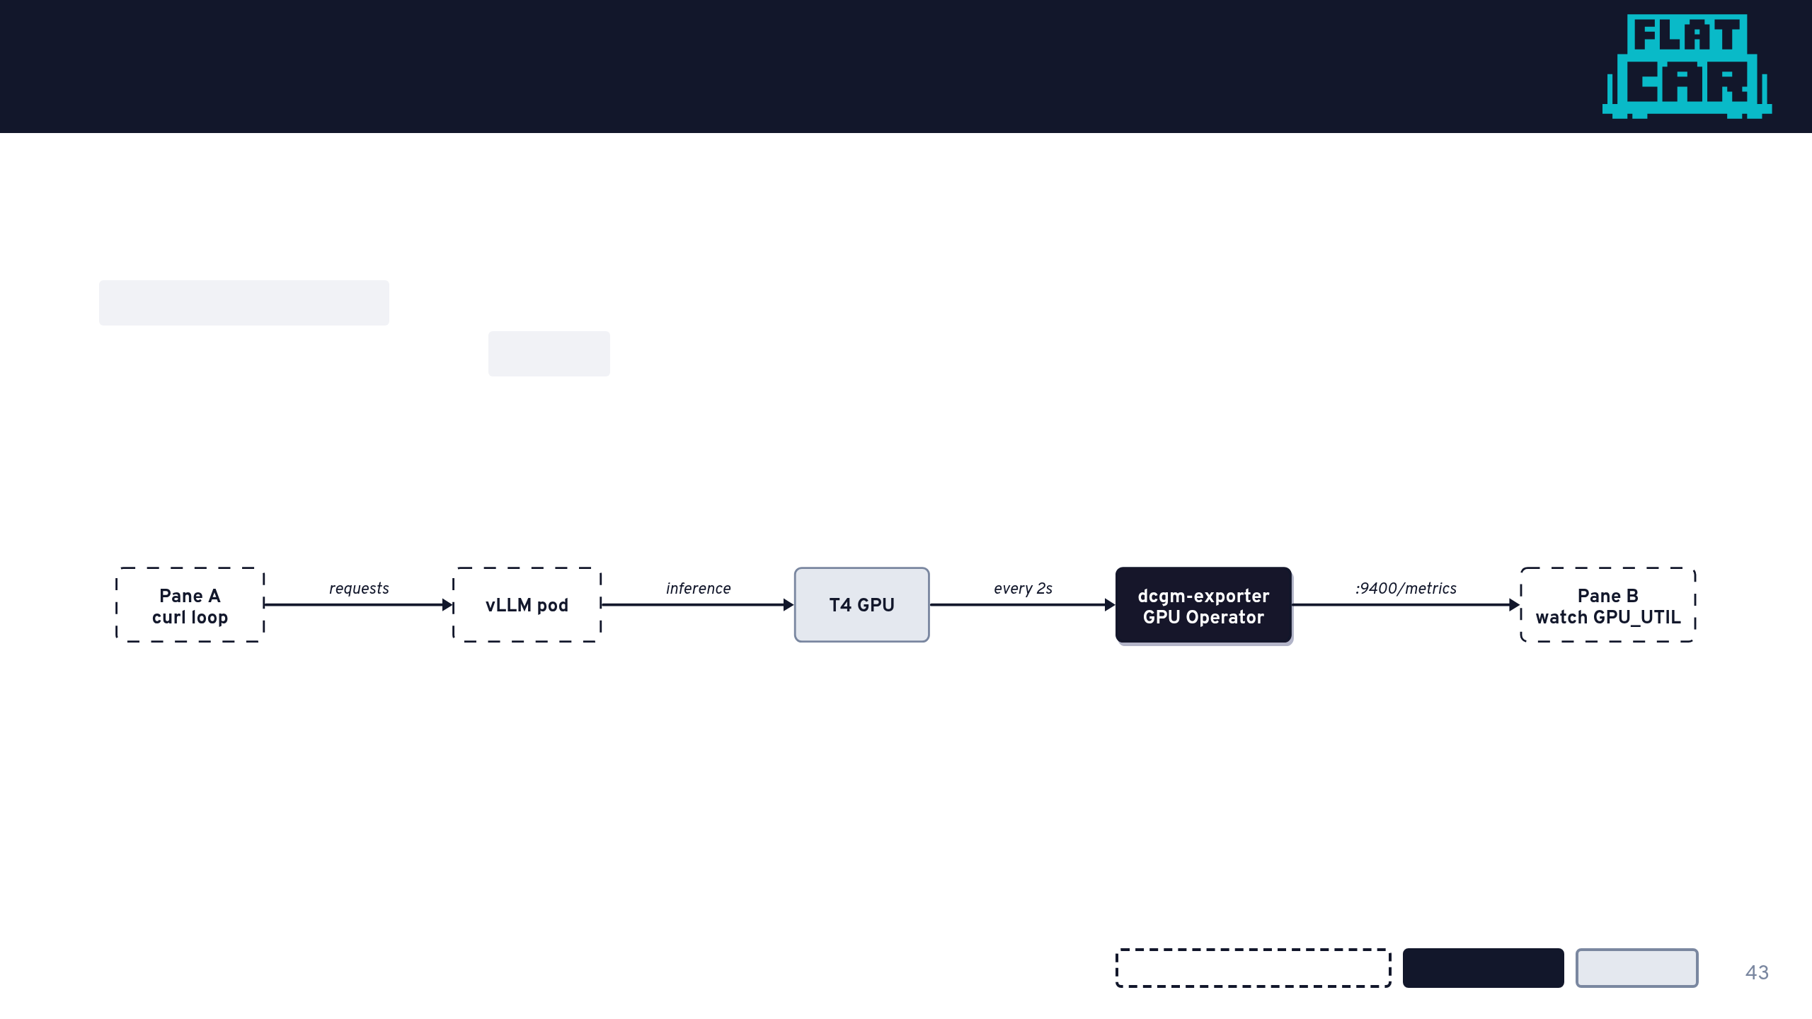
Seeing the GPU work
dcgm-exporter comes with the GPU Operator. It reads GPU counters and serves them as Prometheus metrics on :9400, the same endpoint you would scrape into Grafana.
Your terminals / workload
GPU Operator
Hardware

Slide 44

LIVE DEMO · 07
GPU metrics with DCGM
WATCH FOR
demos/07-dcgm-metrics-demo
GPU utilization near 0 while idle
$ ./demo-tmux.sh
A spike every time a request lands
# pane A: the curl loop against vLLM
Metrics from the GPU Operator, nothing extra installed
$ while true; do curl -s ... ; sleep 2; done
# pane B: the GPU utilization
$ watch -n1 "curl -s $DCGM_POD_IP:9400/metrics \
| grep DCGM_FI_DEV_GPU_UTIL"

Slide 45
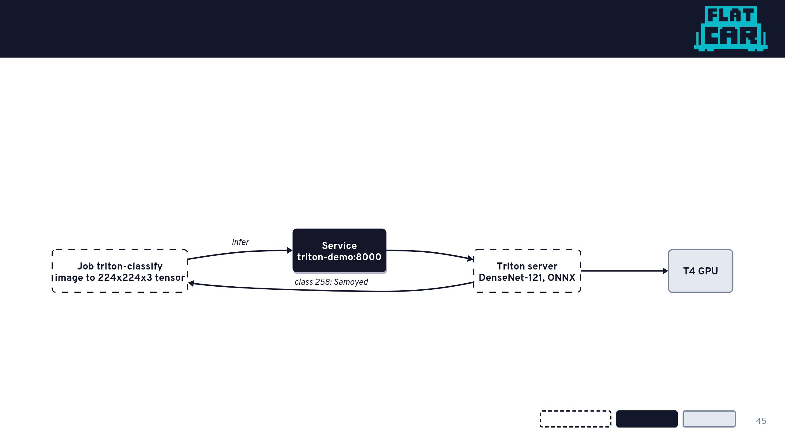
Not locked to one framework
Different model, different server, different API, same node. NVIDIA Triton serves a DenseNet image classifier, and the client runs in-cluster as a Job.
Your workload
Kubernetes
Hardware

Slide 46
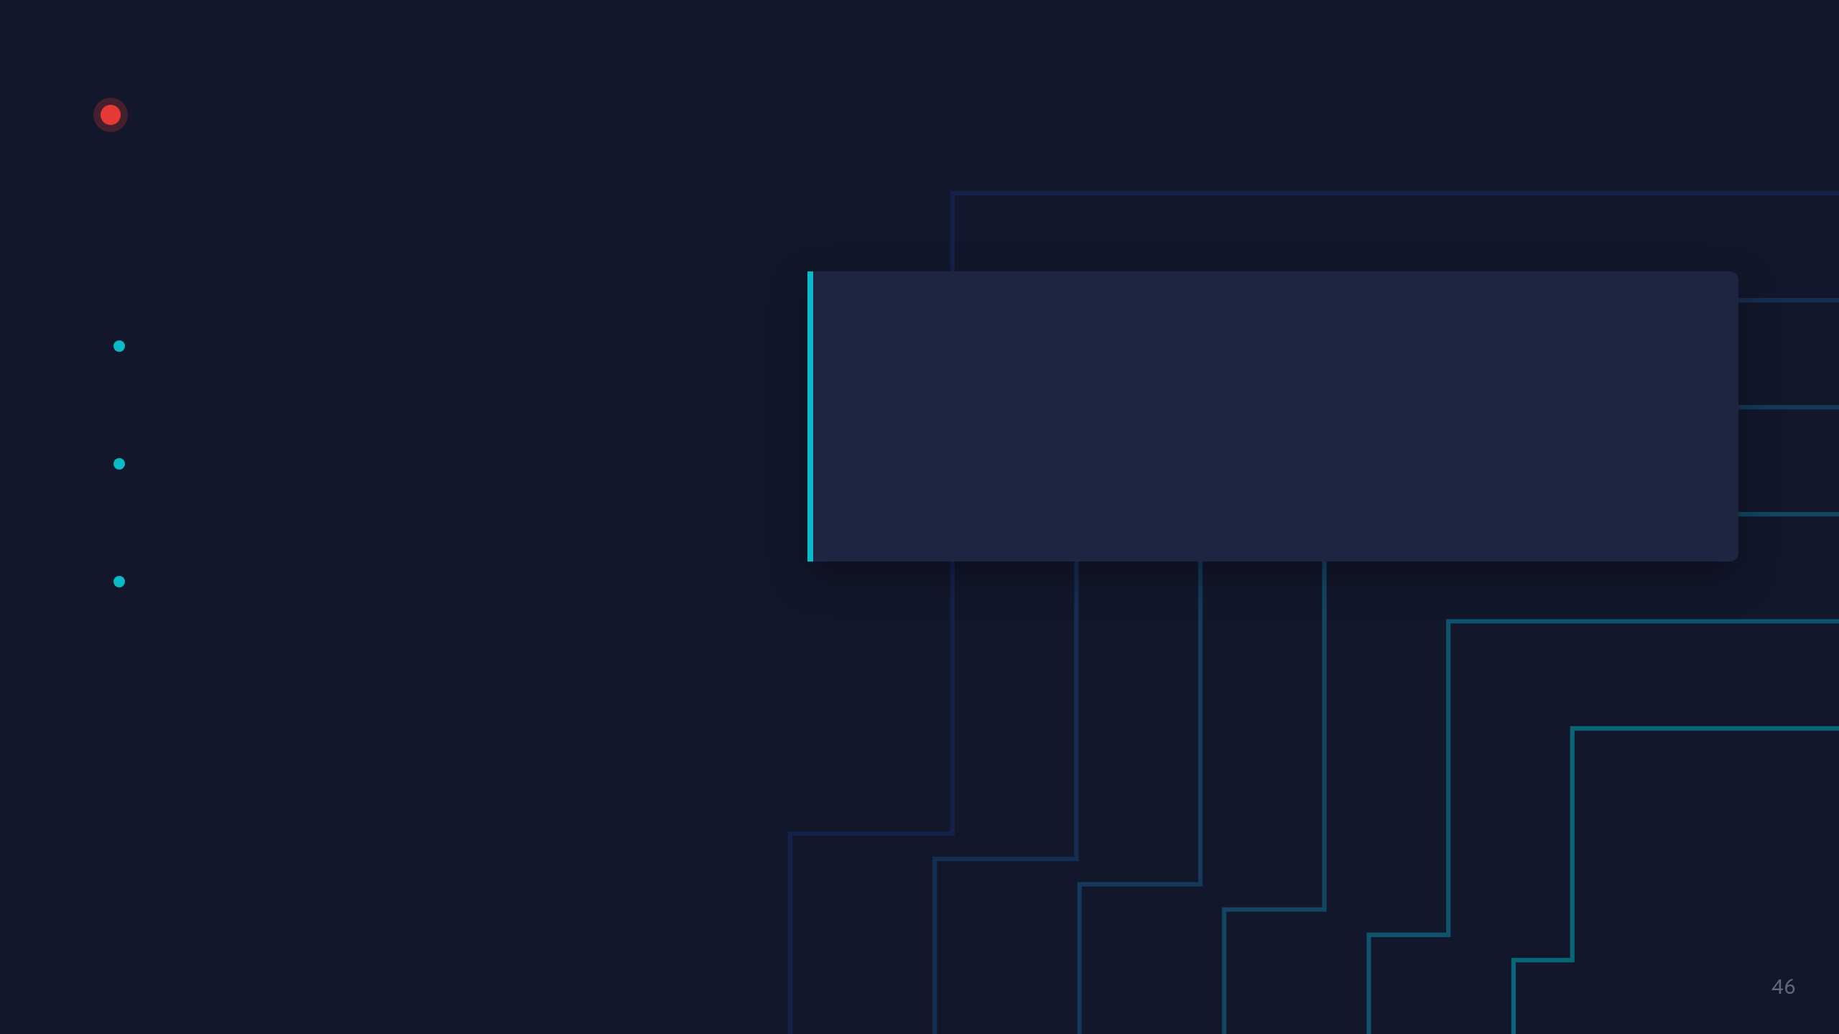
LIVE DEMO · 08 (OPTIONAL)
Triton inference on Flatcar
WATCH FOR
demos/08-triton-inference-on-flatcar
Server and client from a single apply
$ kubectl apply -f triton-demo.yaml
$ kubectl get pods -w
The model fetched by an init container
$ kubectl logs job/triton-classify
# Predicted class index: 258 (Samoyed)
A correct prediction: 258, Samoyed

Slide 47

Try it yourself
github.com/flatcar/flatcar-demos
Local, QEMU, free
AWS, NVIDIA T4
GPU workloads
01 Flatcar on QEMU
05 GPU node
07 vLLM inference
02 Ignition first boot
06 Driver upgrade in place
08 DCGM metrics
03 System extensions
09 Triton inference
04 Kubernetes

Slide 48
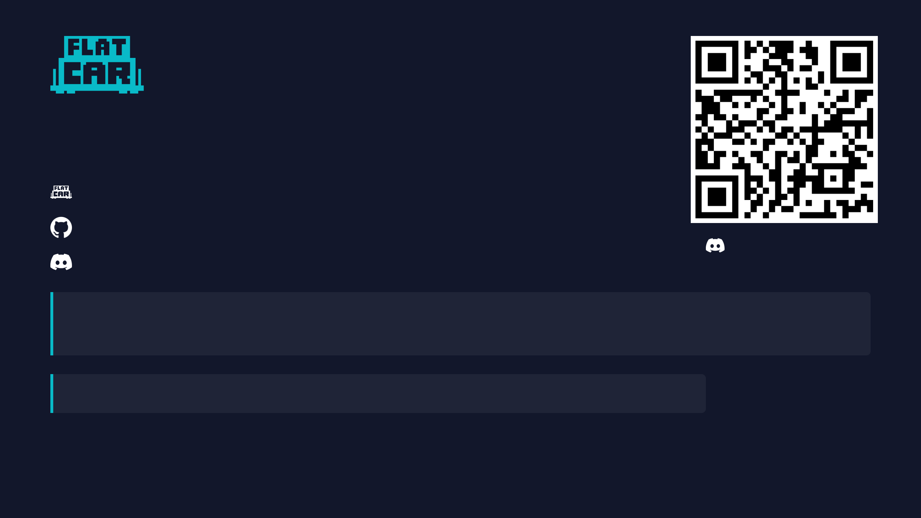
Thank you!
flatcar.org
github.com/flatcar
Join our Discord!
chat.flatcar.org
Find us · Project Pavilion, kiosk P-8A, Hall 5
Shifts (MST) · Tue 3-7 PM · Wed 1:55-5 PM · Thu 12:25-2 PM
Office hours · every 2nd Thu, 16:30 CEST
Dev sync · every 4th Thu, 16:30 CEST
Everyone welcome. Users, contributors, or just curious. Ask questions, get help, share what you're building!

