Slide 1
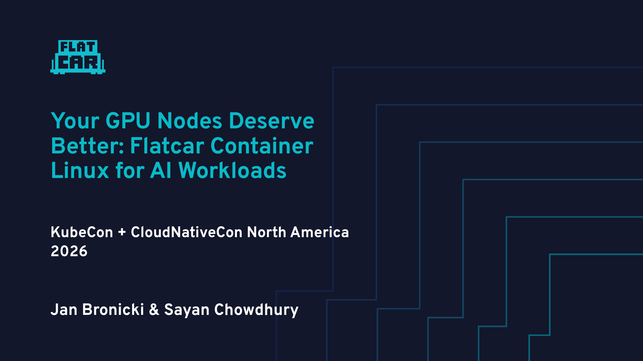

Slide 2
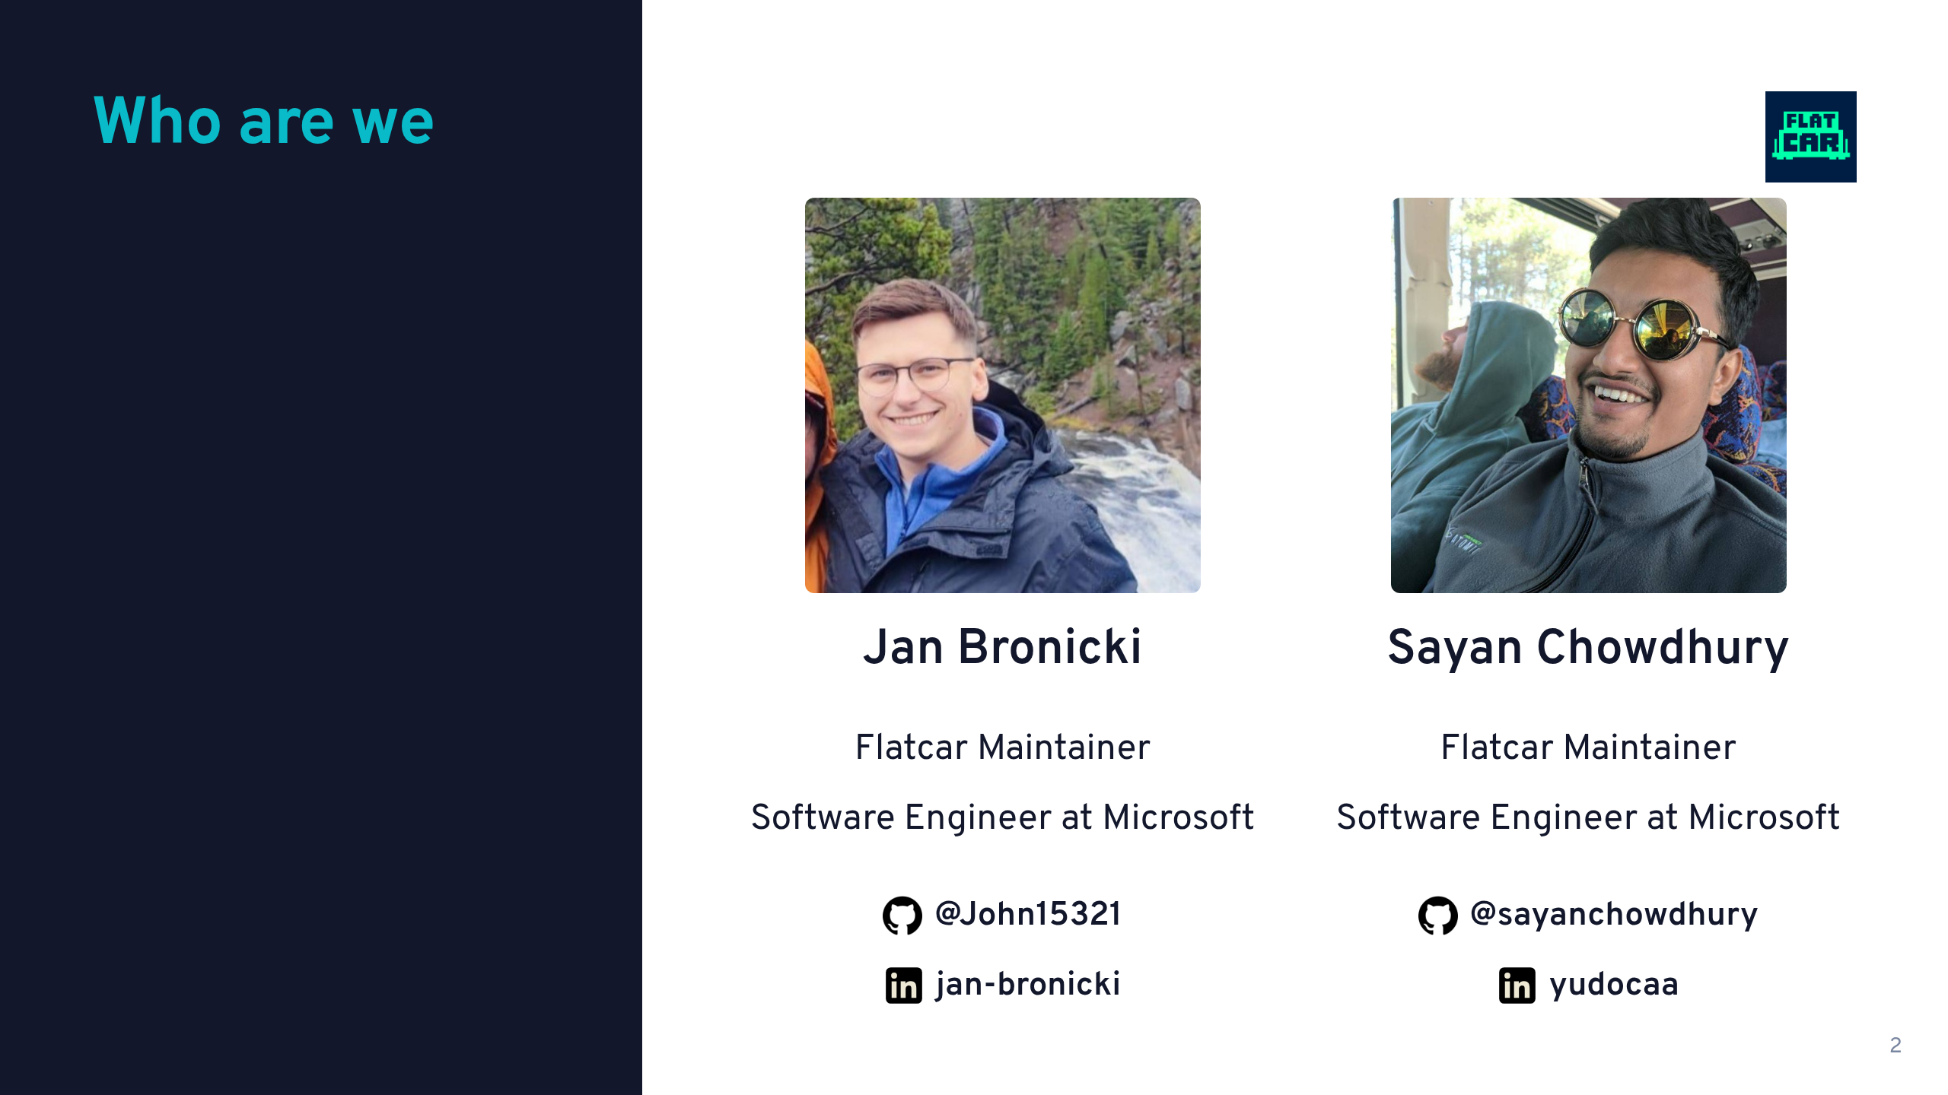

Slide 3
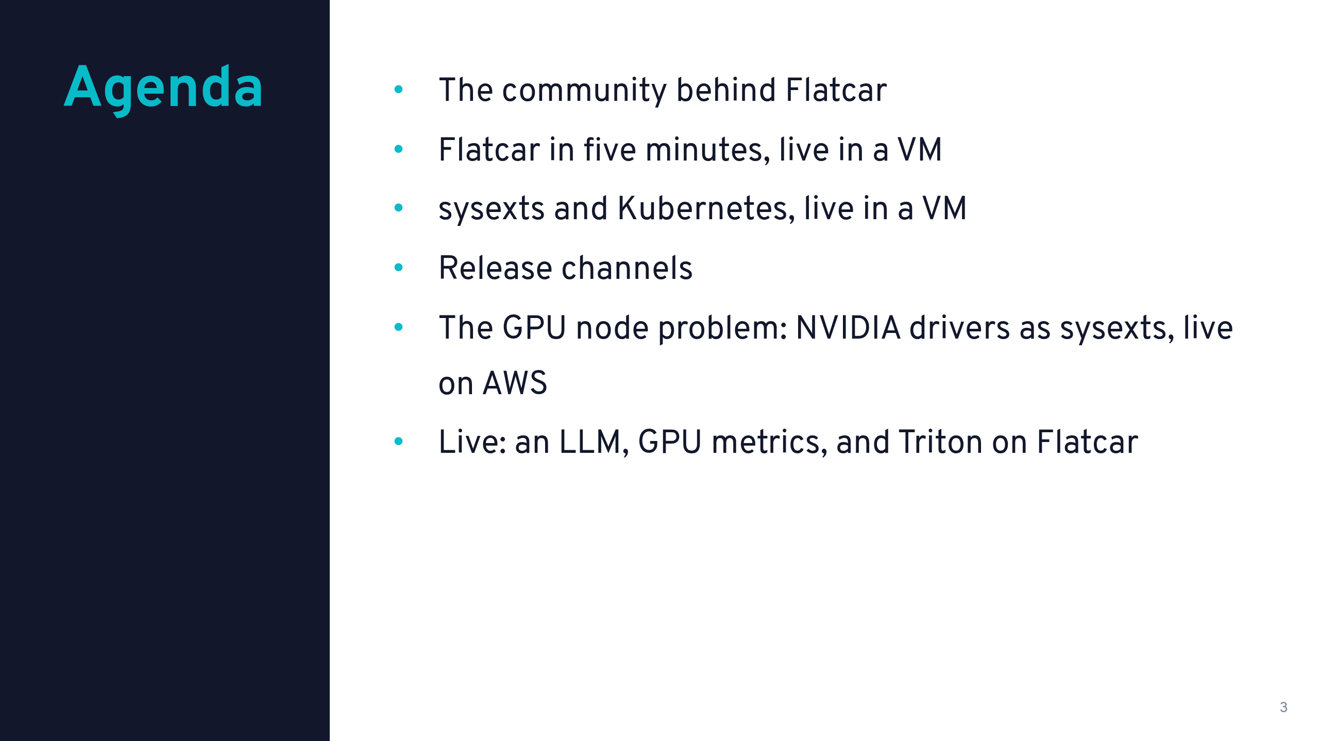

Slide 4
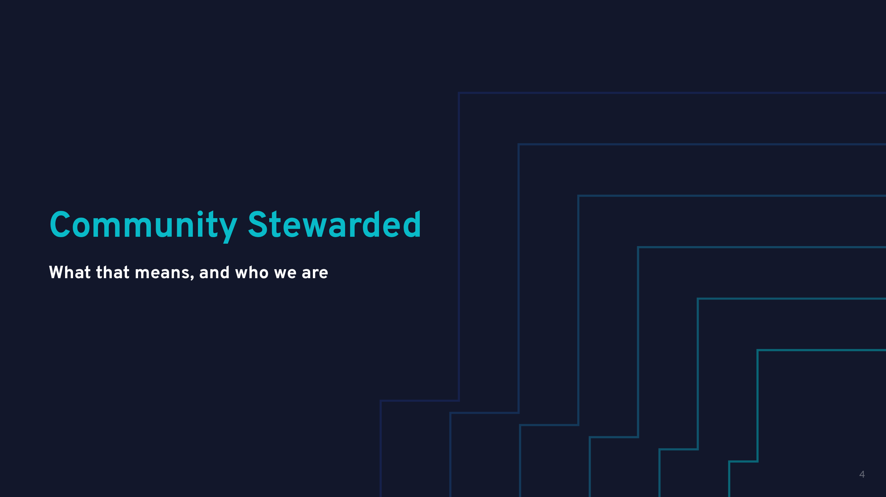

Slide 5
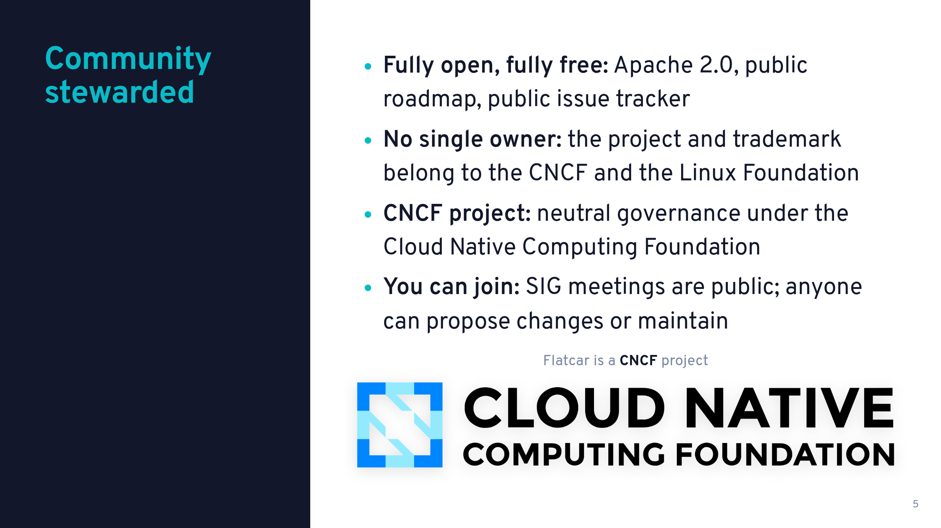

Slide 6
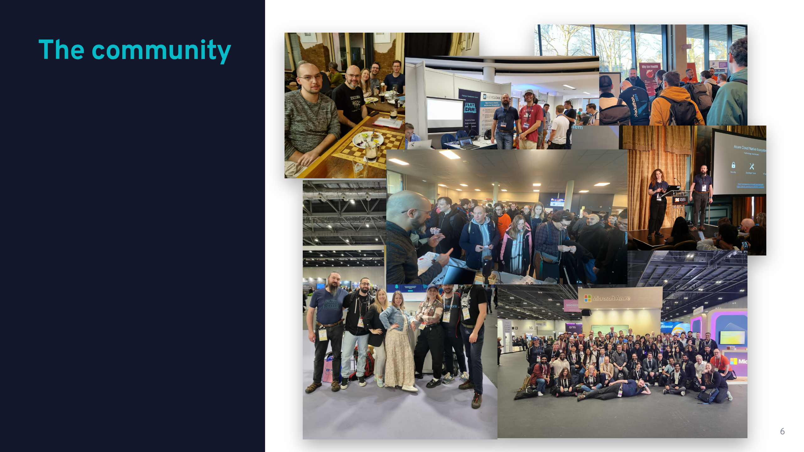

Slide 7
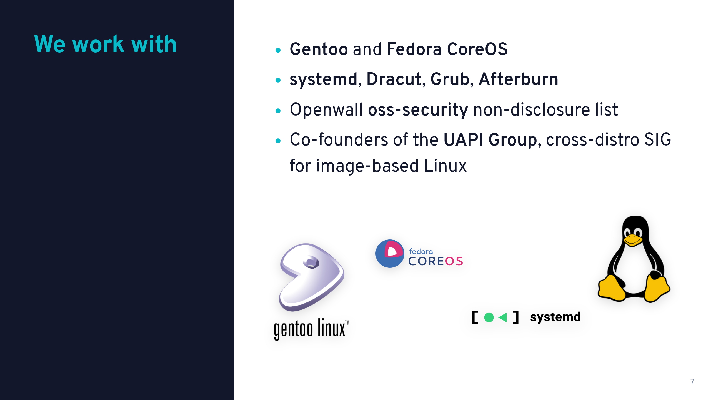

Slide 8
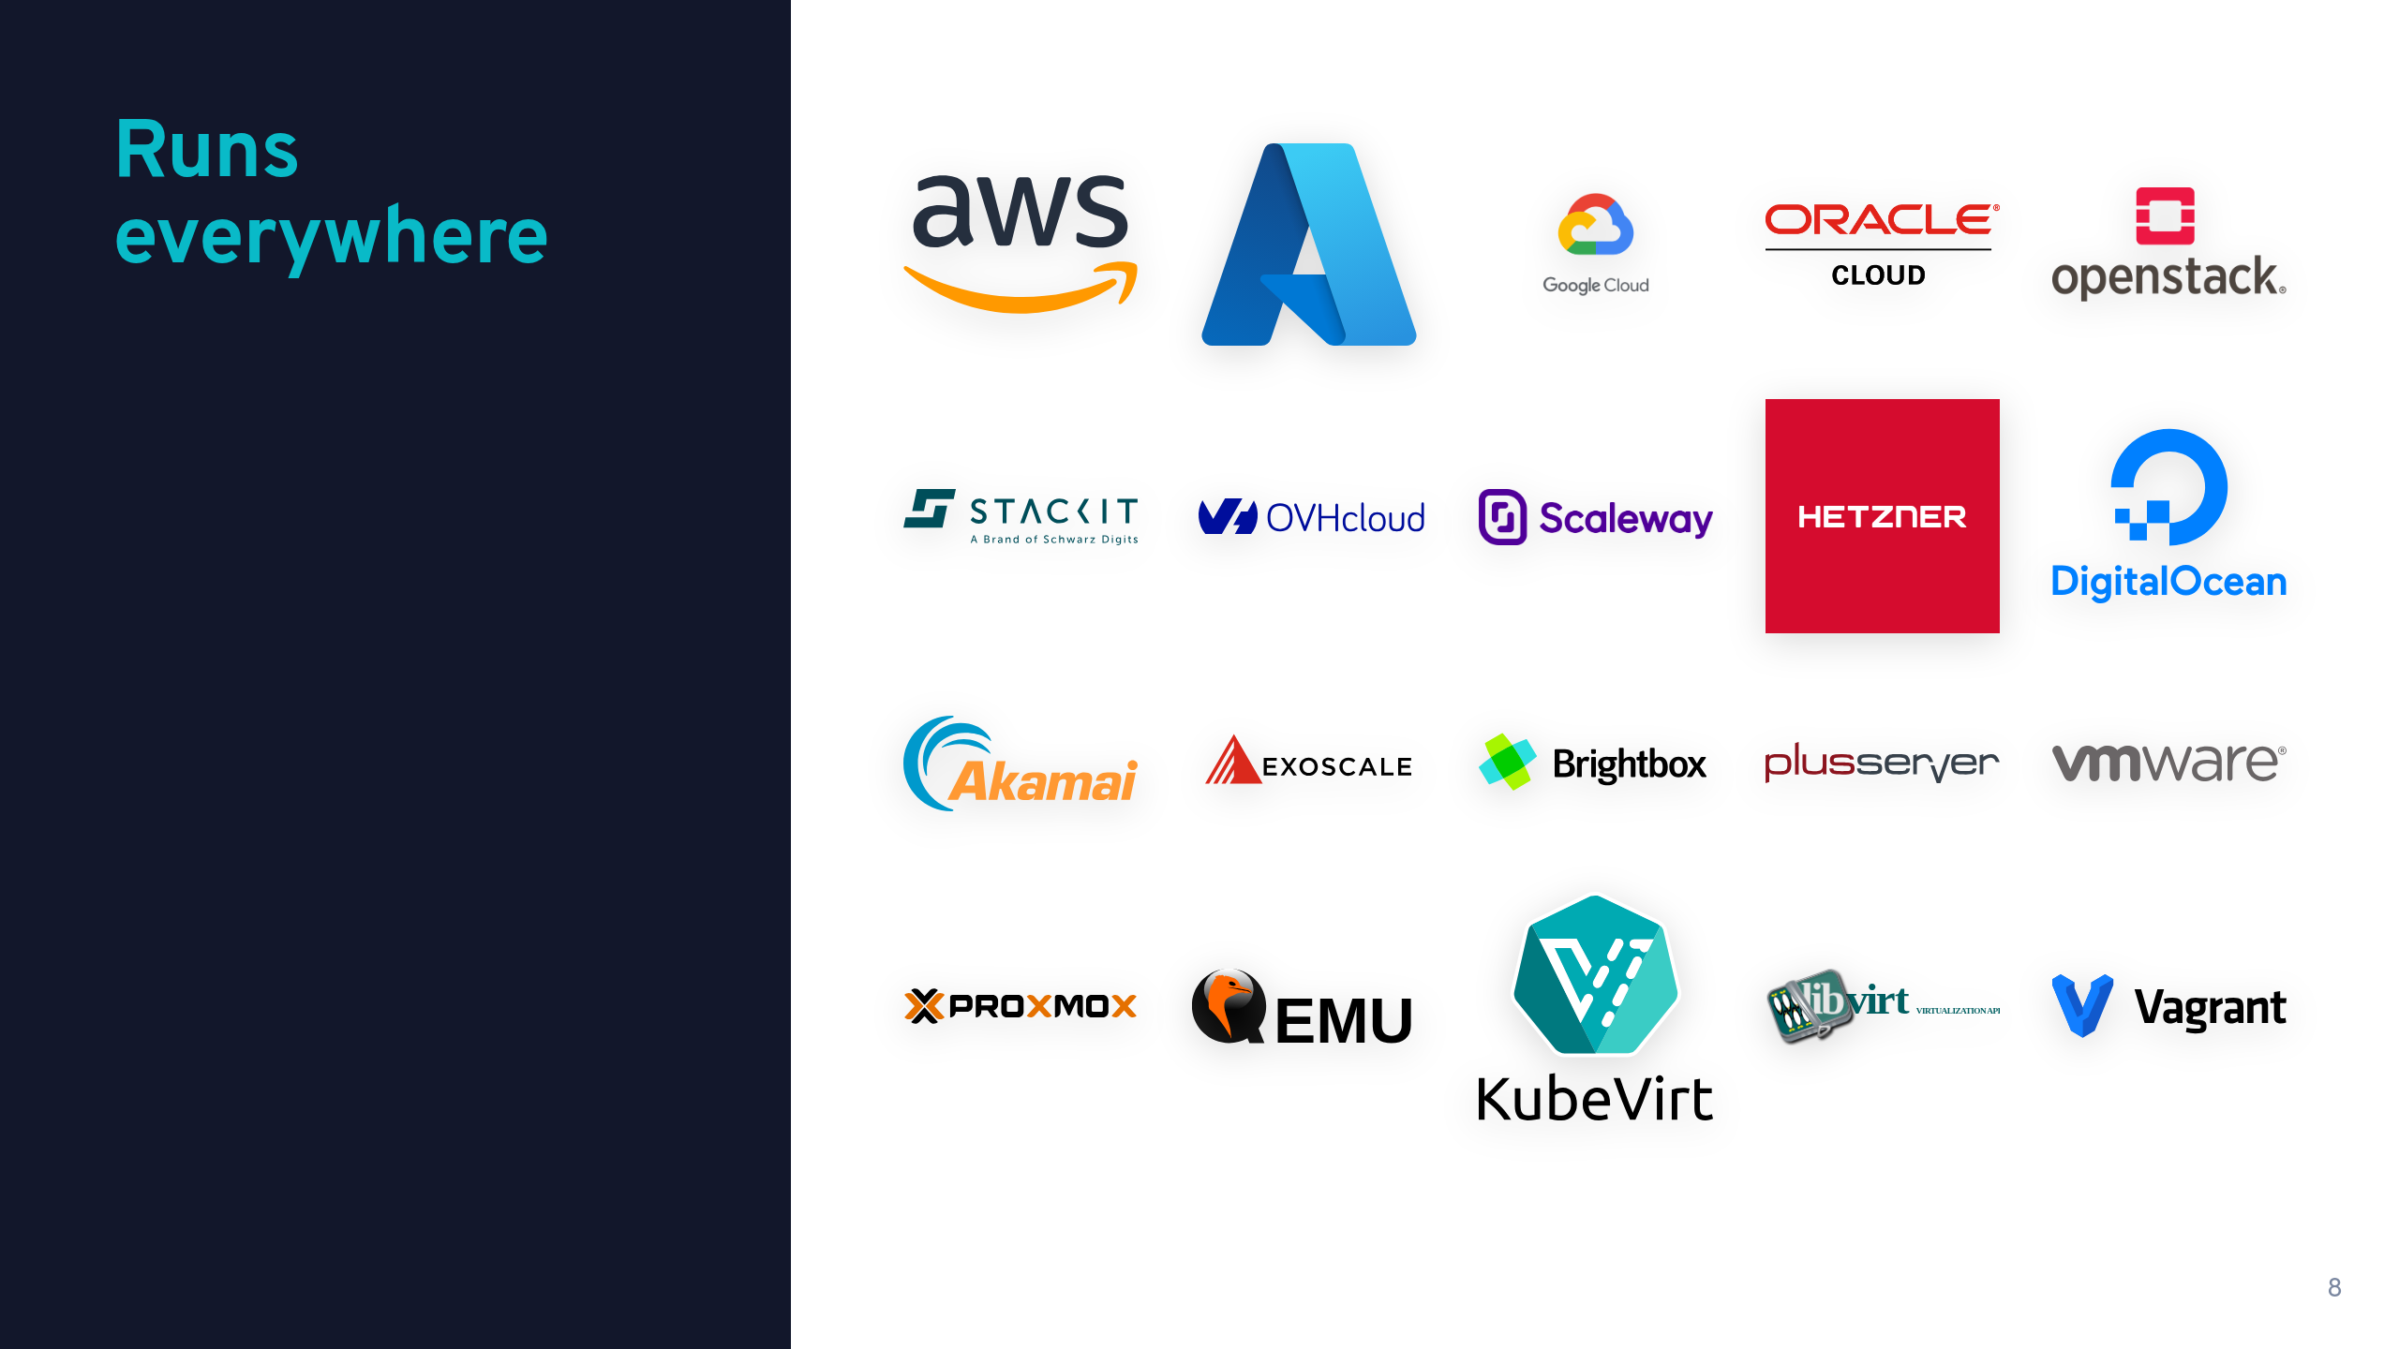

Slide 9
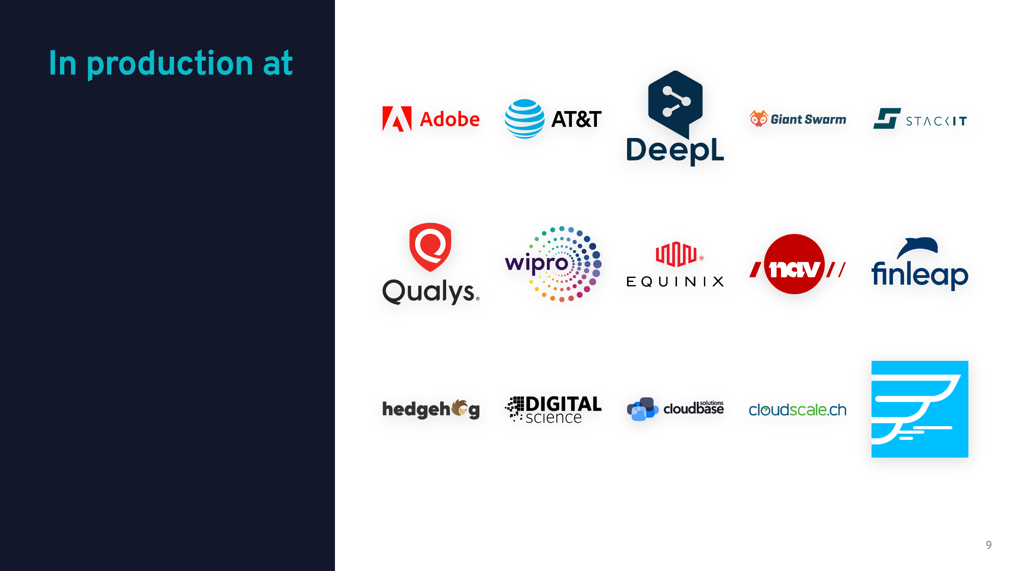

Slide 10
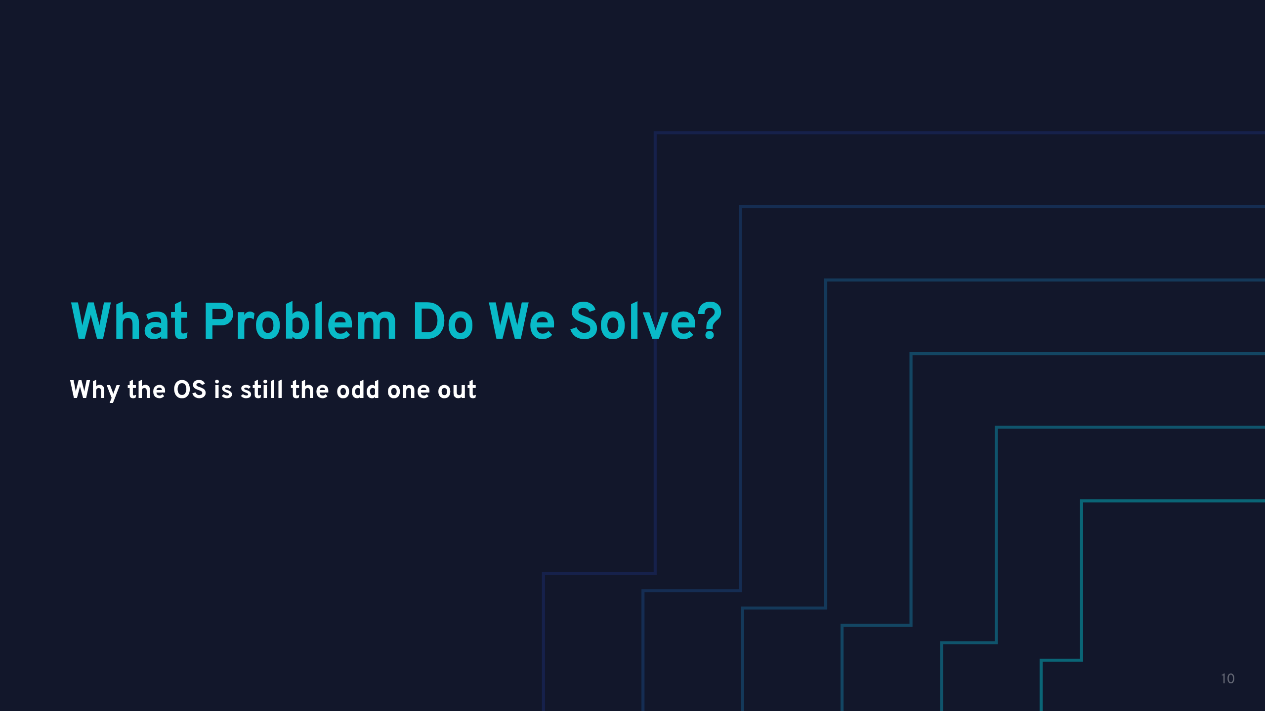

Slide 11
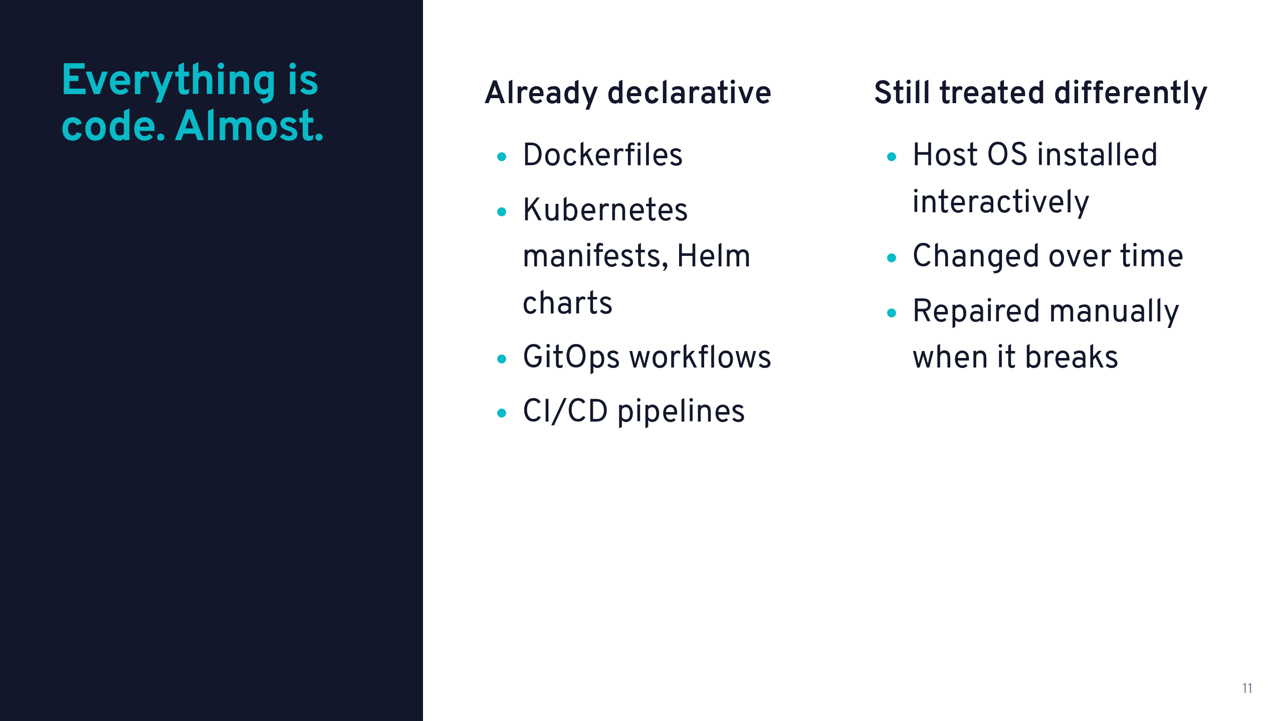

Slide 12
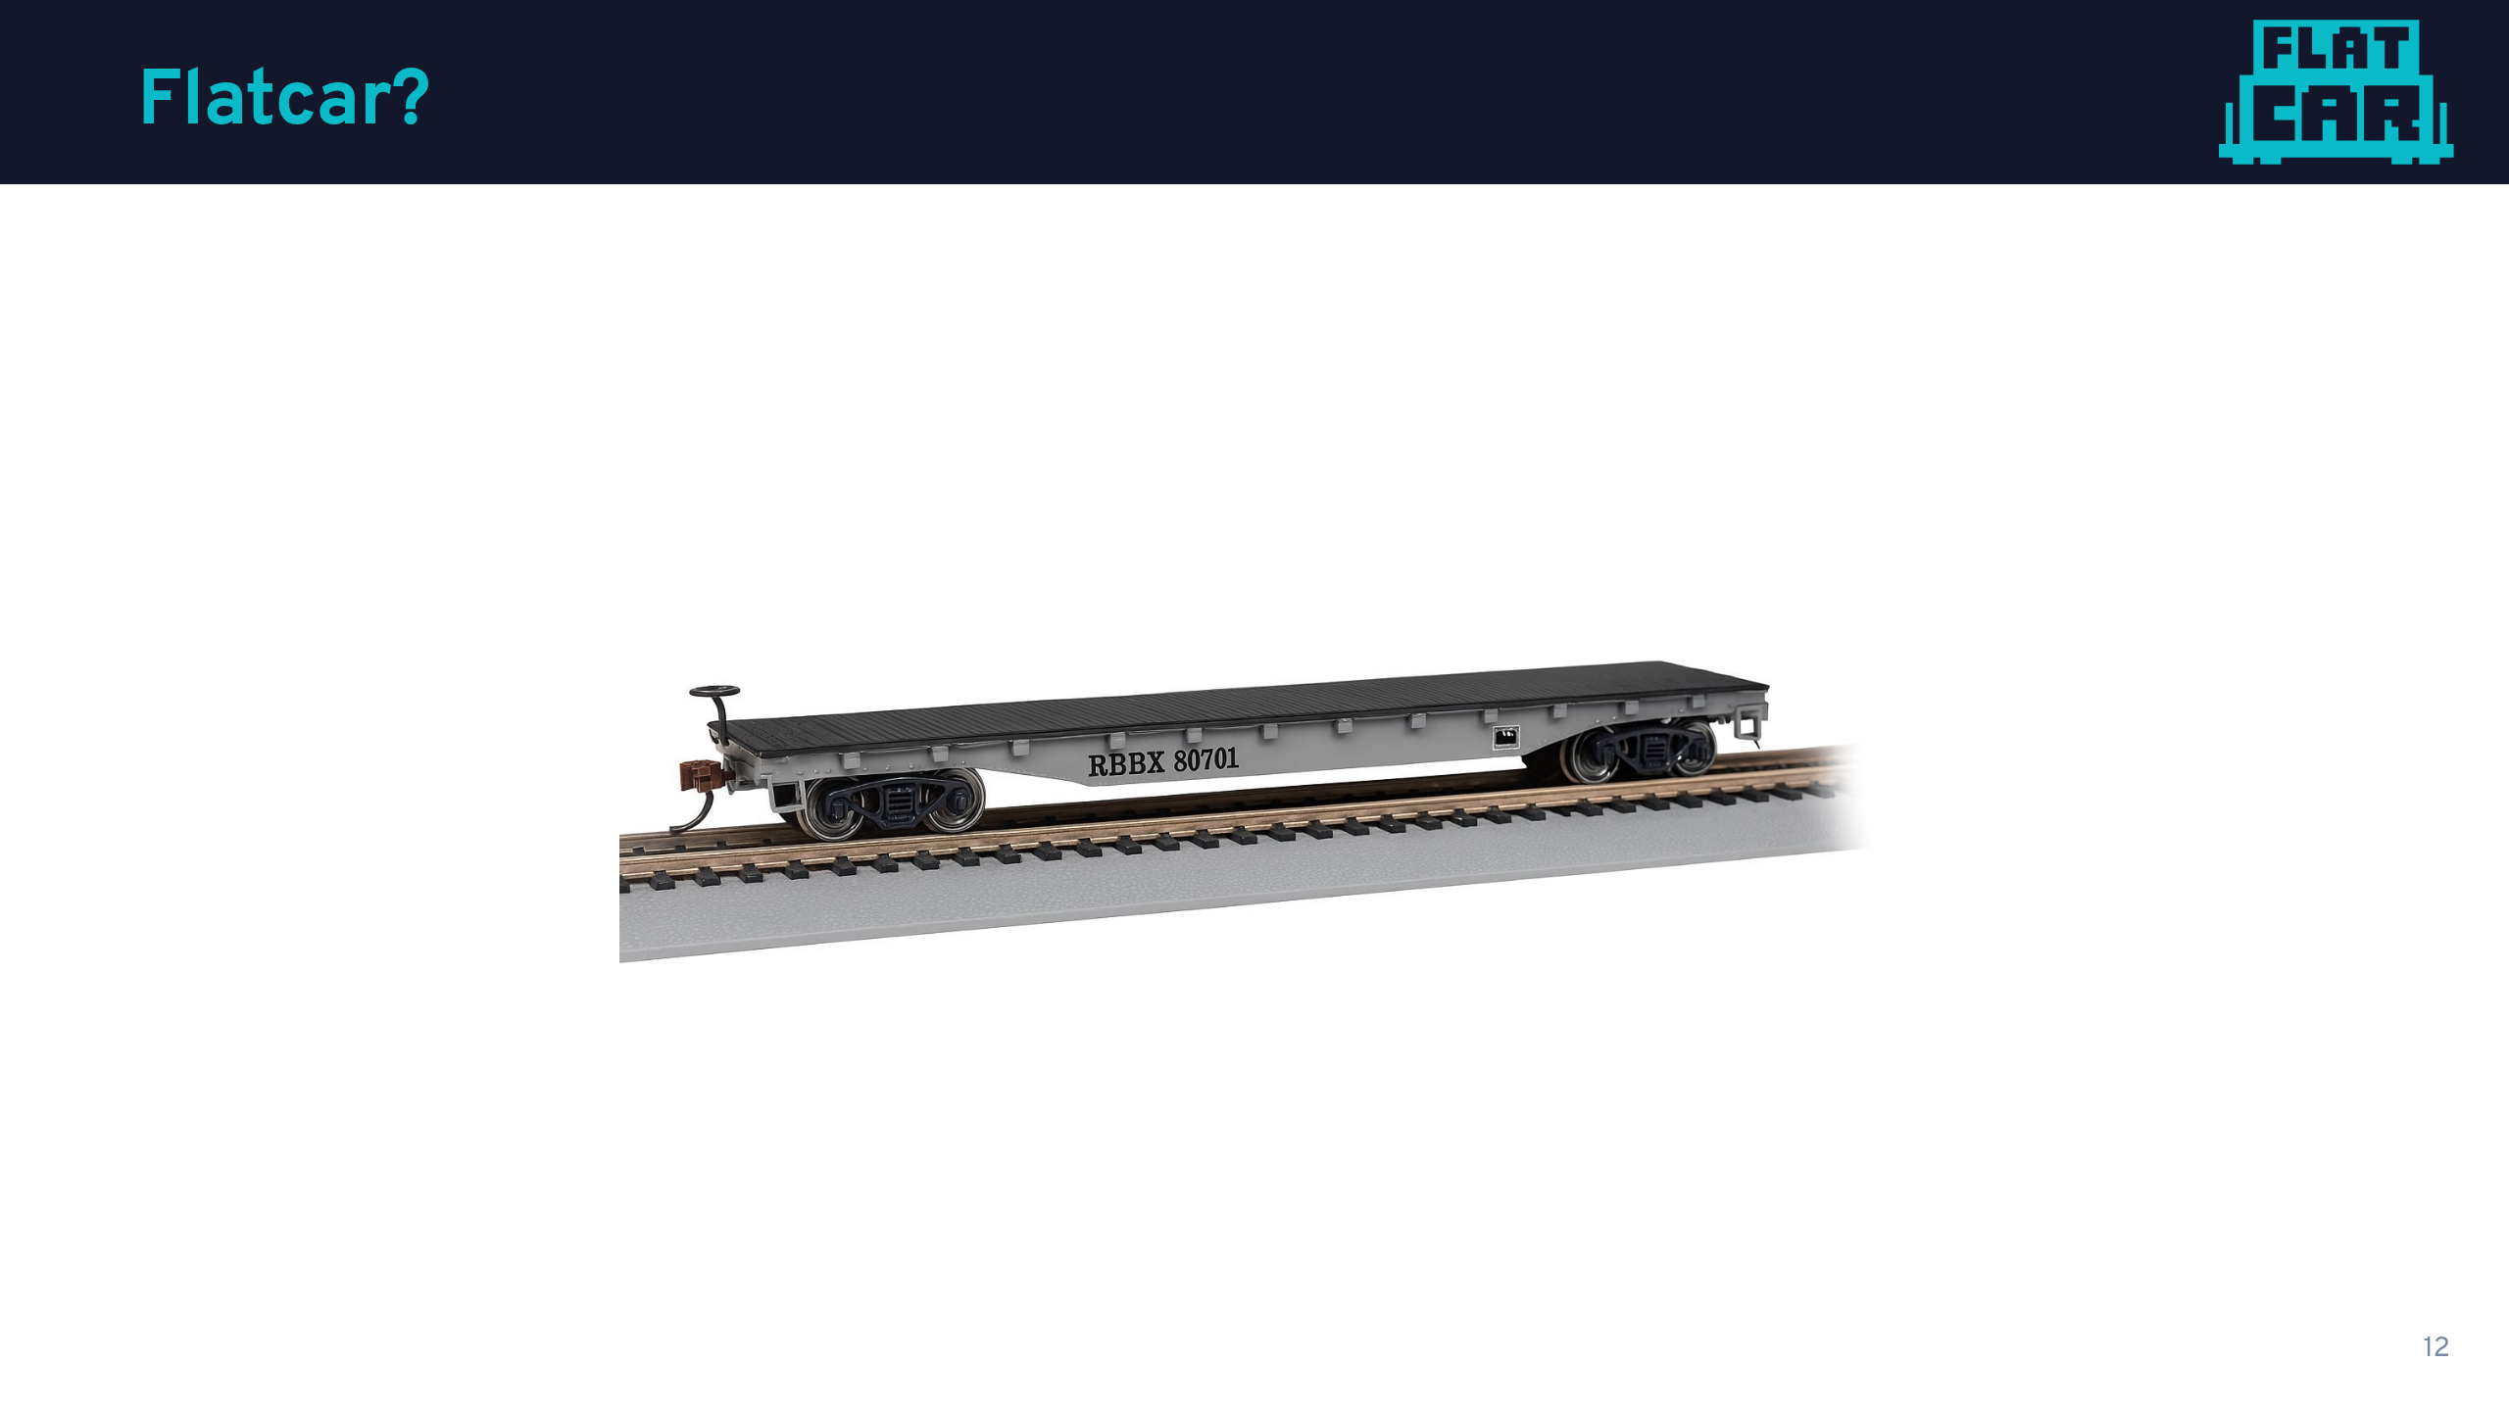

Slide 13
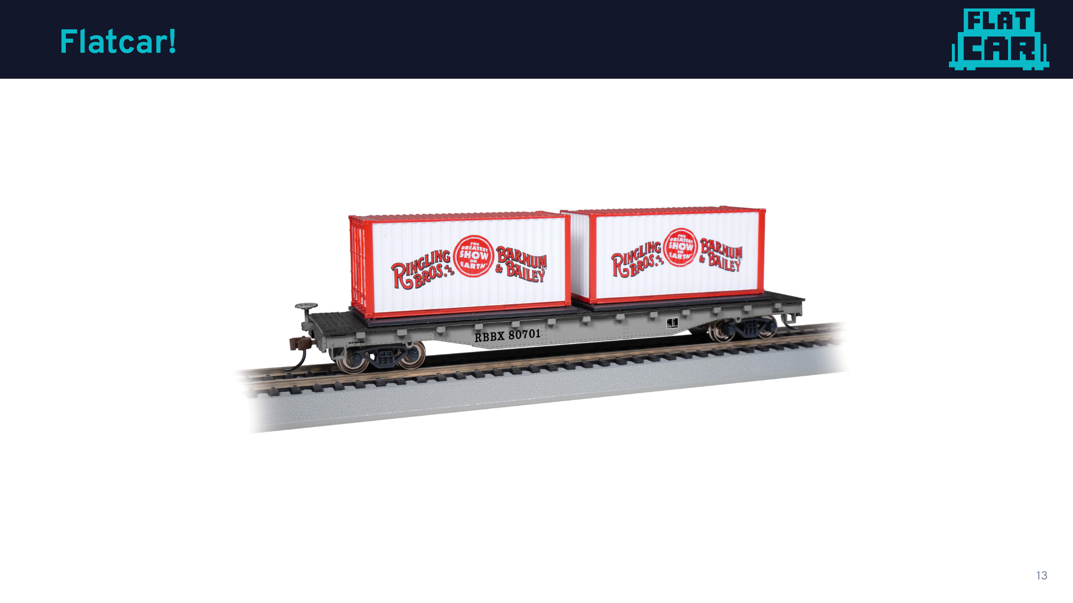

Slide 14
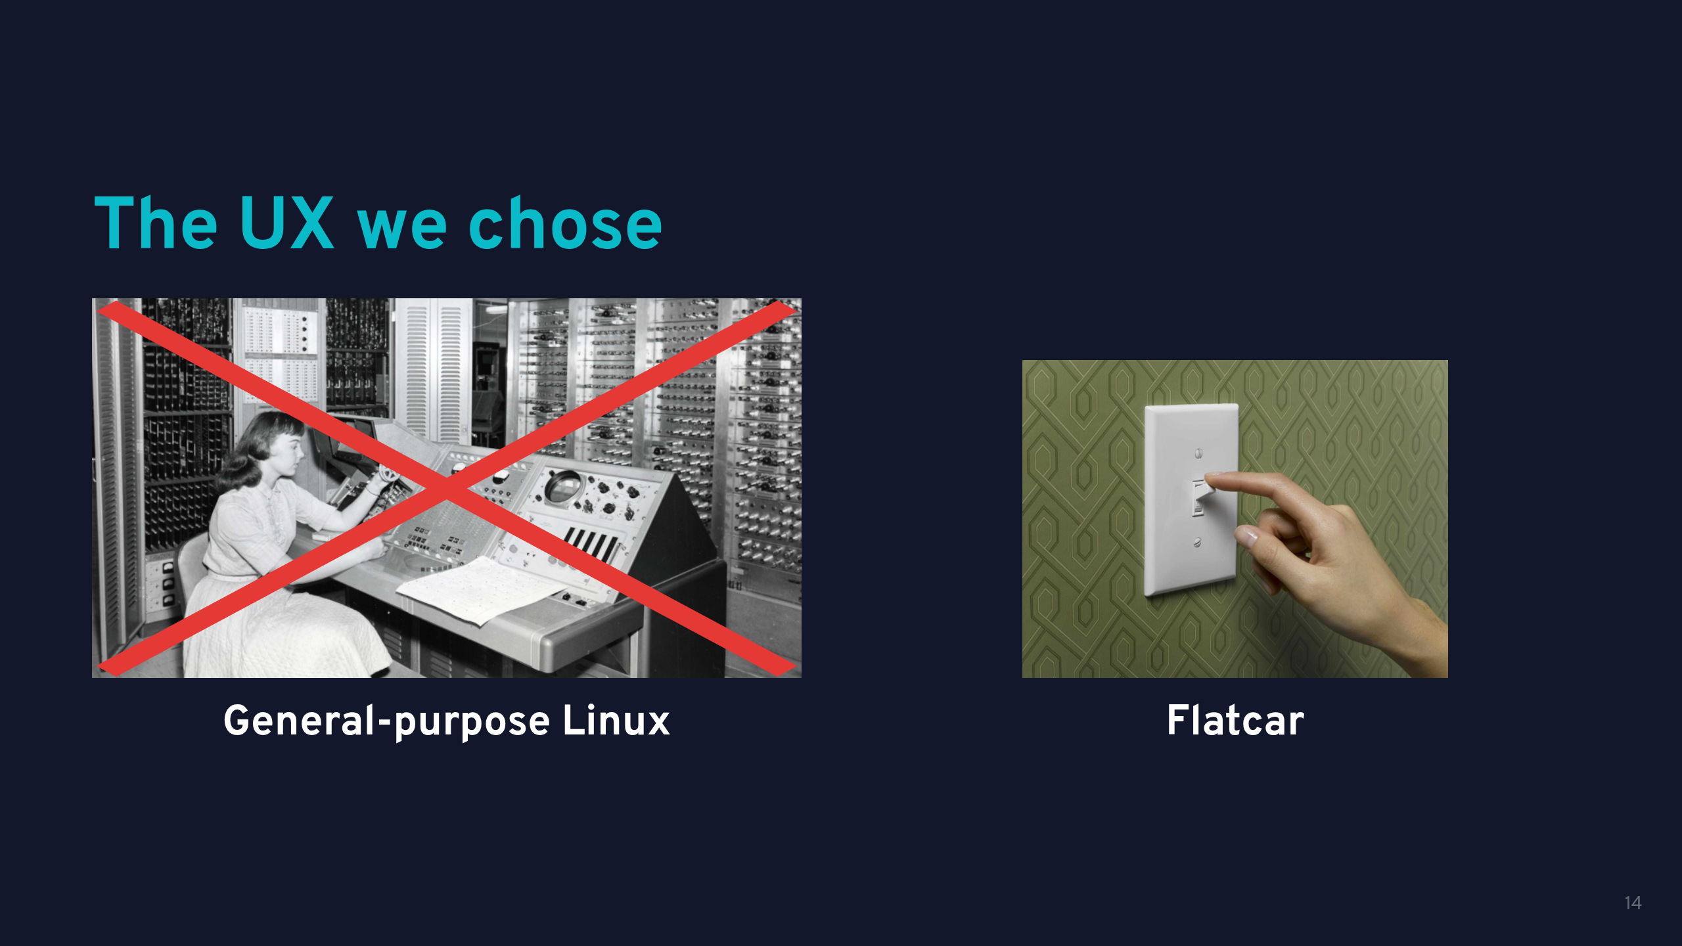

Slide 15
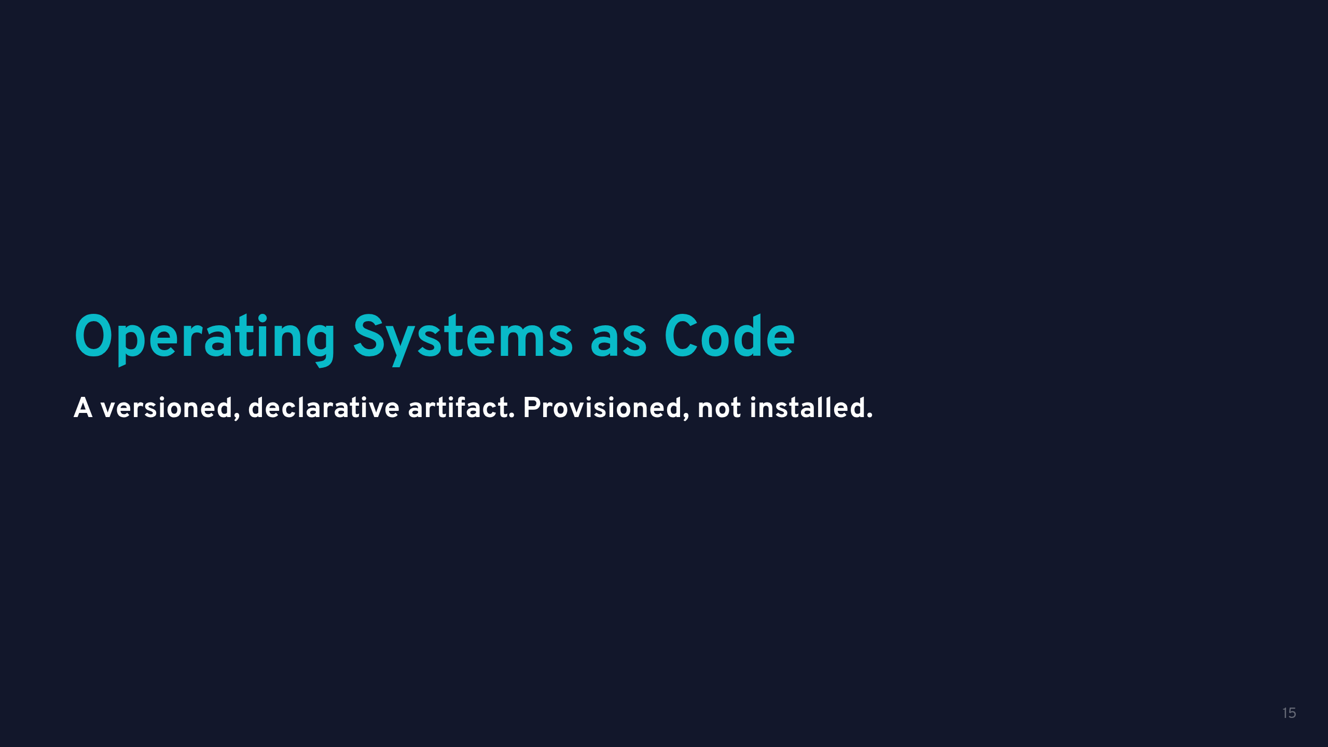

Slide 16
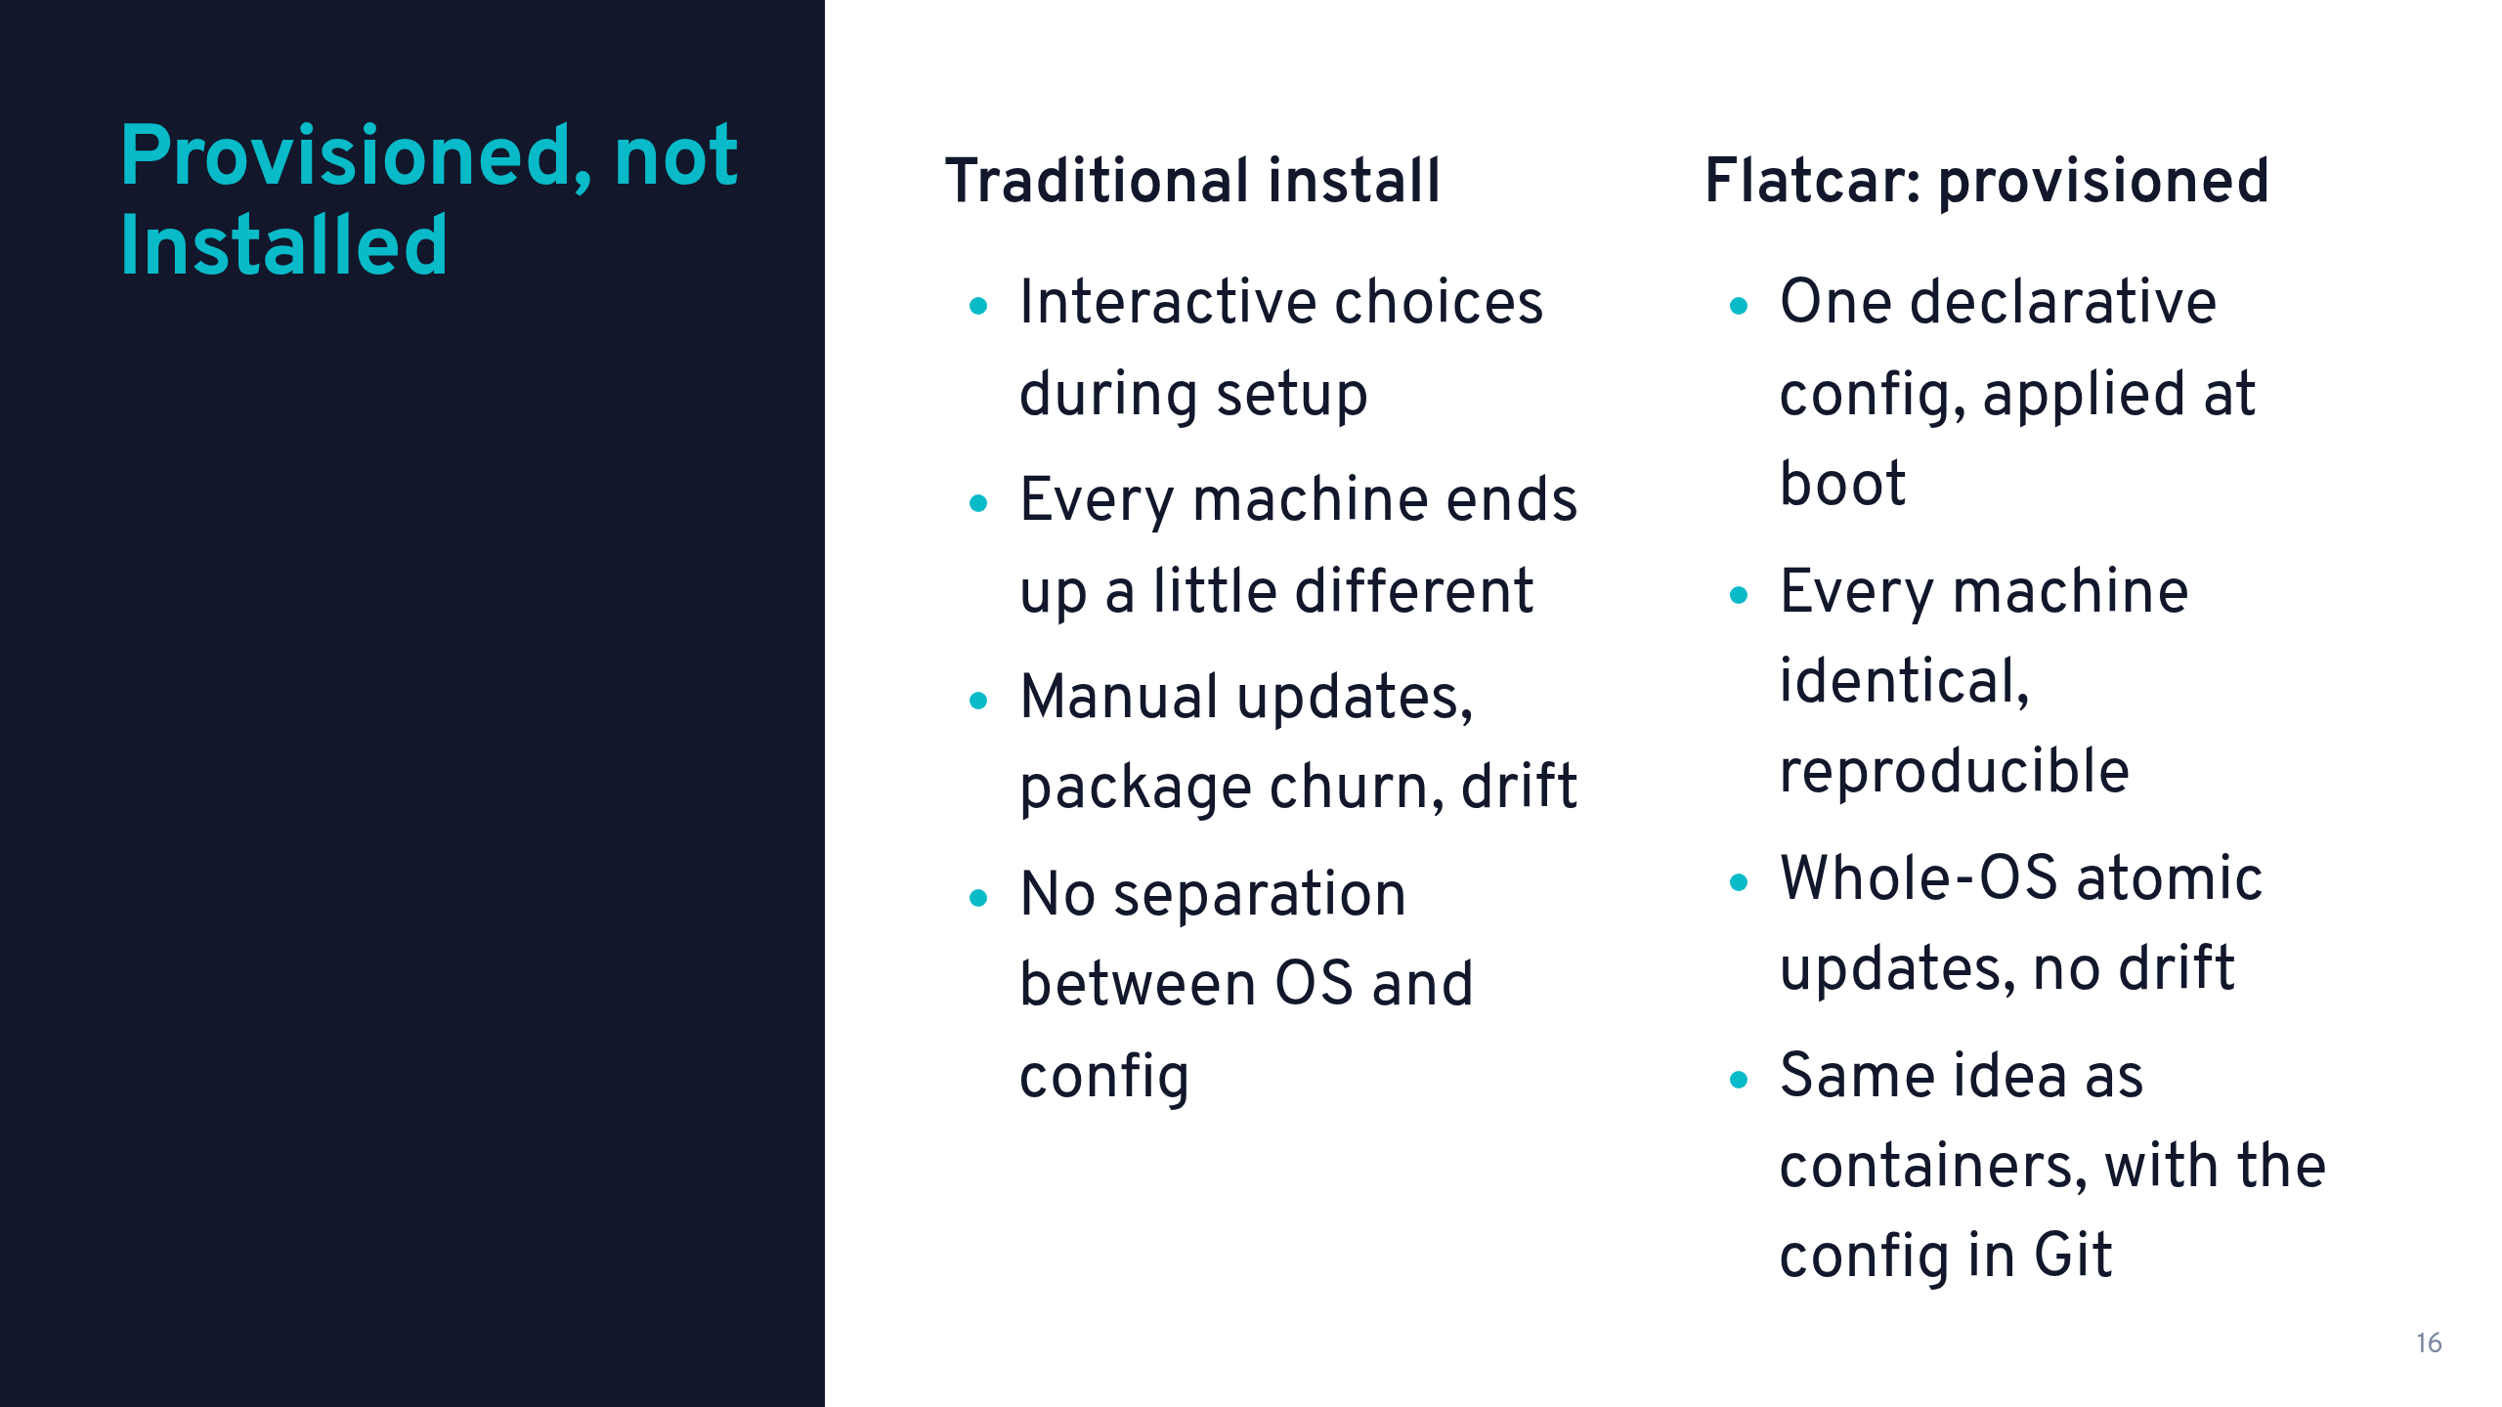

Slide 17
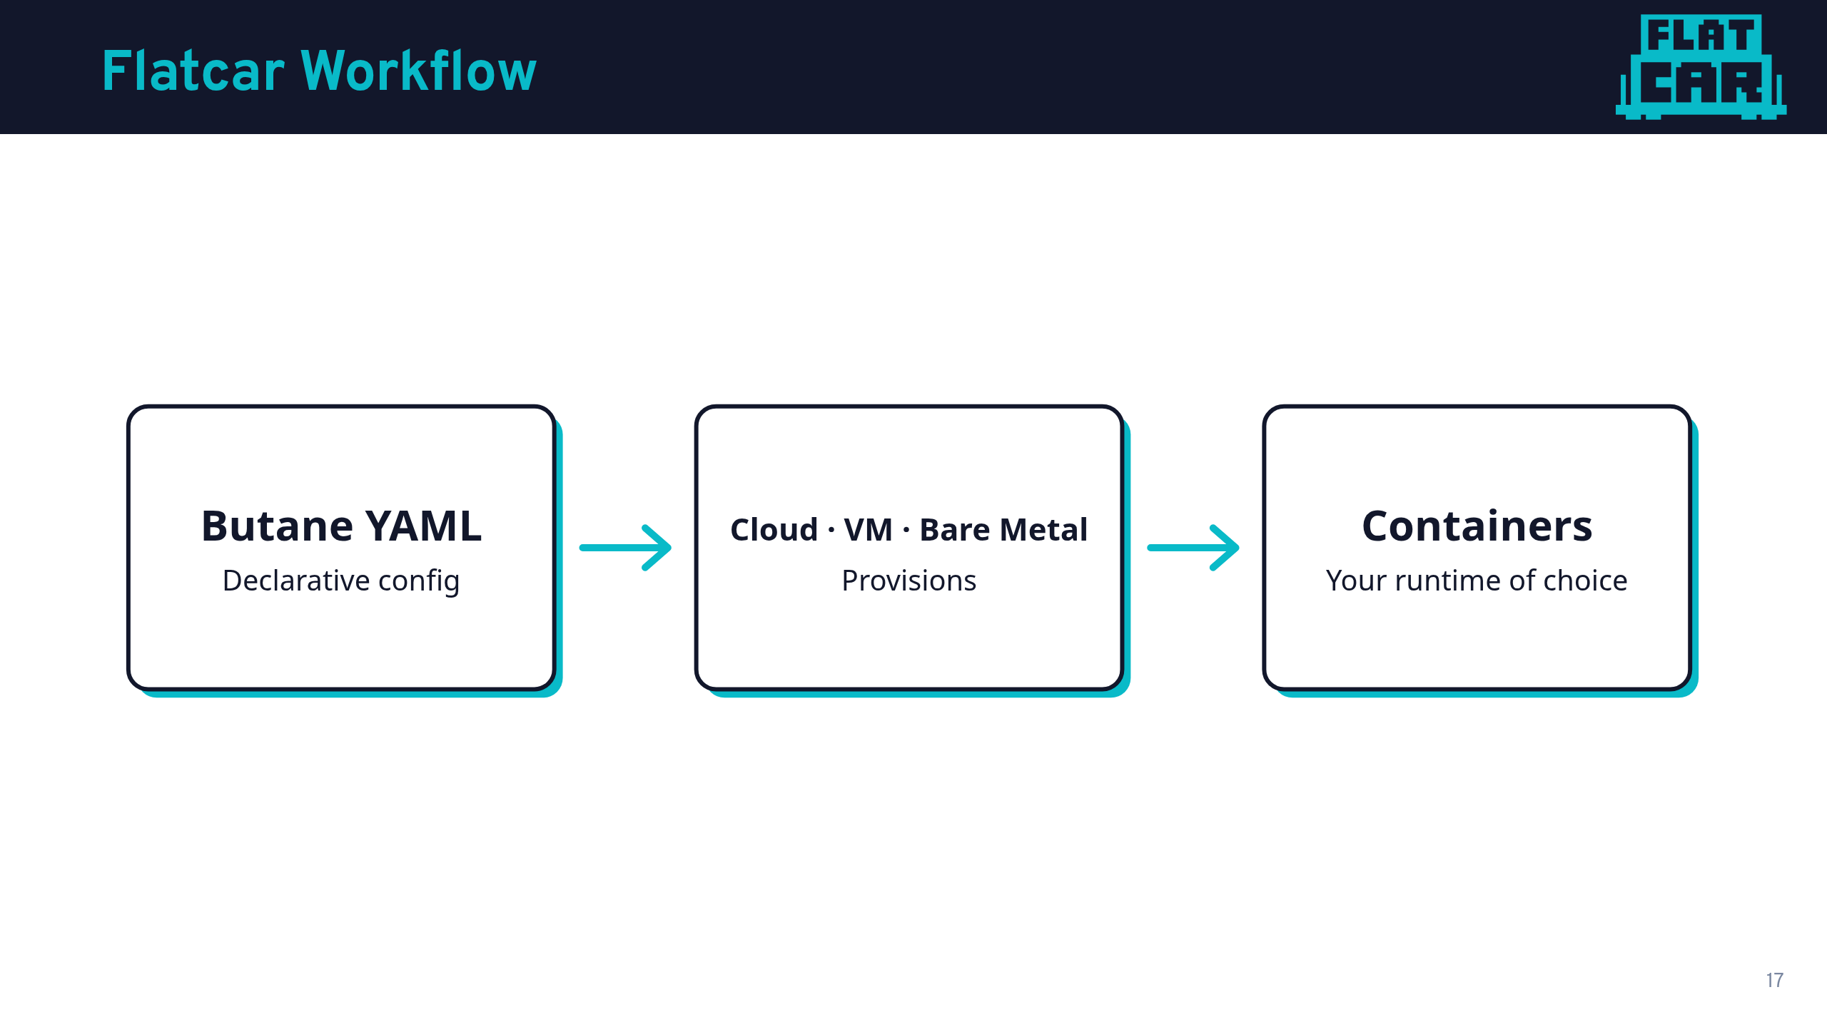

Slide 18
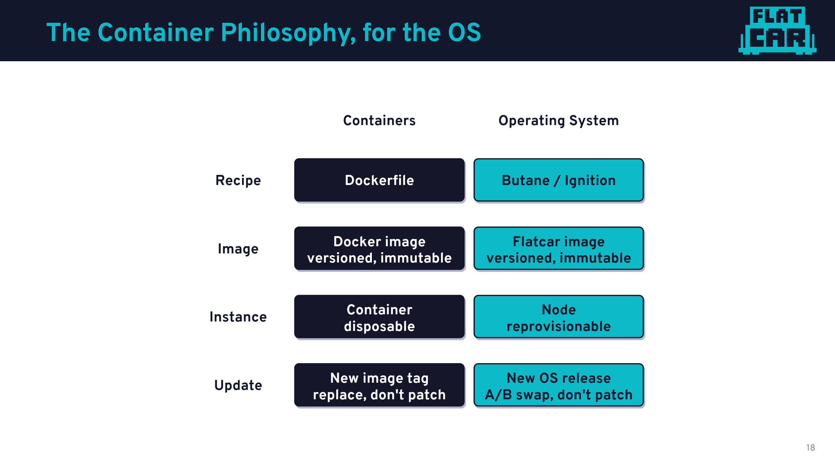

Slide 19
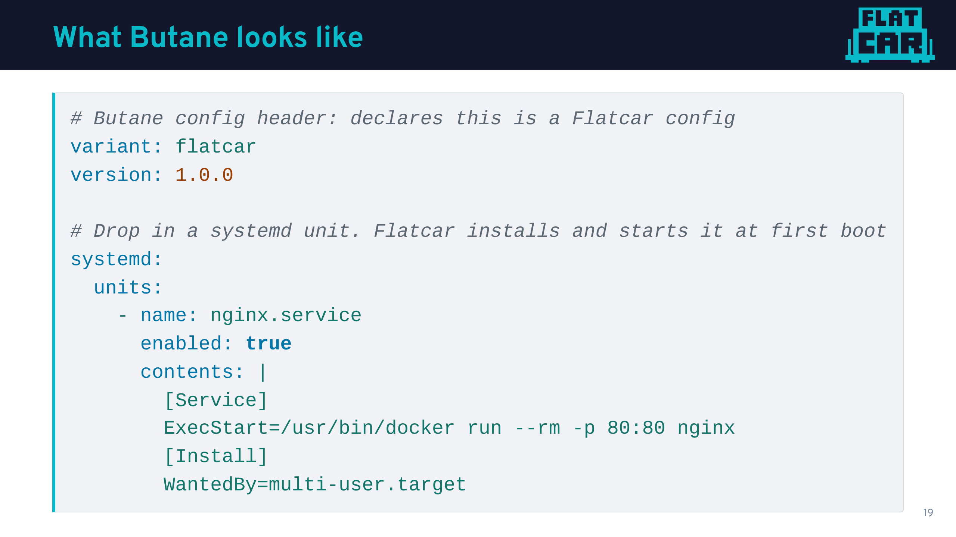

Slide 20
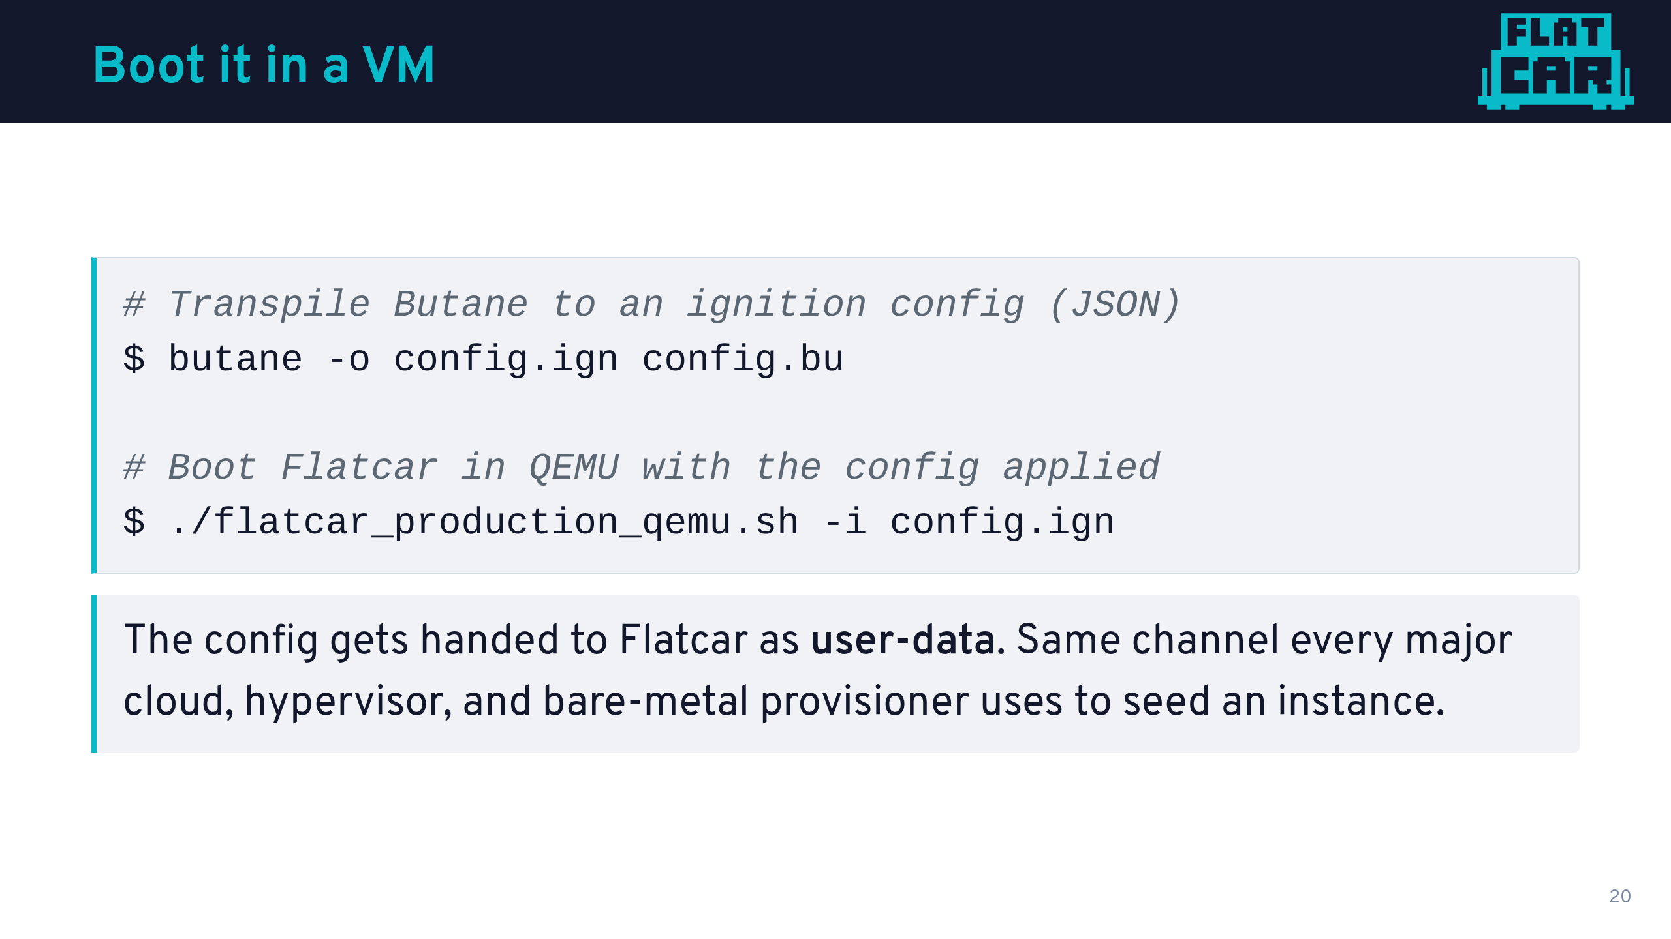

Slide 21
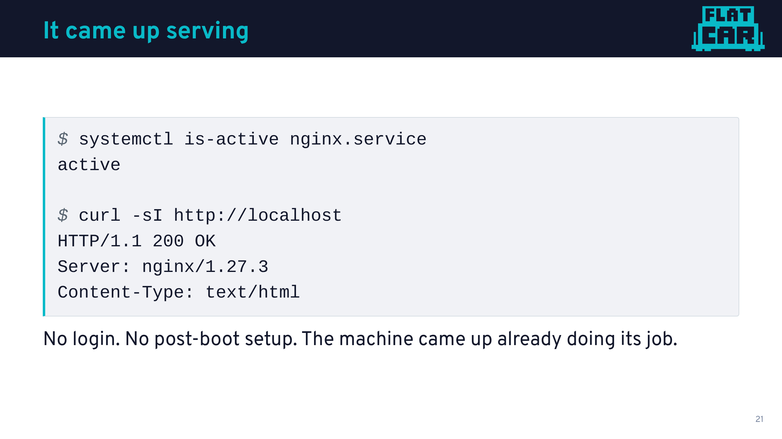

Slide 22
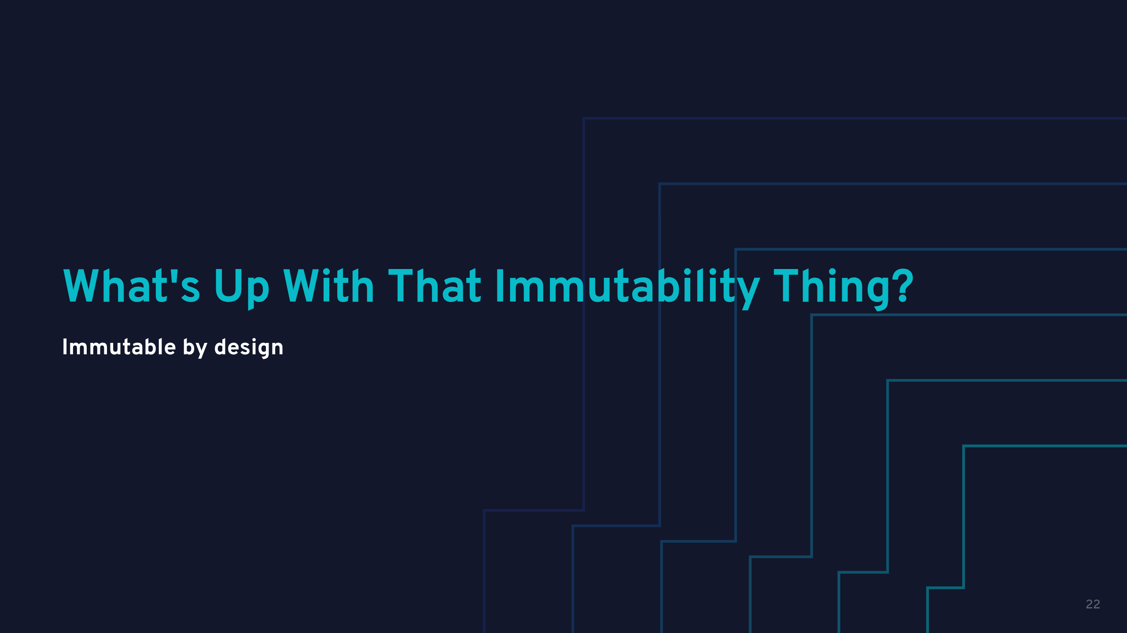

Slide 23
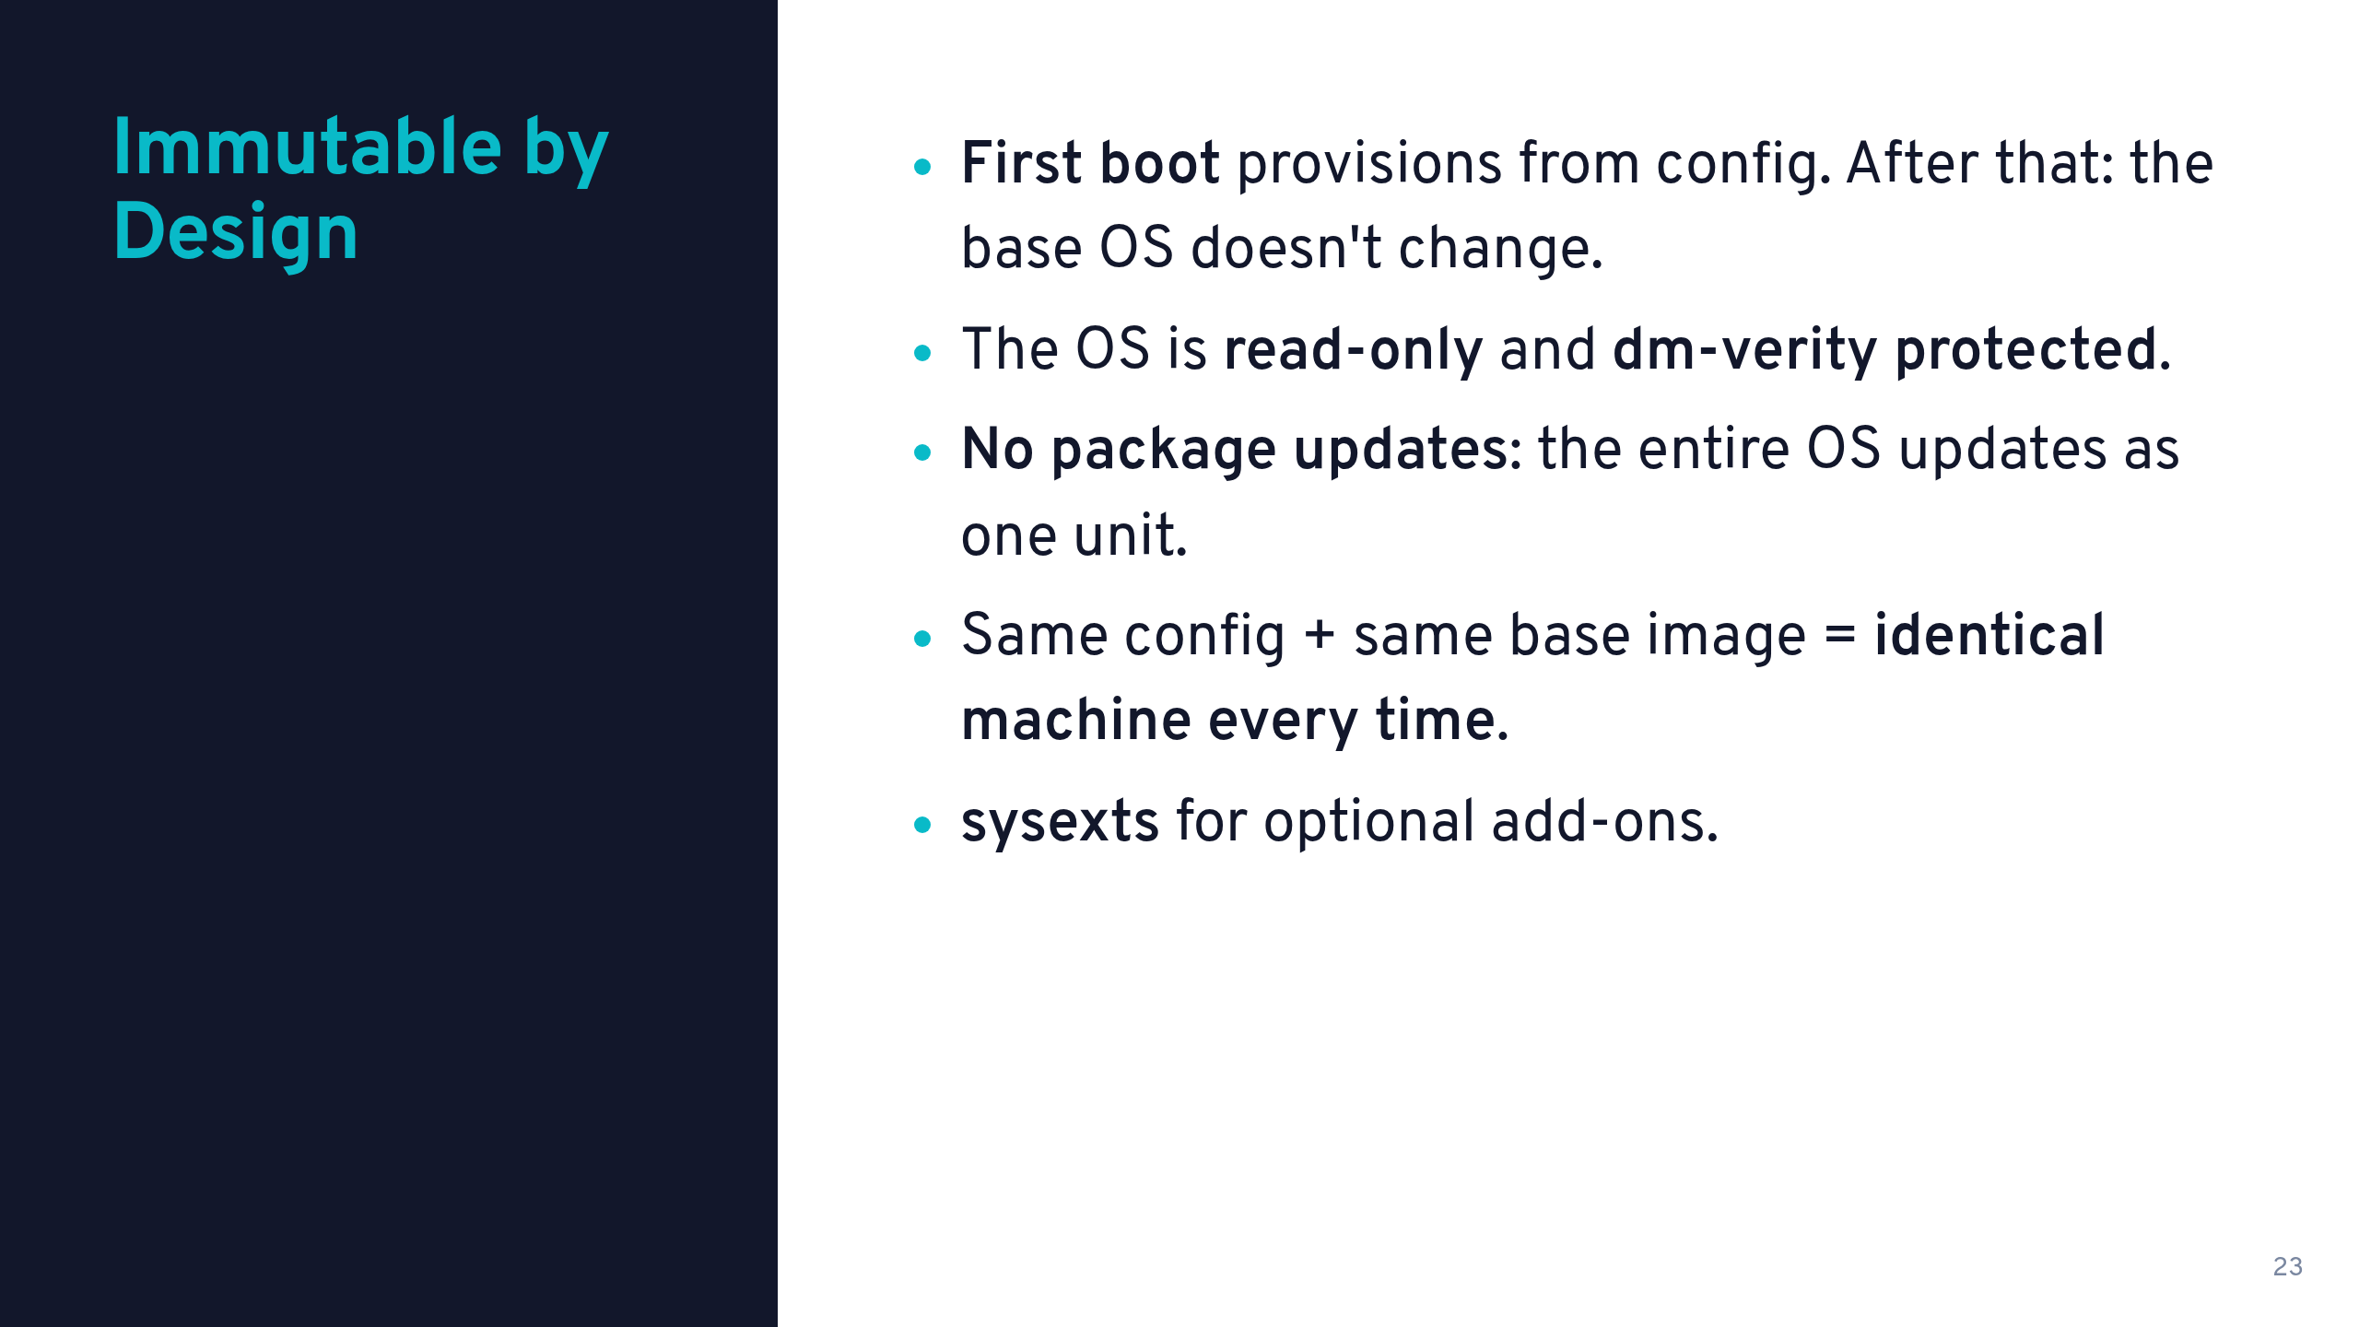

Slide 24
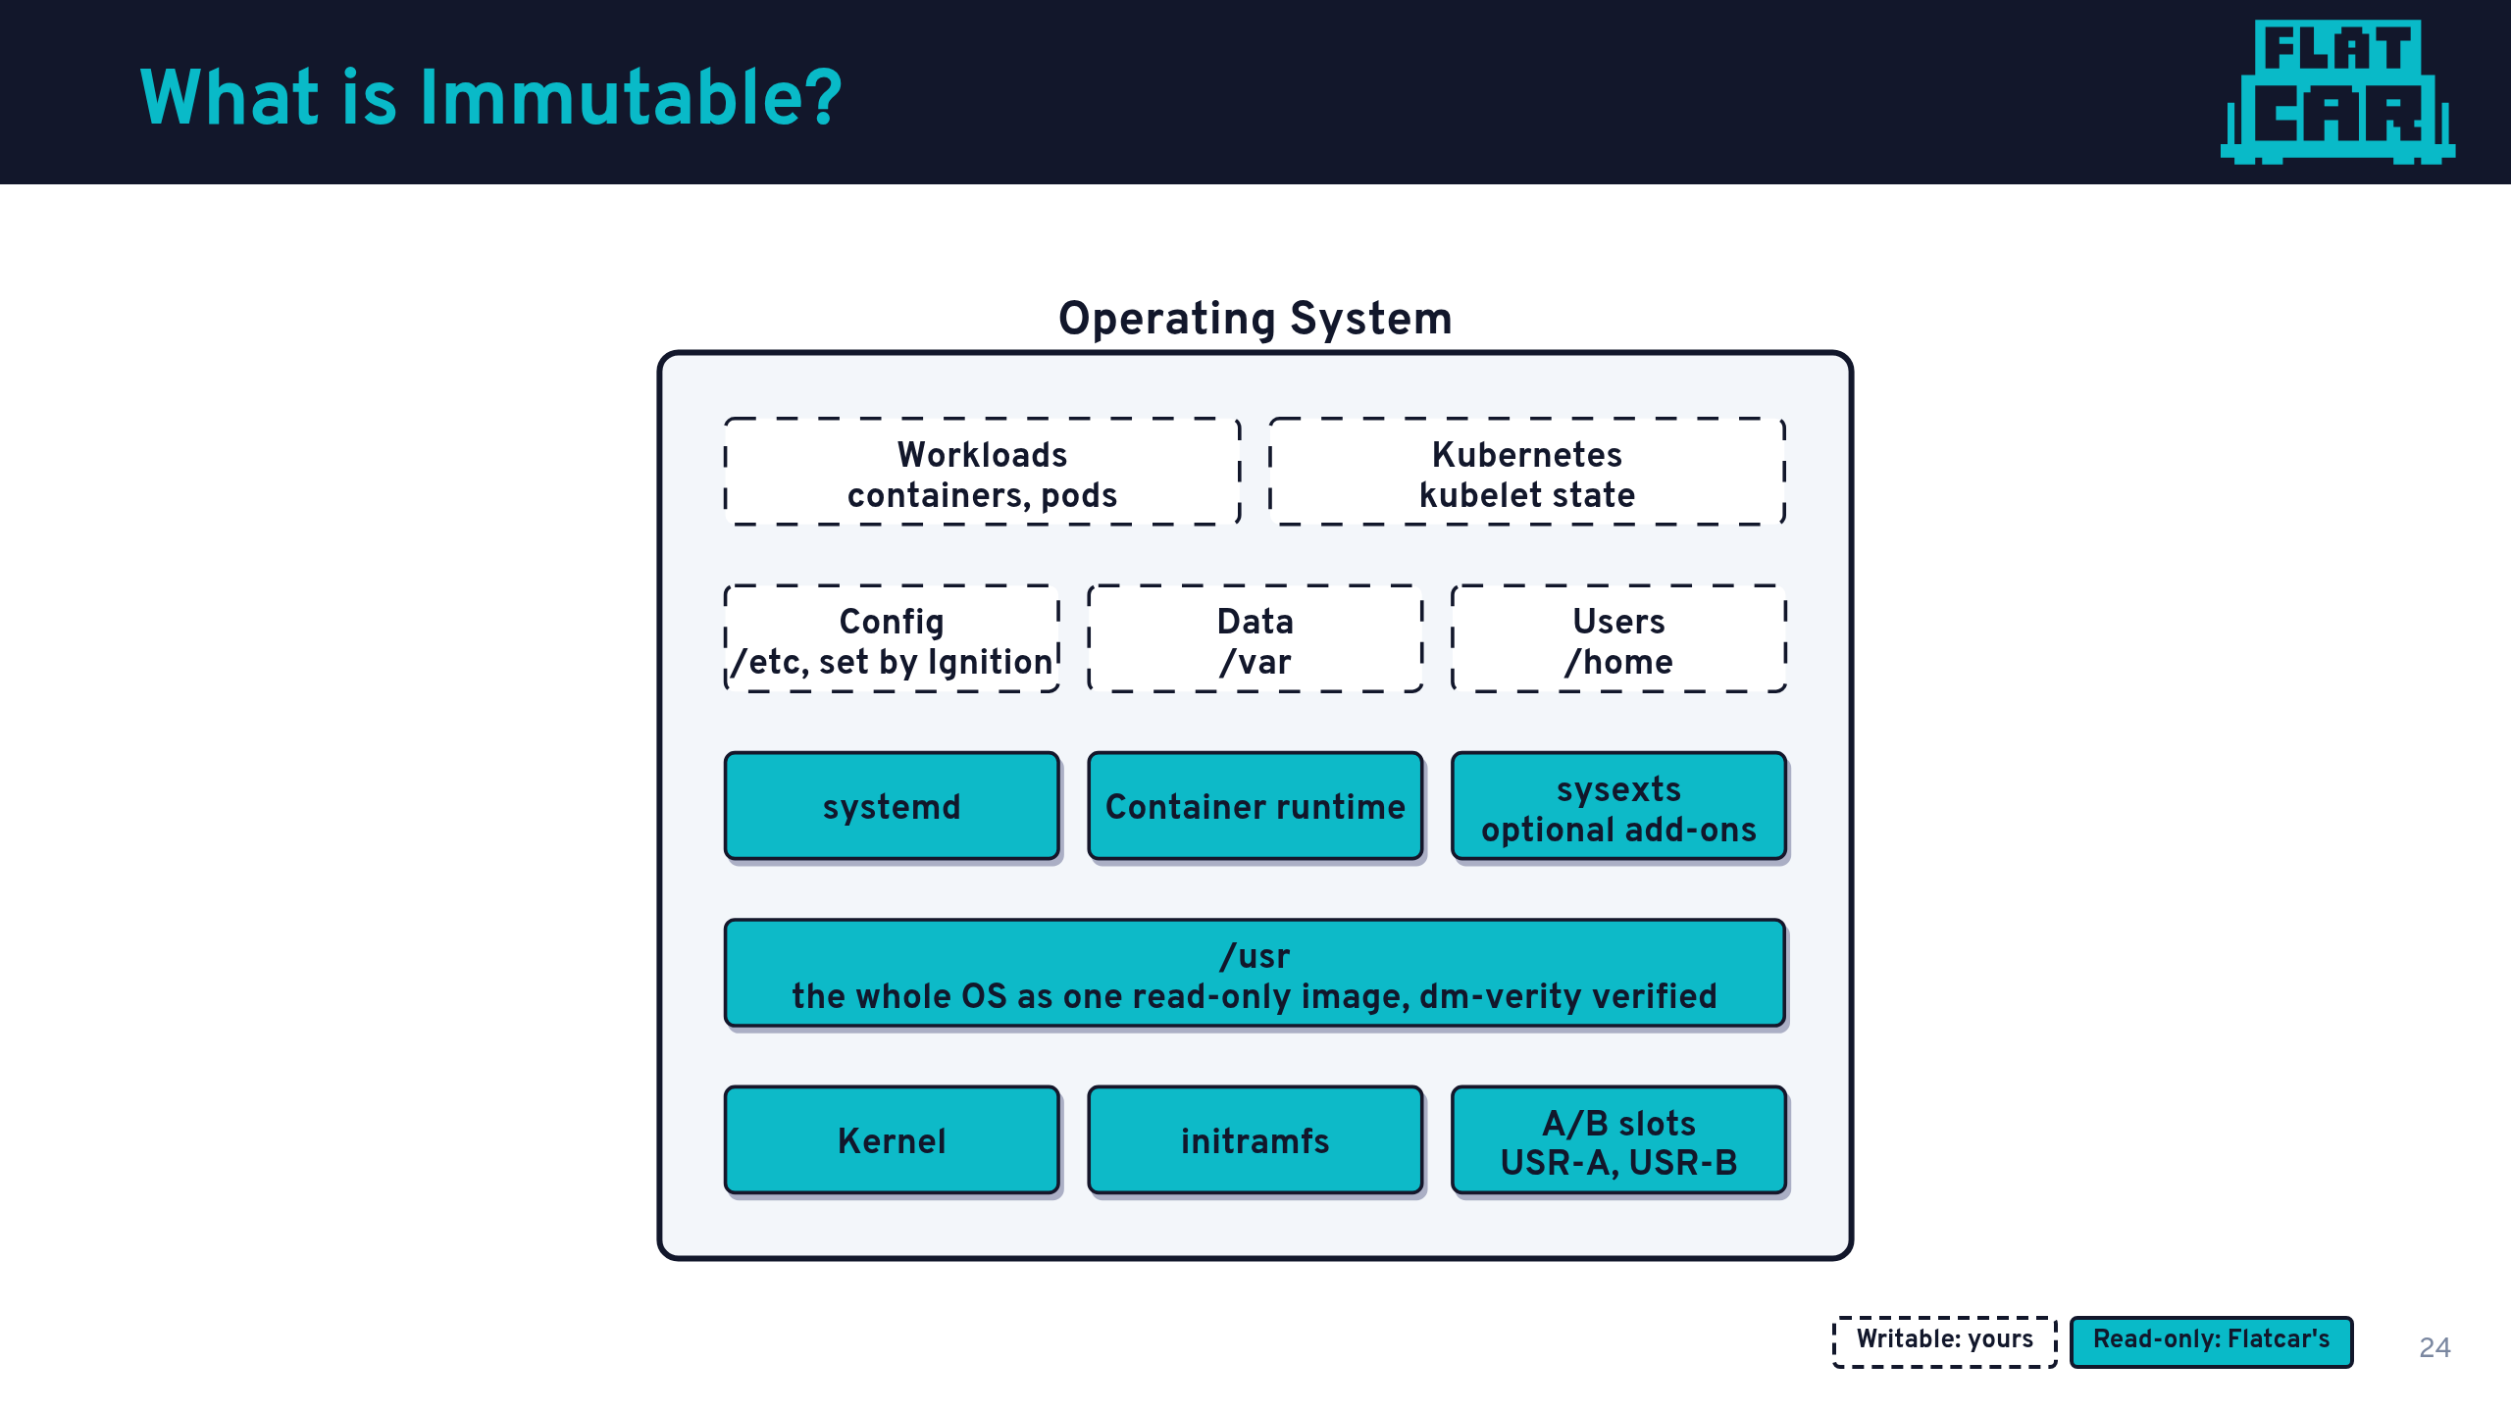

Slide 25
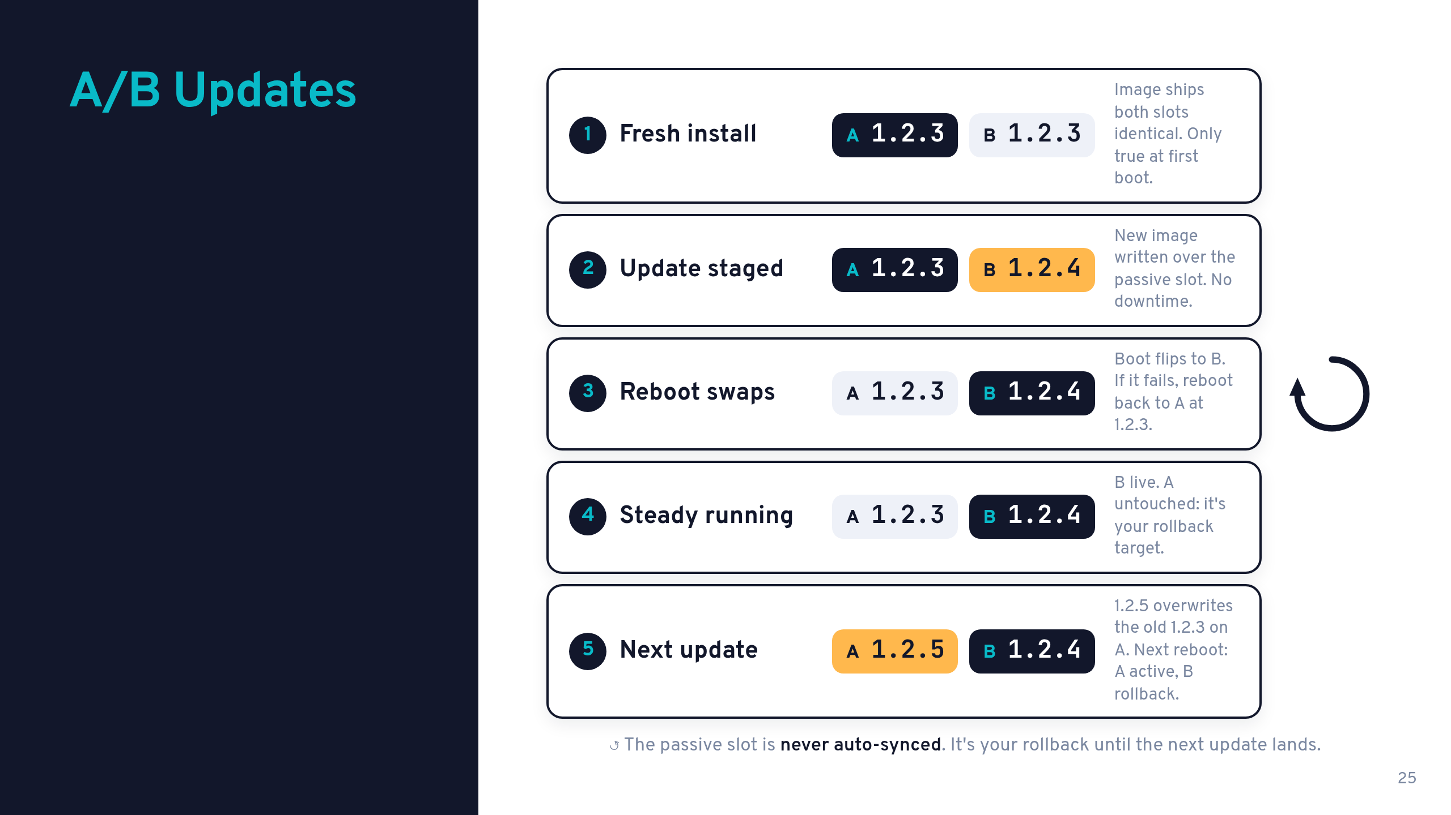

Slide 26
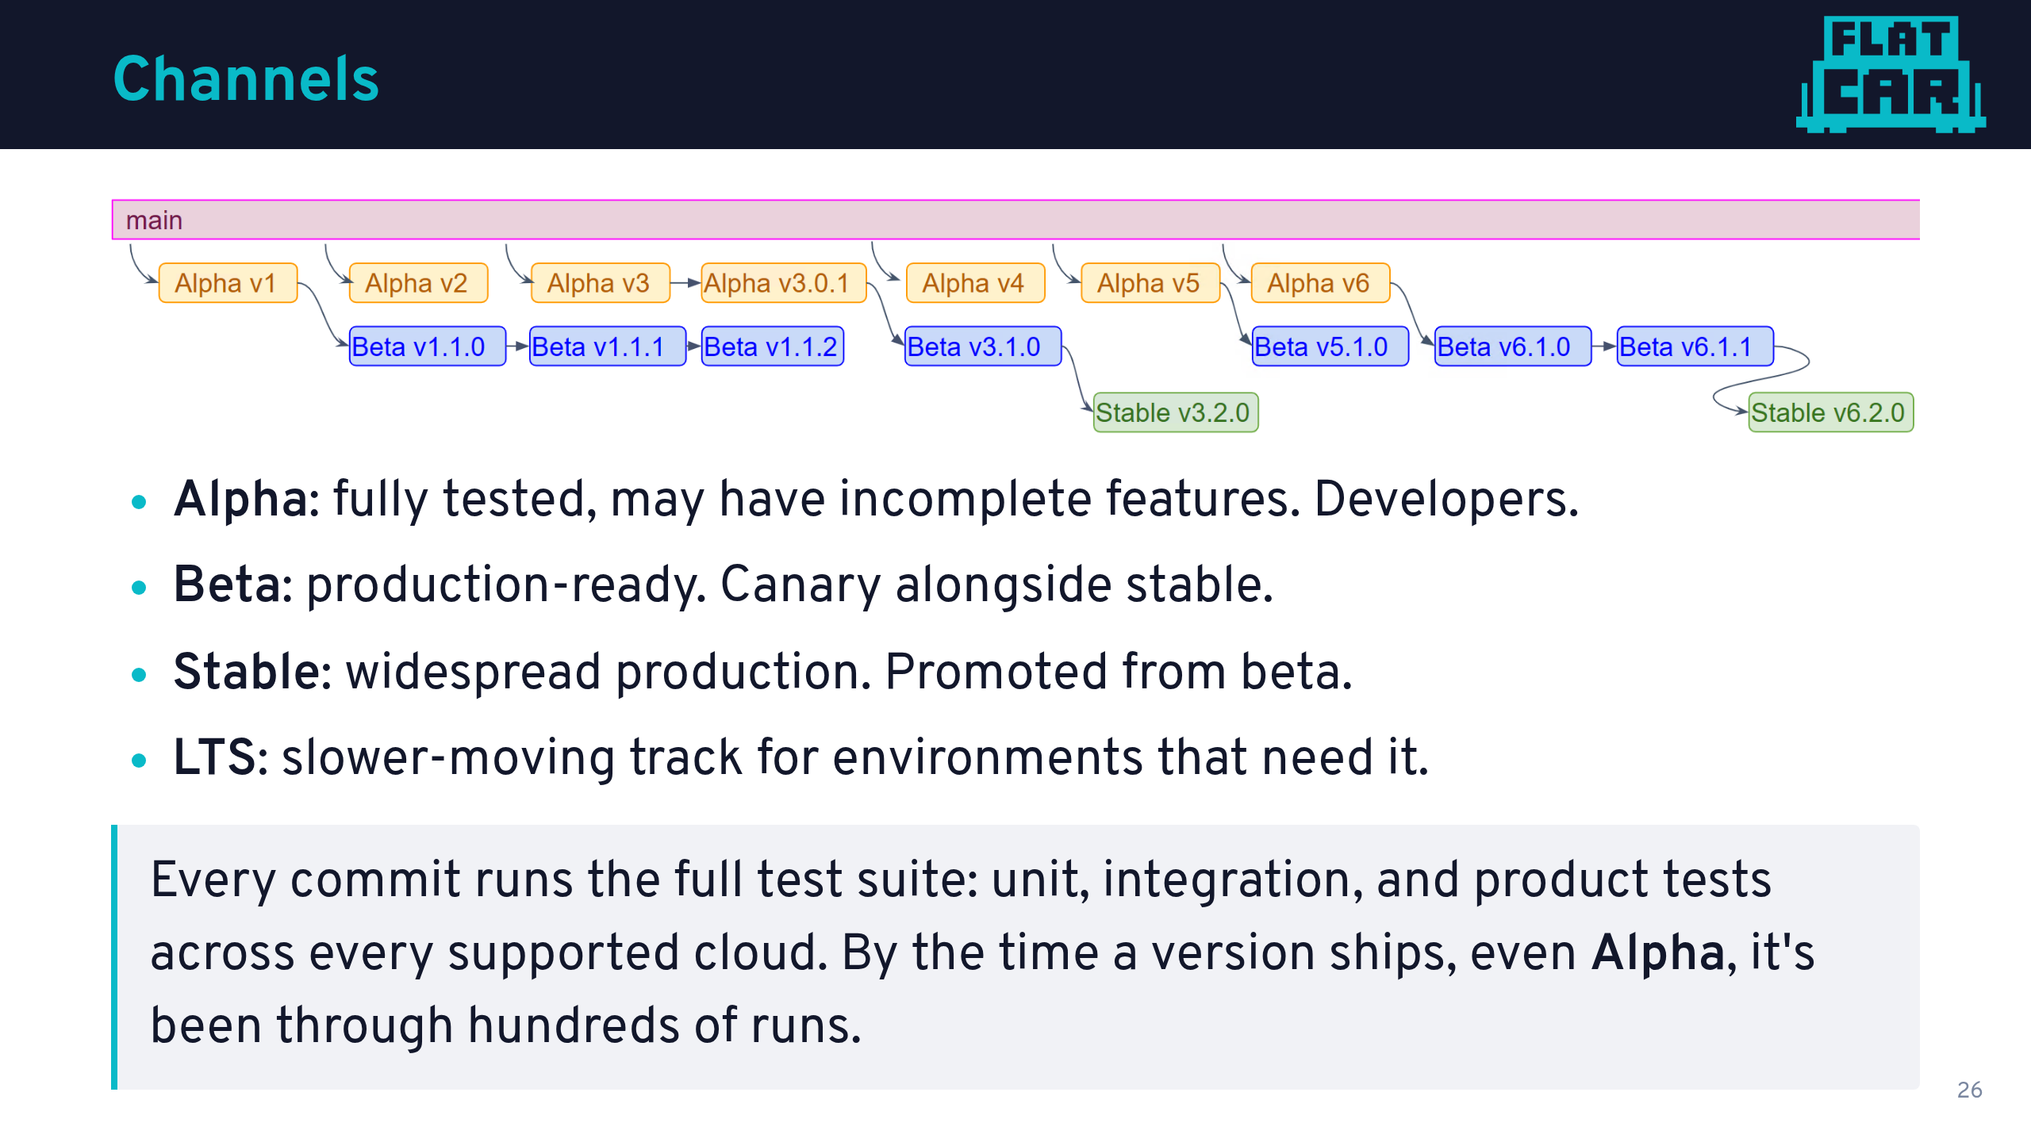

Slide 27
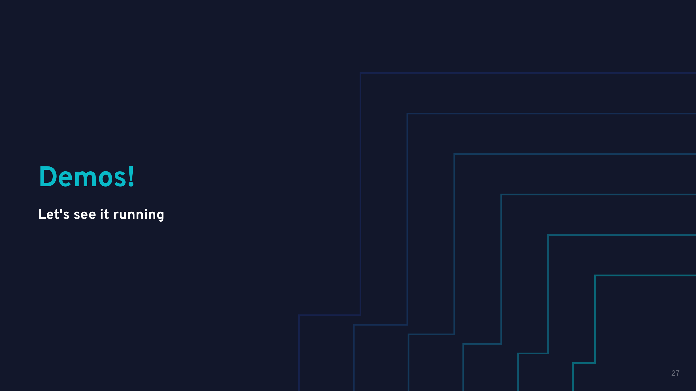

Slide 28
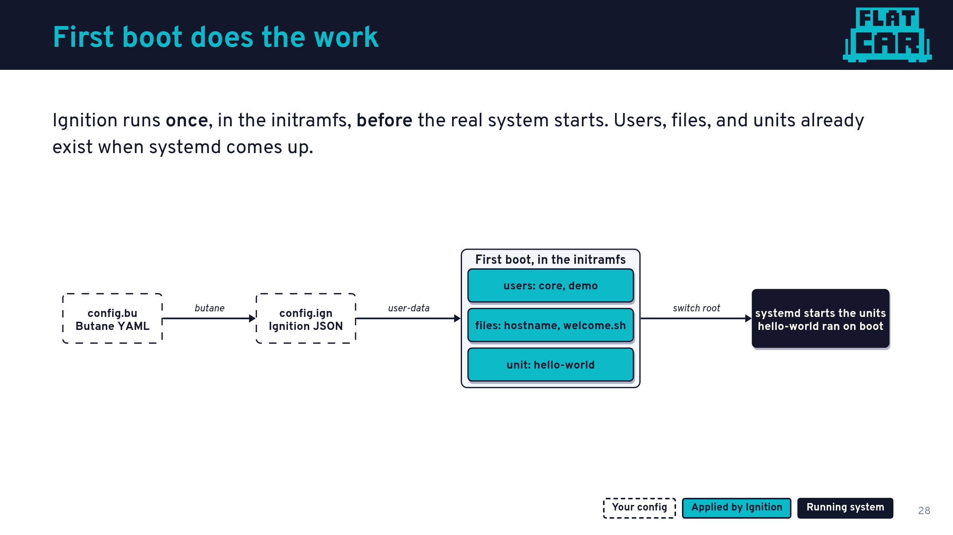
Notes:
Talk track: the difference from cloud-init is timing. Ignition runs before the root filesystem is switched to, so there is no window where the machine is half configured and serving.
Walk the diagram left to right: Butane is what you write and review in Git. butane turns it into Ignition JSON. The platform hands that over as user-data. Ignition writes users, files, and units, then the normal boot continues.
If Ignition fails, the boot fails. That is a feature: a machine never comes up silently wrong.
Next: watch it happen on a real VM.

Slide 29
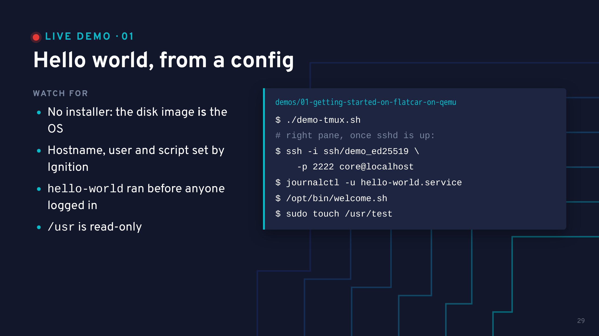
Notes:
Show config.bu briefly in the editor: two users, a hostname, a welcome script and one unit. That is everything this machine will ever be told.
Switch to the terminal. Left pane is the serial console, right pane waits for sshd. While it boots, say: there is no installer step. We downloaded a disk image, handed QEMU a config, and that is the whole procedure. The VM runs with -snapshot, so every run is a genuine first boot.
Payoff 1: SSH in with the key from the config. journalctl -u hello-world.service shows the container already ran at boot, and /opt/bin/welcome.sh is the script Ignition staged. Nobody logged in to set any of it up.
Payoff 2: the OS is immutable. sudo touch /usr/test fails with "Read-only file system". Config and data live in /etc and /var, which stay writable.
Fallback: none recorded, rerun ./demo-tmux.sh (boots in seconds once the image is cached).

Slide 30
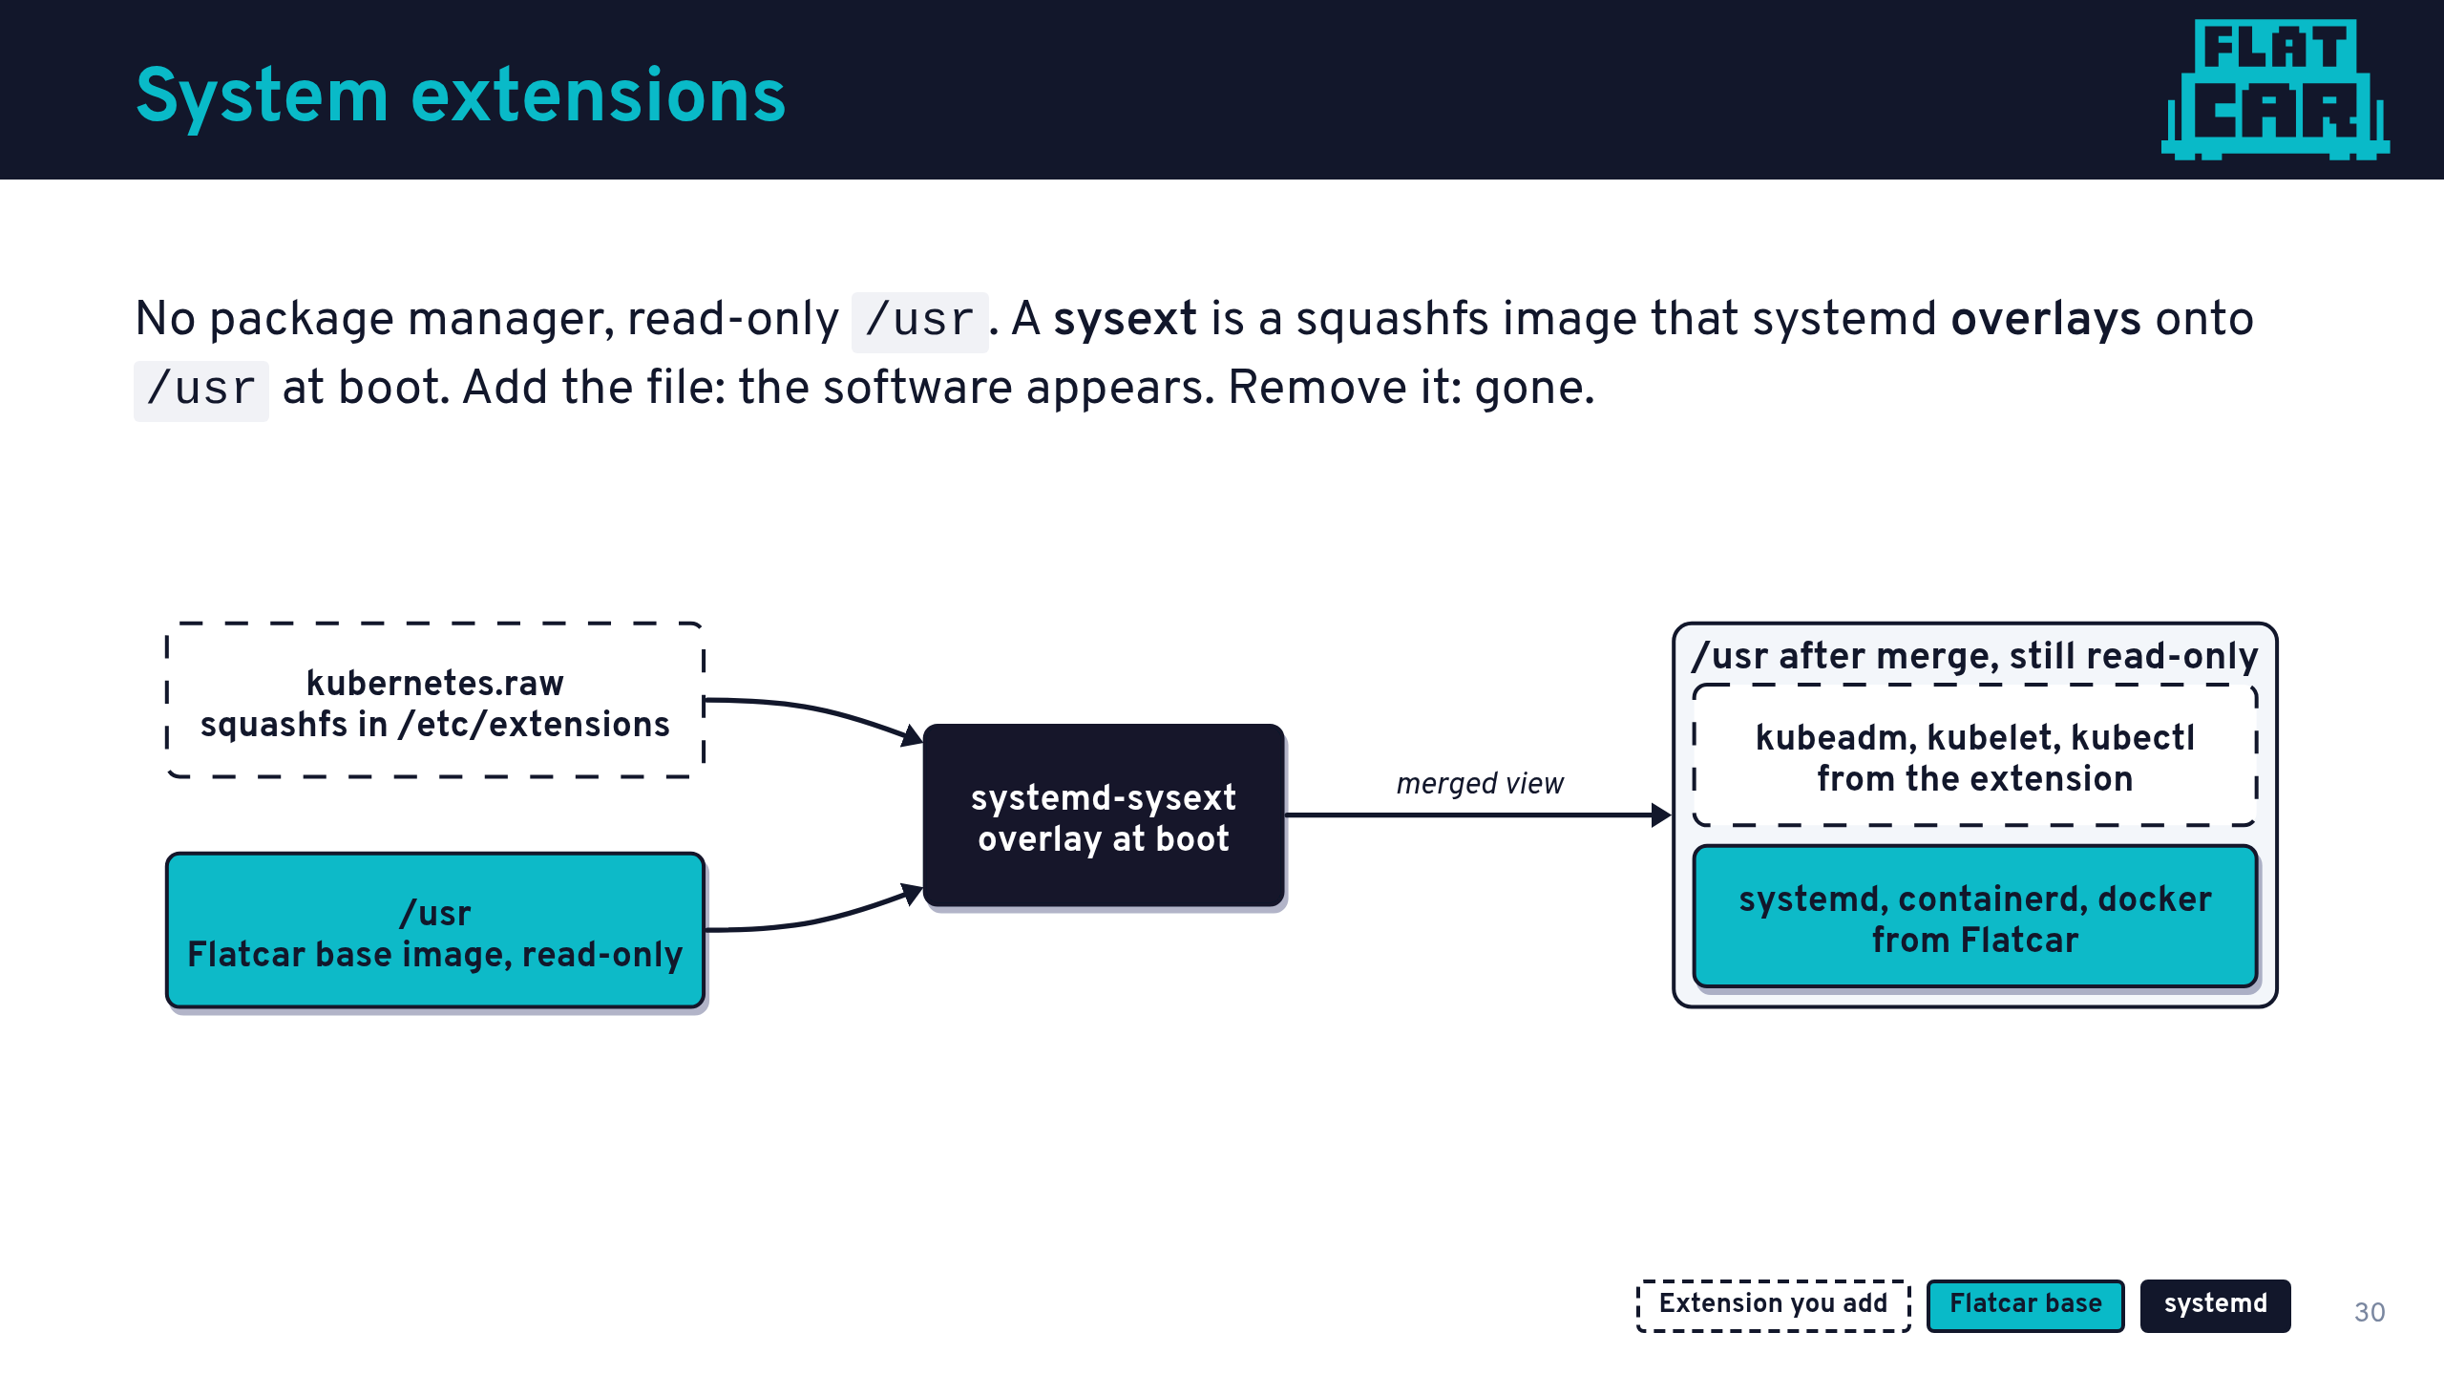
Notes:
Talk track: this answers the question everyone asks at this point. "If /usr is read-only and there is no package manager, how do I install anything?"
A sysext is just a filesystem image. systemd-sysext stacks it on top of /usr with an overlay. The result is still read-only, and the base image underneath is byte-for-byte what we shipped.
This is not Flatcar-specific magic: systemd-sysext is upstream systemd, and the UAPI group we mentioned earlier standardises it across distros.
Lifecycle: drop the file into /etc/extensions, and it is merged. Delete it, restart systemd-sysext, and it is gone. No leftover files, no dependency resolution.
We use Kubernetes as the example because it is the extension this audience cares about most.

Slide 31
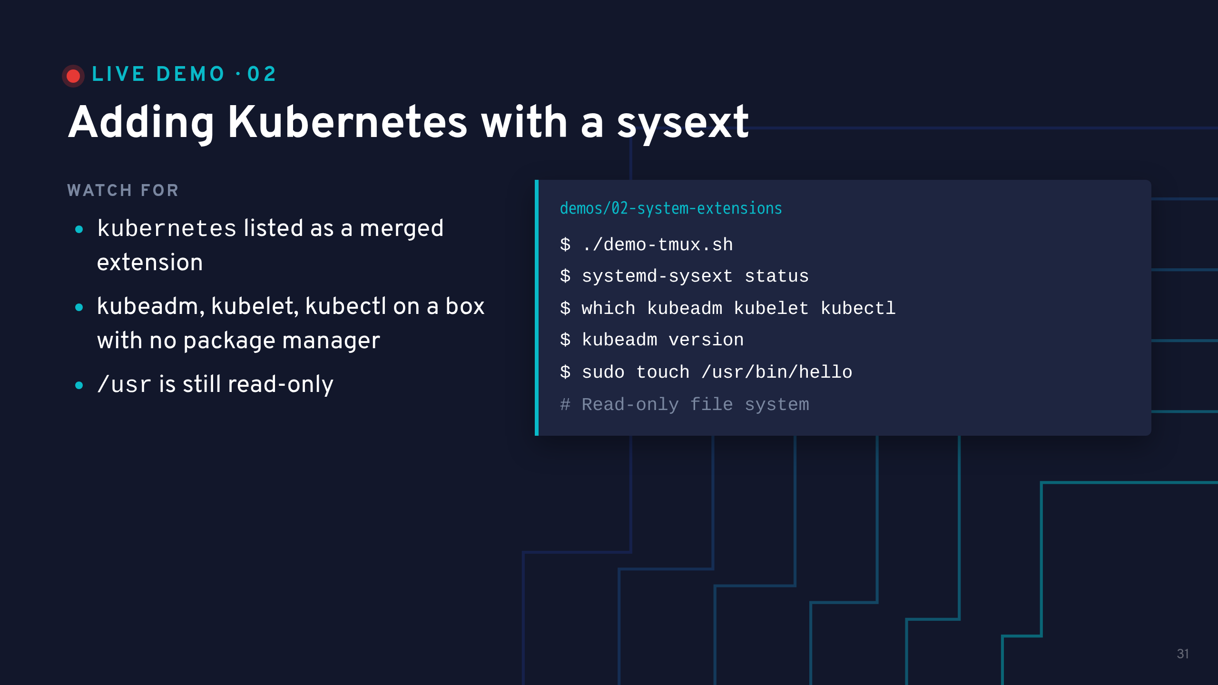
Notes:
Show config.bu first: one file entry pointing at extensions.flatcar.org, and one unit enabled. That is the whole "installation".
While it boots: Ignition downloads the sysext during first boot, so this VM needs network. If the venue Wi-Fi is bad, use the offline fallback in the folder README.
Payoff 1: systemd-sysext status shows the kubernetes extension merged into /usr.
Payoff 2: try to write to /usr and get "Read-only file system". We added software without making the OS mutable.
Bridge: having the binaries is half the job. Next, one more unit turns this into a running cluster.

Slide 32
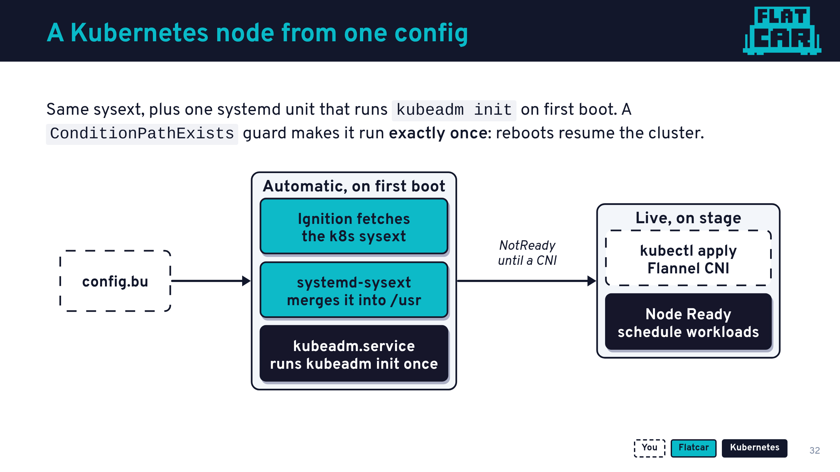
Notes:
Talk track: no special Kubernetes edition of Flatcar exists. It is the same image as the previous demo, with one extra unit.
The guard is ConditionPathExists=!/etc/kubernetes/kubelet.conf. First boot: the file does not exist, kubeadm init runs. Every later boot: the file exists, the unit is skipped, and the existing cluster resumes.
We deliberately leave the CNI as a live step so you can see the node go from NotReady to Ready.
Pinned versions, for the curious: Kubernetes v1.37.1 (v1.37.2 crashes on start), Flannel v0.28.10.

Slide 33
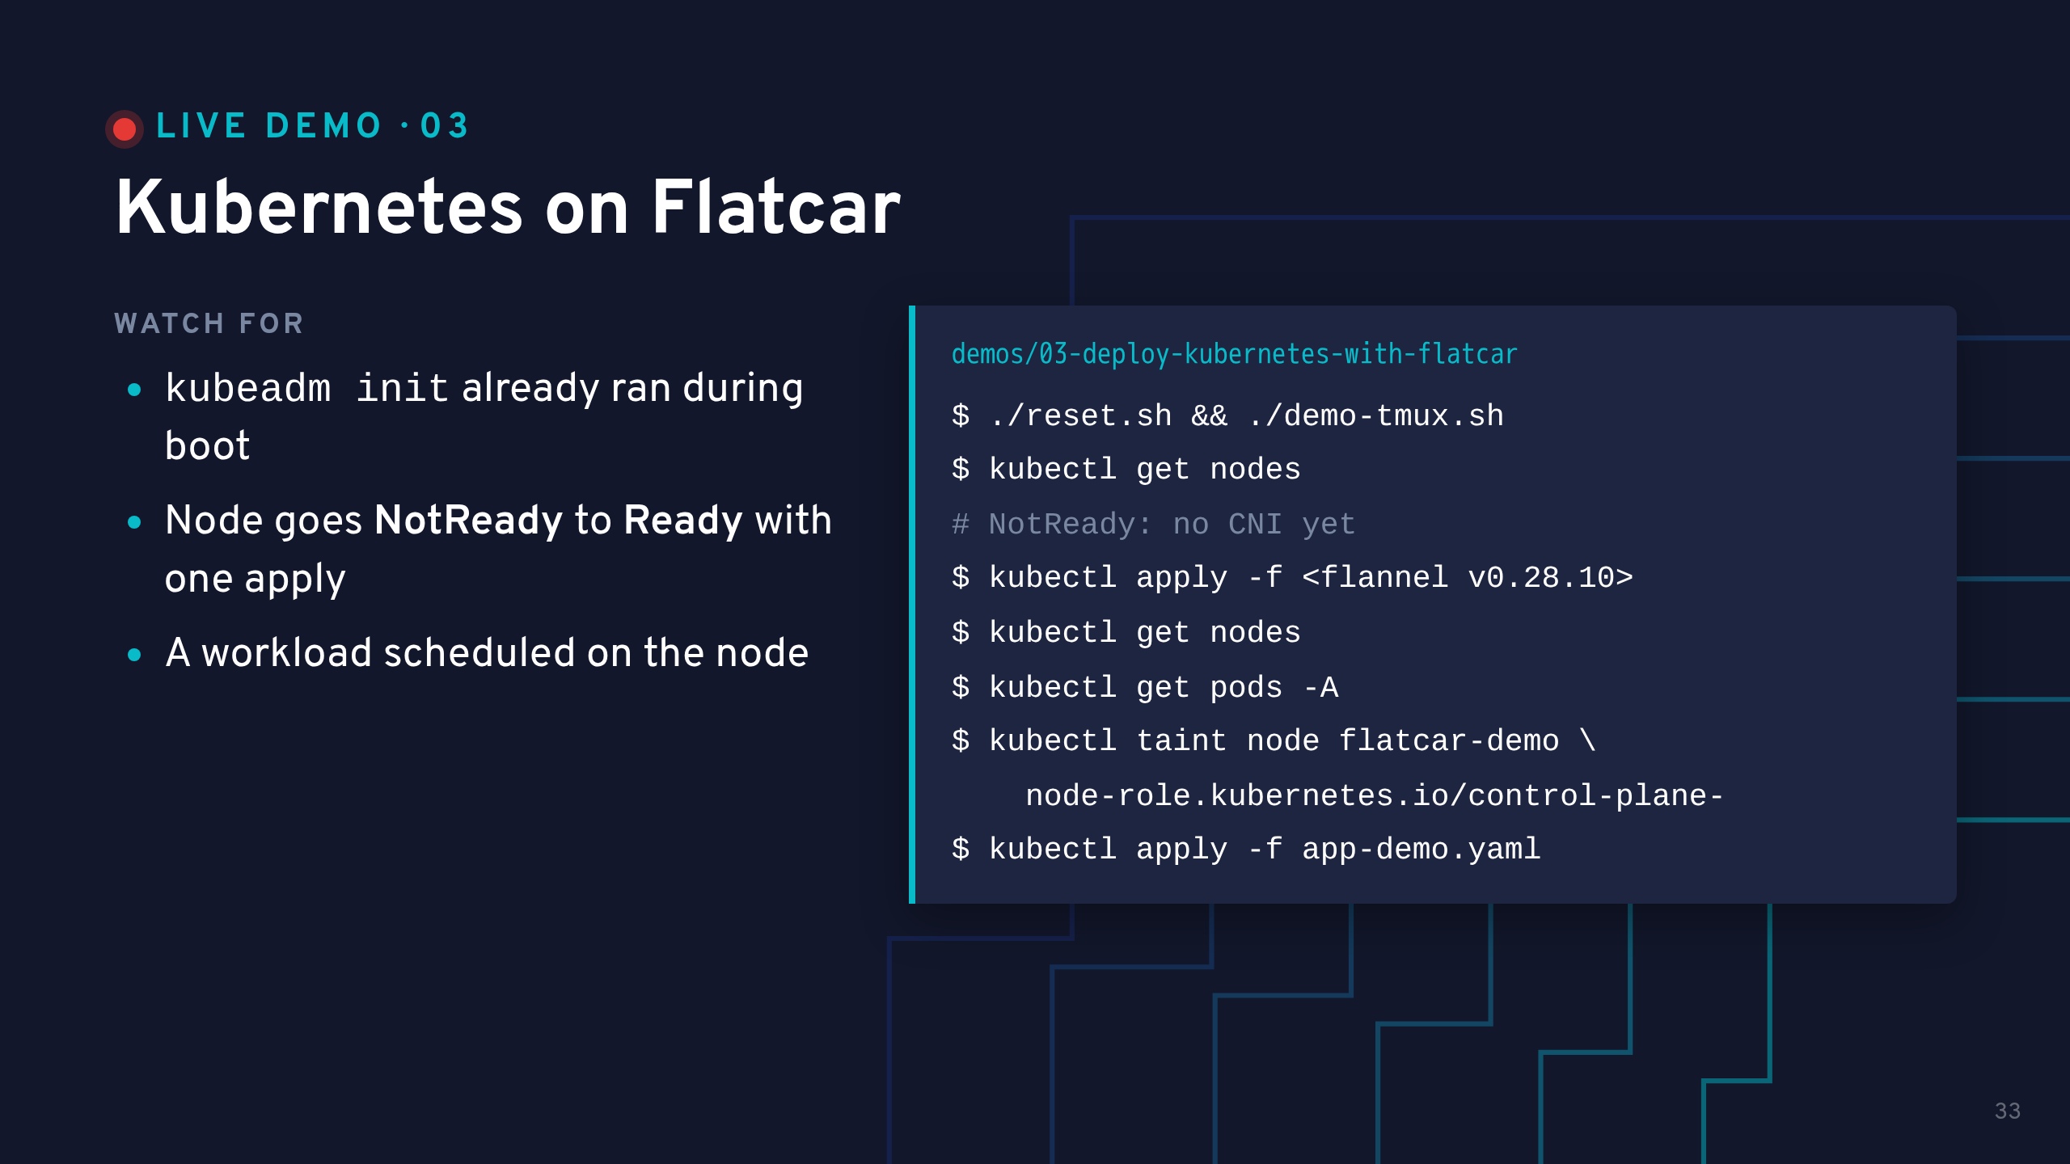
Notes:
Run reset.sh before the talk, not on stage: it restores a fresh disk from the local cache.
The VM needs 4GB RAM and 2 vCPUs for kubeadm, run.sh sets that.
While kubeadm init finishes in the top pane: the kubeconfig is already in /home/core/.kube/config, written by the same unit, so kubectl works without flags.
The exact Flannel URL is in demos/COMMANDS.md, copy it from there.
Optional: untaint the control plane and apply app-demo.yaml, then curl localhost:30080 on the node (NodePort) to show which pod answered. It is not forwarded to the laptop.
Fallback: asciinema play demo.cast in this folder.

Slide 34
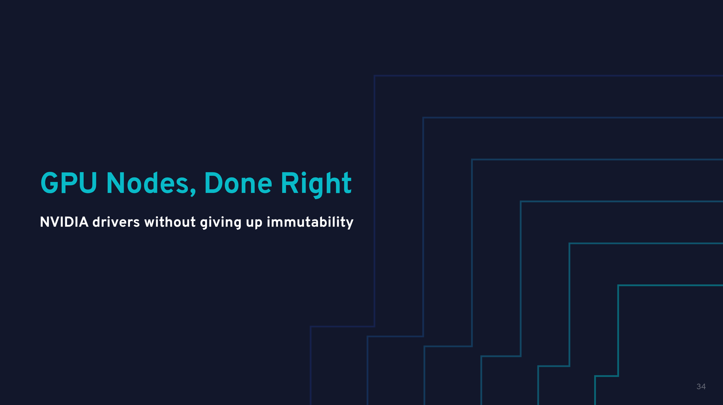

Slide 35
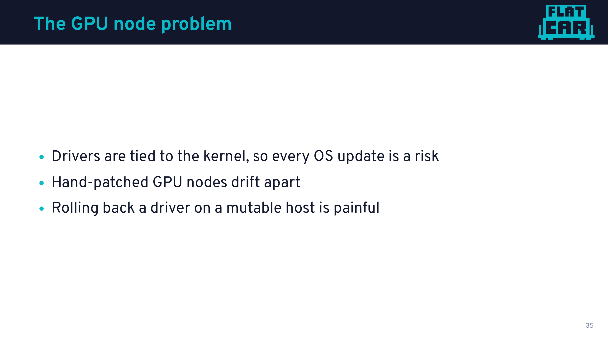

Slide 36
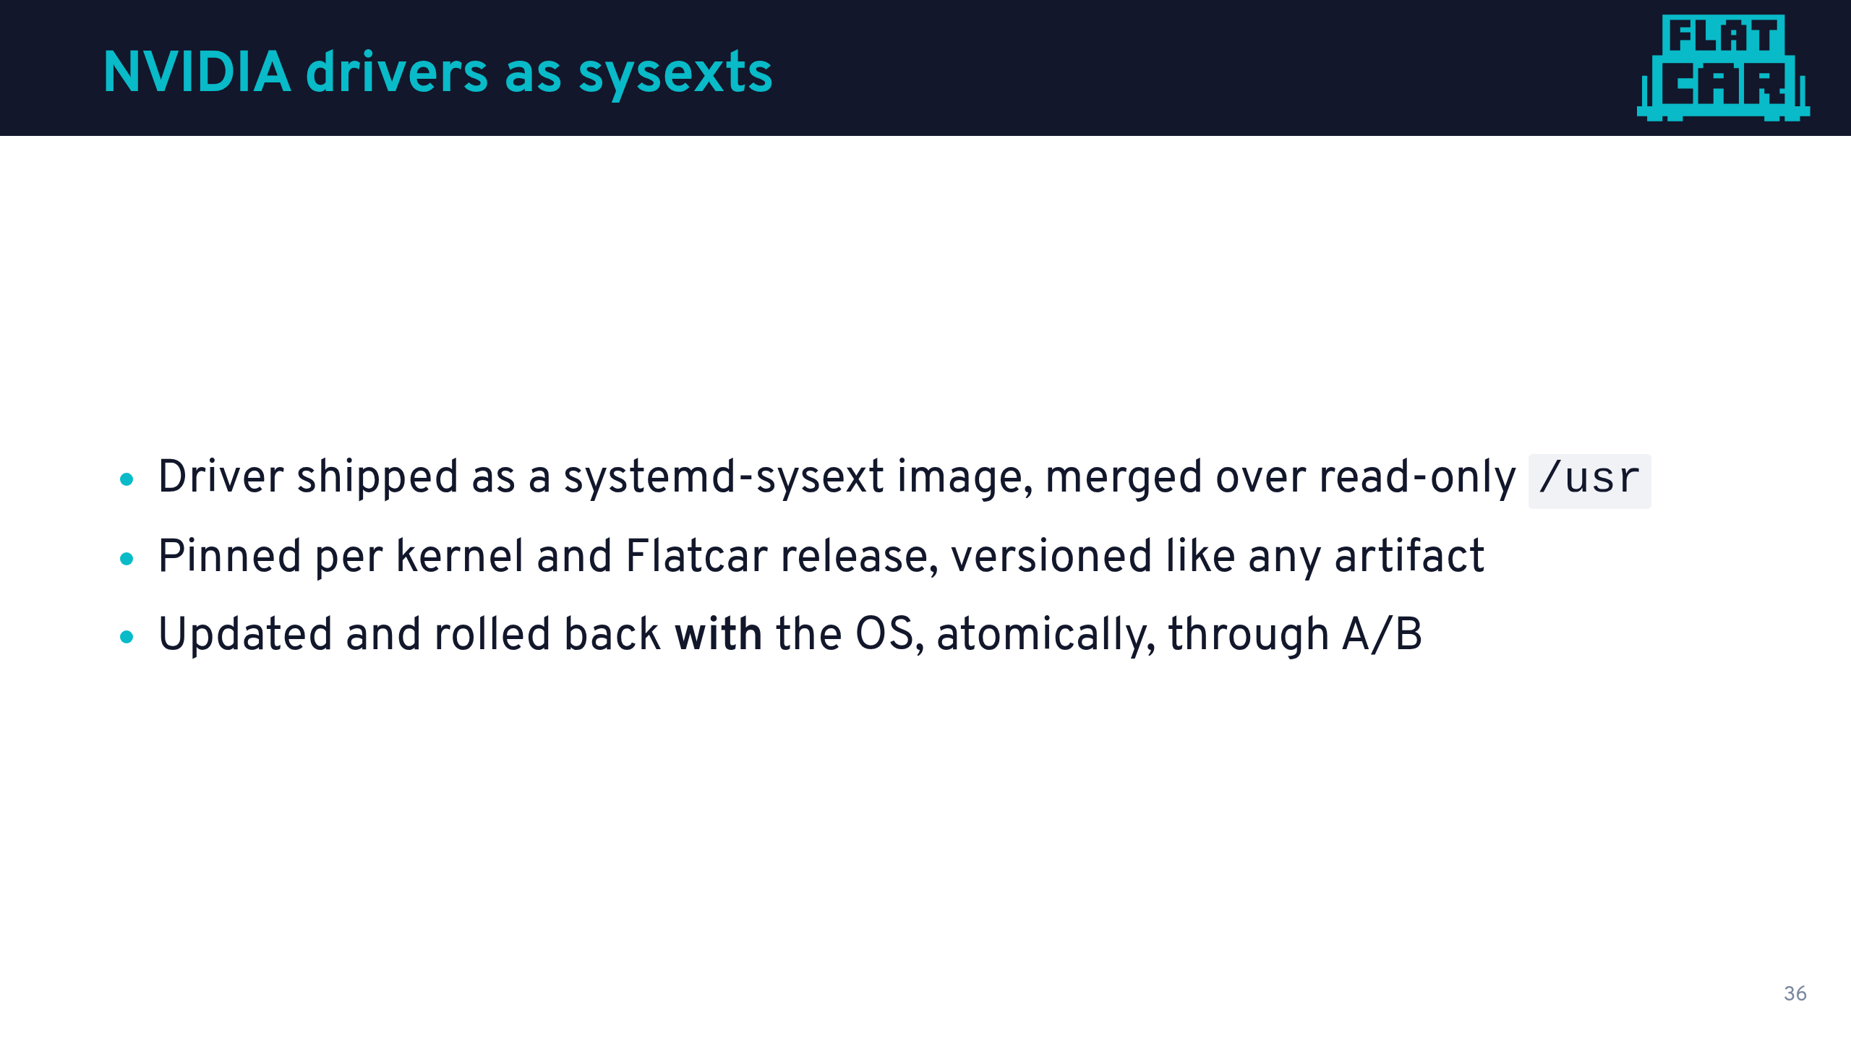

Slide 37
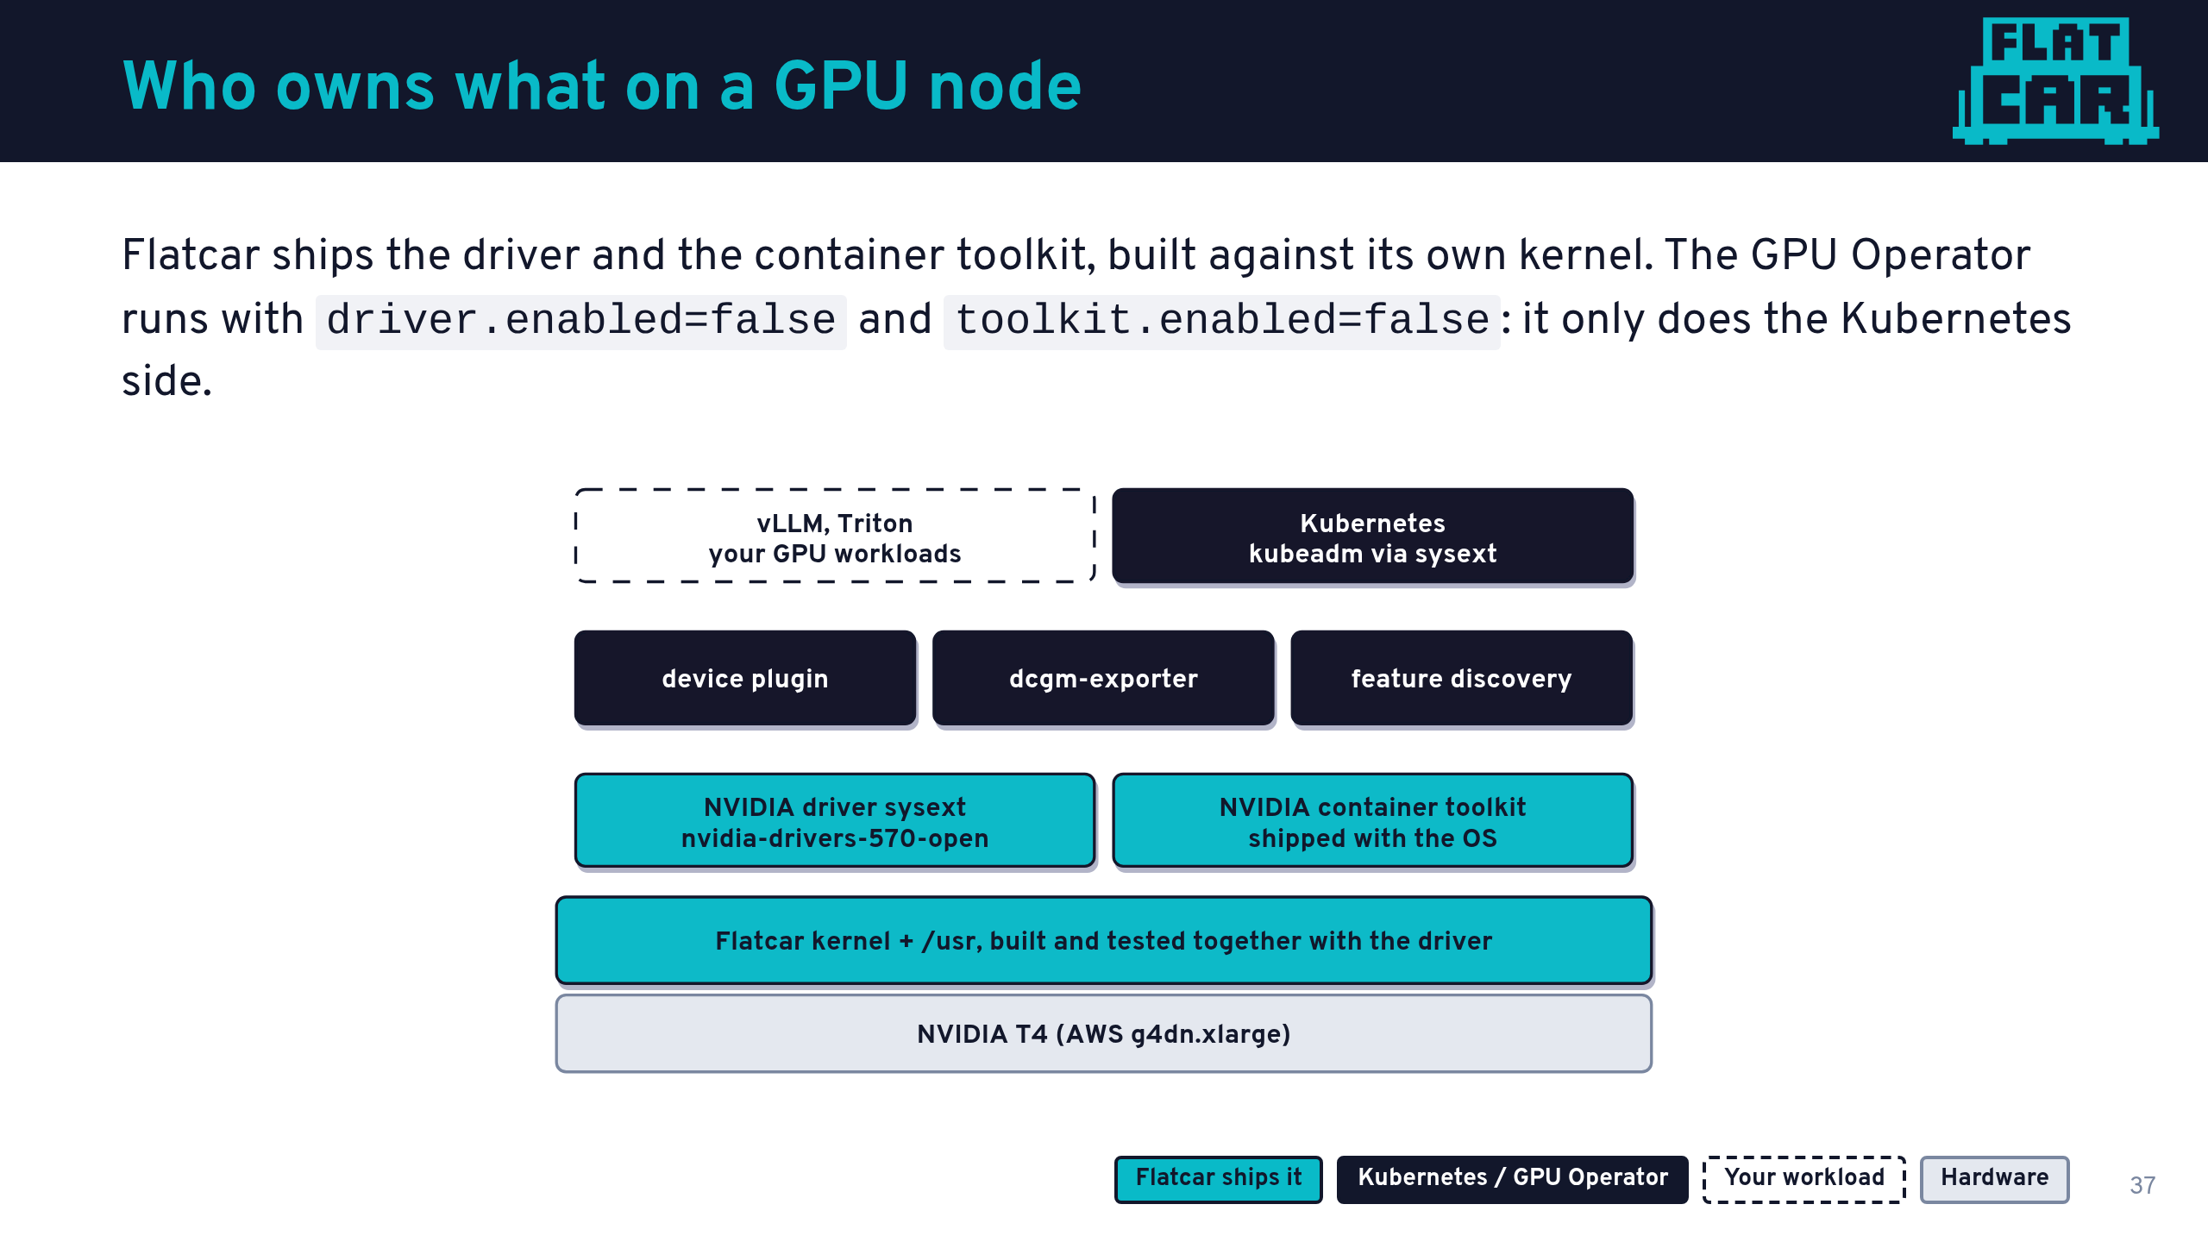
Notes:
Talk track: on a general-purpose distro, the GPU Operator usually compiles and loads the driver at runtime in a privileged container. Every kernel update is a chance for that to break.
On Flatcar the driver is part of the OS release: built against the exact kernel it ships with and tested together in CI. So we turn the Operator's driver and toolkit off, and keep the parts that are genuinely Kubernetes concerns: the device plugin, metrics, and node labels.
The cyan line in the middle is the whole point: the risky part moved from "runtime, on every node" to "build time, once, in CI".
This demo runs on a real AWS g4dn.xlarge with an NVIDIA T4.

Slide 38
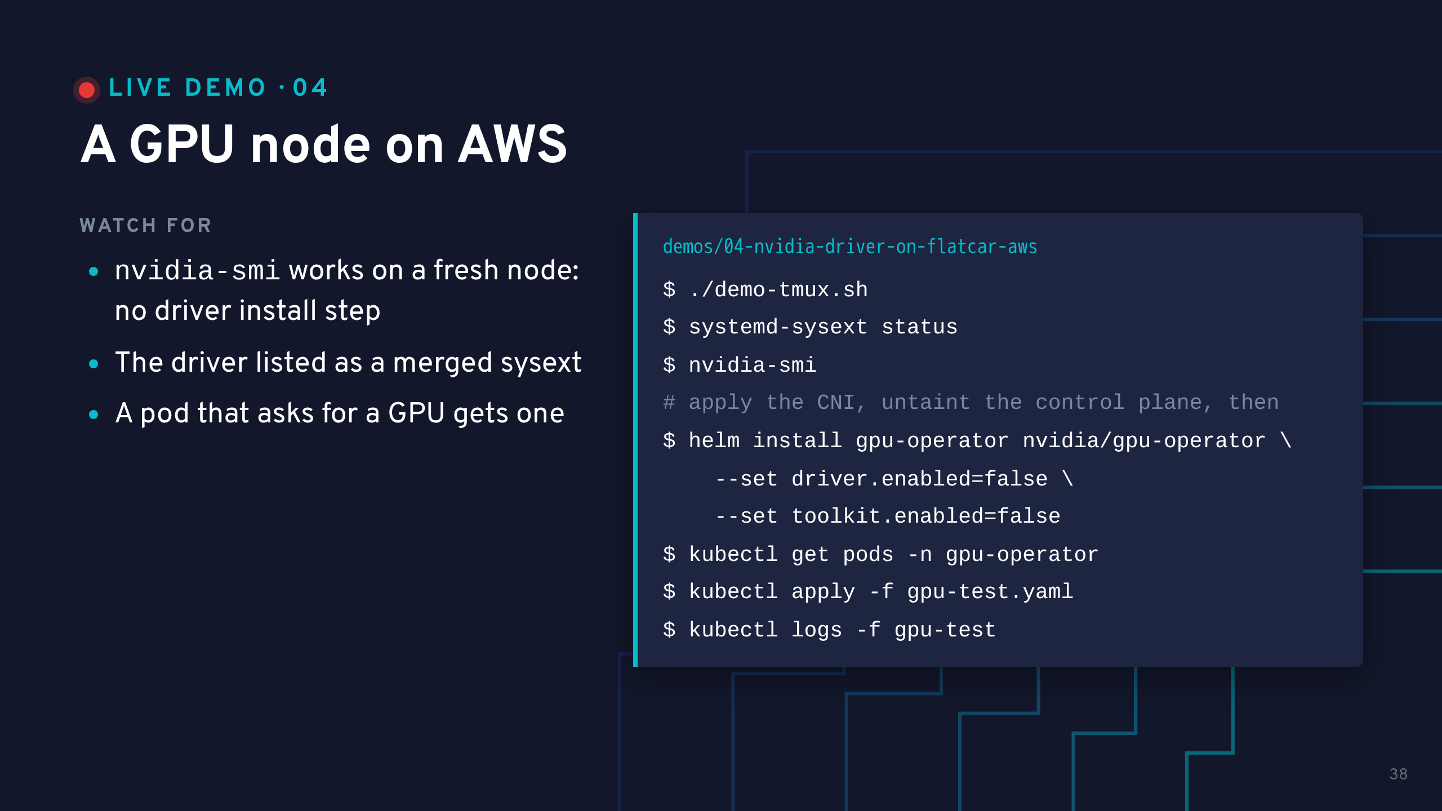
Notes:
Start this instance BEFORE the talk with AWS_PROFILE=<name> ./run.sh. Boot plus kubeadm takes minutes, and run.sh reuses a running instance, so demo-tmux.sh on stage just reattaches.
gpu-test.yaml is staged on the node by config.bu (same pattern as vllm-demo.yaml/triton-demo.yaml), so this is a plain apply, not a typed --overrides JSON blob.
This is real, billed infrastructure (about $0.53/hr). The same instance serves demos 06, 07 and 08. Tear it down after the talk with ./teardown.sh in this folder.
Payoff 1: nvidia-smi on the host, right after boot. Nobody installed a driver.
Payoff 2: the gpu-test pod prints the same nvidia-smi table from inside a container, which proves the device plugin and toolkit wiring.
If time is short, have the GPU Operator installed beforehand and only show kubectl get pods -n gpu-operator.

Slide 39
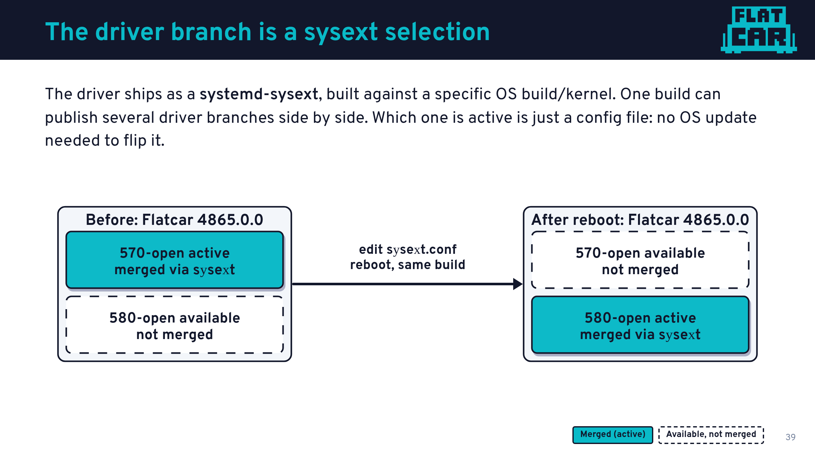
Notes:
Talk track: this is NOT the A/B update from earlier. Same Flatcar build, same boot, before and after.
Flatcar alpha 4865.0.0 publishes both nvidia-drivers-570-open and nvidia-drivers-580-open for its own kernel. /etc/flatcar/enabled-sysext.conf picks which one systemd-sysext merges into /usr. Edit that file and reboot, and the merged one changes -- no update_engine, no version bump.
Concretely, in this demo: Flatcar alpha 4865.0.0 throughout, driver branch 570-open swapped in place to 580-open.

Slide 40
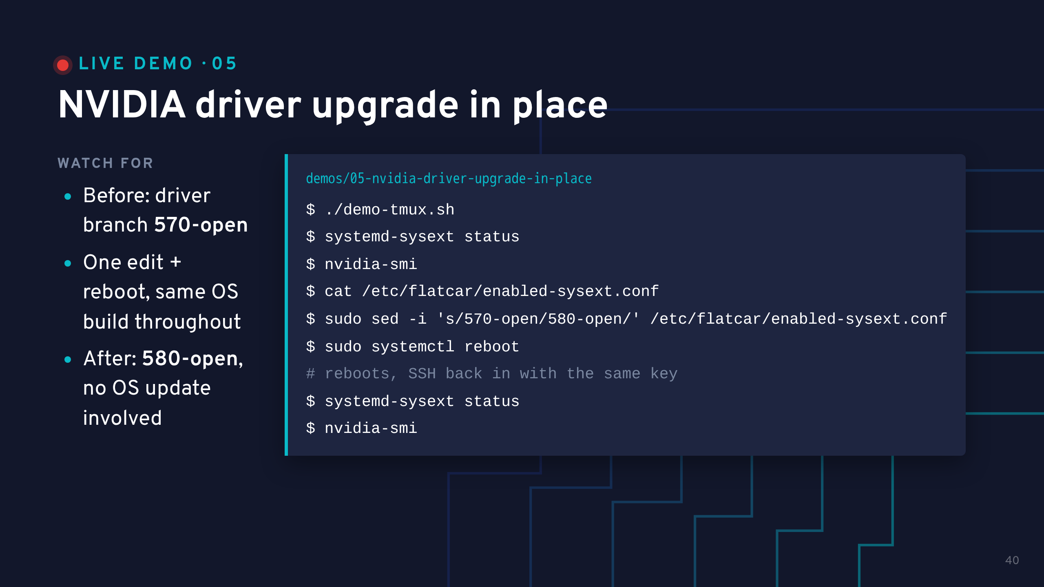
Notes:
This is a SECOND, separate billed instance, pinned to 570-open at boot via Ignition. It does not touch demo 04's cluster. Start it before the talk, and run ./teardown.sh in this folder afterwards.
While the sysext merges and the node reboots, go back to the previous slide: same OS build box on both sides, only which sysext is merged changes.
Payoff: same nvidia-smi command, new driver version, same Flatcar build the whole time -- this is NOT an OS update.
If you are short on time, move this demo to the end; nothing else depends on it.

Slide 41
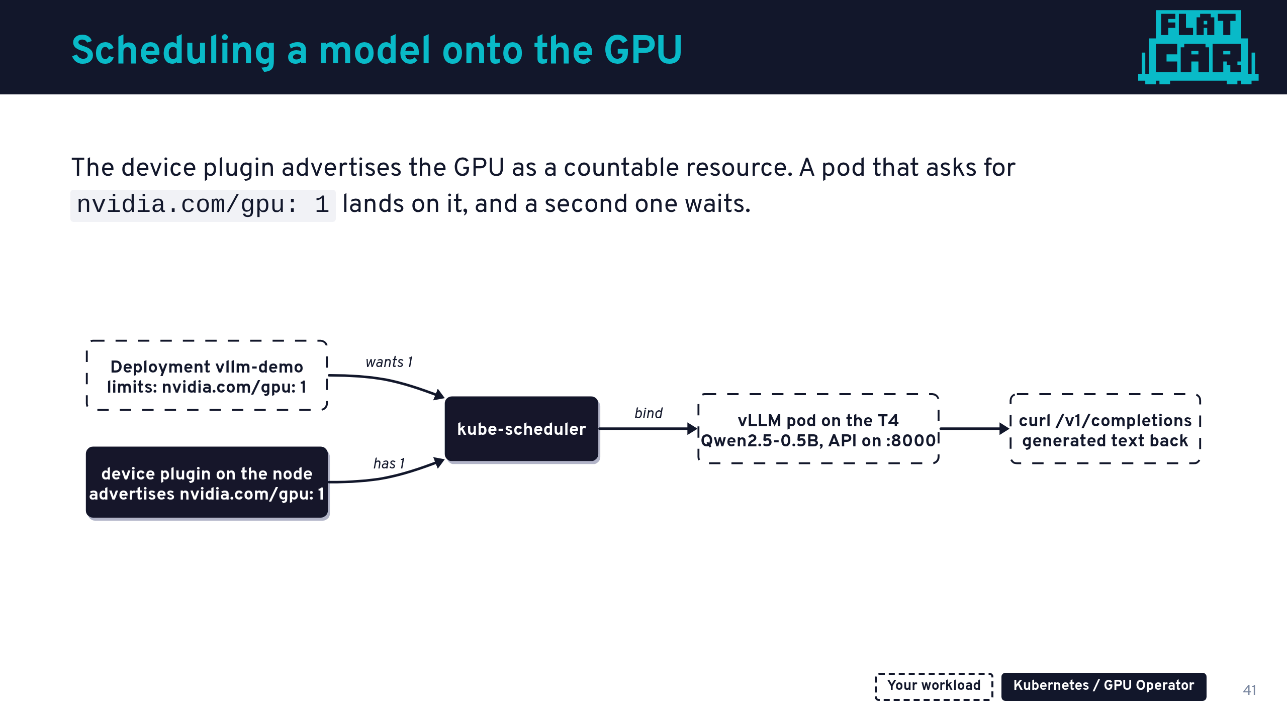
Notes:
Talk track: from here on, nothing is Flatcar-specific, and that is the point. Once the node exposes the GPU properly, it is ordinary Kubernetes.
vLLM serves an OpenAI-compatible API, so the curl you are about to see has the same shape as a call to a hosted model, only this one runs on our node.
Model: Qwen2.5-0.5B-Instruct. Small on purpose, so it downloads in a demo-friendly time and fits the T4's 16GB.

Slide 42
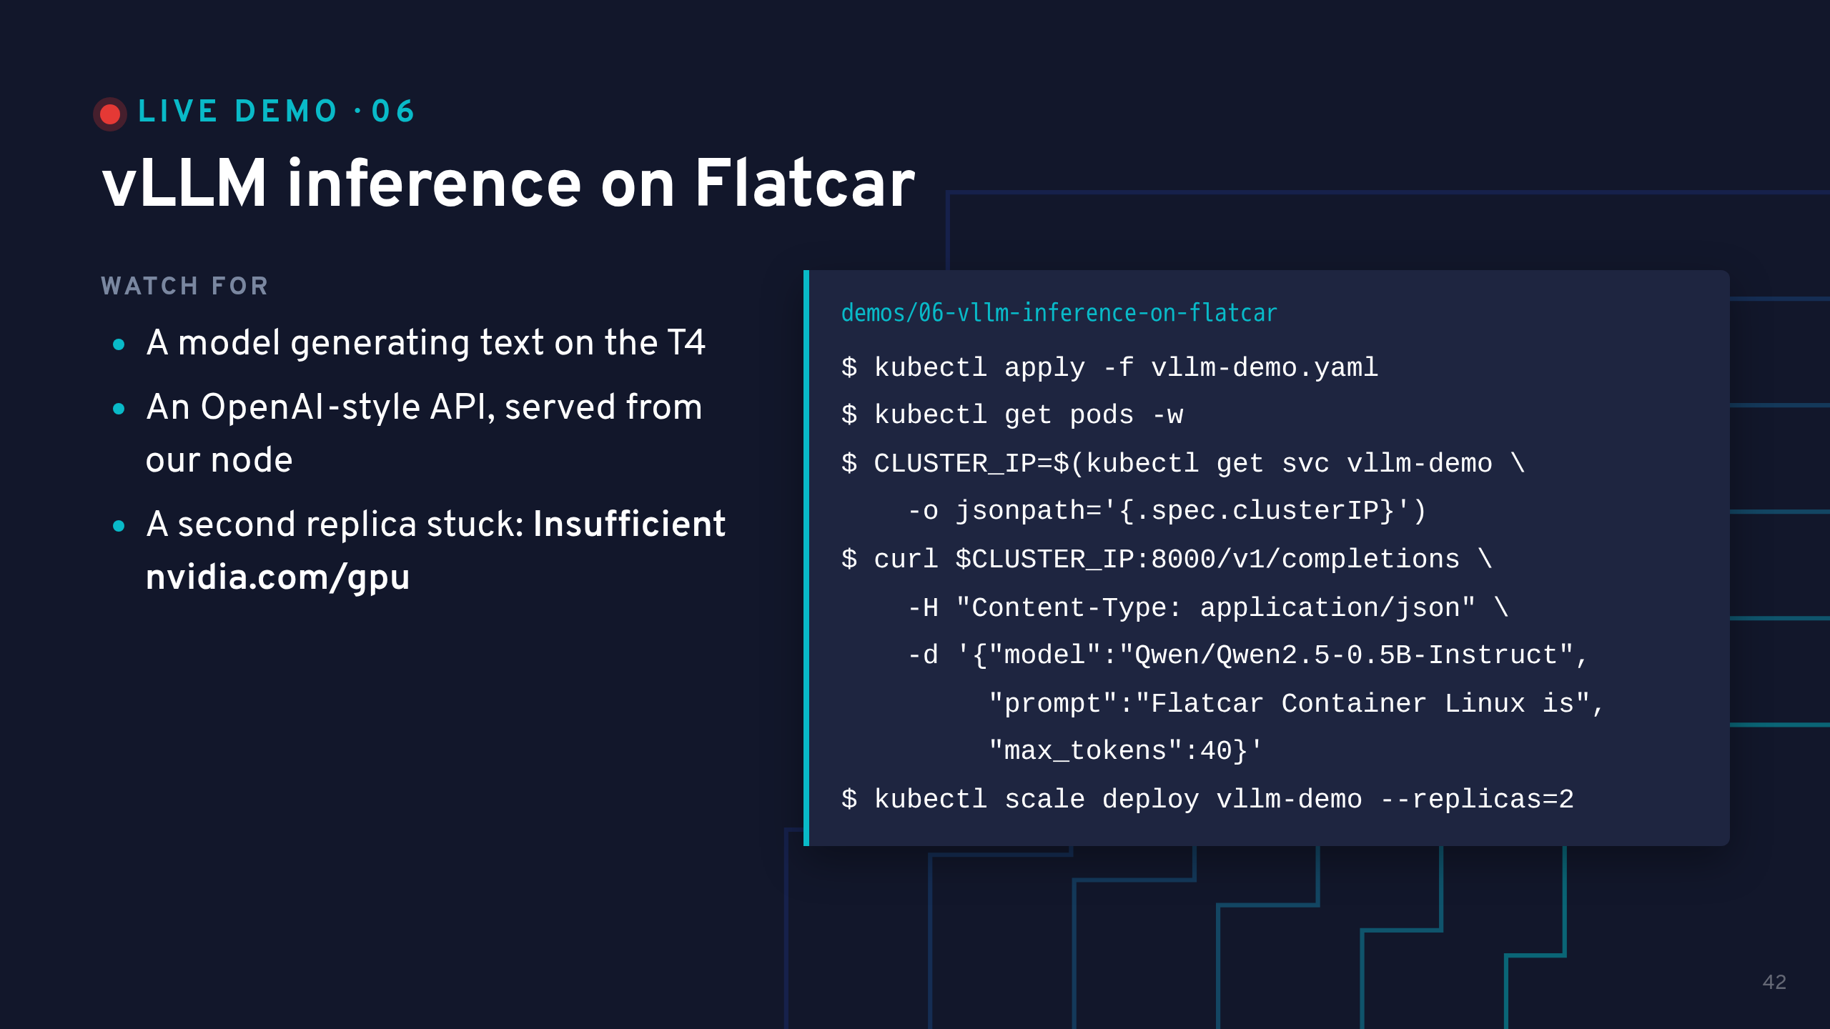
Notes:
The first start pulls about 1GB of model and can take up to 5 minutes. Pre-pull it before the talk (apply once, wait for Ready). On stage, the apply is then near-instant.
While the pod starts, the startup probe fails with "connection refused". That is expected while the model loads.
Use the Service ClusterIP, not the name: cluster DNS serves pods, not the node's own shell.
Payoff: the completion text coming back live. Then the scheduling beat: scale to 2, the second pod stays Pending with Insufficient nvidia.com/gpu, because there is exactly one T4. Scale back to 1.
Leave vLLM running: the next demo needs it.

Slide 43
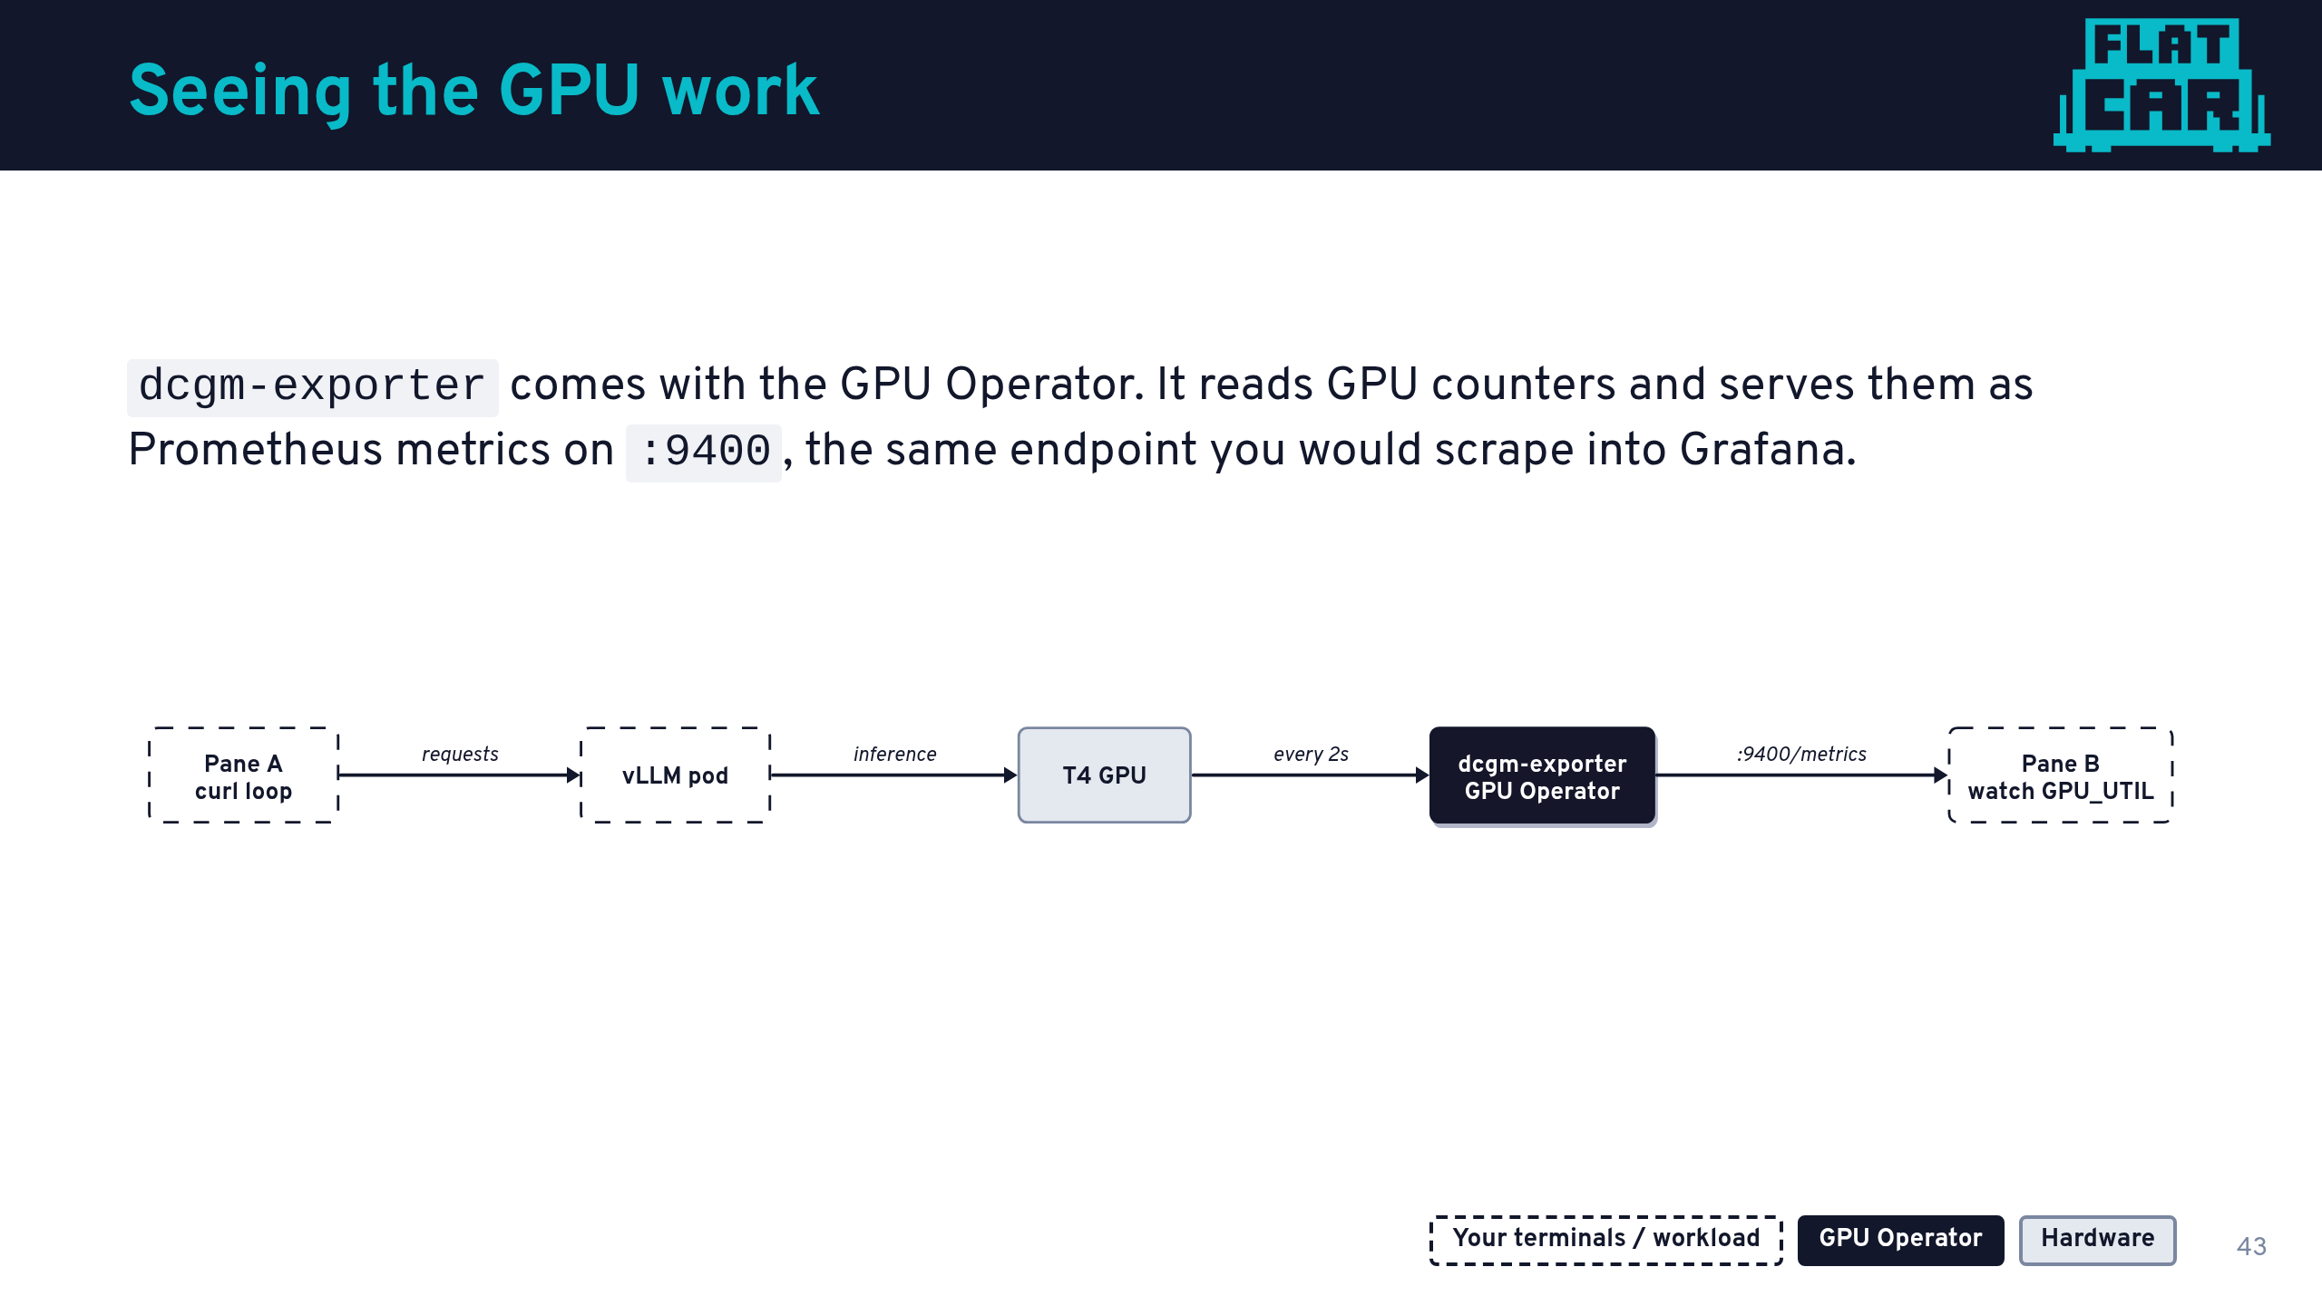
Notes:
Talk track: we just made the GPU do work. Now let us see it working, with the observability path you would use in production.
No Prometheus or Grafana on stage, just two terminal panes, so the cause and effect is obvious: left pane sends requests, right pane shows utilization.
One tuning note: we set the exporter interval to 2s for the demo. The default is 30s, which looks frozen under a short burst.

Slide 44
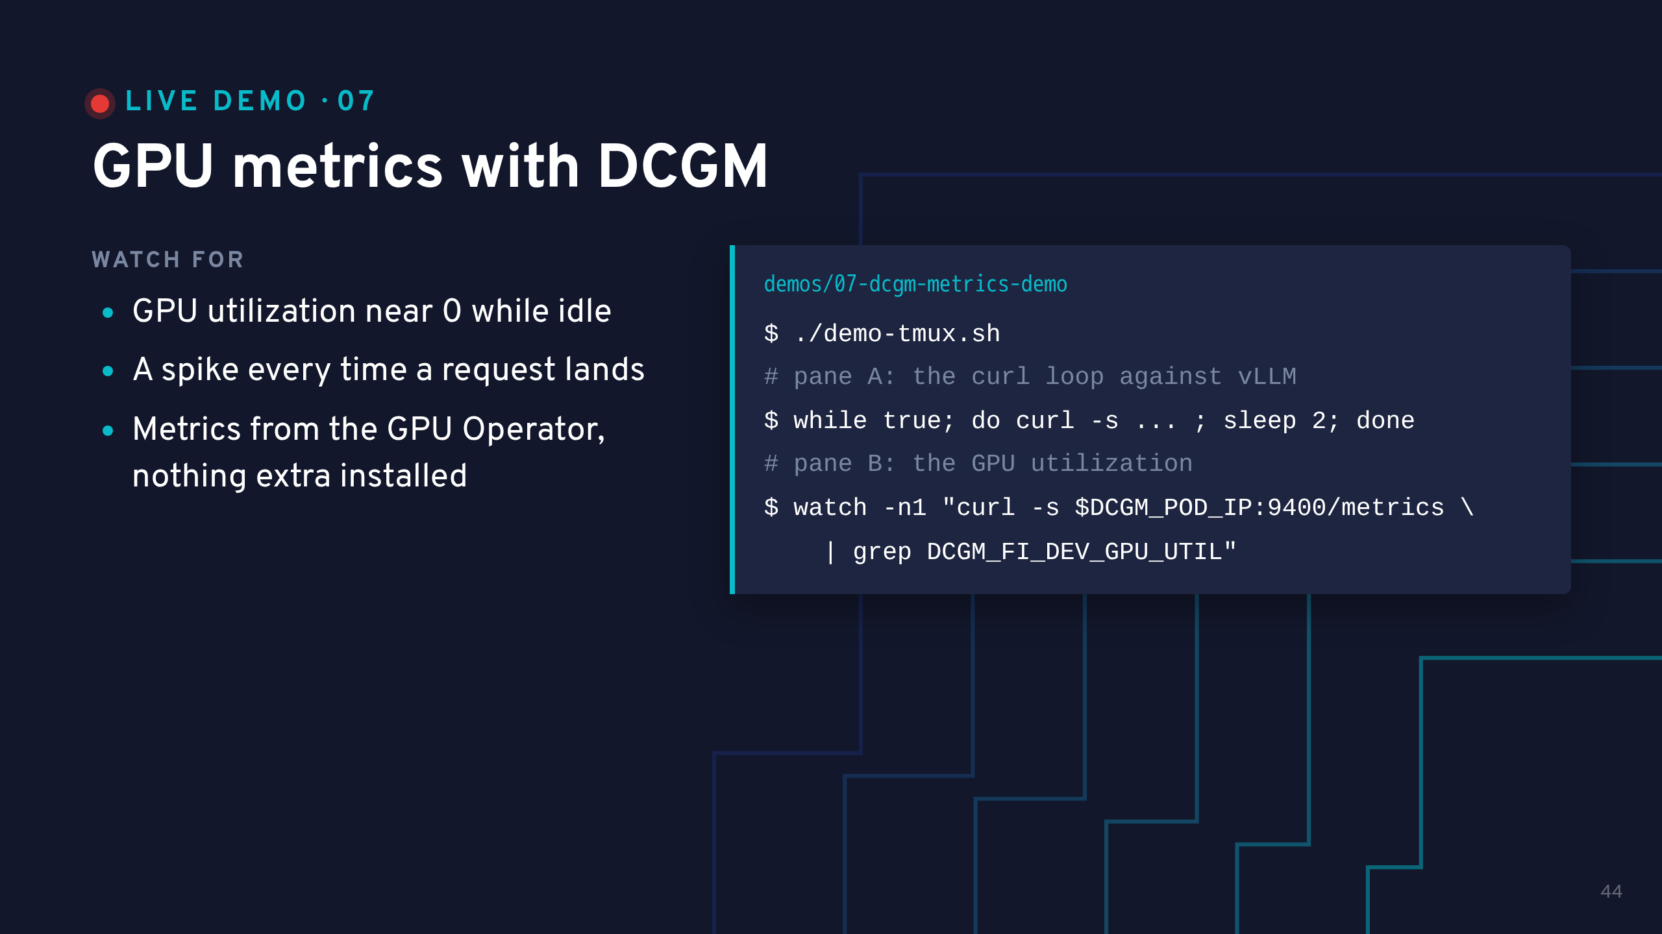
Notes:
Precondition: demo 06's vLLM is Running. Set DCGM_POD_IP and CLUSTER_IP first; both commands are in COMMANDS.md.
Start pane B first so the audience sees the idle baseline, then start the loop in pane A.
Run curl on the host, against the exporter pod's IP. The exporter image has no shell or curl.
Payoff: utilization jumps when a request lands, drops between requests.

Slide 45
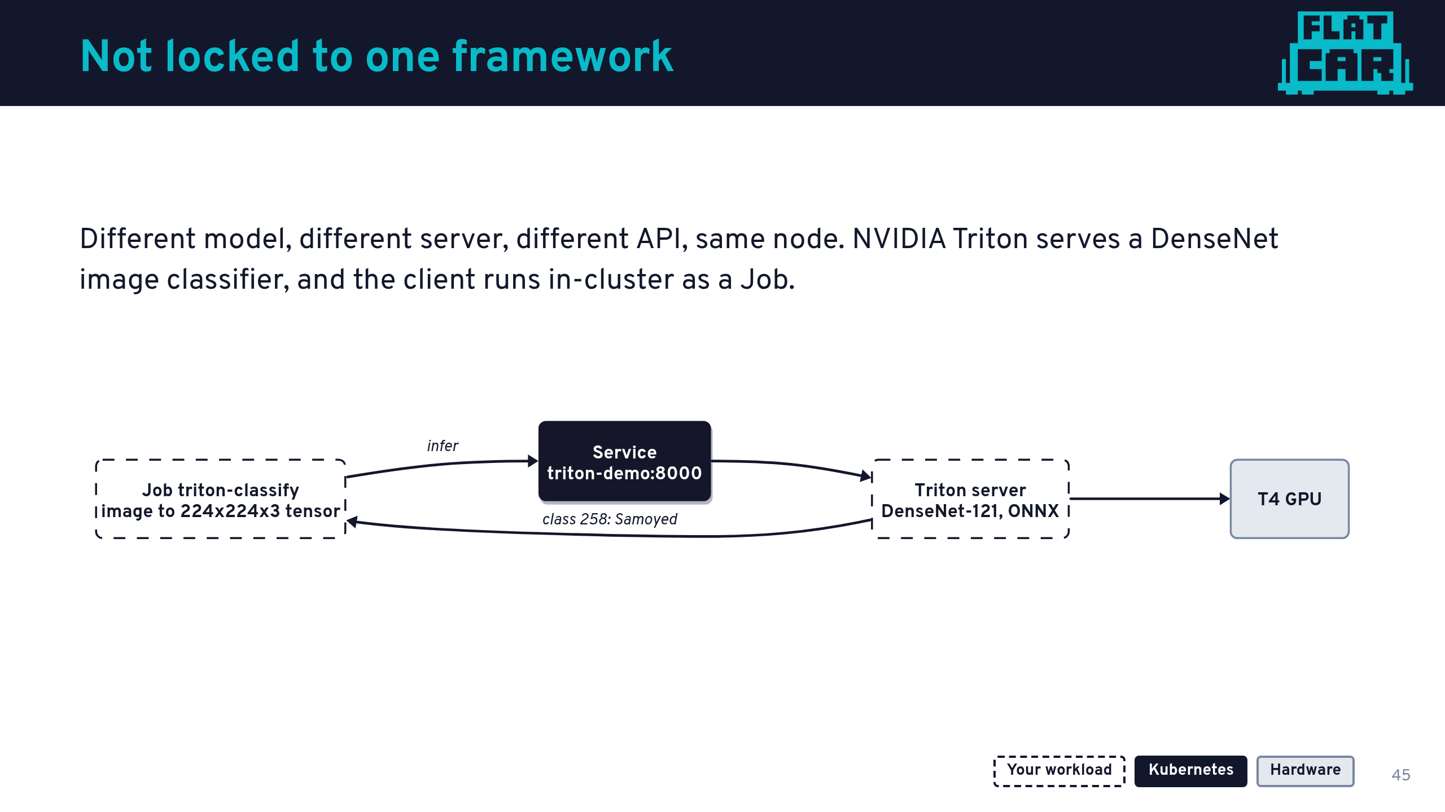
Notes:
Optional segment: skip it if time is short. Nothing depends on it.
Talk track: vLLM was an LLM behind an OpenAI API. Triton is a vision model behind a tensor API. The node did not need to know either way.
Why the client is a Job, not a curl: Triton wants a raw tensor matching the model's input shape. A tiny Python client does the preprocessing, and it runs in the cluster because Flatcar's host has no Python. Which is the point of a minimal host.

Slide 46
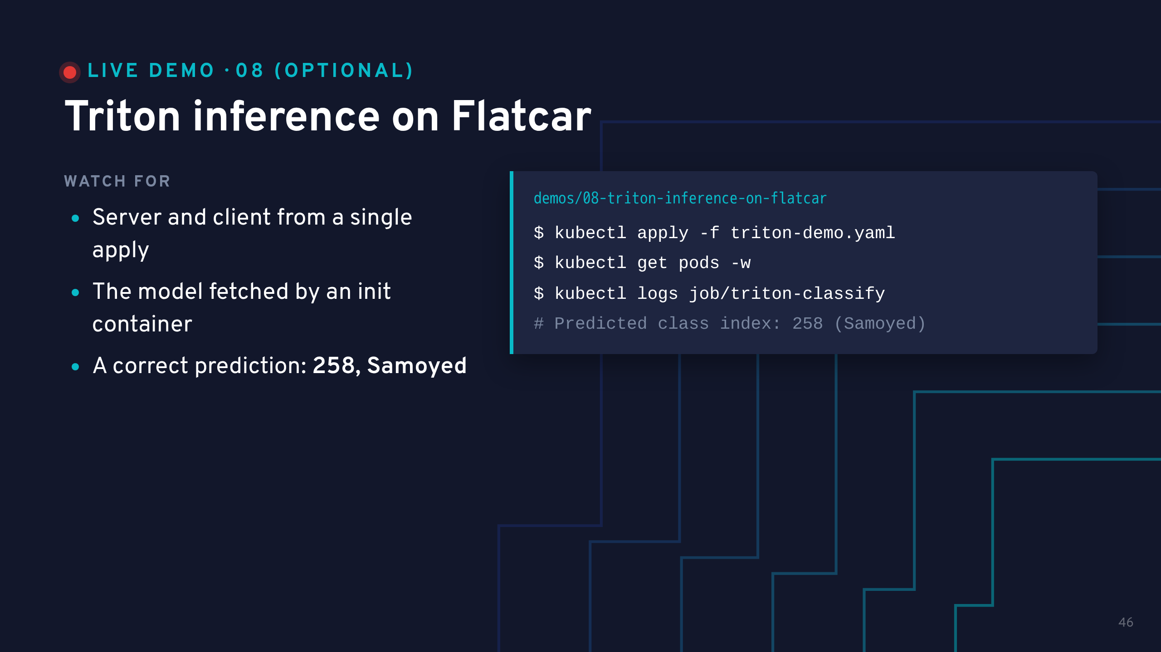
Notes:
The test image is a Samoyed, and index 258 is "Samoyed" in the DenseNet labels, so the answer is checkably right.
The score printed is a raw logit, not a probability, so values above 1 are normal. Expect someone to ask.
To re-run the client: kubectl delete job triton-classify && kubectl apply -f triton-demo.yaml.
After the talk: run ./teardown.sh in demos/04 (and demos/05) to stop AWS billing.

Slide 47
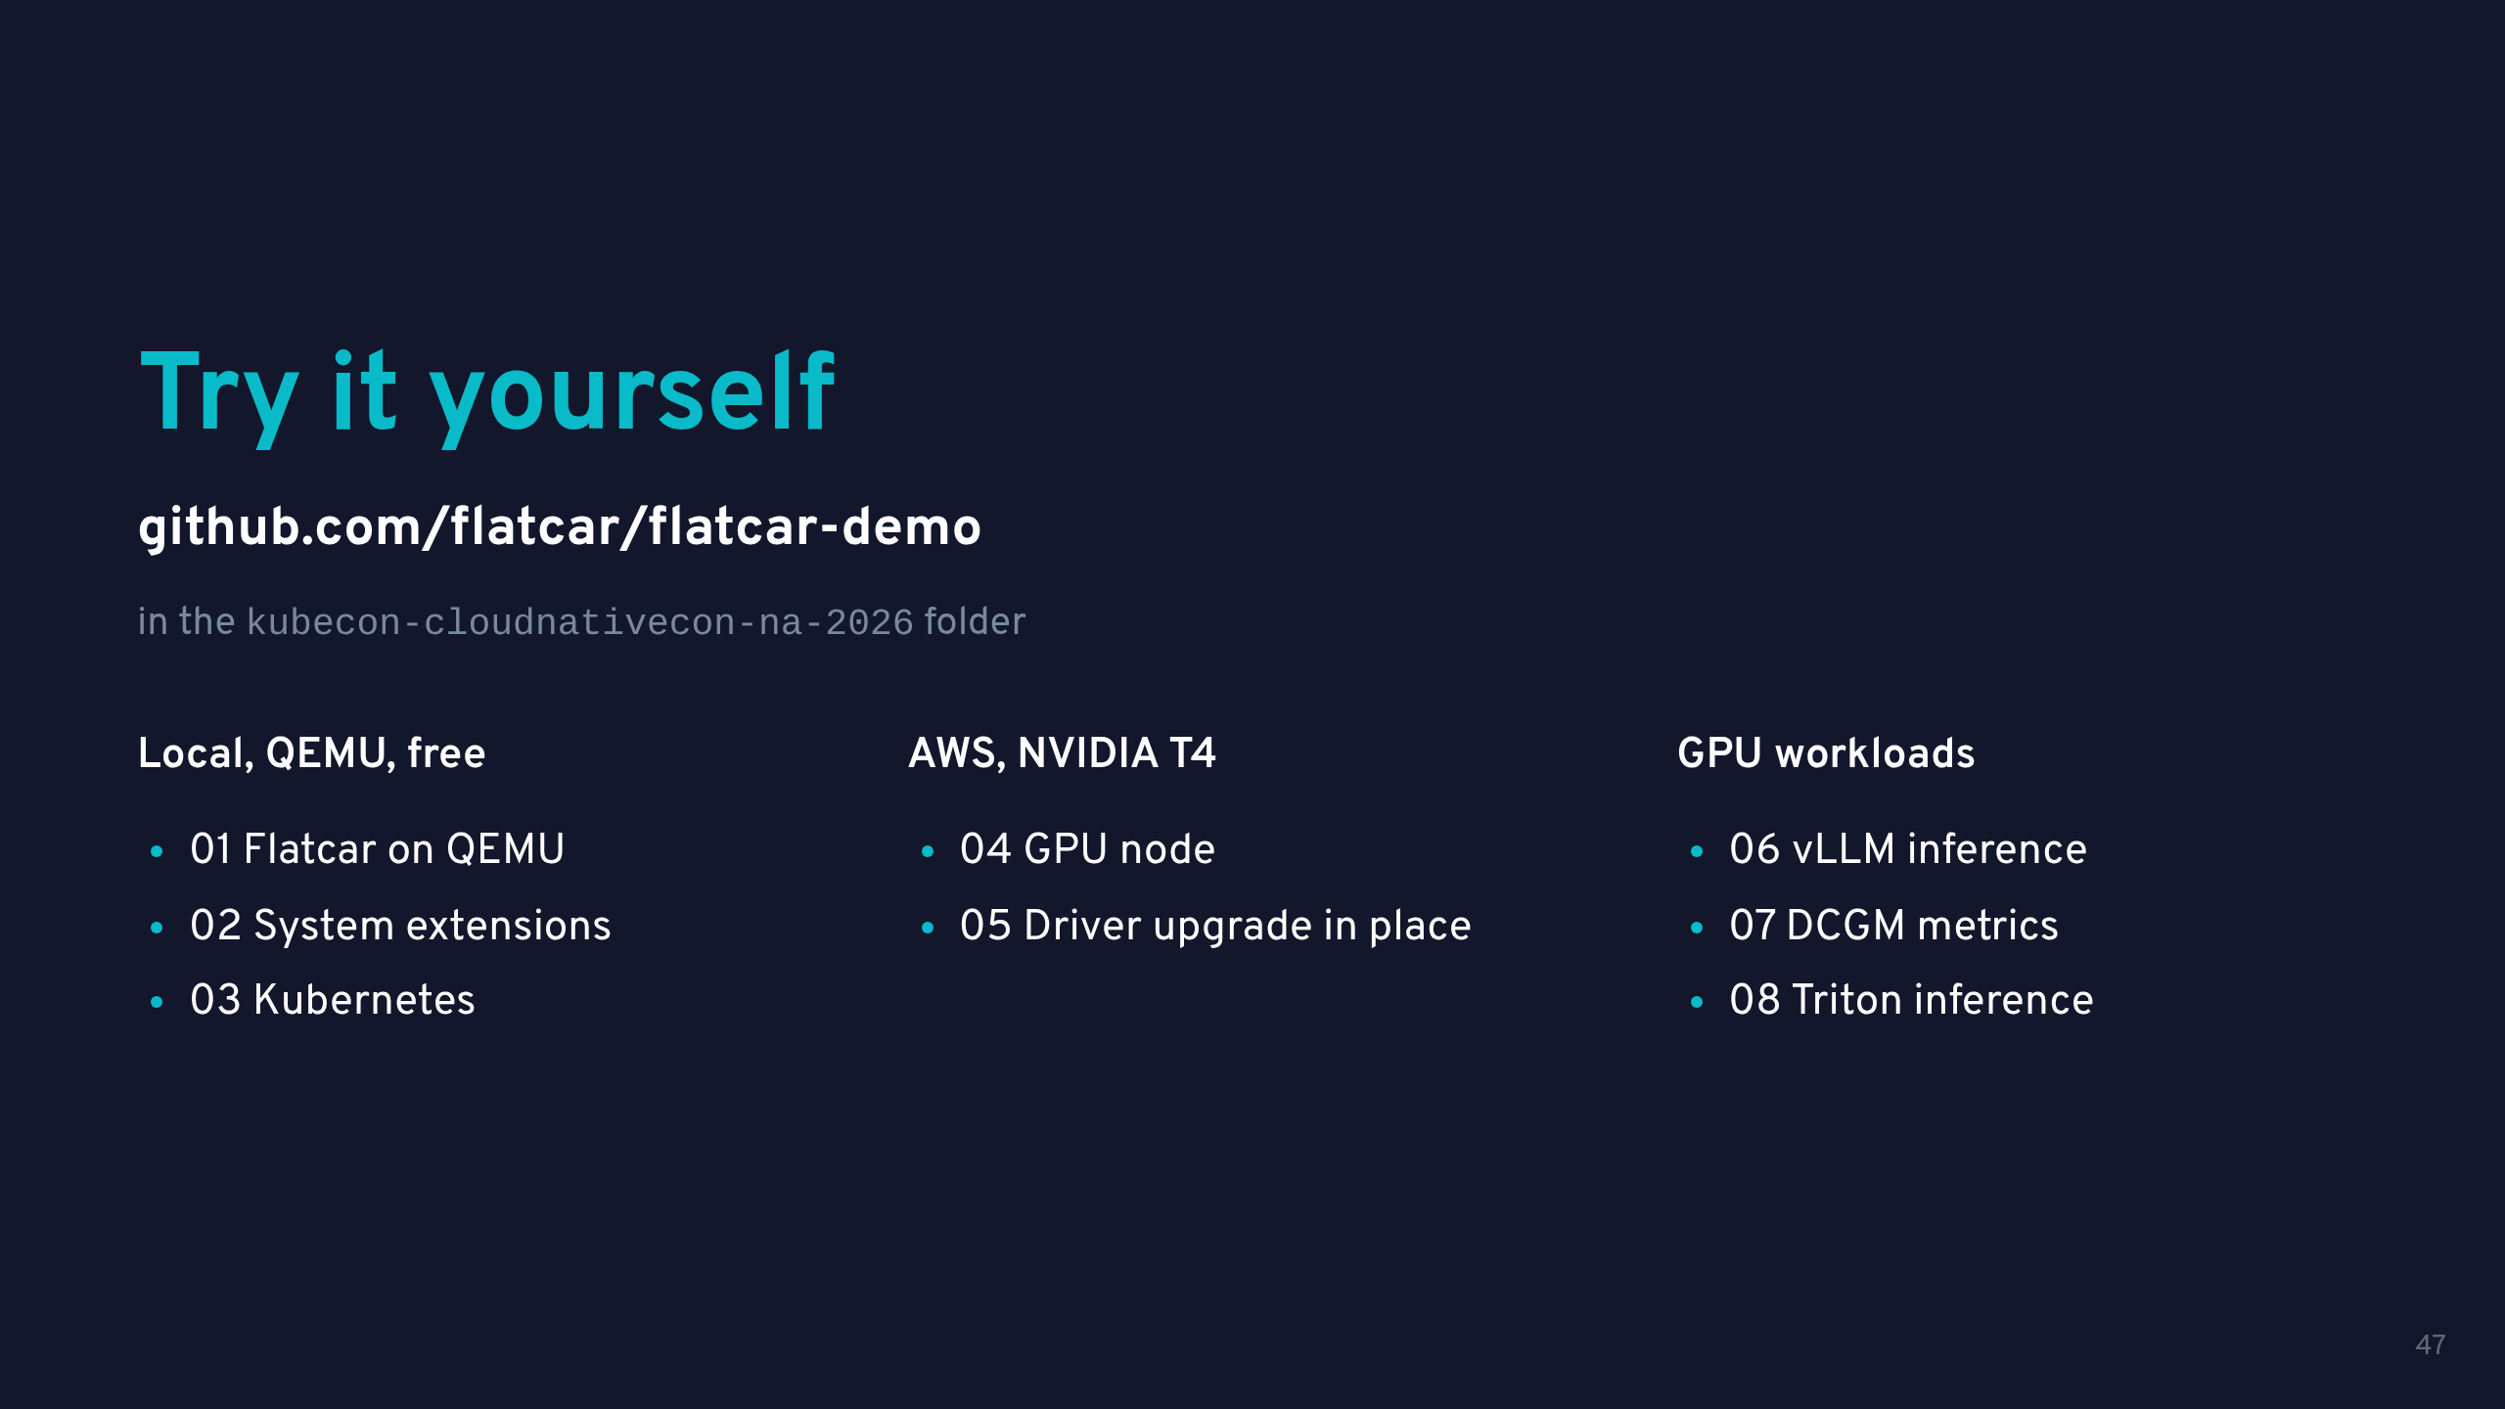

Slide 48


