Slide 1
DAVE
Ai Software Architect in your Pocket

Slide 2
Features
Your own personal software architect
From User Brainstorming sessions generate a Solution Design Document
Auto generate a design diagram from the Technical Design Document
Allow user to ask clarifying questions to Dave and generate modified artificats.
User can use voice chat to communicate with the agent

Slide 3
Technologies Used
Mongo DB Atlas
Streamlit
Together AI
Whisper AI
Langchain
Python

Slide 4
Design
User
TogetherAI Embeddings
Mongo Db Atlas Search
Design Diagram Package
WhisperAI
TogetherAI (Llama 3-70-b)

Slide 5
Sample call transcript
Brainstorming Requirements Session: Art Website
Participants:
CEO: Jane Doe
CFO: John Smith
Product Manager: Alice Brown
CEO (Jane Doe):
"Welcome, everyone. Today, we need to brainstorm the requirements for our new art marketplace website. I want this platform to be the go-to place for buying and selling art. Let's start with the core functionality. Alice, what do you have in mind?"
Product Manager (Alice Brown):
"Thanks, Jane. For the core functionality, we need a robust marketplace where artists can list their works and buyers can easily purchase them. Here are some key features to consider:
User Registration and Profiles: Artists and buyers should have their own profiles. Artists can showcase their portfolios, while buyers can follow their favorite artists.
Art Listings: Artists should be able to upload images, descriptions, prices, and other details for each piece of art.
Search and Filtering: Buyers need powerful search tools with filters for price range, art type, size, medium, and more.
Payment Integration: Secure payment options including credit card, PayPal, and possibly cryptocurrency.
Featured and Curated Art: A prominently displayed section on the homepage for featured and curated pieces.
Reviews and Ratings: Allow buyers to rate and review both the art and the artists."
CFO (John Smith):
"Good points, Alice. From a financial perspective, we need to think about how we monetize this platform. We could charge transaction fees, listing fees, or offer premium memberships for additional features. We also need to ensure secure payment processing and handle taxes correctly."
CEO (Jane Doe):
"Excellent, John. Let's break it down further. Alice, for the homepage, how do you envision the featured and curated art sections working?"
Product Manager (Alice Brown):
"For the homepage, I suggest a dynamic, visually appealing layout. The featured section could rotate high-profile or trending artworks, curated by our in-house experts or through partnerships with galleries. We could also have seasonal themes. Here's a detailed breakdown:
Hero Carousel: A large, rotating banner at the top with high-quality images of featured artworks.
Curated Collections: Below the hero section, curated collections based on themes, mediums, or current trends.
Artist Spotlights: Profiles of selected artists with links to their portfolios.
New Arrivals: A section for newly listed art pieces.
Top Rated: Artworks with the highest ratings and reviews."
CFO (John Smith):
"From a financial perspective, featuring certain artworks or artists could be part of a premium package we offer. Galleries or artists could pay for additional exposure. We need to ensure we have a clear value proposition for these premium offerings."
CEO (Jane Doe):
"Great. Now, let's talk about the user journey. How should the experience flow for both artists and buyers?"
Product Manager (Alice Brown):
"For artists, the journey should be as seamless as possible:
Sign-Up and Verification: Quick registration process, followed by a verification step to ensure quality and authenticity.
Profile Setup: Easy-to-use interface for creating a detailed profile and portfolio.
Art Upload: Intuitive tools for uploading art with high-resolution images, descriptions, pricing, and shipping details.
Sales Dashboard: A dashboard to track views, sales, earnings, and manage inventory.
For buyers:
Browsing and Searching: A visually engaging browsing experience with powerful search and filter options.
Detailed Art Pages: Each art piece should have a detailed page with multiple images, artist information, reviews, and related artworks.
Purchase Process: Simple and secure checkout process with multiple payment options.
Order Tracking: Post-purchase tracking and support for shipping and delivery."
CFO (John Smith):
"Don't forget customer support and dispute resolution. We need a system in place for handling issues like refunds, damaged art, or fraudulent listings."
CEO (Jane Doe):
"Absolutely. Alice, can you outline the user experience aspects and any additional features we might need?"
Product Manager (Alice Brown):
"We should focus on a clean, intuitive design that's visually appealing to art lovers. Additional features could include:
Wishlist and Favorites: Allow buyers to save their favorite pieces and create wishlists.
Social Sharing: Integrate social media sharing to promote artworks and artists.
Newsletter Subscriptions: Offer email subscriptions for updates on new arrivals, featured art, and promotions.
Art Community: Create forums or community spaces where artists and buyers can interact, discuss art, and share insights."
CEO (Jane Doe):
"That sounds comprehensive. Let's wrap up with our next steps. We need to finalize the feature list, allocate budget, and start assembling a development team. John, can you work on the financial projections, and Alice, start drafting a detailed product roadmap?"
CFO (John Smith):
"Sure thing, Jane. I'll have the projections ready by our next meeting."
Product Manager (Alice Brown):
"I'll get started on the roadmap and initial wireframes. Let's aim to have a prototype ready within the next three months."
CEO (Jane Doe):
"Perfect. Thanks, everyone. Let's make this the best art marketplace out there!"

Slide 6
Chat prompt
You are a Solutions Architect specialized in designing technical design documents. Generate a design document using the format below.
Technology Architecture
[Describe the anticipated infrastructure that will be required to support the application and information architecture. At this point in the project, focus on describing the technology architecture at a high level only.]
Platform
[Identify the target platform expected for the system (e.g., mainframe, mid-tier, or other).]
System Hosting
[Identify the target hosting for the system (e.g., EDC, BDC, Other).]
Connectivity Requirements
[Identify network connectivity requirements for the system (e.g., Internet, Extranet).]
Modes of Operation
[Describe the modes that the system will operate in:
• What environments will the system need (e.g., development, test, and production)?
• Will there be just one production instance of the system?
• Will the old and new system run in parallel?
• Will there be a pilot? If so, what is the success criteria and exit strategy?
• Will the existing system be retired?
• Should the new system convert the data from the current system?]
Security and Privacy Architecture
[Describe the anticipated security and privacy architecture. The purpose of this discussion is to identify the general approach to security to ensure that proper controls will be implemented into the system. This is not intended to be a detailed security design.]
Authentication
[Describe the basic user authentication approach to verify user identity before allowing access to the system. For example, will the system use the single-sign-on solution?]
Authorization
[Describe the anticipated approach for authorizing users to perform functional activity once logged into the system.]

Slide 7
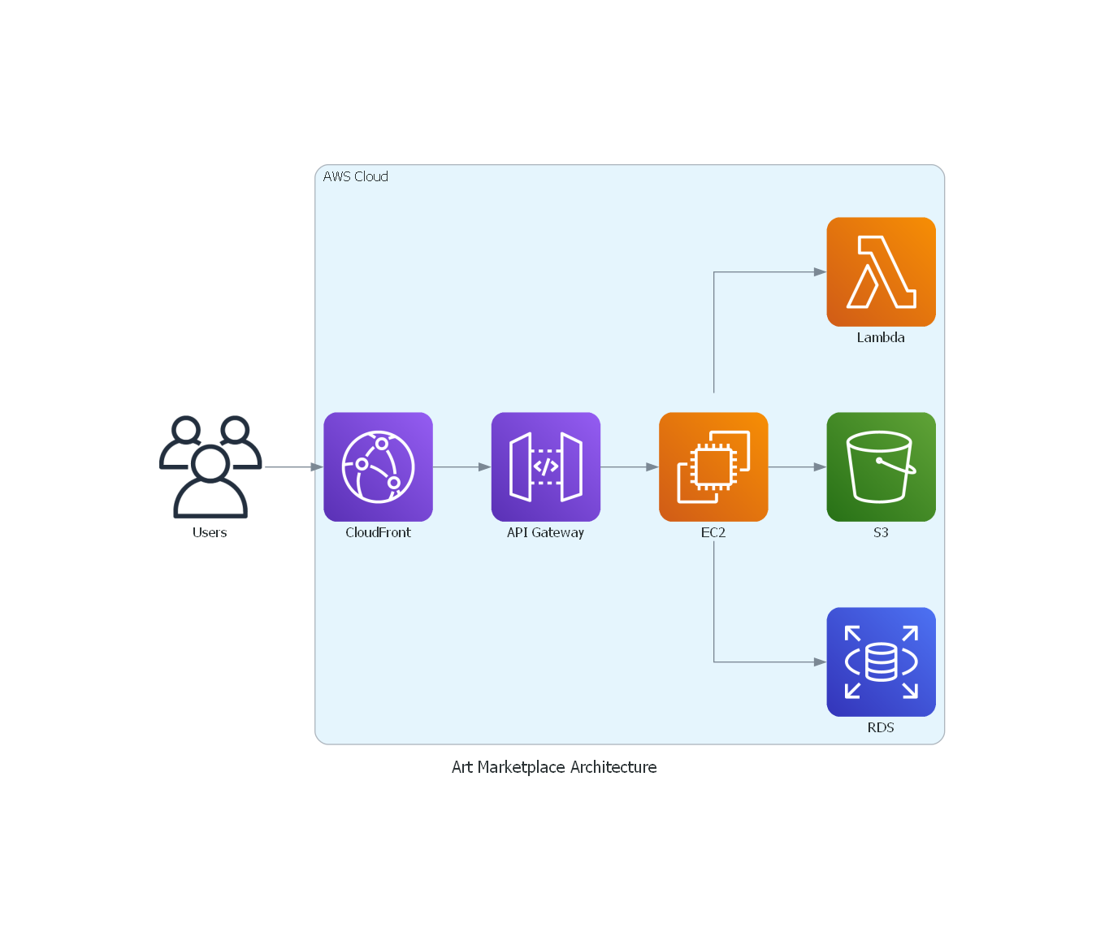
Generated Output Design Diagram

