Slide 1





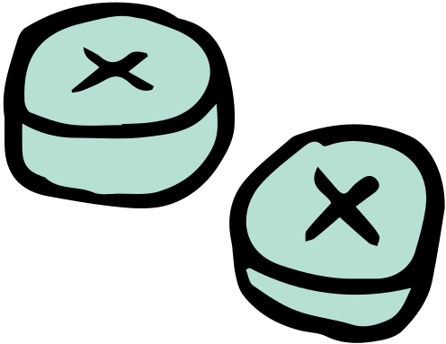




Machine Learning
Diabetic Classification

Slide 2


Introduction
Diabetes is a blight on public health across the United States, and increasingly more so in developing countries as time progresses.
The advent of GLP-1 medications makes early detection and intervention more crucial than ever.
This presents itself as a very compelling area of public health research.

Slide 3



Objective
01. Data Preparation
Using 441K records from the CDC’s Behavioral Risk Factor Surveillance System survey.
02. Model Training
Testing Logistic Regression, LinearSVM, KernelSVM, and ANN to classify patients.
03. Evluation & Results
Testing models for best performance - what does good performance actually look like?

Slide 4

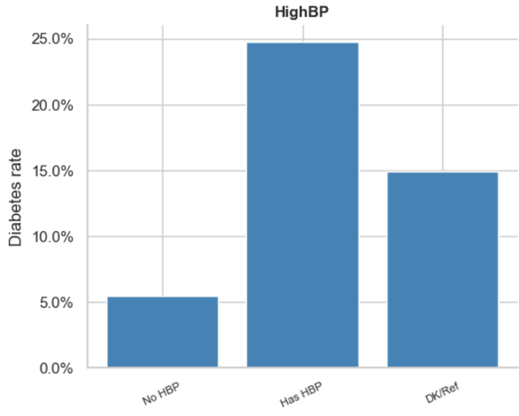
Data Preparation
441K rows, 330 columns. Dataset was looked very complete, less than one percent missing data in any column
01
02
Cleanup dates, cut features to 21 clinically recommended variables
03
Evaluate correlation of features with target variable
Identify survey-specific unknown/missing codes - missing data rate rises considerably. Drop rows with any missing values - lots of data available
04
05
Construct target variables - decide against three-class as the data imbalance is insurmountable

Slide 5
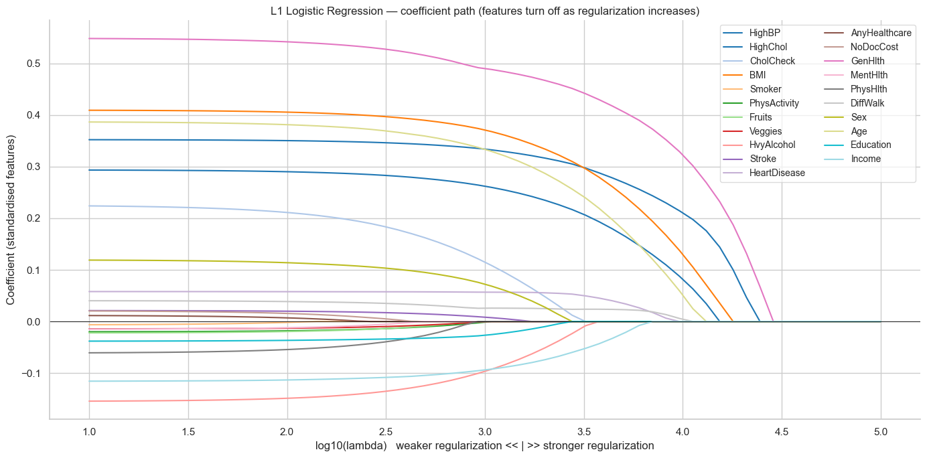
EDA

Slide 6
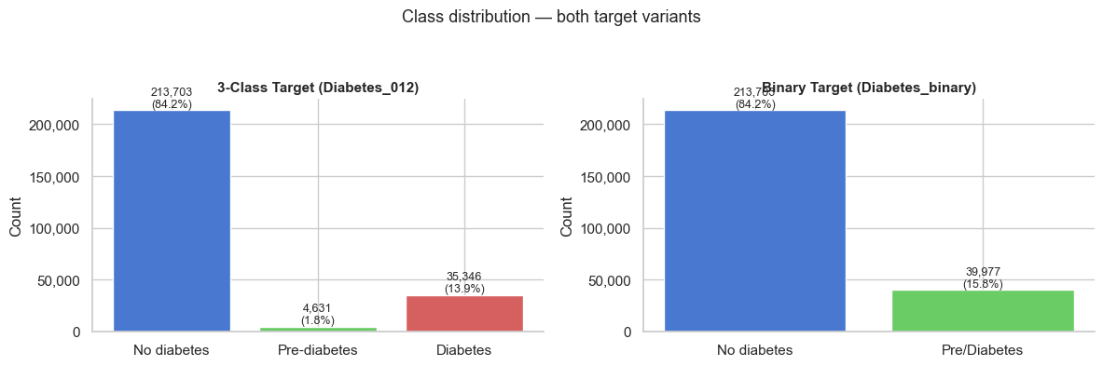
Data Imbalance
Prompted the decision to opt for binary classification
Imbalancing handled by undersampling for SVM
Logistic Regression would use class_weight parameter
Neural Networks will use pos_weight

Slide 7
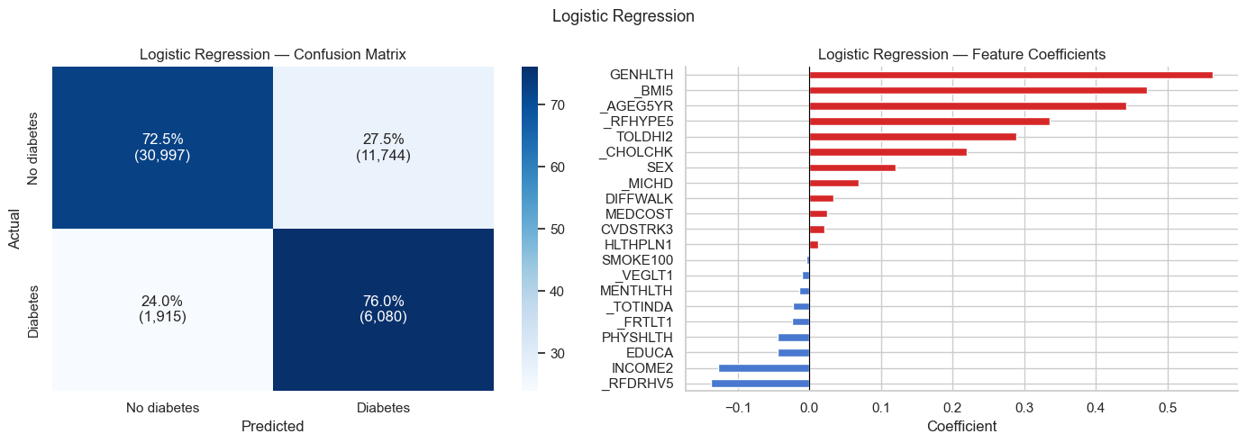
Logistic Regression
Trained on full dataset using balanced class_weight & L2 regularization
5-fold CV

Slide 8
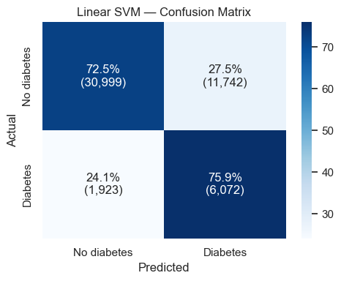
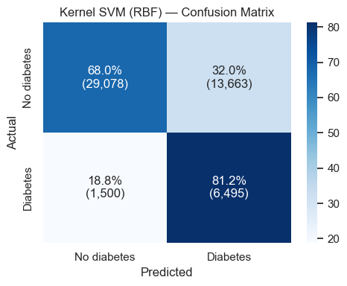
SVM
Trained on rebalanced dataset
Performed GridSearchCV
Little improvement with parameter tuning
Trained on subset of data as it would be computationally prohibitive
Still very long training process
Optimal results wrt minimizing FNR

Slide 9

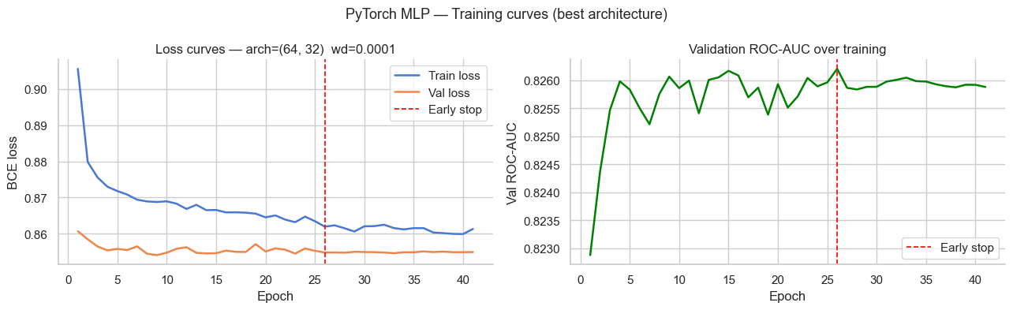
Neural Networks
Used pos_weight to adjust for data imbalance
Struggled to converge smoothly, shallow learning
Marginally better than Logistic Regression and SVM at cost of much more computational work

Slide 10
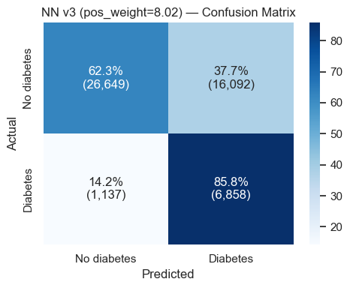
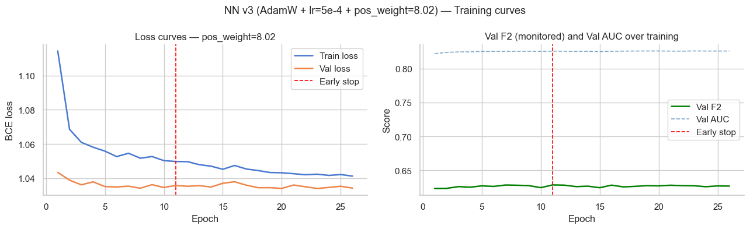
Neural Networks 2
New strategies - use F2 score as early-stopping (doubles the weight of recall)
Used pos_weight to penalize False Negative predictions much more
Traded precision for recall
Ultimately, any performance improvement would require more + better data

Slide 11
Thank You

