Slide 1
FINC 310 | STUDENT GROUP ASSIGNMENT
Build P&G's financial story - then prove it
Audited 10-K data + finance concepts + AI-assisted Python + human verification
FINC 310 | P&G FINANCIAL STORY
1
Notes:
Timing: 2 minutes.
Open with the assignment's governing standard: evidence before elegance.
Tell students that AI will make code faster, but it will not remove responsibility for definitions, signs, sources, or interpretation.

Slide 2
MAKE A PREDICTION BEFORE YOU SEE THE DASHBOARD
Can earnings outgrow sales without a strong revenue year?
P&G's FY2025 net sales barely moved from FY2024. What else could change the financial story?
+0.3%
FY2025 net sales growth versus FY2024
Operating costs and margins
Taxes and non-operating items
Share count and per-share math
Cash conversion and reinvestment
Financial leverage and risk
OPENING QUESTION
2
Notes:
Timing: 5 minutes.
Ask students to vote: yes, no, or it depends.
Collect two mechanisms that could make EPS grow faster than sales. Do not reveal the answer yet.
Return to this question on slide 43.

Slide 3
By the end, you can build and defend the story
READ
CALCULATE
Trace every metric to the audited 10-K and Metric_ID input.
Reconcile profit, cash flow, growth, and DuPont identities.
BUILD
VERIFY
Use AI and Python to create four reproducible visualizations.
Test sources, formulas, code, visual encoding, and interpretation.
LEARNING OUTCOMES
3
Notes:
Timing: 3 minutes.
Read the four outcomes aloud as a sequence: read, calculate, build, verify.
Connect them to Chapters 1-8: value, markets, statements, analysis, time, financing, creditor risk, and risk-return.

Slide 4
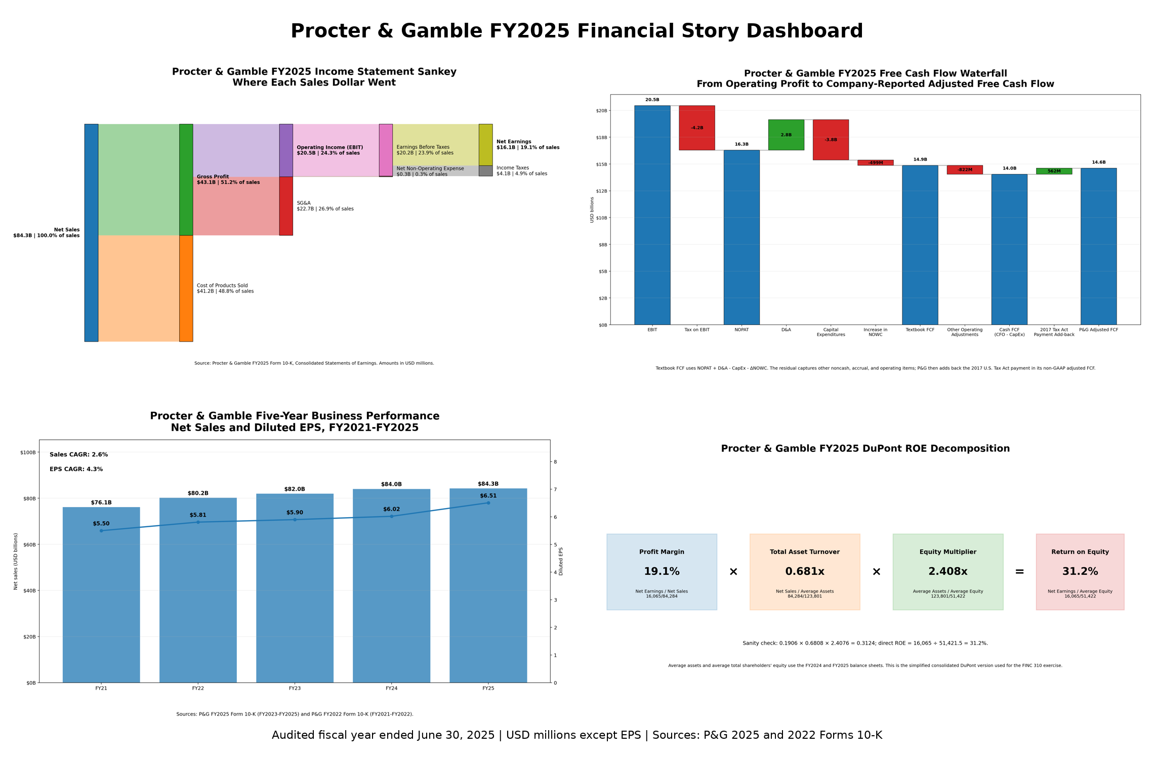
One company. Four lenses. One verified story.
Sources: P&G FY2025 and FY2022 Forms 10-K; supplied FINC 310 package.
CASE OVERVIEW
4
Notes:
Timing: 4 minutes.
Reveal the dashboard and ask students what question each quadrant answers.
Do not interpret the numbers in depth yet. The purpose is to establish the cumulative story arc.

Slide 5
Your assignment turns audited data into four answers
1
2
3
4
Income Statement Sankey
Free Waterfall
Cash
Flow (FCF)
Five-Year Trend
DuPont ROE
Where did each sales dollar go?
How did operating profit become cash?
What changed across FY2021-FY2025?
What drives return on equity?
The shared output is one cautious conclusion supported by all four lenses and an AI verification record.
ASSIGNMENT SETUP
5
Notes:
Timing: 4 minutes.
Explain that the final report is not four isolated charts. Each lens resolves a question left open by the prior lens.
Point students to the complete assignment and workbook rather than reading every deliverable now.

Slide 6
Roles distribute the work - not the responsibility
DATA
SANKEY
CASH
Source, year, units, signs
Income statement flow
NOPAT, NOWC, FCF
Cross-check one result owned by another role.
Cross-check one result owned by another role.
Cross-check one result owned by another role.
TREND + DUPONT
PYTHON + AI
AUDIT + STORY
CAGR and ROE factors
Program and REM
Checks and presentation
Cross-check one result owned by another role.
Cross-check one result owned by another role.
Cross-check one result owned by another role.
TEAM STRUCTURE
6
Notes:
Timing: 5 minutes.
Assign roles now if the class will include a lab.
State that any student may be asked to explain any formula, function, or chart.
If teams are smaller, combine adjacent roles without dropping responsibilities.

Slide 7
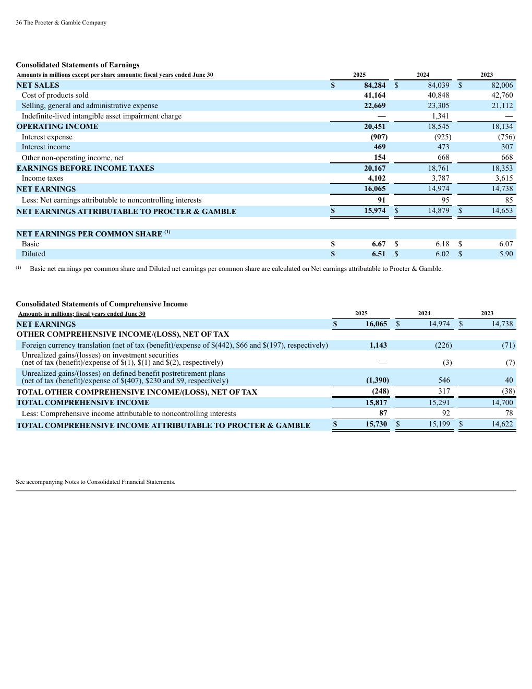
Every number begins in the audited 10-K
Trace one value through the complete evidence chain:
1
10-K statement
Audited line item and fiscal year
2
01_Input
Metric_ID, unit, sign, source reference
3
Model
Formula and denominator choice
4
Chart
Label, width/bar/axis, and interpretation
Source: P&G FY2025 Form 10-K, report p. 36 (PDF p. 38).
SOURCE CONTROL
7
Notes:
Timing: 8 minutes.
Open the annual report to report page 36 and ask students to locate the four highlighted figures.
Then open 01_Input and trace NET_SALES to the same value.
Connect this public reporting process to Chapter 2 financial markets and information quality.

Slide 8
The financial story progresses from profit to risk
01
02
03
04
PROFIT
CASH
TIME
RETURN + RISK
Where sales went
What remained after investment
How results changed
Why ROE is high
STORY WORKFLOW
8
Notes:
Timing: 3 minutes.
Use this slide as the transition into the finance modules.
Explain that each visual answers a different question and creates the need for the next one.

Slide 9
A Sankey is an accounting identity made visible
NET SALES
84,284
= 41,164 COGS + 43,120 gross profit
GROSS PROFIT
43,120
= 22,669 SG&A + 0 impairment + 20,451 EBIT
EBIT
20,451
- 284 net non-operating expense = 20,167 EBT
EBT
20,167
- 4,102 income taxes = 16,065 net earnings
Source: P&G FY2025 Form 10-K, Consolidated Statements of Earnings, report p. 36. USD millions.
INCOME STATEMENT SANKEY
9
Notes:
Timing: 7 minutes.
Write each identity before showing the completed chart.
Ask students to identify which stages are operating and which are non-operating.
Emphasize conservation: every source node must equal its outgoing flows.

Slide 10
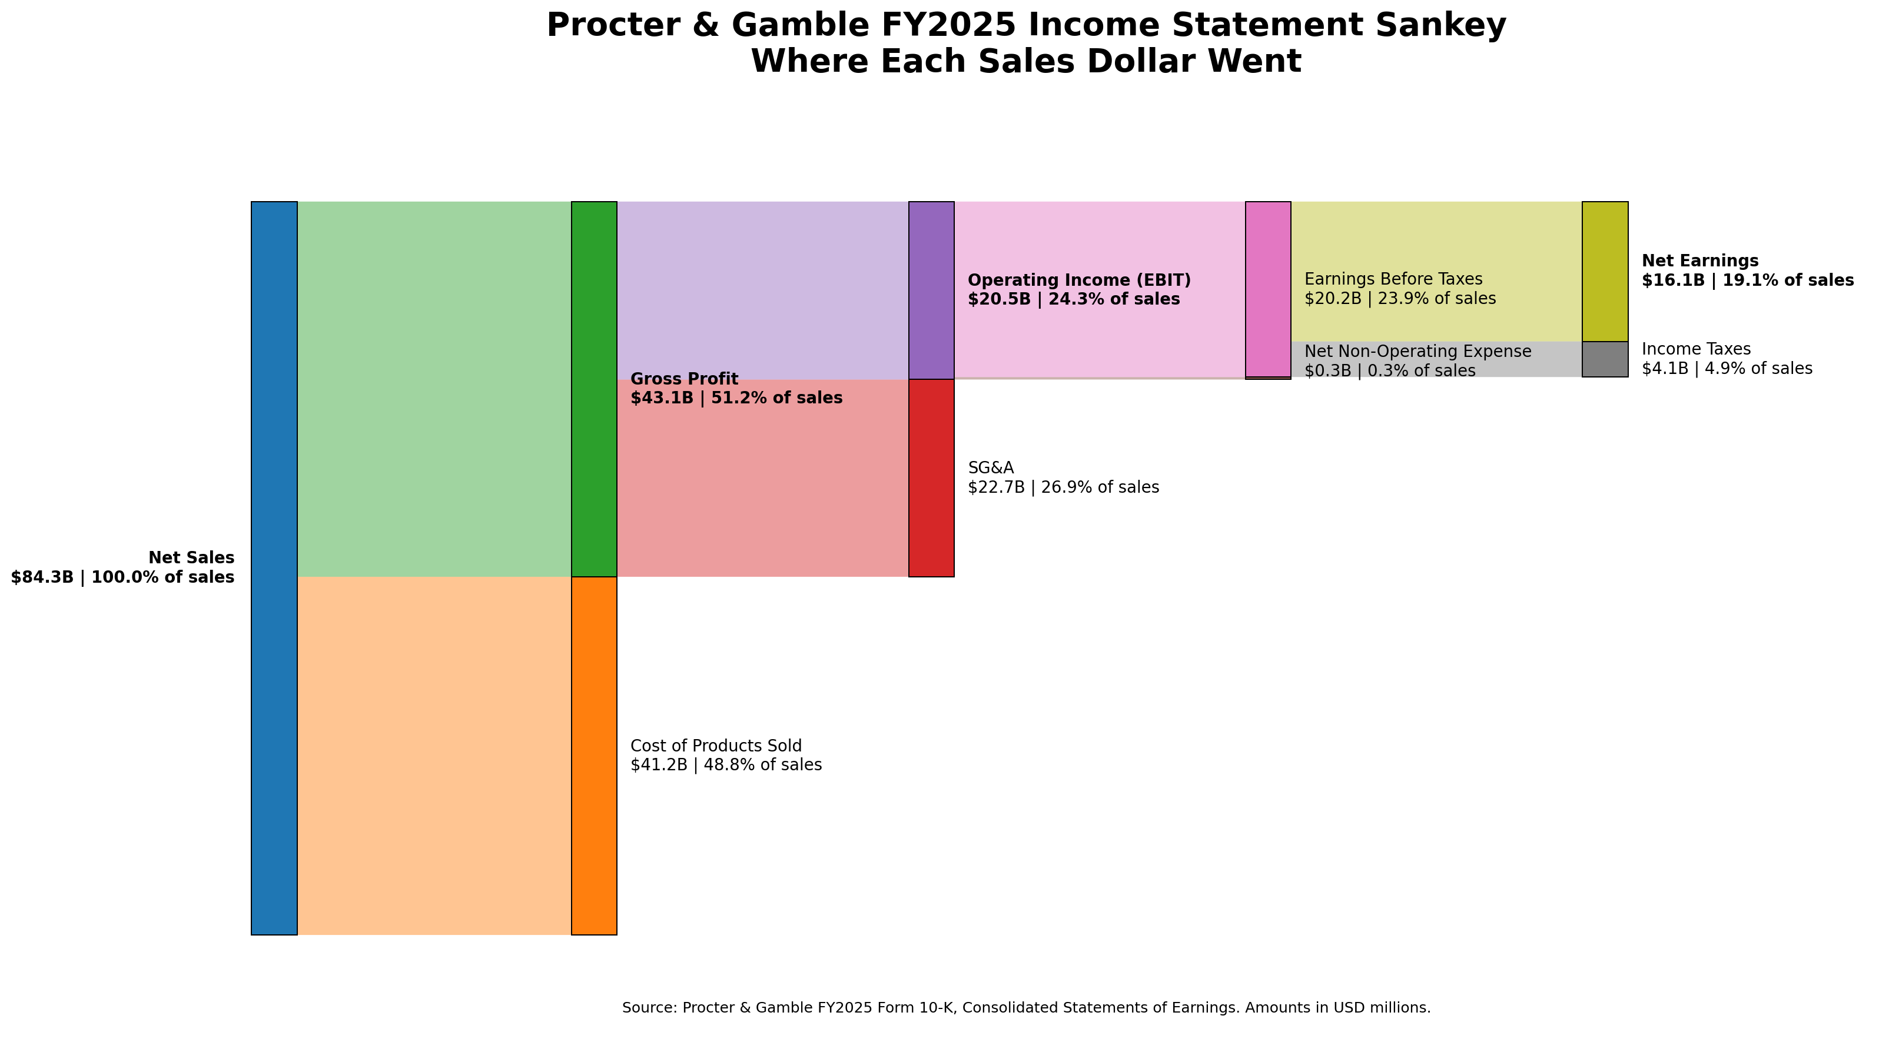
P&G kept about 19 cents of each sales dollar as net earnings
Source: P&G FY2025 Form 10-K, report p. 36. Amounts in USD millions; display labels in billions.
INCOME STATEMENT SANKEY
10
Notes:
Timing: 6 minutes.
Let students read the flow from left to right before you interpret it.
Ask: Which cost absorbs the largest share? Where does the operating/non-operating boundary appear?
Point out that widths and labels must be based on the same dollar values.

Slide 11
Read the Sankey as a one-dollar operating story
$0.49
$0.51
$0.27
$0.24
$0.19
Product costs
Gross profit remains
SG&A
EBIT remains
Net earnings remains
Operating insight: product cost and SG&A absorb most sales dollars; net non-operating expense is small relative to EBIT.
INCOME STATEMENT SANKEY
11
Notes:
Timing: 4 minutes.
Translate common-size percentages into cents per dollar.
Ask students what remains after product costs, after operating expenses, and after taxes.
Clarify that the categories are not all independent slices because gross profit and EBIT are subtotals.

Slide 12
APPLY AND DEFEND
Audit the classification before you audit the colors
YOUR TEAM
AI subtracts interest expense with SG&A before calculating EBIT. Is the Sankey acceptable? Correct the sequence and explain the effect on EBIT.
Name the classification error.
Write the corrected sequence.
State why the change matters.
TEAM AUDIT
12
Notes:
Timing: 5 minutes.
Give teams 2 minutes, then call on the Income Statement Lead from one team and a cross-checker from another.
Answer: interest is non-operating here and belongs after EBIT. Putting it before EBIT understates operating performance.

Slide 13
Profit measures performance; free cash flow measures financial capacity
ACCOUNTING PROFIT
FREE CASH FLOW
Recognizes revenue and expense under accrual accounting to measure performance over a period.
Asks what operating cash remains after reinvestment - the cash available to capital providers.
D&A + working capital + CapEx + other operating adjustments
FREE CASH FLOW
13
Notes:
Timing: 5 minutes.
Ask why a profitable company might still have weak cash flow.
Connect the answer to accruals, noncash expenses, CapEx, and working capital.
Tie FCF to Chapter 1 value creation and Chapter 5 present value.

Slide 14
Three FCF measures answer three related questions
TEXTBOOK FCF
CASH FCF
P&G ADJUSTED FCF
NOPAT + D&A - CapEx - change in operating NOWC
Cash flow from operations - CapEx
Cash FCF + Tax Act payment add-back
Unlevered classroom measure
Direct cash-flow statement measure
Company-defined non-GAAP measure
Do not force equality. Reconcile the definitions.
FREE CASH FLOW
14
Notes:
Timing: 7 minutes.
Define all three measures before comparing totals.
Ask students why similar dollar amounts do not make the definitions interchangeable.
Require the non-GAAP label for the company measure.

Slide 15
Build textbook FCF one controlled sign at a time
$20.451B
-$4.160B
$16.291B
+$2.847B
-$3.773B
-$0.499B
$14.866B
EBIT
- tax on EBIT
NOPAT
+ D&A
- CapEx
- change in NOWC
TEXTBOOK FCF
Operating NOWC rose from -$11.208B to -$10.709B: a $0.499B use of cash in this simplified definition.
FREE CASH FLOW
15
Notes:
Timing: 8 minutes.
Build the bridge left to right and ask students to predict the sign of every change.
Explain why D&A is added back, CapEx is subtracted, and an increase in NOWC uses cash.
Use the effective tax rate on EBIT to calculate NOPAT in this simplified model.

Slide 16
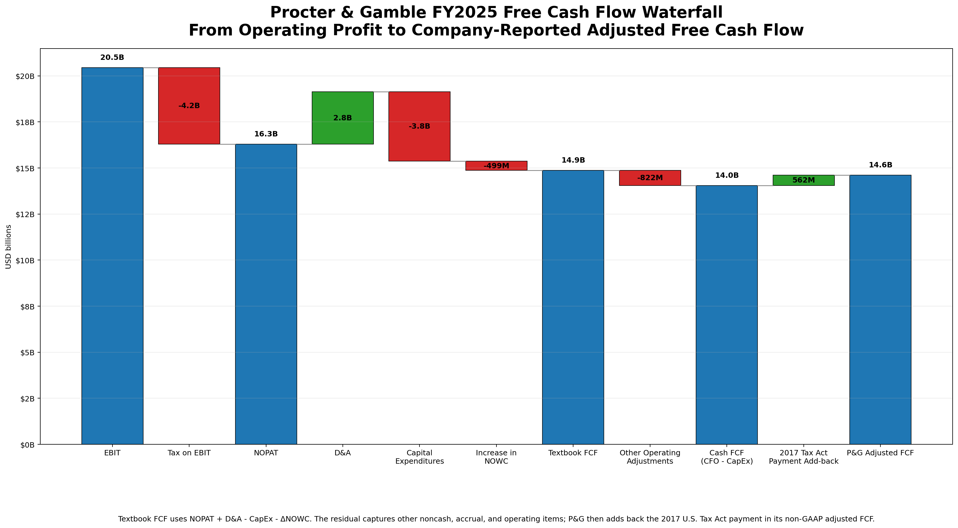
The cash bridge ends at three distinct totals
Sources: P&G FY2025 Form 10-K, report pp. 30 and 39; supplied FINC 310 model. USD millions.
FREE CASH FLOW
16
Notes:
Timing: 6 minutes.
Read the waterfall in three sections: NOPAT, textbook FCF, cash/company FCF.
Ask students to identify subtotal bars, positive changes, and negative changes.
Call out the adjusted FCF non-GAAP label.

Slide 17
The $822M residual is an explanation task - not a deletion task
-$822M
The simplified model captures AR, inventory, prepaids, AP, and accrued liabilities. CFO also reflects share-based compensation, deferred taxes, gains/losses, pensions, and other timing items.
Cash FCF minus textbook FCF
Modeling rule: name the residual, preserve it, and explain what the simplified definition does not capture.
FREE CASH FLOW
17
Notes:
Timing: 5 minutes.
Explain that CFO contains additional accrual, noncash, pension, tax, and timing effects beyond the simplified NOWC definition.
Ask students why a residual is useful evidence about model scope rather than proof of error.

Slide 18
APPLY AND DEFEND
Fix the double-negative CapEx error
YOUR TEAM
The workbook stores CapEx as -3,773. AI writes: FCF = NOPAT + D&A - raw_capex - change_in_NOWC. What happens, and how do you fix it?
Predict the direction of error.
Write one consistent sign rule.
Explain it without using Python jargon.
TEAM AUDIT
18
Notes:
Timing: 6 minutes.
Answer: subtracting raw_capex subtracts a negative and therefore adds CapEx.
Preferred classroom fix: capex = abs(raw_capex); subtract capex once.
Accept an alternative convention only if it is documented and used consistently.

Slide 19
Five annual observations create four growth intervals
FY21
FY22
FY23
FY24
FY25
1
2
3
4
$76.1B
$80.2B
$82.0B
$84.0B
$84.3B
EPS $5.50
EPS $5.81
EPS $5.90
EPS $6.02
EPS $6.51
Net sales: USD billions | EPS: GAAP diluted earnings per share
Sources: P&G FY2025 Form 10-K for FY2023-FY2025; P&G FY2022 Form 10-K for FY2021-FY2022.
FIVE-YEAR TREND
19
Notes:
Timing: 5 minutes.
Have students count the intervals between FY2021 and FY2025.
Read the sales and EPS series for consistency and confirm that all EPS values are GAAP diluted EPS.

Slide 20
CAGR measures one smoothed annual pace across four intervals
2.58%
Sales CAGR = (84,284 / 76,118)^(1/4) - 1
Net sales CAGR
4.30%
EPS CAGR = (6.51 / 5.50)^(1/4) - 1
GAAP diluted EPS CAGR
CAGR answers 'what constant pace connects the endpoints?' - not 'what happened every year?'
FIVE-YEAR TREND
20
Notes:
Timing: 5 minutes.
Write the exponent as 1/4 and ask why it is not 1/5.
Remind students that CAGR describes endpoints and does not reveal annual volatility.

Slide 21
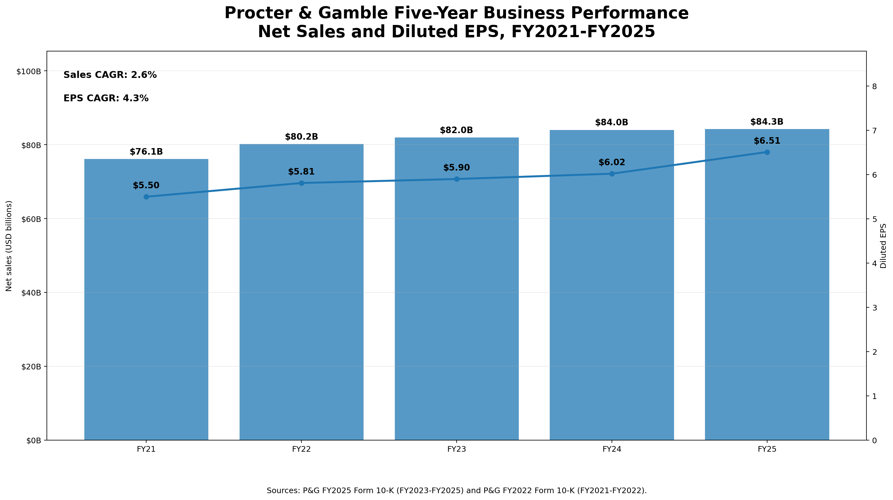
EPS grew faster than sales - the chart shows the gap, not its cause
Sources: P&G FY2025 Form 10-K (FY2023-FY2025) and P&G FY2022 Form 10-K (FY2021-FY2022).
FIVE-YEAR TREND
21
Notes:
Timing: 6 minutes.
Ask students to compare the slopes and the CAGR callouts.
Then ask how the dual axes could be manipulated to overstate or understate the relationship.
Separate the observed growth gap from hypotheses about its cause.

Slide 22
APPLY AND DEFEND
Explain the growth gap without overclaiming
YOUR TEAM
EPS CAGR is 4.30%; sales CAGR is 2.58%. List three possible drivers. Mark each as a fact, a plausible hypothesis, or unsupported by this chart.
Separate evidence from inference.
Name one additional source you would inspect.
Identify one dual-axis visual risk.
TEAM AUDIT
22
Notes:
Timing: 6 minutes.
Strong hypotheses include margins, taxes, impairment charges, non-operating items, and diluted share count.
Do not accept 'stronger brands' or 'better management' as chart-supported conclusions without additional evidence.
Connect the evidence/inference distinction to the final executive story.

Slide 23
DuPont separates profitability, efficiency, and leverage
PROFIT MARGIN
ASSET TURNOVER
EQUITY MULTIPLIER
ROE
19.06%
0.681x
2.408x
31.24%
x
x
=
Net earnings / Net sales
Net sales / Average assets
Average assets / Average equity
Net earnings / Average equity
The identity is exact; the interpretation requires judgment.
DUPONT ROE
23
Notes:
Timing: 6 minutes.
Write the three factors before inserting numbers.
Ask what managerial question each factor answers.
Connect profit margin to operations, turnover to asset use, and the multiplier to financing.

Slide 24
Use average balance-sheet values with full-year income measures
AVERAGE TOTAL ASSETS
AVERAGE SHAREHOLDERS' EQUITY
($125,231M + $122,370M) / 2
($52,284M + $50,559M) / 2
$123,800.5M
$51,421.5M
Used in turnover and multiplier
Used in multiplier and direct ROE
Source: P&G FY2025 Form 10-K, Consolidated Balance Sheets, report p. 37.
DUPONT ROE
24
Notes:
Timing: 5 minutes.
Explain the stock-versus-flow mismatch: the balance sheet is a point in time; sales and earnings cover a period.
Calculate the average assets and average equity live or ask teams to verify them.

Slide 25
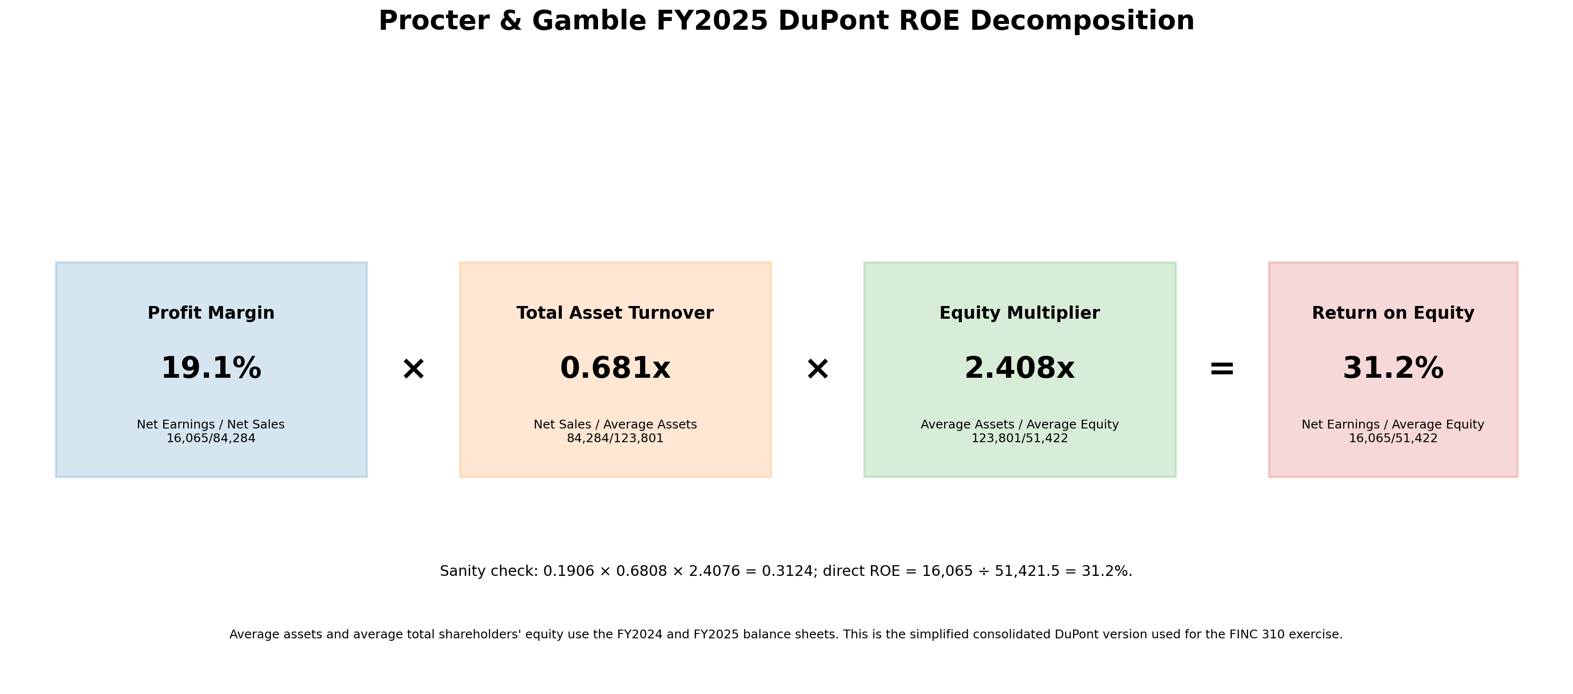
P&G's strong margin is magnified by a 2.408x equity multiplier
Source: P&G FY2025 Form 10-K, report pp. 36-37; simplified consolidated FINC 310 DuPont model.
DUPONT ROE
25
Notes:
Timing: 6 minutes.
Interpret each factor separately before discussing the product.
Describe turnover as relatively modest rather than automatically poor; asset intensity and intangibles matter.
Connect leverage to creditor risk and Chapter 8 risk-return.

Slide 26
APPLY AND DEFEND
Name the strength, the constraint, and the risk
YOUR TEAM
P&G has a 19.06% profit margin, 0.681x asset turnover, and 2.408x equity multiplier. Which factor supports ROE, which constrains it, and what risk is visible?
Interpret each factor in words.
Verify the 31.24% identity.
Connect leverage to downside risk.
TEAM AUDIT
26
Notes:
Timing: 6 minutes.
Answer: strong margin supports ROE; turnover is comparatively modest; leverage magnifies the result and financial risk.
Avoid saying one factor is 'the cause' without explaining the multiplicative relationship.

Slide 27
05
AI is the junior analyst. Your team is the reviewer.
The financial model controls the code - not the other way around.
FINC 310 | P&G FINANCIAL STORY
27
Notes:
Timing: 3 minutes.
Transition from finance meaning to tool use.
State that AI is required, but every source, formula, sign, label, and conclusion remains the team's responsibility.

Slide 28
A strong prompt creates controls before it creates code
01
DATA LOCK
Use the supplied workbook; do not invent replacements.
02
DEFINITION LOCK
Name textbook, cash, and adjusted FCF separately.
03
OUTPUT CONTRACT
Four PNGs, dashboard, CSV, executable program.
04
FAILURE CONTRACT
Validate required inputs and stop on failed identities.
05
AUDIT TRAIL
REM, function comments, sign conventions, prompt history.
AI PROMPT
28
Notes:
Timing: 6 minutes.
Ask students which control is most likely to prevent a persuasive but wrong output.
Have teams add one stronger constraint based on the errors seen so far.

Slide 29
The model prompt specifies inputs, outputs, and stop conditions
Use PG_FinancialStory_Student.xlsx. Do not search for or invent replacement data.
Write one executable Python program that:
• reads 01_Input using Metric_ID;
• creates the four required visuals;
• writes a CSV of sanity checks;
• stops if a required identity fails;
• saves four PNGs and one dashboard;
• uses relative paths or arguments.
FOLLOW-UP AUDITS
List hard-coded numbers.
Map every identity to a test.
Explain negative signs.
Find misleading chart risks.
Replace fixed row numbers.
Recommend a human revision.
AI PROMPT
29
Notes:
Timing: 7 minutes.
Read the prompt as a requirements document, not as magic words.
Point students to the complete prompt in the assignment guide.
Ask which requested behavior is a control and which is merely an output.

Slide 30
REM comments make the program auditable
REASONING SUMMARY
EQUATIONS
What the program does and how the four visuals fit together.
Formulas, denominators, signs, averages, and time intervals.
METHOD
LIMITATIONS
Input, validation, calculations, plotting, export, and failure behavior.
Simplified NOWC, non-GAAP FCF, source scope, rounding, and visual risk.
REM DOCUMENTATION
30
Notes:
Timing: 6 minutes.
Clarify that REM means concise visible rationale, not private chain-of-thought.
Ask teams to write one limitation that would protect a reader from overinterpreting the dashboard.

Slide 31
The code architecture follows the financial workflow
01
02
03
04
05
LOAD
MODEL
CHECK
VISUALIZE
EXPORT
Read and validate Metric_ID inputs
Calculate finance metrics
Test independent identities
Encode verified values
Write PNGs, dashboard, CSV
No PASS -> no chart export
ANNOTATED PYTHON
31
Notes:
Timing: 5 minutes.
Walk the sequence in order and ask what finance job each function performs.
Stress that all required checks run before chart export.

Slide 32
ANNOTATED PROGRAM ARCHITECTURE
Workbook input uses Metric_ID - not fragile row numbers
def load_metrics(workbook_path):
df = pd.read_excel(
workbook_path,
sheet_name="01_Input",
header=4,
)
required = {
"Metric_ID", "FY2025", "FY2024",
"FY2023", "FY2022", "FY2021",
}
missing = required.difference(df.columns)
if missing:
raise ValueError(f"Missing: {sorted(missing)}")
WHAT TO EXPLAIN
Which line selects the worksheet?
Why is header=4 required?
What happens if a column is renamed?
Why are Metric_ID values safer than row 12 or D7?
AI + PYTHON
32
Notes:
Timing: 6 minutes.
Ask a non-Python lead to explain the input control in finance terms.
Point out that missing inputs should fail loudly rather than become zero or NaN in a chart.

Slide 33
ANNOTATED PROGRAM ARCHITECTURE
Finance definitions and sign controls belong in one model
model["sales"] = value(metrics, "NET_SALES", 2025)
model["cogs"] = value(metrics, "COGS", 2025)
model["gross_profit"] = model["sales"] - model["cogs"]
raw_capex = value(metrics, "CAPEX", 2025)
model["capex"] = abs(raw_capex)
model["avg_assets"] = (
value(metrics, "TOTAL_ASSETS", 2025)
+ value(metrics, "TOTAL_ASSETS", 2024)
) / 2
model["sales_cagr"] = (
model["sales"] / value(metrics, "NET_SALES", 2021)
) ** (1 / 4) - 1
WHAT TO EXPLAIN
Gross profit is calculated, not hard-coded.
CapEx becomes a positive magnitude once.
Average assets match a full-year flow measure.
Five observations create four CAGR intervals.
AI + PYTHON
33
Notes:
Timing: 7 minutes.
Trace each code line back to a finance concept already taught.
Ask what would happen if abs() were omitted or if the exponent were 1/5.
Reinforce that chart functions should consume the verified model rather than re-calculate definitions independently.

Slide 34
ANNOTATED PROGRAM ARCHITECTURE
Sanity checks stop a bad chart before it becomes persuasive
def require_check(name, actual, expected, tolerance):
if not math.isclose(
actual, expected, abs_tol=tolerance
):
raise RuntimeError(
f"{name} failed: {actual} vs {expected}"
)
require_check(
"Revenue identity",
model["cogs"] + model["gross_profit"],
model["sales"],
1.0,
)
# Plot only after every required identity passes.
WHAT TO EXPLAIN
Actual and expected sides are constructed independently.
Tolerance reflects rounding - not permission to ignore errors.
A RuntimeError makes failure visible.
Checks precede all save_* functions.
AI + PYTHON
34
Notes:
Timing: 7 minutes.
Demonstrate or describe changing sales by $10M and observing the stop condition.
Ask why a PASS result is not enough if the expected value was copied from the same wrong formula.

Slide 35
Verification is a chain - not a green cell
01
02
03
04
05
SOURCE
FORMULA
PROGRAM
VISUAL
INTERPRETATION
→
→
→
→
Correct period, unit, sign, and audited value
Correct definition and denominator
Correct implementation and failure behavior
Truthful width, direction, axis, label, and color
Evidence, inference, and limitation separated
A PASS cell is evidence only when the source and expected formula are also correct.
AI VERIFICATION
35
Notes:
Timing: 7 minutes.
Walk left to right and have students name one failure at every layer.
Add interpretation as the final narrative layer: a correct chart can still support an overconfident claim.

Slide 36
Six identities must pass before the dashboard is accepted
REVENUE
GROSS PROFIT
COGS + Gross Profit = Net Sales
SG&A + Impairment + EBIT = Gross Profit
PRETAX
NET EARNINGS
EBIT - Net Non-Operating Expense = EBT
EBT - Income Taxes = Net Earnings
ADJUSTED FCF
DUPONT
Cash FCF + Tax add-back = Adjusted FCF
Product of factors = Direct ROE
Expected package result: PASS x 6
AI VERIFICATION
36
Notes:
Timing: 6 minutes.
Ask teams to match each identity to the chart it protects.
Remind them that a DuPont check protects denominator consistency while the FCF check protects the non-GAAP bridge.

Slide 37
Document one meaningful human correction
VALIDATION
Add a missing metric/year check.
BEFORE -> AFTER
DATA ACCESS
Replace a fixed row number with Metric_ID.
BEFORE -> AFTER
FINANCE LOGIC
Correct a sign, denominator, average, or interval.
BEFORE -> AFTER
VISUAL TRUTH
Fix a misleading axis, width, unit, or label.
BEFORE -> AFTER
INTERPRETATION
Separate fact from inference and add a limitation.
BEFORE -> AFTER
AI VERIFICATION
37
Notes:
Timing: 5 minutes.
Explain that cosmetic wording alone is not a meaningful revision.
Ask teams to choose one correction category and record before/after evidence.

Slide 38
A strong executive story connects the lenses without overclaiming
P&G's FY2025 story is one of mature top-line growth, strong profitability, substantial cash generation, and a high ROE supported by margin and magnified by leverage.
PROFIT
CASH
TIME
RISK
19.1% net margin; product cost and SG&A dominate the sales-dollar flow.
$14.0B cash FCF; $14.6B adjusted FCF after a company add-back.
EPS CAGR 4.30% exceeded sales CAGR 2.58%; causes require further analysis.
31.24% ROE includes a 2.408x equity multiplier and its associated leverage risk.
FINANCIAL STORY
38
Notes:
Timing: 7 minutes.
Model a concise synthesis, then ask which clauses are facts and which are interpretations.
The goal is integration, not repeating chart titles.

Slide 39
Submit the full evidence package - not only the pictures
FILES
AUDIT + COMMUNICATION
Completed student workbook
Executable pg_financial_story.py
Four individual PNG visuals
One combined dashboard PNG
Sanity-check CSV
Exact AI prompt history
REM block and annotated code
Completed AI verification log
Two-page financial interpretation
Five-minute team presentation
Portable run test: submit a folder another team can execute.
REQUIRED DELIVERABLES
39
Notes:
Timing: 4 minutes.
Point students to the complete acceptance criteria in the student assignment.
Emphasize the portable run test: copy the folder elsewhere and run the same command.

Slide 40
Your five-minute presentation is an argument with evidence
0:00
THESIS
State the most important conclusion.
0:30
SANKEY
Show the sales-dollar flow and one identity.
1:30
FCF
Distinguish three measures and explain the residual.
2:30
TREND + DUPONT
Explain growth gap, margin, efficiency, leverage.
3:30
AI AUDIT
Show one correction, one check, one visual risk.
4:30
CAVEAT + CLOSE
Name a limitation and return to the thesis.
PRESENTATION EXPECTATIONS
40
Notes:
Timing: 5 minutes.
Explain the pacing and remind students that every member must participate.
Random oral questions may address any formula, code block, or interpretation.

Slide 41
Accuracy and understanding outrank visual polish
01
DATA + RECONCILIATION
Correct fiscal year, units, signs, sources, and identities
02
FINANCIAL MODEL
Correct Sankey, FCF, trend, and DuPont definitions
03
CODE + AI CONTROL
Executable, documented, validated, reproducible
04
VERIFICATION
Checks, corrections, and human judgment
05
STORY + ACCOUNTABILITY
Integrated conclusion and explainable work
Material invented data or an unreconciled model can trigger severe deductions.
GRADING PRIORITIES
41
Notes:
Timing: 4 minutes.
Explain that the analytic rubric totals 100 points and includes individual accountability.
Use this slide to make clear why a beautiful unreconciled chart earns little credit.

Slide 42
Work session: leave with a verified model, not a finished-looking draft
1
SOURCE
2
FORMULAS
3
PROMPT + REM
Trace one metric from 10-K to chart label.
Complete the four model worksheets.
Lock definitions and failure behavior.
4
RUN + CHECK
5
REVISE
6
STORY
Pass all six identities.
Document one meaningful human correction.
Write one thesis, four evidence points, one caveat.
TEAM WORK SESSION
42
Notes:
Timing: 25-30 minutes in the 3-4 hour versions.
Circulate in the order shown: sources, formulas, prompt, run, checks, revision, story.
Ask a different student to report each checkpoint.
In the 2-hour version, use this slide to assign outside work.

Slide 43
EXIT TICKET
Show me one formula, one check, and one risk
1. Write the formula that mattered most today.
2. Name the check that protects it.
3. Name one risk the dashboard does not capture.
The opening answer: yes - EPS can outgrow sales. The financial story explains how, tests whether the claim is supported, and states what remains uncertain.
FINC 310 | P&G FINANCIAL STORY
43
Notes:
Timing: 5 minutes.
Collect individual responses, not one per team.
Return to the opening prediction and distinguish the observed growth gap from any claimed cause.
Use the responses to identify which concept needs reinforcement before presentations.

