Slide 1

Kubernetes
Hassen Yahia

Slide 2
Agenda
What is Kubernetes?
Basic Architecture of Kubernetes
Features of Kubernetes

Slide 3

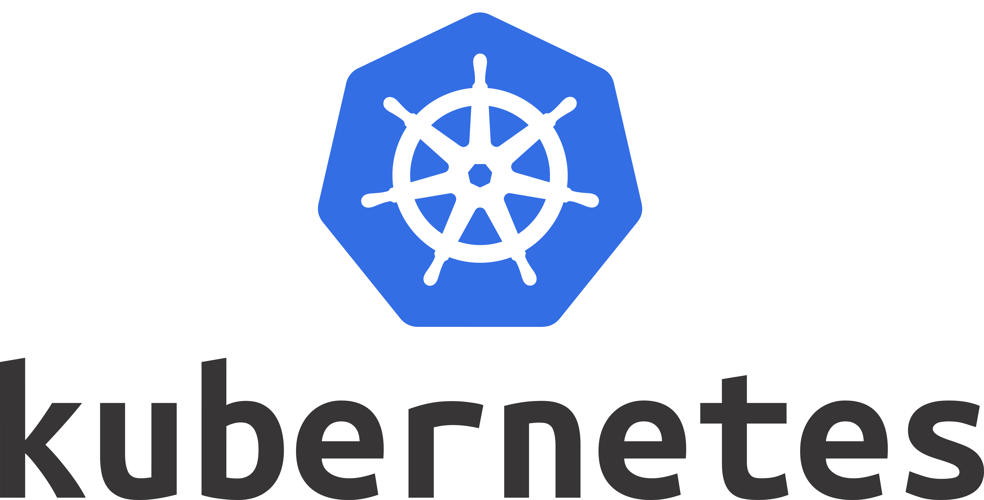
Kubernetes is the Greek word for helmsman or captain of ship

Slide 4
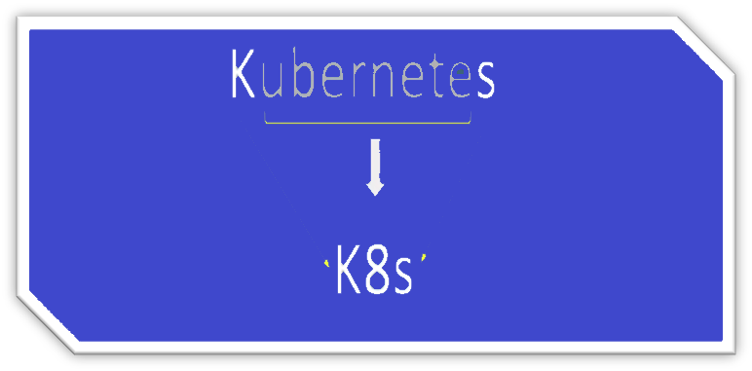
Kubernetes is also known as K8s

Slide 5
What is Kubernetes
What is Kubernetes
What is container orchestration Engine
Why do we need Kubernetes

Slide 6
What is Kubernetes?
Is a Container Management (orchestration) tool
Developed by google lab & later donated to CNCF(Cloud Native Computing Foundation)
Open source
Written on Golang

Slide 7
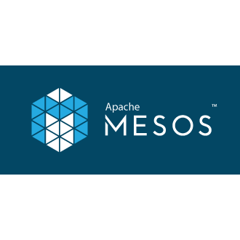
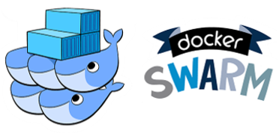
What is container management Tool
Container Management/orchestration tool or engine automates deploying, scaling , and managing containerized application on a group of servers

Slide 8
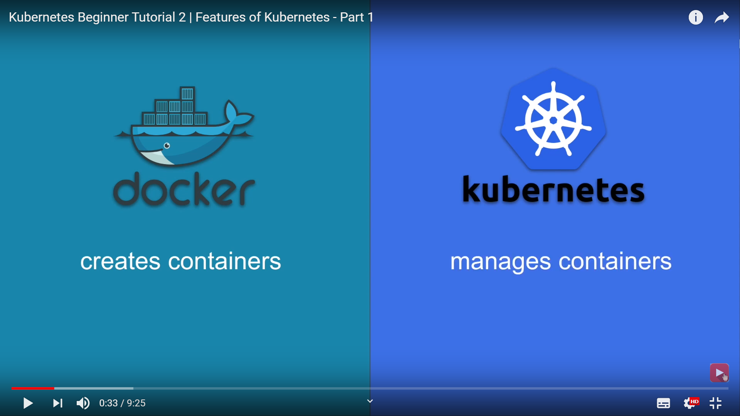

Slide 9
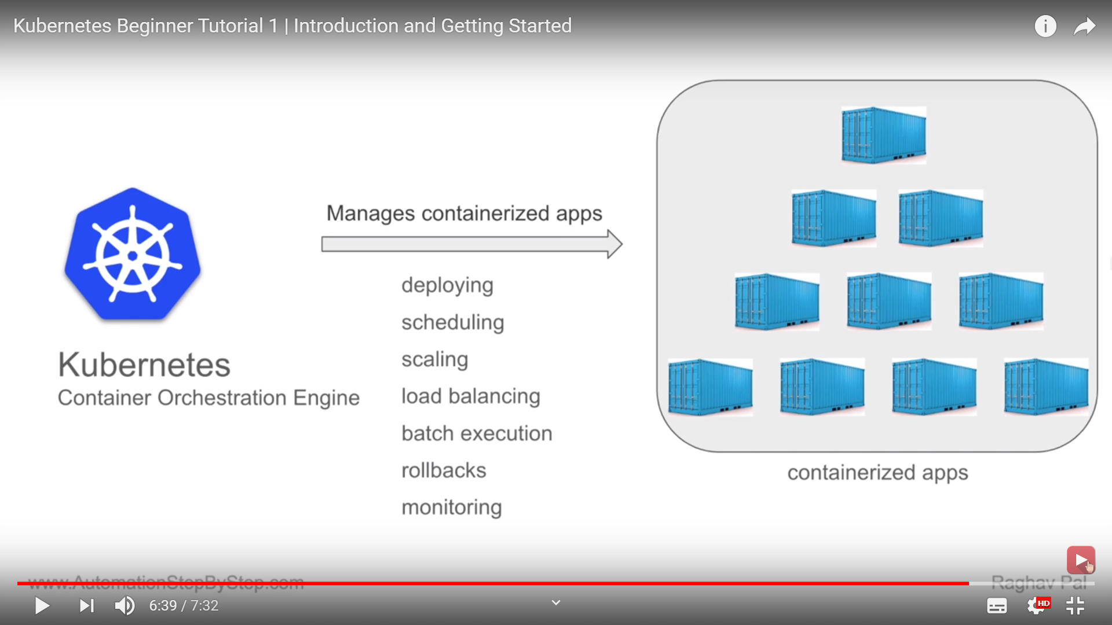
Why do we need Kubernetes?

Slide 10
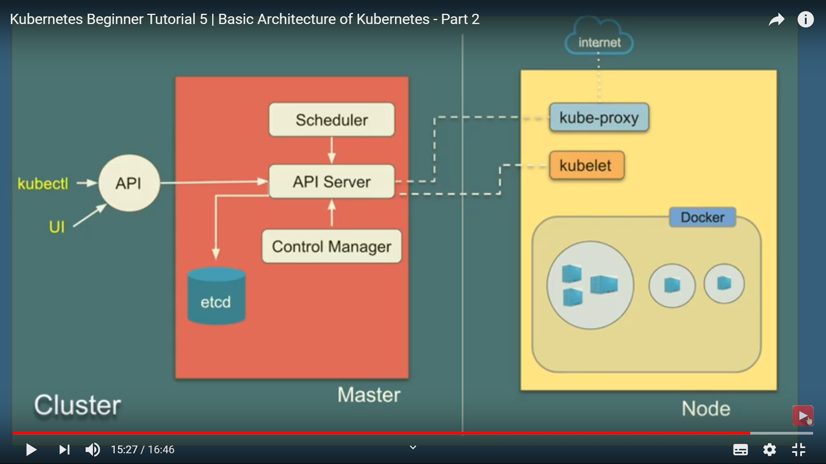
Kubernetes Architecture

Slide 11
Kubectl is the command line utility for users to interact with API (GO language binary)
UI the Kubernetes dashboard
Mater Node
Responsible for managing the cluster
It has 4 components
API Server – for all communication (Json over HTTP API)
Scheduler – schedule pods on nodes
Controller Manager – runs controllers
ETCD – open source, distributed key-value database from CoreOS – it can be configured externally
Worker Node
Can be any physical or virtual machine where container are deployed
Every node Kubernetes cluster must run a container runtime like docker
It has 3 components
Kubelet – agent running on each node communicatees with components from master node using API Sever
Kube-proxy – agent which runs on each node responsible for maintain network configuration and rules
Container runtime – software that is responsible for running containers
Kubernetes supports several container runtimes like, Docker, container d, cri-o, Rktlet, Kubernetes CRI (Container Runtime interface).
Kubernetes does not have the capability to directly handle containers

Slide 12
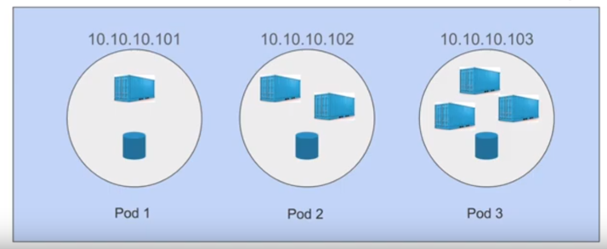
Features of Kubernetes
Automatic bin packing
Kubernetes automatically packages your application and schedules the container based on the requirements and resources available.
Automatically places container based on their resource requirements like CPU & Memory(RAM).
saves resources.
We have the option of specify how much CPU and Memory(RAM) each container needs. When containers have resource requests specified, the scheduler can make better decisions about which nodes to place pods on .
Service discovery and load balancing
Kubernetes doesn’t run containers directly instead it wraps one or more containers into a higher-level structure called pod
Gives pods their own IP addresses and a single DNS name for a set of Pods, and can load-balance across them
With this system, it has control over network and communication between pods and can load load-balance across them
Service (DNS Name)

Slide 13
Storage Orchestration
Containers running inside a pod may need to store data
Pods can have a storage volumes
Usually a single volume is shared within all the containers in a pod
Storage system of your choice Like, Local , cloud, network (NFS).`
Self Healing
If container fails - restarts container
If node dies - replaces and reschedule containers on other nodes
If container does not respond to user defined health check - kills container
Automated rollouts and rollbacks
Rollout: deploy changes to application or its configuration
Rollback: revert the changes and restore to previous state
Ensures there is no downtime during this process

Slide 14
Secret and configuration management
Secret is Kubernetes object that separates sensitive data from pods and containers
Config Map is Kubernetes object that separates configuration from pods and containers
Both are stored in ETCD(is a key-value datastore or database).
Batch Execution
Kubernetes supports batch execution, long-running jobs, and replaces failed containers
Horizontal Scaling
In Kubernetes , we can scale up or down the containers
Using commands
From the dashboard (Kubernetes UI)
Automatically based on CPU usage

Slide 15
Options to use /install Kubernetes
Online Kubernetes Labs
Kubernetes playground
Play with Kubernetes
Play with Kubernetes classroom
Kubernets installation tools
Minikube – one master and one worker node
Kubeadm
Cloud based Kubernetes services
GKE – Google Kubernetes Engine
AKS – Azure Kubernetes Service
Amazon EKS

Slide 16
Thank You

