Slide 1

W2SO Membership database
Josef Mechure, john apel, Thomas Jones

Slide 2
Executive Summary
Purpose: Modernize and scale LARC’s data management system
Key Impact: Secure membership tracking, streamlined dues collection, and enhanced communication
Platform Transition: From Microsoft Access → Microsoft SQL Server Future-ready features: Triggers, transaction safety, and real-time reporting

Slide 3


About the Lancaster Amateur Radio Club (LARC)
Established in 1987 in Buffalo, NY
Over 150 active members
Community-focused: Events, emergency management, and education
ARRL Special Service Club since 2002
Transitioned from hobby-based tracking to operational data needs

Slide 4
Why Modernization Was Needed
Legacy system lacked scalability and security
Microsoft Access Database to convert to Microsoft SQL Server
No automation for dues or membership tiering
Limited accessibility for officers and volunteers
New solution introduces automation, accuracy, and compliance
Improvements we're making
Badges for membership length
Managing annual dues

Slide 5
Database Modeling
Business Needs :
Membership management system
Need a system for collecting dues (membership expiration date)
Improve communication with contact information for group members
Track leadership roles
Assign and track club issued keys
Track licenses
Volunteer coordination ( field day events, hamfests, committees)
Goals
Ensure data integrity and accuracy
Support membership management
Support membership engagement
Support volunteer coordination
Ensure scalability for future growth of the organization

Slide 6



Membership database entities
Members
Contact Info
Licenses
Membership Types
Officers
Keys
Key Holders
Dates

Slide 7
Technical Enhancements at a Glance
SQL Server-based architecture
Membership tier recognition (Bronze, Silver, Gold)
Created Rosters:
Officer
Key Holder
Contact information

Slide 8
conceptual Model

Slide 9
Logical Model

Slide 10
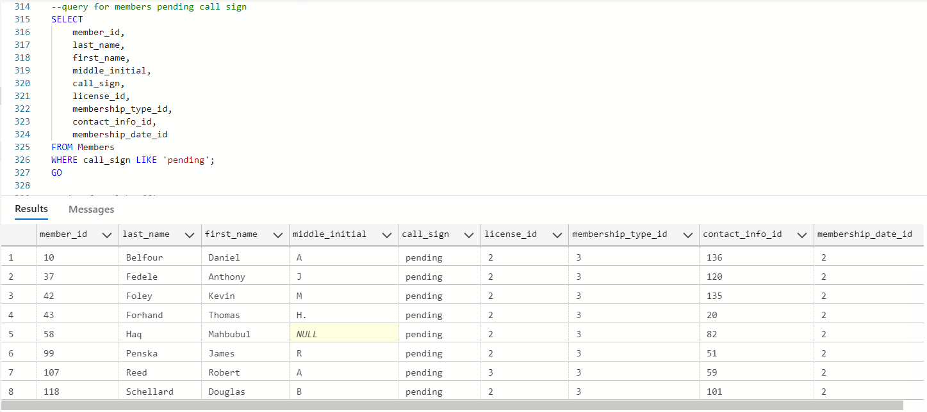
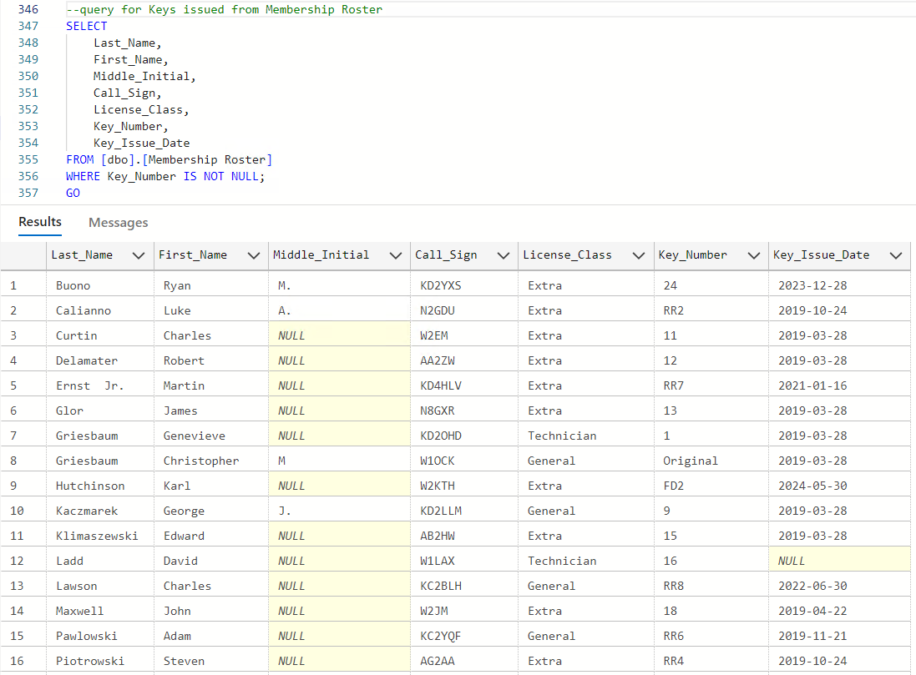
Example Queries
Query for Members Pending Call Sign
Query for Keys Issued to Club Members

Slide 11
Roadmap and Scalability
Importing roster information into Database
Identifying queries for the owners for desirable information
Test queries
Importing current roster into database to consider adjustments that need to be made
Updating Project Charter
Working on Technical Report
Real-time member portal
Volunteer hours tracking
Integration with payment processors
Enhanced analytics for membership growth

Slide 12
Measurable Outcomes
Increased data integrity and automation
Reduced manual updates
Improved compliance with radio regulations
Scalability to 200+ members and beyond

Slide 13
Future Planning
Addition trigger for members paying annual dues
Update of initial membership dates.
Update volunteer willingness statues
Automated dues tracking using triggers
Role-based access for officers
Reporting dashboards
Ideas for additions to database:
Emergency Contact Information
Member of the Year
Rookie of the Year
Query of geographical information
Transferrable to another program for mapping

Slide 14

Thank You!

