Slide 1


Regularization framework
Constraint the values of w to select few parameters which explain well the data.
Use of penalization Minimization problem :
λJ(w) is the penalization term.
l(y, Xw) is the loss function, usually for regression.
λ ≥ 0 balances the loss function and the penalty.
Perform jointly the feature selection and the parameter estimation
procedures.

Slide 2

Penalized multivariate regression for feature selection
One step-approach: fit the multiple linear regression model while finding a subset of p important predictors with indices {k1 , k2 , . . . , kp' }  {1, 2, . . . , p} with p'≪p
all having non-zero regression coefficients.
This is achieved by fitting a penalized regression model:
The penalization ψ(β) imposes a constraint on β. We use convex functions to have unique optimum
The coupling parameter λ controls the trade-off between the OLS (unpenalized) solution and the penalized solution.

Slide 3


Ridge regression
The problem can be rewritten as
λ controls the amount of shrinkage
Some properties are:
  Closed-form solution
  Useful when the data matrix X is singular and X^{T} X non invertible
  Bias-variance trade-off – better predictions
  Grouping effect – correlated variables get similar coefficients
  No variable selection

Slide 4

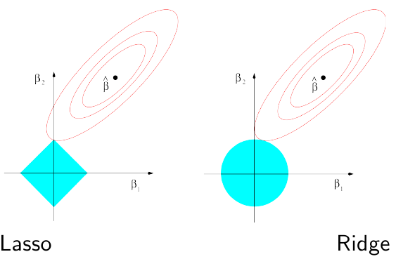
LASSO regression
Lasso regression finds w subject to
Performs both continuous shrinkage and variable selection
λ controls the amount of sparsity
For instance, with p = 2:

Slide 5
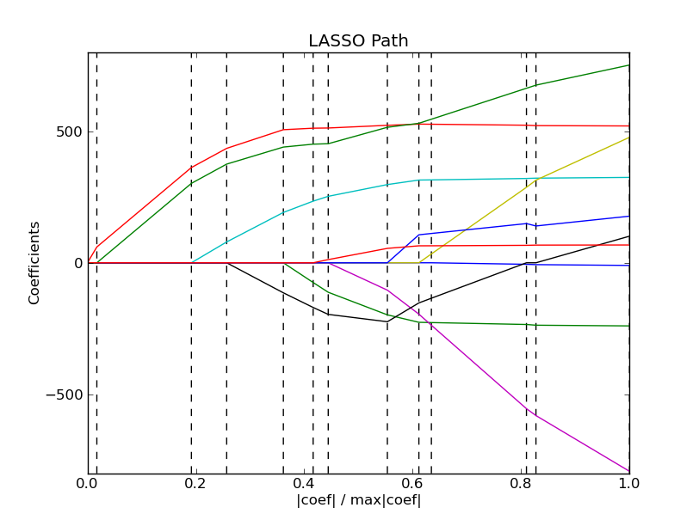
Example of Lasso regularization path
The higher the regularization, the sparser the solution
Run it yourself http://scikit-learn.sourceforge.net/modules/linear_model.html

Slide 6



Elastic net regression: convex combination of L1 and L2 penalties
Elastic net regression solves
It retains the benefits of both individual penalties
Setting
the penalty simplifies to

