Slide 1
General Conclusions
Look at what you do: black box models are not useful
ML is nothing but multivariate estimation
You probably need more data
Do not reinvent the wheel: Pronto, PyMVPA, Nilearn
Some topics not covered here:
  covariance estimation (e.g. functional connectivity)
  unsupervised models (ICA, dictionary learning...)
  Representational similarity analysis [Kriegskorte et al. PNAS 2008]
  Deep nets

Slide 2
Part III Machine Learning for functional Neuroimaging
Outline
The standard multivariate pattern analysis setting
Identification of predictive features
Mapping and predicting: Spatial Regularization
Toward big data analysis
Transfer learning

Slide 3
Introduction: functional Magnetic resonance Imaging
Introduction: The neuro-vascular coupling. The BOLD signal only indirectly reflects neural activity.

Slide 4
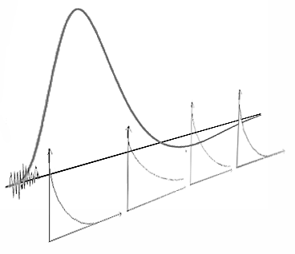
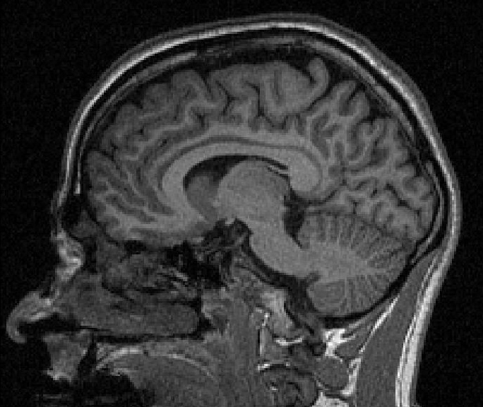
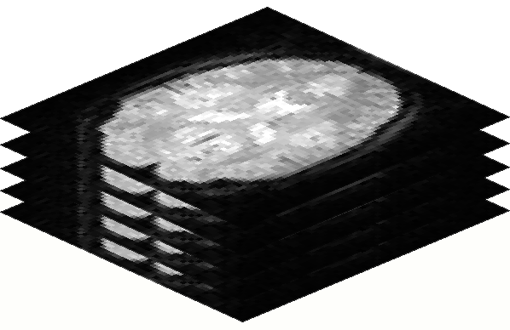
The BOLD response
Hemodynamic response
=temp. variation of [oxy-Hg]
time
TR
14 s
6 s
10 s
time
2 s
stimulus
T2
EPI :
80 slices, TR=2000 ms, TE=30ms,
voxel=2x2x2mm, 96x96 matrix
Anat :
TR=1600ms, FOV=256x256mm2,
256X256 matrix, 192 slices
Slice thickness 1mm
Example

Slide 5
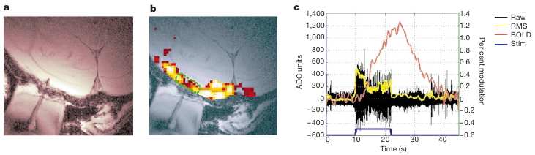
Human BOLD imaging
BOLD response approximately linear in the stimulus function
  Application of simple linear model for data analysis [Friston et al. 1995]
BOLD signal highly correlated with LFPs [Logothetis et al. Nature 2001]
High spatial accuracy (~2mm) [Ugurbil et al. NeuroImage 2007]
Poor temporal resolution, no consensual model on the signal

Slide 6
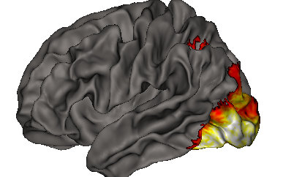
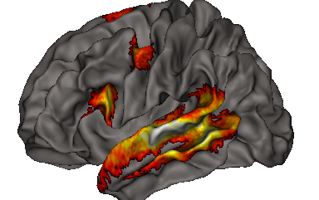
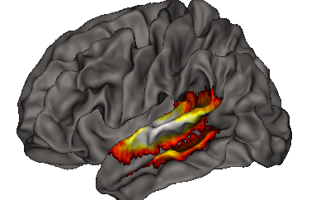
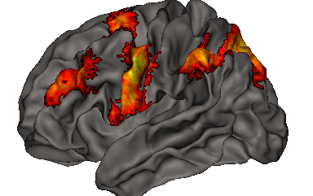
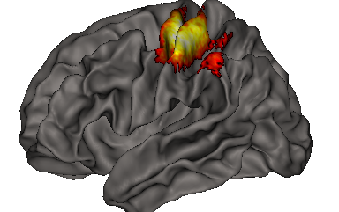
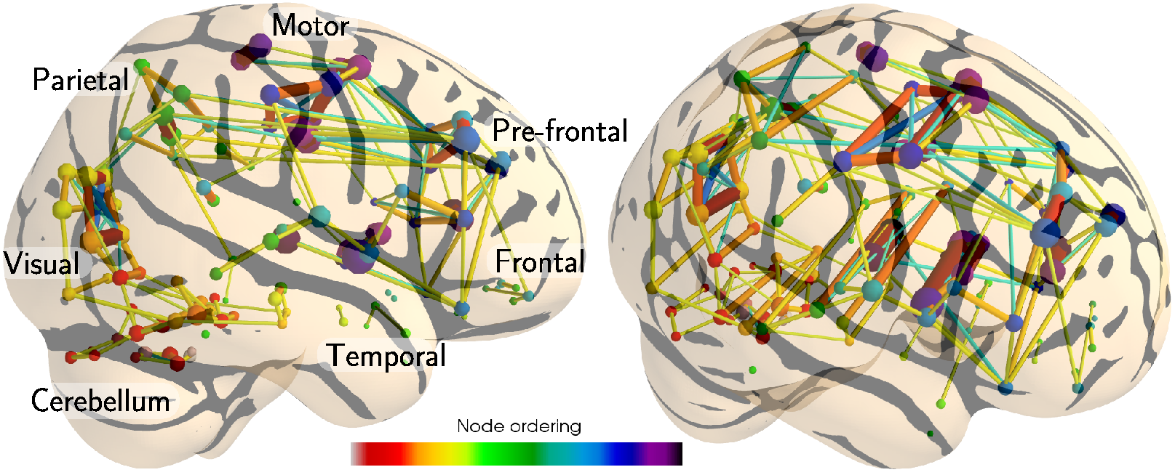
Human BOLD imaging
fMRI used intensively to map cognitive functions in the human brain.
BOLD correlations across regions used to study functional connectivity
Combining the signals across regions can be used to fit accurately the subject's behavior

Slide 7
Machine learning for cognitive neuroimaging : decoding and encoding models
Statistical analysis of fMRI data
encoding models: mapping stimulus features to brain activations
decoding models: predicting behavior from activation maps / “Vanilla MVPA”

Slide 8
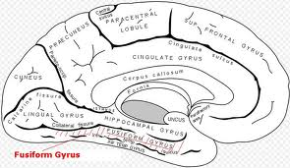
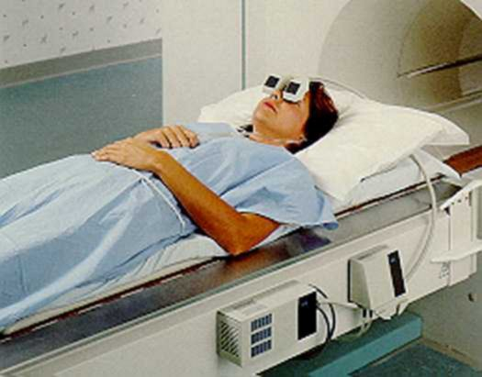
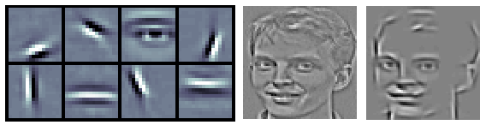
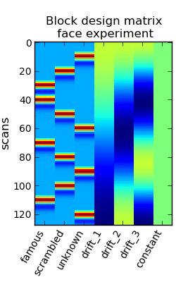
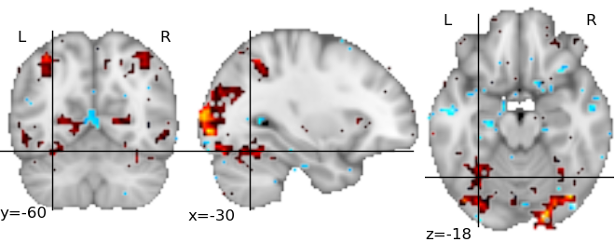
fMRI data from acquisition to analysis
Complex metabolic pathway

Slide 9
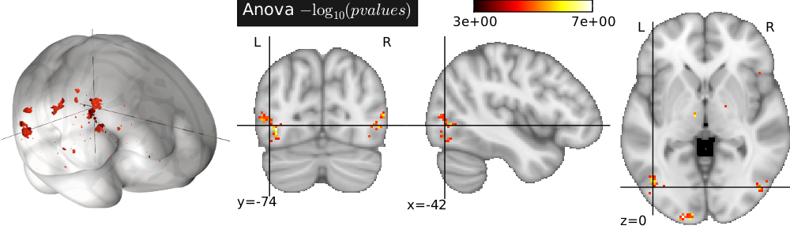
Statistical inference
Question 1 : Is there any effect of the paradigm on the data ?
“omnibus test”
Can I discriminate between the two conditions ?
Question 2 : What regions actually display an effect of the paradigm ?
What are the relevant features ?

Slide 10
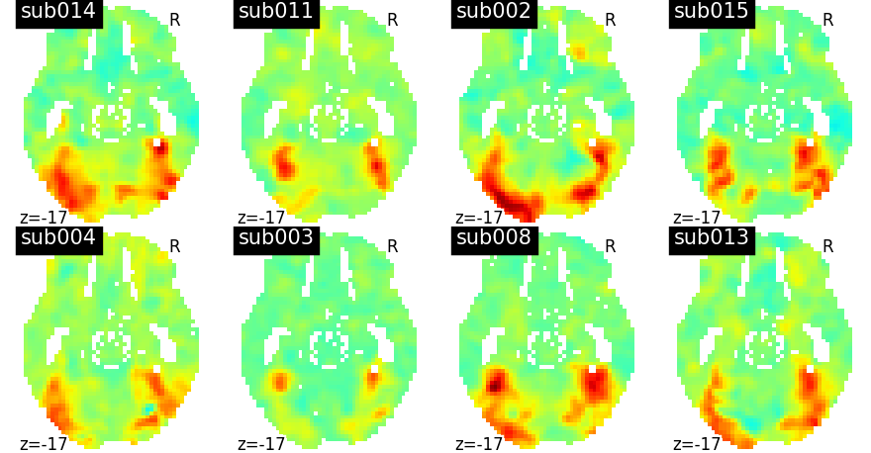
Common problems
Low SNR
High variability between subjects
Small sample sizes

Slide 11
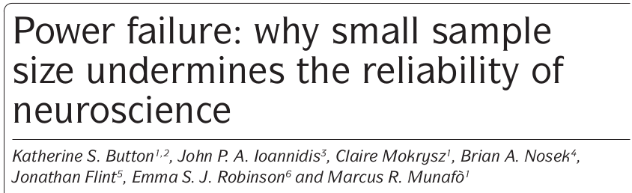

Common problems: sample size
Small number of subjects → Lack of power
→ many false negatives
→ results are weakly informative
→ reported effects are inflated
All these issues are present in MVPA
Reflected in classifier instability, variable performance
Motivation for multivariate models ?

Slide 12
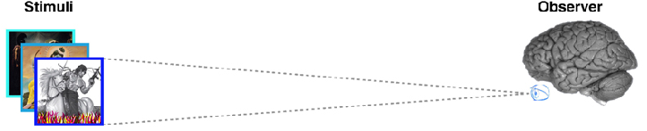
Input space
Feature space
Activity space
pixel 2
feature 2
voxel 2
encoding model
Linear
mapping
Nonlinear
mapping
pixel 1
feature 1
voxel 1
pixel 3
feature 3
voxel 3
Input space
Feature space
Activity space
Linear
classifier
pixel 2
feature 2
voxel 2
Nonlinear
mapping
Linear
mapping
pixel 1
feature 1
voxel 1
pixel 3
feature 3
voxel 3
[Naselaris et al. NeuroImage 2009]

Slide 13

Encoding visual stimuli
Activation patterns encode some information about the stimuli
Population receptive field
  Location-specific (depends on where you are on the cortex)
  Feature-related (position, contrast, speed, color...)
e.g. = wavelet transform
Signal in a voxel
Input image
Voxel-specific response

Slide 14
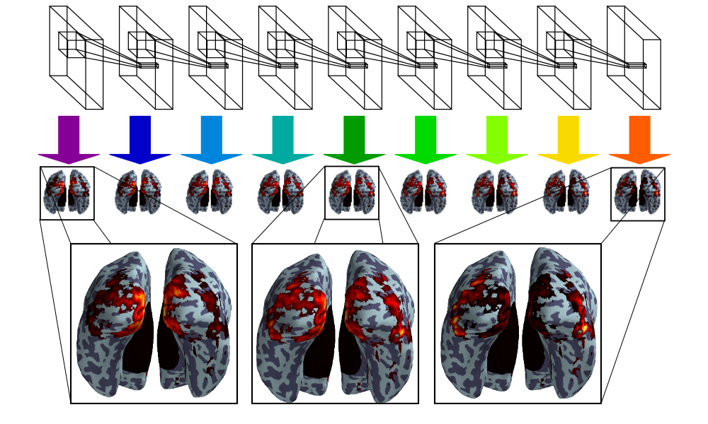
Encoding visual stimuli
Create Features
Convolution model: Feedfoward model of vision for object recognition
Comparison with fMRI
How well are brain regions explained by the features ?
[Eickenberg et al. submitted]

Slide 15
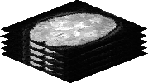

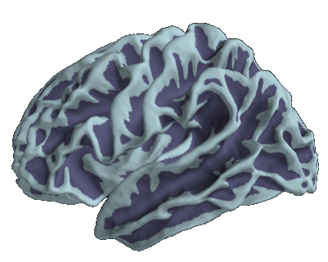


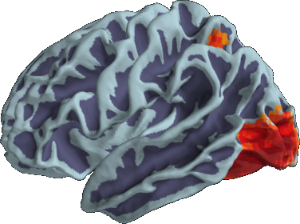
FMRI decoding: Reverse inference
Aims at decoding brain activity by predicting a cognitive variable
[Dehaene et al. 1998],
[Haxby et al. 2001],
[Cox et al. 2003]
?
MVPA

Slide 16
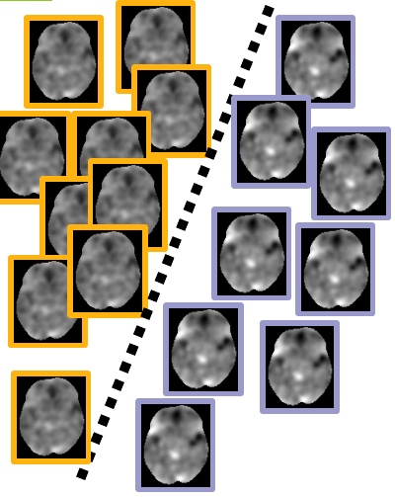

Training classifiers for FMRI data
Main setting:
features = the voxel-level BOLD contrast
Target = conditions (discrete)
Given x in R^{p}, (fMRI volume with p voxels), predict a label y in {-1, 1} i.e. █ or █
or better the class probability Proba(x = 1|y)

Slide 17
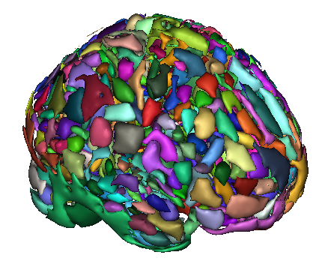
Evaluation of the decoding
Prediction accuracy
→ Quantify the amount of information shared by the pattern and y.
Layout of the resulting maps of weights: The discriminative pattern characterizes brain processes / biomarkers
Common hypothesis = segregation into functionally specific territories
→ sparse: few relevant regions implied
→ compact structure: grouping into connected clusters.

Slide 18
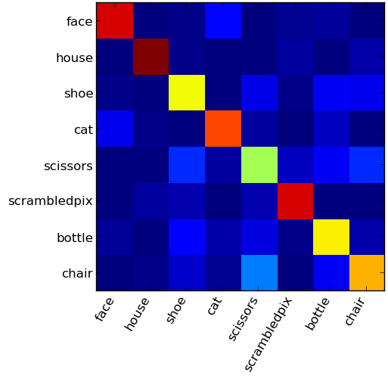







Decoding visual categories
Visual categories very well discriminated indivudally
[Haxby et al. Science 2001]
http://nilearn.github.io/auto_examples/decoding/plot_haxby_multiclass.html#example-decoding-plot-haxby-multiclass-py

Slide 19
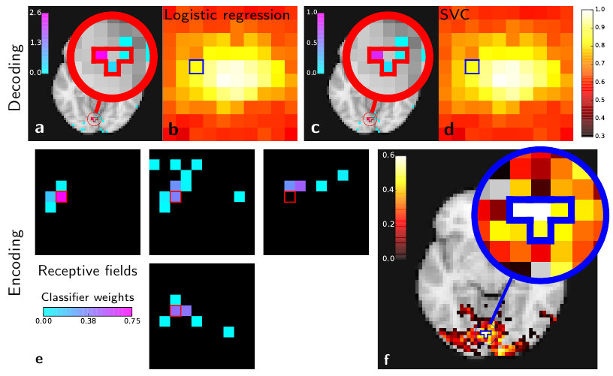
Encoding and decoding: do it yourself !
http://nilearn.github.io/

Slide 20
More topics
Separate GLM approach improves classification accuracy [Mumford et al. NIMG 2012]
Data-driven hrf estimation alos yields more accurate models [Pedregosa et al. Nimg 2014]

Slide 21
Region selection and Identification
Spatial models in MVPA
Identification : Recover the truly associated features
Ill-posedness of the problem. Current solutions.

Slide 22
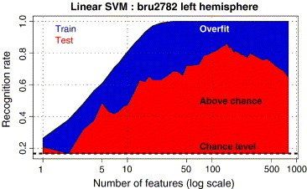
Curse of dimensionality in MVPA
Problem: p ≫ n
  Overfit the noise on the training data
Solutions
  Prior region selection
    prior-bound result
  Data-driven feature selection
  Univariate methods (Anova)
  Multivariate methods
Regularization (e.g. Lasso, Elastic net)
  Shrink w according to your prior

Slide 23
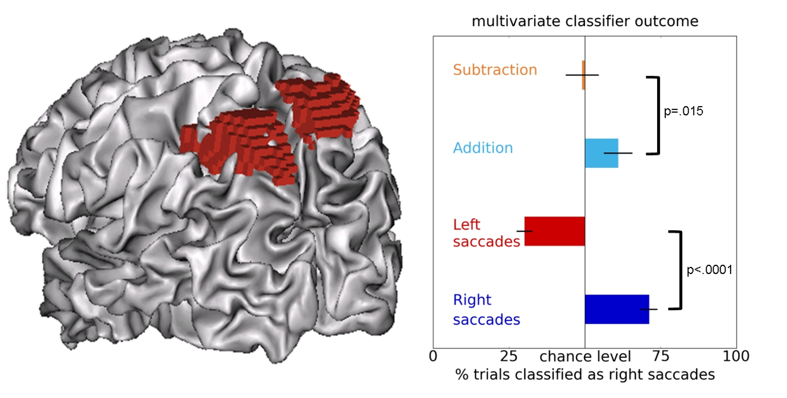
ROI-based analysis
Example:
Selection of results involved in performance of ocular saccades
Succesful prediction of mental arithmetics
Same neural populations involved in ocular saccades and arithmetics ?
[Knops et al., 2009]

Slide 24
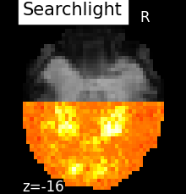
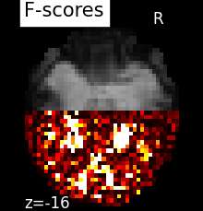
The searchlight method
|Kriegeskorte et al. PNAS 2006]
Prediction based on a small group of neighboring voxels
Change the region location
Obtain a map of statistical association
Drawbacks:
- Cost (loop over voxels + permutation testing)
- Advantage wrt standard brain mapping ?

Slide 25
(Non-)identifiability of the model
W = Wtrue ?
[Haufe et al. Neuroimage 2013] In decoding, you don't recover the true pattern but a filter
The encoding model violates the conditions for good reconstruction [Varoquaux et al. 2012]
Better support recovery by introducing relevant priors on the decoder [Varoquaux et al. 2012]
  Sparsity
  Block structure

Slide 26
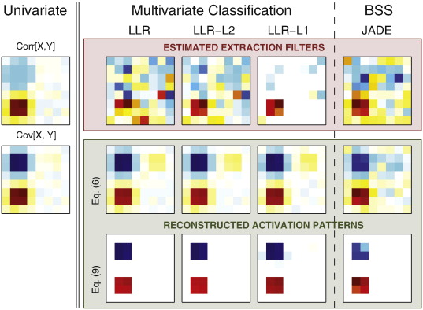
Non-identifiability of the model ?
MVPA cannot recover the true sources ;
  aims at finding a good discriminative model (“filters”)
  not at estimating the signal.
A correction taking covariance structure is necessary...
… but you cannot estimate the signal/noise covariance properly !
However, this can be improved by choosing relevant priors
[Haufe et al. NIMG 2013]

Slide 27
Recovery...
Compressive sensing:
  detection of k signals out of p (voxels)
  with only n observations << k
  Problem: neuroimaging data are correlated (spatially)
    Violate Restricted Isometry property
How to measure the recovery of the set of regions ?
How to improve recovery?
A small fraction of the brain is involved in the task: sparsity
fMRI data are highly correlated spatially

Slide 28
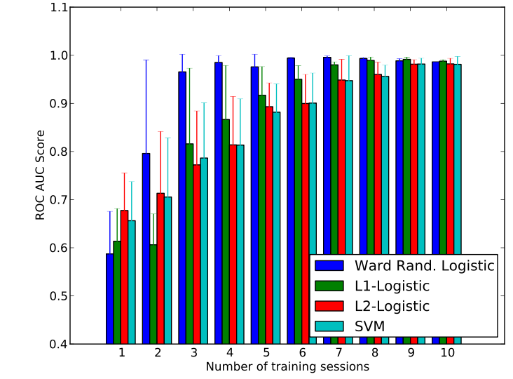
Measuring recovery by subsampling
[Haxby Science 2001] dataset:
Trying to discriminate faces vs houses: level of performance achieved with limited number of samples

Slide 29
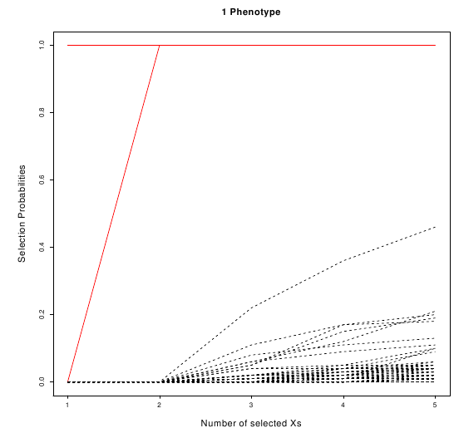
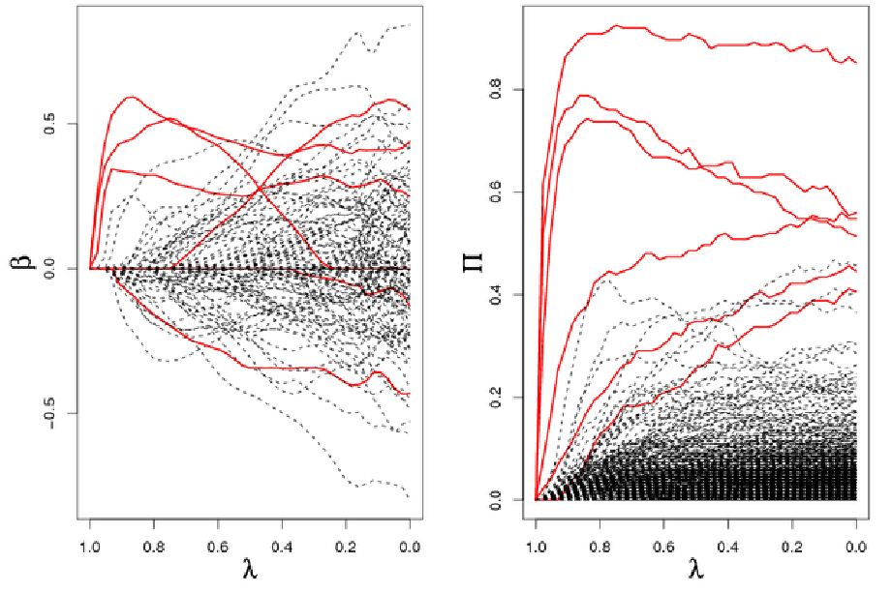
Solution: bagging to better identify
Lasso path
stability path of Lasso
Stability selection = randomization of the features + bootstrap on the samples
Improved feature recovery... for few, weakly correlated features
[Meinshausen and Bühlman, 2009]

Slide 30




Hierarchical clustering and randomized selection
Algorithm Randomized-Ward-Logistic
Loop: randomly perturb the data
Ward agglomeration to form q features
sparse linear model on reduced features
accumulate non-zero features
threshold map of selection counts
[Gramfort et al. MLINI 2011]

Slide 31
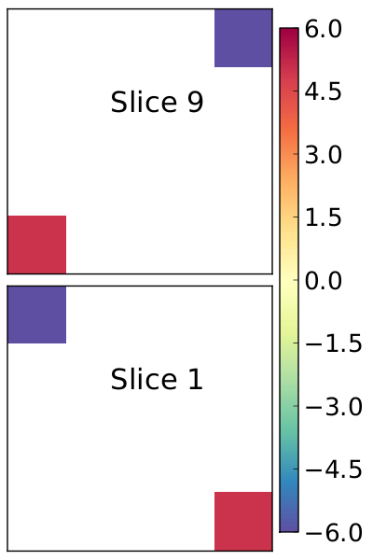
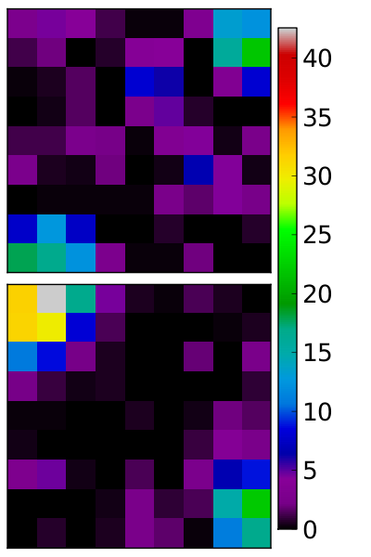
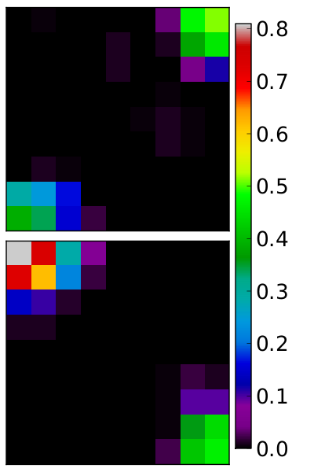
Simulation study
Ground truth
F test
Randomized Ward logistic

Slide 32
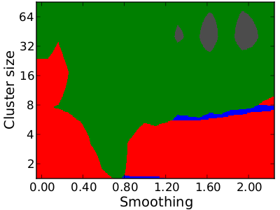
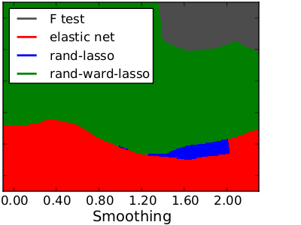
The best approach for feature recovery depends on the problem
The response depends on the characteristics of the problem: smoothness (coupling between signal and noise) and clustering (redundancy of features)
128 samples
256 samples
[Varoquaux et al. ICML 2012]

Slide 33
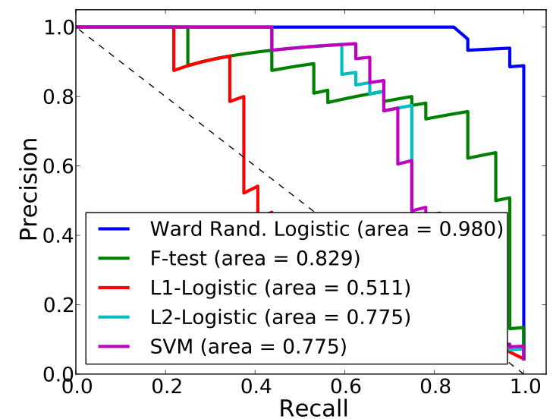
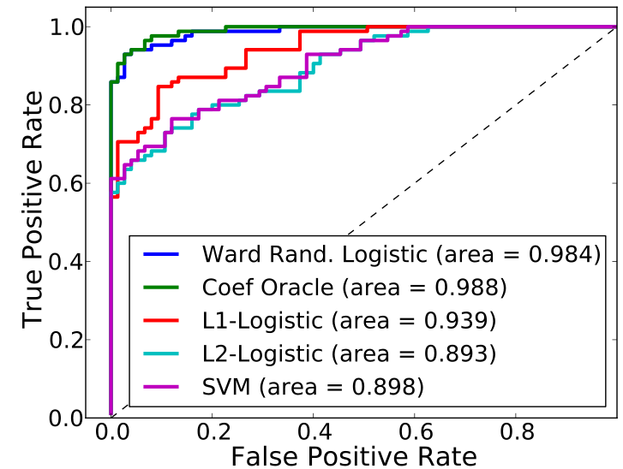
Simulation study
Identification accuracy
Prediction accuracy
Improves both prediction and identiﬁcation !

Slide 34
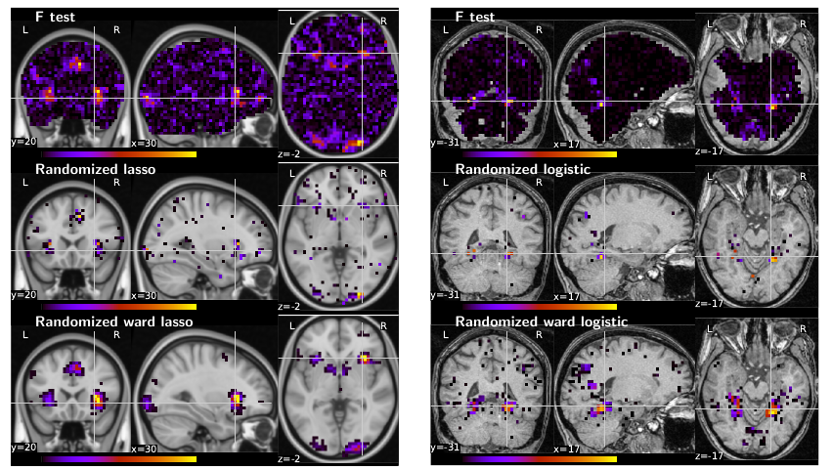
Examples on real data
Regression task
[Jimura et al. 2011]
Classification task
[Haxby et al. 2001]

Slide 35
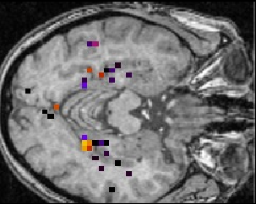
Discussion
SVM and sparse models less powerful than univariate methods for recovery.
Sparsity + clustering + randomization: good recovery
  ⇒ Multivariate brain mapping
cc
High computational cost (parameter setting)

Slide 36
Tailored priors for brain activity decoding
- Relevant priors: smoothness, sparsity, analysis sparsity
- Engineering of penalized regression models

Slide 37
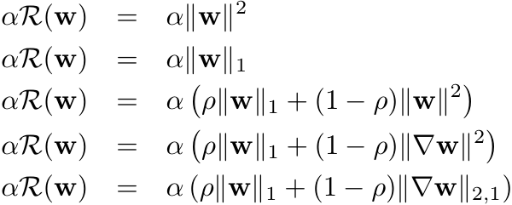
Regularization framework
w = the discriminative pattern
Constrain w to select few parameters that explain well the data.
→ Penalized regression
L(y, X,w) is the loss function
αR(w) is the penalization term, α > 0
Ridge (no sparsity)
Lasso (very sparse)
Elastic net (sparsity + grouping)
Smooth lasso (sparsity + smoothness)
Total variation (piecewise sparsity)

Slide 38
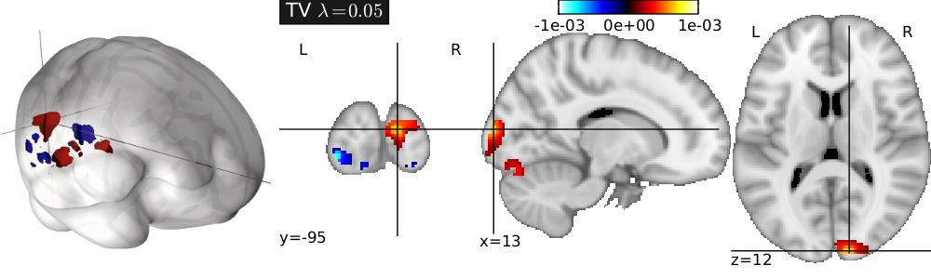
Priors and penalization:
Brain decoding = engineering problem ?
Prior on the relevant activation maps
Design of a norm ║w║ to be minimized
Penalization in regularized regression
Example: Total Variation penalization [Michel et al. 2011]

Slide 39
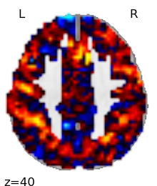
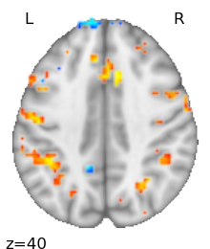
Do we need to bother about sparsity ?
Is brain activation (connectivity,..) “sparse” ? No !
But...
In neuroscience, people estimate discriminative patterns that look like:
But in a neuroimaging article, it will look more like
If you want to show the truly discriminative pattern, you need it to be sparse !

Slide 40

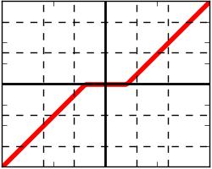
Solution: (F)ISTA
w^{(t)}
Gradient descent on the smooth terms
w^{(t+1)}
projection on the non-smooth constrains
Lasso: the proximal operator is simply soft-threshodling
FISTA = accelerated ISTA (much faster convergence)

Slide 41
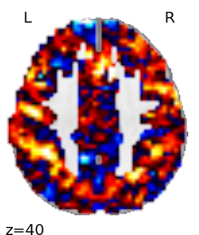






Smooth lasso: the proximal operator
smoothness
sparsity
Stronger penalty

Slide 42






Sparse total variation: proximal operator
Small TV
sparsity
Stronger penalty

Slide 43

Example on real data
Can nevertheless be improved with adapted techniques
Encoding
Elastic net decoding
Sparse flat decoding
[Gramfort et al PRNI 2013]

Slide 44

Performance on recovery (simulation)
Example of recovery (simulated data):
The TV-l1 prior outperforms alternatives

Slide 45
Discussion
Do not try to implement these methods if not ncessary. Technical issues [Dohmatob et al. PRNI 2015]
Bayesian alternatives (ARD, smooth ARD) [Sabuncu et al.TMI 2012]
  You lose the convexity
  Empirical Bayes: adapts well to new data
Cost of these methods
  Convergence monitoring is hard
  Smoothing + ANOVA selection + SVM is a good competitor...

Slide 46
Toward Big data in cognitive neuroimaging
- Multi-label problems in cognitive neuroimaging: meta-analyses
- Mapping terms to activation maps
- Major bottlenecks

Slide 47



Multi-class classification is not the right setting for brain mapping
Important questions pending....
  Functional degeneracy between cognition and function
- What is
this brain doing?
?

Slide 48











General concept
Observed SPMs
Experimental conditions /
Functional contrasts
Cognitive components
Activation patterns

Slide 49



Encoding
?
Across experiments what
brain response to symbols ?
Which regions are recruited by tasks containing a given term?
General Linear Model (GLM) for terms effects
Conditions images
Design matrix
Terms effect
Error

Slide 50

Pb with encoding approach
Correlation of the design matrix: difficulties from the heavily correlated terms (database bias)

Slide 51



Results

Slide 52


Results

Slide 53
Decoding / Reverse inference
?
What is
this brain doing?
Which regions are predictive of tasks containing a given term?
Multilabel classification problem
  more than one class may be associated with each sample
Predict cognitive terms
Data: experimental
condition images
Target

Slide 54
Decoding
Problems
  Class distribution (imbalance & covariate shift)
  Long tailed distribution of terms
  Standard recovery issues; noisy patterns
Improving learning procedure
  Two-step learning: discriminative sub-space selection, then prediction
  Dimension reduction: feature clustering & Anova.
Cross validation
  Leave-one study out
  Predict unseen conditions

Slide 55

Method summary
[Schwartz et al. NIPS 2013]

Slide 56

Precision: does not label as positive a sample that is negative
Recall: finds all the positive samples
[Schwartz et al. NIPS 2013]

Slide 57

Forward and reverse inference
“Place”

Slide 58

Cognitive brain atlases
[Schwartz et al. in prep]

Slide 59
Computational bottlenecks
Obvious limitation atm = number of training images
  OpenfMRI and Neurovault developing fast.
But the data handling cost. If one image = 1MB
  10⁴ images = 10GB
  10⁵ images = 100 GB
  10⁶ images = 1TB
  Moreover the resolution increases !
Need fast learner, data compression, online training procedures. The bottleneck is memory.
[Varoquaux et al. IPMI 2013, Thirion et al. Subm.]

Slide 60



Available resources
Pattern Recognition for Neuroimaging Toolbox (PRoNTo)
PyMVPA: Multivariate Pattern Analysis in Python
Nilearn: Machine learning for functional neuroimaging

Slide 61
General Conclusions
Look at what you do: black box models are not useful
ML is nothing but multivariate estimation
You probably need more data
Do not reinvent the wheel: Pronto, PyMVPA, Nilearn
Some topics not covered here:
  covariance estimation (e.g. functional connectivity)
  unsupervised models (ICA, dictionary learning...)
  Representational similarity analysis [Kriegeskorte et al. PNAS 2008]
  Deep nets

Slide 62


Predictive linear model
y = f (X, w, b)
y is the behavioral variable.
X ∈ R^{n×p} is the data matrix, i.e. the activations maps
(w, b) are the parameters to be estimated.
n activation maps (samples), p voxels (features).
y ∈ R^{n} → regression setting :
f (X, w, b) = X w + b ,
y ∈ {-1, 1}^{n} → classification setting :
f (X, w, b) = sign(X w + b) ,
where “sign” denotes the sign function.

Slide 63


Training a predictive model
Learning w from a given training set (y, X)
Choice of the loss
  Regression: Least-squares, Hinge, Huber
  Classification: Hinge, logistic
Choice of the regularizer
  Convex setting: a norm on w
  Bayesian setting: prior distribution on w
A REVOIR

Slide 64

Precision: does not label as positive a sample that is negative
Recall: finds all the positive samples

