Slide 1
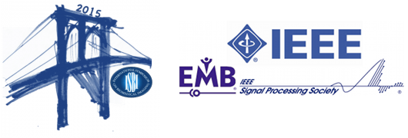
Machine learning for Neuroimaging
Bertrand Thirion, John Asburner
Part I: Pattern recognition for Neuroimaging
Part II: Machine Learning for anatomical Neuroimaging
Part III: Machine Learning for functional Neuroimaging
ISBI 2015

