Slide 1
dfs.name.dir
Notes:
Embeded systems will collect big data at a fraction of the cost of a VM or rack server.
Embedded systems will interface and link humans to machine (both in data collection and interaction).
Will reduce ongoing power costs that keeping on larger servers would incur.
Todo: Add most of big data from outside corp.
SCM considered to be Data puddle or dropping big data.
DOC Me: Pictures in: https://hadoop.apache.org/docs/r1.0.4/hdfs_design.html#NameNode+and+DataNodes
Fix:
WARN org.apache.hadoop.hdfs.server.namenode.FSNamesystem: Only one image storage directory (dfs.namenode.name.dir) configured. Beware of data loss due to lack of redundant storage directories!
2018-09-11 23:04:14,163
WARN org.apache.hadoop.hdfs.server.namenode.FSNamesystem: Only one namespace edits storage directory (dfs.namenode.edits.dir) configured. Beware of data loss due to lack of redundant storage directories!
WARN org.apache.hadoop.conf.Configuration: No unit for dfs.heartbeat.interval(3) assuming SECONDS
Document multiplexing logs:
dfs.name.dir dfs.name.edits.dir |  | Determines where on the local filesystem the DFS name node should store the name table(fsimage). If this is a comma-delimited list of directories then the name table is replicated in all of the directories, for redundancy. Determines where on the local filesystem the DFS name node should store the transaction (edits) file. If this is a comma-delimited list of directories then the transaction file is replicated in all of the directories, for redundancy. Default value is same as dfs.name.dir

Slide 2
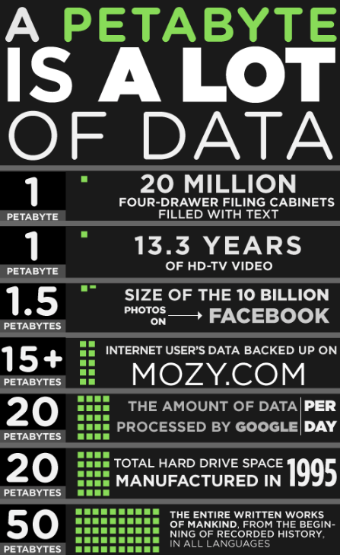
Trivia from Macy’s Department Stores

Slide 3
What’s this about? Should I take notes?
Soft copy of Presentation includes links
To:
software documentation
more info on
Hadoop
Raspberry Pi

Slide 4
What’s this about?
Taking the approach of:
Talk a little about Big Data
A nebulous beginning quickly became clear.
Current state estimates
Talk about Hadoop
talk about work and Hadoop
Talk about Embedded Devices in General.
Bigger is not better but size is
Communication improvements and potential to scale.
Talk a little about the raspberry pi
Close with important ITEMS you did to get Hadoop running on the Raspberry pi
TOPIC:
HADOOP on Embedded device Raspberry Pi 3B+

Slide 5
What’s this about?
Talk a little about Big Data
Hadoop
work and Hadoop
raspberry pi
Hadoop running on the Raspberry pi
TOPIC:
Big Data

Slide 6
What’s this about?
What we All agree on:
Tera: 1,000 GB
Peta: 1,000 TB
Exa: 1,000 PB
Zetta: 1,000 EB
Yetta: 1,000 ZB
TOPIC:
Big Data

Slide 7
What’s this about?
Beyond Greek prefixes,
agreement starts to wane:
TOPIC:
Big Data

Slide 8

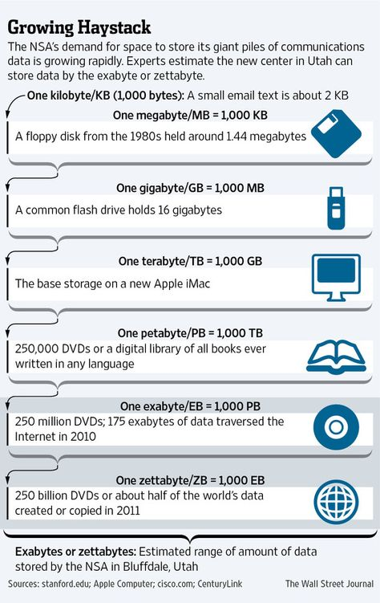
When did Big Data start? How big is Big Data?

Slide 9
Big Data – When did it start? How big was it? 2013: Data generated hit the EXABYTE volume. 2015: Data generated passed 4 EXABYTES. Close of 2018: Projected volume to be 17.1 EXABYTES.
From: Mapping the Future – The Power of Algorithms – The Film Group

Slide 10

Big Data It’s all about the V.

Slide 11

Big Data

Slide 12
What’s the answer?
Hadoop solves the big data issues facing traditional information systems.
TOPIC:
Hadoop

Slide 13
Here’s what Forbes says about Hadoop:
ITS ALL About THE DATA: COLLECTING AND ANALYZING unstructured and semi-structured data:
Images
social media data
call center transcripts
clickstream data
From: What is Hadoop and What Does it Mean for Supply Chain Management?
AS companies become DEMAND DRIVEN, use OF social media and internet traffic to forecast new product introductions.
omni-channel retailers ARE SEEKING TO UNDERSTAND PROMOTION POTENTIAL LIFT BY CHANNEL.
“…your IT department really shouldn’t be on the fence about Hadoop because it’s a given. It’s a done deal…”
https://www.forbes.com/sites/stevebanker/2014/08/01/what-is-hadoop-and-what-does-it-mean-for-supply-chain-management/#2aed8c344048

Slide 14
45,000 foot view of Hadoop
Hadoop does not care what kind of files or data you store.
The term data lake is often associated with Hadoop-oriented object storage.
Analogy:
Think of a fish as datum.
Fish swim in schools. (Files).
There are many types of schools. (Unstructured, or many differ file types).
The lake does not favor one over the other. It holds them all.
It’s up to the fisherman to decide which fish to catch.
Not just a file system, It’s an open sourced, purposeful framework.
Specifically, it’s a parallel Distributed file system which can manages its resources in parallel.

Slide 15
So the material does not seem so…far, far away Comparing RDBMS to Hadoop
So the material does
not seem so…far, far away Comparing RDBMS to Hadoop
Relational Database
Hadoop HDFS
RDBMS expects consistent, structured data to match a particular schema
Uses Write on Schema validating data against the schema before writing
Reads are faster as data format is known ahead of time
Can be costly with licensing
Hadoop takes unstructured, semi-structured or structured data
Superior write speed attained by doing the opposite, Read on Schema
Writes are faster as there is no schema validation overhead
Free and Open-Source

Slide 16
What’s the part about Distributed File System?
It’s called Hdfs:
Hadoop
Distributed
File
system
40,000 foot view of Hadoop
IT’s Comprised of:
HDFS
Map-Reduce
Yarn

Slide 17
HDFS: Java-based Distributed File System. Default block size is 64 MB. *Even though you can override the block size, Hadoop does not like to work with small files.
35,000 foot view of Hadoop
File Management:
file is divided into blocks.
Blocks concurrently written to various worker (data) nodes.
Once the write completes, A Background process Copies Blocks to different nodes (File level replication).

Slide 18
HDFS: Java-based Distributed File System. How does Hadoop keep track of Files?
Components of
HDFS Architecture:
(Master and workers).
NameNode
DataNode
30,000 foot view of Hadoop

Slide 19
HDFS: Java-based Distributed File System. How does Hadoop keep track of Files?
30,000 foot view of Hadoop
Components of
HDFS Architecture:
NameNode :
Talks to client interfacing with Hadoop
Decides how to divide up large files
Keeps track of files and Blocks written
Administers MetaData
DataNode:
responds to requests from the NameNode for filesystem operations.
Receives Namenode handoff to talk directly to the Client application to read or write.

Slide 20

Keep it simple: HDFS NameNode in a nutshell.
Conductor:
Does not play any instrument, he directs musicians to play
Has the entire score in front of him
Knows what has been performed, whom is playing and whom is to play next
Name Node:
Does not read or write data, the workers do
Analyzes application request, decides how to break up the data and which Worker Nodes are to process the data
Keeps track of all the data and Worker Nodes

Slide 21

Keep it simple: HDFS NAMENODE in a nutshell.
When a Client wants to write an HDFS file:
the NAMENODE plays match-maker to find the Client the right Workers to fulfill the data request.
The Client Application interacts directly with one DATANODE.
The data replication to other nodes takes place after the Client has completed his request.

Slide 22

Keep it simple: HDFS NameNode in a nutshell.
When a client wants to read an HDFS file:
the NameNode plays Librarian. Keeps track of books but does not read the books.
NAMENODE instructs Client where to find the blocks making up the file.

Slide 23

No more simple, let’s disarticulate what it takes to prepare block write requests
Start Here:
HDFS client brings the Namenode a request to write the first block:
The NameNode will then grant the client the write permission and will provide the IP addresses of the DataNodes where the file blocks will be written.
The client confirms whether each of the DataNodes are ready to receive the data or not.
3. The client makes an HTTP connection to the first DataNode.
The client informs DataNode 1 of intent to write the block.
Then, the client gives DataNode 1 the IPs of the other two DataNodes.
DataNode 1 connects to DataNode 2 and informs DataNode 2 of the block write AND gives it the IP of DataNode 3. Then, DataNode 2 tells DataNode 3 about the block write.
DataNode 3 replies “ready” to DataNode 2 who replies to DataNode1 that they are ready.
DataNode 1 replies to client that the DataNodes are ready.
We haven’t written anything yet! That is just the prep…
Block
A

Slide 24

Writing the block… If you think things appear confusing now…
Moving on...

Slide 25
(Back to) 45,000 foot view of Hadoop
What’s the part about parallel processing of data?
It’s called map-reduce.
It’s about bringing the code to the data to arrange it , process it and return the requested data
IT’s Comprised of:
HDFS
Map-Reduce
Yarn

Slide 26
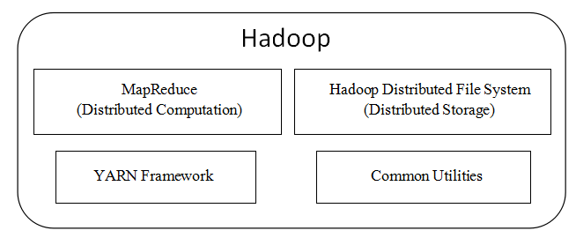
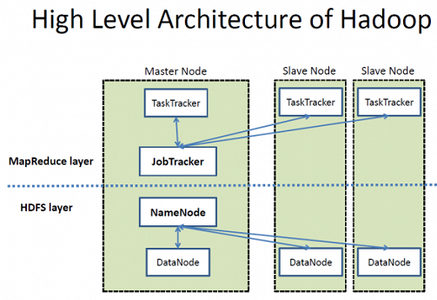
WTH is Map Reduce and why should I care? map is a procedure (or method), which copies the data to disk and performs filtering and sorting. reduce method, which performs a summary operations. Hadoop’s MapReduce System orchestrates distributed processing, managing all communications and data transfers between the various parts of the system, and providing for redundancy and fault tolerance.
http://beyondcorner.com/learn-apache-hadoop/hadoop-ecosystem-architecture-components/apache-hadoop-ecosystem-architecture/

Slide 27

Map-Reduce: Can you keep it simple? How about an analogy?

Slide 28
(Back to) 45,000 foot view of Hadoop
What’s the part about processing the data in parallel?
YARN is a resource manager and batch job scheduler
IT’s Comprised of:
HDFS
Map-Reduce
Yarn

Slide 29
YARN - Resource Manager that’s separate from HDFS and sits between the Ecosystem and HDFS
30,000 foot view of Hadoop

Slide 30
YARN has many parts. Resource Manager Node Manager Application Master Container and More…
20,000’ view of YARN
Resource Manager
Job Scheduler
NodeManager
Application Master
Container
NodeManager
Application Master
Container
Application
Manager
NodeManager
Application Master
Container

Slide 31
Resource Manager: 1. Master daemon that manages all other daemons & accepts job submission 2. Allocates FIRST container for the AppMaster The Node Manager: Responsible for containers, monitoring their resource usage and reports to RM. The AppMaster: 1. One per application 2. Coordinates and manages MR jobs 3. Negotiates resources from RM Container: Allocates fraction of RM resources (Mem., CPU) and reports to NM.
20,000’ view of YARN
Resource Manager
Job Scheduler
NodeManager
AppMaster
Container
NodeManager
AppMaster
Container
Application
Manager
NodeManager
AppMaster
Container

Slide 32
20,000’ view of YARN Ugly when Map-Reduce comes into play
Client Request
Resource Manager
Master Node
Worker (Slave) Node
A. NM Launches AppMaster B. RM starts FIRST Container C. AppMaster coordinates resources with RM
HBeats, Status,Stats
Container Resource Requests
NodeManager
Responsible for reporting Container resource usage to RM
Starts Containers as needed
Administer MR Jobs
Container
Acquire resources from RM
Heart Beats
Status
Stats
App Master
Run MR Task

Slide 33
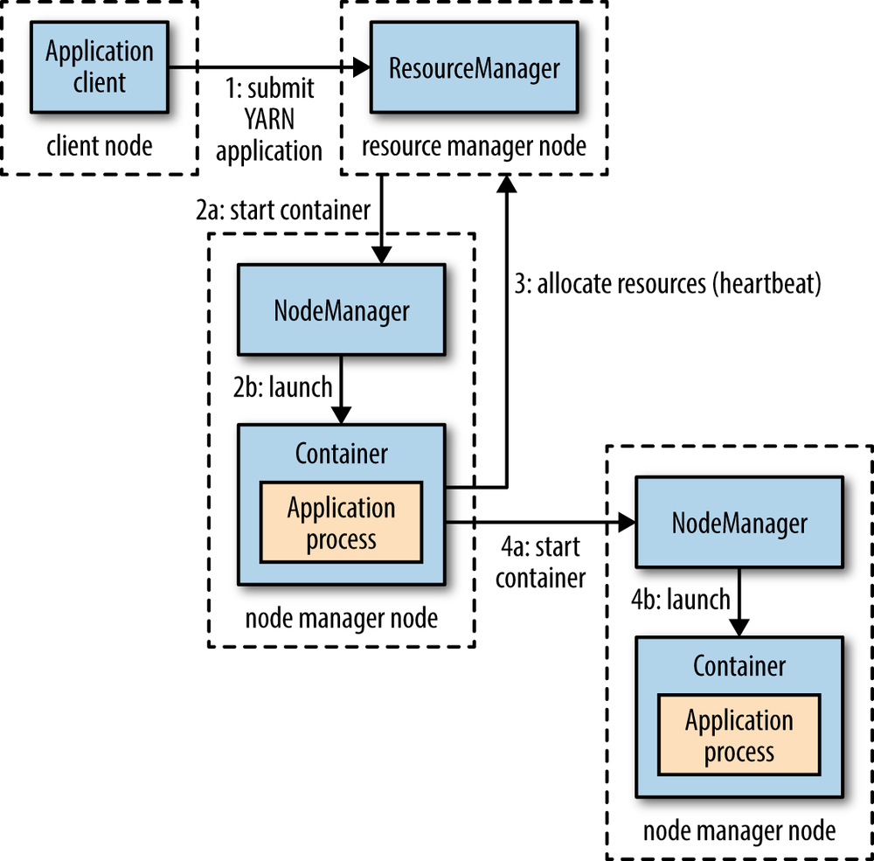
Below 20,000 feet, YARN starts to get ugly…
Taken from https://www.oreilly.com/library/view/hadoop-the-definitive/9781491901687/ch04.html

Slide 34
Hadoop Ecosystem

Slide 35
Hadoop Ecosystem
open source applications and frameworks that sit on top of Hadoop core and work with HDFS.

Slide 36
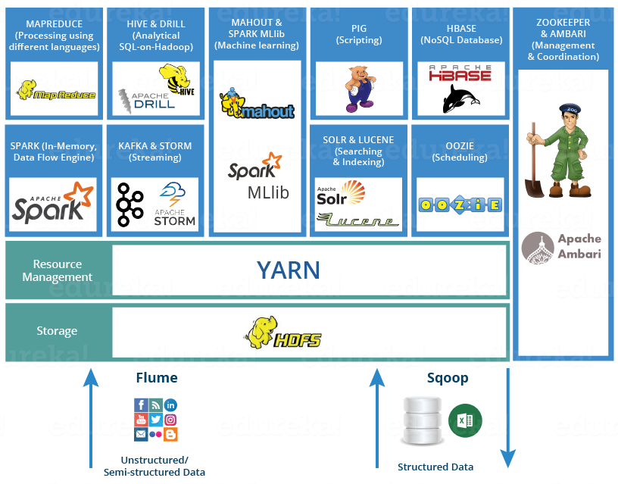
Summary of the Hadoop Ecosystem

Slide 37
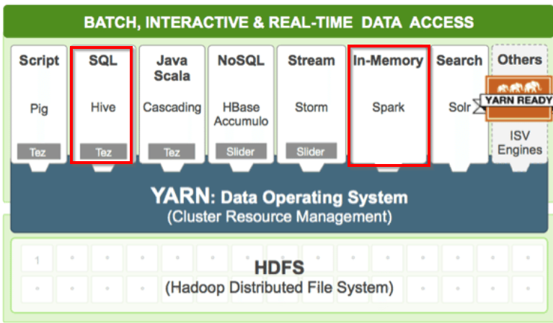
Hadoop Ecosystem
Which parts are included in the demo?

Slide 38
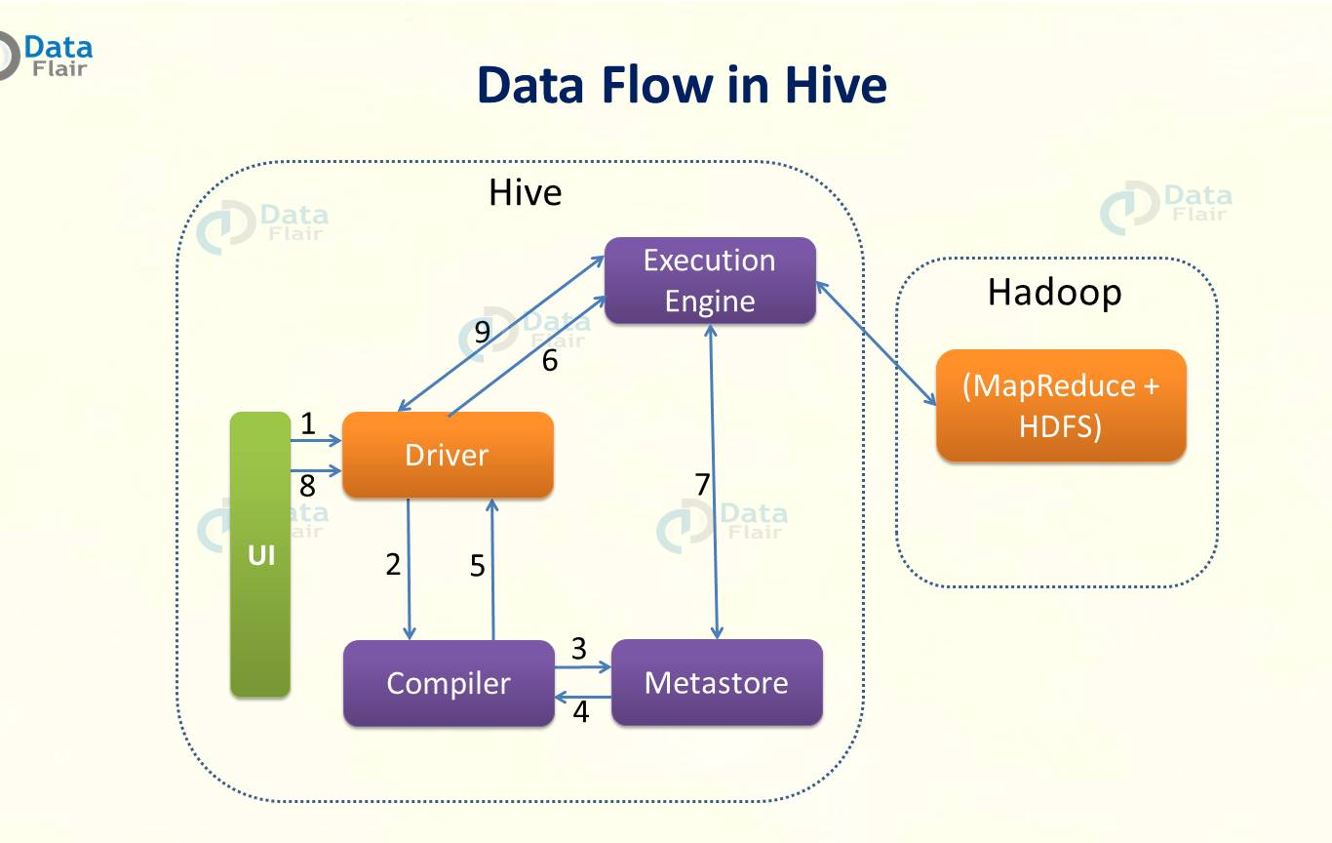
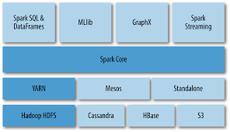
Hadoop Ecosystem Components for Hive and Spark Components for Hive and Spark Taken from: https://data-flair.training/blogs/apache-hive-architecture/ and https://www.safaribooksonline.com/library/view/data-analytics-with/9781491913734/ch04.html

Slide 39
A visit from the Analytics team How does this information apply to Manhattan?

Slide 40
The Raspberry Pi

Slide 41
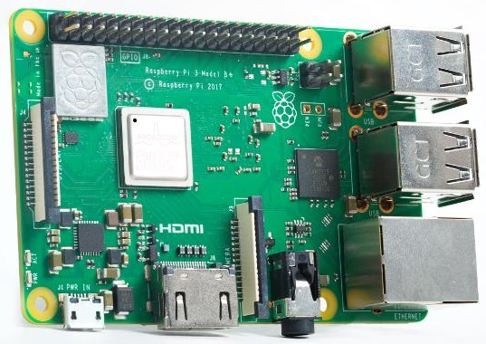

What is a Raspberry Pi?
R-Pi is a mini computer which runs on ARM-Cortex micro-processor.
What is a Micro SD Card?
It’s the smallest
commercially
Available
memory card.

Slide 42
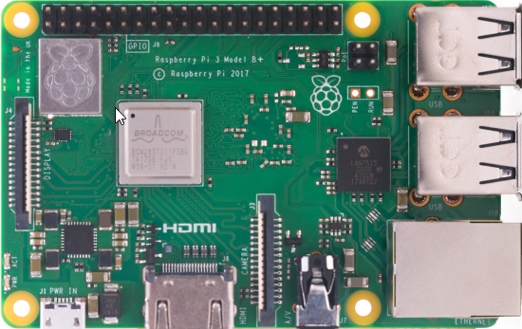
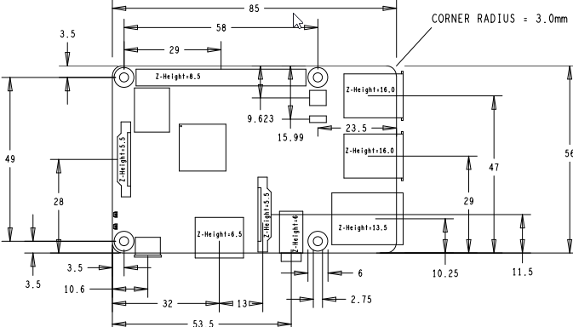
What is a Raspberry Pi? R-Pi is a mini computer which runs on ARM-Cortex micro-processor.
Visual Layout
Physical Layout

Slide 43
The Raspberry Pi System Vitals for the ARM microcomputer
Master
SoC: | Broadcom BCM2837B0 quad-core A53 (ARMv8) 64-bit @ 1.4GHz
GPU: | Broadcom Videocore-IV
RAM: | GB LPDDR2 SDRAM
Networking: | Gigabit Ethernet (via USB channel), 2.4GHz and 5GHz 802.11b/g/n/ac Wi-Fi
Bluetooth: | Bluetooth 4.2, Bluetooth Low Energy (BLE)
GPIO: | 40-pin GPIO header
Ports: | HDMI, 3.5mm analogue audio-video jack, 4x USB 2.0, Ethernet, Camera Serial Interface (CSI), Display Serial Interface (DSI)

Slide 44
Raspberry Pi options and features
Expand the functionality and ability to do the same task as the larger VM and Servers:
PoE (Power over Ethernet) HAT module available

Slide 45
Compare Raspberry Pi to other ARM based microcomputers
Terms
Single Board Computers, known as SBC. Examples are the Raspberry Pi, Asus Tinkerboard…
System On Chip microprocessor Boards, known as SoC. Examples are ESP32 or Nrf52382
Processing Speed
CPU brand and number or cores. More cores means faster, but pay attention to the type of CPU as that can lock you into a particular and often proprietary operating system.
Is GPU mentioned at all? Generally, if so, it’s going to be faster than it’s generic counterpart
Memory – what kind (DDR2, 3 or 4?) and how much? Higher DDR means faster
Storage – how much comes installed and is it expandable?
Power consumption – how many volts AND AMPS ; which type of adapter do you need to power it?
Links to sites comparing various ARM hardware:
http://socialcompare.com/en/comparison/arm-boards

Slide 46
The Raspberry Pi

Slide 47
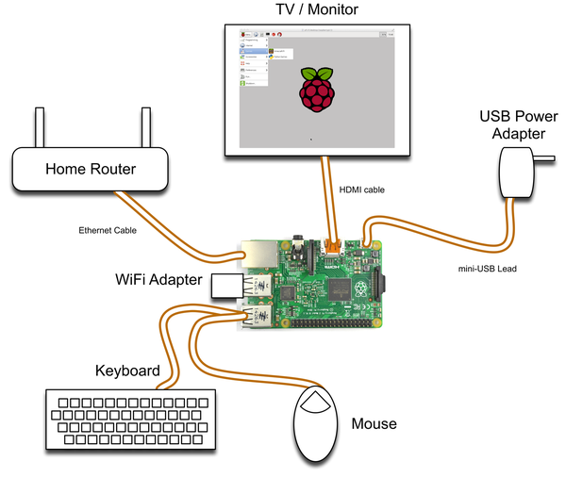
Setup
High Level
hardware overview:
What a typical setup looks like.

Slide 48
The Raspberry Pi Recipe Ingredients:
HARDWARE:
1 or more Raspberry PI with power supply , keyboard,hdmi cable, Ethernet and mouse
A 16 GB MICRO Sd CARD FOR EACH RASPBERRY PI
1 computer to run ETCHER or WIN32 DISK IMAGER

Slide 49
The Raspberry Pi Recipe Ingredients:
Software, Installation Instructions and refence documentation appear in Appendix A.

Slide 50
Hadoop P.O.C. configuration Changes for the Raspberry Pi : An Overview
Hadoop Set up
Hadoop File System Set up
Initialize Hadoop and Start up
Review configurations

Slide 51
The Raspberry Pi System Vitals for the Hadoop P.O.C.
Master |  | Worker | Worker
Server Name: node1 |  | Server Name: node2 | Server Name: nodex
PRETTY_NAME=Raspbian GNU/Linux 9 (stretch)
Kernel Version: Linux 4.14.52-v7+ armv7l 1123 SMP Wed Jun 27 17:35:49 BST 2018
Total SD Card Space: 57,996 |  | 58,534 | 58,534
MemTotal: 896,672 kB |  | MemTotal: 896,672 kB | MemTotal: 896,672 kB
SwapTotal: 15,150,076 kB |  | SwapTotal: 102,396 kB | SwapTotal: 102,396 kB
Shmem: 1,672 kB

Slide 52
Real World NAMENODE System Setting
Master
Server Name: node1 (DATANODE)
Kernel Version:
Total Disk Space:
MemTotal (RAM): Largest memory available should be on the NAMENODE, as the NAMENODE keeps track of all the Blocks in memory.

Slide 53
Hadoop P.O.C. configuration: Hadoop File System Setup.
Delete hdfs storage, add permissions and repeat for all nodes
#############################################
# Delete existing data
#############################################
1. rm -rf /opt/hadoop/hadoop_data
#############################################
# Add DATANODE directories
#############################################
2. $sudo mkdir -p /opt/hadoop/hadoop_data/hdfs/namenode (not required for DATA nodes)
#############################################
# Allocate DATANODE directory
#############################################
3. $sudo mkdir -p /opt/hadoop/hadoop_data/hdfs/datanode
#############################################
# Set directory permissions
#############################################
4. $sudo chown hduser:hadoop /opt/hadoop/hadoop_data/hdfs -R 5. $sudo chmod 750 /opt/hadoop/hadoop_data/hdfs

Slide 54
Hadoop P.O.C. configuration: Initialize Hadoop and startup.
Initialize node1 NAMENODE $hdfs namenode –format #<< This wipes away all FAT entries, with a
# blank Table of Contents of your Files.
Start up hadoop on node 1 and run jps to validate things are running 1. $cd $HADOOP_HOME/sbin 2. $./start-dfs.sh 3. $./start-yarn.sh 4. $jps (test on all nodes)

Slide 55
Hadoop P.O.C. configuration Changes for the Raspberry Pi : An Overview
Hadoop Set up
Hadoop File System Set up
Initialize Hadoop and Start up
Review configurations

Slide 56
# hdfs-site.xml
<property>
<name>dfs.namenode.checkpoint.dir</name>
<value>file:///var/hadoop/NAMENODE/FSimage,file:///hadoop/FSimage</value>
</property>
<property>
<name>dfs.namenode.edits.dir</name>
<value>file:///var/hadoop/NAMENODE/FSedits,file:///hadoop/FSedits</value>
</property>
<property>
<name>dfs.blocksize</name>
<value>5242880</value>
</property>
<property>
<name>dfs.replication</name>
<value>3</value>
</property>
<< Multiplex Fsimage, Block Storage Map
<< Multiplex Transaction Log
<< Reduce the I/O Block size to 5 MB for the Raspberry PI. Default setting is 64 MB.
<< Here is the REPLICATION Setting

Slide 57
# hadoop-env.sh
#############################################
# Out of the box settings
#############################################
export JAVA_HOME=/usr/lib/jvm/jdk-8-oracle-arm32-vfp-hflt/jre/
#####################################################################
# Added settings to ensure Hadoop uses secure access and manages JAVA resources
#####################################################################
export HADOOP_HEAPSIZE=250
export HADOOP_OPTS="-Djava.library.path=$HADOOP_HOME/lib"
export HADOOP_OPTS="$HADOOP_OPTS -XX:-PrintWarnings -Djava.net.preferIPv4Stack=true"
export HDFS_DATANODE_SECURE_USER=hduser

Slide 58
# mapred-site.xml
<!-- mapred-site.xml -->
<!-- mapred-site.xml -->
<!-- mapred-site.xml -->
<configuration>
<property>
<name>mapreduce.framework.name</name>
<value>yarn</value>
</property>
<property>
<name>yarn.app.mapreduce.am.resource.mb</name>
<value>1024</value>
</property>
<property>
<name>mapreduce.map.memory.mb</name>
<value>512</value>
</property>
<property>
<name>mapreduce.reduce.memory.mb</name>
<value>512</value>
</property>
</configuration>
How we are tuning the Hadoop components to run on Raspberry Pi:
<< Yarn component Application Master is allowed 1024 MB from 1 GB RAM
<< Hadoop Map-Reduce is given 512 MB for Map phase.
<< Hadoop Map-Reduce is given 512 MB for Reducing phase.

Slide 59
# yarn-site.xml
<property>
<name>yarn.resourcemanager.hostname</name> << Bug Fix – “YARN is confused”
<value>node1</value>
</property>
<property>
<name>yarn.nodemanager.resource.memory-mb</name> << YARN component tuning
<value>2048</value>
</property>
<property>
<name>yarn.scheduler.maximum-allocation-mb</name> << YARN component tuning
<value>1536</value>
</property>

Slide 60
# core-site.xml
Additional entry to allow REMOTE access from user “hduser”.
Added to allow Apache Nifi user “hduser” to manipulate Hadoop.
Hadoop discriminates REMOTE access originatin outside Hadoop Core, even if the user definitions and credentials are identical between local server and REMOTE server.
<property>
<name>hadoop.proxyuser.hduser.hosts</name>
<value>*</value>
</property>
<property>
<name>hadoop.proxyuser.hduser.groups</name>
<value>*</value>

Slide 61
Hadoop P.O.C. Hadoop Ecosystem Demonstration Basic Hadoop: An Overview
O.S. Commands
Display Hadoop modifiable xml configurations
Display Ecosystem modifiable xml configurations
Hadoop Commands
Display all HDFS files
Hadoop DemonstRation
Hadoop write
Hadoop word count
Spark Word Count

Slide 62
Hadoop P.O.C. Demonstration O.S. Commands Display Hadoop modifiable xml configurations
hdfs-site.xml-<configuration>
hdfs-site.xml- <property>
hdfs-site.xml- <name>dfs.blocksize</name>
hdfs-site.xml: <value>5242880</value>
hdfs-site.xml- </property>
.
.
core-site.xml-<configuration>
core-site.xml-<property>
core-site.xml- <name>hadoop.proxyuser.hduser.hosts</name>
core-site.xml: <value>*</value>
core-site.xml-</property>
# cd $HADOOP_HOME/conf
# grep -RHC3 'value' *.xml
* Great way to see XML settings in relationship to one another.

Slide 63
Hadoop P.O.C. Demonstration O.S. Commands Display Ecosystem modifiable xml configurations
hdfs-site.xml-<configuration>
hdfs-site.xml- <property>
hdfs-site.xml- <name>dfs.blocksize</name>
hdfs-site.xml: <value>5242880</value>
hdfs-site.xml- </property>
.
. (Next lines are from Apache Hive)
hive-site.xml-<configuration>
hive-site.xml- <!--property>
hive-site.xml- <name>hive.support.concurrency</name>
hive-site.xml: <value>true</value>
hive-site.xml- </property-->
hive-site.xml- <property>
/hive-site.xml- <name>hive.metastore.schema.verification</name>
hive-site.xml: <value>false</value>
hive-site.xml- </property>
# cd /opt
# find . -name '*.xml'|xargs grep -RHC3 'value'|grep -i conf|egrep -i "hadoop|hive"
* Great way to see XML settings in relationship to one another.

Slide 64
Hadoop P.O.C. Demonstration Basic Hadoop Commands Display all HDFS Files
hdfs dfs -ls -R /
Actual command used was:
hdfs dfs -ls -R / |awk '{print $3,$4,$6,$7,$8}'|less
hduser supergroup 2018-07-21 14:44 /opt
hduser supergroup 2018-08-15 16:00 /opt/hadoop
hduser hadoop 2018-08-15 16:00 /opt/hadoop/databases
hduser hadoop 2018-08-15 16:00 /opt/hadoop/databases/mysql
hduser supergroup 2018-09-09 02:01 /opt/hadoop/work
hduser supergroup 2018-07-21 14:44 /opt/hive
hduser supergroup 2018-07-22 17:56 /opt/hive/warehouse
hduser supergroup 2018-08-09 18:38 /spark-libs
hduser supergroup 2018-08-09 18:38 /spark-libs/spark-libs.jar
hduser hadoop 2018-08-05 22:05 /tmp
hduser hadoop 2018-07-22 17:14 /tmp/hadoop-yarn
hduser hadoop 2018-09-09 02:15 /tmp/hadoop-yarn/staging
hduser hadoop 2018-09-09 02:15 /tmp/hadoop-yarn/staging/hduser

Slide 65
Hadoop P.O.C. Demonstration Basic Hadoop Commands Display

Slide 66
Hadoop P.O.C. Hadoop Ecosystem Demonstration Hadoop Demonstration
O.S. Commands
Display Hadoop modifiable xml configurations
Display Ecosystem modifiable xml configurations
Hadoop Commands
Display all HDFS files
Hadoop DemonstRation
Hadoop write
Hadoop word count
Spark Word Count

Slide 67
Appendix A: Raspberry Pi links for operating system install / setup
Setup Recipe – list of Hardware and Software
Guides to installing the operating system on the Raspberry Pi

Slide 68
Recipe Ingredients:
SoftWARE:
Raspbian OS Image
Hadoop binaries
ETCHER or WIN32 DISK IMAGER running on a computer

Slide 69
Unofficial doc to Installing System Images using Windows
Acquire Win32 Disk Imager. https://sourceforge.net/projects/win32diskimager/
Installing ETCHER or Win32 Disk Imager. http://www.raspberry-projects.com/pi/pi-operating-systems/win32diskimager

Slide 70
Writing Raspbian image to the SD card
Download Etcher or
Win32 Disk imager
and install it.
Unzip your downloaded OS image.
Connect an SD card reader with the SD card inside to your computer.
Open Etcher and select from your hard drive the Raspberry Pi .img.
Select the SD card you wish to write your image to.
Review your selections and click 'Flash!'

Slide 71
Official Raspberry Pi Documentation to Installing System Images using Windows
https://www.raspberrypi.org/documentation/installation/installing-images/windows.md

Slide 72
Appendix B: Raspberry Pi links for operating system install / setup
Setup Recipe – list of Hardware and Software
Guides to installing the operating system on the Raspberry Pi

Slide 73
Bibliography and inspiration resources
https://www.dezyre.com/article/hadoop-architecture-explained-what-it-is-and-why-it-matters/317
https://searchaws.techtarget.com/definition/data-lake
https://en.wikipedia.org/wiki/Raspberry_Pi
https://developer.ibm.com/recipes/tutorials/building-a-hadoop-cluster-with-raspberry-pi/
https://blogs.sap.com/2015/04/25/a-hadoop-data-lab-project-on-raspberry-pi-part-14/
https://dqydj.com/raspberry-pi-hadoop-cluster-apache-spark-yarn/
http://tech.marksblogg.com/billion-nyc-taxi-rides-spark-raspberry-pi.html
https://www.quora.com/Is-it-possible-to-build-a-PC-with-Raspberry-Pi
Jamie Whitehorn - https://www.youtube.com/watch?v=n6ONKshWSMg
Jonas Widrikson - http://www.widriksson.com/raspberry-pi-2-hadoop-2-cluster/
Carsten Mönning - https://blogs.sap.com/2015/04/25/a-hadoop-data-lab-project-on-raspberry-pi-part-14/
Bram Vandewalle - http://www.becausewecangeek.com/building-a-raspberry-pi-hadoop-cluster-part-1/
DQYDJ - https://dqydj.com/raspberry-pi-hadoop-cluster-apache-spark-yarn/
http://data.andyburgin.co.uk/post/157450047463/running-hue-on-a-raspberry-pi-hadoop-cluster
https://www.edureka.co/blog/hadoop-tutorial/

Slide 74
Bibliography and inspiration resources
http://tech.marksblogg.com/billion-nyc-taxi-rides-spark-raspberry-pi.html

