Slide 1
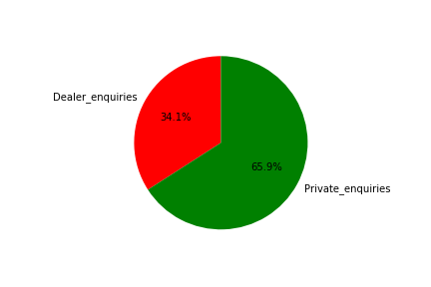
Insight for Carsales monthly enquiries
In September 2016, two major types of enquiries are investigated:
1- Private enquiries (66%)
2- Dealer enquiries (34%)

Slide 2
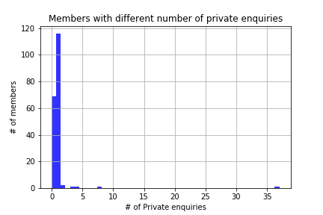
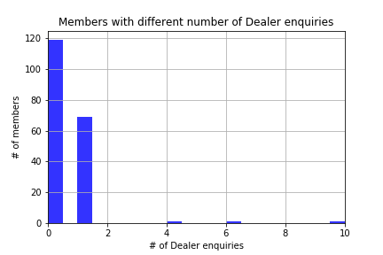
Number of members with different Private enquiries and dealer enquiries
The number of members with no dealer-enquiry are twice the number of members with no private- enquiry.
The members with one dealer-enquiry enquiry are half of the members with one private- enquiry.
There are a few members who had numerous enquiries (up to 37) whereas maximum of dealer enquiries is 10.

Slide 3
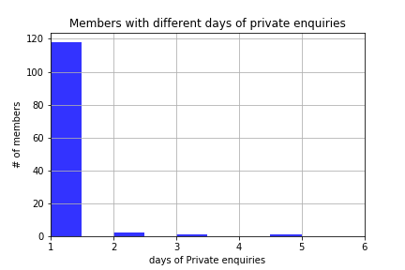
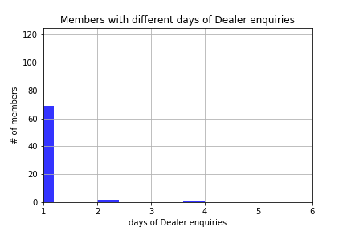
Number of members with different enquiry duration for private and dealer
Although the higher number of enquiries per member for private sellers, the enquiry duration is similar for private and dealer.

Slide 4
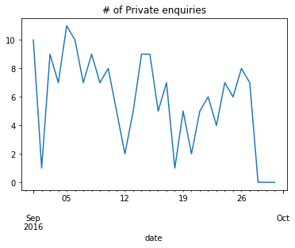
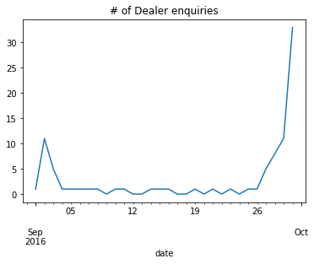
Number of enquiries in September 2016 for private and dealer
The number of enquiries for private sellers is fluctuating throughout the September.
The number of enquiries for dealer sellers is very low during the September but it rises sharply at the end of the month.
There is no weekly pattern. But on 5th September which was a holiday, we see the pick of private enquiries.

Slide 5
Insight for enquiries per members

Slide 6
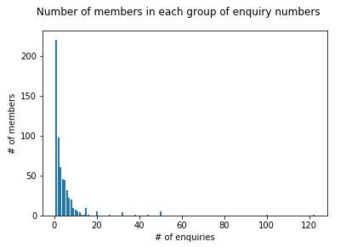
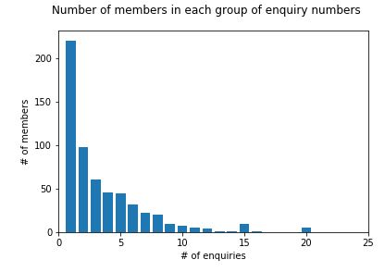
Number of members with different enquiry number
Majority of members have only one to five enquiries. There are limited number of members with more than ten enquiries.

