Slide 1

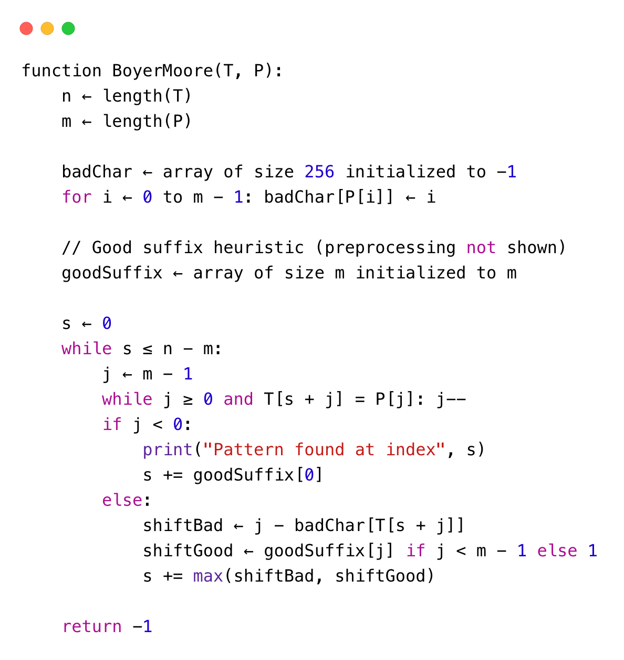
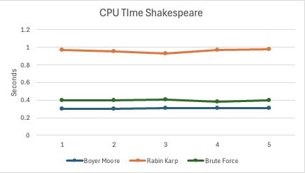
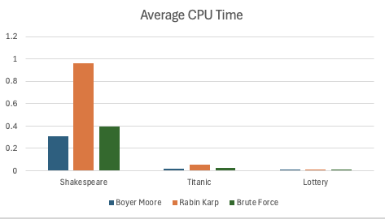
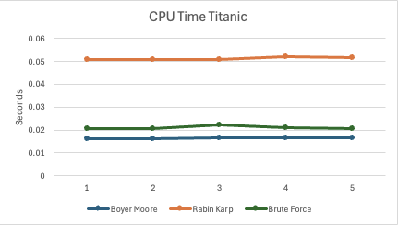
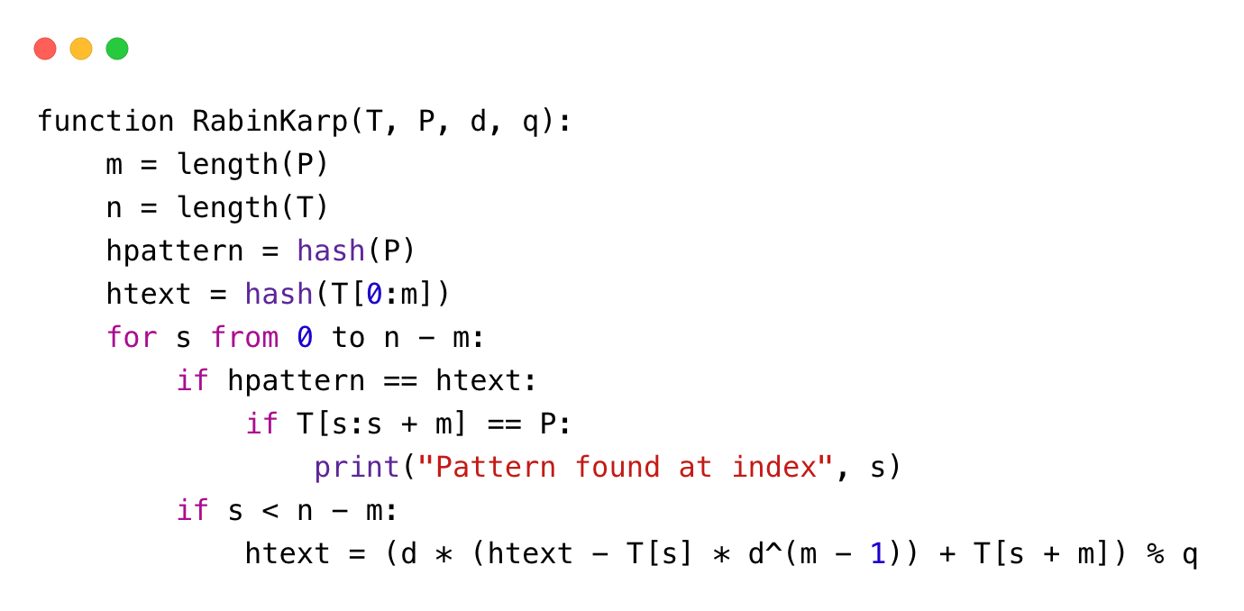
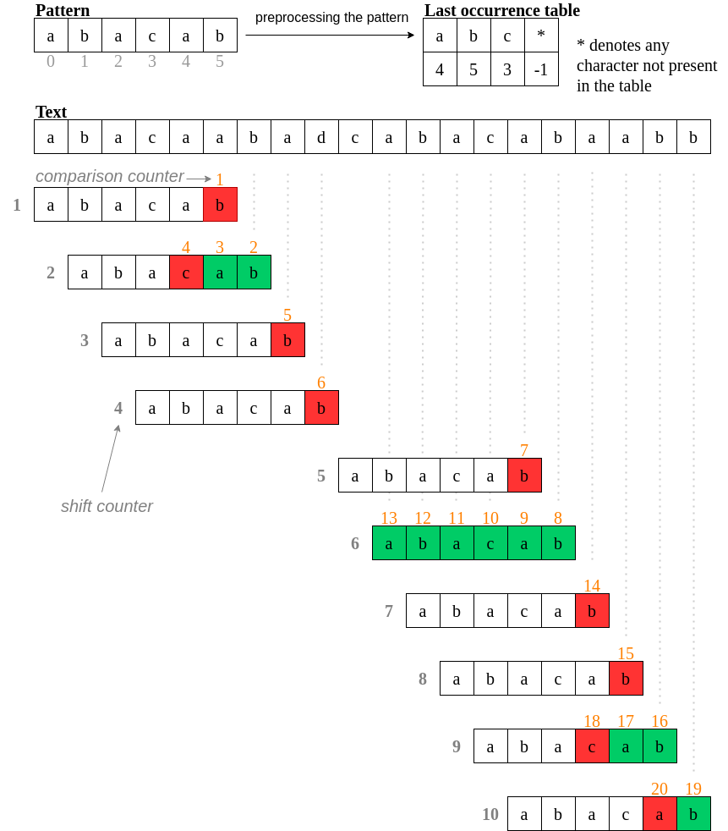
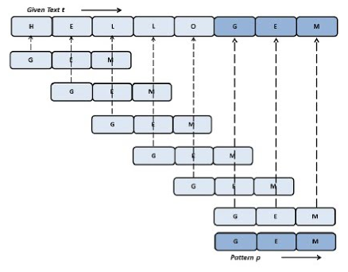
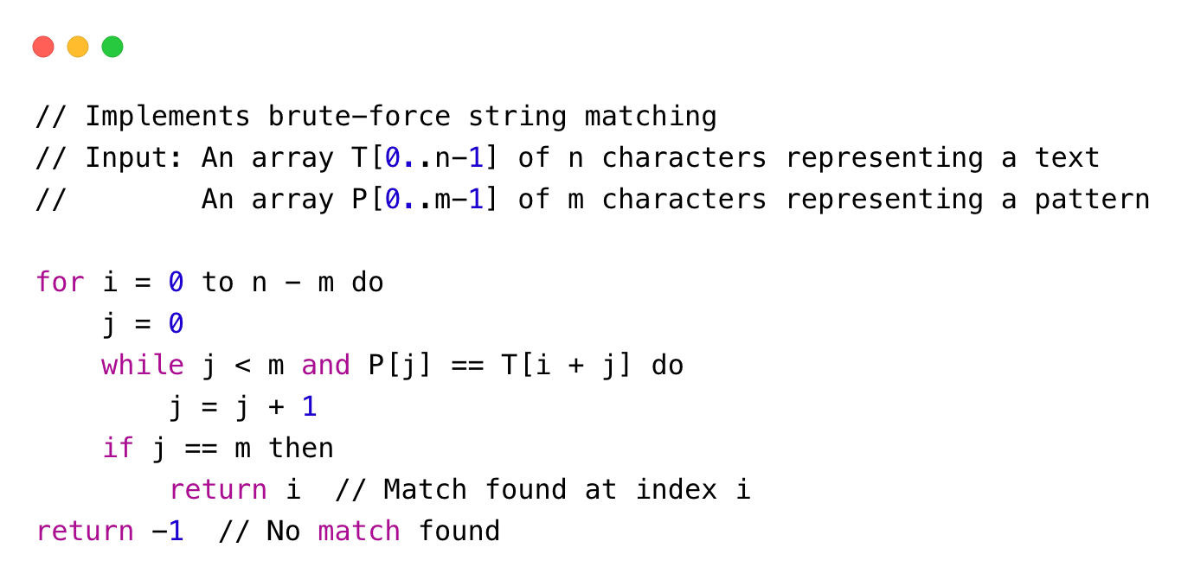
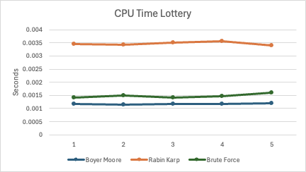
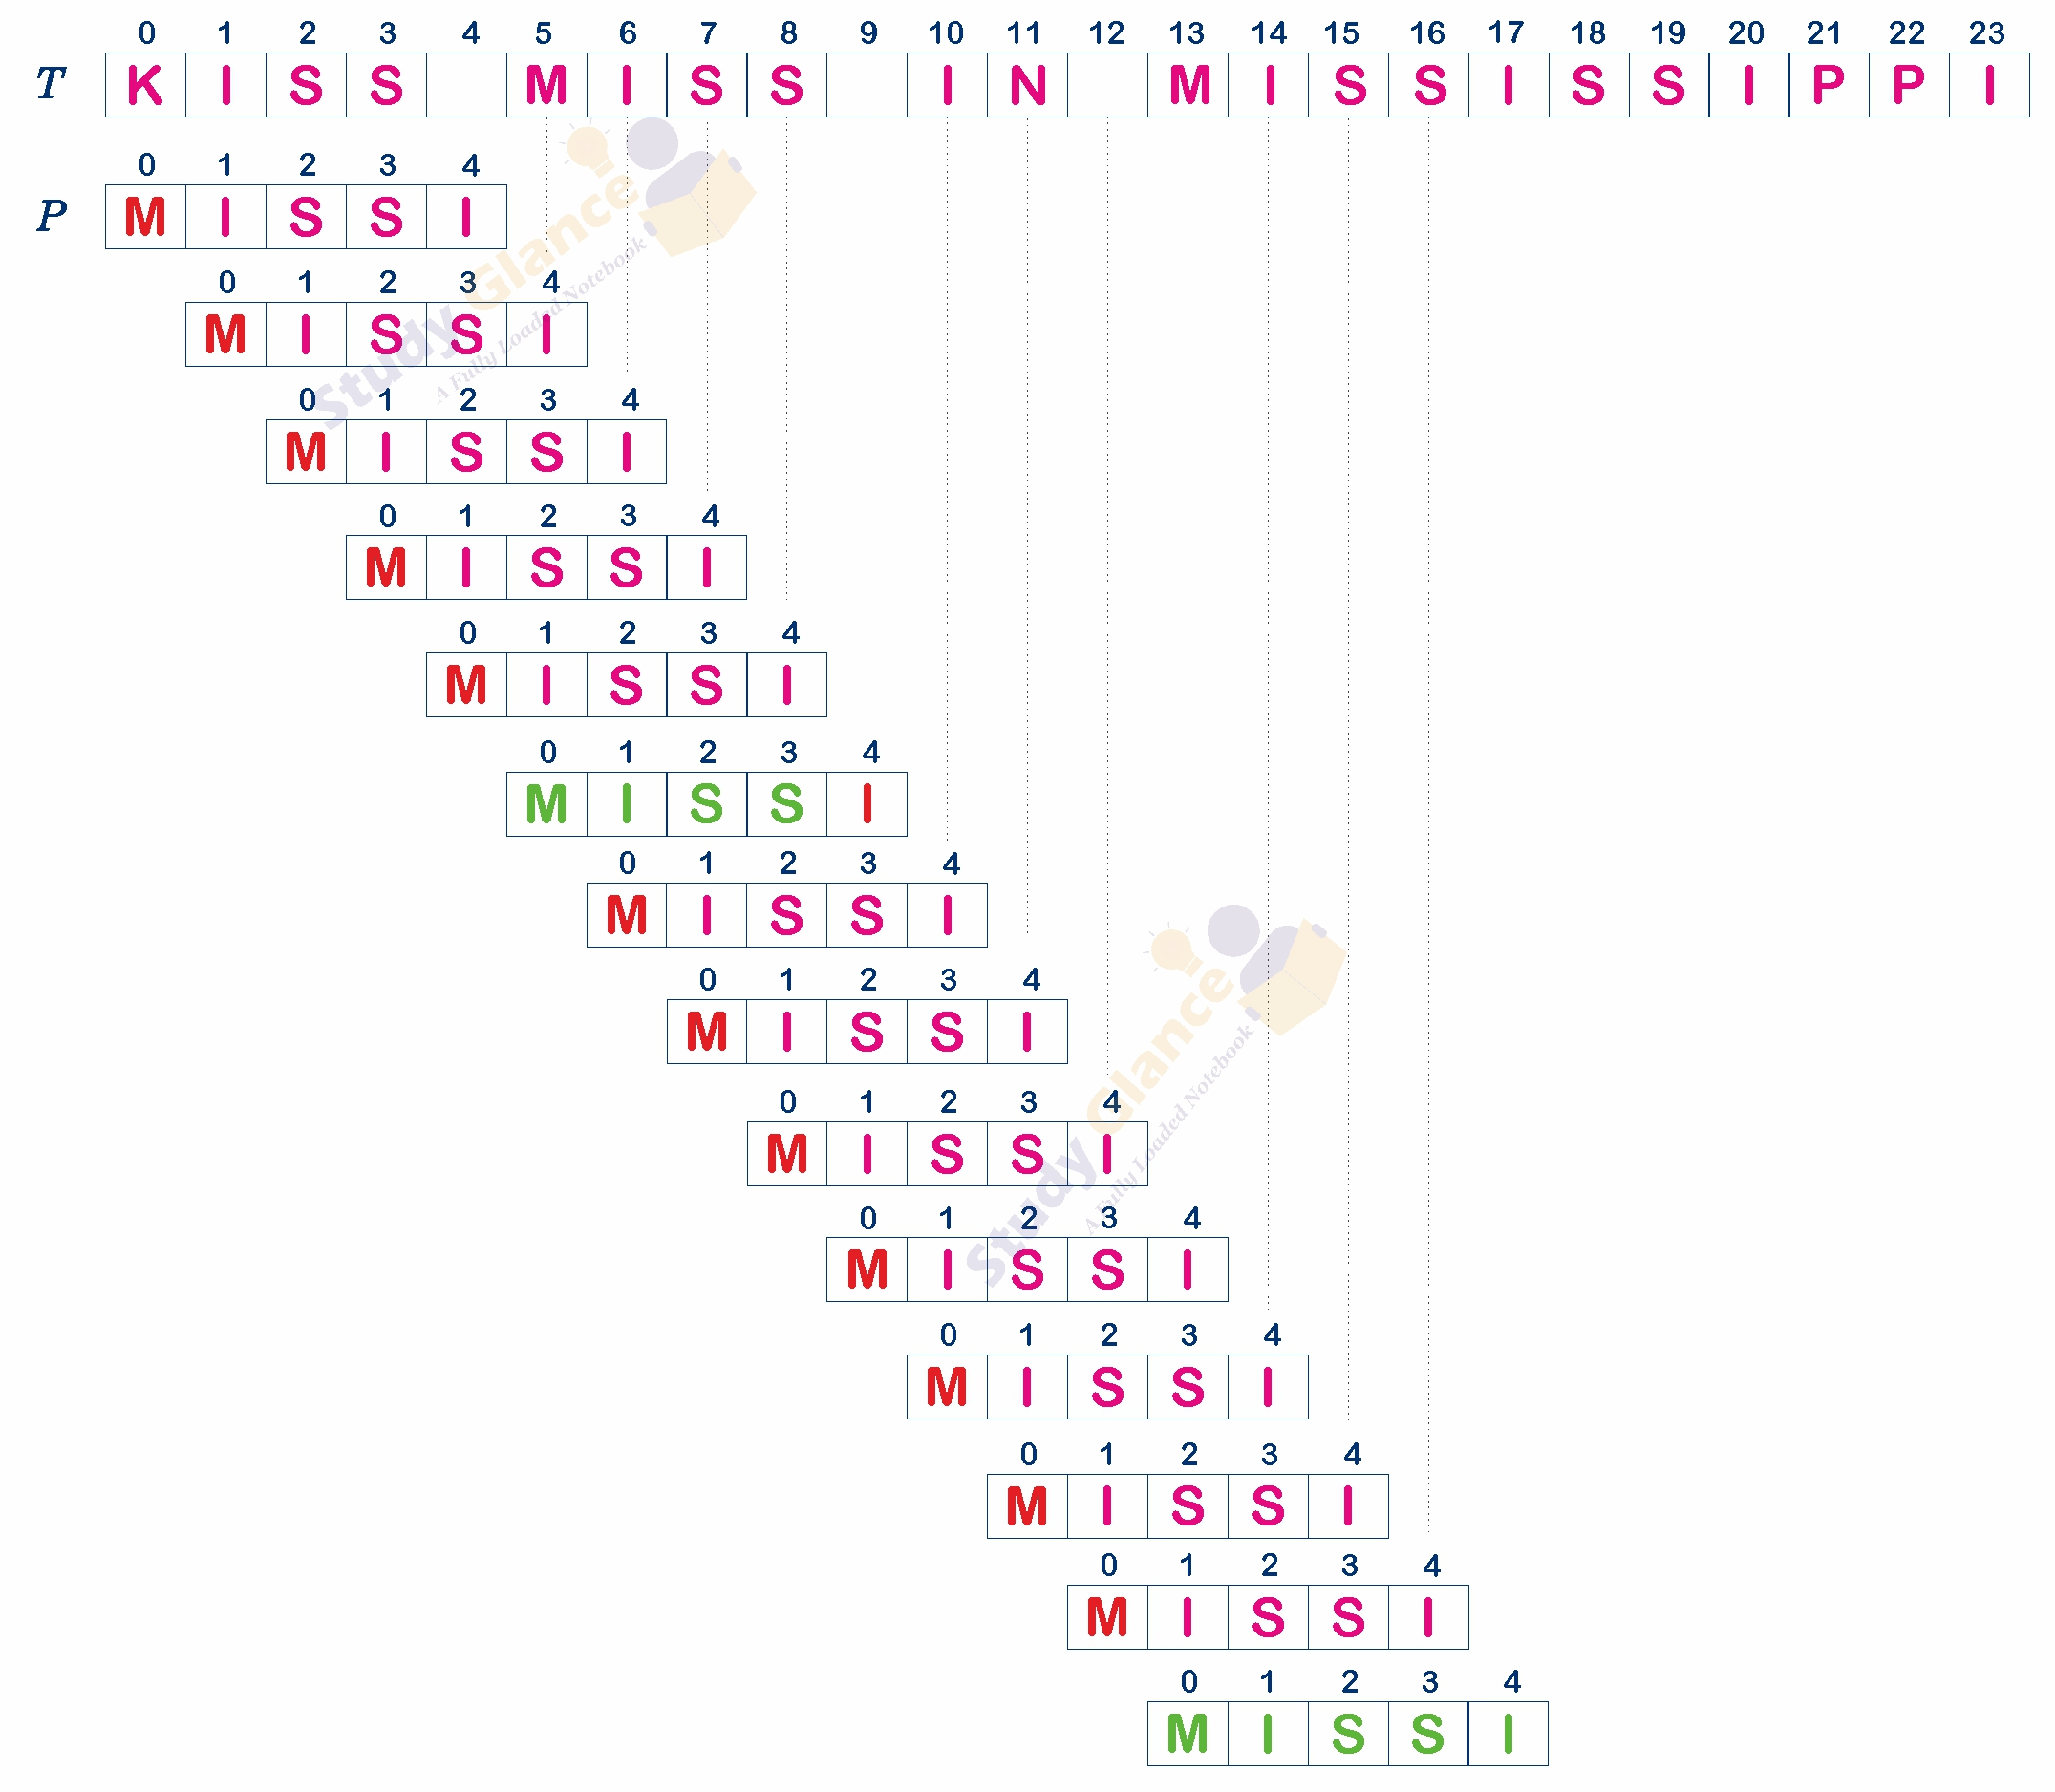
Comparative Analysis of String Searching Algorithms:
Brute Force, Rabin-Karp, and Boyer-Moore
Gavin Miller, John Bacho, Logan Camp Project Mentor: Dr. Christine Cumming Department of Computer Science, Baldwin Wallace University, Berea, Ohio 44017, CSC7
Introduction
String matching is a foundational problem in computer science with applications across areas such as data retrieval, text processing, and computational biology. In the following project, we will compare three well-known string-matching algorithms: Brute Force, Rabin-Karp, and Boyer-Moore. Each of these three algorithms attacks the string searching problem with a different strategy and, therefore, exhibits different performance characteristics concerning computational complexity and efficiency. The Brute Force method, for instance, relies on an exhaustive search approach, while Rabin-Karp incorporates hashing to expedite matching, and Boyer-Moore uses heuristic-based shifts to minimize comparisons. This project investigates the efficiency and trade-offs of each approach under varying conditions, contributing insights that are crucial for selecting optimal algorithms in real-world applications.
The study’s approach involves implementing each algorithm to search for the word "the” - the most common word in the English language - in diverse text datasets, including all of Shakespeare’s Works, the Titanic movie script, and The Lottery (short story). By focusing on this frequently occurring word, the study evaluates the CPU processing time for each algorithm, providing a clear comparison of processing speed and efficiency across different text sizes and structures, which reflects real-world performance in handling common search terms.
Boyer-Moore
The Boyer-Moore algorithm is an efficient string-matching method known for its use of Bad Character and Good Suffix rules, which reduce the number of comparisons needed when searching for a pattern in a dataset. It scans from right to left and can skip portions of the text on mismatches, allowing for large jumps, particularly with unique or repetitive patterns (Figure 1). This results in an average time complexity of O(n/m), where (n) is the text length and (m) is the pattern length (GeeksforGeeks, 2024). While it has a worst-case complexity of O(n*m) for repetitive sequences, its efficiency in practical applications makes it a preferred choice for string matching, especially with large datasets.
Rabin-Karp
The Rabin-Karp algorithm uses hashing to compare the text and pattern, which in our case is the word "the," to determine if the text contains the pattern. The algorithm runs a for loop to check if the pattern's hash matches any text substring's hash. If there’s no match, the hash shifts by the pattern length, restarting the process until the pattern is found or the text is fully examined. We tested various values for (q), finding that 101 yielded the best performance for this search.
Brute Force
The Brute Force algorithm is a straightforward approach to string-matching. It scans text from left to right without skipping any portion. For each mismatch, the search shifts one character to the right and restarts the pattern check giving an average efficiency of O(m + n) and a worst-case scenario of O(mn). While not the most efficient, the algorithm is simple and makes can be suitable for small or less complex datasets with less headache and more readable and easier to use code.
Shakespeare
This dataset, at 5,458,199 characters containing all the works of William Shakespeare, in turn providing a rich, complex text with varied vocabulary. It's ideal for testing algorithms on large-scale literary data. Analysis of the word “the” in these texts found fairly consistent completion time amongst all three algorithms with Rabin Karp coming in around 1 second, performing worse than brute-force at 0.4 seconds and Boyer Moore who did the best with just around 0.3 seconds.
Titanic Movie
At 296,482 characters, this modern dialogue-heavy text provides a moderate-sized dataset for testing. The conversational format and repetitive dialogue patterns help evaluate an algorithm’s ability to manage redundancy and handle moderately large text files. For this test, all three algorithms were very consistent with time, resulting in similar rankings as the Shakespeare test but in half the time. Rabin Karp still did the worst at 0.05 seconds, followed by brute-force at 0.02 seconds and Boyer Moore just bellow at around 0.016 seconds.
The Lottery
This dataset, with only 20,049 characters, is concise allowing for quick testing of algorithms on smaller inputs. It’s suitable for evaluating an algorithm’s performance on compact datasets and understanding baseline behavior in terms of CPU time. For this test the time tended to be a bit less consistent than the others but still relatively consistent due to the reduction in time with the smaller dataset. Like the other datasets, Rabin Karp came out the worst at 0.0035 seconds, brute-force and Boyer Moore under that at around 0.001 and 0.0015 seconds.
Conclusions
Looking at our results, we can see how well each algorithms performed with our different texts and finding "the" in our chosen texts.
Looking at our times across all the texts, we see that no matter what scale the dataset is, the Boyer-Moore algorithm consistently runs quicker and finds the string faster than any other of the algorithms.
When we compare the speeds of the other two algorithms, we see that the Rabin-Karp algorithm is the slowest option of the three.
The way that Rabin-Karp works, we have an average and best-case time complexity of O(m + n) where m equals the length of the pattern, which is "the" in our case, and n is the length of the text , but in the worst-case we have a time complexity of O(mn). When we attempt to change the q value for the algorithm, we see that we’re still at our fastest when q equals 101.
The Brute Force algorithm has the same complexity for as Rabin-Karp, but because of the overhead computing and hash checking that occurs in the Rabin-Karp code, the Brute Force algorithm ends up taking less time than Rabin-Karp.
Algorithm Visualization
Figure 1. Visualization of the Boyer-Moore algorithm use of pattern shifting for faster string matching
Literature cited
“Boyer Moore Algorithm for Pattern Searching.” GeeksforGeeks, GeeksforGeeks, 11 Mar. 2024, www.geeksforgeeks.org/boyer-moore-algorithm-for-pattern-searching/#.
Levitin, Anany. Introduction to the Design & Analysis of Algorithms. Pearson, 2012.
Brute Force Pattern Matching: Study glance. Data Structures Tutorial | Study Glance. (n.d.). https://studyglance.in/ds/display.php?tno=40&topic=Brute-force-Pattern-Matching
Working of Karp-Rabin algorithm. (n.d.). https://www.researchgate.net/figure/Working-of-Karp-Rabin-Algorithm_fig5_332773245
Figure 2. Visualization of the Rabin Karp algorithm string matching
Figure 3. Visualization of the Brute Force algorithm string matching
For further information
Please contact jbacho22@bw.edu, gmiller22@bw.edu, lcamp22@bw.edu. More information on this project can be obtained at https://github.com/JohnBacho/CSC430

