Slide 2

Addressing Risk Governance Deficits with Scenario Modeling Practices
Strategic
Foresight
&
Innovation
John
Benjamin
Cassel
A Major Research Project submitted in
defense of a Masters of Design

Slide 3
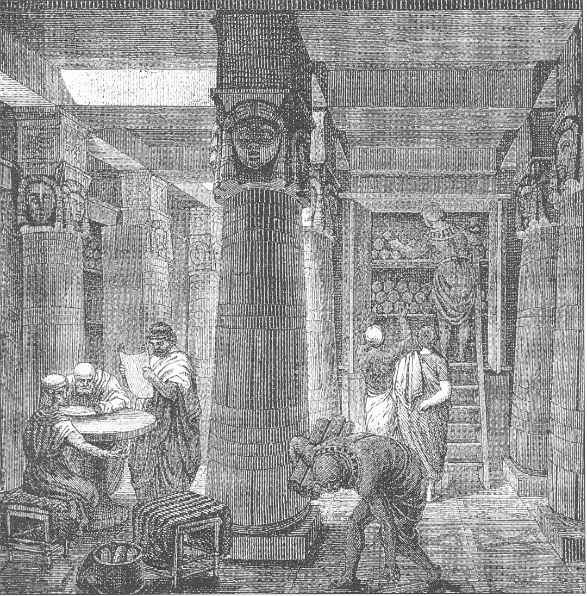
the scope of history

Slide 4
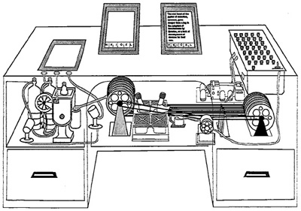
Foresight
the inverse of history

Slide 5
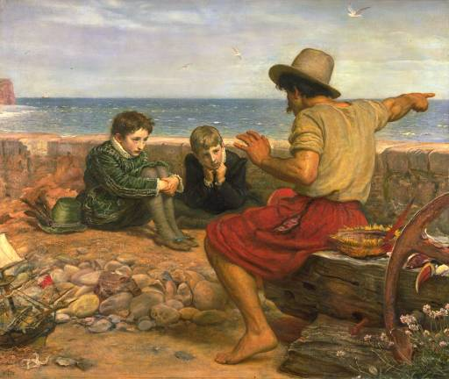
Narratives of a great challenge

Slide 6

Risk

Slide 7
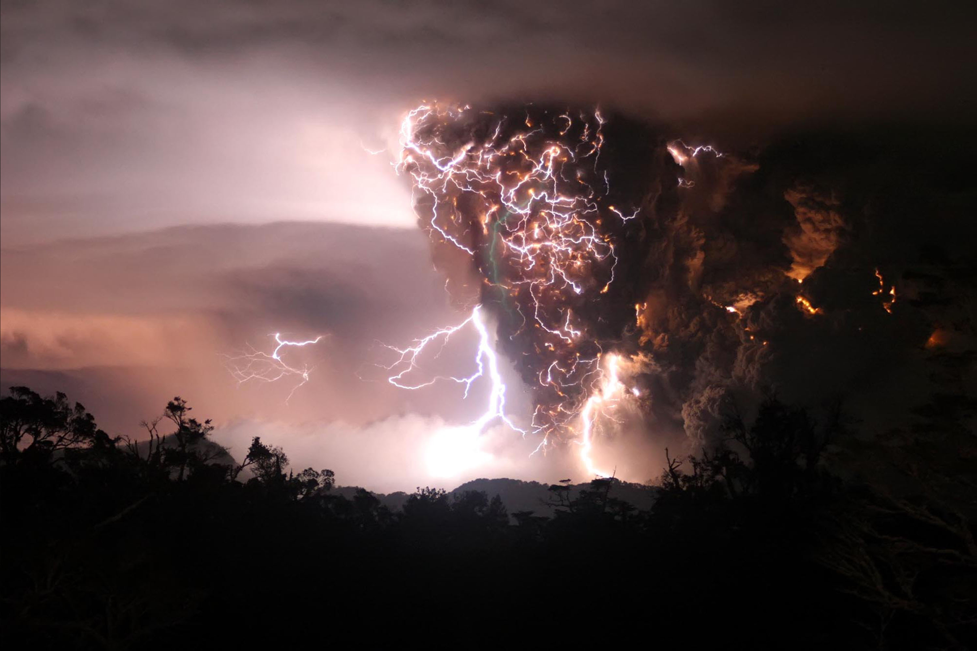
Nobody in their right mind plans for this when booking a flight

Slide 8

everyday infrastructures and everyday institutions

Slide 9
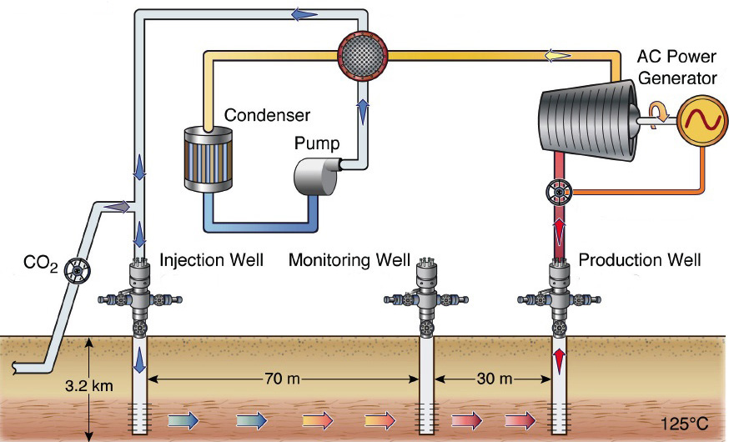
Infrastructural Transitions

Slide 10
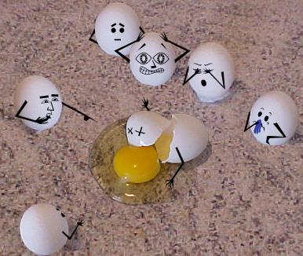
Inevitable Regrets

Slide 11
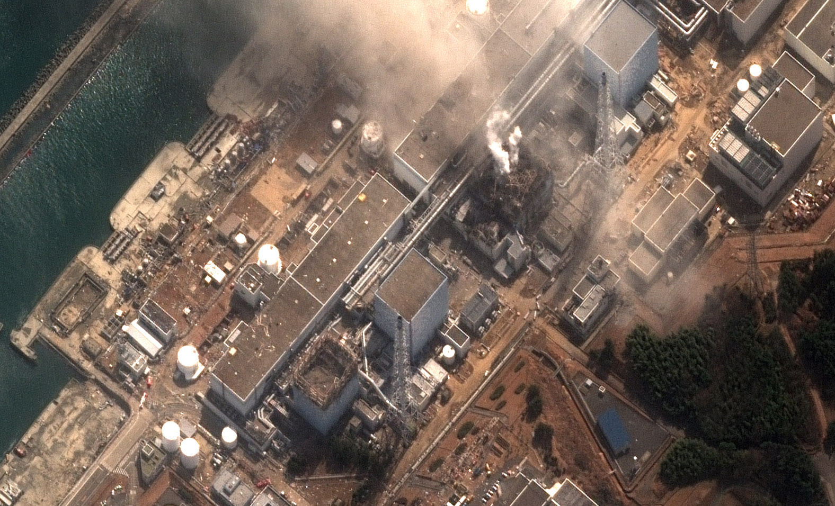
How can institutions survive by merit given inevitable regrets?

Slide 12
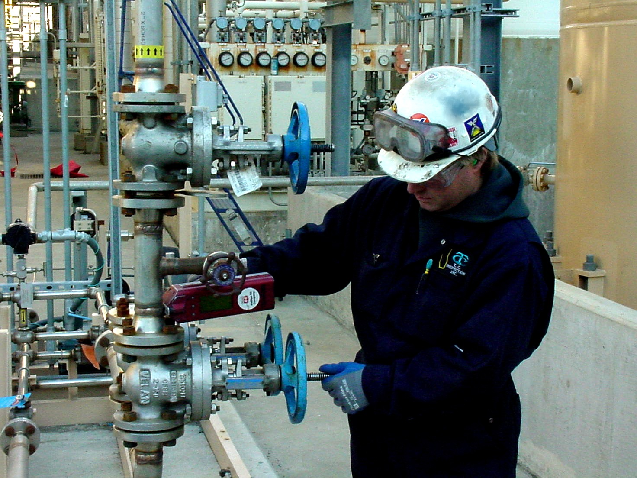
Due diligence

Slide 13
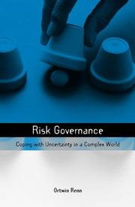
Good Risk Governance

Slide 14

What is good risk governance when considering a plurality of worldviews?

Slide 15
A plurality of stories suggests scenario methods

Slide 16
But the stories we tell are tangled with bad judgment

Slide 17
"What is it about politics that makes people so dumb?"
-Daniel Kahneman

Slide 18


Slide 19
"If we're so dumb, how come we're so smart?"
-Clark Glymour

Slide 20


Slide 21
Is bad judgment fundamental or are there structurally better ways to ask?

Slide 22
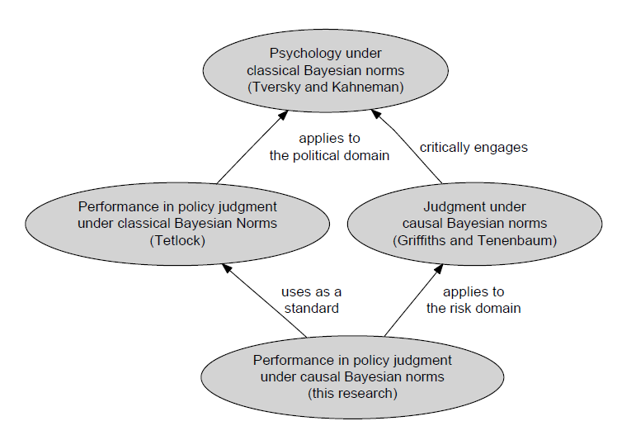

Slide 23
The Burden of Proof is High, but Fair
"Promoters of 'debiasing' schemes should shoulder a heavy burden of proof. Would-be buyers should insist that schemes that purportedly improve 'how they think' be grounded in solid assumptions about
(a) the workings of the human mind and -in particular- how people go about translating vague hunches about causality into the precise probabilistic claims measured here;
(b) the workings of the external environment and -in particular- the likely impact of proposed correctives on the mistakes that people most commonly make in coping with frequently recurring challenges."
-from Expert Political Judgment by Philip Tetlock

Slide 24
Purpose
  Discovery
    How do we find out what we know?
  Knowledge Critique
    How do we find out what we don't know?
  Analysis
    What does what we know imply?

Slide 25
Objectives
  Engineer scenario representation methods that allow for the capture, analysis,
  storage, and reuse of causal and impact information
  Develop elicitation methods that progressively delimit and arbitrate governance deficits
  Implement simulation methods capable of demonstrating plausible scenarios from
  elicited causal structures
  Position uncertainty discovery as a valid governance need

Slide 26
Limits
Theoretical Contributions
More of a thesis than a project
Subject matter large=contribution small

Slide 27
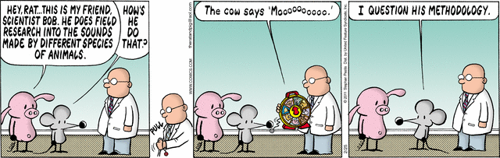
Methodology

Slide 28
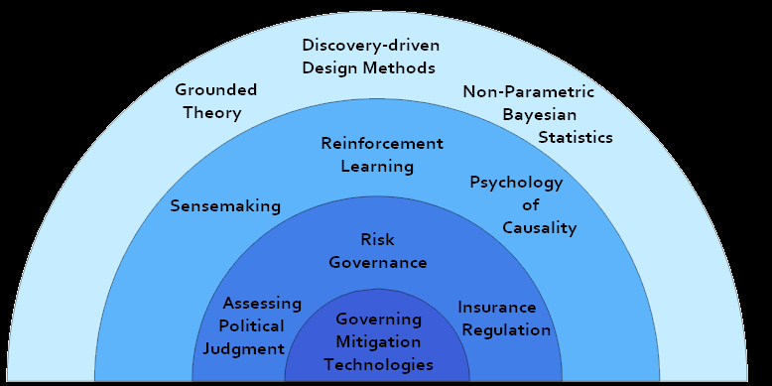
Methodological Approach
Layers of Inductive Constraint

Slide 29
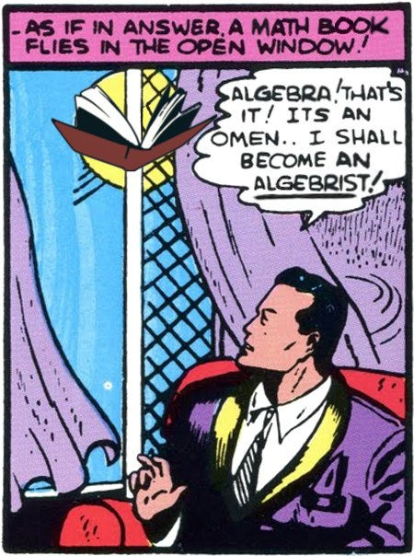
Why Technical Methods?

Slide 30
Technical methods are a means of self-skepticism

Slide 31
Core

Slide 32
What aspects of worldview are appropriate to distinguish?

Slide 33
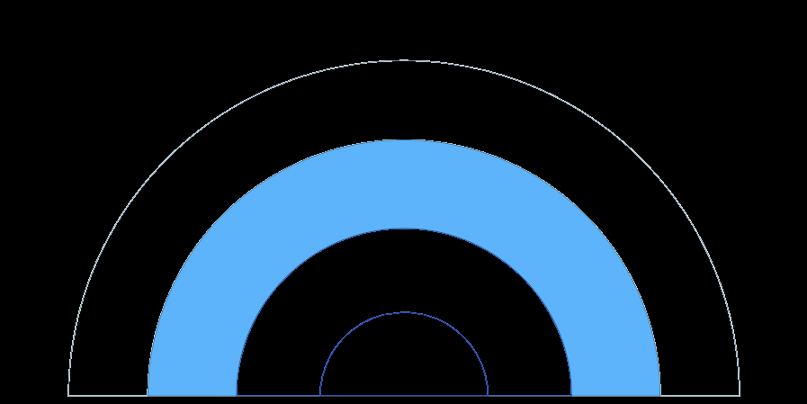
Distinctions
objective understanding
subjective perceptions
objective orientation
subjective perception of objective knowledge

Slide 34
Elements
objective understanding
structures, states-of-affairs, events, dependences,
actions, observations, senses, and anticipations
subjective perceptions
stakeholders, rewards, and criteria
understanding of objective orientation
current conditions
subjective perception of objective knowledge
deferences

Slide 35
Element Model
A model consists of structures, states-of-affairs,
stakeholders, rewards, criteria, events, dependences,
actions, observations, senses, anticipations, and deferences

Slide 36
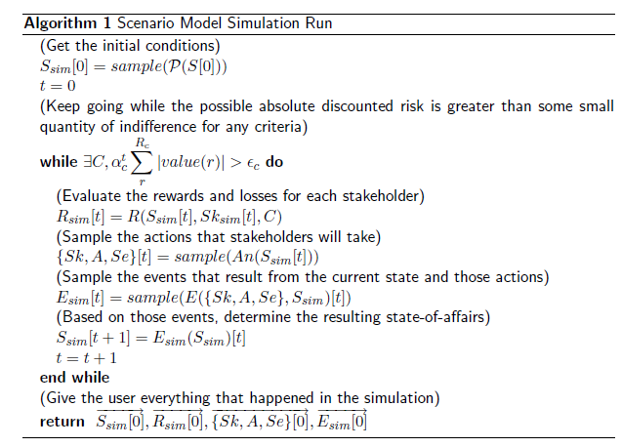
Simulation

Slide 37
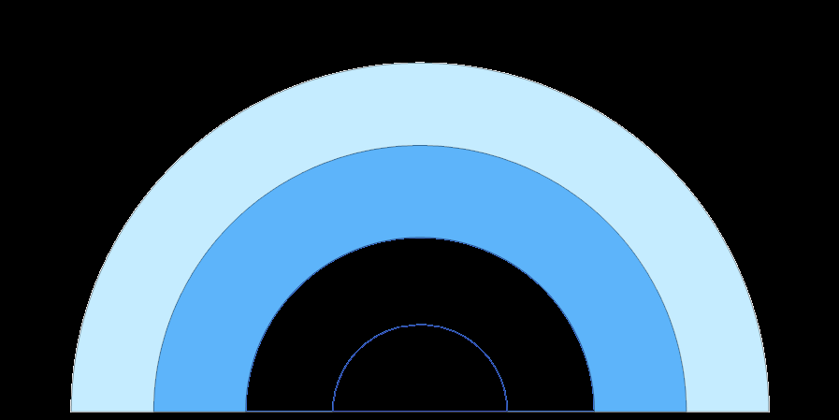
But how do you get those elements?

Slide 38
What is a stakeholder, anyway?

Slide 39
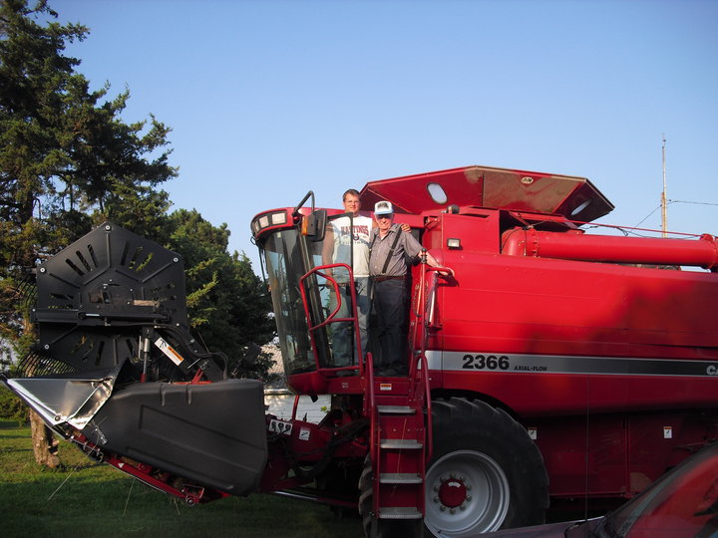
Consider two neighboring farmers

Slide 40
They hold similar stakes in some cases

Slide 41
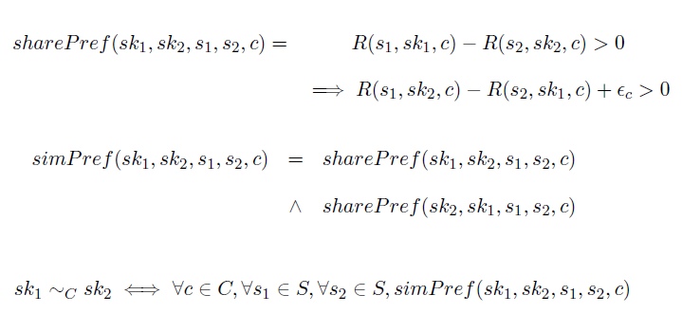
Similar Stakeholders = Similar Preferences

Slide 42
But you can't get there from here

Slide 43
You can discover how people generally put things together

Slide 44
Non-Parametric Methods
We can reason about the processes by which we discover what we don't know

Slide 45
Chinese Restaurant Process
As you ask, you discover the categories you've discovered before, and some new ones, with diminishing returns

Slide 46
Indian Buffet Process
As you ask, you discover the features you've discovered before, and some new ones, with diminishing returns

Slide 47
CRP IBP
As you ask, you find categories with features in proportion to what you've discovered before, and some new ones, with diminishing returns

Slide 48
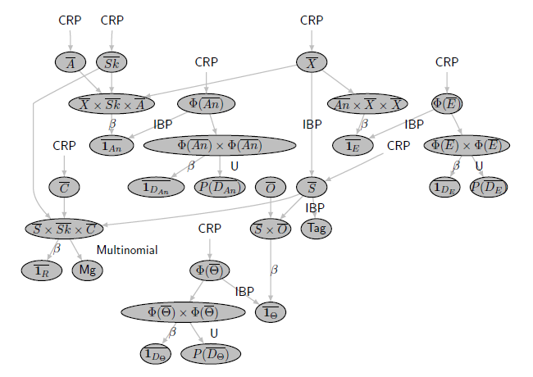
Inference

Slide 49
You may have shown that discovery processes could generate open models of these elements, but how could open discovery work?

Slide 50
Interview as Depth-first Search
(Process)
  Create a series of iteratively more specific prompt questions
  Search over the responses of each prompt with open-ended questions composed of model elements

Slide 51
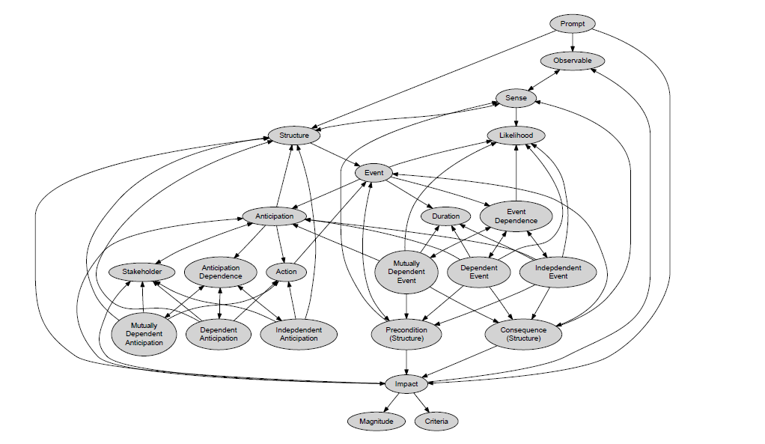
Interview as Depth-first Search

Slide 52
Interview as Depth-first Search
(Specifics)
Event (all kinds) → Precondition
• What could cause described event?
• Is anything else needed to cause described event?
• Are there any other causes for described event?
Structure (all kinds) → Impact
• As a result of being in that condition, would any of the stakeholders experience gains or losses?
• Are there any potential harms to being in this condition, or any rewards for that matter?

Slide 53
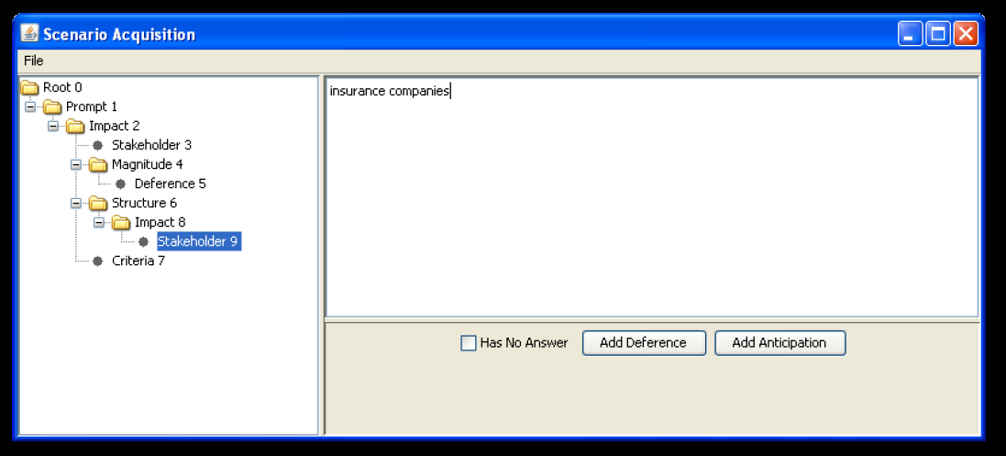
Interview as Depth-first Search
(Tools)

Slide 54
Synthesis

Slide 55
Addressing the Criteria

Slide 56
Addressing the Criteria
(two steps)

Slide 57
Addressing the Criteria
(step one)

Slide 58
Addressing the Criteria
(step one)
"Promoters of 'debiasing' schemes should shoulder a heavy burden of proof. Would-be buyers should insist that schemes that purportedly improve 'how they think' be grounded in solid assumptions about
(b) the workings of the external environment and -in particular- the likely impact of proposed correctives on the mistakes that people most commonly make in coping with frequently recurring challenges."
-from Expert Political Judgment by Philip Tetlock

Slide 59
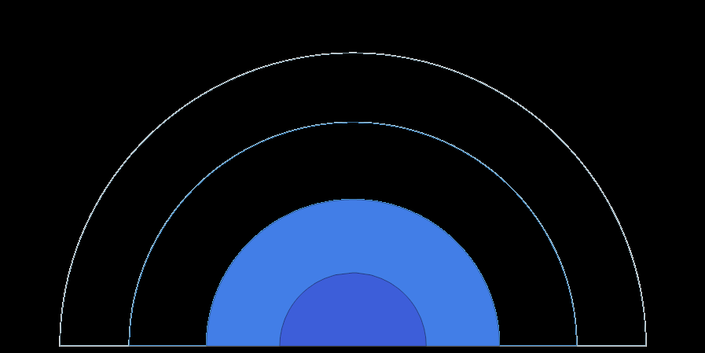
Simplifying Assumption
A list of Risk Governance Deficits,
as provided by the International Risk Goverance Council,
represent hard-won guidelines that are suitable for designing risk governance methods
In other words, if we show that we mitigate risk governance deficits, then we have methods suitable for governing a wide range of risks

Slide 60
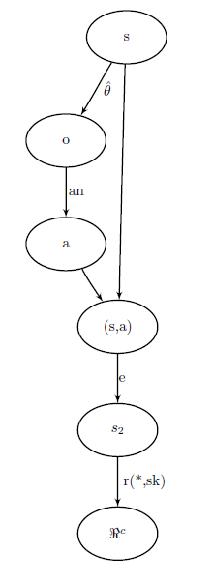
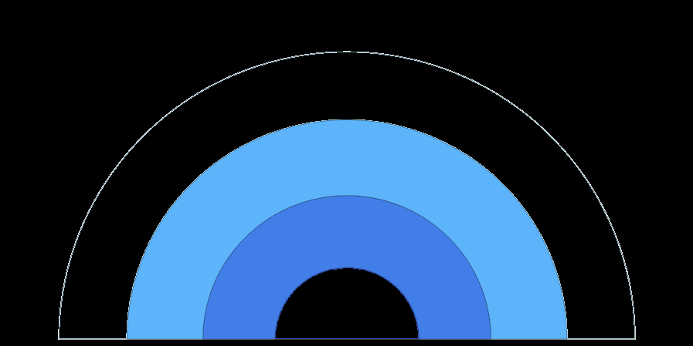
Method of Resolution
Demonstrating interventions
in paths to potential harms
(Shown here is a mistaken perception)

Slide 61
Interventions in Paths to Harm
(Example 1: Standard)
A3 The omission of knowledge related to stakeholder risk
A mitigation measure would need to inquire, in all states-of-affairs, who might be affected, how they are affected, and in what magnitude. It would also need to inquire who else and how else, after receiving an initial answer.
The elicitation method developed here will do exactly that.

Slide 62
Interventions in Paths to Harm
(Example 2: Exceptional)
A5 The failure to properly evaluate a risk as being acceptable or unacceptable to society
What is acceptability? One interpretation is as a separate harm resulting from the judgment of a harm.
This deficit highlights the importance of continuing to ask about observations and other stakeholders even after the "damage is done". The interview protocol does this.

Slide 63
Addressing the Criteria
(step two)

Slide 64
Addressing the Criteria
(step two)
"Promoters of 'debiasing' schemes should shoulder a heavy burden of proof. Would-be buyers should insist that schemes that purportedly improve 'how they think' be grounded in solid assumptions about
(a) the workings of the human mind and -in particular- how people go about translating vague hunches about causality into the precise probabilistic claims measured here"
-from Expert Political Judgment by Philip Tetlock

Slide 65
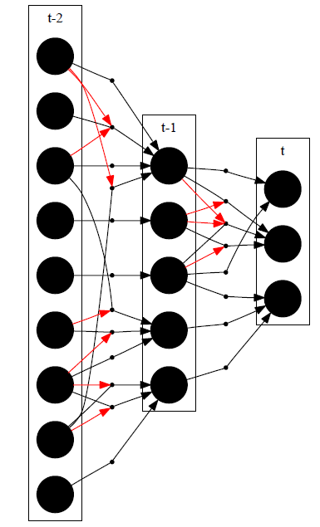
Method of Resolution
Reducing Interventions to Probability Scores

Slide 66
Reducing Interventions to Probability Scores
  Dependencies We would need not only to score point predictions, but would also need to score paths of causal dependencies predicting those factors.
  Interventions We would need to elicit the conditions under which those paths are intervened upon, or severed.

Slide 67
Reducing Interventions to Probability Scores
Algorithm
Dependencies
Average the predictions of weighted paths
Interventions
Weight the paths by the interventions of other weighted paths, dampening cycles

Slide 68
Contingency
As a result of predictions occurring along a path of events, the prediction changes before the time of the prediction is due
Let us call this change the contigency

Slide 69
Implications

Slide 70
Design Systems for
Risk Governance
This work demonstrates that one can design "design methods" that address the core problems of risk governance

Slide 71
Design of Foresight
How we ask the question qualitatively has quantitative consequences

Slide 72
Design Statistics
Non-parametric methods imply that we can reason quantitatively about qualitative uncertainty

Slide 73
Everything is as it should be
Implicit human capabilities, such as visual, causal, and associative reasoning, allow designers to learn in even the most difficult problem settings

Slide 74
Everything is as it should be
In other words, design is still practiced by, of, and for people

Slide 75
Conclusion

Slide 76
Amongst inevitable regrets, institutions might yet arbitrate worldviews fairly

Slide 77
Therefore, despite changing infrastructure, institutions can appropriately persist

Slide 78
Thank you!
(Questions?)

Slide 79
