Slide 1


Dynamic Access Point Selection using Machine Learning for Cyber Physical Systems
Institute of Industrial Automation
and Software Engineering
Student: John Benny
Supervisor: Sheng Ding
Examiner: Andrey Morozov

Slide 2
AGENDA
1.Motivation
2.Literature Review
4.CMI-EVSI
5.Comparison
3.Basics

Slide 3


Motivation
A complex cyber-physical system(CPS) has more than thousands of sensors and associated signals and several states of operation.
Owing to the inherent dynamic behaviour of the system, an algorithm must be trained to predict the relevant access points as the system progresses through different states.
State1
State2
State3
State4
State5
State6
State7
State8
State9
Notes:
A Complex cyber physical system has thousands of sensors and even more number of associated signals.
Owing to this, access points must be selected to detect faults.
In addition, Modern CPS pass through several states during the tenure of its operation.
Threfore, the selected access point subset must be able to switch when the system passes to a different state.
For a time sensitive CPS, all this should happen within a minimum time span for response.

Slide 4
Literature Review - Outcome
CMI and EVSI
DYNAMIC SELECTION
Conditional Mutual Information (CMI) is a parameter that measures the information that the access point under consideration holds about the response variable (Fault Present or Absent Signal).
SYSTEM IMPACT
Expected Value of Sample Information (EVSI) is a concept that is used to determine the cost that is associated with considering an additional access point for the decision making.
Notes:
An extensive research was conducted to study the exisiting state of the art methods to tackle the problem of access point selection.
As a result, two approaches were identified to hold merit to solve the issue at hand.
Conditional mutual information CMI, holds prospective as a tool to realize the idea of dynamically predicting the access points of a multi state or variational system.
EVSI on the other hand, quantifies how this selection parametersed by different feature budget impacts the cost to the system in the event of a fault.

Slide 5
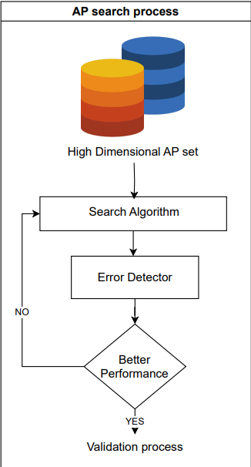
Grasshopper Optimization
Why is it applicable only for static data?
The error detector itself is used in loop to determine the best subset of access points.
This means that this model cannot be deployed in real-time to select the subset that can be used by the error detector at that point of time.
Input superset: 5 signals
Selected subset: 1 signal
Figure 1 : AP search [1]
Notes:
We would like to explain the merits of the new approach considering a baseline model, its architecture and shortcomings to better illustrate the concept.
For a model to be defined as dynamic and at the same time deployable in a time sensitive and safety intensive scenario, it must be able to feed in optimum access point subsets to the error detector during operation.
Here, we could observe that it holds possibility to realize a dynamic training scenario by feeding data in batches as the system changes its state, it is unable directly select an optimum subset.
Which means instead of feeding the optimum subset into the ED, ED itself is involved in the decision making process for optimum access point.
By this time frame, there is no quantified proof that an optimum subset would be achieved before the fault occurs.

Slide 6
Grasshopper Optimization
Ideal structure: For deployment in real time
The error detector has to be detached from the selection algorithm which must be able to independently select access points.
This realizes the potential of the APSA to select the optimum subset and feed the input to the Error Detector in a real-time deployed state.
Notes:
To be a practical model to provide optimum access point subset, the APSA algorithm must work independent of the ED once deployed.

Slide 7
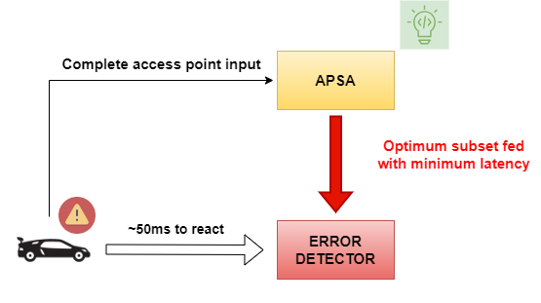
Solution
An APSA with machine learning capabilities to directly select the optimum access points can overcome this difficulty.

Slide 8
Advantage of Greedy CMI method – Dynamic Selection
DATASET
CMI trains a policy and a predictor separately i.e. the selection of access points is using a policy model and then, a predictor is used to make subsequent predictions using the subset selected.
Dynamic Selection – The CMI method stands out due to its greedy policy model that predicts an optimal subset for each batch independent of the error detector once deployed.
Notes:
How does CMI solve this effectively.

Slide 9
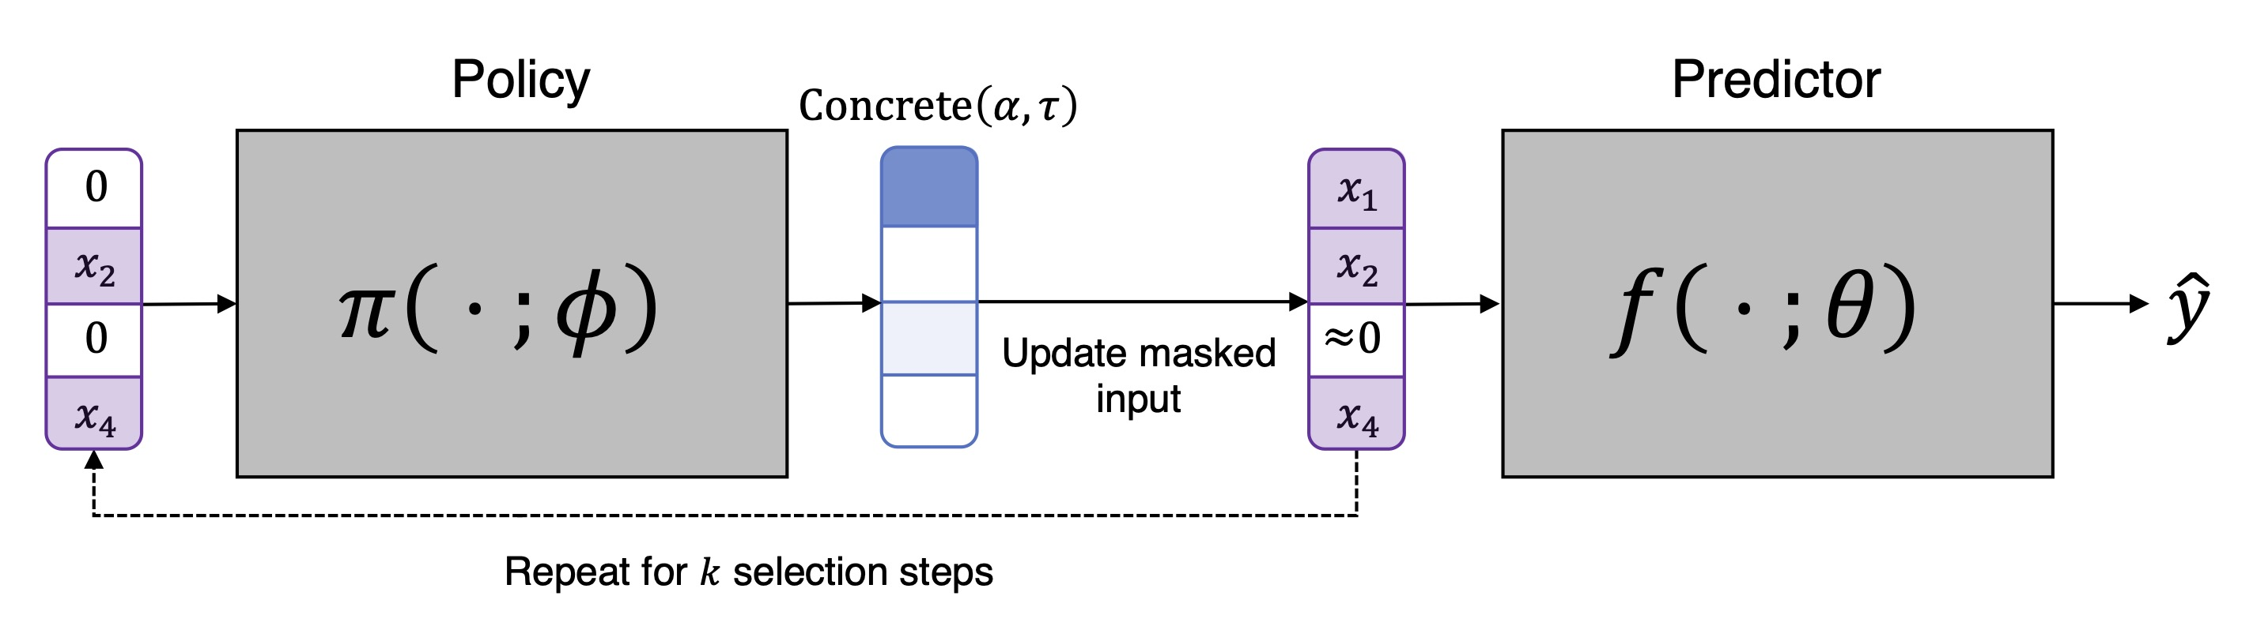
CMI
Figure 2: CMI model training for one batch [2]
k is the maximum feature budget. The policy model adds one element for each loop of the k selection steps.
The k feature mask input to the predictor is generated for each batch.

Slide 10
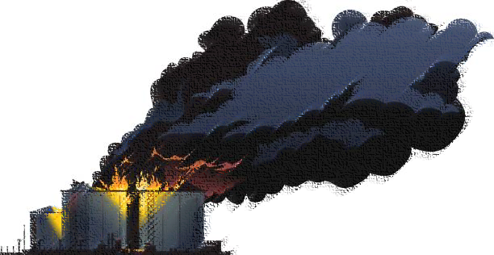

Why EVSI? (Can CMI method be improved?)
CMI can be used to directly predict anomalies in scenarios where safety is not an immediate responsibility.
For example, a medical imaging system using CMI may not consider the impact on the patient in adding one more signal to its subset for several reasons.
Doctor can cross check if it is a false positive, computational time is not critical.
This is not favourable in determining faults in safety sensitive systems.
Cost of Remediation
Cost of Plant Damage

Slide 11

EVSI
${\text{E}}_{\text{(}\text{sensor} \text{subset}\text{)}}$ = Pr(signal)∗min(R ∗ Pr($\overline{fault}$|signal),P ∗ Pr(fault|signal)) + Pr($\overline{signal}$)∗min (R ∗ Pr($\overline{fault}$| $\overline{signal}$),P∗Pr(fault| $\overline{signal}$))
Sensor Subset
$$signal$$
𝑠𝑖𝑔𝑛𝑎𝑙
Fix
No Fix
$$\overline{signal}$$
(𝑠𝑖𝑔𝑛𝑎𝑙) ̅
$$fault$$
𝑓𝑎𝑢𝑙𝑡
$$\overline{fault}$$
(𝑓𝑎𝑢𝑙𝑡) ̅
$$fault$$
𝑓𝑎𝑢𝑙𝑡
$$\overline{fault}$$
(𝑓𝑎𝑢𝑙𝑡) ̅
Fix
$$fault$$
𝑓𝑎𝑢𝑙𝑡
$$\overline{fault}$$
(𝑓𝑎𝑢𝑙𝑡) ̅
No Fix
$$fault$$
𝑓𝑎𝑢𝑙𝑡
$$\overline{fault}$$
(𝑓𝑎𝑢𝑙𝑡) ̅
R = Cost of Remediation, P = Plant Damage

Slide 12
Optimum Selection
Dynamic CMI Maximization
Impact on System Cost in terms of Remediation [EVSI]
Dynamic Access Point Subset
=

Slide 13
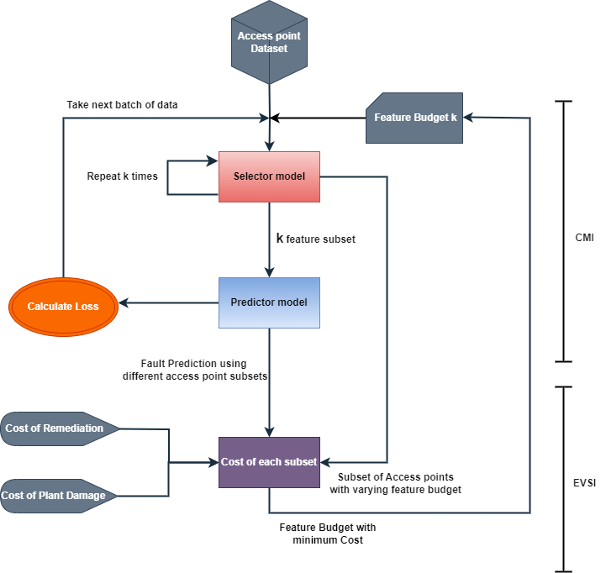
CMI-EVSI
Method Overview

Slide 14
CMI-EVSI
Method Overview
Can be deployed independently

Slide 15
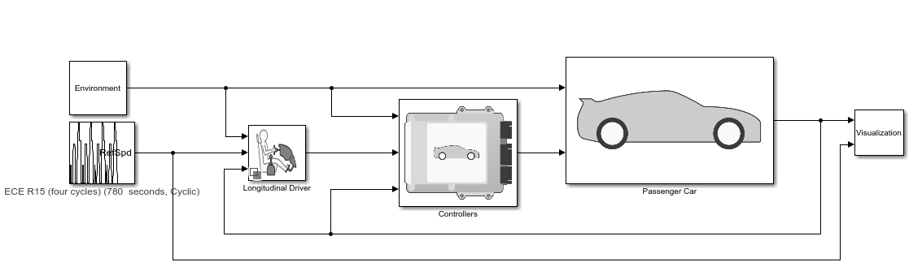
Case Study
The case study considered here is a P2 Hybrid Electric Vehicle model from Simulink
Fault is injected to the passenger car subsystem in the Simulink model.
35 access points are selected from the entire array of signals present in the subsystems of the Simulink model for testing.
Figure 3: Simulink model for P2 HEV [4]

Slide 16
Case Study
Simulation Overview – Drive Cycles
ECE R15
FTP75
US06

Slide 17
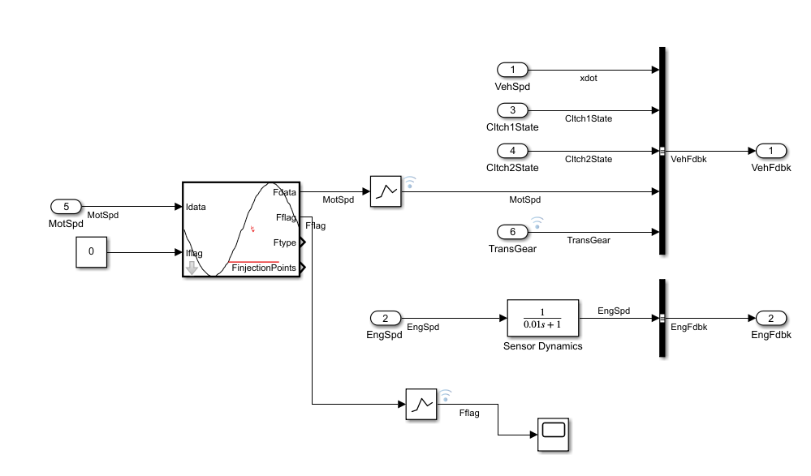
Case Study
Fault Injection
Access points
Note: Access points are distributed over different subsystems and cannot be shown with a single image.

Slide 18
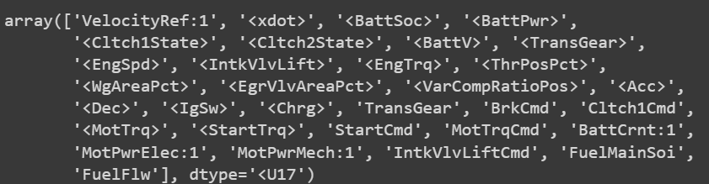
CMI-EVSI – Dynamic Selection
Consider the above signals in the set of possible access points.
As the combined selector and predictor models encounter additional data in the batches, the probability of the signals being the most valuable signal changes after each step.

Slide 19
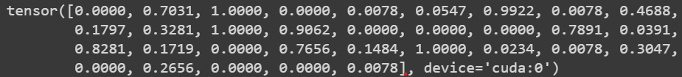
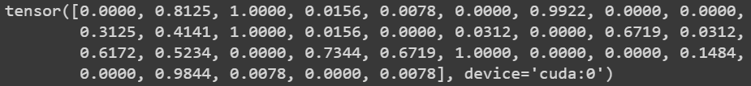
CMI-EVSI – Dynamic Selection
Access point is termed not valuable for a different batch.
Access point is termed as valuable for a different batch.

Slide 20
CMI - EVSI
Role of EVSI in CMI-EVSI Method
In CMI as a standalone model, there is no mechanism to choose an efficient feature budget.
The impact of the prediction on the system goes unmeasured.
1.How to identify the best feature budget? 2.How can we quantitatively measure the impact of the selected features on the system in terms of ‘Cost of Remediation’ and ‘Plant Damage’? 3.How can we measure the increase/decrease in cost due to addition of an extra access point? i.e. (Cost of sensor information acquisition)

Slide 21
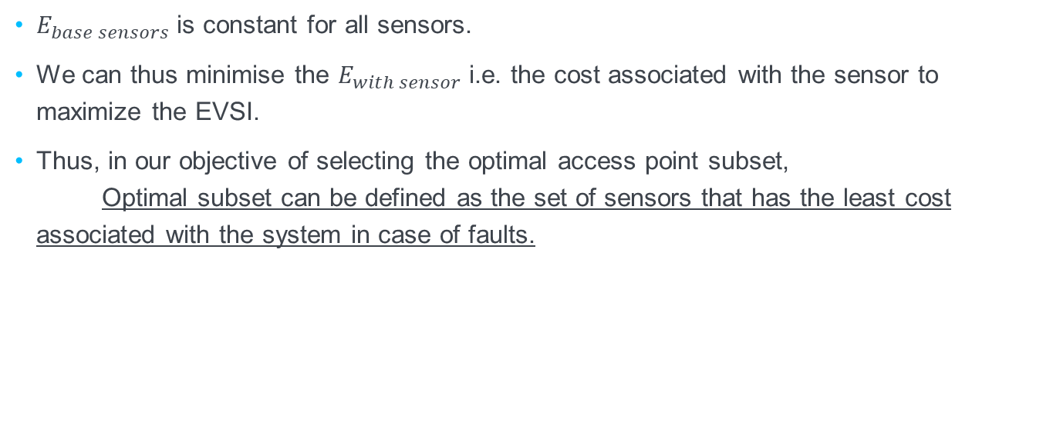
CMI - EVSI
$${EVSI}_{sensor}=E_{base sensors}−E_{with sensor}$$
$E_{base sensors}$ is constant for all sensors.
We can thus minimise the $E_{with sensor}$ i.e. the cost associated with the sensor to maximize the EVSI.
Thus, in our objective of selecting the optimal access point subset, Optimal subset can be defined as the set of sensors that has the least cost associated with the system in case of faults.

Slide 22
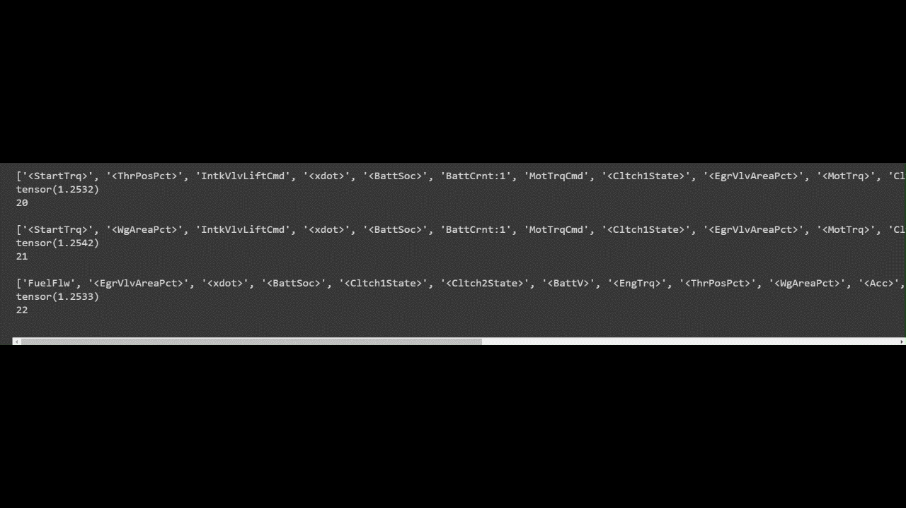
CMI – EVSI : Results
We can see from the results that the selector is providing an optimum set of access points with each set of data.

Slide 23
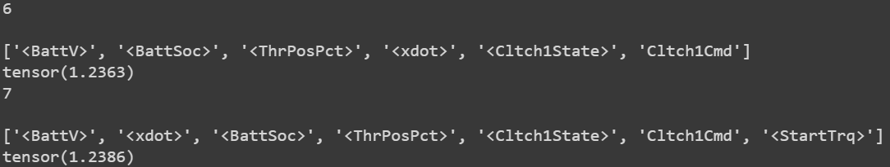
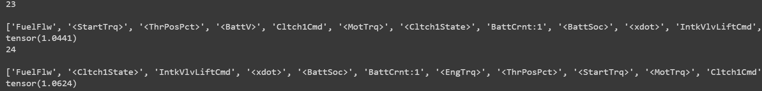
CMI – EVSI : Results
We can see from the results that the expected cost for different budgets vary depending on the cost of remediation and the plant damage costs.

Slide 24
Access Point Selection Models
Comparison
Characteristics | GOA (Swarm Optimization) | EVSI | CMI
Accuracy |  | 82% | 85.48%
AUROC Score |  | 95.00 | 97.21
Behaviour for deployment | Static | Static | Dynamic
Impact on System (Cost) | Not Considered | Considered | Not Considered
Optimum Feature Budget | Irrelevant (Not Dynamic) | Irrelevant (Not Dynamic) | Cannot be calculated
CMI-EVSI
89%
98.43
Dynamic
Considered
Calculated

Slide 25
Citations
V. G. Naik, T. Fabarisov and A. Morozov, "MACHINE LEARNING BASED SEARCH FOR ACCESS POINTS IN ANOMALY DETECTION MODEL," in International Mechanical Engineering Congress and Exposition, New Orleans, Louisiana, 2023.
I. Covert, W. Qiu, M. Lu, N. Kim, N. White and S.-I. Lee, "Learning to Maximize Mutual Information for Dynamic Feature Selection," 2023.
Simulink, "HEV P2 Reference Application," R2023b.

Slide 26

Institut of Industrial Automation
and Software Engineering
John Benny
st181908@stud.uni-stuttgart.de; johnbenny5355@gmail.com;
000
000
Institute of Automation and software systems
Pfaffenwaldring 47, 70550 Stuttgart

Slide 27
BACKUP SLIDES AFTER THIS

Slide 28
Case Study
Simulation Overview – Fault Types
0 Normal
1 MotSpd
2 TrqCmd

Slide 29
CMI-EVSI
ITERATED BATCHWISE
1.Selection from one batch of data.
Locally available data ensures dynamic behaviour.
2.Predictor model to predict probabilities.
Predictor is used to make fault predictions on the data.
3.Calculate the loss in conditional mutual information.
The loss is backpropagated to learn to maximize mutual information.
4.Move to the next batch of data.
Move to next batch of data, suitable for a variational system behaviour.

Slide 30
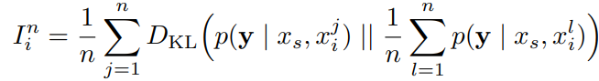

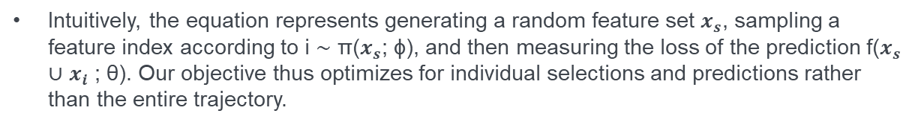
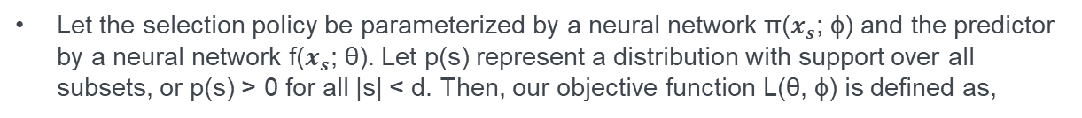
CMI-EVSI
CMI equation
This score measures the variability among predictions and captures whether different $x_{i}$ values significantly affect y’s conditional distribution.
CMI implemented as an objective function using amortized optimization
Let the selection policy be parameterized by a neural network π($x_{s}$; ϕ) and the predictor by a neural network f($x_{s}$; θ). Let p(s) represent a distribution with support over all subsets, or p(s) > 0 for all |s| < d. Then, our objective function L(θ, ϕ) is defined as,
Intuitively, the equation represents generating a random feature set $x_{s}$, sampling a feature index according to i ∼ π($x_{s}$; ϕ), and then measuring the loss of the prediction f($x_{s}$ ∪ $x_{i}$ ; θ). Our objective thus optimizes for individual selections and predictions rather than the entire trajectory.

Slide 31
Disadvantage of Swarm Optimization method – Static Selection
DATASET
ACCESS POINTS
The ED, in this case, can work on historic data of the system to predict optimum access points.
However, this has the disadvantage that it is not reliable in modern complex CPS with an ever evolving set of dependencies.
Notes:
However, in this scenario, the ED can only work offline and analyse the system to converge into an optimum access point.
It is not suitable for a variational system with thousands of possibilities for paths taken to reach a faulty state.

