Slide 1
Numerical Integration

Slide 2
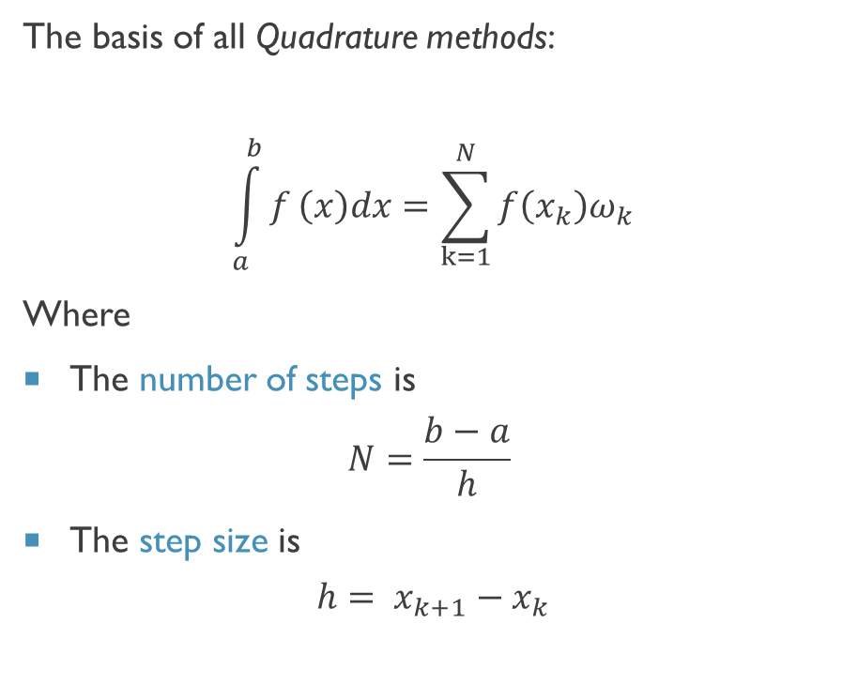
Quadrature
Quadrature –the process of finding a square equal in area to a given area
Many methods for finding these areas, we’ll concentrate on three:
Trapezoid Rule
Simpson Rule
Romberg Integration
The basis of all Quadrature methods:
$$\int_{a}^{b}{f}\left(x\right)dx=\sum_{k=1}^{N}{f\left(x_{k}\right)ω_{k}}$$
Where
The number of steps is
$$N=\frac{b−a}{h}$$
The step size is
$$h= x_{k+1}−x_{k}$$

Slide 3
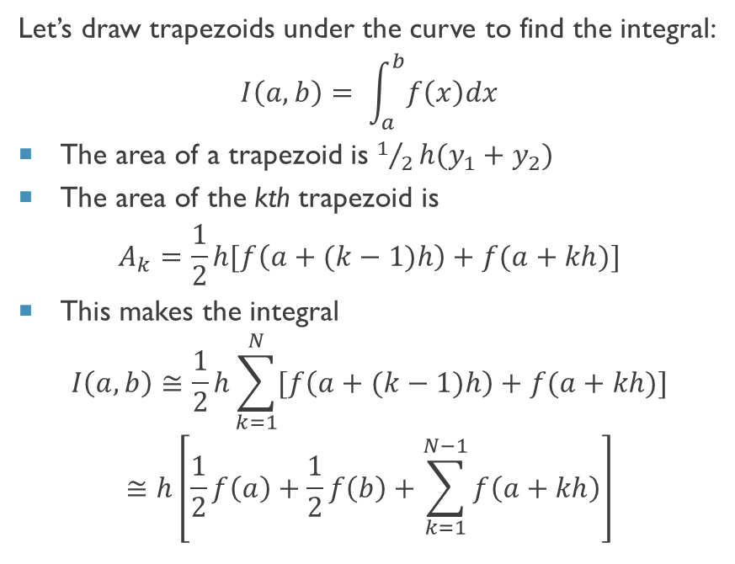
Trapezoid Rule
Let’s draw trapezoids under the curve to find the integral:
$$I\left(a,b\right)= \int_{a}^{b}{f\left(x\right)dx}$$
The area of a trapezoid is $1/2h(y_{1}+y_{2})$
The area of the kth trapezoid is
$$A_{k}=\frac{1}{2}h[f\left(a+(k−1)h\right)+f(a+kh)]$$
This makes the integral
$$I\left(a,b\right)≅\frac{1}{2}h\sum_{k=1}^{N}{[f\left(a+(k−1)h\right)+f(a+kh)]}$$
$$≅h\left[\frac{1}{2}f\left(a\right)+\frac{1}{2}f\left(b\right)+\sum_{k=1}^{N−1}{f\left(a+kh\right)}\right]$$

Slide 4
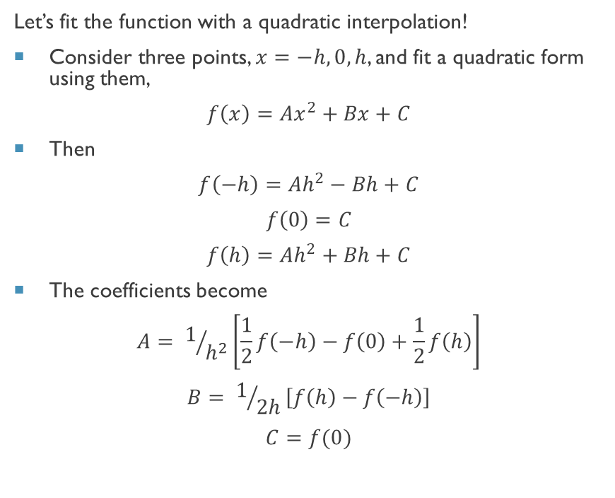
Simpson Rule
Let’s fit the function with a quadratic interpolation!
Consider three points, $x=−h,0,h$, and fit a quadratic form using them,
$$f\left(x\right)=Ax^{2}+Bx+C$$
Then
$$f\left(−h\right)=Ah^{2}−Bh+C$$
$$f\left(0\right)=C$$
$$f\left(h\right)=Ah^{2}+Bh+C$$
The coefficients become
$$A= 1/{h^{2}}\left[\frac{1}{2}f\left(−h\right)−f\left(0\right)+\frac{1}{2}f\left(h\right)\right]$$
$$B= 1/{2h}\left[f\left(h\right)−f\left(−h\right)\right]$$
$$C=f(0)$$

Slide 5
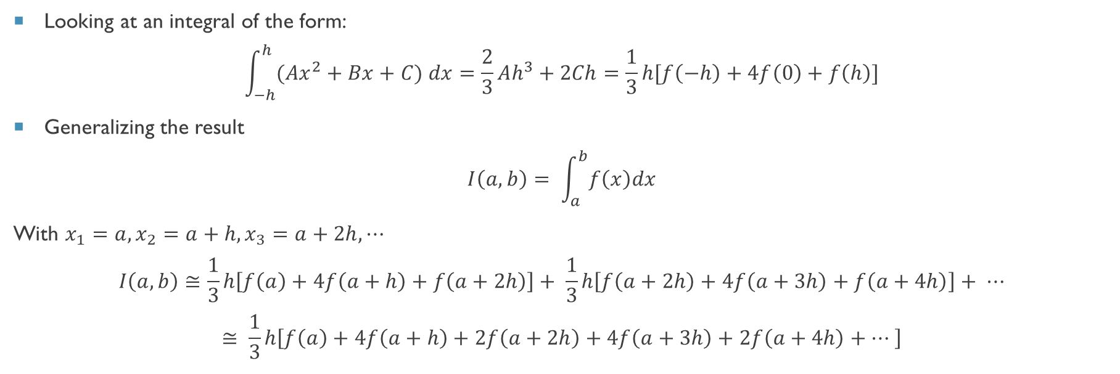
Simpson Rule (In the Weeds)
Looking at an integral of the form:
$$\int_{−h}^{h}{(Ax^{2}+Bx+C) dx}=\frac{2}{3}Ah^{3}+2Ch=\frac{1}{3}h[f\left(−h\right)+4f\left(0\right)+f\left(h\right)]$$
Generalizing the result
$$I\left(a,b\right)= \int_{a}^{b}{f\left(x\right)dx}$$
With $x_{1}=a,x_{2}=a+h,x_{3}=a+2h,⋯$
$$I\left(a,b\right)≅\frac{1}{3}h\left[f\left(a\right)+4f\left(a+h\right)+f\left(a+2h\right)\right]+ \frac{1}{3}h\left[f\left(a+2h\right)+4f\left(a+3h\right)+f\left(a+4h\right)\right]+ ⋯$$
$$≅ \frac{1}{3}h\left[f\left(a\right)+4f\left(a+h\right)+2f\left(a+2h\right)+4f\left(a+3h\right)+2f\left(a+4h\right)+⋯ \right]$$

Slide 6
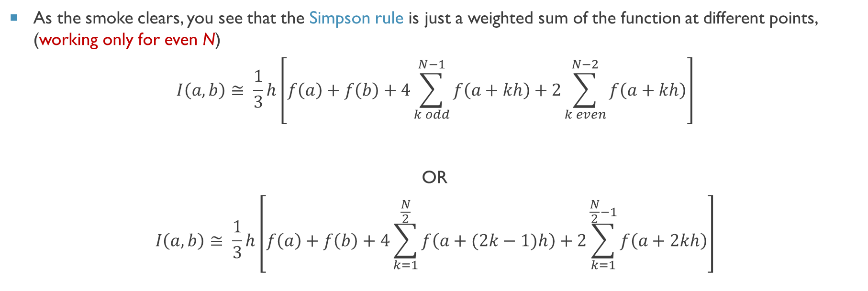
Simpson Rule (Last of the math)
As the smoke clears, you see that the Simpson rule is just a weighted sum of the function at different points, (working only for even N)
$$I\left(a,b\right)≅ \frac{1}{3}h\left[f\left(a\right)+f\left(b\right)+4\sum_{k odd}^{N−1}{f\left(a+kh\right)}+2\sum_{k even}^{N−2}{f\left(a+kh\right)}\right]$$
OR
$$I\left(a,b\right)≅ \frac{1}{3}h\left[f\left(a\right)+f\left(b\right)+4\sum_{k=1}^{\frac{N}{2}}{f\left(a+(2k−1)h\right)}+2\sum_{k=1}^{\frac{N}{2}−1}{f\left(a+2kh\right)}\right]$$
Simpson Rule

Slide 7
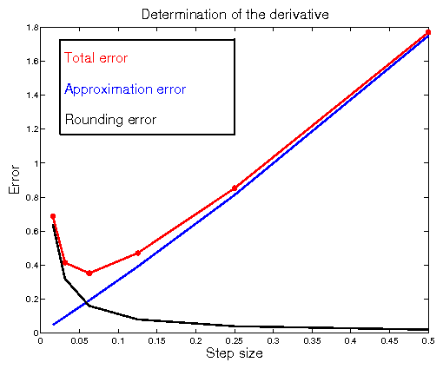
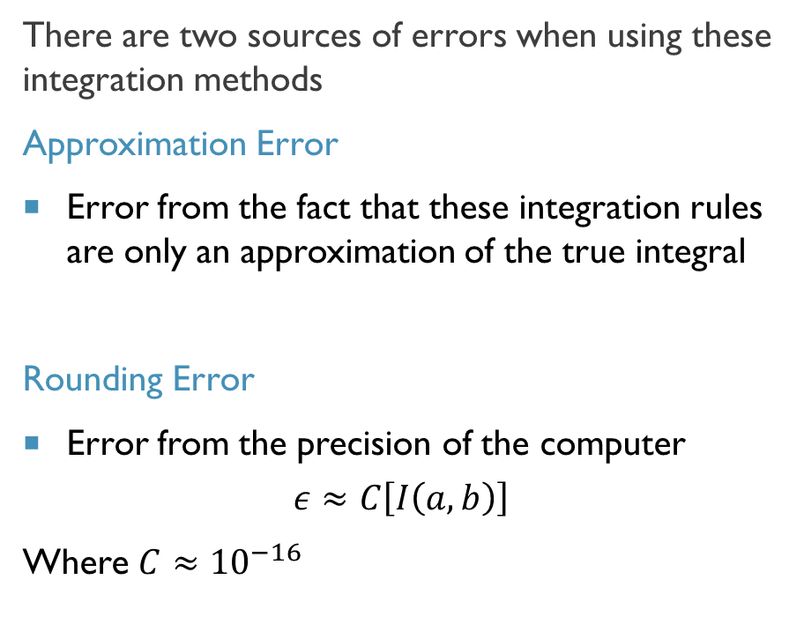
How Accurate are These Methods?
There are two sources of errors when using these integration methods
Approximation Error
Error from the fact that these integration rules are only an approximation of the true integral
Rounding Error
Error from the precision of the computer
$$ε≈C\left[I\left(a,b\right)\right]$$
Where $C≈{10}^{−16}$

Slide 8
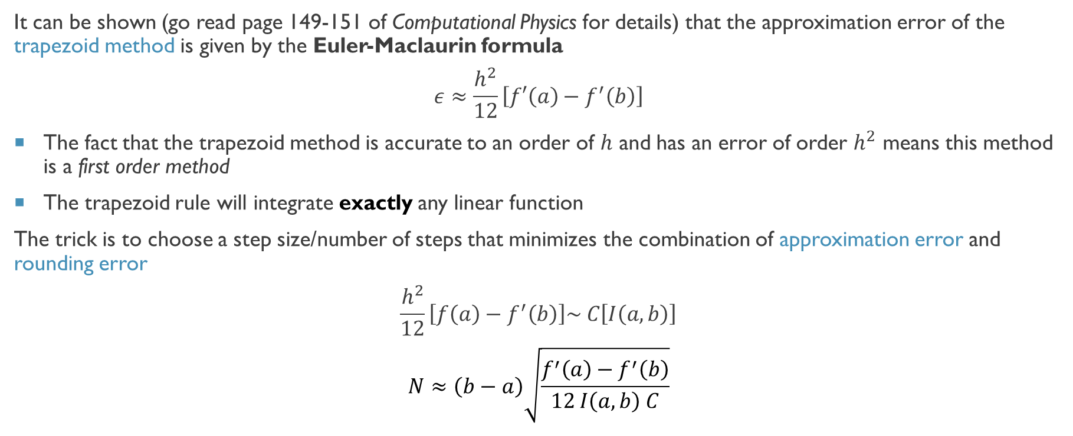
Errors in the Trapezoid Rule
It can be shown (go read page 149-151 of Computational Physics for details) that the approximation error of the trapezoid method is given by the Euler-Maclaurin formula
$$ε≈\frac{h^{2}}{12}\left[f′\left(a\right)−f^{′}\left(b\right)\right]$$
The fact that the trapezoid method is accurate to an order of $h$ and has an error of order $h^{2}$ means this method is a first order method
The trapezoid rule will integrate exactly any linear function
The trick is to choose a step size/number of steps that minimizes the combination of approximation error and rounding error
$$\frac{h^{2}}{12}\left[f\left(a\right)−f^{′}\left(b\right)\right]\sim C\left[I\left(a,b\right)\right]$$
$$N≈\left(b−a\right)\sqrt{\frac{f^{′}\left(a\right)−f^{′}\left(b\right)}{12 I\left(a,b\right) C}}$$

Slide 9
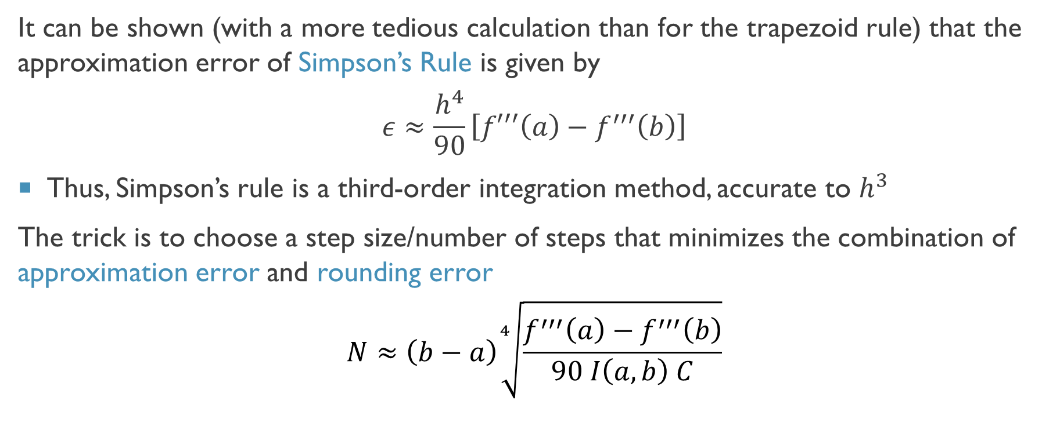
Errors in Simpson’s Rule
It can be shown (with a more tedious calculation than for the trapezoid rule) that the approximation error of Simpson’s Rule is given by
$$ε≈\frac{h^{4}}{90}\left[f′′′\left(a\right)−f^{′′′}\left(b\right)\right]$$
Thus, Simpson’s rule is a third-order integration method, accurate to $h^{3}$
The trick is to choose a step size/number of steps that minimizes the combination of approximation error and rounding error
$$N≈\left(b−a\right)\sqrt[4]{\frac{f^{′′′}\left(a\right)−f^{′′′}\left(b\right)}{90 I\left(a,b\right) C}}$$

Slide 10
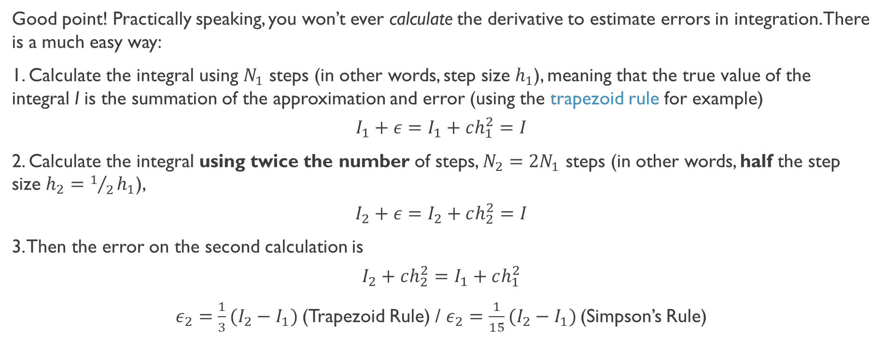
That’s all great, IF we knew the function!!
Good point! Practically speaking, you won’t ever calculate the derivative to estimate errors in integration. There is a much easy way:
1. Calculate the integral using $N_{1}$ steps (in other words, step size $h_{1}$), meaning that the true value of the integral I is the summation of the approximation and error (using the trapezoid rule for example)
$${I_{1}+ε=I}_{1}+ch_{1}^{2}=I$$
2. Calculate the integral using twice the number of steps, $N_{2}=2N_{1}$ steps (in other words, half the step size $h_{2}=1/2h_{1}$),
$${I_{2}+ε=I}_{2}+ch_{2}^{2}=I$$
3. Then the error on the second calculation is
$$I_{2}+ch_{2}^{2}=I_{1}+ch_{1}^{2}$$
$ε_{2}=\frac{1}{3}(I_{2}−I_{1})$(Trapezoid Rule) / $ε_{2}=\frac{1}{15}(I_{2}−I_{1})$(Simpson’s Rule)

