Slide 1
Romberg integration and the finer points
AKA Holy Math, Batman!

Slide 2
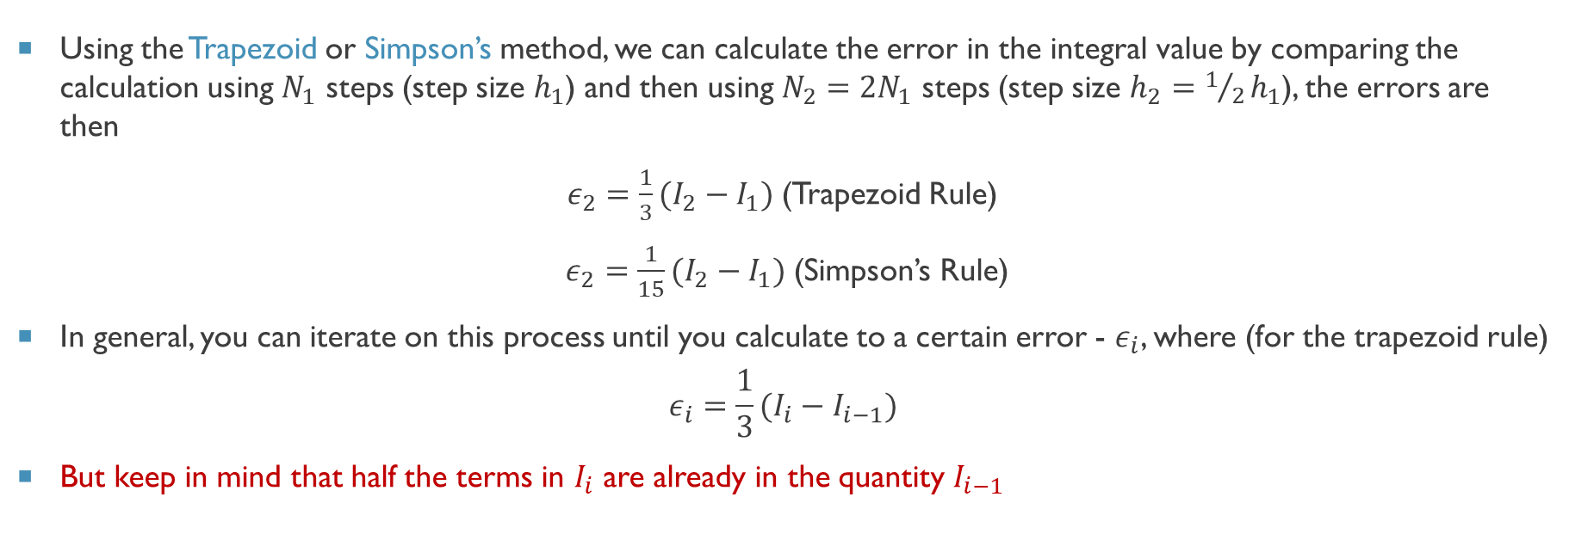
From last time
Using the Trapezoid or Simpson’s method, we can calculate the error in the integral value by comparing the calculation using $N_{1}$ steps (step size $h_{1}$) and then using $N_{2}=2N_{1}$ steps (step size $h_{2}=1/2h_{1}$), the errors are then
$ε_{2}=\frac{1}{3}(I_{2}−I_{1})$(Trapezoid Rule)
$ε_{2}=\frac{1}{15}(I_{2}−I_{1})$(Simpson’s Rule)
In general, you can iterate on this process until you calculate to a certain error - $ε_{i}$, where (for the trapezoid rule)
$$ε_{i}=\frac{1}{3}(I_{i}−I_{i−1})$$
But keep in mind that half the terms in $I_{i}$ are already in the quantity $I_{i−1}$

Slide 3
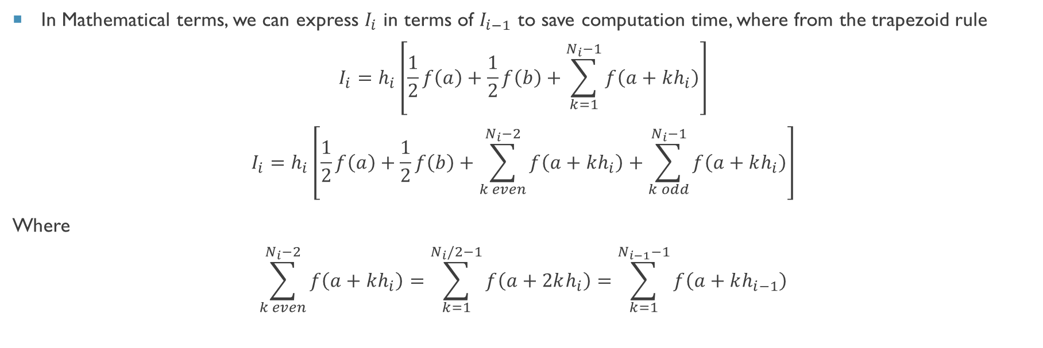
Adaptive Integration Techiniques
In Mathematical terms, we can express $I_{i}$ in terms of $I_{i−1}$ to save computation time, where from the trapezoid rule
$$I_{i}=h_{i}\left[\frac{1}{2}f\left(a\right)+\frac{1}{2}f\left(b\right)+\sum_{k=1}^{N_{i}−1}{f\left(a+kh_{i}\right)}\right]$$
$$I_{i}=h_{i}\left[\frac{1}{2}f\left(a\right)+\frac{1}{2}f\left(b\right)+\sum_{k even}^{N_{i}−2}{f\left(a+kh_{i}\right)}+\sum_{k odd}^{N_{i}−1}{f\left(a+kh_{i}\right)}\right]$$
Where
$$\sum_{k even}^{N_{i}−2}{f\left(a+kh_{i}\right)=\sum_{k=1}^{N_{i}/2−1}{f\left(a+2kh_{i}\right)}=\sum_{k=1}^{N_{i−1}−1}{f\left(a+kh_{i−1}\right)}}$$

Slide 4
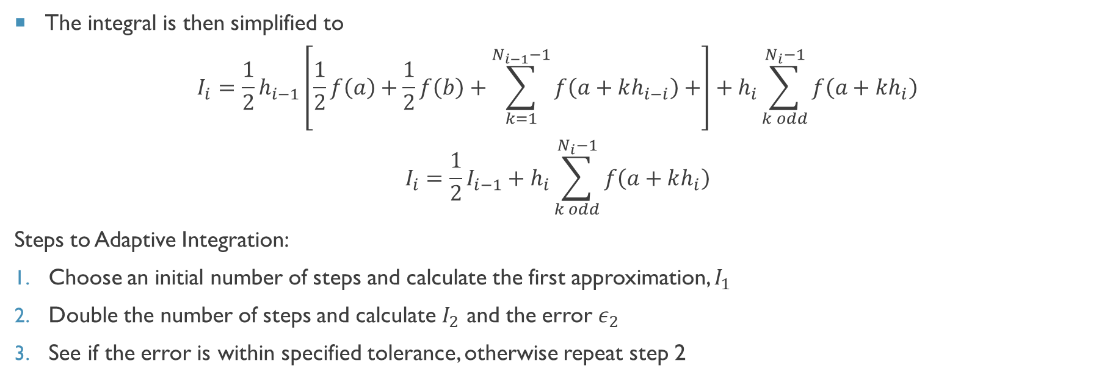
Adaptive Integration Techiniques
The integral is then simplified to
$$I_{i}={\frac{1}{2}h}_{i−1}\left[\frac{1}{2}f\left(a\right)+\frac{1}{2}f\left(b\right)+\sum_{k=1}^{N_{i−1}−1}{f\left(a+kh_{i−i}\right)}+\right]+h_{i}\sum_{k odd}^{N_{i}−1}{f\left(a+kh_{i}\right)}$$
$$I_{i}=\frac{1}{2}I_{i−1}+h_{i}\sum_{k odd}^{N_{i}−1}{f\left(a+kh_{i}\right)}$$
Steps to Adaptive Integration:
Choose an initial number of steps and calculate the first approximation, $I_{1}$
Double the number of steps and calculate $I_{2}$ and the error $ε_{2}$
See if the error is within specified tolerance, otherwise repeat step 2

Slide 5

Adaptive Integration methods
Using Simpson’s Rule, we can find something similar – define
$$S_{i}=\frac{1}{3}\left[f\left(a\right)+f\left(b\right)+2\sum_{k even}^{N_{i}−2}{f\left(a+kh_{i}\right)}\right]$$
$$T_{i}=\sum_{k odd}^{N_{i}−1}{f\left(a+kh_{i}\right)}$$
Where $S_{i}=S_{i−1}+T_{i−1}$ and the integral at iteration i is
$$I_{i}=h_{i}{(S}_{i}+{2T}_{i})$$

Slide 6
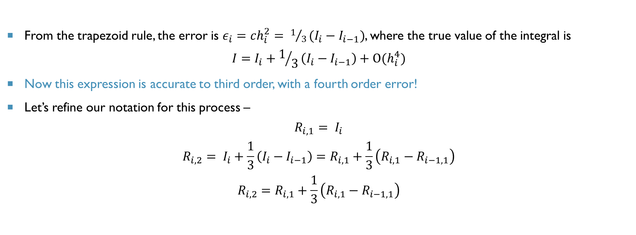
Romberg Integration -We can do even better!
From the trapezoid rule, the error is $ε_{i}=ch_{i}^{2}= 1/3(I_{i}−I_{i−1})$, where the true value of the integral is
$$I=I_{i}+1/3\left(I_{i}−I_{i−1}\right)+O(h_{i}^{4})$$
Now this expression is accurate to third order, with a fourth order error!
Let’s refine our notation for this process –
$$R_{i,1}= I_{i}$$
$$R_{i,2}= I_{i}+\frac{1}{3}\left(I_{i}−I_{i−1}\right)=R_{i,1}+\frac{1}{3}\left(R_{i,1}−R_{i−1,1}\right)$$
$$R_{i,2}=R_{i,1}+\frac{1}{3}\left(R_{i,1}−R_{i−1,1}\right)$$
Relates iterations

Slide 7
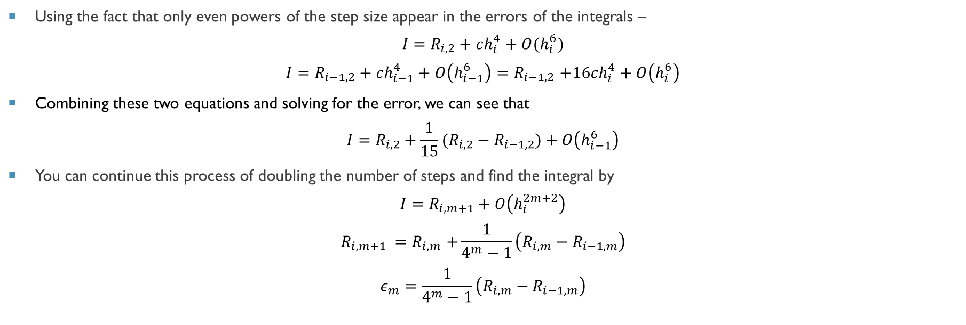
Romberg Integration – The process
Using the fact that only even powers of the step size appear in the errors of the integrals –
$${I=R}_{i,2}+ch_{i}^{4}+O(h_{i}^{6})$$
$${I=R}_{i−1,2}+ch_{i−1}^{4}+O\left(h_{i−1}^{6}\right){=R}_{i−1,2}+16ch_{i}^{4}+O\left(h_{i}^{6}\right)$$
Combining these two equations and solving for the error, we can see that
$${I=R}_{i,2}+\frac{1}{15}(R_{i,2}−R_{i−1,2})+O\left(h_{i−1}^{6}\right)$$
You can continue this process of doubling the number of steps and find the integral by
$${I=R}_{i,m+1}+O\left(h_{i}^{2m+2}\right)$$
$$R_{i,m+1} {=R}_{i,m}+\frac{1}{4^{m}−1}\left(R_{i,m}−R_{i−1,m}\right)$$
$$ε_{m}=\frac{1}{4^{m}−1}\left(R_{i,m}−R_{i−1,m}\right)$$
Relates iterations
Best error estimate

Slide 8

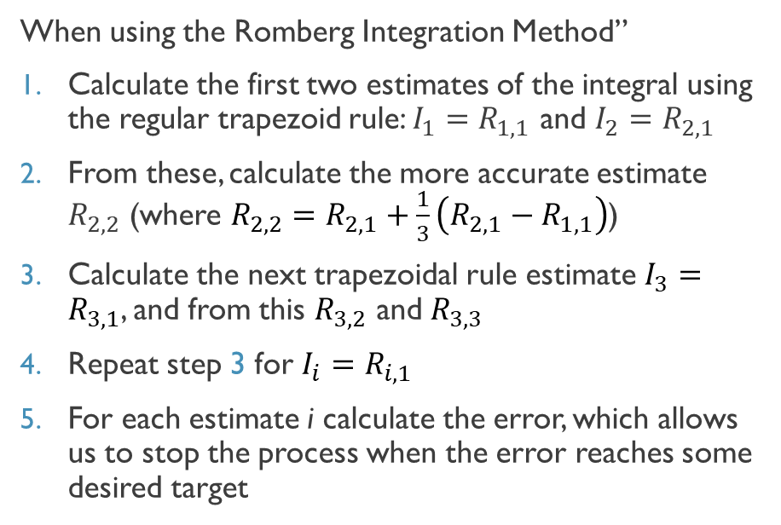
Romberg Integration Algorithm
When using the Romberg Integration Method”
Calculate the first two estimates of the integral using the regular trapezoid rule: $I_{1}=R_{1,1}$ and $I_{2}=R_{2,1}$
From these, calculate the more accurate estimate $R_{2,2}$ (where $R_{2,2}=R_{2,1}+\frac{1}{3}\left(R_{2,1}−R_{1,1}\right)$)
Calculate the next trapezoidal rule estimate $I_{3}=R_{3,1}$, and from this $R_{3,2}$ and $R_{3,3}$
Repeat step 3 for $I_{i}=R_{i,1}$
For each estimate i calculate the error, which allows us to stop the process when the error reaches some desired target
$I_{1}≡R_{1,1}$
$I_{2}≡R_{2,1}→R_{2,2}$
$I_{3}≡R_{3,1}$ $→R_{3,2}$ $→R_{3,3}$
$I_{4}≡R_{4,1}$ $→R_{4,2}$ $→R_{4,3}$ $→R_{4,4}$

Slide 9
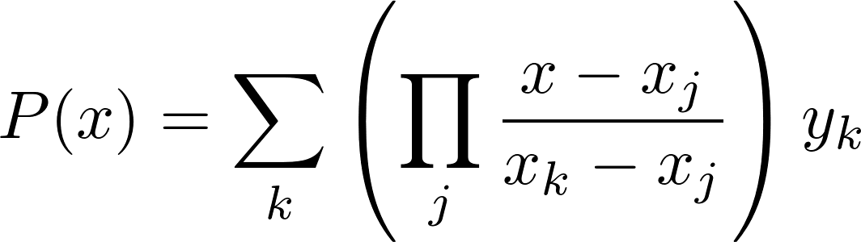
Higher order integration techniques
Lagrange Interpolating Polynomial
Given N points we can fit a (N-1)th degree polynomial
Why don’t we just do that and then integrate that polynomial?
Good question! Such methods exist and are called Newton-Cotes formulas – the weightings for cubic and quartic curve fittings is on pg 164 of Computational Physics
There is also a method that allows you to vary the weights and evaluation positions to integrate a (2N-1)th-degree polynomial with just N evaluations called Gaussian Quadrature

