Slide 1
Solving Ordinary Differential Equations in MATLAB/Python

Slide 2
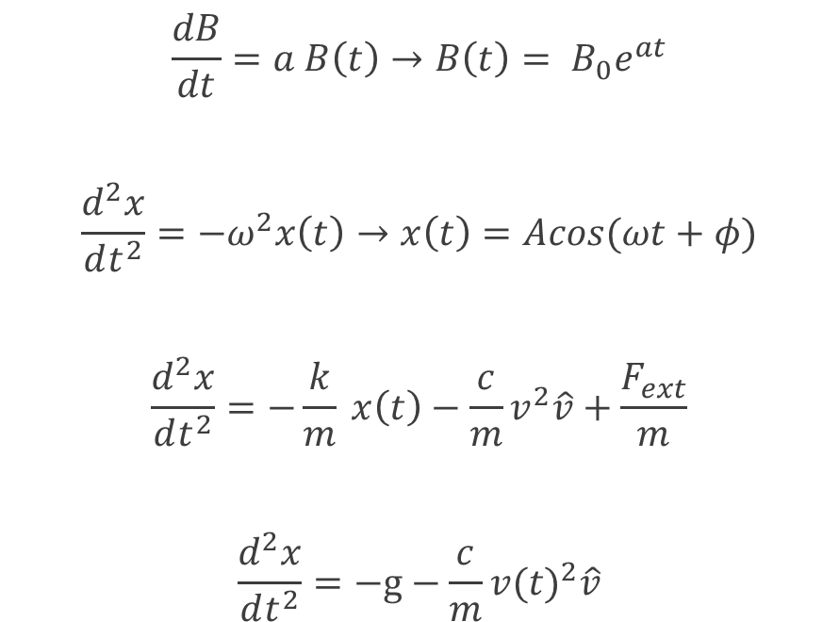
Differential Equations in Physics
Exponential decay/growth
Simple Harmonic Motion
Damped, driven Harmonic Motion
Projectile motion with Air Resistance
$$\frac{dB}{dt}=a B\left(t\right)→B\left(t\right)= B_{0}e^{at}$$
$$\frac{d^{2}x}{dt^{2}}=−ω^{2}x\left(t\right)→x\left(t\right)=Acos(ωt+φ)$$
$$\frac{d^{2}x}{dt^{2}}=−\frac{k}{m} x\left(t\right)−\frac{c}{m}v^{2}\hat{v}+\frac{F_{ext}}{m}$$
$$\frac{d^{2}x}{dt^{2}}=−g−\frac{c}{m}{v(t)}^{2}\hat{v}$$

Slide 3
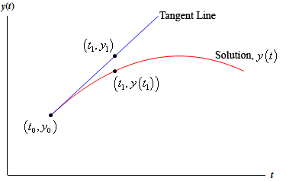
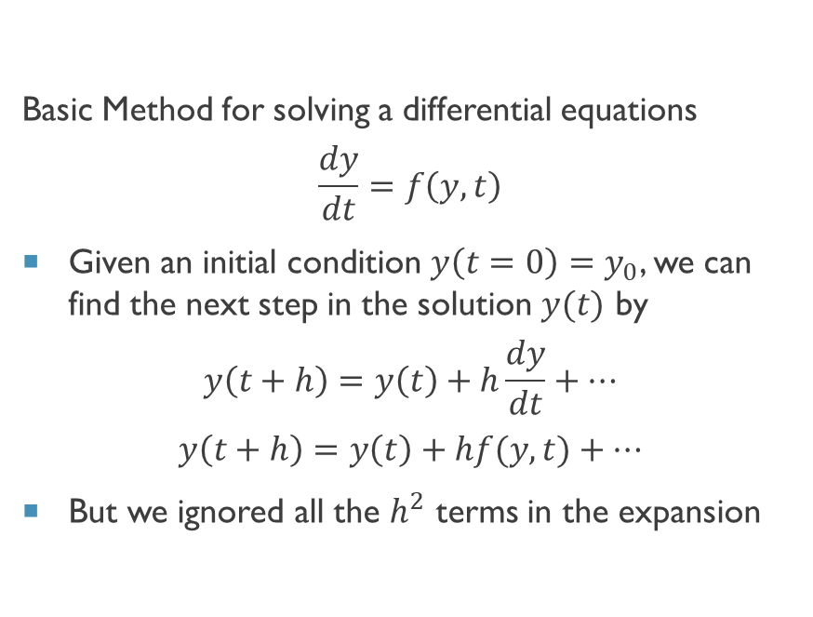
Euler’s Method (1st Order Runge-Kutta)
Basic Method for solving a differential equations
$$\frac{dy}{dt}=f\left(y,t\right)$$
Given an initial condition $y\left(t=0\right)=y_{0}$, we can find the next step in the solution $y(t)$ by
$$y\left(t+h\right)=y\left(t\right)+h\frac{dy}{dt}+⋯$$
$$y\left(t+h\right)=y\left(t\right)+hf(y,t)+⋯$$
But we ignored all the $h^{2}$ terms in the expansion

Slide 4
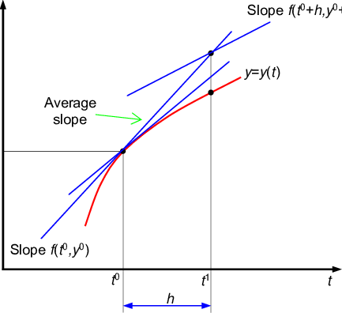
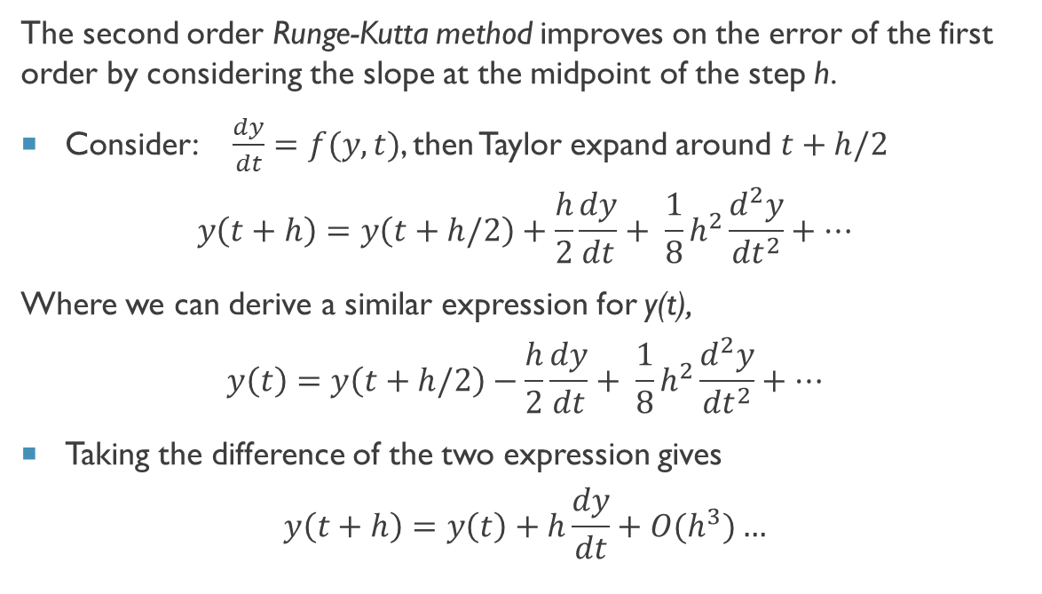
2nd order Runge Kutta
The second order Runge-Kutta method improves on the error of the first order by considering the slope at the midpoint of the step h.
Consider: $\frac{dy}{dt}=f(y,t)$, then Taylor expand around $t+h/2$
$$y\left(t+h\right)=y\left(t+h/2\right)+\frac{h}{2}\frac{dy}{dt}+ \frac{1}{8}h^{2}\frac{d^{2}y}{{dt}^{2}}+…$$
Where we can derive a similar expression for y(t),
$$y\left(t\right)=y\left(t+h/2\right)−\frac{h}{2}\frac{dy}{dt}+ \frac{1}{8}h^{2}\frac{d^{2}y}{{dt}^{2}}+…$$
Taking the difference of the two expression gives
$$y\left(t+h\right)=y\left(t\right)+h\frac{dy}{dt}+O(h^{3})…$$

Slide 5
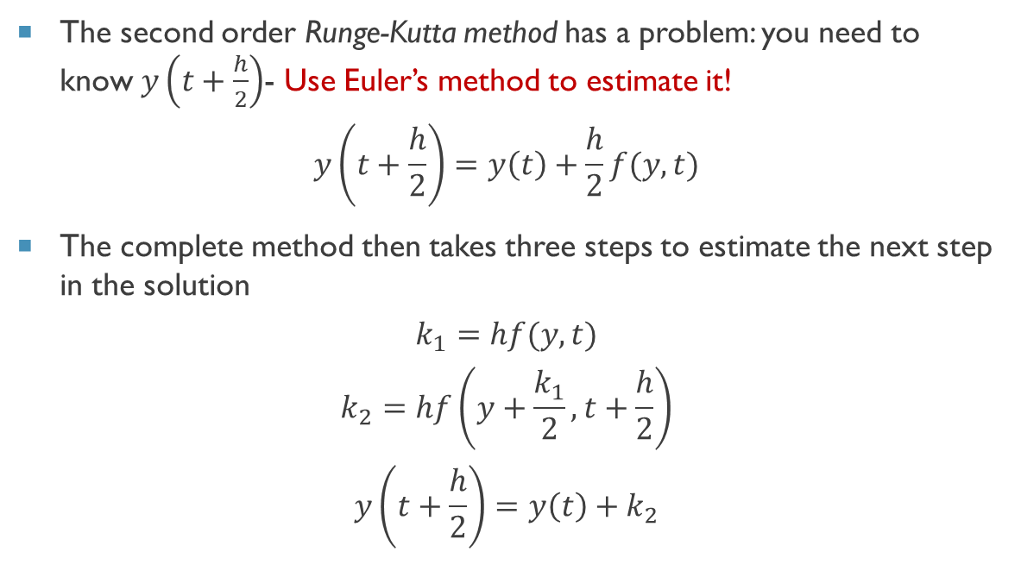
2nd order Runge Kutta
The second order Runge-Kutta method has a problem: you need to know $y\left(t+\frac{h}{2}\right)$- Use Euler’s method to estimate it!
$$y\left(t+\frac{h}{2}\right)=y\left(t\right)+\frac{h}{2}f(y,t)$$
The complete method then takes three steps to estimate the next step in the solution
$$k_{1}=hf(y,t)$$
$$k_{2}=hf\left(y+\frac{k_{1}}{2},t+\frac{h}{2}\right)$$
$$y\left(t+\frac{h}{2}\right)=y\left(t\right)+k_{2}$$

Slide 6
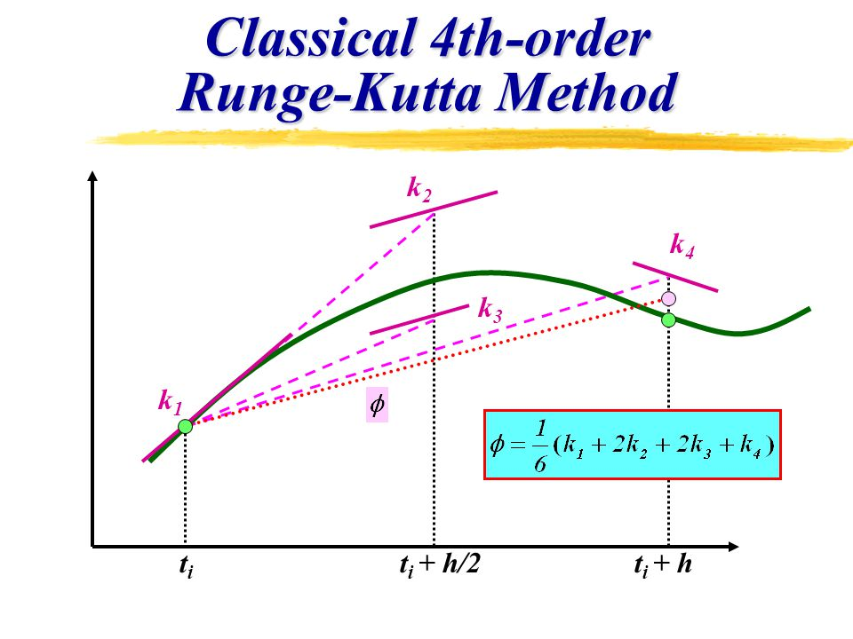
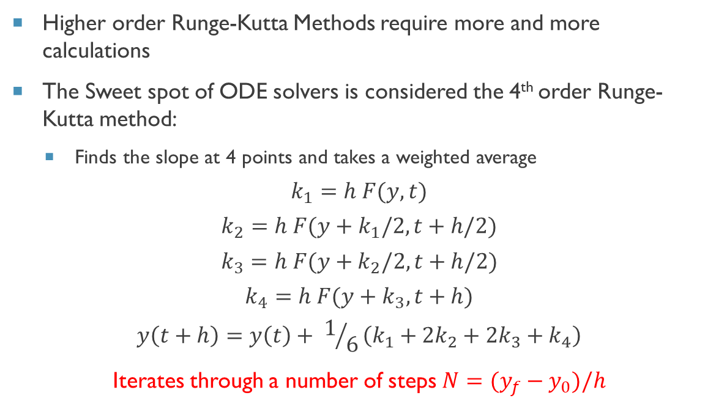
4th order Runge Kutta (the sweet Spot)
Higher order Runge-Kutta Methods require more and more calculations
The Sweet spot of ODE solvers is considered the 4th order Runge-Kutta method:
Finds the slope at 4 points and takes a weighted average
$$k_{1}=h F(y,t)$$
$$k_{2}=h F(y+k_{1}/2,t+h/2)$$
$$k_{3}=h F(y+k_{2}/2,t+h/2)$$
$$k_{4}=h F(y+k_{3},t+h)$$
$$y\left(t+h\right)=y\left(t\right)+ 1/6\left(k_{1}+{2k}_{2}+{2k}_{3}+k_{4}\right)$$
Iterates through a number of steps $N=(y_{f}−y_{0})/h$

Slide 7
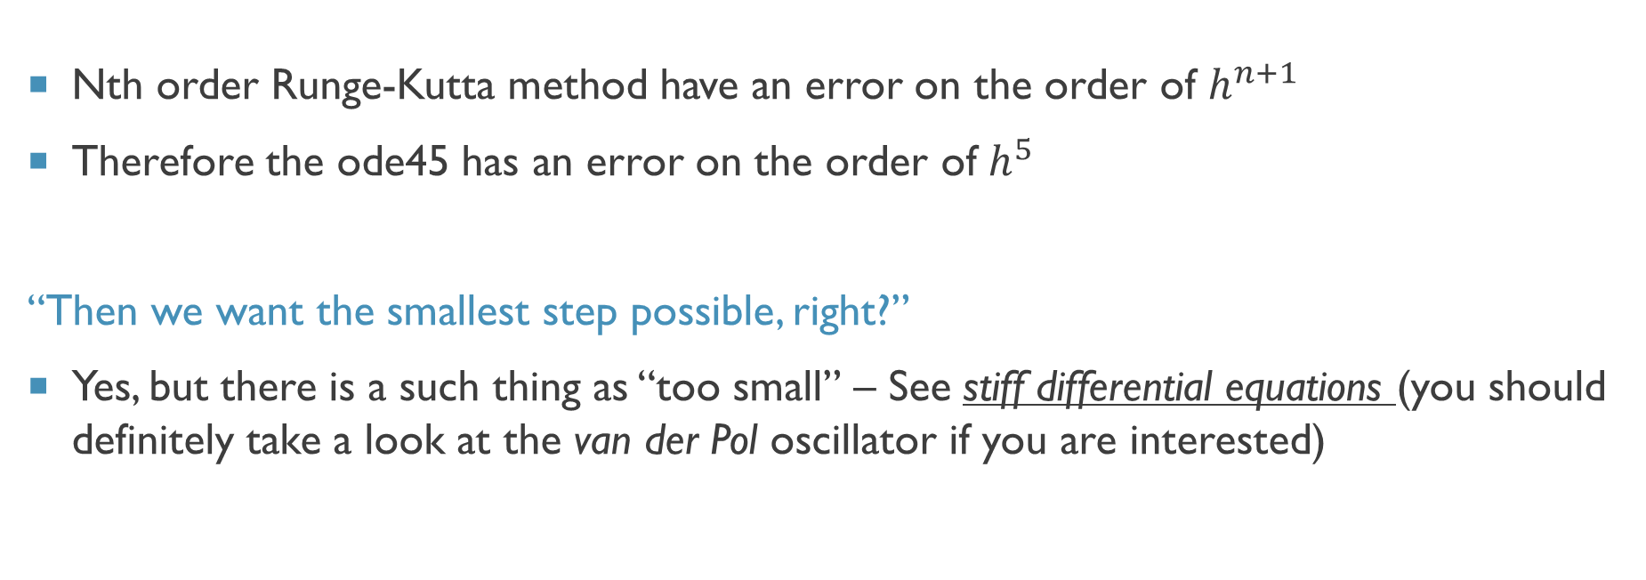
How accurate are These methods
Nth order Runge-Kutta method have an error on the order of $h^{n+1}$
Therefore the ode45 has an error on the order of $h^{5}$
“Then we want the smallest step possible, right?”
Yes, but there is a such thing as “too small” – See stiff differential equations (you should definitely take a look at the van der Pol oscillator if you are interested)

Slide 8
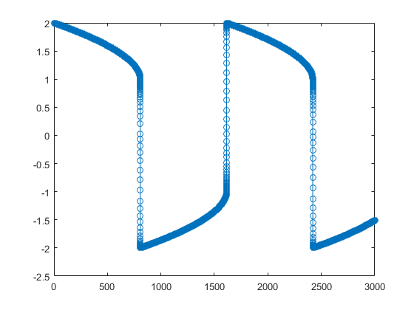
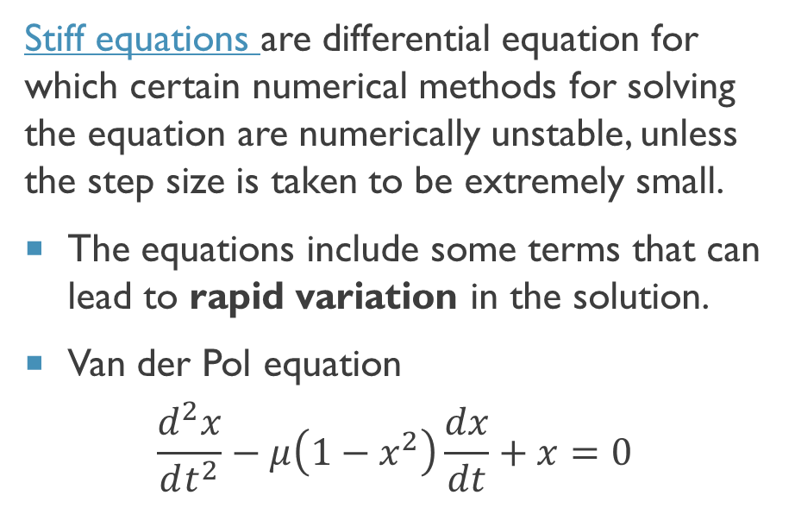
Side Note: Stiff equations
Stiff equations are differential equation for which certain numerical methods for solving the equation are numerically unstable, unless the step size is taken to be extremely small.
The equations include some terms that can lead to rapid variation in the solution.
Van der Pol equation
$$\frac{d^{2}x}{dt^{2}}−μ\left(1−x^{2}\right)\frac{dx}{dt}+x=0$$
Solution to van der Pol oscillator

Slide 9
MATLAB ODE Solvers
Solver | Uses | Notes
ode45 | The standard first try | Based on the Runge-Kutta (4,5) order algorithm
ode23 | Faster, but more crude than ode45 | Based on the Runge-Kutta (2,3) method
ode113 | Use when you have stringent tolerance requirements | This is a variable-step, variable-order (VSVO) Adams-Bashforth-Moulton PECE solver of orders 1 to 13
ode15s | Use if ode45 fails, and you suspect a stiff system | This is a variable-step, variable-order (VSVO) solver based on the numerical differentiation formulas (NDFs) of orders 1 to 5.
ode23s | Use if ode15s fails and you can tolerate a cruder answer | This is based on a modified Rosenbrock formula of order 2 (part of the implicit Runge-Kutta family).
Download ode23tx from Numerical Computing with MATLAB website for a closer look at the algorithm

Slide 10
MATlab Syntax
The function ode45 takes a number of arguments and returns the solution to the differential equation
@func – is a function handle or an anonymous function
tspan – specifies the range of the solution
y0 – is the initial value
opts – contains a number of optional arguments that can be useful (projectile motion)
[t,y,tf,yf] = ode45(@func,tspan,y0,opts);
…
…
function func(t,y)
<function definition>

Slide 11
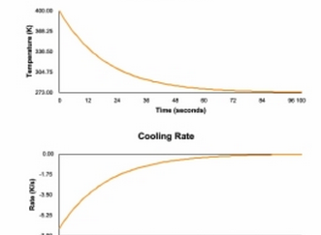
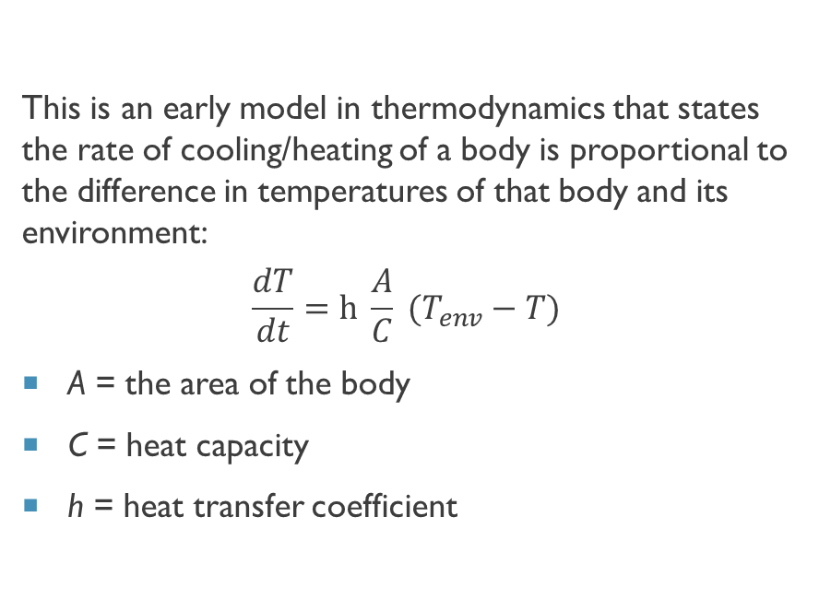
Newton’s Heating/Cooling Law
This is an early model in thermodynamics that states the rate of cooling/heating of a body is proportional to the difference in temperatures of that body and its environment:
$$\frac{dT}{dt}=h \frac{A}{C} (T_{env}−T)$$
A = the area of the body
C = heat capacity
h = heat transfer coefficient

Slide 12
Events function
is a mathematical expression describing the ith event. An event occurs when value(i) is equal to zero.
Use the ‘events' option of the odeset function to specify an event function
value - is a mathematical expression describing the event. An event occurs when value is equal to zero.
isterm - 1 to terminate the integration when the event occurs. Otherwise, 0.
dir - 0 if all zeros are to be located (the default). +1 locates only zeros where the event function is increasing, and -1 locates only zeros where the event function is decreasing
Must input the independent and dependent variables
function [value,isterm,dir] = EventsFcn(t,y)

Slide 13
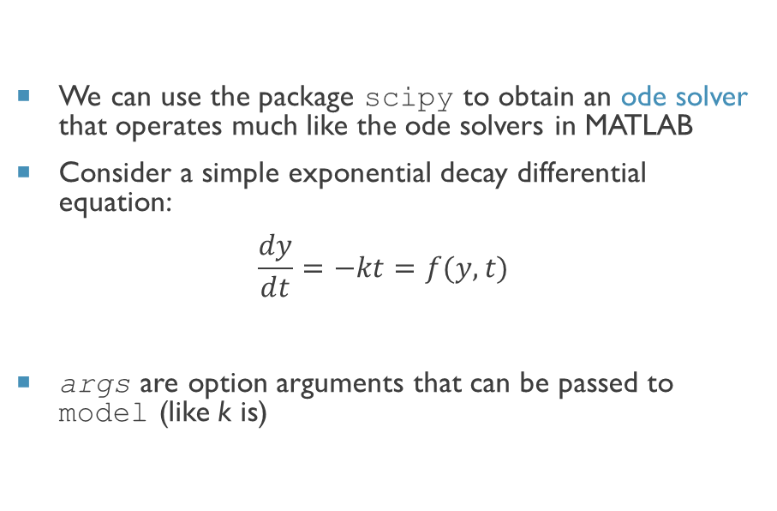
A look at A Python ODE Solver
We can use the package scipy to obtain an ode solver that operates much like the ode solvers in MATLAB
Consider a simple exponential decay differential equation:
$$\frac{dy}{dt}=−kt=f(y,t)$$
args are option arguments that can be passed to model (like k is)
from scipy.integrate import odeint
# function that returns dy/dt def model(y,t,k): dydt = -k * y return dydt # initial condition y0 = 5 # time points t = np.linspace(0,20)
odeint(model, y0, t, args=(k,))

Slide 14
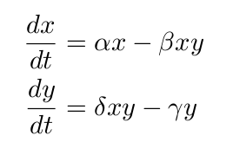
Solving Simultaneous Differential equations
Lotka-Volterra Equations
Simultaneous differential equations are those that contain more than one variable, where the derivative of each variable can depend on any or all other variables, as well as t
Example: Predator-prey model
Solving such equations requires no more than what we talked about – you just need to take advantage of arrays
Let’s Look at odesim.py

