Slide 1

Group 3 CI/CD/CD Continuous Integration | Delivery | Deployment
Sohaib Sohail, John Byrne, Max Palmer

Slide 2
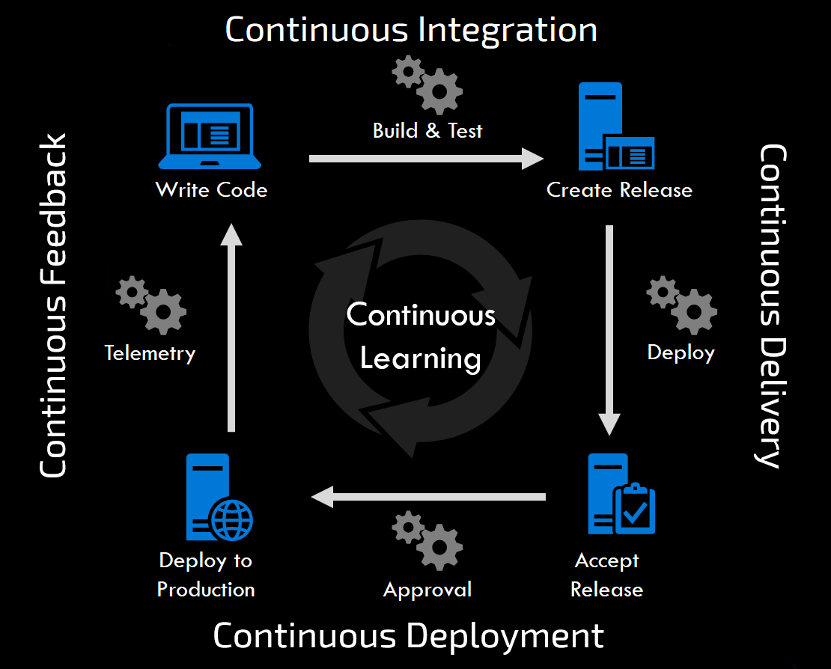
Layout
Continuous integration
Continuous delivery
Continuous deployment
Why do we use it
Jenkins
SDLC
Cloud Computing:
Software as a service
Platform as a service
Infrastructure as a service
Notes:
Introduction - S
Integration – S
Delivery – S
Deployment – S
Why do we use it - J
Jenkins – J
SDLC – J
SaaS - M
PaaS - M
LaaS - M
Comparison of all three - M
- Finished by 3:45/ 4

Slide 3
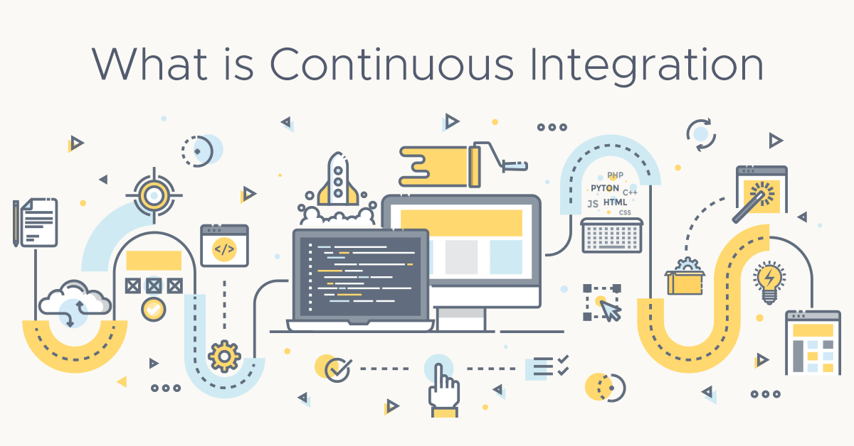
What is continuous integration(CI)?
In software engineering, CI is the practice of merging all developers' working copies to a shared mainline several times a day.
The CI process is comprised of automatic tools that assert the new code’s correctness before integration.
CI is used alongside an Agile methodology.
Notes:
CI is the practice of merging all developers' working copies to a shared mainline several times a day.
CI is a standard fixture of modern high efficiency software development organizations. The best companies have robust CI pipelines and don’t think twice about further efficiency investments.
CI is generally used alongside an agile software development workflow.
The benefits of CI are not limited to the engineering team and applicable to the whole organization.
Enables scaling, in terms of team-size, codebase and infrastructure as code.
Improve feedback
Enhance progression – ensure safe collaboration, progression through the CI pipeline, for example you cannot merge code unless it has passed the test
Challenges
Adoption can be tricky especially if you are coming from NON-CI solution
Thus, considerations need to be made around the existing engineering infrastructure when installing a CI pipeline.
Can be learning curve to learn technologies required, such as version control systems, hosting infrastructure, and orchestration technologies.
Many 3rd party tools exist to aid in CI management and installation. There are many options to choose from. Some popular options are Codeship, Bitbucket Pipelines, SemaphoreCI, CircleCI, Jenkins, Bamboo, Teamcity and many others.

Slide 4
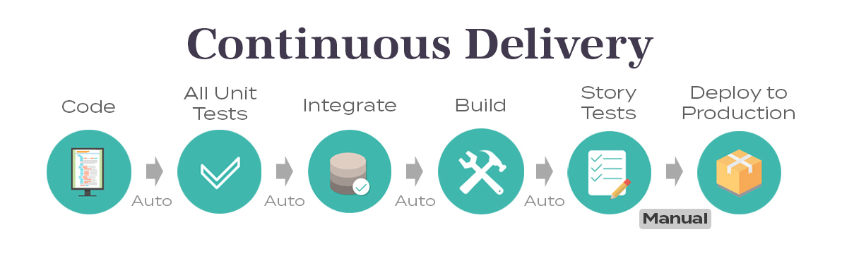
What is continuous delivery(CD)?
CD is the process of automating code changes in real-time.
It’s the concept of deploying software more frequently through push sequences.
It’s also running automated tests on newly published code/software to detect problems.
However, the deployment to production is towards the end.

Slide 5
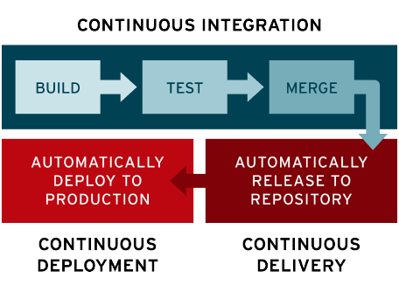
What is continuous deployment(CD)?
This is a one step forward from delivery. The changes which have successfully passed the tests in the continuous delivery process are released to clients.
This is an automated process, and requires no human intervention unless a test fails which would require a new change to be deployed.
Notes:
continuous development:
The key idea is for a client to ask for the current development version of the software to be deployed into production at any given moment.

Slide 6
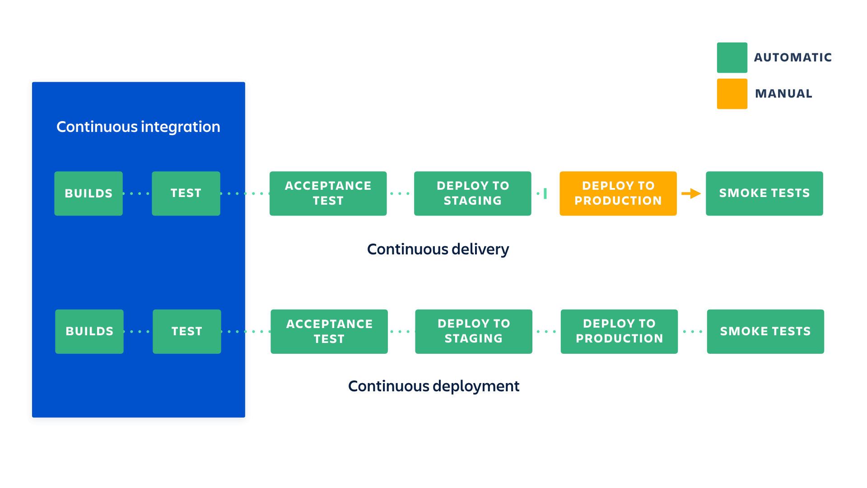
Why do we use it? Benefits, cases and tools
Increased speed of innovation and ability to compete in the marketplace, you automate the process of deployment and allow code to be released much faster.
Code in production is making money instead of sitting in a queue waiting to be deployed
Great ability to attract and retain talent
Higher quality code and operations due to specialisation
Notes:
Organizations that have implemented CI/CD are making revenue on the features they deploy, not waiting for a manual check to see if the code is up to par. They already know the code is good because they have tests that are automated, and continuous delivery means that code is deployed automatically if it meets certain standards. They’ve removed human error and delays from the process.
A good CI/CD strategy means engineers can work on important projects and not worry about time-consuming manual tasks. They can also work confidently knowing that errors are caught automatically, not right before deployment. This cooperative engineering culture inevitably attracts talent.
Dev can focus on dev. Ops can focus on ops. Bad code rarely makes it to production because testing is automated. Developers can focus on the code rather than the production environment, and operations doesn’t have to feel like a gatekeeper or a barrier. Both teams can work to their strengths, and automated handoffs make for seamless processes.
Jenkins is just one of many tools that are available for CI/CD pipelines, there is Gitlab, Microsoft VSTS, Bamboo and many more! All there to automate process.
Use Cases
United Airlines changed their continuous testing paradigm within the company saving $500,000 while increasing code coverage 85%
An online financial trading company used to be able to deploy only after trading hours which meant long nights or weekends for employees. We enabled them to deploy in 45 seconds.

Slide 7
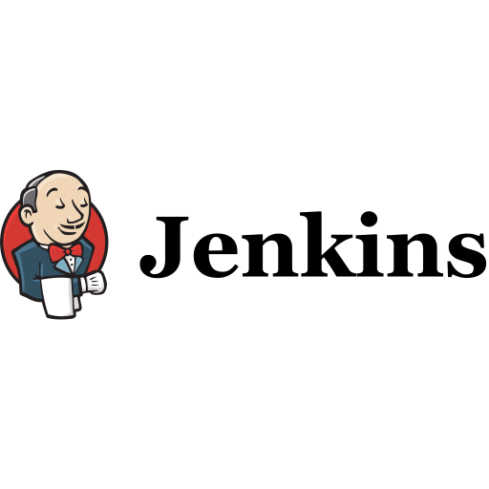
Jenkins
Jenkins is an automation server which is open sourced. It’s the world’s most popular CI/CD server, with companies using the automation of software development processes. The DevOps culture with continuous delivery accelerates the process of software delivery using Jenkins. The Jenkins community offers more than 1700 plugins to integrate with any virtual tool offering unique solutions throughout the continuous delivery process.
Notes:
Bullet points:
Built and tested as developer commits code, can test code many times a day.
Will automatically deploy code into the test server if the build is successful. (Error/ success)
Code is built continuously
Easier to detect problems within code
Save time as process is automated and reduced defects
Deployed continuously after each successful build
The SDLC is now much faster in this fashion of deployment.

Slide 8
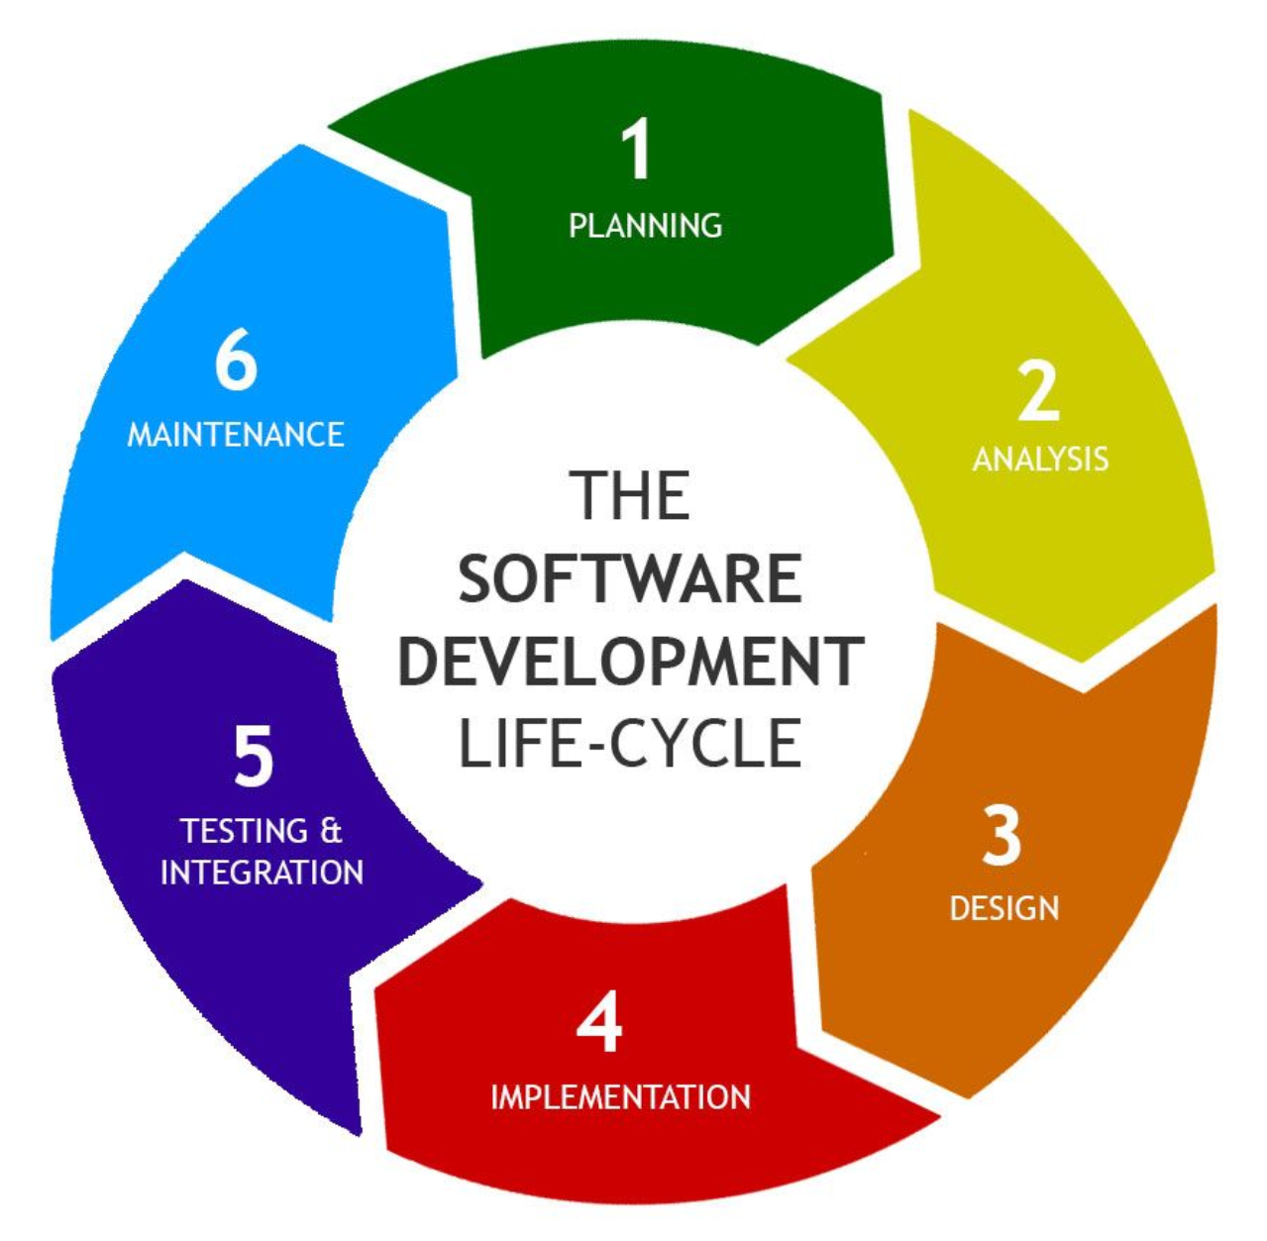
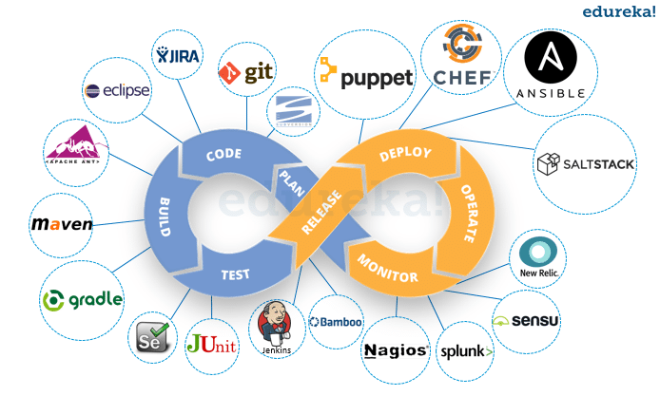
Software development lifecycle(SDLC)
Traditional SDLC
Planning
Analysis
Design
Implementation
Testing and integration – UAT etc.
Maintenance
DEVOPS SDLC
Notes:
Planning – requirements
Analysis – breaking down requirements
Design – creating plan
Implementation – developing software
Testing etc. – testing and integrating software with existing code/ users
Maintenance – alpha and beta release, get feedback
https://arkbauer.com/blog/software-development-life-cycle-sdlc/
UAT = user acceptance testing
Also performance testing
Slow compared to devops
Lots of manual work with little automation
Three years between windows 7 (2009) and windows 8 (2012)

Slide 9
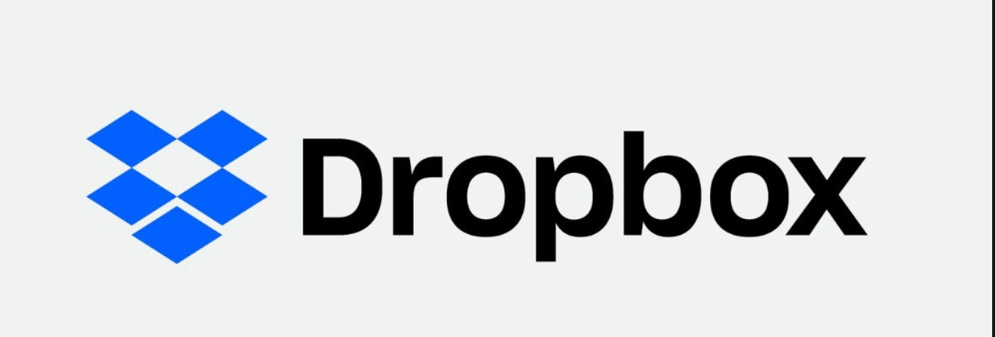

Software as a service(SaaS)
Cloud application services
Internet used to deliver applications
Good to reduce unnecessary tasks and staff workload
However leads to greater need for cyber security
Notes:
Internet use could just be through browser(majority of SaaS services)
Concur is corporate expenses app
https://www.bmc.com/blogs/saas-vs-paas-vs-iaas-whats-the-difference-and-how-to-choose/

Slide 10
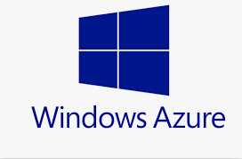
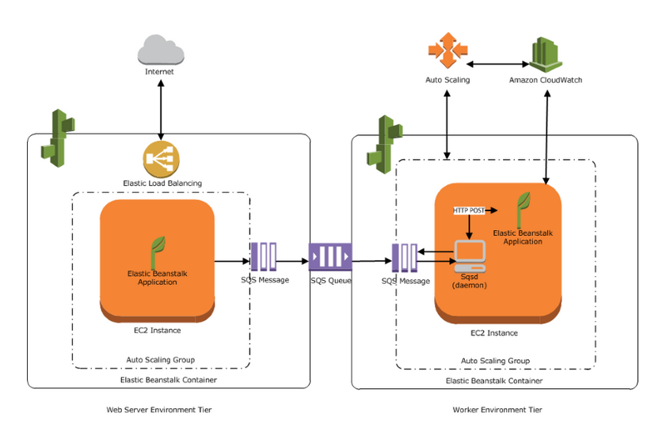
Platform as a service(PaaS)
Provides a cloud framework in which developers can work
Provides a platform for software development
This allows easy automation and scalability for app development
However it increases reliance on others, which affects your ability to change software
Notes:
Also known as cloud platform services
Differs from software as a service as it used more in business to business relationships by providing a platform to work in
Easy automation as you are relying on pre-created 3rd party model
Increases reliance on others – bad for : data security, and custom ability
Top image is AWS elastic beanstalk – tool for web development

Slide 11

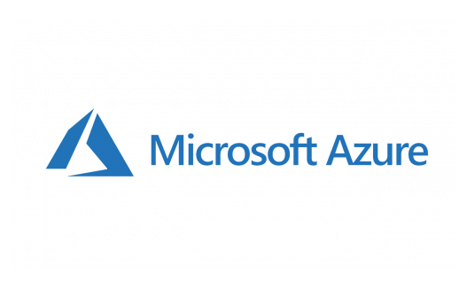
Infrastructure as a service(IaaS)
Delivers cloud computing infrastructure
Allows purchase of resources when needed, through a virtual data centre
Provides powerful flexibility and scalability
But requires training and means some legacy software may not work well
Notes:
Cloud infrastructure = servers, storage, technology, virtualisation technology
Basically is AWS, Microsoft azure etc.

Slide 12
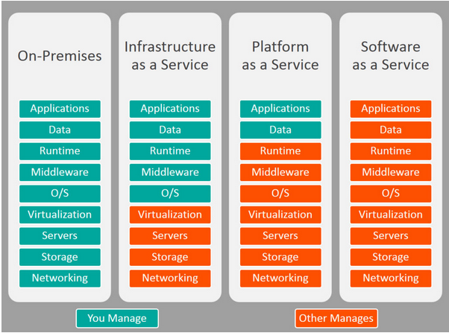
SaaS vs PaaS vs IaaS
Notes:
Everything as a servive – XaaS. Internet of things, data driven

Slide 13
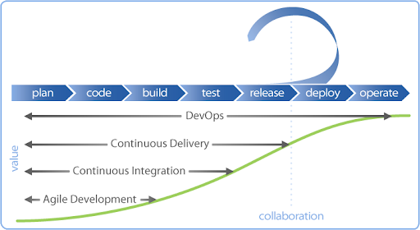
Summary
Notes:
CICD a automated system of project development and deployment
DevOps revolutionised software development
Quicker, more automation

Slide 14

Any Questions?

