Slide 1


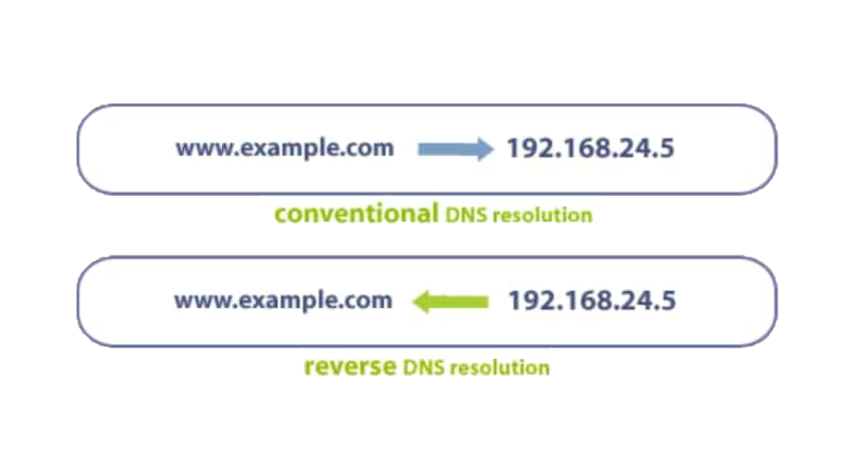

Route 53 and DNS Reverse
Mehdi, Max, Andrew, John

Slide 2
Layout
DNS
Types of record
A Records
CNAMEs
Alias's
MX records
TTLs
Propogation

Slide 3
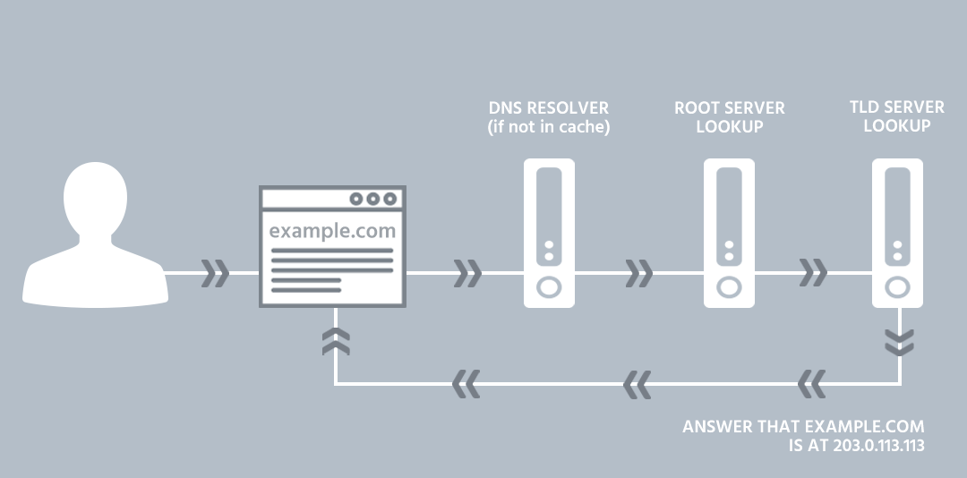

DNS
Stands for Domain Name System
Computers communicate with each other via IP Addresses which are long numerical patterns, which are not user friendly
DNS is used to transfer an actual name such as example.com into those numerical patterns (192.233.4.1)
URLS have a ‘.’ at the end which we do not see, this dot refers to the root of the internet’s name space
Notes:
Stands for Domain Name System
Computers communicate with each other via IP Addresses which are long numerical patterns, not user friendly at all
DNS is used to transfer an actual name such as example.com into those numerical patterns (192.23.34.1)
URLS have a ‘.’ at the end which we do not see, this dot refers to the root of the internet’s name space
First our OS checks if it has the route of this IP in it’s cache, if
not the OS asks a RNS, if this doesn’t it will ask the TLD server
which will tell us the IP associated with the DNS
When a DNS is purchased , the domain registry updates the TLD name servers with how to find the root. Thus when we get to this name server it will tell our operating system to go to server IP ‘192.168.1.1’ to find that web page.
The operating system can store this information in it’s cache, thus meaning if the user tries to access that webpage soon after there will be no need to query all of those servers for the root IP
All of this happens in a matter of milliseconds

Slide 4
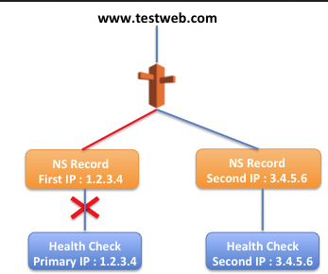
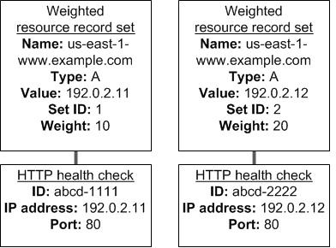
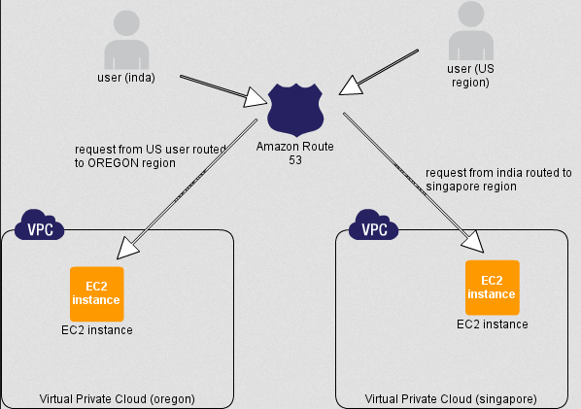
What Amazon Route 53 brings to the DNS tablE
Weighted routing policy, we can assign different numerical weights to multiple servers, thus directing a higher or lower percentage of traffic to each server
Latency-based routing policy, this will direct traffic requests to the server that has the lowest possible latency
Failover routing policy, will send traffic to the primary server if it’s healthy. It if’s failing it will be diverted to back up resources

Slide 5
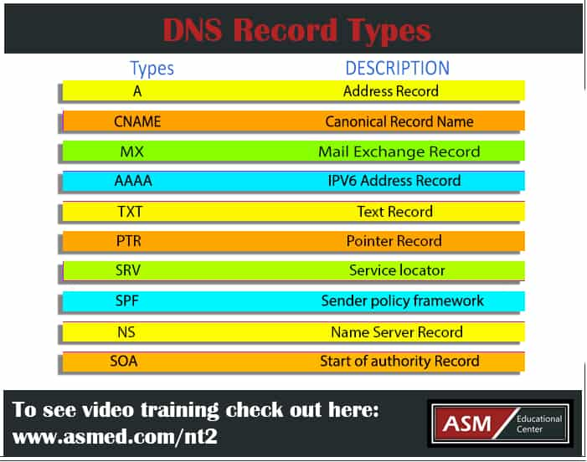
Types of Records
DNS records are instructions that provide information about a domain including what IP address is associated with that domain
They consist of a series of text files written in DNS syntax
All domains are required to have at least a few essential DNS records for a user to be able to access their website using a domain name

Slide 6

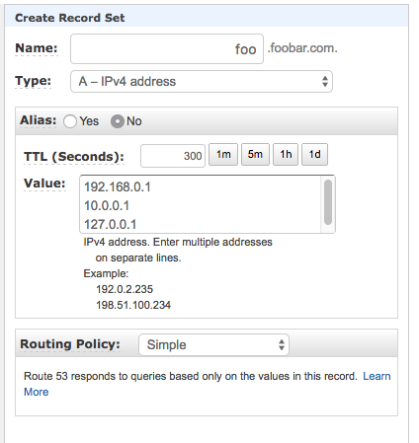
A Records
Stands for 'Address Record'
Used to route traffic to a resource such as a web server, using an IPv4 address
An A record is always an IP address
Used to map your domain name to your server IP

Slide 7
CNAME Records
A CNAME record maps a name to another name
Can NEVER be an IP address
A Record
123.123.123.123
spartaglobal.com
CNAME Record
A Record
www.spartaglobal.com
spartaglobal.com
123.123.123.123

Slide 8

Alias Records
A virtual record type created to provide CNAME like behaviour
Can be used when a CNAME record is not available.
Amazon Route 53-specific virtual record
Creates the same result as CNAME records, just resolves the DNS record differently
Where the CNAME Records has the authoritive server and root name server, the alias just uses an authoritive server
Notes:
Mimics CNAME records for apex domains
For example, if your domain is example.com, and you want it to point to a host name like myapp.herokuapp.com, you can’t use a CNAME record, but you can use an ALIAS record. The ALIAS record will automatically resolve your domain to one or more A records at resolution time, and resolvers see your domain as if it had A records.
4. This is quicker than C Name and can be used anywhere an A record can be used (inc zone apex). Therefore more flexible than CNAME (non usable in zone apex)
- Zone apex is top node of DNS namespace
But is not geo targeted so will get server traffic from server maybe not close to you. E.g. Califronia not new York
Within AWS can only redirect queries to selected aws resources. Cname can redirect NDS queries to any DNS record
https://help.ns1.com/hc/en-us/articles/360017511293-What-is-the-difference-between-CNAME-and-ALIAS-records-
https://support.dnsimple.com/articles/dnsimple-services/
https://docs.aws.amazon.com/Route53/latest/DeveloperGuide/resource-record-sets-choosing-alias-non-alias.html

Slide 9
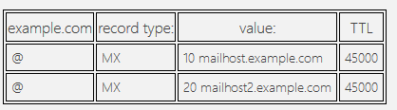
MX Records
Mail exchange record. Directs email to a mail server
Indicates how emails should be routed using Simple Mail Transfer Protocol (SMTP)
Notes:
Similar to CNAME – must point to another domain
In image number before value show preference. First MX record will be done before second as 10<20

Slide 10
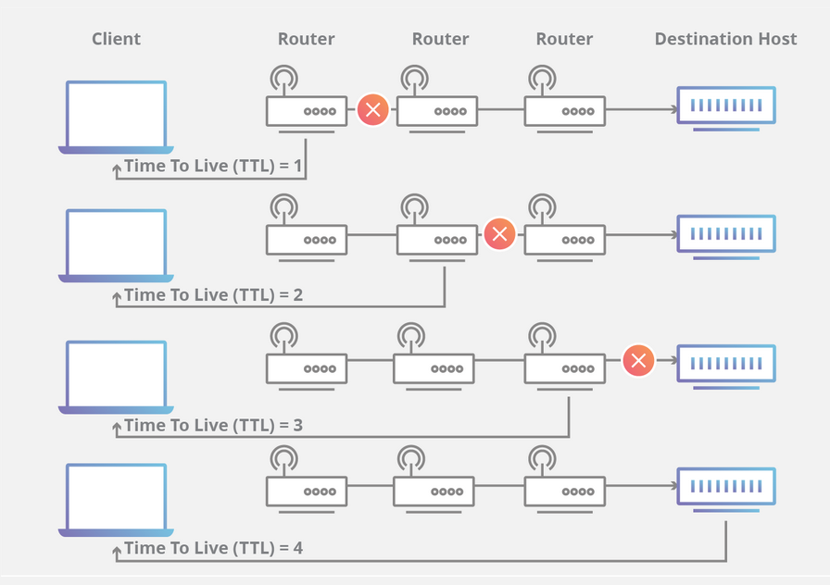
Time to live(TTL)
Time to Live limits the lifespan or lifetime of data in a computer or network.
It is the time for which a DNS resolver caches a response that is associated with every record.
When the time expires the caching server will reach out and receive the current (possibly changed) value for the record.
A TTL of 60 is recommended by AWS when using DNS failover as; this minimizes the time it takes for traffic to stop being directed to a failed endpoint.
Notes:
LINE 1
Prevent a data packet from circulating indefinitely, this can help improve performance.
Helps manage the caching of data. Stop hopping.
TTL can also help determine a packets path through the network.
LINE 2
LINE 3
Each packet has a place where it stores a numerical value determining how much longer it should continue to move through the network.
Every time a router receives a packet, it subtracts one from the TTL count and then passes it onto the next location in the network. If at any point the TTL count is equal to zero after the subtraction, the router will discard the packet and send an ICMP message back to the originating host.
The commonly used network commands ping and traceroute both utilize TTL.
Because each step along the connection is the last stop for one of the packets, each location will return an ICMP message to the sender after discarding the packet. The time it takes for the ICMP message to return to the sender is then used to determine how long it takes to get to each successive hop along the network.
TTL is also used for the context of caching information for a set period of time, which leads me onto my next topic of prop.
Line 4

Slide 11
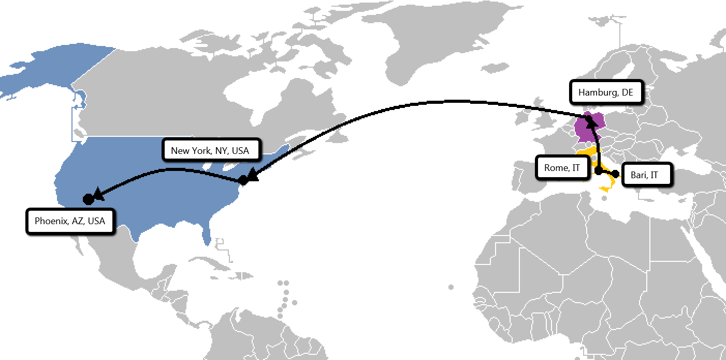
Propagation
If an IP address, or any other information about a hostname is changed or added in a DNS record, these changes need to be propagated to all DNS servers.
Time frame for changes to update across the internet, this can take up to 72 hours.
DNS information lives on local machine. New data won’t take effect on other DNS servers until the TTL expires.
Notes:
LINE 1 : If an IP address, or any other information about a hostname is changed or added in a DNS record, these changes need to be propagated to all systems around the world participating in the DNS process.
LINE 2 : Time frame for changes to update across the internet, this can take up to 72 hours.
LINE 3 :
Issues: the problem with DNS propagation is that it is only as strong as its weakest link. (A DNS resolver refuses to take the change – FAIL)
3 factors – propagation time.:
TTL – The DNS information is allowed live on a local machine or DNS server. When it expires the system purges the DNS information and reaches out to the global network for more. If the TTL is set to 60 minutes, the servers around the world will continue to use the old data for the next hour.
ISP – ISP cache DNS records to allow users to access websites faster, this is done by a single DNS lookup. Sometimes this can ignore the TTL even if its expired, causing propagation to these users even longer.
Domain name register – changing the authoritative name servers, E.G. .com will need to reflect in higher up in the DNS hierarchy in root servers which sometimes have a TTL of 48 hours to prevent overuse.
Reduce TTL, define an exact hostname instead of relying on the DNS to resolve it through propagation.
Simple but can increase propagation time.

Slide 12

Summary
DNS
Record types – A, CNAME, Alias, MX
Time to live
Propogation

Slide 13

Any questions?

