Slide 1
Stars Catalog — Data Quality Audit
Where is the data trustworthy, thin, or incomplete?
For data practitioners · 972 host stars · 5 analytical columns

Slide 2
The Dataset
Source: stars.csv — NASA Exoplanet Archive stellar catalog
972 host stars
10 columns total: identifiers, stellar properties, positional data, num_planets
Columns audited (analytically important stellar properties):
metallicity_fe_h Stellar metallicity [Fe/H] // Requires spectroscopy → most expensive to measure
teff_k Effective temperature (K) // Can be estimated photometrically
distance_pc Distance (parsecs) // Parallax-based; widely available from Gaia
radius_solar Stellar radius (R☉) // Can be estimated from T_eff and luminosity
mass_solar Stellar mass (M☉) // Estimated from stellar models
Left out: star_id, star_name, ra_deg, dec_deg, num_planets — 0 % missing, not analytically risky

Slide 3
Story Hypothesis
Completeness is uneven and concentrated: a single column (metallicity_fe_h) accounts for nearly all missingness, and stars missing that column are data-sparse across the board.
A. Missingness is concentrated in metallicity
metallicity_fe_h is missing 6.2 % of the time vs. <2 % for all other columns. Gap reflects measurement cost: metallicity requires high-resolution spectroscopy; temperature, mass, and radius can be estimated photometrically.
B. Missing metallicity predicts missing everything else
Stars without metallicity show dramatically elevated missingness across all other columns: teff_k is missing 25 % in that group (vs. 0.1 % otherwise), radius_solar 11.7 % (vs. 0.2 %), distance_pc 10.0 % (vs. 0.7 %). These are data-sparse stars, not random gaps.
C. Distance does not explain it
Median distance for stars with vs. without metallicity is nearly identical (~255 pc vs. ~290 pc), ruling out observational depth as the driver. The gap is about which stars received spectroscopic follow-up.

Slide 4
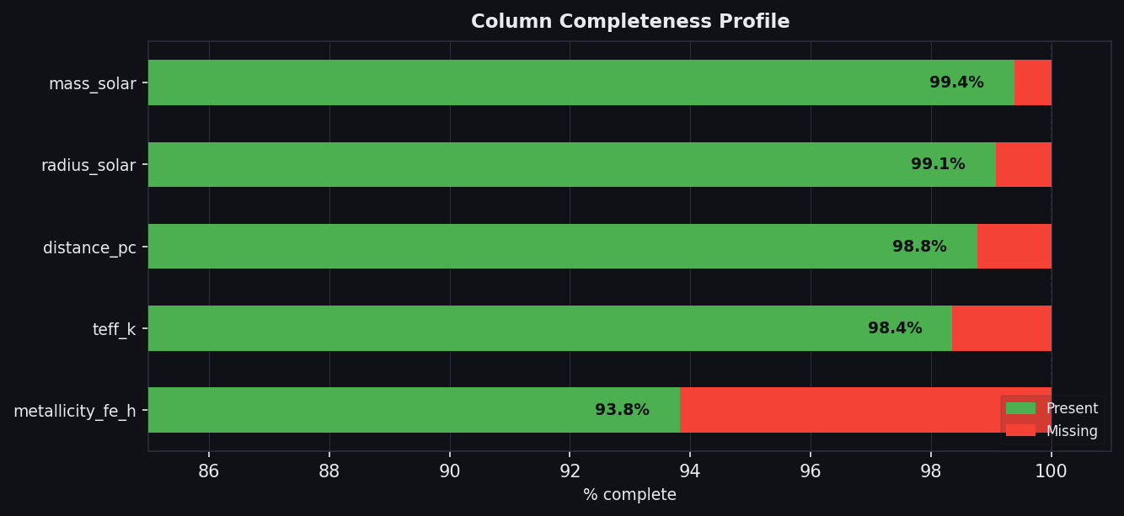
Panel 1 — Column Completeness Profile
Key findings
metallicity_fe_h → 93.8% complete
Clear worst offender — 4× worse than nearest peer
teff_k → 98.4% complete
distance_pc → 98.8% complete
radius_solar → 99.1% complete
mass_solar → 99.4% complete
All other columns ≥ 98.4% complete
Sorted worst → best (metallicity at bottom)

Slide 5
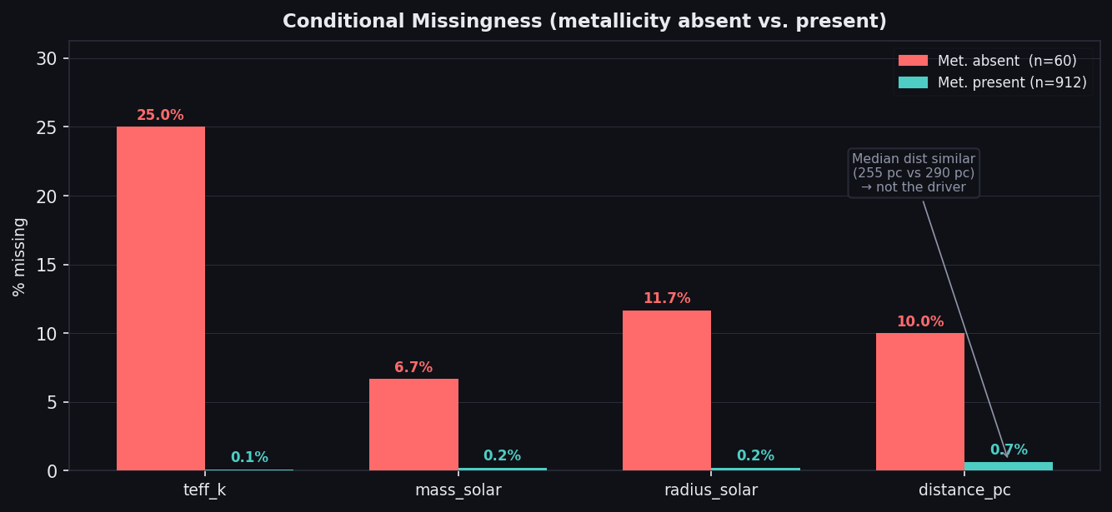
Panel 2 — Conditional Missingness
Key findings
Stars missing metallicity (n=60):
teff_k → 25% missing
radius_solar → 11.7% missing
distance_pc → 10.0% missing
mass_solar → 6.7% missing
Stars with metallicity (n=912):
teff_k → 0.1% missing
All others ≤ 0.7% missing
Median distance similar (~255 vs ~290 pc)
→ distance is not the driver

Slide 6
Risks & Caveats
⚑ Small absent group
Only 60 stars (6.2%) lack metallicity — conditional rates have wider uncertainty. Flag n on Panel 2.
⚑ Co-missingness vs. causality
Missing metallicity correlates with, but does not cause, missing other columns. Frame as 'data-sparse stars', not 'metallicity gap causes other gaps'.
⚑ metallicity_fe_h outlier status
6.2% vs. <2% for peers is striking — could be a pipeline artifact. Flag as 'investigate before using as feature' rather than 'don't use'.
⚑ num_planets completeness masks planet-data gaps
This audit covers stellar columns only. Planet-level data quality is not captured here.
⚑ Snapshot in time
stars.csv is a point-in-time pull. Stars missing data may gain measurements as surveys continue.

Slide 7
What We Built
Deliverables
design_diagram.png — two-panel matplotlib figure (dark theme, 150 dpi)
stars_data_quality_audit.pptx — this 7-slide narrative deck
Methodology
• Loaded stars.csv (972 rows, 10 columns) with pandas
• Computed per-column missingness rates and present-pct across 5 analytical columns
• Split data by metallicity_fe_h presence (absent n=60, present n=912)
• Computed conditional missingness rates for each secondary column in each group
• Panel 1: horizontal bar chart sorted by completeness (worst → best)
• Panel 2: grouped bar chart showing conditional missingness with distance callout
• Composed two-panel figure with shared dark-theme styling
• Generated narrative PowerPoint deck from the same computed metrics
Both scripts are idempotent — re-running produces identical outputs.

