Slide 1
Exoplanet Catalog
Data Quality Audit
Understanding completeness, derived values, and recency gaps before modeling or analysis
Audience: Data Practitioner

Slide 2
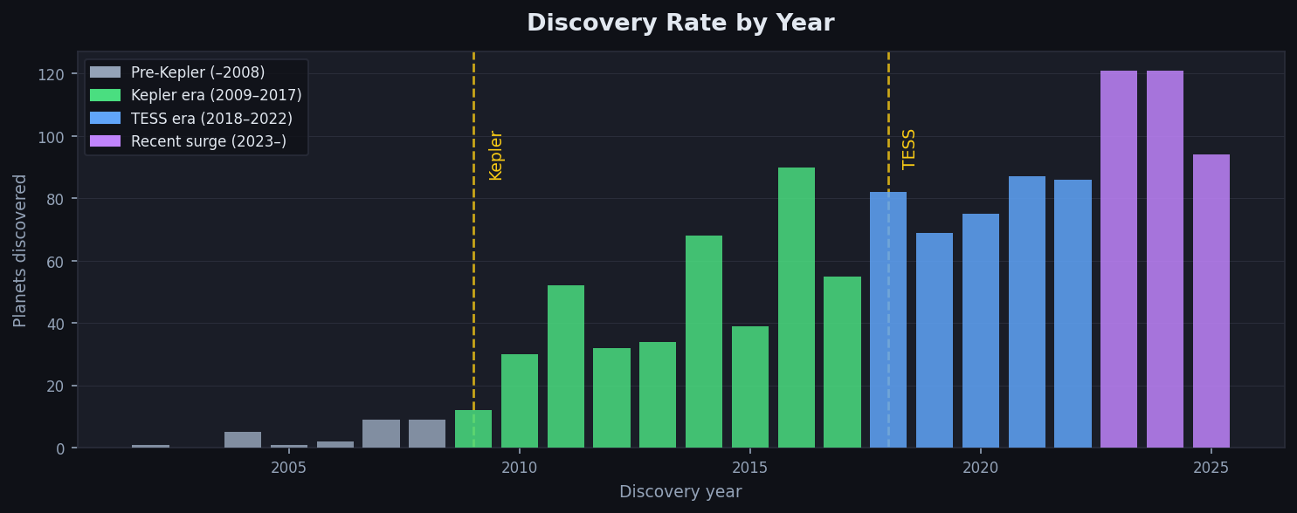
The Dataset
1,173
972
19
96%
2002–2025
exoplanet records
unique star systems
columns
transit-detected
discovery years
Discovery rate exploded after Kepler (2009) and again after TESS (2018). More planets ≠ more complete data.

Slide 3
Story Hypothesis
Completeness in this catalog is uneven and systematic.
A
Missingness is structured, not random
st_met (metallicity) is missing 7× more than peer columns. Spectrometry costs more than photometry — the gaps reflect measurement economics.
B
Measured ≠ computed
pl_eqt_computed flags temperatures derived from stellar models vs. directly observed. A reliability dimension invisible without reading the schema.
C
Recent discoveries are shallower
100+ planets/year since 2023. High-volume survey planets have less follow-up data than earlier discoveries. More rows, thinner rows.

Slide 4
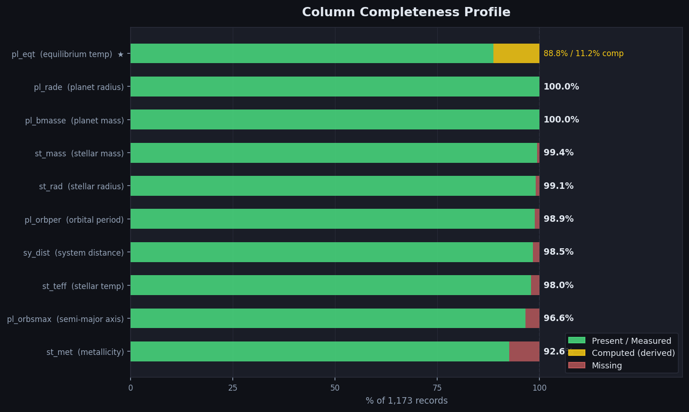
Column Completeness Profile
Covers claims A + B
st_met stands alone at 92.6% — 7× worse than peers. pl_eqt bar is split: green = directly observed, yellow = derived from stellar model.

Slide 5
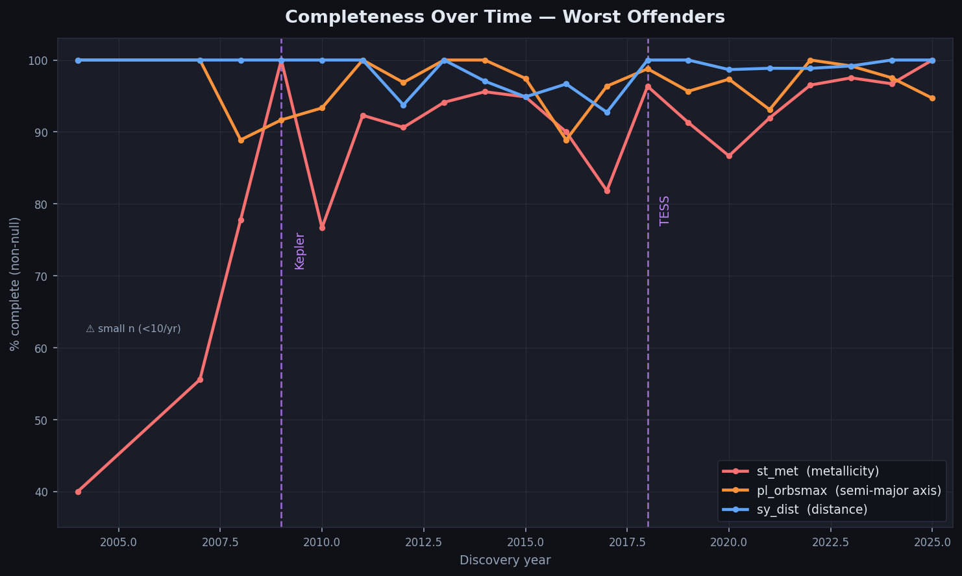
Completeness Over Time — Worst Offenders
Covers claim C
st_met completeness dips after TESS ramp-up (2020+). All columns show volatility pre-2009 due to small sample sizes (<10 planets/yr).

Slide 6
Risks & Caveats
▸
Small year bins
Pre-2009 has <10 planets/year — percentages are noisy. Annotate or bin early years.
▸
Computed ≠ wrong
pl_eqt_computed is a reliability flag, not an error flag. Derived temperatures can be accurate.
▸
Snapshot in time
Recent planets gain follow-up data over time. Completeness will improve — this is a point-in-time view.
▸
Transit bias as confound
96% transit-detected. Missingness may correlate with discovery method, not just recency.
▸
st_met outlier
7% vs <1% for peers is striking — could be a pipeline artifact. Flag for investigation before use as a feature.

Slide 7
What We Built
1
Computed per-column missingness rates and pl_eqt_computed split from 1,173 records
2
Computed per-year completeness for st_met, pl_orbsmax, and sy_dist
3
Panel 1 — horizontal segmented bar chart (present / computed / missing)
4
Panel 2 — line chart with Kepler (2009) and TESS (2018) structural break annotations
5
7-slide deck documenting the full data quality story for a practitioner audience
All outputs are reproducible: run diagram.py for the PNG, build_ppt.py for this deck.

