Slide 1
Introduction to JavaScript

Slide 2
History of JavaScript
Initial version by Brandon Eich for NetScape Navigator version 2 beta, May 1995.
Design points
Syntax lightweight and Java-like.
First-class functions, influenced by Scheme.
Prototype-based object-orientation, influenced by Self (Smalltalk dialect).
Single-threaded but asynchronous event-based execution model, influenced by HyperCard.
Rich runtime functionality – introspection, reflection, garbage collection
Backward compatibility – code written in 1995 still runs.
ECMA standard established 1997, current official version is ECMAScript 8 or ES 2017
AJAX pattern emerges ~2000, and 2004-2005 gets large-scale use in Google Maps, Gmail.
Fast interpreters appear ~2004-08 – Firefox, Chrome. JavaScript and AJAX become the underlying technologies of the Web 2.0 revolution.
As of May 2017, 94.5% of the 10 million most popular websites use JavaScript.

Slide 3
My TODO’s
Create a simple web application to track household chores.

Slide 4
Let’s Get Started
We'll start with a basic HTML document, called index.html, and use an unordered list for the TODO's:
<!DOCTYPE HTML>
<html>
<head>
<title>My TODO’s</title>
</head>
<body>
<ul>
<li>Feed the cat</li>
<li>Rake the lawn</li>
<li>Tidy the garage</li>
</ul>
</body>
</html>

Slide 5
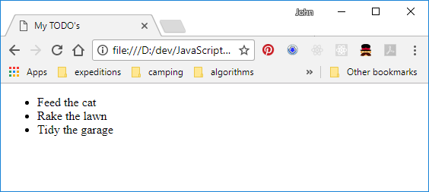
Ta Da!
Hmm, pretty bland.

Slide 6
Give It Some Style
Add a style to the first list item
. . .
<ul>
<li style="height:150px; width:150px;
border-style:solid;
background: #ffc">
Feed the cat
</li>
. . .
And similarly for the other two list items.

Slide 7
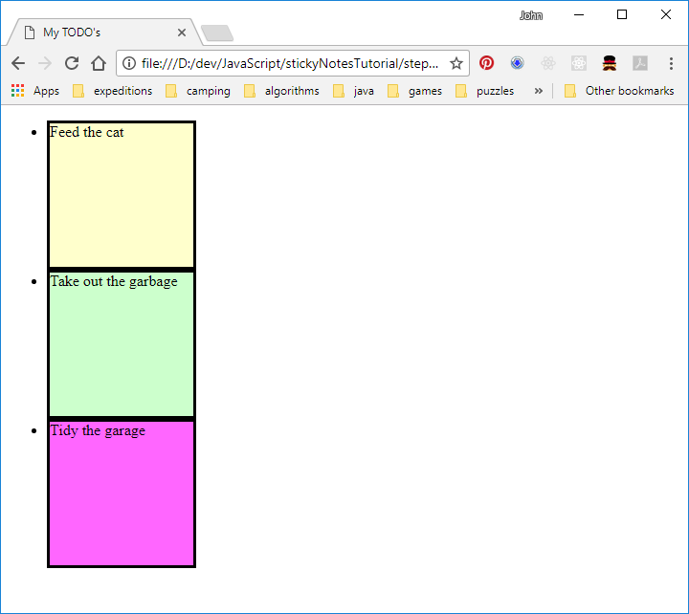
Give It Some More Style
Better …
Needs more work, but first …
What can we do about all the copy-and-paste?

Slide 8
Cascading Style Sheets (CSS)
Used to declaratively apply styling to selected HTML elements
Can completely override the presentation aspects of selected elements
Can add content before or after selected elements
Cannot remove content (but can style it to be invisible)
Cannot affect behavioural aspects of elements (e.g. 'readonly')
Domain of the ‘web designer’

Slide 9
Give It Some CSS
We remove the style=“…” from the list items:
<li style=" . . . ">Feed the cat</li>
<li style=" . . . ">Rake the lawn</li>
<li style=" . . . ">Tidy the garage</li>
And add a CSS link to the html header section:
. . .
<head>
<title>My TODO's</title>
<link type="text/css" rel="stylesheet" href="styles/notes.css" />
</head>
. . .

Slide 10
Give It Some CSS
And put our styling into a styles/notes.css file:
li {
height: 150px; /* make them 150 by 150 pixels */
width: 150px;
border-style: solid; /* with solid black borders */
background: #ffc; /* and a bright yellow background */
}
This specifies that all <li> elements in the document should have those attributes applied to their styles.

Slide 11
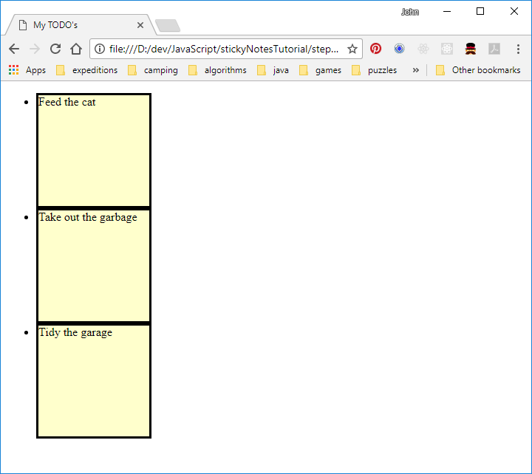
Give It Some CSS
Same results (almost), less work!

Slide 12
CSS Syntax
A CSS file is a series of
<selector> { <attribute>: <value>; … }
Selector types
HTML element tag: e.g. li selects all <li> elements.
.classname selects all elements with the specified class.
#id selects the element with the specified ID.
* selects all elements.
[ attribute] selects all elements having the specified attribute.
[ attribute = value ] selects all elements where the specified attribute has the specified value.
:modifier is a pseudo-class selector, e.g. :hover selects elements when the cursor is hovering over them.
::modifier is a pseudo-element selector, e.g ::after and ::before add content before and after selected elements -- ::before { content: "-->"; } inserts an arrow before every element.

Slide 13
CSS Syntax
Multiple selectors can be combined in a few different ways.
concatenated, means 'and':
p.special selects all <p> elements that also have class name 'special'.
li:hover selects <li> elements only when the cursor is over them.
Space separated, means 'descendant of':
div p selects all <p> elements that have a <div> ancestor.
With an arrow, means 'child of':
div > p selects all <p> elements that are an immediate child of a <div> element.
With a plus sign, means 'after':
img + p selects all <p> elements that immediately follow an <img> element.
With a squiggle, means 'sibling of':
div ~ p selects all <p> elements that are siblings of a <div> element.
Multiple combinations can be specified, comma-separated:
p, div > li selects all <p> elements, and all <li> elements that are children of a <div> element.

Slide 14
Finish the Styling
We can finish styling the list items without all the copy and paste (and add a background shade that's easier on the eyes):
body {
background: #888;
}
li {
height: 150px; /* make them 150 by 150 pixels */
width: 150px;
border-style: solid; /* with solid black borders */
background: #ffc; /* and a bright yellow background */
list-style: none; /* get rid of the bullets */
float: left; /* arrange left-to-right with wrapping */
margin: 15px; /* leave some space between the notes */
padding: 15px; /* leave some space around the text */
box-shadow:
5px 5px 7px rgba(33, 33, 33, .7); /* drop shadow */
}

Slide 15
Finish the Styling
We can find a nice font on Google Fonts, and add a link to the HTML:
<head>
<title>My TODO's</title>
<link type="text/css" rel="stylesheet" href="styles/notes.css" />
<link href="http://fonts.googleapis.com/css?family=Rock+Salt"
rel="stylesheet" />
</head>
Then update the style to apply it to the list items
li {
. . .
font-family: 'Rock Salt', cursive;
font-weight: bold;
font-size: 120%;
letter-spacing: 2px;
}

Slide 16
Finish the Styling
There's a neat way to bring back the colour assortment. We’ll use a ‘pseudo-class’ selector called :nth-child. Other useful pseudo-class selectors: :first-child, :last-child, :hover, :active, :focus.
It happens that nth-child can do 'modular' arithmetic:
li:nth-child(3n) {
background: #ffc;
}
li:nth-child(3n+1) {
background: #cfc;
}
li:nth-child(3n+2) {
background: #f6f;
}

Slide 17
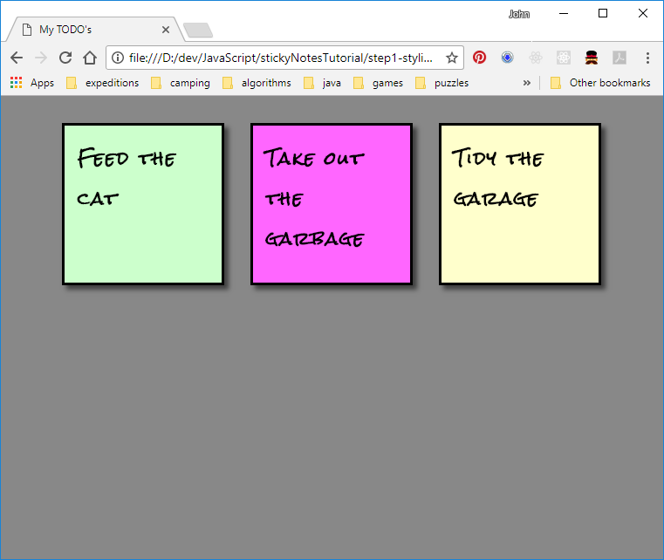
Finish the Styling
Now that’s style!!
The webpage in its current form is available in the repo as the 'step 1 - static' commit.

Slide 18
Document Object Model (DOM)
The DOM is a hierarchy of objects (called elements). These elements expose interfaces that allow JS scripts to interact with the document content and structure, and to register handlers for user interactions.
The root object is a global variable called ‘document’.
The document type may be XML, XUL, … but of course is most commonly HTML.
The document may contain one or more child ‘elements’ (the document itself is also an element).
Elements may contain child elements and attributes.

Slide 19
Document Object Model (DOM)
Document
head
body
title
ul
li
li
li
text: feed the cat
style: “…”

Slide 20
DOM Properties and Methods
Useful properties of document:
The main document elements: body, head, title, documentElement (html)
Some other properties: URL, baseURI, cookie, referrer
Useful properties of element:
className, id, innerHTML, style
Others like value, text are element-specific
Useful methods of document:
getElementById(id), createElement(tag)
Useful methods of elements:
getElementsByClassName(name), getElementsByTagName(tag)
querySelector(cssSelectors), querySelectorAll(cssSelectors)
appendChild(element), removeChild(element), remove()
getAttribute( name ) , setAttribute( name, string ), removeAttribute( name )

Slide 21
Making the Notes Draggable
All elements inherit the EventHandler interface, which allows handlers for specific types of events to be attached. We will use three event handlers.
onmousedown ( mouseEvent )
Called when a mouse button is pressed while over the element. The mouseEvent has x, y coordinates, button ID, shify/ctrl/alt key states, …
Save the current x, y coordinates of the mouse, and attach the onmousemove/onmouseup handlers.
onmousemove ( mouseEvent )
Called when the mouse is moved while over the element.
Update the note position and save the new current x,y coordinates.
onmouseup ( mouseEvent )
Called when a mouse button is released while over the element.
Detach the onmousemove/onmouseup handlers.

Slide 22
The onmousedown handler
<head>
. . .
<script>
var currX, currY;
function startDragging() {
var e = window.event;
var elem = e.currentTarget;
// get the current mouse cursor position
currX = e.clientX;
currY = e.clientY;
// set handlers for mouse move, up
elem.onmousemove = continueDragging;
elem.onmouseup = endDragging;
}
</script> </head>

Slide 23
The onmousemove handler
<script>
function startDragging(e) {
. . .
}
function continueDragging() {
var e = window.event;
var elem = e.currentTarget;
// calculate the mouse movement
offsetX = e.clientX - currX;
offsetY = e.clientY - currY;
currX = e.clientX;
currY = e.clientY;
// set the element's new position:
elem.style.top = (elem.offsetTop + offsetY) + "px";
elem.style.left = (elem.offsetLeft + offsetX) + "px";
}
</script>

Slide 24
The onmouseup handler
<script>
function continueDragging(e) {
. . .
}
function endDragging() {
var e = window.event;
var elem = e.currentTarget;
// clear the handlers when the mouse button is released
elem.onmousemove = null;
elem.onmouseup = null;
}
</script>

Slide 25
Hook up the onmousedown handler to the list items
Add to each <li> tag in index.html:
<li onmousedown="startDragging()">Feed the cat</li>
<li onmousedown="startDragging()">Take out the garbage</li>
<li onmousedown="startDragging()">Tidy the garage</li>

Slide 26
Allow the notes to be positioned absolutely
By default HTML elements are positioned relative to the preceding element, in a left-to-right, top-to-bottom document ‘flow’.
This can be modified by style attributes – we need to change the following in notes.css:
li {
. . .
float: left; /* arrange left-to-right with wrapping */
margin: 15px; /* leave some space between the notes */
position: absolute; /* will be positioned by setting top & left */
}

Slide 27
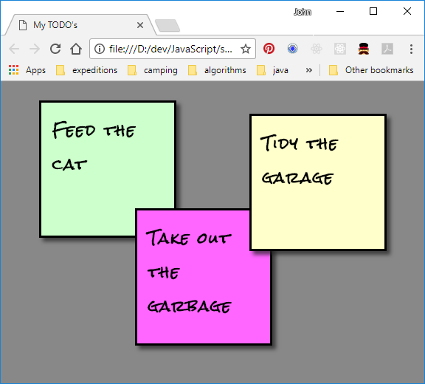
Draggable!
The notes will initially be on top of each other (due to the position: absolute attribute)
They can be dragged to new locations (don’t drag too fast!)
This version of the page is available in the 'step 2 - draggable' commit of the repo

Slide 28
Clean up the HTML
Our HTML file is getting a little messy – let’s clean it up. We can move all of our JavaScript into its own file – scripts/draggable.js.
Then add a link to it in the document head:
<script src="scripts/draggable.js" type="application/javascript"></script>
This has no effect on the page.

Slide 29
Closures
A ‘closure’ is a function along with the scope in which it was declared.
Let's try this simple function:
function show() {
var item = "The item";
function showItem() {
alert(item);
}
showItem();
}
show();
As you would expect, the call to alert() displays the value of item from the surrounding scope.

Slide 30
Closures
Instead of displaying the item, now we'd like the outer function to just return a function that we can call later to do the actual display. This type of function, whose purpose is to create or modify another function is known as a higher-order function :
function makeShowFunction() {
var item = "The item";
function showItem() {
alert(item);
}
return showItem;
}
var showFunction = makeShowFunction();
showFunction();
When makeShowItem returns the reference to showItem, that function reference is accompanied by the surrounding scope – it still has access to the value of item.
Don’t try this in C++!

Slide 31
Closures
The captured scope could also include parameters:
function makeShowFunction(item) {
function showItem() {
alert(item);
}
return showItem;
}
var showFunction1 = makeShowFunction("Item 1");
var showFunction2 = makeShowFunction("Item 2");
showFunction1();
showFunction2();
Each instance of showItem that is returned captures the scope in which it was created.
makeShowFunction is called twice, so two scopes are created, each with their own instance of item.

Slide 32
Closures
Here is a common error:
function makeShowFunctions() {
var item = "item 1";
function showItem1() {
alert(item);
}
item = "Item 2";
function showItem2() {
alert(item);
}
return [ showItem1, showItem2 ];
}
var showFunctions = makeShowFunctions();
showFunctions[0]();
showFunctions[1]();
There is only one scope, shared by both functions, and only one copy of item.

Slide 33
Closures – Exercise 1
The setTimeout( millis, function) can be used to tell JavaScript to call a function after the specified delay.
Say we want a function that will pop up a specified number of alert boxes, 100 milliseconds apart. Let's try this:
function doAlerts(n) {
for (var i = 0; i < n; i++ ) {
setTimeout( function() { alert("Alert number " + i); },
i * 100
);
};
}
doAlerts(3);
Try it out … oops! Can you fix it? You can find this broken version in the 'exercise 1' commit of the repo.

Slide 34
Closures – Exercise 1
Here's one way:
function setTheAlert(i) {
setTimeout( function() { alert("Alert number " + i); }, i * 100);
}
function doAlerts(n) {
for (var i = 0; i < n; i++ ) {
setTheAlert(i);
};
}
doAlerts(3);
Each call to setTheAlert is capturing the current value of i in a closure, so that it's preserved for later on when the function that does the alert is invoked.

Slide 35
Encapsulate the event handlers, using closures
We can use a closure to improve the reliability of our event handlers. In draggable.js, enclose our event handlers in an outer function by wrapping all of the existing code in:
function makeDraggable(elem) {
. . .
}
The startDragging function is no longer visible to the HTML, so we remove it from the <li>'s (we'll hook it back in using a different method later on):
<li onmousedown="startDragging()">Feed the cat</li>
<li onmousedown="startDragging()">Take out the garbage</li>
<li onmousedown="startDragging()">Tidy the garage</li>

Slide 36
Encapsulate the event handlers, using closures
The element 'elem' is captured in a closure that's available to all three of our dragging functions. So we no longer need to rely on event.currentTarget, and the dragging will be more reliable.
Because we will hook the event handlers directly into the DOM, we can use the fact that the event is actually passed to the event handler as a parameter. We'll use window.event just as a fallback:
function startDragging(e) {
e = e || window.event;
var elem = e.currentTarget;
function continueDragging(e) {
e = e || window.event;
var elem = e.currentTarget;
function endDragging(e) {
e = e || window.event;
var elem = e.currentTarget;

Slide 37
Encapsulate the event handlers, using closures
We don't need to use event.currentTarget any more, so once we start dragging we can attach the onmousemove and onmouseup handlers to the document.
In startDragging:
// set handlers for mouse move, up
elem document.onmousemove = continueDragging;
elem document.onmouseup = endDragging;
And in endDragging:
// clear the handlers when the mouse button is released
elem document.onmousemove = null;
elem document.onmouseup = null;

Slide 38
Encapsulate the event handlers, using closures
Lastly, we need to hook startDragging back into the <li>'s. We can do this at the top of makeDraggable:
function makeDraggable(elem) {
var currX, currY;
elem.onmousedown = startDragging;
. . .
Right now makeDraggable is just a function declaration, no one ever calls it. So we add to the very bottom of draggable.js (outside the makeDraggable function):
window.onload = function() {
for (var elem of document.getElementsByTagName("li")) {
makeDraggable(elem);
}
}
When a script is loaded, everything in the 'outer block' is executed. The anonymous function will be called once the document has been loaded, hooking up the <li>'s.

Slide 39
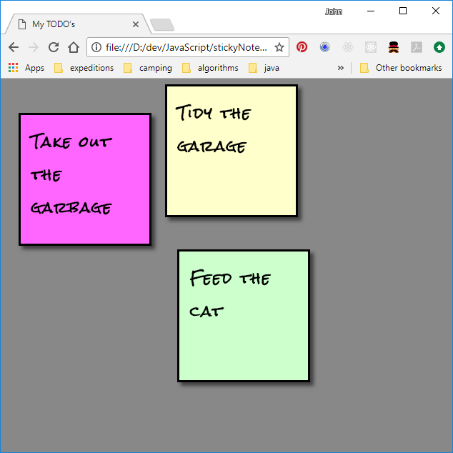
Try it out
The web page is it appears now is available in the repo as the 'step 3 - closure' commit.
The notes should drag more reliably now.
There are still issues where the text gets selected, but this is more complicated to resolve.

Slide 40
Tidy up
We're not getting any value from the unordered list, in fact it's adding some complexity to the positioning.
HTML defines two 'generic container' elements that have no inherent properties:
<div> elements are used to contain things that should not be broken across lines.
<span> elements are used to contain text that can be broken across lines.
Because multi-level <div>'s are commonly used to structure a page, we usually give them a class name so they can be identified.
In index.html, we'll get rid of the <ul> and change the <li>'s to <div>'s with class name 'note':
<body>
<div class="note">Feed the cat</div>
<div class="note">Take out the garbage</div>
<div class="note">Tidy the garage</div>
</body>

Slide 41
Tidy up
We need to update the CSS to match. Instead of using tag selectors, we'll make use of the class name we assigned to the notes. Also, we don't need the list-style attribute any more:
.note {
height: 150px;
. . .
list-style: none;
}
.note:nth-child(3n) {
background: #ffc;
}
.note:nth-child(3n+1) {
background: #cfc;
}
.note:nth-child(3n+2) {
background: #f6f;
}

Slide 42
Tidy up
Lastly, we need to fix the code that attaches the onmousedown event handler to the notes. In draggable.js, update the window.onload handler:
window.onload = function() {
for (var elem of document.getElementsByClassName("note")) {
makeDraggable(elem);
}
}
This version is available in the 'step 4 - divs' commit of the repo. Test it out, there should be (almost) no difference.

Slide 43
Editable notes
It would be nice to be able to edit our notes right on the page, instead of having to edit index.html.
This can be quickly done by using a <textarea> element. Update index.html to add a <textarea> inside the <div> for each note:
<div class="note"><textarea>Feed the cat</textarea></div>
<div class="note"><textarea>Take out the garbage</textarea></div>
<div class="note"><textarea>Tidy the garage</textarea></div>
Let's try that out …

Slide 44
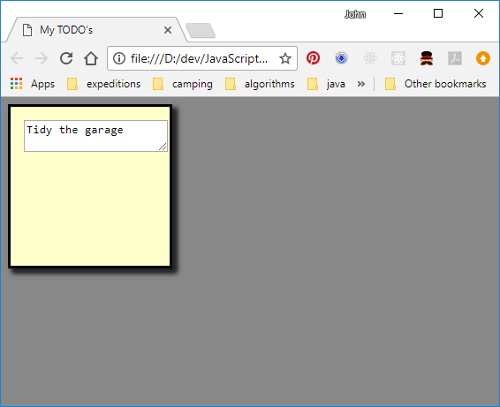
Editable notes
Hmm, not so nice looking.

Slide 45
Editable notes
We lost some styling and the text area comes with visuals that don't quite work.
Let's make that text area the right size first. In notes.css, add a selector and some sizing attributes:
.note>textarea { /* <textarea>'s that are children of a class="note" element */
width: 100%; /* make them as big as their container */
height: 100%;
}
Then we get rid of the resize handle, and remove the borders, selection outline and background:
.note>textarea { /* <textarea>'s that are children of a class="note" element */
. . .
resize: none; /* no resize handle */
background: transparent; /* transparent */
border: none; /* no border */
outline: none; /* no outline when selected */
}

Slide 46
Editable notes
And, transfer the font-related attributes from the .note class to the text area:
.note {
. . . font-family: 'Rock Salt', cursive;
font-weight: bold;
font-size: 120%;
letter-spacing: 2px;
}
.note > textarea {
. . . font-family: 'Rock Salt', cursive;
font-weight: bold;
font-size: 120%;
letter-spacing: 2px;
}

Slide 47
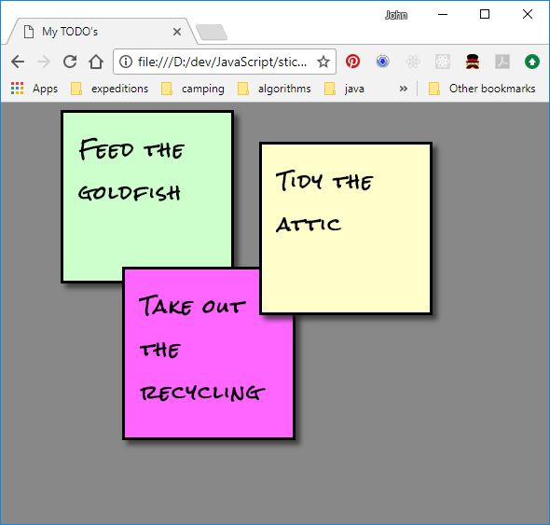
Editable notes
Try it out, you should be able to update your chores
This version of the page is available in the step 5 - editable commit.

Slide 48
Action bar
How to edit the note is a little non-obvious, and the dragging functionality interferes a little. Let's add an action bar with an edit button to explicitly edit a note.
We first add a new <div> to each note; this will be the container for the action bar. The textarea is changed to be read-only initially:
<body>
<div class="note">
<div class="action"></div>
<textarea readOnly=true>Feed the cat</textarea>
</div>
<div class="note">
<div class="action"></div>
<textarea readOnly=true>Take out the garbage</textarea>
</div>
<div class="note">
<div class="action"></div>
<textarea readOnly=true>Tidy the garage</textarea>
</div>
</body>

Slide 49
Action bar
We'll create a new script for the editability aspect - editable.js. So we add a script link into the HTML head:
<head>
. . .
<script src="scripts/editable.js" type="application/javascript"></script>
</head>
We'll also need an icon for our edit button - https://material.io/icons is a good spot to find one.
We'll download the SVG version of the 'edit' icon to the images subdirectory (it's called ic_edit_black_24px.svg).

Slide 50
Action bar
We'll use a pattern similar to 'draggable'. When we make a note editable, we'll set up its action bar.
function makeEditable(note) {
var actionBar = note.getElementsByClassName("action")[0];
var editButton = document.createElement("img");
editButton.src = "images/ic_edit_black_24px.svg";
editButton.className = "edit button";
editButton.onclick = startEdit;
actionBar.appendChild(editButton);
}
function startEdit() {
// TODO
}
window.onload = function() {
for (var note of document.getElementsByClassName("note")) {
makeEditable(note);
}
}

Slide 51
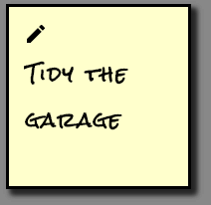
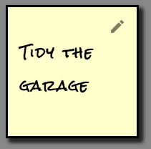
Action bar
The icon would look better at the right hand end.
Also, let's make it lighter and darken it when the cursor is over it.
We can do this with a couple more style specifications:
.button {
opacity: 0.5;
float: right;
}
.button:hover {
opacity: 1;
}

Slide 52
Action bar – Exercise 2
Now let's make the button do something. Checkout the 'exercise 2' commit of the repo and fill in the startEdit function in editable.js. You can modify the html if you need to. We just need to set the 'readonly' attribute of the textarea back to false so we can edit it.
Hints:
When startEdit is called, it will be passed a MouseEvent which isn't too useful. But also the built-in this variable will be set to point to the edit button element – this will be useful.
Elements have a useful property called parentElement.
There are various ways to find a child of an element:
element.getElementsByClassName("class")
element.getElementsByTagName("tag")
element.querySelector("selector"), element.querySelectorAll("selector")
https://developer.mozilla.org and https://www.w3schools.com are good resources for more info
When you're done, save and try it out in the browser. If it's not working, see if you can debug it.

Slide 53
Action bar – Exercise 2
Here's one way that's simple and no need to change the HTML.
function startEdit() {
var actionBar = this.parentElement;
var note = actionBar.parentElement;
// make the textarea editable
note.querySelector("textarea").readOnly = false;
}
Bonus points if you updated the HTML to give the <textarea>'s a unique class name, then used note.getElementsByClassName() – this is a more robust solution.

Slide 54
Action bar
Still have a little work to do:
Need a way to get out of 'edit' mode.
What happened to the draggability?
When we're in edit mode, we'll replace the 'edit' button with 'done' and 'cancel' buttons.
First, we need some more icons. We'll use the 'done' and 'clear' buttons from https://material.io/icons (ic_done_black_24px.svg and ic_clear_black_24px.svg).

Slide 55
Action bar
In editable.js, we add the following to the end of the makeEditable function to create some extra buttons. Note we give these buttons an extra class name – 'button_hidden'. We hook these buttons up to some functions that we haven't written yet.
function makeEditable() {
. . .
var cancelButton = document.createElement("img");
cancelButton.src = "images/ic_clear_black_24px.svg";
cancelButton.className = "cancel button button_hidden";
cancelButton.onclick = cancelEdit;
actionBar.appendChild(cancelButton);
var doneButton = document.createElement("img");
doneButton.src = "images/ic_done_black_24px.svg";
doneButton.className = "done button button_hidden";
doneButton.onclick = saveEdit;
actionBar.appendChild(doneButton);
}

Slide 56
Action bar
When we start editing a note, we'll want to hide the edit button, and display the done and cancel buttons. We'll do this by adding or removing the button_hidden class:
function startEdit() {
. . .
// update button visibility
actionBar.querySelector(".edit").classList.add("button_hidden");
actionBar.querySelector(".done").classList.remove("button_hidden");
actionBar.querySelector(".cancel").classList.remove("button_hidden");
}
What's this button_hidden - some kind of built-in magic?
Nope, but all we need to do is to add a style to the CSS:
.button_hidden {
display: none;
}

Slide 57
Action bar – Exercise 3
Time for another exercise – checkout the 'exercise 3' commit of the repo and fill in the saveEdit function. It needs to hide the cancel and done buttons, and display the edit button. It also needs to set the <textarea> back to read-only.
Remember:
The function gets a built-in 'this' variable that is set to the button that was clicked. Elements have a useful property called parentElement.
There are various ways to find a child of an element:
element.getElementsByClassName("class")
element.getElementsByTagName("tag")
element.querySelector("selector"), element.querySelectorAll("selector")
element.classList.add("class") and element.classList.remove("class") to add/remove a class name.
https://developer.mozilla.org and https://www.w3schools.com are good resources for more info

Slide 58
Action bar
Here's one way:
function saveEdit() {
var actionBar = this.parentElement;
var note = actionBar.parentElement;
// update button visibility
actionBar.querySelector(".edit").classList.remove("button_hidden");
actionBar.querySelector(".done").classList.add("button_hidden");
actionBar.querySelector(".cancel").classList.add("button_hidden");
// make the textarea uneditable
note.querySelector("textarea").readOnly = true;
}

Slide 59
Action bar – Exercise 4
Let's do another exercise – checkout the 'exercise 4' commit (or just continue if you got your save button working nicely), and finish the functionality for cancel.
We'll want to save the existing contents of the <textarea> when we start editing, and restore them if the cancel button is pressed.
If you have the idea to call one event handler from another, you need to make sure to give it a this reference that will work. There are a number of possibilities:
saveEdit() will not work because the this pointer will be 'window' (or 'undefined' depending on strict mode)
saveEdit.apply(this) will call saveEdit with the same this reference as was passed to us.
saveEdit.apply(saveButton) will call saveEdit with this set to the saveButton element.
saveButton.onclick() will call the onclick handler for the save button (which is saveEdit) with this set to the saveButton element.
saveButton.saveEdit() will not work because saveEdit is not a method of the saveButton element.

Slide 60
Action bar – Exercise 4
Here's a simple way –once we've restored the original text, we can just leverage the save functionality to do the rest. We just have to make sure it gets a usable this reference.
var savedText;
function startEdit() {
. . .
// save the current text
savedText = note.querySelector("textarea").value;
}
function cancelEdit() {
var actionBar = this.parentElement;
var note = actionBar.parentElement;
note.querySelector("textarea").value = savedText;
actionBar.querySelector(".done").onclick();
}

Slide 61
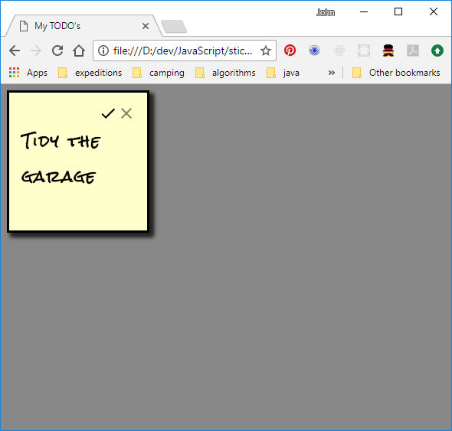
Try it out
We should have save and cancel buttons working properly.
The web page at this point is available in the 'step 6 ‑ action bar' commit of the repo.

Slide 62
Modularity
OK, now to figure out what happened to draggability. Any ideas?
Oh right, there's only one window and it has only one window.onload property, so we can't hook up two different initialisation functions to it.
In JavaScript, functions are just like any other value. So we can use a standard 'chaining' pattern. We'll change the window.onload function in editable.js to look like:
var prevOnload = window.onload;
window.onload = function() {
. . .
if (prevOnload) {
prevOnload.apply(this, arguments);
}
}

Slide 63
Modularity
And we'd better do the same to draggable.js just in case:
var prevOnload = window.onload;
window.onload = function() {
for (var elem of document.getElementsByClassName("note")) {
makeDraggable(elem);
}
if (prevOnload) {
prevOnload.apply(this, arguments);
}
}
This version of the page is available in the 'step 7 – fix drag' commit of the repo. Try it out again. Excellent, we have our dragging capability back.

Slide 64
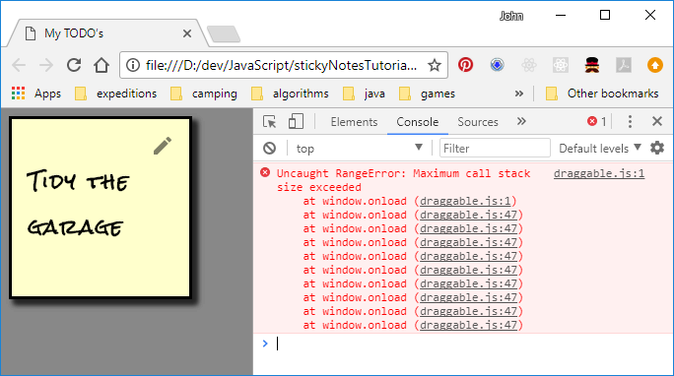
Modularity
But if we check the console window – oh oh!
The problem is that we have only one 'prevOnload' variable, in global scope.
The way to create a local scope in JavaScript is by using a function.
(However namespaces and domains are recent additions to the language and can also create scope.)

Slide 65
Modularity
We will enclose all of the code in our two modules inside an 'immediately invoked function expression' or IIFE. This is standard practice, to prevent collisions in the global scope. In both draggable.js and editable.js, enclose all of the existing code inside:
(function() {
. . .
. . .
} () )
What you say?! Let's break that down:
The inside part is a normal function declaration. It's anonymous, to avoid polluting the global scope with an unnecessary name. This is the function() { … } part. It's basically a 'function literal'.
This is followed by empty parentheses, indicating the function we just declared is to be called immediately, with an empty parameter list.
The outermost pair of parentheses is just to prevent JavaScript from complaining about an anonymous function declaration. It changes the syntax to a function expression, which is allowed to be anonymous.

Slide 66
Modularity
The effect of enclosing our module inside an IIFE is to hide everything we declare inside it from the outside world, by creating a local scope.
Because we now have two different prevOnload vars residing in different scopes, we don't see any nasty console messages.
Have you noticed that while you're editing a note, it's difficult to select a range of text with the mouse? The silly note just gets dragged.
Let's fix that. In the process, we'll see how to export public entry points from a module, then we'll move on and finally put this page onto a web server.

Slide 67
Modularity
First, we'll add a function to draggable.js to make the note undraggable:
(function() {
function makeUndraggable(elem) {
elem.onmousedown = null;
}
function makeDraggable(elem) {
. . .
Now we would like to call makeUndraggable from editable.js when we start editing, and call makeDraggable again when we're finished. But these functions are not visible outside of the IIFE in draggable.js.

Slide 68
Modularity
But we can export them. First, we assign the return value from the IIFE in draggable.js to a global variable:
var draggable = (function() {
Then, at the bottom of draggable.js, we can have it return an object that contains the two entry points that need to be 'public':
return {
makeDraggable: makeDraggable,
makeUndraggable: makeUndraggable
};
} () )

Slide 69
Modularity
In editable.js, we can now access these entry points as follows:
function startEdit() {
. . .
// make it undraggable
draggable.makeUndraggable(note);
}
function saveEdit() {
. . .
// make it draggable again
draggable.makeDraggable(note);
}

Slide 70
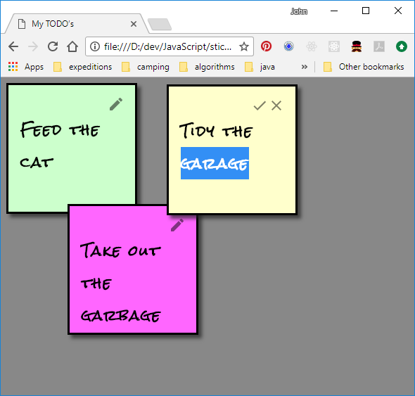
Modularity
Much better!
This version of the page is available in the 'step 8 – fix select' commit of the repo.
Time to put a server behind this page.

Slide 71
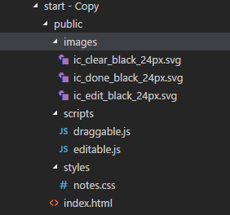
Static web server
The first step is to get a web server that can deliver the 'static assets' – the html, css, images and javascript that make up the page.
For security reasons, these are usually placed in a subdirectory so that our server-side machinery is not accessible on the web.
We create a subdirectory called 'public, and move everything - index.html, and the images, styles and scripts subdirectories -into it (preserving the directory structure).

Slide 72
Static web server – Exercise 5
Checkout the 'exercise 5' commit and in the main directory, create a file called package.json that describes our application:
{
"name": "stickynotes",
"version": "0.1.0",
"main": "app",
"dependencies": {
"express": "4.16.2"
}
}
Open a command prompt in the main directory. Enter the command:
> npm install

Slide 73
Static web server
You should see about 48 packages installed – the express packages and various other packages it depends on. These are put into the node_modules subdirectry. There is also a package-lock.json file generated, don't worry about it.
Now we just need the app. Create a file called app.js in the main directory, and enter:
var express = require("express");
var app = express();
app.use(express.static("public"));
var server = app.listen(3000);
Save app.js

Slide 74
Static web server
There are two options for running the server.
From Visual Studio Code (under a debugger):
Click on the 'no bug' icon in the left panel
From the pulldown at the top of the left panel, pick 'Launch Program'
Press the green triangle
To stop the server, press the red square in the title bar.
From the command line:
Navigate to the main directory and enter the command:
> node app.js

Slide 75
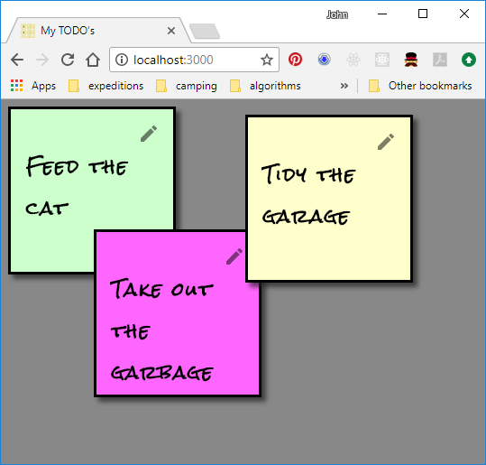
Static web server
Go to the browser and navigate to localhost:3000
We have a web server!
Press Ctrl-C in the console window to stop the server.
This version of the web site is also available in the 'step 9 - static server' commit, you can try it from there if there is a problem.

Slide 76
Dynamic web server
Now that we have a web server, we can use it to store our notes centrally.
Normally we'd use a database, but for demo purposes we'll just store all the notes in one big JSON file.
Following REST API naming standards, we'll create an endpoint /api/notes .
We'll arrange that a POST to this endpoint, with a JSON body containing the notes, will store all the notes onto the server.
A GET to this endpoint will return a JSON body containing all the notes as objects in an array.

Slide 77
Dynamic web server
We'll use the 'fs-extra' package to read/write the JSON file. We can let npm update our package.json for us – press Ctrl-C to stop the web server, and enter the command:
> npm install fs-extra --save
Four more packages installed. Add to the top of app.js:
var fs = require("fs-extra");
We'll also use the built-in package 'path', no need to install this. Just add after the line above:
var path = require("path");

Slide 78
Dynamic web server
We'll add the GET endpoint handler first, and try it out. Update app.js:
app.use(express.static("public"));
app.get("/api/notes", function(req, res) {
res.setHeader("Cache-Control", "no-cache, no-store, must-revalidate");
var notes = fs.readJsonSync(path.resolve(__dirname, "notes.json"));
res.json(notes);
});
var server = app.listen(3000);
Create a file called notes.json in the main directory, beside app.js, and enter:
[ { "text": "This is the note text" } ]

Slide 79
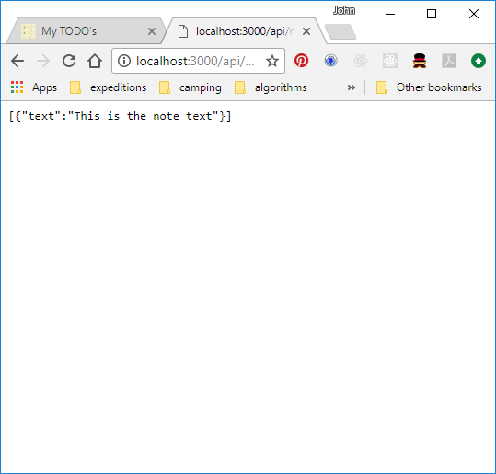
Dynamic web server
Save everything, run 'node app.js' in the console window, and navigate to //localhost:3000/api/notes.
Check that it returns the contents of notes.json.
Stop the server (Ctrl-C or the square red button).
This version is available in the 'step 10 – get API' commit of the repo. Run 'npm install' and it's ready to go.

Slide 80
Unit tests
Being conscientious developers, we'd so like to write some unit tests. We'll need three packages: mocha (test framework), sinon (stubbing, mocking, spying, etc.), and supertest (for HTTP endpoint testing).
From the command line, enter:
> npm install mocha --save-dev
> npm install sinon -–save-dev
> npm install supertest -–save-dev
Because these packages are needed only during development, we use the --save-dev option, which places them under 'devDependencies' in package.json. We should get about 22, 12 and 17 packages installed, respectively.

Slide 81
Unit tests
Create a subdirectory called 'tests', and create a file in that directory called 'testapp.js'.
In testapp.js, first we require all our dependencies, and sketch in the mocha structure:
require("mocha");
var sinon = require("sinon");
var request = require("supertest");
var app = require("../app");
var fs = require("fs-extra");
describe("GET /api/notes", function() {
it("Should respond 200 OK if the JSON file is valid", function(done) {
done();
});
});

Slide 82
Unit tests
In Node.JS, every source file is automatically wrapped in an IIFE. We can export our public functions or variables by assigning to the module.exports object.
We will need to get express's app and server objects from the app module, so let's export them. We can export ordinary variables as readily as functions.
Add the following to the end of app.js:
module.exports = {
app: app,
server: server
};

Slide 83
Unit tests
Add some test data. In the outer scope of testapp.js, enter:
var fs = require("fs-extra");
var notes = [ { "text": "This is the note text" } ];
describe("GET /api/notes", function() {

Slide 84
Unit tests
We're ready to write the first test case:
it("Should respond 200 OK if the JSON file is valid", function(done) {
sinon.stub(fs, "readJsonSync").returns(notes);
request(app.app)
.get("/api/notes")
.expect("Content-Type", /json/)
.expect(200, notes, done);
});
We also need to close the server when we're done, so the test suite exits.
describe("GET /api/notes", function() {
after( function() {
app.server.close();
});
it("Should respond 200 OK if the JSON file is valid", function(done) {

Slide 85
Unit tests
The finished unit tests are in the 'step 11 – unit test' commit of the repo. (You may need to run npm install after checking it out). A VS Code launch configuration and a script in package.json have been provided for running the tests.
To run the tests from Visual Studio Code:
press the 'no bug' icon on the left hand side
select 'Unit Tests' from the pulldown on the top bar.
press the green arrow and the unit test will run.
To run the tests from the command line, enter the command:
> npm test
Check that we have 1 test passing. OK, I'm convinced -- let's ship it ;)

Slide 86
Storing the notes
We need to fill in the POST endpoint handler that will let us store the notes. For this we need an additional package – body-parser. Install it:
> npm install body-parser --save
In app.js, require it and install it as express 'middleware':
app.use(express.static("public"));
var bodyParser = require("body-parser");
app.use(bodyParser.json());
app.use(bodyParser.raw( { type: function() { return true; } } ));

Slide 87
Storing the notes
Finally, add the POST endpoint handler, just before the call to app.listen:
app.post("/api/notes", function(req, res) {
var payload;
if (req.body instanceof Uint8Array) {
payload = JSON.parse(req.body.toString("utf8"));
}
else if (req.body instanceof Object) {
payload = req.body;
}
fs.writeJsonSync(path.resolve(__dirname, "notes.json"), payload);
res.status(200).send();
});

Slide 88
Storing the notes
This version is available in the 'step 12 - post API' commit of the repo.
Try it with Postman or curl if you have them. Start the server, then send a POST request to the /api/notes endpoint with a valid JSON body, and confirm it gets stored into notes.txt.
We totally got the hang of this – no need for unit tests ☺
Stop the server (Ctrl-C or the square red button).

Slide 89
AJAX
Now we can update our web page to use our new API's. We'll use a pattern called Asynchronous JavaScript and XML (AJAX). (Nowadays, JSON is more commonly used than XML, but the acronym is still used).
We could put an action bar on the window, but to save time, let's just:
Load the notes once when the web page is opened (or refreshed).
Save the notes every time we move or edit one.
We'll put the load/save logic in a new module, so create a file 'persist.js' in the public/scripts subdirectory, and give it our usual IIFE wrapper:
var persist = function() {
}()

Slide 90
AJAX
Add the save logic. Inside the IIFE in persist.js, enter:
function saveNotes() {
var notes = []; // build an array containing note text and positions
Array.from(document.getElementsByClassName("note")).forEach( function(note) {
var textArea = note.querySelector("textarea");
notes.push({
text: textArea.value,
top: note.offsetTop,
left: note.offsetLeft
});
});
// send it to the server
xhr = new XMLHttpRequest();
xhr.open("POST", "/api/notes");
xhr.send( JSON.stringify(notes) );
}

Slide 91
AJAX
We'll need to export that function from the persist module so that draggable and editable can access it. Add to the bottom of the IIFE:
return {
saveNotes: saveNotes
};
} ()

Slide 92
AJAX
Add to the saveEdit function in editable.js:
function saveEdit() {
. . .
// save the notes
persist.saveNotes();
}
And also to the endDragging function in draggable.js:
function endDragging(e) {
. . .
// save the notes
persist.saveNotes();
}

Slide 93
AJAX
We add the new script to index.html:
<head>
. . .
<script src="scripts/persist.js" type="application/javascript"></script>
</head>
Let's try it out. The commit 'step 13 - save' in the repo has this version if you got lost.
Save everything and start the server. Browse to localhost:3000, and drag or edit some notes.
Check that the notes.json file has the current state of all the notes.
Stop the server.

Slide 94
AJAX
Now for loading. In persist.js, we add the functions:
function loadNotes() {
xhr = new XMLHttpRequest();
xhr.onload = loadRequestReady;
xhr.open("GET", "/api/notes");
xhr.send();
}
function loadRequestReady() {
if (xhr.readyState === XMLHttpRequest.DONE) {
if (xhr.status === 200) {
alert(xhr.responseText); // TODO
}
else {
alert("Cannot load notes, status = " + xhr.status);
}
}
}

Slide 95
AJAX
We'll load the notes from the server once, when the page is loaded. Using our usual chaining pattern, enter the following near the bottom of persist.js (just above the return statement):
var prevOnload = window.onload;
window.onload = function() {
loadNotes();
if (prevOnload) {
prevOnload.apply(this, arguments);
}
}

Slide 96
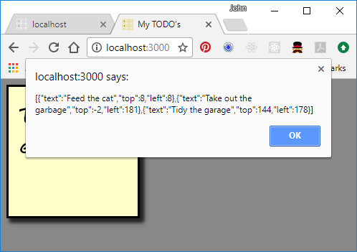
AJAX
Let's try it – save everything and start the server. Refresh the browser page, and we should get a popup as at right.
This version is available in the repo as the 'step 14 - load' commit.

Slide 97
AJAX
Looks good, let's write the last bit of code to rebuild the notes based on the response from the server.
In persist.js, change the alert call in loadRequestReady to call a rebuild function with the parsed JSON array:
function loadRequestReady() {
if (xhr.readyState === XMLHttpRequest.DONE) {
if (xhr.status === 200) {
alert(xhr.responseText); // TODO
rebuildNotes(JSON.parse(xhr.responseText));
}
. . .
}

Slide 98
AJAX
rebuildNotes() is our longest function, let's build it in paragraphs. First the pseudo-code:
function rebuildNotes(notesArray) {
// get rid of the existing notes
// rebuild each download note and add to the document
notesArray.forEach( function(noteObj) {
// create the <div> for the note
// create the <div> for the action bar and add it to the note
// create the note's text area and add it to the note
// make the note draggable and editable
// add the note to the document body
});
}

Slide 99
AJAX
We need to remove all of the existing notes from the document:
// get rid of the existing notes
Array.from(document.getElementsByClassName("note")).forEach( function(note) {
note.remove();
});
Create the <div> just like it was in the HTML, but also assign the position we got from the server:
// create the <div> for the note
var noteElem = document.createElement("div");
noteElem.className = "note";
noteElem.style.top = noteObj.top + "px";
noteElem.style.left = noteObj.left + "px";

Slide 100
AJAX
The action bar is straightforward, just needs to have the right class name:
// create the <div> for the action bar and add it to the note
var actionBar = document.createElement("div");
actionBar.className = "action";
noteElem.appendChild(actionBar);
The text area also is easy, set the text we got from the server into its value and make it readonly:
// create the note's text area and add it to the note
var textArea = document.createElement("textarea");
textArea.readOnly = true;
textArea.value = noteObj.text;
noteElem.appendChild(textArea);

Slide 101
AJAX
Before we add the note to the document, make it editable and draggable:
// make the note draggable and editable
editable.makeEditable(noteElem);
draggable.makeDraggable(noteElem);
And lastly, add the note to the document:
// add the note to the document body
document.body.appendChild(noteElem);

Slide 102
AJAX
We now need to access makeEditable from outside of editable.js, so export it by changing the top line of editable.js to:
var editable = (function() {
And then adding just before the last line:
return {
makeEditable: makeEditable
};
} () )

Slide 103
AJAX
As a finishing touch, we don't actually need the HTML body any more. This is our final HTML. It looks more like a linker input file ☺
<!DOCTYPE HTML>
<html>
<head>
<title>My TODO’s</title>
<link type="text/css" rel="stylesheet" href="styles/notes.css" />
<link href="http://fonts.googleapis.com/css?family=Rock+Salt"
rel="stylesheet" />
<script src="scripts/draggable.js" type="application/javascript"></script>
<script src="scripts/editable.js" type="application/javascript"></script>
<script src="scripts/persist.js" type="application/javascript"></script>
</head>
<body>
</body>
</html>

Slide 104
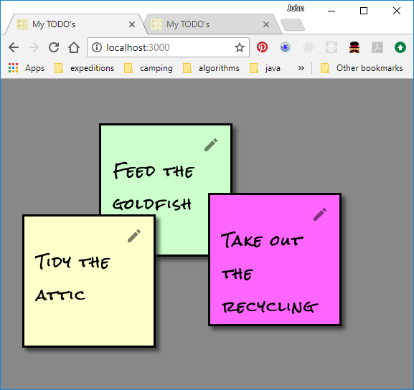
AJAX
This final version is available in the 'step 15 - rebuild' commit of the repo.
Save everything and restart the server.
Load the page, and confirm your notes are loaded as you last left them.
Drag them around, edit them, and then close the page and reopen it.

Slide 105
We're done!!
Hope you had fun ☺
Homework exercises:
Would be nice to be able to create new notes – maybe by double-clicking on the background
A wastebasket icon on the action bar to delete a note. After all, someday we might actually get around to doing some of these chores.
Smarter storage on the server.
Maybe even eventing to other clients when a new note is created.

Slide 106
Resources
These are my top resources when working on no-framework web pages like this one:
Mozilla Developer Network - https://developer.mozilla.org
HTML/CSS/JavaScript fiddle – https://jsfiddle.net/
NPM (documentation for JS packages) - https://www.npmjs.com/
Google fonts - https://fonts.google.com/
Material icons and guidelines - https://material.io/
Color picker - https://www.w3schools.com/colors/colors_picker.asp
Douglas Crockford's site - https://www.crockford.com/javascript/

