Slide 1
Notation used
Layer
Communication between layers
Communication between components
Module

Slide 2
Presentation layer
Application layer
Persistent layer
Layered architecture

Slide 3
From Application Layer – Data Access
Login View
From Application Layer – Data Access
From Application Layer – Data Access
Previous Run Browsing
Previous Run Review
To Application Layer – Sim Communication
From Application Layer – Data Access
Enter Demand Details
Test Results
Enter Swarm Details
Review and Test
To Application Layer
To Application Layer
Partial refinement of Presentation Layer

Slide 4
From Presentation Layer
Sim Communication
From Persistent Layer
Data Access
Sim Analysis
To Presentation Layer – Run Browsing, Review, and Test Results
From Persistent Layer – Test Storage
To Presentation Layer – Test Results
Partial refinement of Application Layer

Slide 5
Cycle Check
Sim Setup
From Presentation Layer –
Demand Details and Swarm Details
Partial refinement of Sim Communication

Slide 6
To Presentation Layer – Test Results
To Presentation Layer – Test Results
Sim Graph
Collect Stats
From Test Storage/Retrieval
From Test/Storage Retrieval
Partial refinement of Sim Analysis

Slide 7
To Application Layer – Data Access
To Application Layer – Sim Graph, Collect Stats
User Directory Access/Storage
Test Run Access/Storage
Partial refinement of Persistent Layer

Slide 8
Customer
Order
Model
- name
- id
- billingInfo
-
-
-
-
-id
-products
-deliveryAddress
-estimatedDeliveryDate
-
-dimensions
-Materials
-timeToBuild
-
-
-
Invoice
Product
- customerID
- OrderID
- price
- date
-
-
-
id
name
model
- cost
-
-
-
-

Slide 9
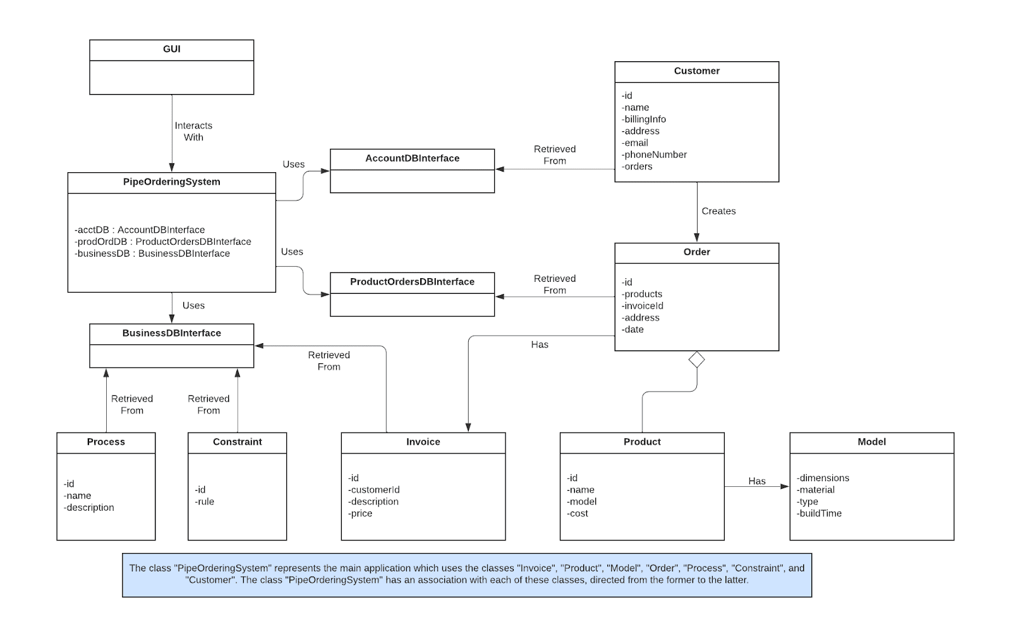

Slide 10
Data Flow Diagram
Tasks:
Login
Logout
Admin –
Change product display page
Change Business Processes
Change Business Constraints
Sales Staff –
//Create Customer Account
//Edit customer account
//Create order
//Edit order
//Get Product List
Check Order Status
//Get order invoice
//Get customer credentials (not really sure what this is, but its in his presentation layer)
Get Business constraints
Get business processes
DBs:
Accounts
Products and Orders
Business Constraints/Processes

Slide 11
d1
login
Validate login credentials
d1
d2
d1
d2
Accounts
Database
d2
logout
d3
Update Product Display Page
d3
Update Product in DB
d9
d3
Update Product
d3
Admin
d4
Products and
Orders Database
d4
d4
d5
d6
Update Business Process
Update Business Processes Display
d5
d5
d7
Update Business Process in DB
d10
d8
d6
d5
d6
Business
Database
Update Business Constraint
d7
d7
Update Business Process in DB
d8
d8
d7
d11
Update Business Constraints
Display
Data Flow Diagram for Admin – Part 1

Slide 12
Data Flow Diagram for Admin – Part 2 Legend
d1 | Login credentials | d7 | Business constraint information to update
d2 | Confirmation/failure of login | d8 | Confirmation/failure of updating the business constraint
d3 | Product information to update | d9 | Confirmation/failure of updating the product display page
d4 | Confirmation/failure of updating the product | d10 | Confirmation/failure of updating business processes display
d5 | Business process information to update | d11 | Confirmation/failure of updating business constraints display
d6 | Confirmation/failure of updating the business process | d12

Slide 13
d1
login
Validate login credentials
d1
d2
d1
d2
Accounts
Database
d2
logout
d3
d3
d4
d3
Create customer account
Enter account info into database
Sales Staff
d4
d4
d5
d6
d5
d5
Update account in database
Products and
Orders Database
d6
Edit customer account
d8
d6
d11
Display product list
Retrieve products from database
d7
d9
d7
d9
Display order invoice
d9
d10
Retrieve order invoice
d10
Data Flow Diagram for Sales Staff – Part 1

Slide 14
d12
d12
Display customer credentials
Retrieve credentials from database
Accounts
Database
d13
d13
d12
d15
d14
Generate Schedule
d15
Analyze Order
d15
d16
d15
d16
d16
Add order to database
d15
Create Order
d17
Sales Staff
Generate Schedule
Products and
Orders Database
d16
Analyze Order
d17
d16
d17
d17
d18
d17
d18
d18
Update order in database
d18
d19
d18
Edit Order
d20
d19
d19
Retrieve order status from database
d20
Display order status
d20
d22
Retrieve Business Processes
Business
Database
Display Business Processes
d21
d24
d21
Display Business Constraints
Retrieve Business Constraints
d23
d23
Data Flow Diagram for Sales Staff – Part 2

Slide 15
Data Flow Diagram for Sales Staff – Part 3 Legend
d1 | Login credentials | d7 | Product list
d2 | Confirmation/failure of login | d8 | Formatted list of products
d3 | Customer account info | d9 | Order id
d4 | Confirmation/Failure | d10 | Order invoice info
d5 | Customer account info | d11 | Formatted order invoice
d6 | Confirmation/Failure | d12 | Customer id

Slide 16
Data Flow Diagram for Sales Staff – Part 4 Legend
d13 | Customer credentials | d19 | Order id
d14 | Formatted customer credentials | d20 | Order status
d15 | Order info (products, dimensions, etc.) | d21 | Business process from database
d16 | Confirmation/Failure | d22 | Formatted business processes
d17 | Order info (products, dimensions, etc.) | d23 | Business constraints from database
d18 | Confirmation/Failure | d24 | Formatted business constraints

