Slide 1



THESIS PRESENTATION
Presented By:
Dayrit, James Christian
Bautista, Jon Allain
Pamisaran, Ricky
Ramilla, Razel Anne
Reyes, Angela
COURSE AND SECTION: BACHELOR OF SCIENCE IN COMPUTER SCIENCE / BC7DC

Slide 2
SMART SMS AND EMAIL REMINDER WITH TIME-BASED TRIGGER FOR VETERINARY CLINIC FOLLOW-UP APPOINTMENT

Slide 3

INTRODUCTION
Regular veterinary visits are important for maintaining pet health, but many appointments are missed due to forgotten schedules. Veterinary clinics often use manual reminder methods, which are inefficient and prone to errors, affecting clinic operations, client compliance, and pet care quality. Using SMS and Email as reminder tools is reliable and cost-effective, and implementing a Smart SMS and Email Reminder System with time-based triggers can automate reminders, reduce missed appointments, improve communication, and enhance overall animal welfare.
Although automated reminder systems are effective in human healthcare for reducing missed appointments and improving service efficiency, their implementation in veterinary clinics remains limited. Research on the implementation of SMS and Email reminders with time-based triggers specifically for veterinary care is insufficient. This gap highlights the need to study how the implementation of automated reminder systems can improve appointment management, workflow efficiency, client compliance, and communication in veterinary practices.

Slide 4

BACKGROUND OF THE STUDY
The Smart SMS and Email Reminder with Time-Based Trigger is designed to improve pet healthcare by reducing missed veterinary follow-up appointments. Manual reminder methods used by veterinary clinics are time-consuming, prone to errors, and difficult to manage due to limited staff and high patient volume.
Automated SMS and Email reminders can effectively notify pet owners in advance, increase attendance rates, improve workflow efficiency, and allow veterinary staff to focus more on animal care. This system demonstrates how technology can enhance service quality, communication, and overall pet health management in veterinary clinics.

Slide 5

1
STATEMENT OF THE PROBLEM
What problems and inefficiencies do veterinary clinics currently face in their reminder and follow-up processes?
What system features could be developed that can help to automate the SMS and email reminders for pet owners based on their pet's scheduled follow-up treatments?
2
The system is designed to help veterinary clinics efficiently manage and keep track of follow-up appointments by automatically sending reminders to pet owners through SMS and email based on a set schedule. To better understand the focus of this study, it seeks to address the following questions:
What are the possible system tools or technologies can be used to create an automated and time-based reminder system?
3
What types of testing could be used to evaluate the usability, reliability, and overall performance of the proposed system?
4
To what extent might the proposed system improve clinic efficiency, reduce missed appointments, and enhance client compliance?
5

Slide 6
1
To develop a system to resolve the existing problems of veterinary clinics related to reminder and follow-up processes.
OBJECTIVES OF THE STUDY
To develop existing system features that supports efficient appointment scheduling and automated reminders.
2
The main objective of this study is to design, develop, and evaluate a Smart SMS and Email Reminder System with Time-Based Trigger to help veterinary clinics manage and reduce missed follow-up appointments. To achieve this, the study pursues the following specific objectives:
3
To implement the essential technologies for an effective and impactful Smart SMS and Email Reminder system that will automatically notify pet owners based on scheduled appointments.
Evaluate the system’s functionality and reliability through testing methods such as unit testing, ensuring that it meets the required performance standards and user expectations.
4
5
Evaluate the effectiveness of automated, time-based SMS and Email reminders in improving client compliance to scheduled visits and decrease missed follow-up appointments.

Slide 7

For Veterinary Clinics. This study helps veterinary clinic follow-up management process become more efficient by reducing manual routing and scheduling tasks.
For Veterinarians. Patient management will be a lot easier for veterinarians as the systems automatically sends the reminders to the clients that has a follow-up check-up or appointments on time.
SIGNIFICANCE OF THE STUDY
For Pet Owners. Pet owners will experience greater convenience and peace of mind through automated, time-based reminders sent via SMS and Email. These notifications help them remember upcoming follow up appointments vaccination schedules, and medical check-ups, ensuring that their pets will stay healthy and well monitored.
For Future Researchers and Developers. This study serves as a reference for future researchers and system developers who wish to integrate smart notification systems, time-based triggers, or automated scheduling tools into other industries such as human healthcare, dentistry, or service-based businesses.
For Academic Community. This Research adds to the existing knowledge of information systems, automation, and smart reminders, showing how technology can be address in real world instances in the field of veterinary practice management.

Slide 8
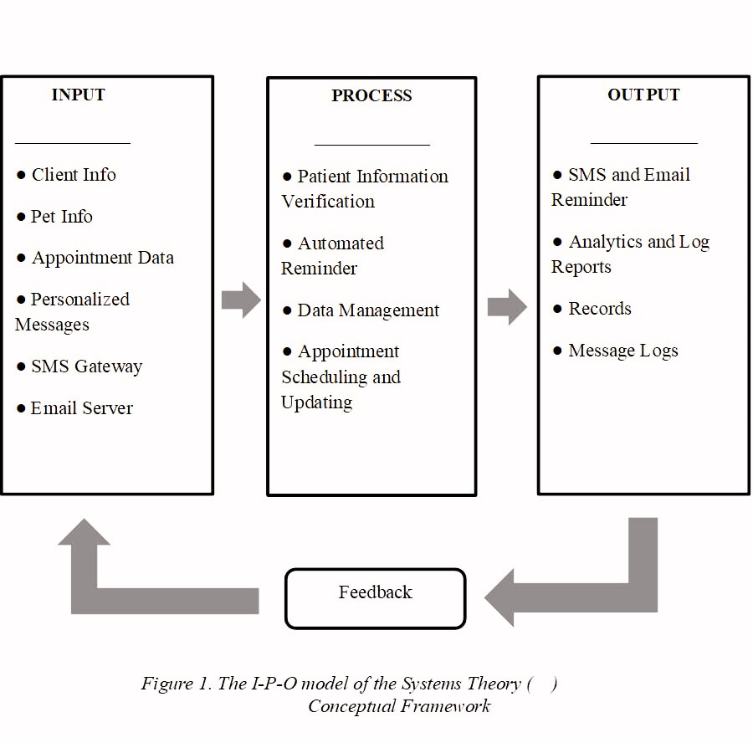
CONCEPTUAL FRAMEWORK

Slide 9
TIME AND PLACE
OF THE STUDY
•
Location: 24/Seven Veterinary Clinic Manggahan Branch
•
Timeline: Academic Year of 2025 - 2026
•
Jan - Feb: Feature planning, System Design, System Development
•
Mar - May: Initial Testing, Use Case Testing Data Gathering,
•
Jun: Data Analysis, Final Documentation, Maintenance

Slide 10
•
Develops a Smart SMS and Email Reminder System with time-based triggers for veterinary patient follow-up appointments.
•
Automates notifications to pet owners via SMS and email for upcoming and scheduled veterinary dates.
SCOPE
OF THE STUDY
•
Facilitates communication between clients and clinics to increase compliance and reduce missed appointments.
•
Includes basic appointment management functionalities to simplify scheduling for veterinary personnel.

Slide 11
•
Relies on SMS and email only, excluding other channels like in-app notifications, two-way communication, or phone calls.
•
Dependent on reliable internet and mobile networks; weak or fluctuating coverage may delay or disrupt message delivery.
LIMITATION
OF THE STUDY
•
Web-based system requires internet connection and cannot function offline.
•
Excludes online payment gateways and inventory control.
•
No integration with large-scale veterinary management software or external databases beyond the testing environment.
•
Implementation and evaluation limited 24/seven veterinary clinic.

Slide 12
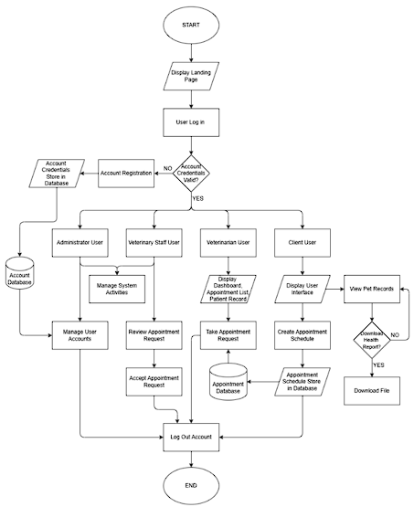
PROCEDURAL FLOW
OF SMS/EMAIL REMINDER WITH TIME-BASED TRIGGER FOR VETERINARY FOLLOW UP APPOINTMENTS
The Smart SMS and Email Reminder System with Time-Based Trigger for Veterinary Patient Follow-Up Appointment begins with a landing page featuring clinic information and options to log in or sign up. New users register an account before accessing the login procedure, while existing users proceed directly to authentication.
User Access Levels
Upon successful login, role-based interfaces unlock specific features.
Administrator and Staff:
Review and manage appointment requests.
Handle patient records.
Create SMS/email reminder templates.
Configure automated notifications.
Manage user accounts.
Veterinarian:
Access dashboard and appointment lists.
View patient records.
Select and claim appointments for procedures.
Client:
Submit appointment requests.
View and download pet health reports.

Slide 13

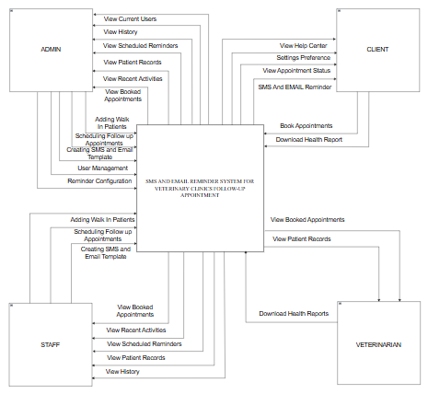
CONTEXT DIAGRAM ( LEVEL 0)
OF SMS/EMAIL REMINDER WITH TIME-BASED TRIGGER FOR VETERINARY FOLLOW UP APPOINTMENTS

Slide 14
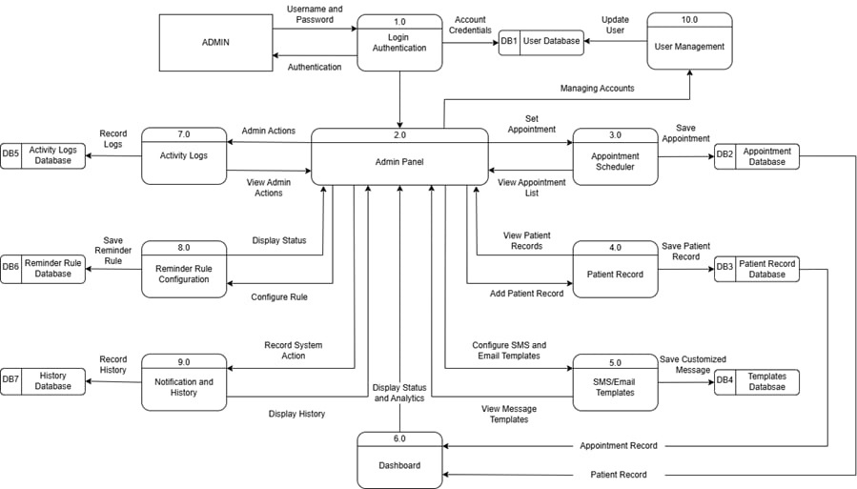
ADMIN USER DATA FLOW DIAGRAM (LEVEL 1)

Slide 15
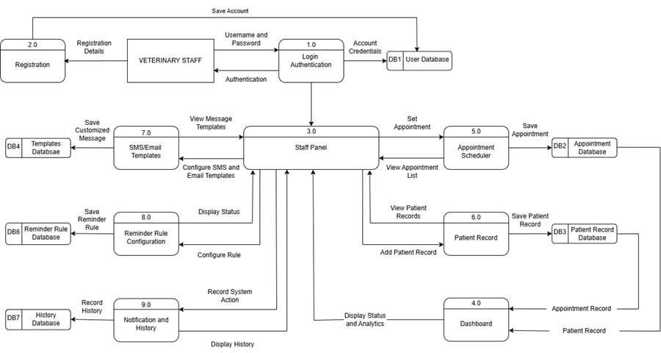
VETERINARY STAFF USER DATA FLOW DIAGRAM ( LEVEL 1)

Slide 16

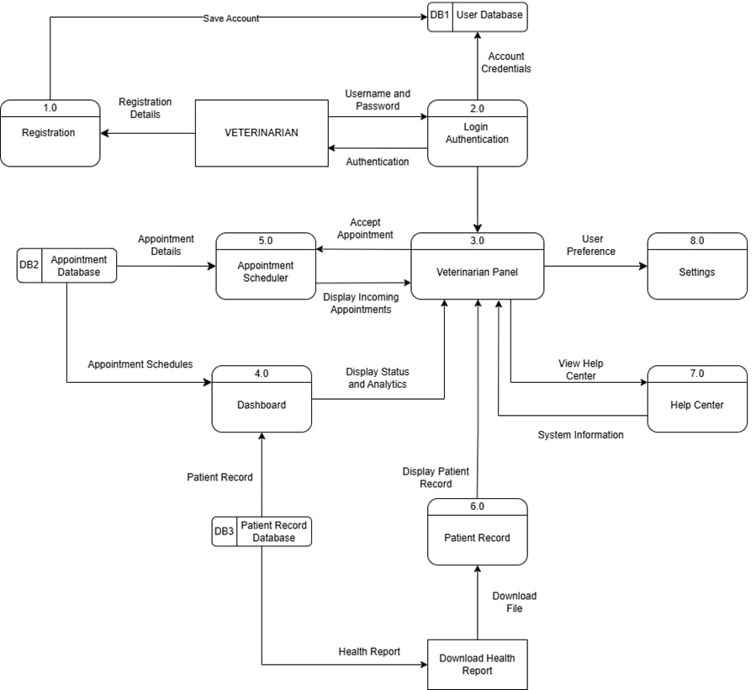
VETERINARIAN USER DATA FLOW DIAGRAM ( LEVEL 1)

Slide 17
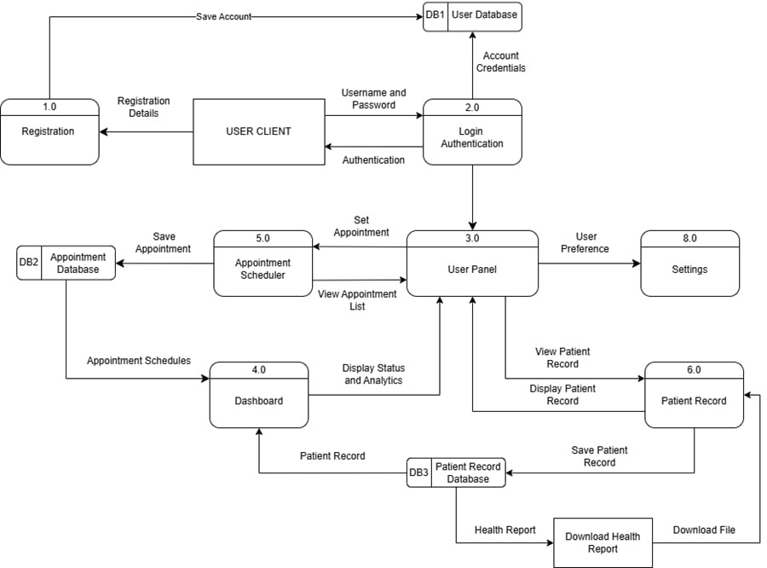
CLIENT USER DATA FLOW DIAGRAM ( LEVEL 1)

Slide 18

AISAT COLLEGE DASMARINAS
BACHELOR OF SCIENCE IN COMPUTER SCIENCE
THANK YOU
FOR LISTENING
SMART SMS AND EMAIL REMINDER TIME- BASED TRIGGER FOR VETERINARY CLINIC FOLLOW - UP APPOINTMENT

