Slide 1
Joomla
Charles Kann

Slide 2
Content Management Systems
Content Management Systems (CMS) are used for nearly 50% of all web sites.
WordPress is used for about 27% of all web sites, Joomla 7%, Drupal 5%.
WordPress is easier to use but less flexible than Joomla and Drupla.
Cite: https://w3techs.com/technologies/overview/content_management/all

Slide 3
WordPress
At Gettysburg, WordPress = Digital Content
You can make a career doing simple WordPress and Drupal/Joomla sites…
Everyone in this class needs to be at least a little familiar with the tools.
You will do two web sites, with the same information, one in Joomla/Drupal and one in Word Press (you can substitute Jekyll or other CMS tool if you like, I will ask you to share your site).

Slide 4
Next Week
Monday and Wednesday classes will be CMS
One group do a presentation of WordPress (30 minutes or so)
One group do a presentation of more advanced features of Joomla (30 minutes or so)
Anyone who did a site using other CMS will have 5 - 10 minutes to present their site (I will add this to the group grade).

Slide 5
Overview of how to build a site in Joomla

Slide 6
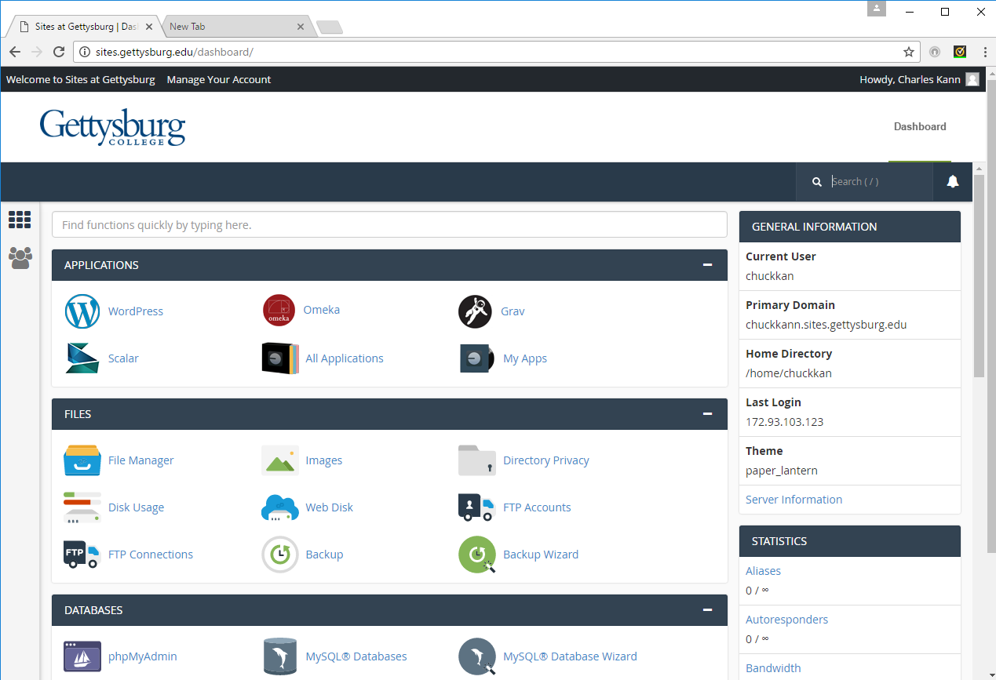
Step 1 – Log on to sites.gettysburg.edu

Slide 7
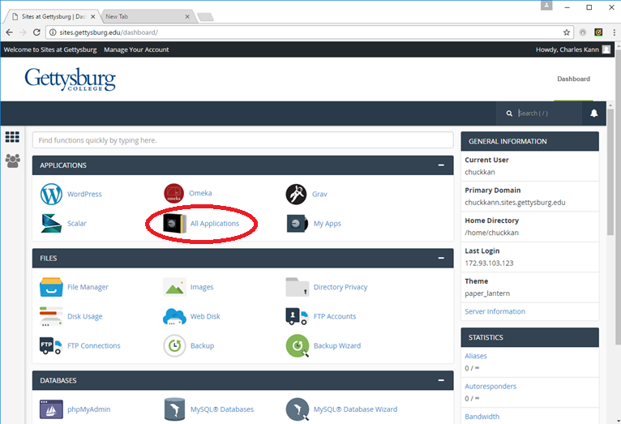
Step 2 – Select All Applications

Slide 8
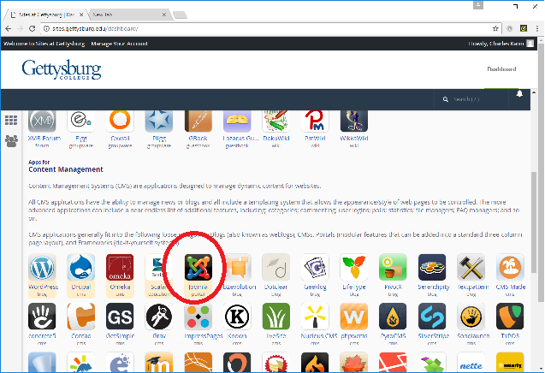
Select Joomla

Slide 9
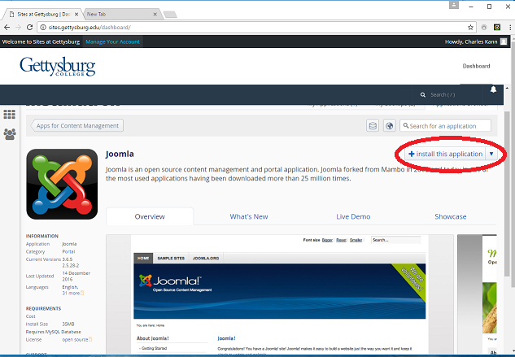
Install Application

Slide 10
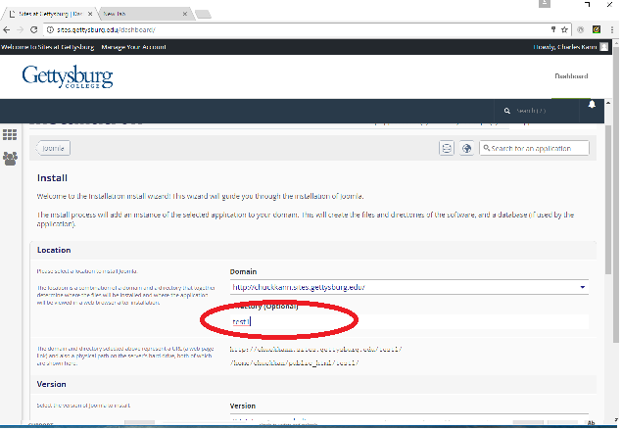
Specify Directory

Slide 11
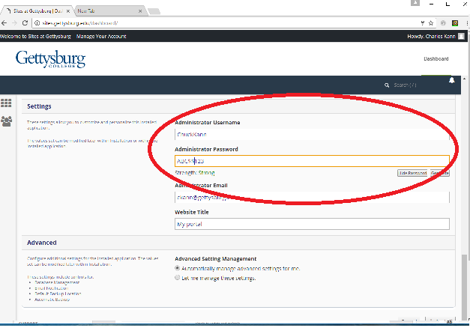
And Administrator and Password

Slide 12
And Administrator and Password

Slide 13
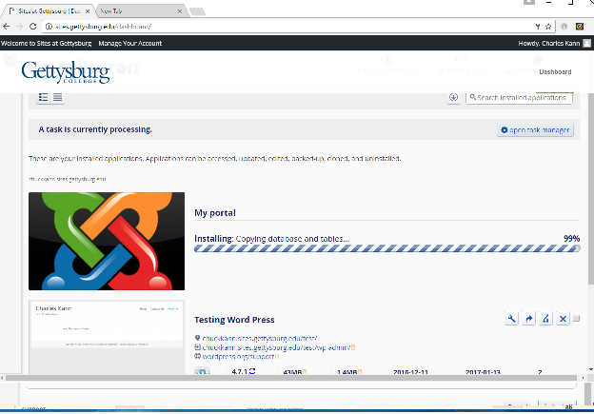
Click install and wait….

Slide 14
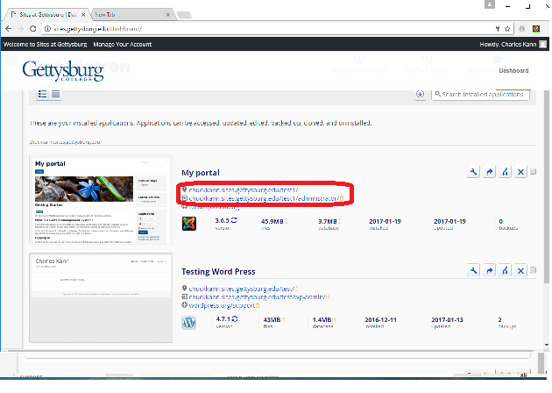
You now have 2 sites, the administrator and user. Bring each up in a separate browser.

Slide 15
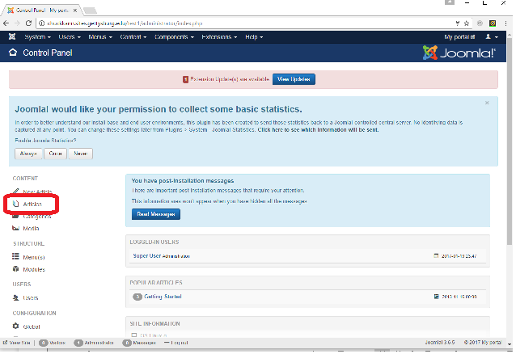
Log into the Administrator logon, choose articles

Slide 16
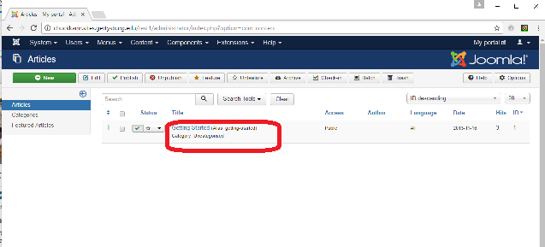
Edit the only article

Slide 17
Edits on article
Change title and alias to “Welcome”
Add a table, one row two columns
Stretch the first column to fit about a picture, the second takes the rest of the page.
Size a picture, and insert it in the first column.
Type some text in the second column.
Save and close.

Slide 18
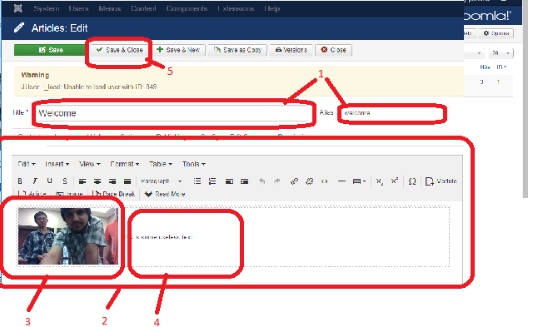
Edits on article

Slide 19
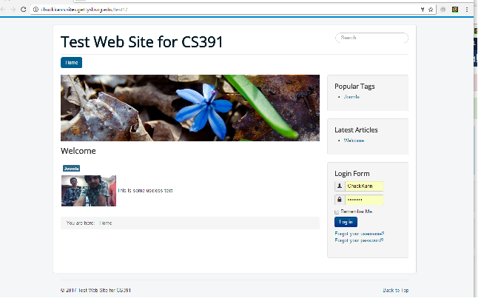
Check your work by reloading the user window

Slide 20
Adding a menu
Menus in Joomla are created by creating content (in the first case, an article) to be referenced, and then creating a menu to reference it.
Step 1 – Create an article
Step 2 – Put it in a menu

Slide 21
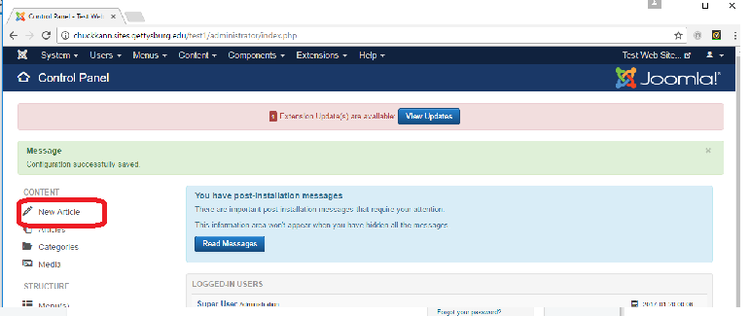
Select a “New Article”

Slide 22
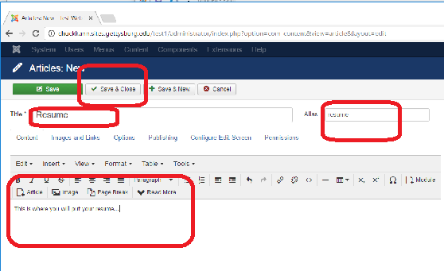
Create your resume Article

Slide 23
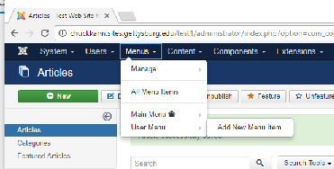
Choose the menus/manage option

Slide 24
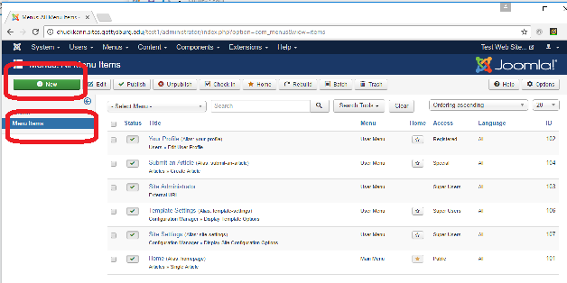
Choose “Menu Items”, then “New”

Slide 25
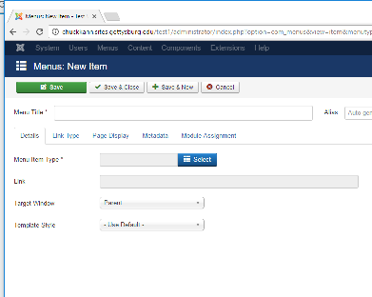
Adding a menu item, start here

Slide 26

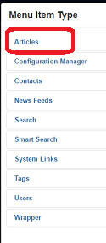
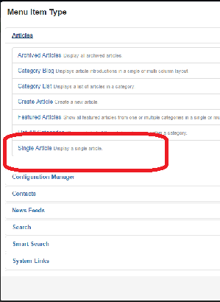
Choose a single article

Slide 27
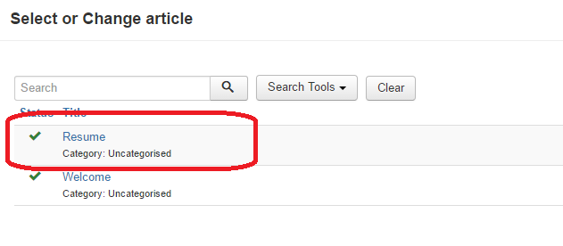

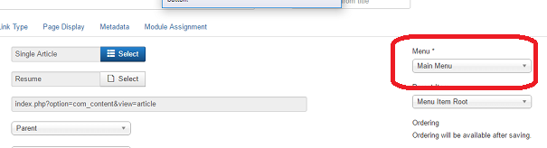
Select our resume, and put it on the main menu, then save and close

Slide 28
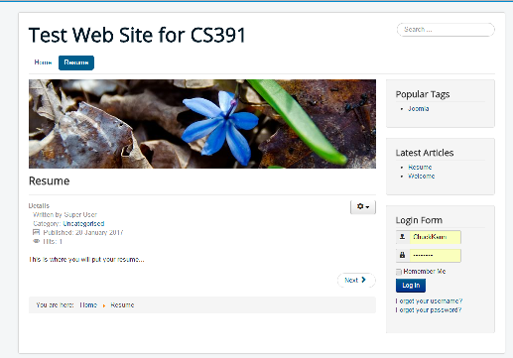
Test and see we have the new menu option and it links to our resume.

Slide 29
Get rid of the other non-sense on the page…

Slide 30
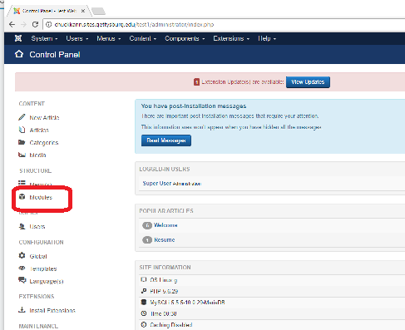
From the control panel, choose modules

Slide 31
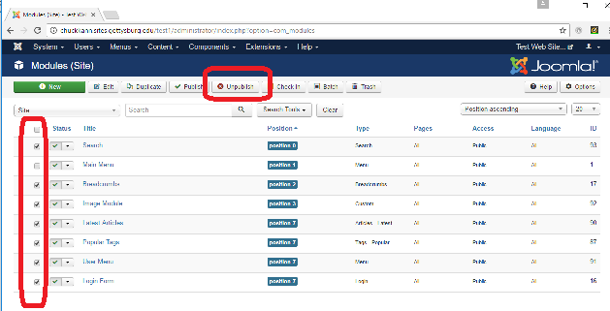
Check everything except “Main Menu”, and click “unpublish”

Slide 32
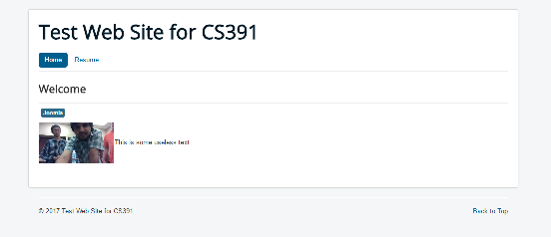
Testing shows those things went away…

Slide 33
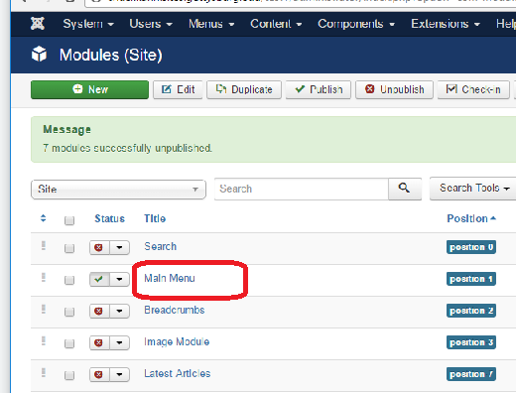
While we are on the modules page, select “Main Menu”

Slide 34
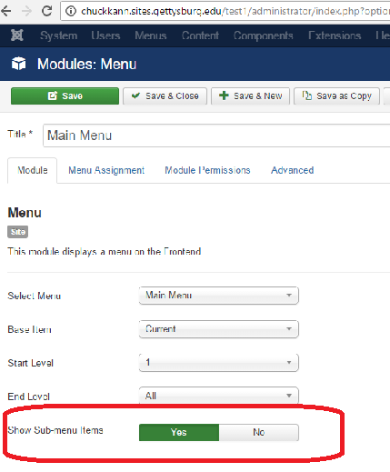
We want sub menus, so lets fix it now

Slide 35
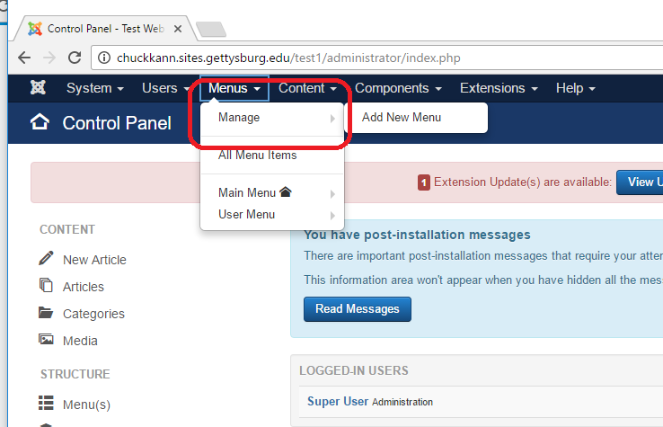
Let’s add some classes. Go to the Manage Menu Panel

Slide 36
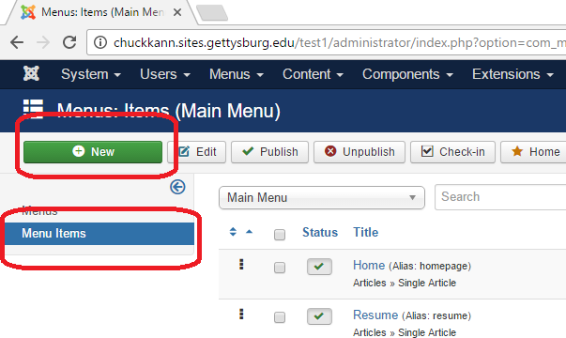
Add a new menu item

Slide 37
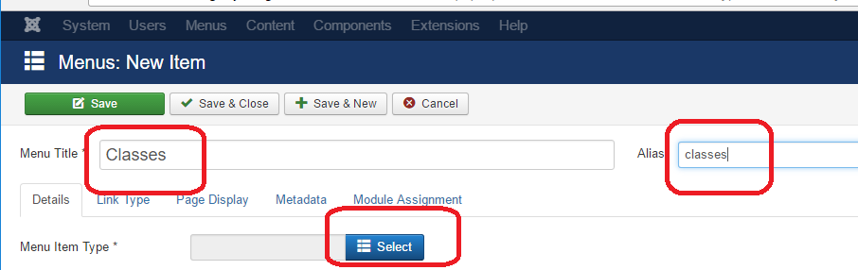
Call this item classes, and select a type

Slide 38
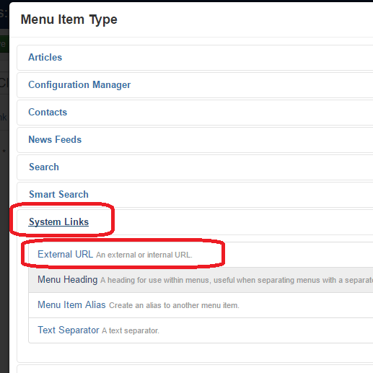
The type is “system links”, and we want an “external url”

Slide 39
The type is “system links”, and we want an “external url”

Slide 40
What is #?
Remember we said that in Joomla, content (e.g. an article) is created, and a menu item is then linked to it. This classes menu is just going to be a menu to reference other menus, so we really want it to do nothing is selected.
So we have to play a little trick. For the link, we are going to use “#”. In HTML, # always means the current document. So by linking to “#” we are saying link to what you are doing, or in effect, do nothing. This is exactly the content we want to address…
If that doesn’t make sense, just remember how to do this.

Slide 41
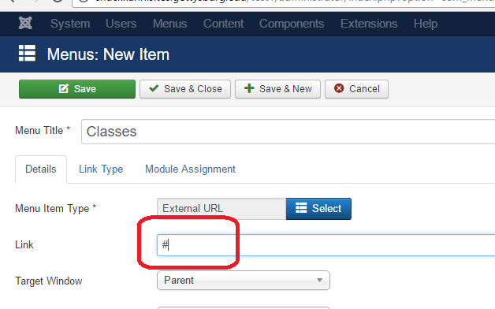
Link menu to #

Slide 42
Link menu to #, “Save & Close”

Slide 43
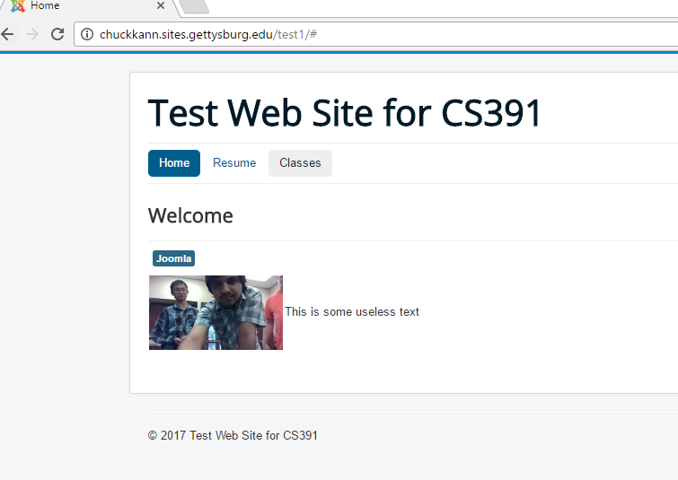
Test the site again. Note we have a classes menu which does nothing.

Slide 44
Create a new article called CS391-A
Create a CS391-A article as before. It can just have some text, it does not need pictures, etc.

Slide 45
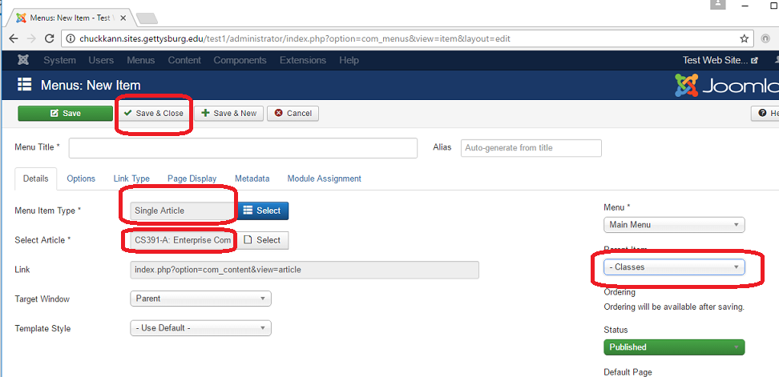
Create a menu option for CS391-A – Note the parent item is “classes”

Slide 46
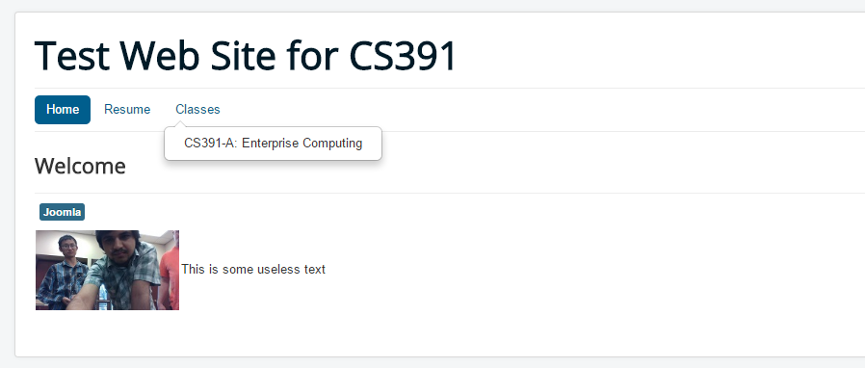
Retest and note we have a sub menu option

Slide 47
Your assignment
Create a web site you can show to employers
You can use any template you want (I am not good with graphics, so I like plain things).
You must include your resume, and a menu item that lists some classes you have taken. For CS classes, include some code samples.
This is going to help you get a job!!! Make it nice…

