Slide 1
Server Concepts
Dr. Charles W. Kann

Slide 2
Server Concepts
Basic components in a web application architecture
Web Interface and transaction to application
Parts of the application
Session
Routing
Controllers
Model
View
Application Model

Slide 3
Basic components in a web application architecture
Most modern applications consist of tiers (or layers), where the idea is that the tiers are designed in isolation with well defined interfaces which allow them to be “plugged in” and “swapped” where needed.
Most applications consist of multiple tiers, each responsible for specific sets (or types) of tasks. They should do not other task.
Can be implemented as objects, but objects have a much more application specific meaning (a Person or ArrayList is never a tier).
Examples of objects that could be thought of as tiers are a “zip” object that takes a string and produces a “zipped” version of it.
Another example is an encryption object.

Slide 4
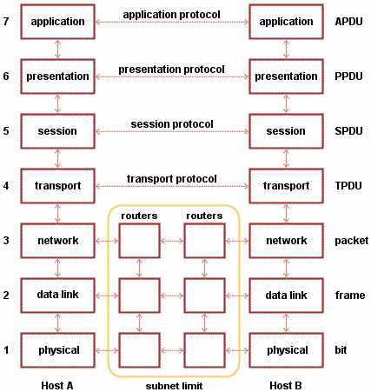
OSI Model

Slide 5
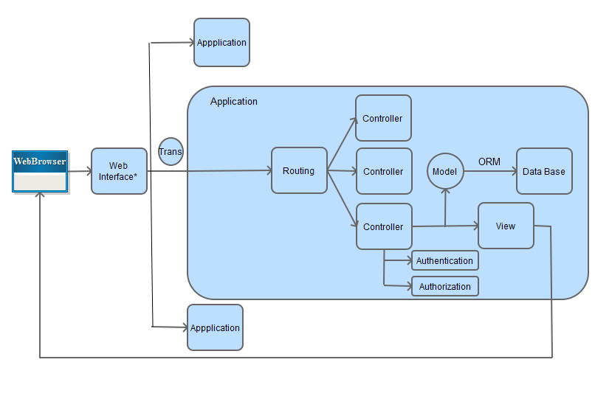
Typical Web Application

Slide 6
Web Browsers
Web browsers are often stateless
Old application used to maintain state through hidden variables. -- If you see one of these, it better be on a local net, because the state can be hacked!
You can run a Java application in a browser
We will keep state in a browser (later) when using AJAX. But don’t think about that now!
For now, browsers take a form, present it to the user, and generate a transaction to be sent to the application.

Slide 7
Web Interface

Slide 8
Web Interface
The web (or internet) interface is a complex labyrinth of computers, protocols, and messages designed to protect the applications. It can include (but is not limited to):
Routers and other computers to unpack the message and send it to the web server.
Network Address Translation (NAT) servers to determine the real address of the computer to get the message.
Firewalls to filter packets, throwing away bad or malicious packets.
Web Servers (Apache, IIS, etc) to route the packet to the correct application
We don’t care what is there. From our point of view, it all produces a transaction that we can use in our application.

Slide 9
Transaction to application
Once the web interface has processed the message, a transaction is generated to an application. Included are:
Request Header (e.g. content-type: text/json)
URL to process (with protocol, how to route transaction)
Protocol (put, get, delete, etc)
Data needed to process the request.

Slide 10
Application Session
An application is the program we are running to interact with the user.
An application is typically run in an application server, in a module.
Instances of modules are often called a containers. A container is generally (almost always) a process that contains:
state objects for each connection (user login or browser connection) being managed by the application.
A set (pool) of connections to a Data Base server to quickly access the database, called a connection pool.
A set (pool) of threads to run the transactions on (note: this is difficult for some languages which do not support concurrency, such as Perl. Mod_perl is single threaded, but still runs transactions in a process because of the ease of handling connections as state objects).

Slide 11
Application Routing
When a transaction is processed in the application, it must be sent to the correct method to handle that transaction.
URL determines the controller to use.
Protocol (get, put, delete, etc.) determine the method in that controller.
Normally an application will contain a routing engine to correctly route the request.

Slide 12
Application Controllers
Each URL that can be processed will be associate with an application controller, and each request type (protocol) will be associated with a method.
The application controller is responsible to authenticating the user for the request, building the model (or information handling object) for the request, and dispatching the view.

Slide 13
Application Model
The application model is responsible to implementing all business logic and storage policies for the transaction
The model is created in the controller, and used in the view to create the form to send back to the browser.
This is the model complex part of the system, and so will get it own section of this talk.

Slide 14
Application View
The view processes the data from the model to create a form to send back to the user.

Slide 15
Model

Slide 16
Model
Authenticate and Authorize user – Done in Controller
Retrieve/store and validate data from/to the backing store (DB)
Implement Business logic

Slide 17
Authenticate and Authorize User
Parts of security
Identification – Are you who you say your are
Authentication – Checking your access credentials
Authorization – What are you allowed to do.
Authentication – Devise and Authlogic
Authorization – Pundit
Authorization
Role Based Authorization
Document Base Authorization
Classification (Secret, ACL, etc).

Slide 18
Database access
Application authentication and authorization is handled in the controller, so the application (NOT the end user) is the user to the database.
This means that there is a single user and password for the application in the database.
Since all users go through the same account, a pool of connections are made to the database, and transactions are made through that pool. This is called a connection pool.

Slide 19
Object Relational Mapping
The application makes requests to the database for data that can be used in the application (hence as objects).
Data in the database are access using a relational model, generally using Structured Query Language (SQL).
To link the program to the database, an Object Relation Mapping is made from the relational database to application objects.
The ORM software used in Rails is ActiveRecord. There are a number of ORM tools, e.g. myBatis, hibernate, etc.

Slide 20
Routing Engine
Based on the transaction:
heading determines the format of the data (e.g. text/JSON)
URL determines which controller to call
Protocol determines which method to call in controller
Payload or transaction data determines the specific action

Slide 21
Model-View-Controller (MVC) pattern
Model – The business logic and backing store. The data, what it means, etc.
View – The form presented to the user, and the procedures generating it.
Controller – Gets the information, decides how to build the model and transfer control to a view.

Slide 22
Applying this to ROR
http://guides.rubyonrails.org/getting_started.html

