Slide 1
Update – 1/22/23
John Lee

Slide 2
Healthy Model

Slide 3
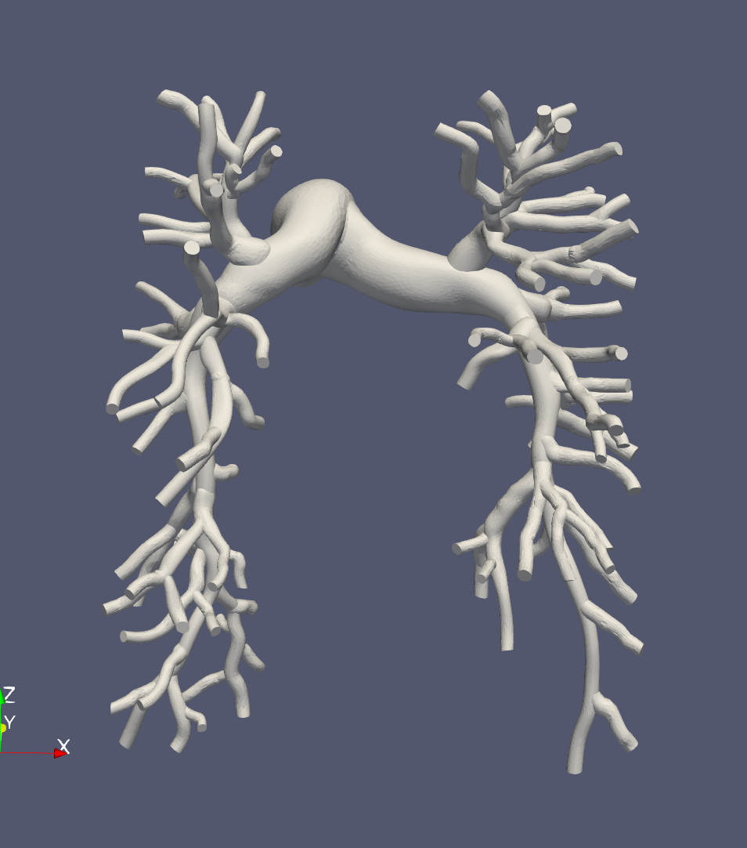
3D Model (0080_0001)
Not much needs to change in the 3D model
Mesh → same fidelity as original geometry

Slide 4
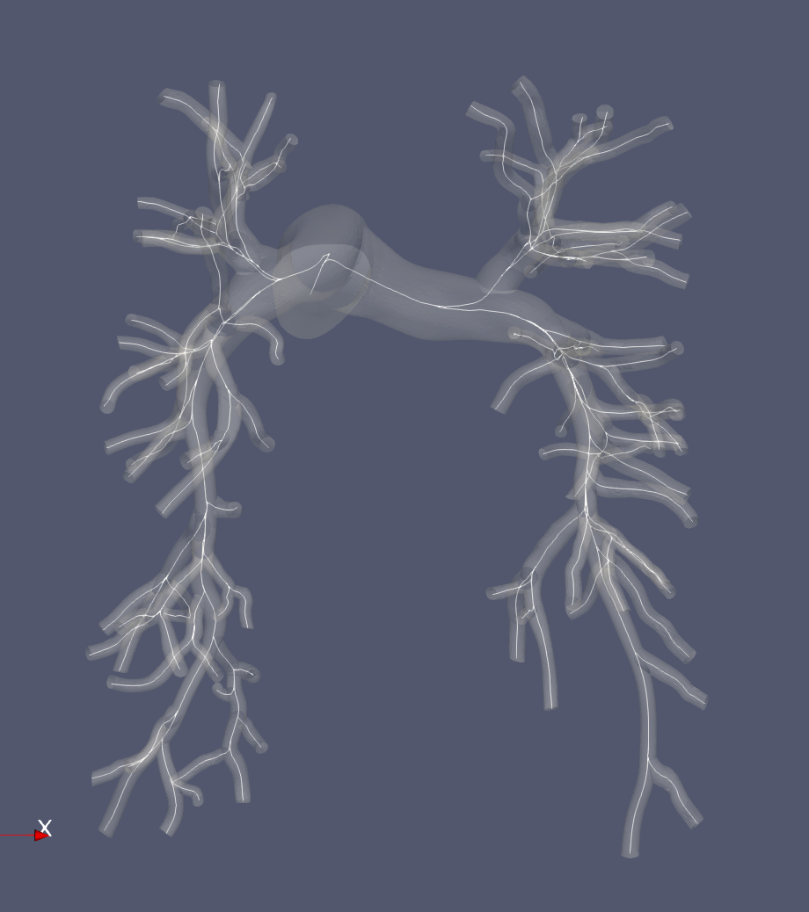
Centerlines
Generated using sv centerlines from the 3D model
Centerlines are adequate (no problems)

Slide 5
0D LPN / JC coefficients
Linear EH/R is 1.2e6 acceptable? Why?
How can we reason using Junction Coefficients like stenosis coefficients? Does it even properly reflect how flow would be distributed?
Is the fidelity of the 0D model enough?
How much can we mitigate 0D 3D differences in mmHg due to model fidelity rather than junctional coefficients?
Can we accurately capture the stenosis region for repair down the road?

Slide 6
Tuning
Does the tuning method match closely enough with the original 0D model?

Slide 7
3D Simulation
Should compute adequately regardless of changes in boundary conditions.
Does the BC tuned to the 0D model cause values in 3D simulation to go unreasonably high (beyond physiological targets) due to inaccuracy of 0D model? We know this can be 10%+ off.

Slide 8
Main Problem
0D & 3D do not coincide well.
Junction Pressure Loss & inaccuracy of 0D RCL’s at capturing full branch
Junction pressure loss
Using JC or Mynard Method
JC coefficients may not be the best and probably needs modification (could use angle of bifurcation.
Inaccuracy of RCL’s
Increase fidelity of 0D models by partitioning each branch into smaller parts.
Or at least specify the region that has the stenosis and separate it from the rest (the Stenosis coefficient may be insufficient to capture the stenosis effect)

Slide 9
Diseased Model

Slide 10
3D Model (AS_0308)
3D geometry needed to remove RPA_03_04 from Ingrid’s model due to meshing concerns
Increased mesh quality.

Slide 11
Centerlines
Centerlines generated from 3D geometry work.

Slide 12
0D LPN
Same problems as Healthy

