Slide 1
Research Update - 2/27/2023
John Lee

Slide 2
Current Work
Simplified BC tuning
Better Junctional Modeling

Slide 3
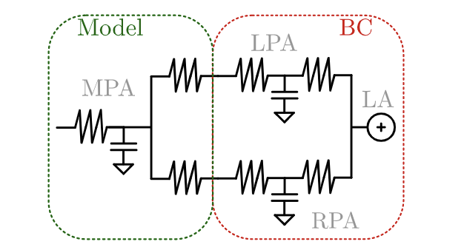
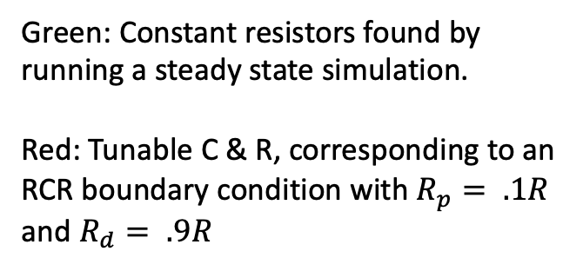
Simplified BC tuning
Green: Constant resistors found by running a steady state simulation.
Red: Tunable C & R, corresponding to an RCR boundary condition with $R_{p}= .1R$ and $R_{d}= .9R$
3 optimization parameters, ~4 targets of mPAP, sysPAP, diaPAP, flow split.
Shared Capacitor

Slide 4
Slides
../../../../../Downloads/Stenosis_SGT.pdf

Slide 5
Better Junctional Modeling
Motivation --> accuracy and responsiveness of 0D model.
Cannot produce appropriate pressure changes with repairs & artificial stenosis without some junctional model

Slide 6
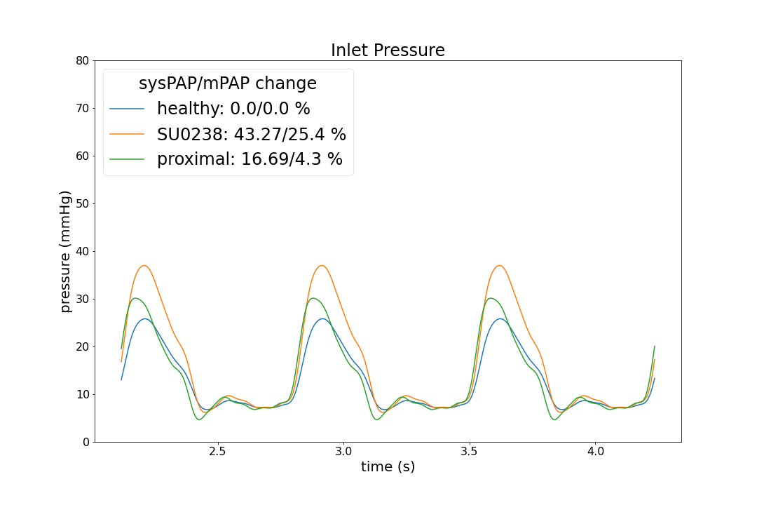
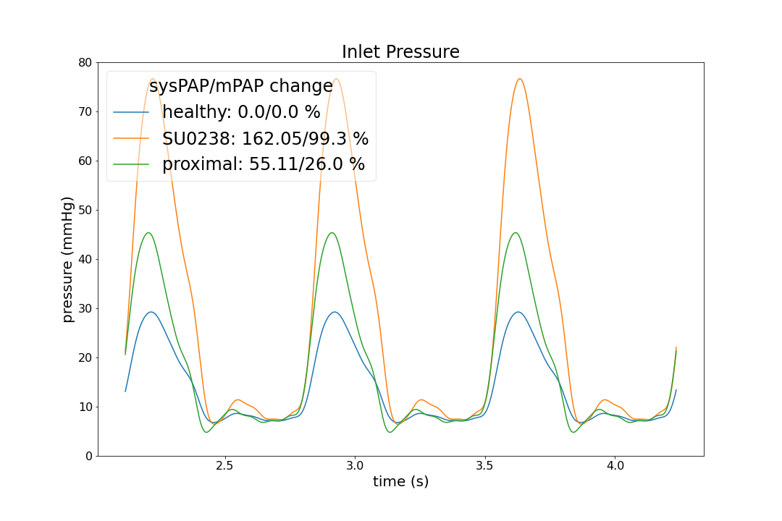
Artificial Stenosis (0080_0001)
Original
JC

Slide 7
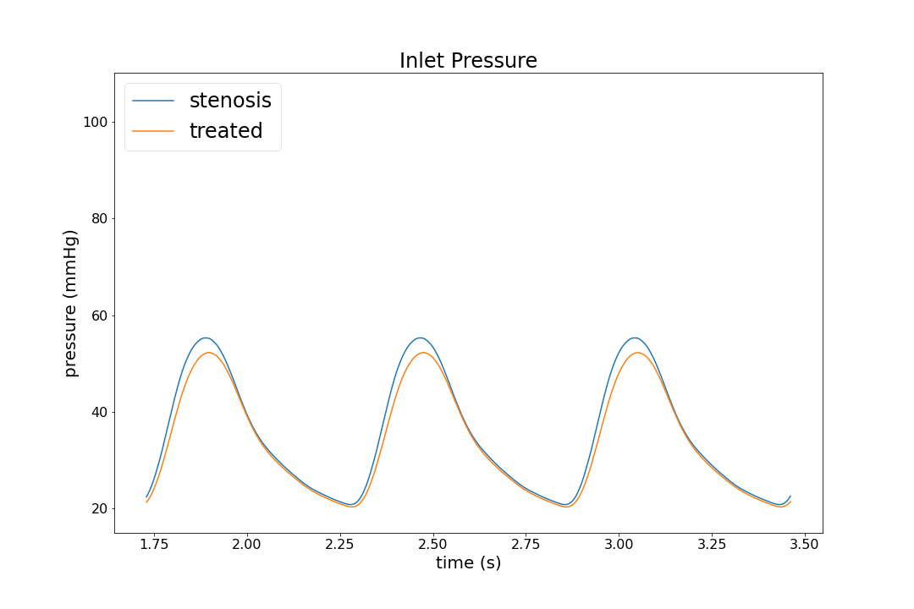
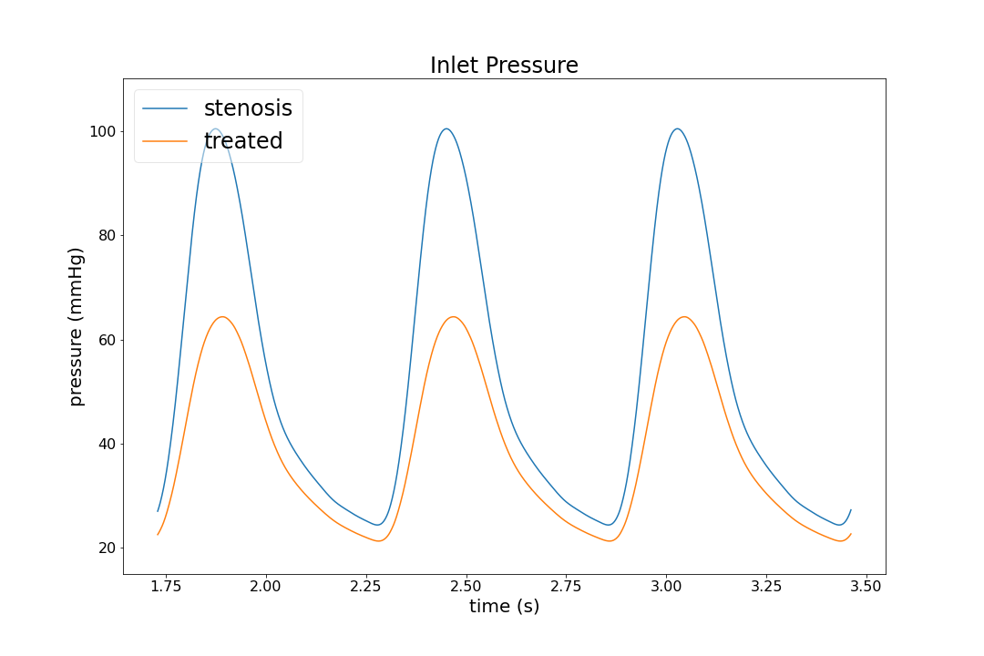
Treatment (0118_0001)
Original
JC
Significant change
Similar to previous literature’s ~47% reduction

Slide 8
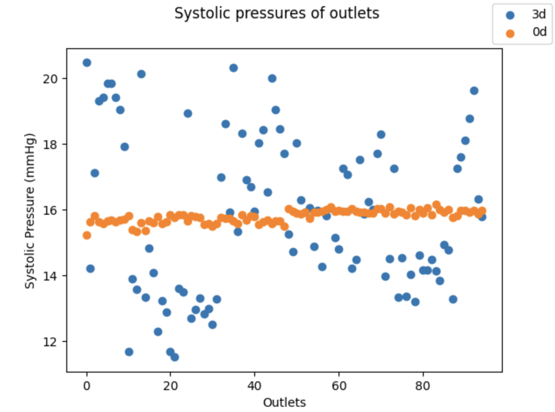
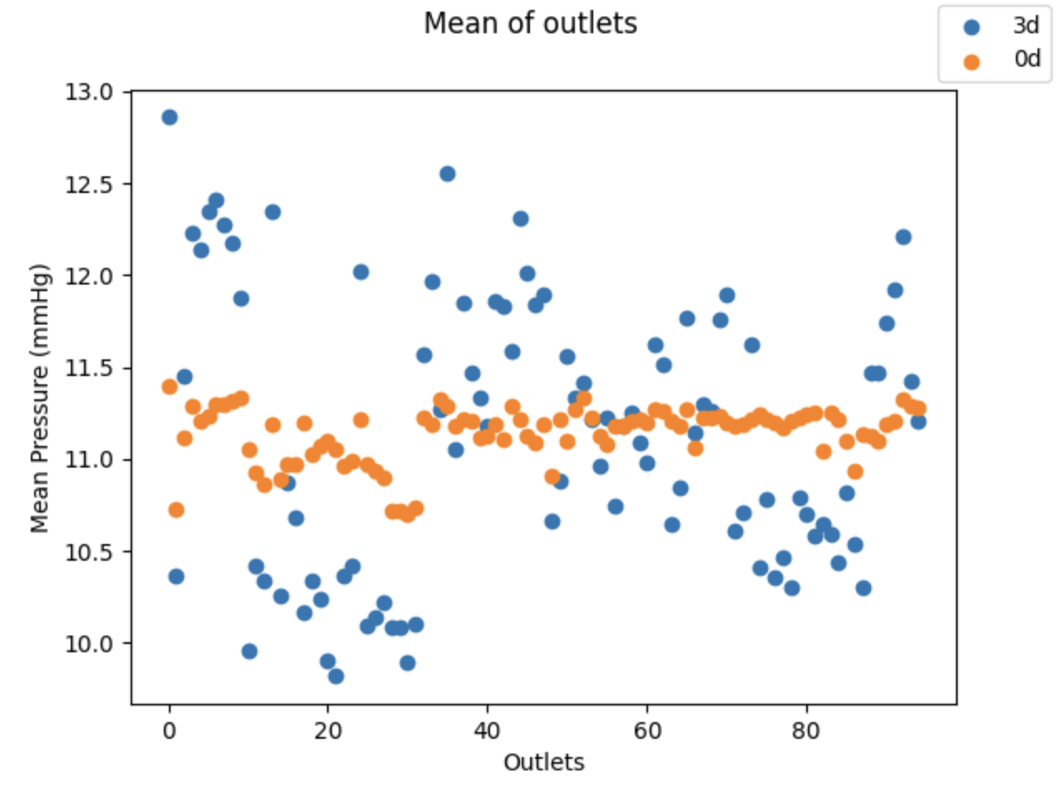
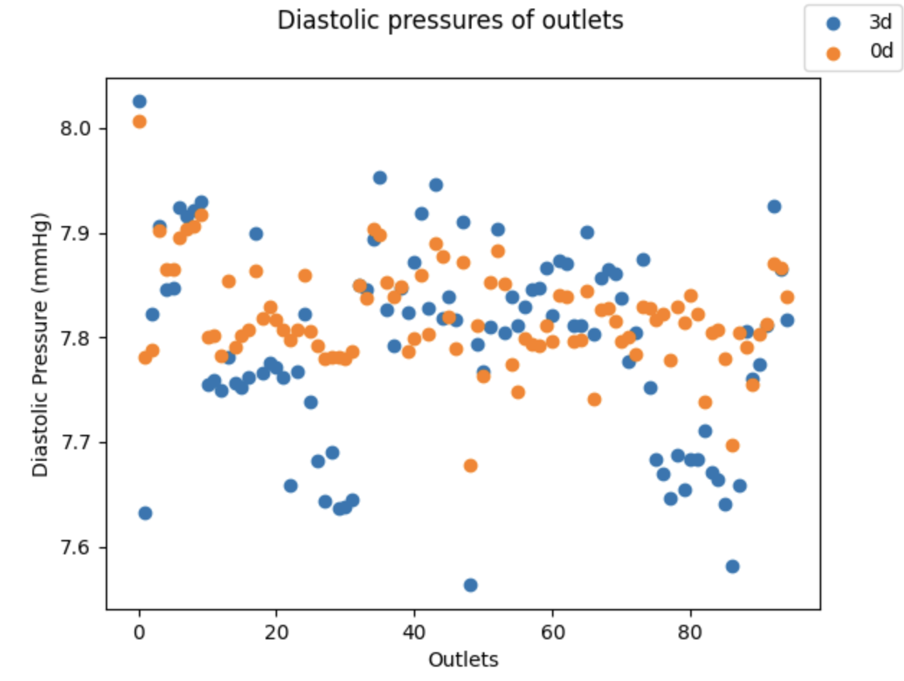
Distributions
No Junctional Modeling

Slide 9
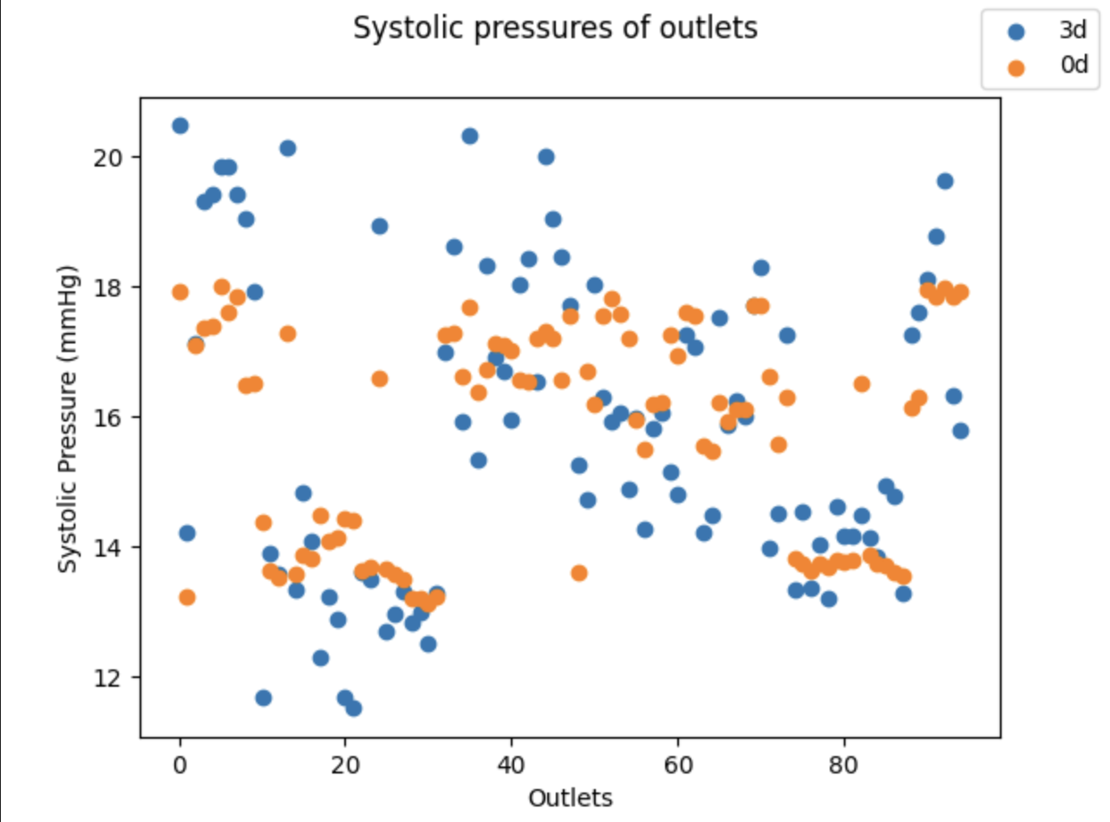
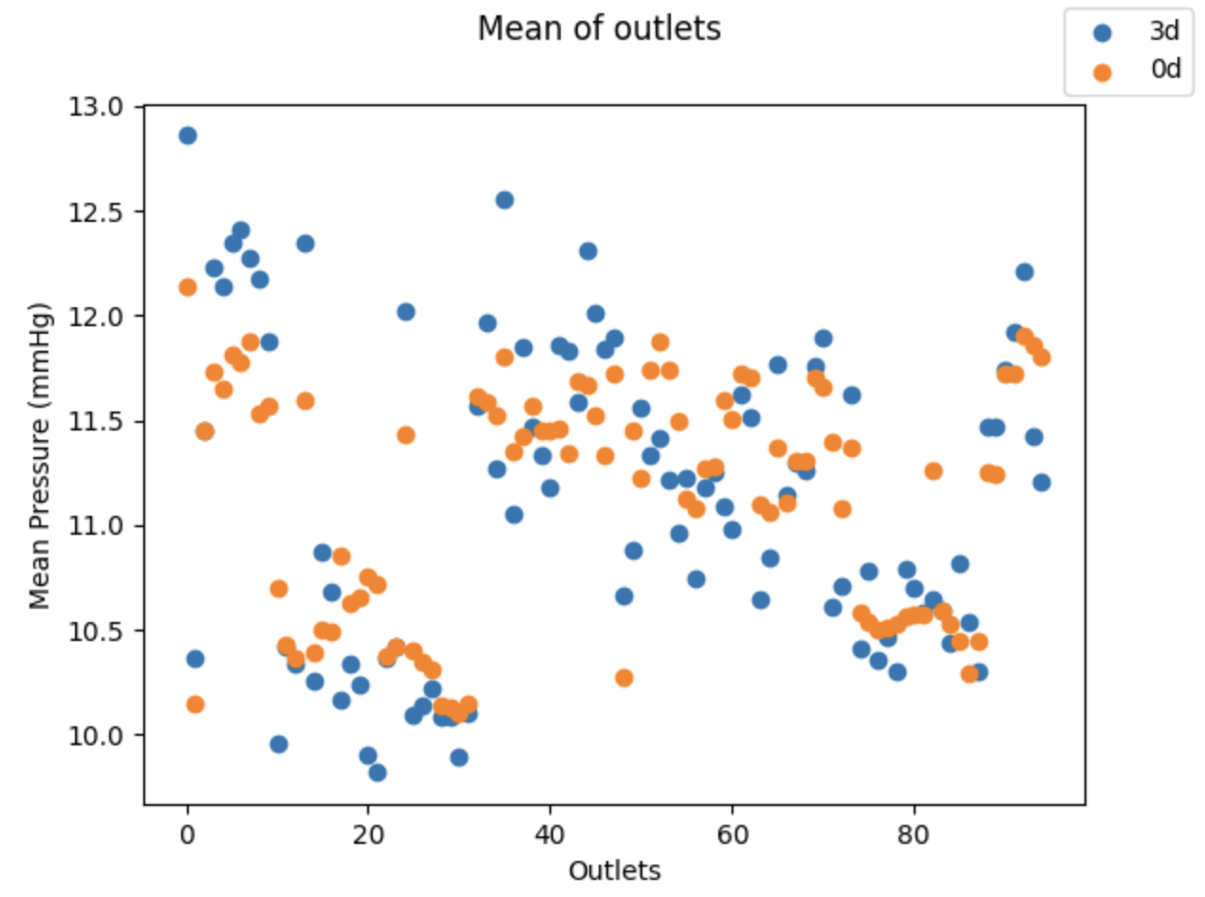
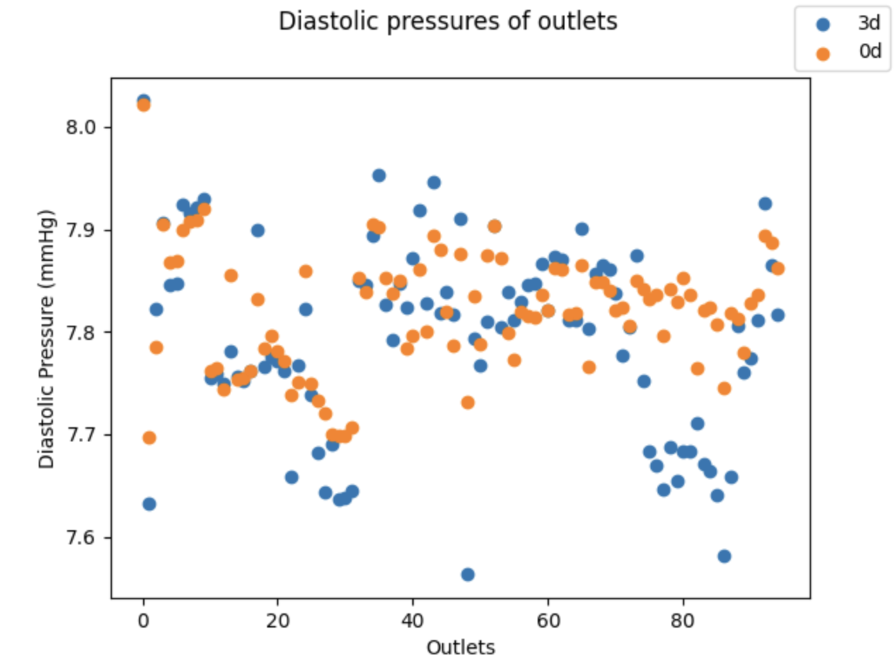
Distributions
Basic Junctional Modeling

Slide 10
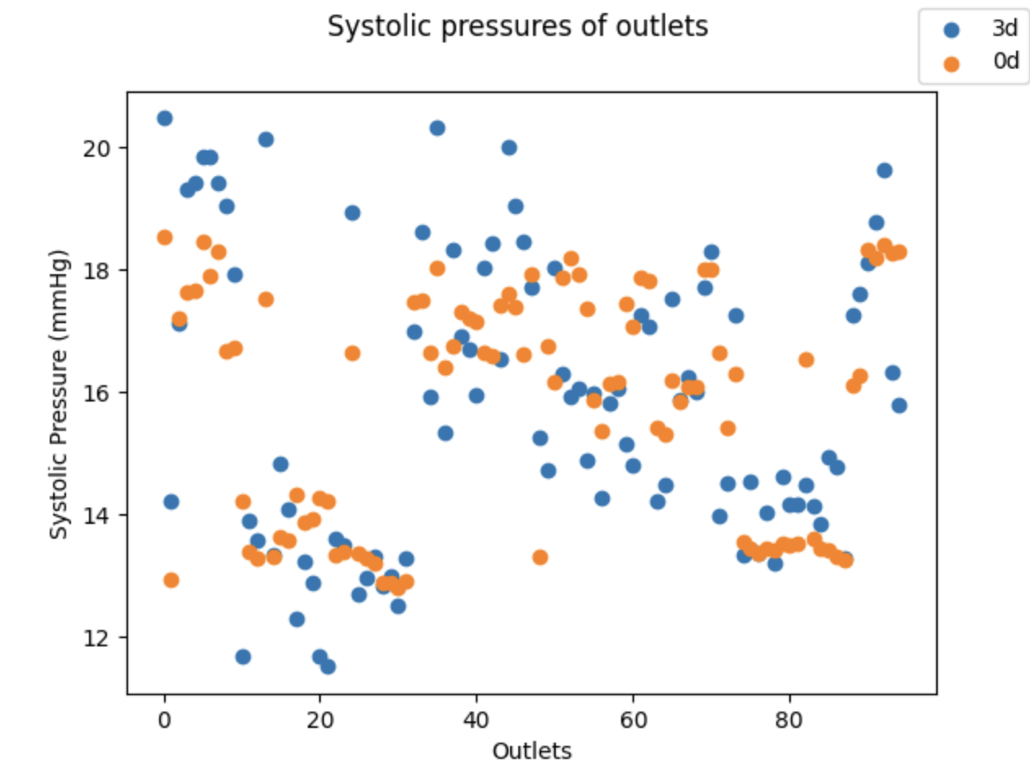
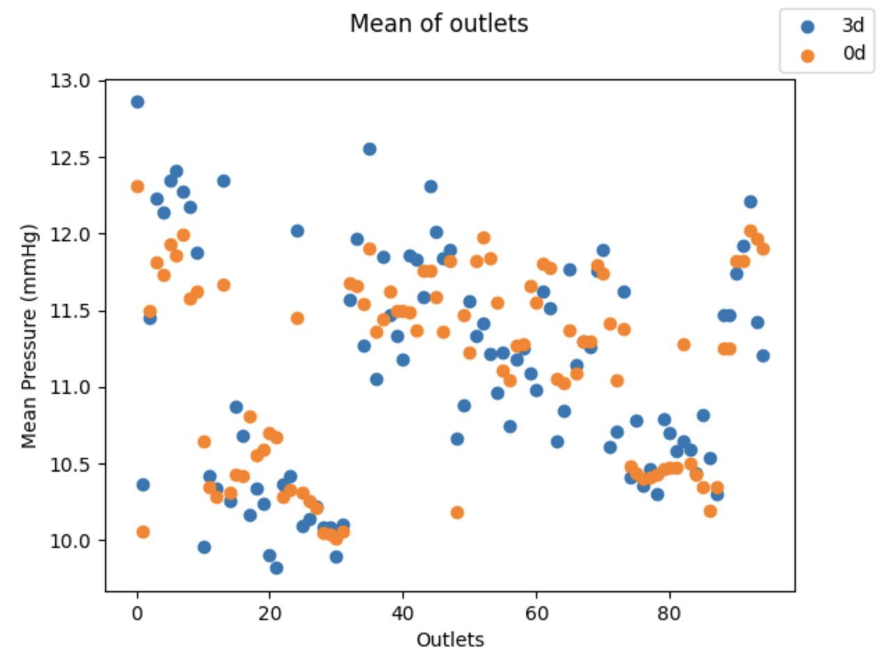
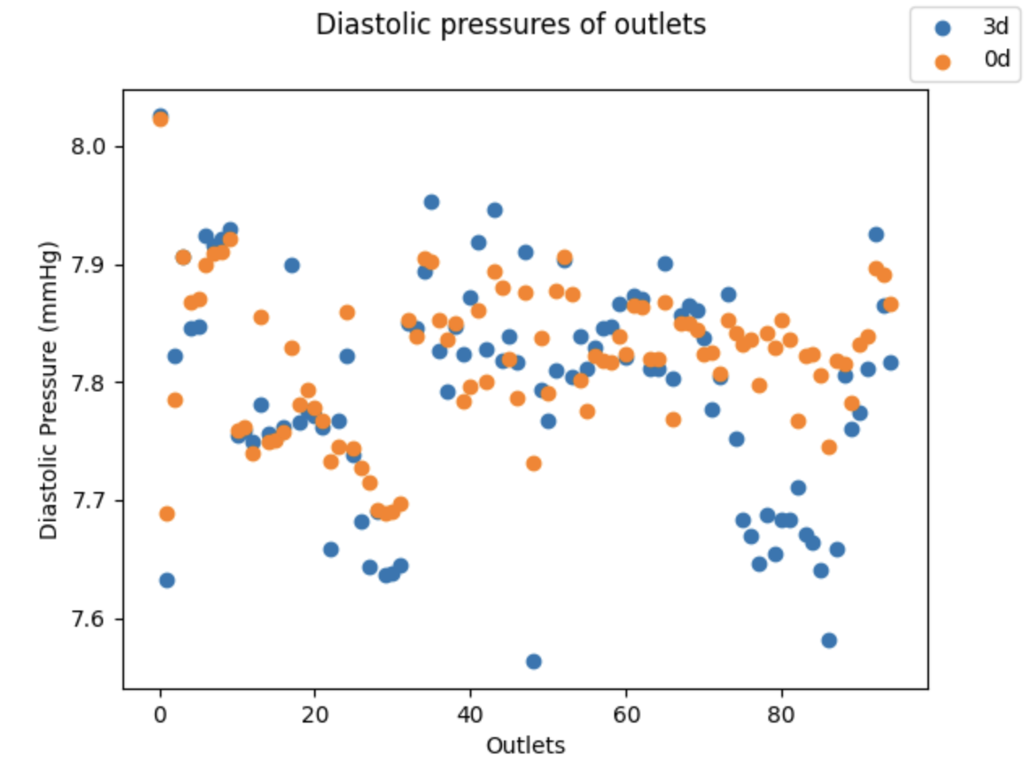
Distributions
Tuned Junctional Modeling – coefficient = 1.93
- Insignificant difference from previous

Slide 11
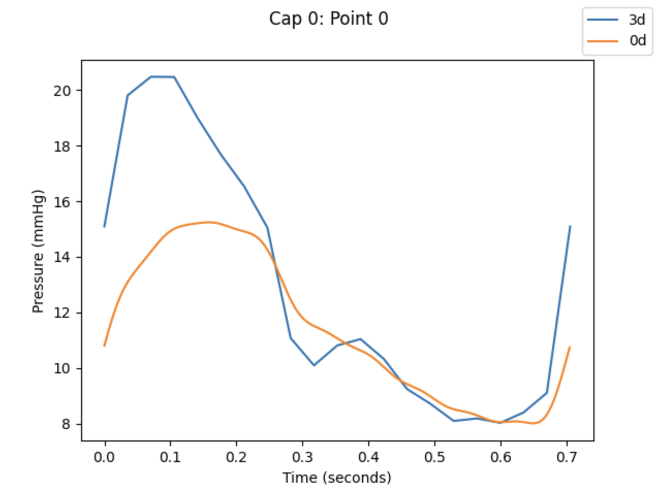
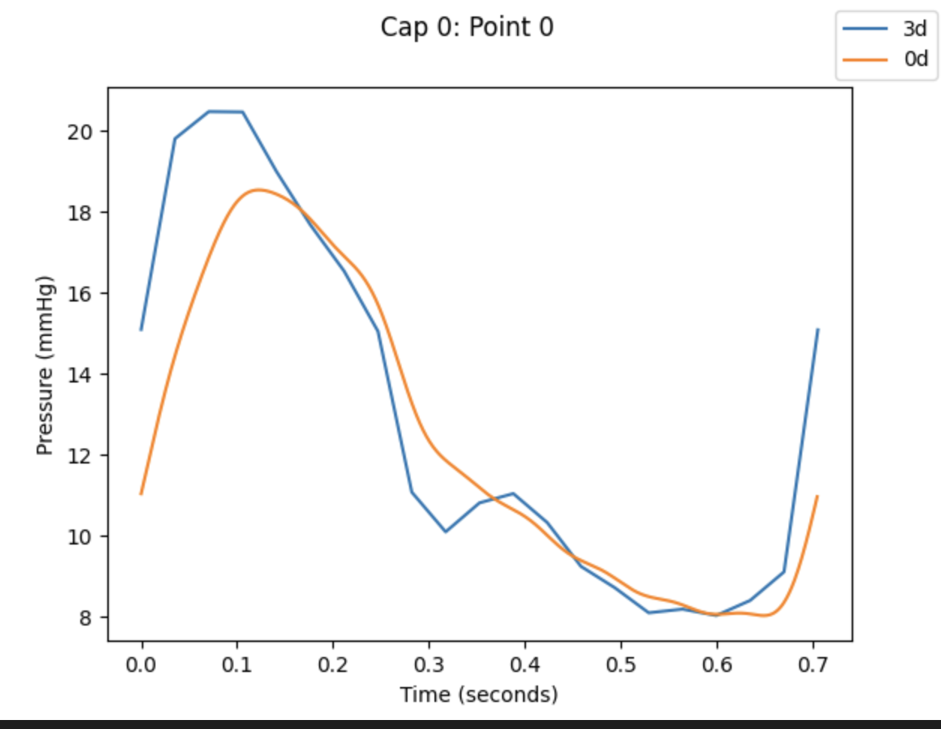
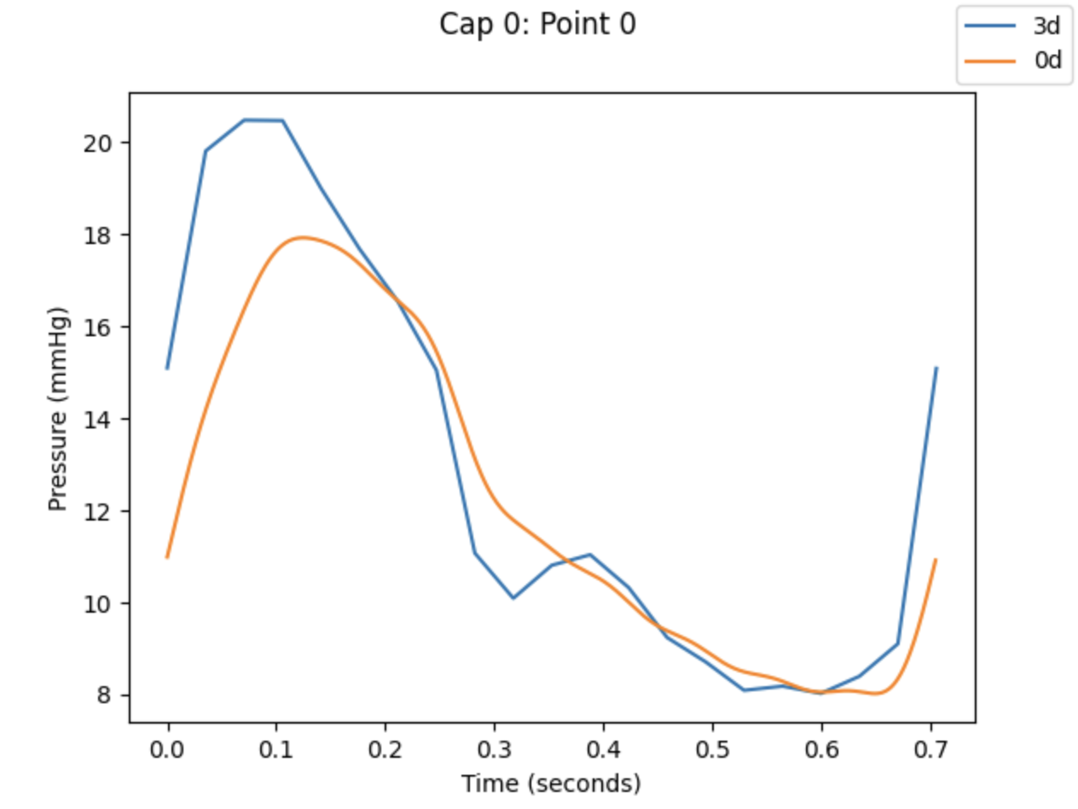
Inlet Comparison
No Modeling
Tuned JC
Basic JC

Slide 12
Solutions
JC
We need an explanation for why it works.
The problem of making accurate 0D representations should be a separate problem from my work. All we need is to demonstrate that if a 0D exists, we can stochastically model a surgical repair from it?
Implement Jakob’s tuning
Computationally expensive / not finalized
Linear system
Next page
Have not gotten it to work. Need to re-consider some assumptions and details.

Slide 13
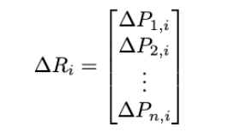



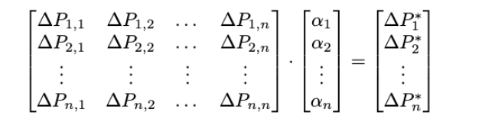
Linear System
n downstream vessels of the junctions in a model.
Consider where
Determine set of s.t.
Solver for

Slide 14
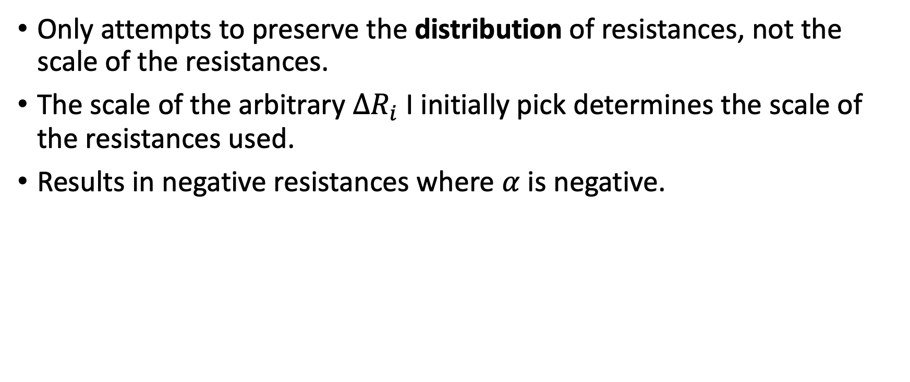
Problems
Only attempts to preserve the distribution of resistances, not the scale of the resistances.
The scale of the arbitrary $ΔR_{i}$ I initially pick determines the scale of the resistances used.
Results in negative resistances where $α$ is negative.

Slide 15
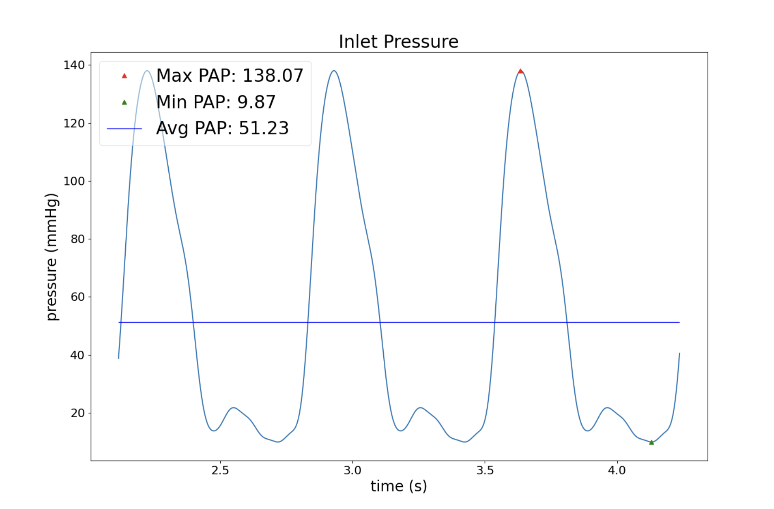
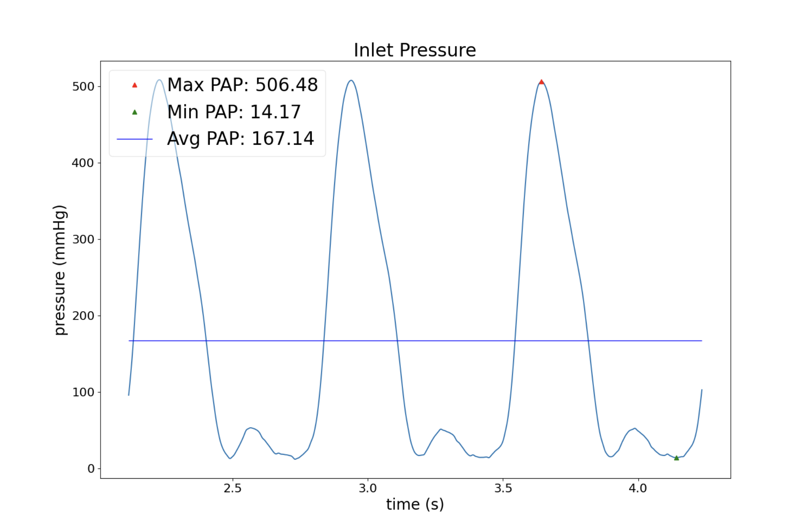
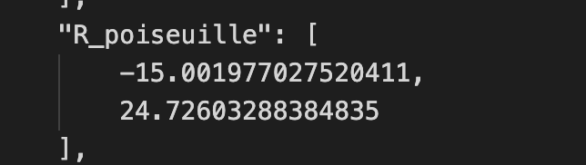

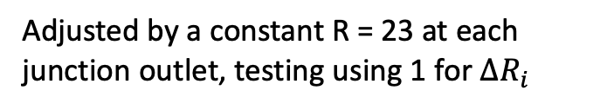

Example
Adjusted by a constant R = 23 at each junction outlet, testing using 1 for $ΔR_{i}$
No adjustment, testing using 100 for $ΔR_{i}$

