Slide 1
Research Update – 4/17/2023
John Lee

Slide 2
Current Work
Correcting 0D models to match 3D simulations (Done)
Parametrizing Stenosis

Slide 3
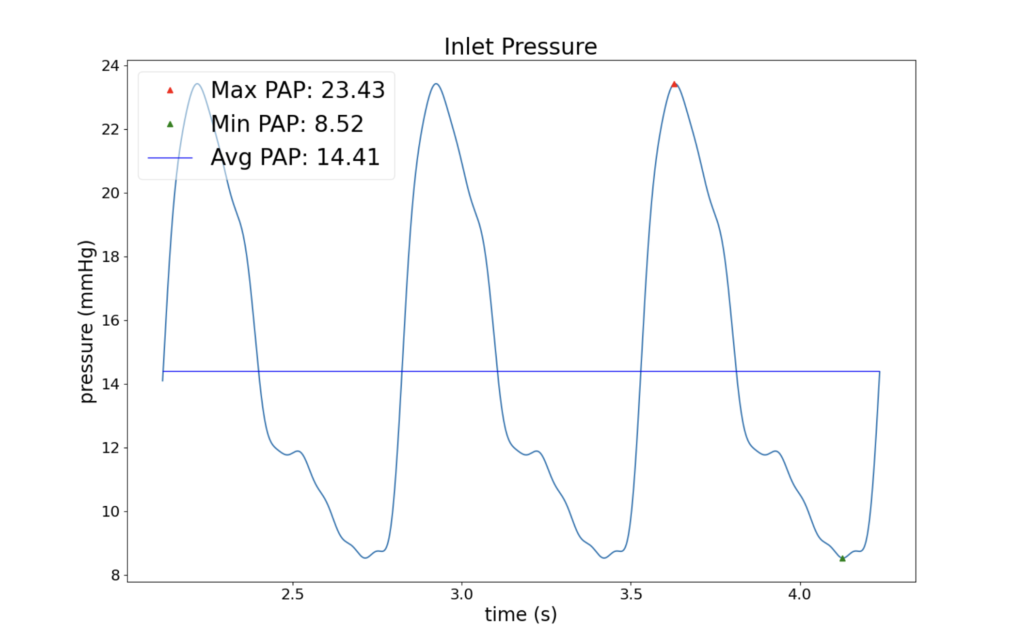
Problems in Parametrizing (Healthy)
The new method of correction adds a resistance to a JunctionVessel, rather than adding it to the downstream vessel
Previously, when artificially stenosing, we also modified the junctional resistances too.
We have shown that just modifying vessels alone is insufficient to cause a pressure change.
Extreme artificial stenosing-->

Slide 4
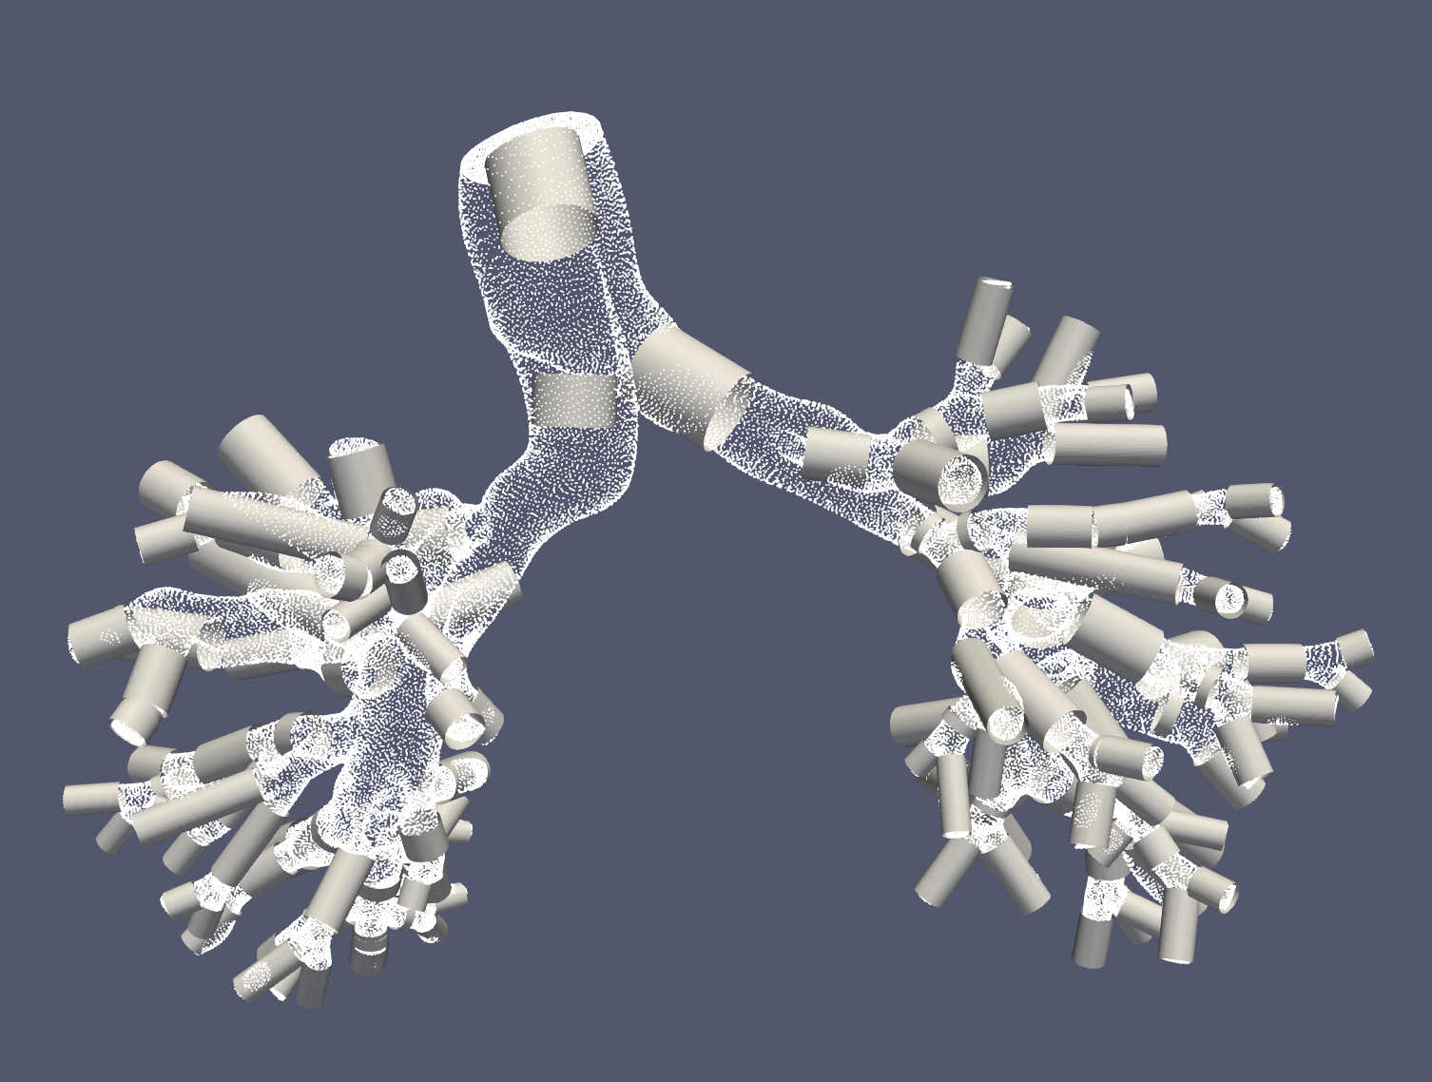
Problems in Parametrizing (Diseased)
True stenosis is often in junctions (since there are so many) →
For vessels, we don’t know how much to reduce the resistance by (an option is observing the radial increase corresponding to the stent size)
For junctions, there is no inherent geometrical meaning to changing the resistance of a junction.

Slide 5
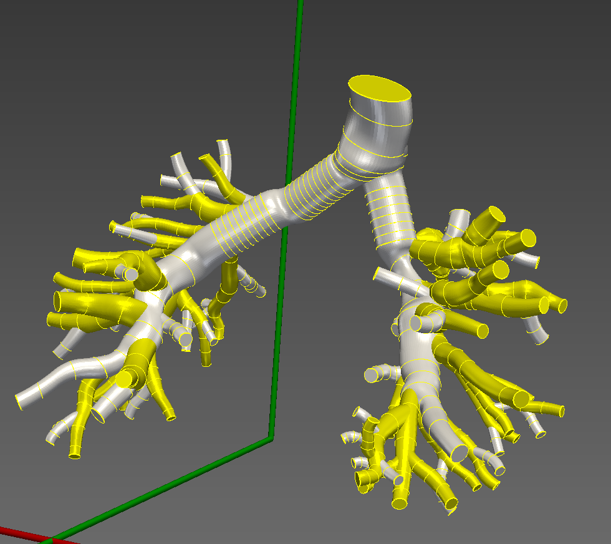
Proposed Solution
Let the original linearly-corrected 0D model be “0”.
Take the stented version, run the 3D simulation and perform a second correction on the 0D model on ALL elements.
Serves as “1”
Sample from 0 – 1.
~4 large stenosis regions

Slide 6
Anticipated Challenges
Lofting 3D model
Will the centerlines correspond when mapping the 3D solutions, since stenting changes 3D geometry?
Identifying the regions where the stenting covers in the 0D model
What if it only includes part of a segmentation?
Will the linear correction cause odd behaviors?

