Slide 1
John Lee Summer Project
Probability Based Surgical planning tool for balloon angioplasty

Slide 2
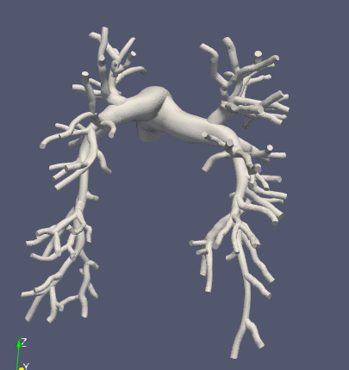
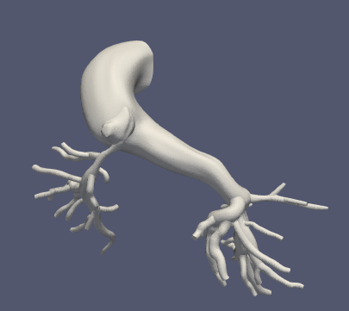
Model Gathering
Healthy Models
Artificially stenose models
Helpful to know actual healthy values for uncertainty quantification later
Stenosis Models
Have actual stenosis which must be identified
Should have previously computed RCR boundary conditions
Issues
['0005_1001', '0119_0001', '0081_0001', '0084_0001’,]
Have problems w/ mesh or blend having problems w/ centerline creation
0080_0001 (Healthy)
0118_1000 (Alagille)
Notes:
Model Issues
- Some models are not finely meshed/blended well and have issues constructing centerlines
- Ingrid’s models are in an older version of simvascular and must be reconstructed.

Slide 3
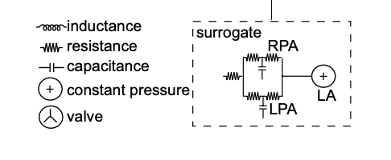


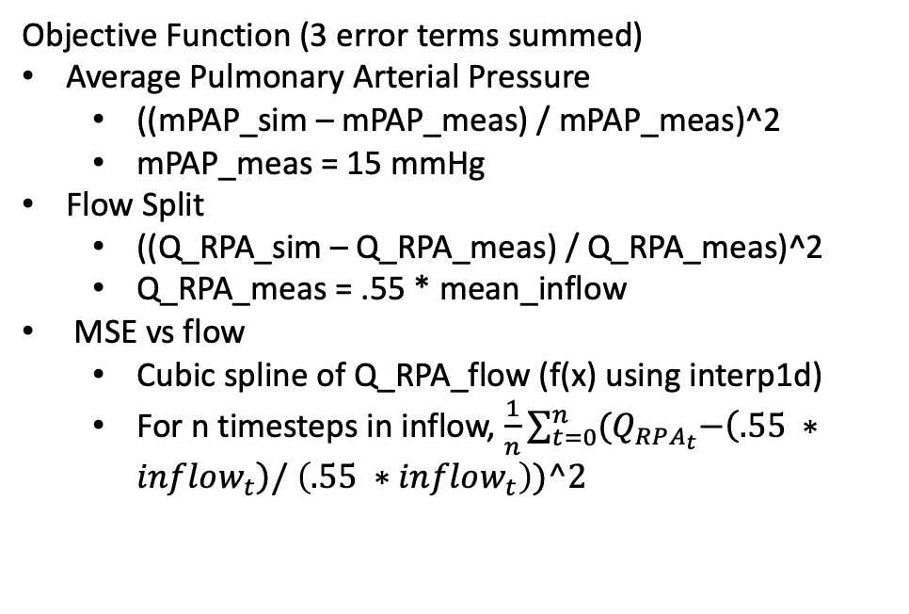
Healthy Models/ BC tuning
Objective Function (3 error terms summed)
Average Pulmonary Arterial Pressure
((mPAP_sim – mPAP_meas) / mPAP_meas)^2
mPAP_meas = 15 mmHg
Flow Split
((Q_RPA_sim – Q_RPA_meas) / Q_RPA_meas)^2
Q_RPA_meas = .55 * mean_inflow
MSE vs flow
Cubic spline of Q_RPA_flow (f(x) using interp1d)
For n timesteps in inflow, $\frac{1}{n}\sum_{t=0}^{n}{{(Q}_{RPA_{t}}−\left(.55 ∗inflow_{t}\right)/}$ $\left(.55 ∗inflow_{t}\right))^2$
Yang et. al. 2019 Surrogate model (Modified)
MPA
Constant RCL values for MPA
C is computing assuming linear eh_r of 1.2e6 dynes/cm^2
Tunable RCR boundary conditions for LPA and RPA, with constant capillary wedge pressure.
Optimization
Ideal: obj func < .01 (1% error)
Early stop: patience (5 iter), patience_tolerance (1e-6)
Split RCRS

Slide 4
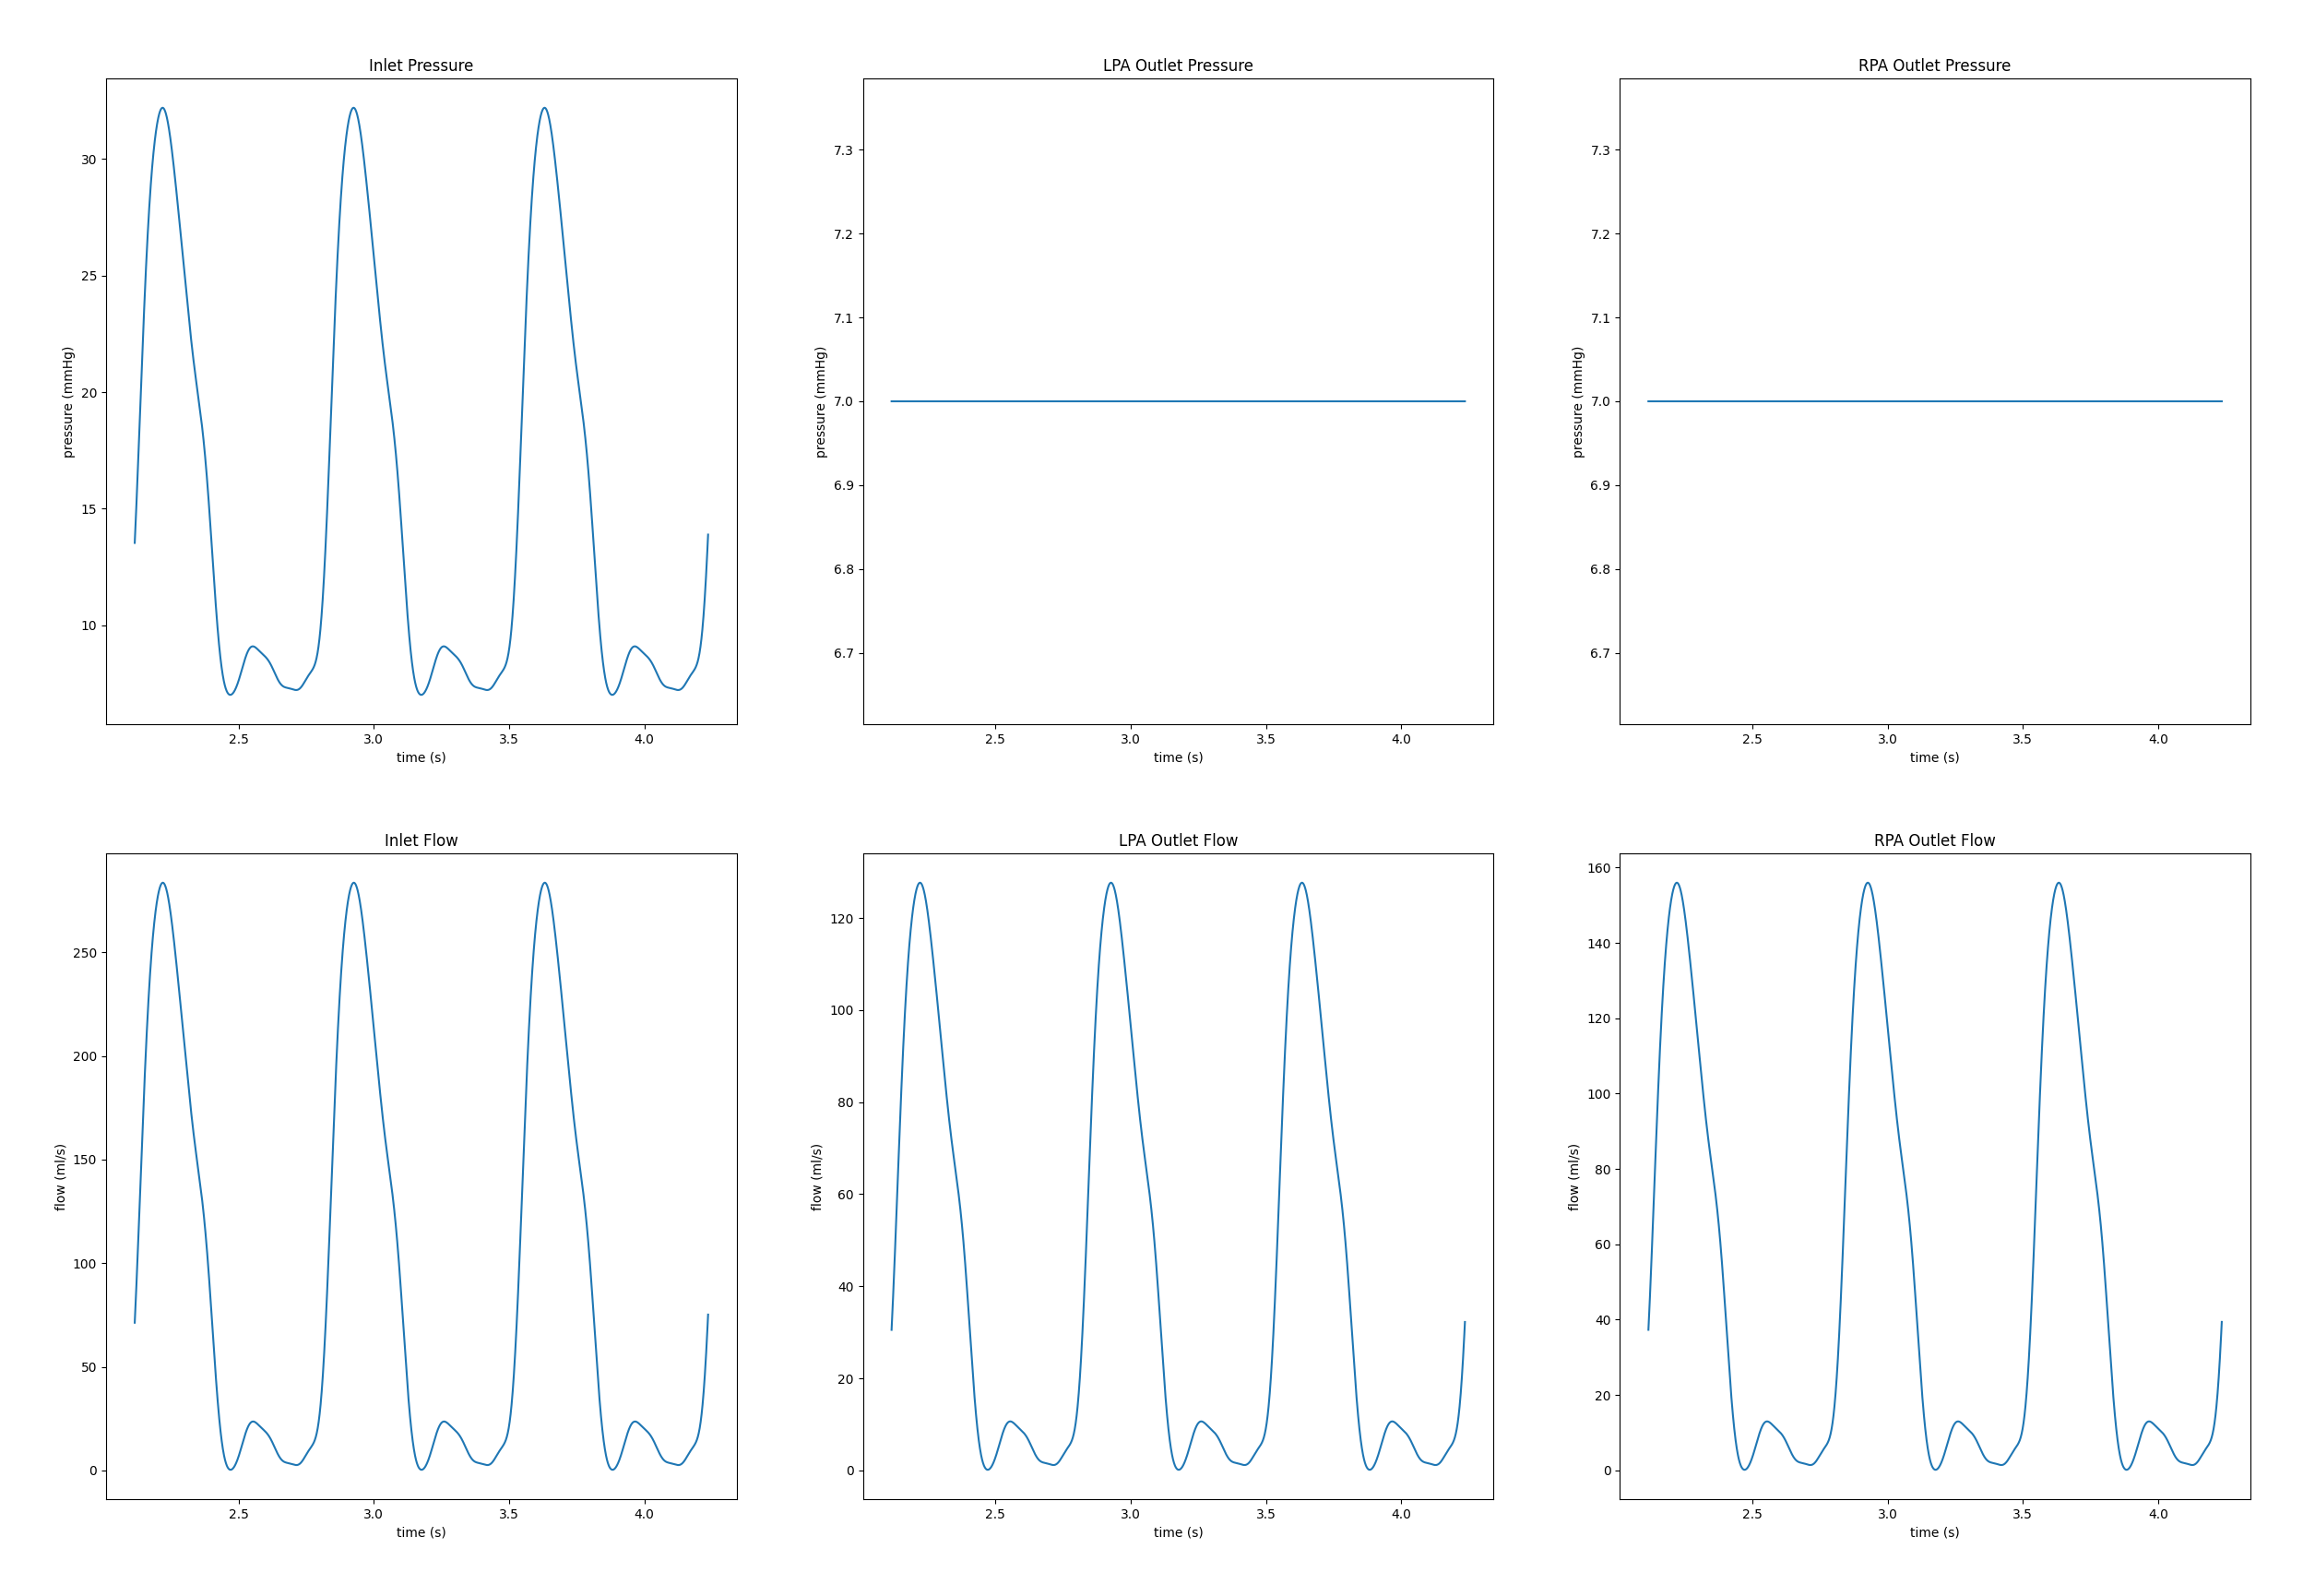
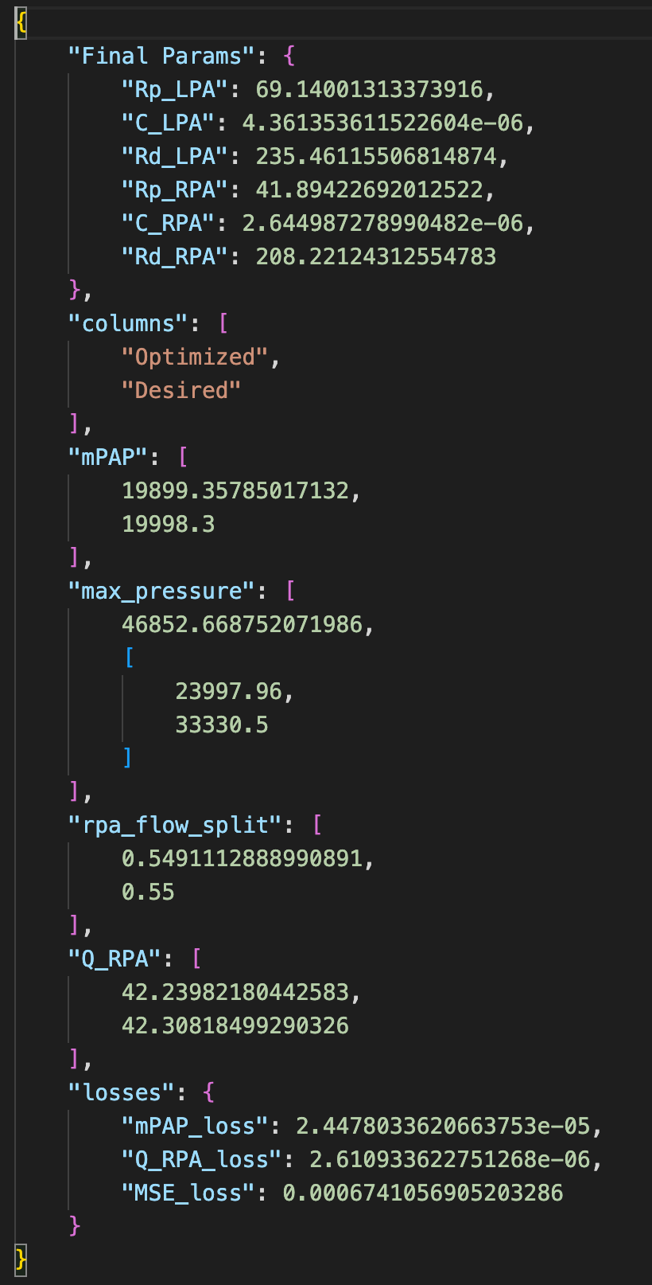
Optimization Results/Sanity Checks

Slide 5
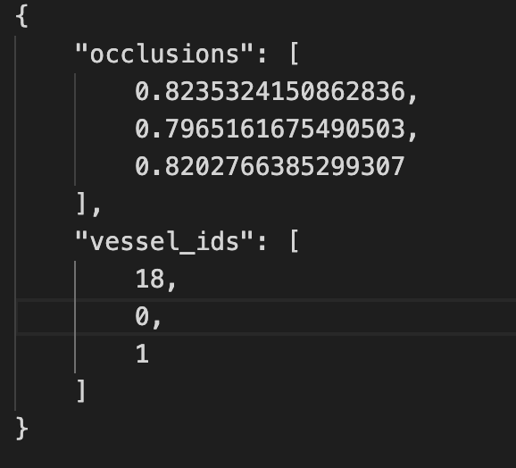
Artificial Stenosis
Construct a generational tree
Gen 0 = MPA, Gen 1 = LPA, RPA
Using the generational tree, identify n possible vessel locations to stenose in first x generations
Use a y = poisson(lambda = 2 * x ) to determine how many locations exactly to stenose
Uniformly select y vessels from all n locations, and give it a occlusion value from .75 - .9
Make corresponding change in solver file
Sample Stenosis only stenoses MPA, LPA, RPA (Gen 0 and 1)

Slide 6
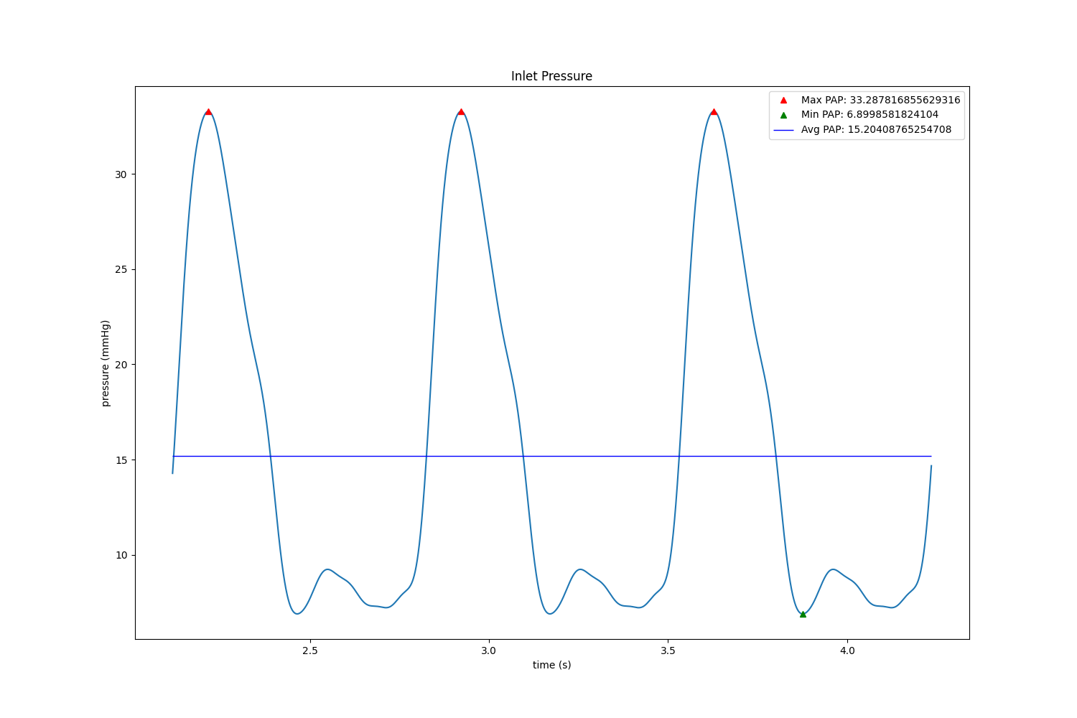
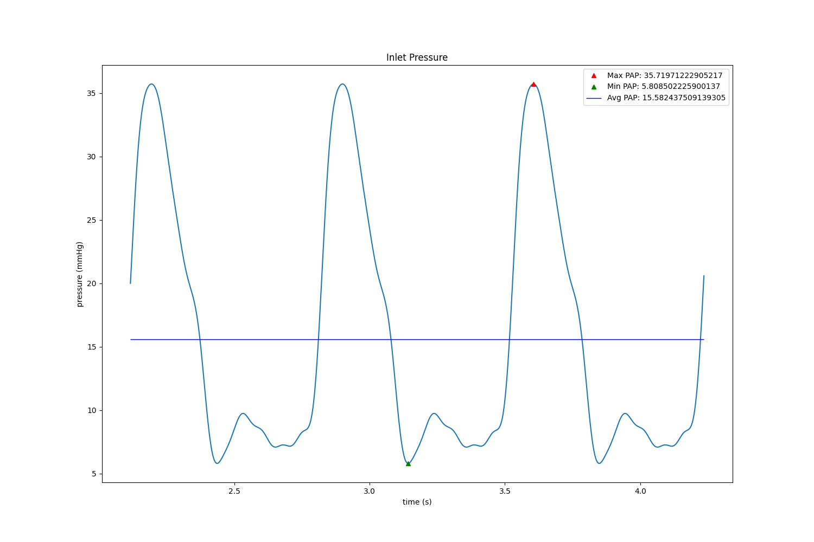
Issues
Uses Stenosis points on previous slide (MPA, LPA, RPA) which should have a significant effect but doesn’t really
Insensitivity to changes
Increasing the length (and therefore resistance) by 10+ fold barely makes a dent
Before Stenosis
After Stenosis

Slide 7
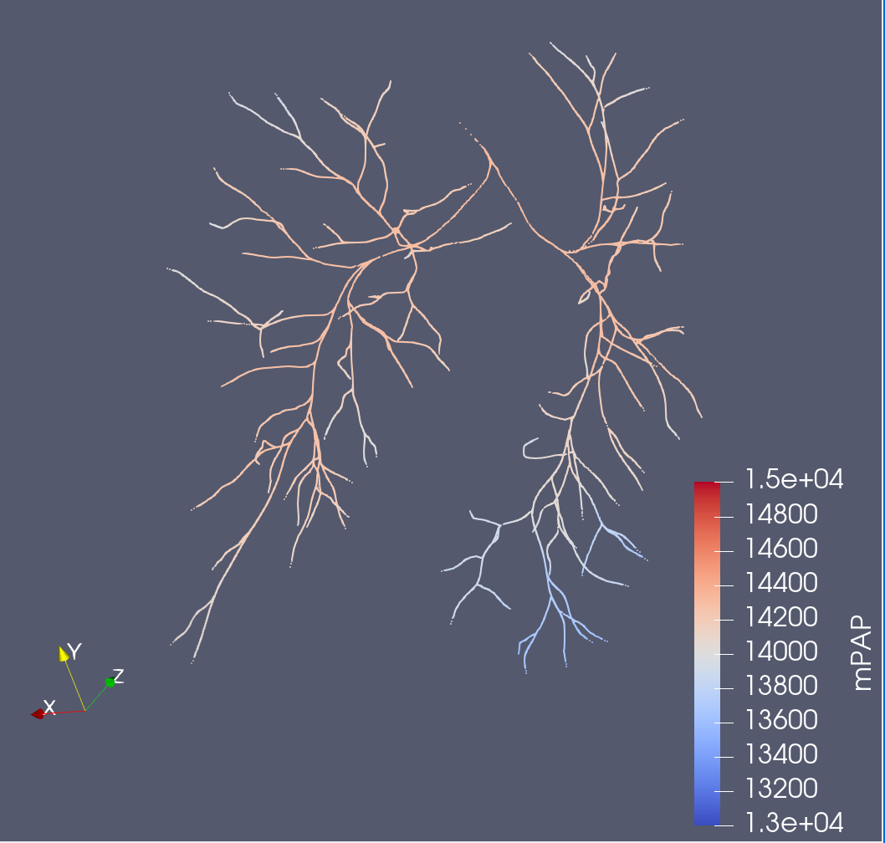
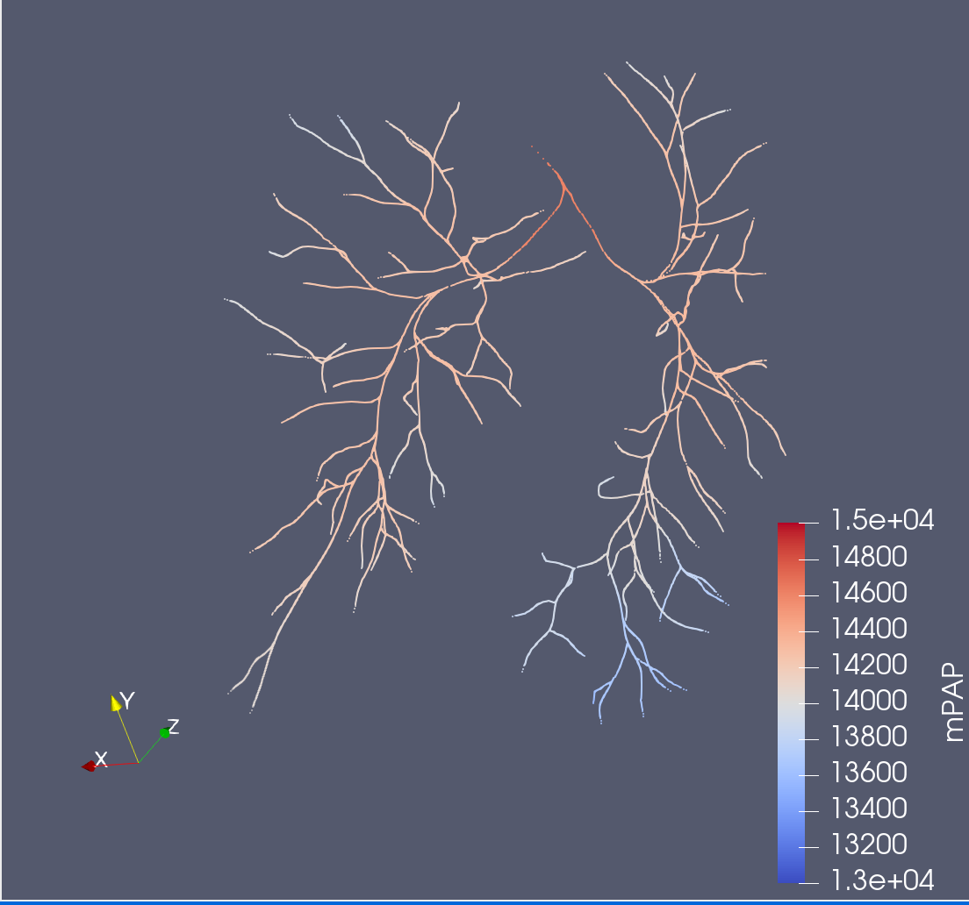
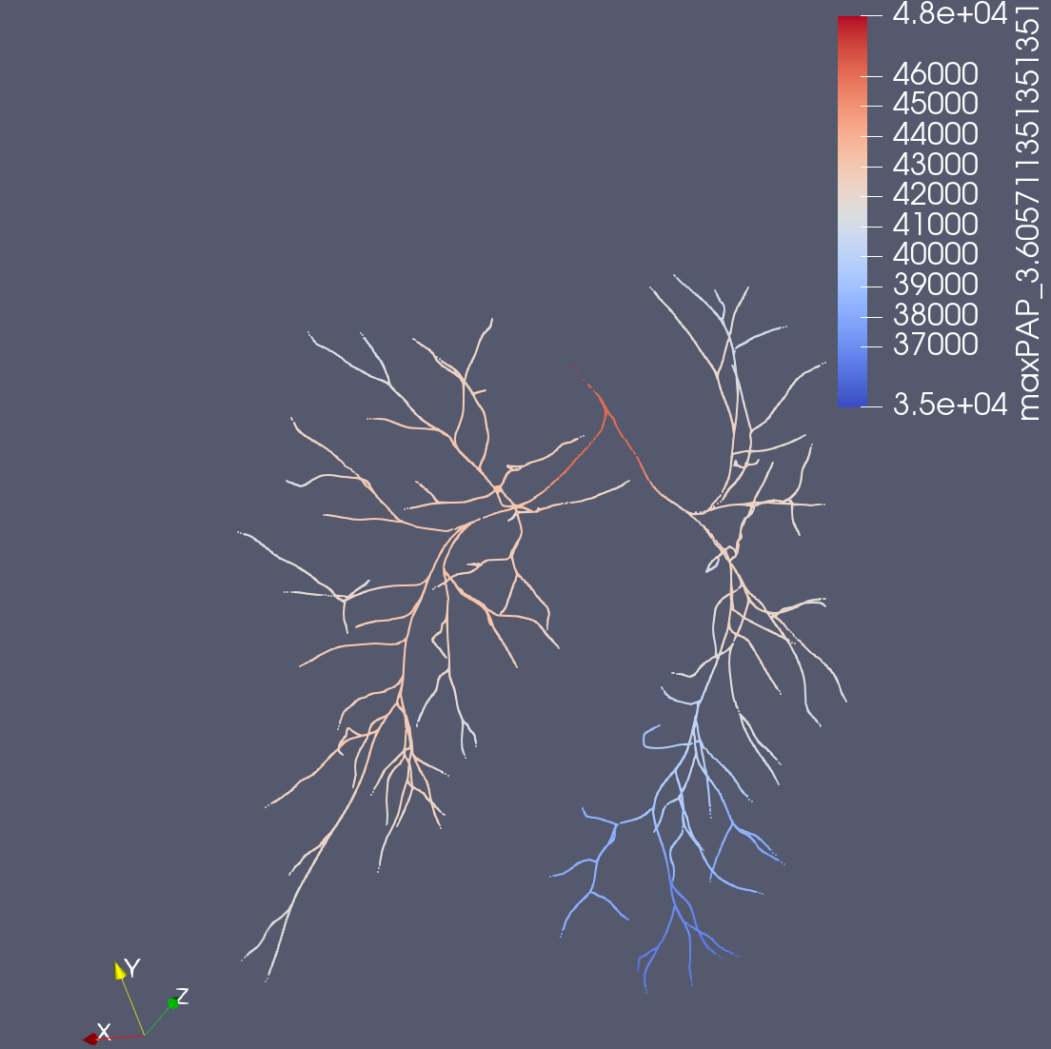
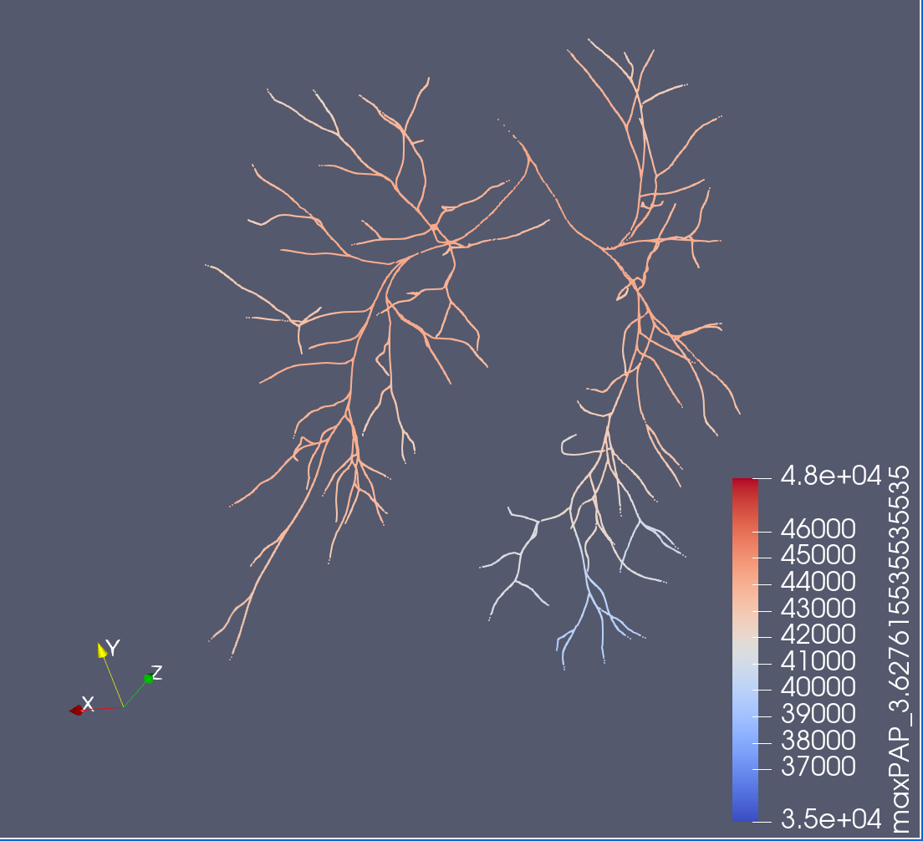
Projected to Centerlines
Before Stenosis
After Stenosis
← mPAP →
← Peak systole/max PAP →

Slide 8
Stenosis Models
Only use models where an RCRT.dat file is provided for 3D simulations
Must be mapped back to 0D style where face/cap names are also included in the file
Comes from both VMR & Ingrid’s previous models

Slide 9
Identifying Stenosis
Map Generations like w/ Healthy Models
Using D = 0.001 + a * order * e^(b * order ) * (age ^ c) from
a = 1.203e-4, b = 0.3927, c = 0.2381
We assume order is roughly 16 – generation, since gen 0 = MPA = order 16
https://journals.physiology.org/doi/full/10.1152/ajpheart.00123.2020
Given approximate diameter of an average vessel, for each real vessel in the stenosis patient, compute what a standard resistance should be for a vessel of that length, compare it to the actual resistance, and if it is n (4) times higher than the control, consider it a stenosed vessel
Alternative Proposal: Run a 0D simulation and observe the local effect where pressure drops > n%

Slide 10
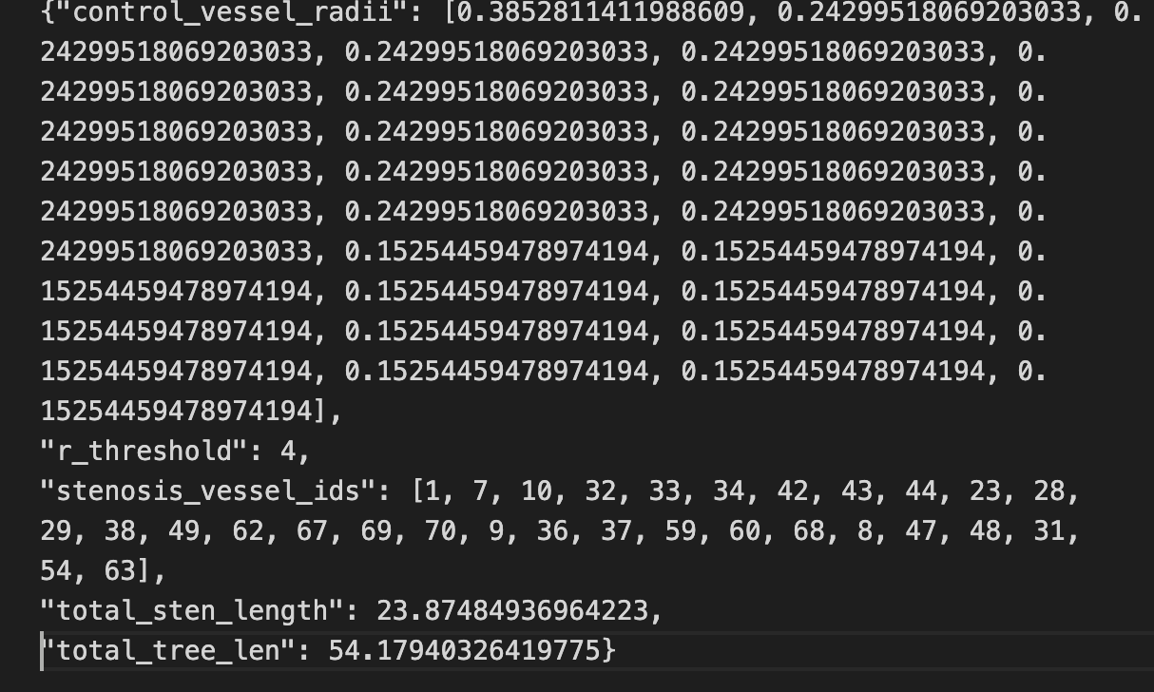
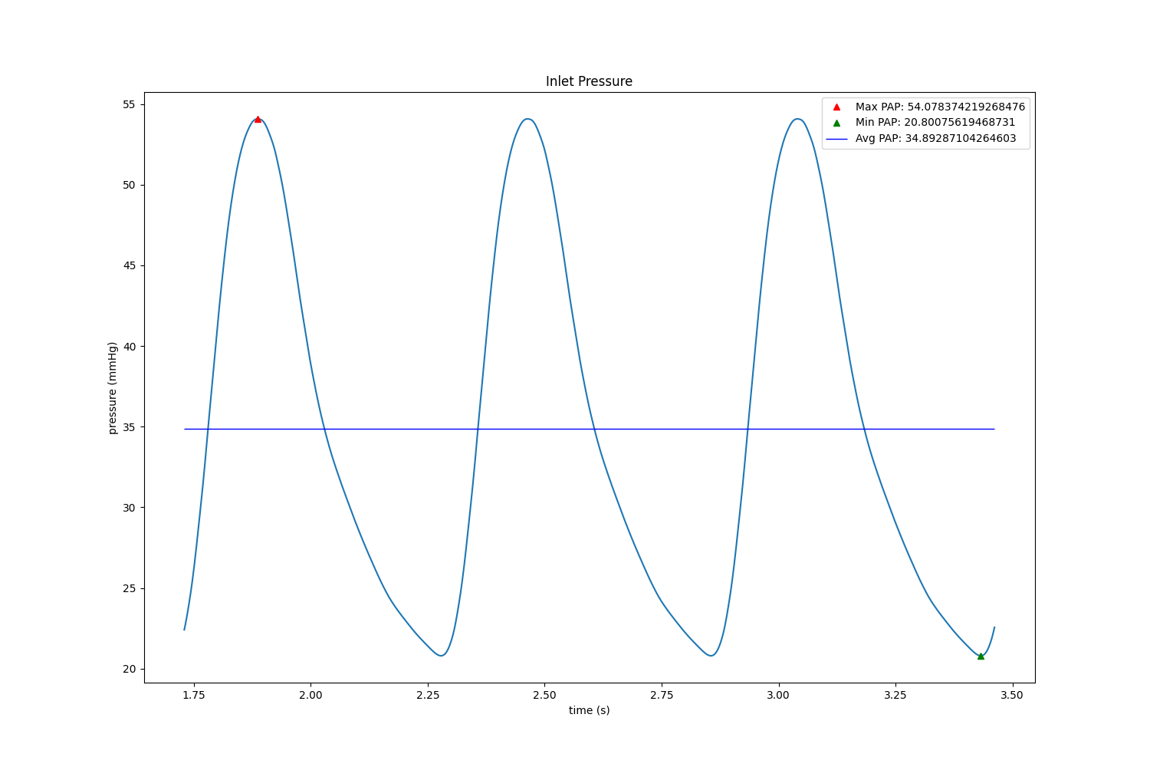

Stenosis Sanity Check/Issues
Before Fix
Stenosis Points
After Fix
Note: Wave forms not exactly correct, but only used RCRT.dat provided (Could retune the model using the mPAP, but what about flow split?

Slide 11
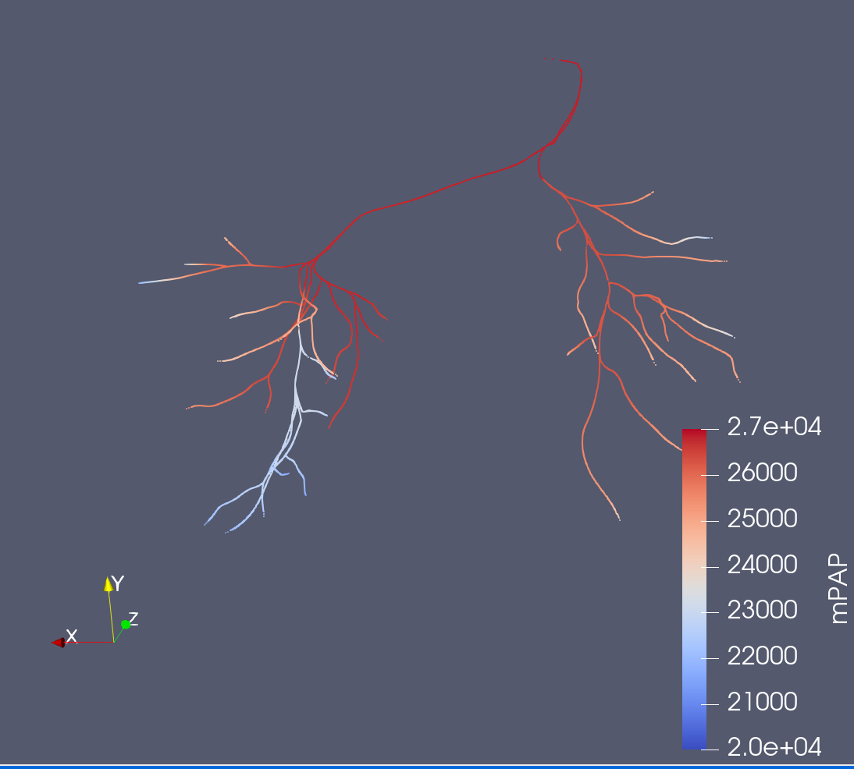
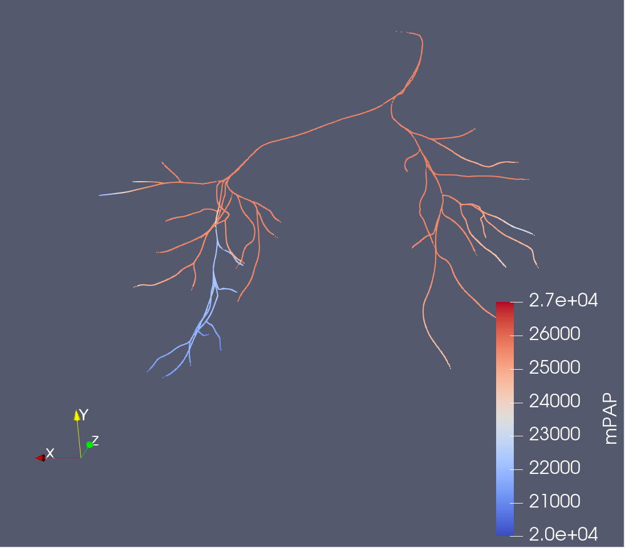
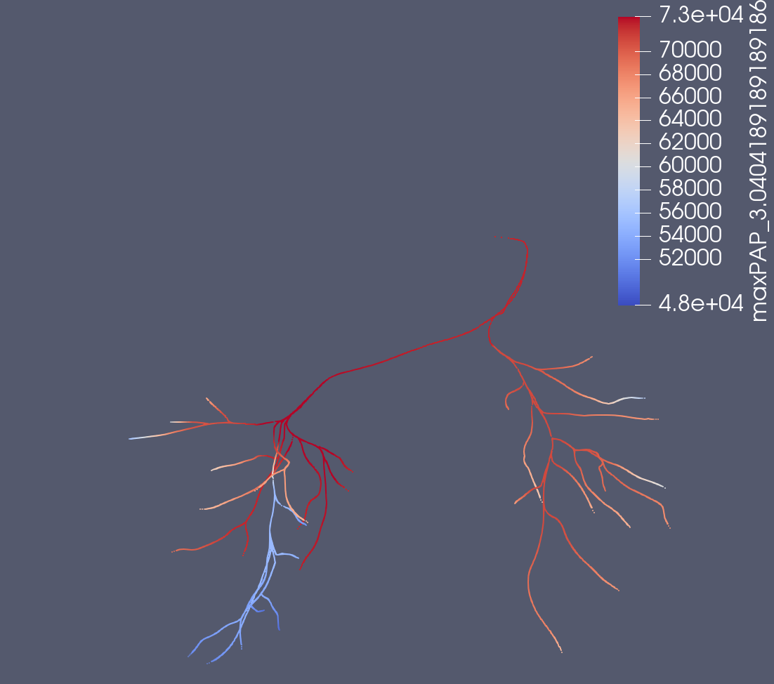
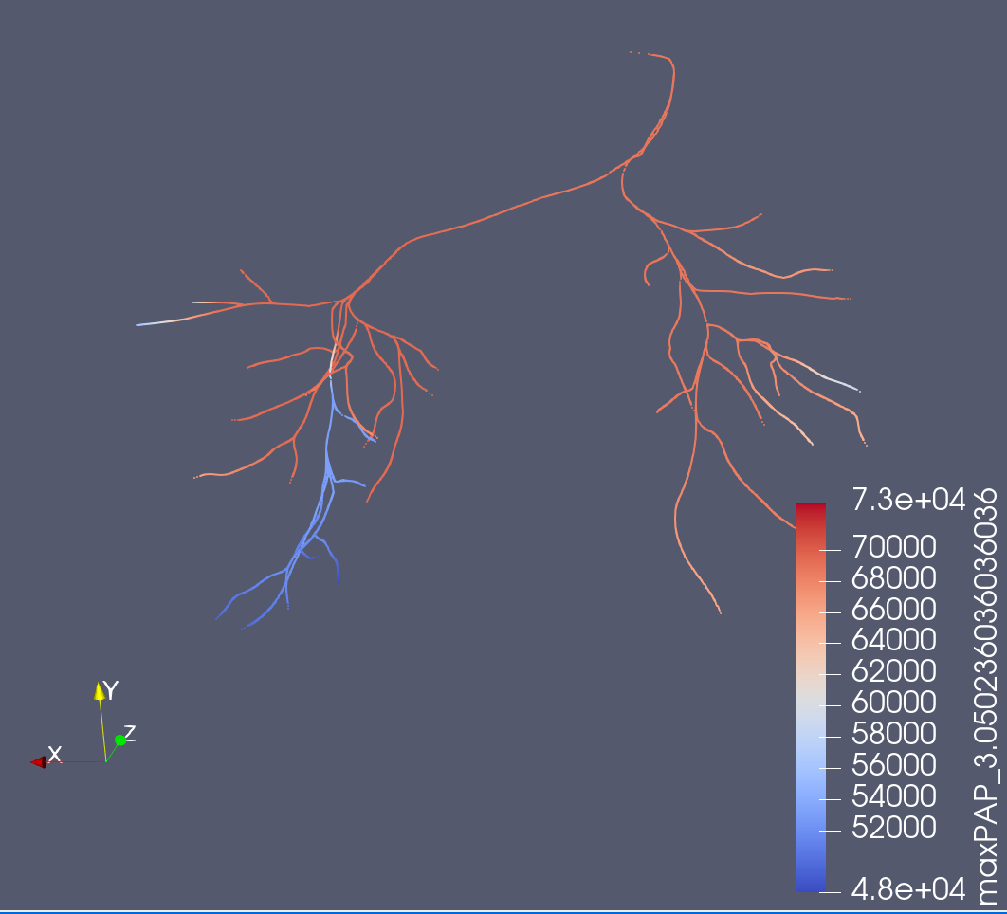
Projected to Centerlines
Before Fix
After Fix
← mPAP →
← Peak systole/max PAP →

Slide 12
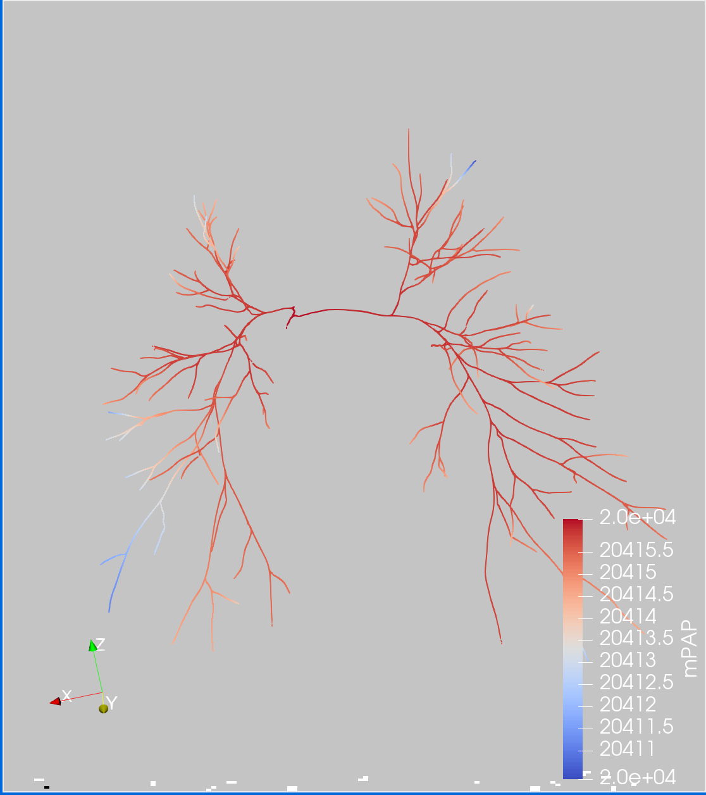
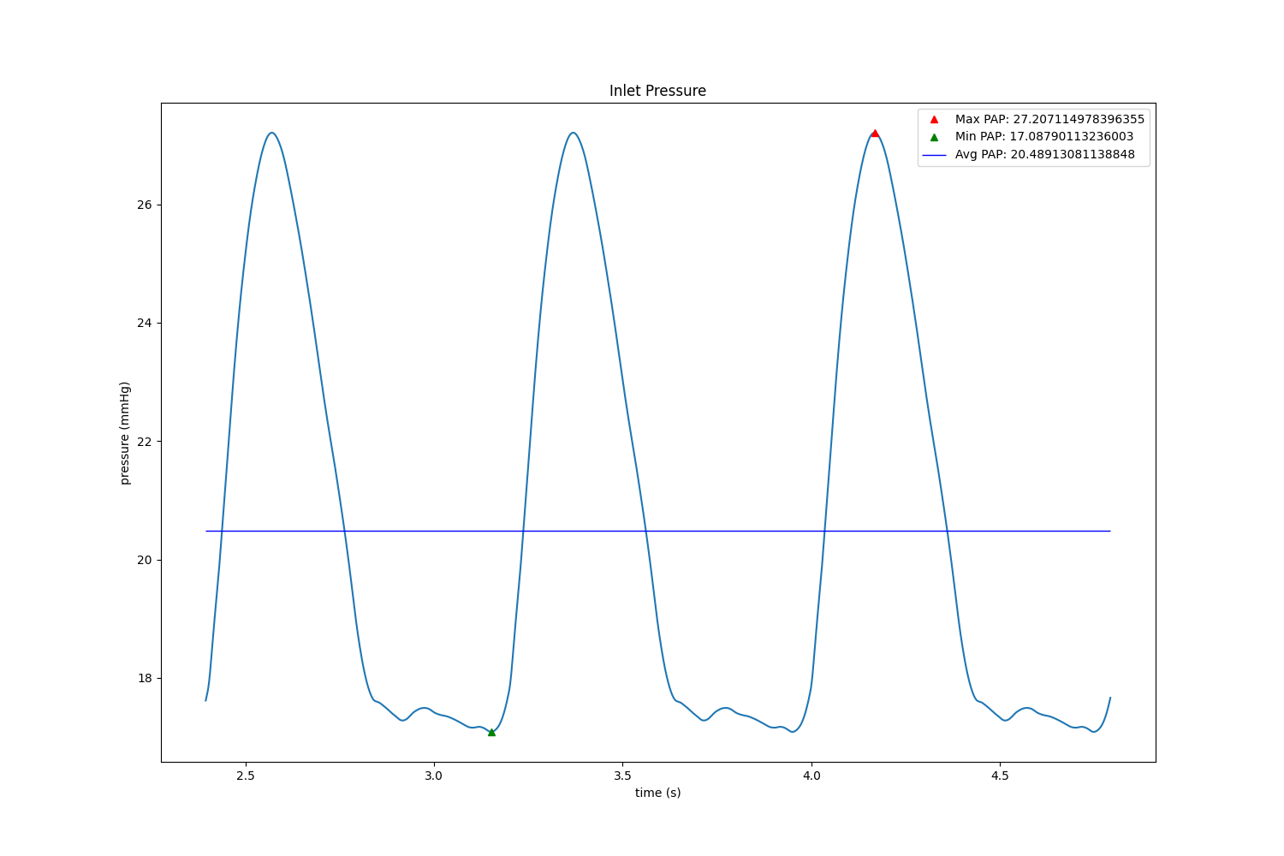
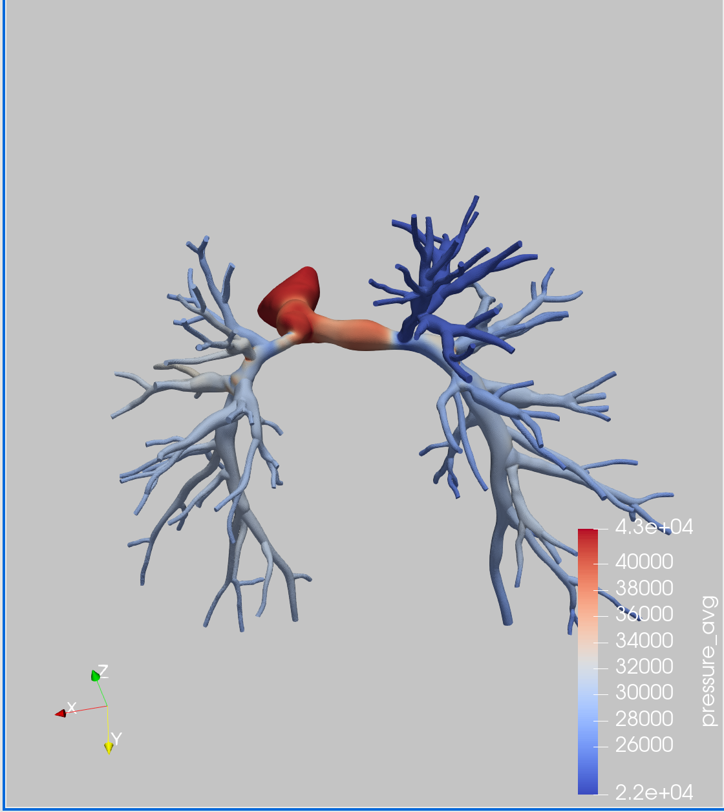
Comparison b/w 3D and 0D
0D Waveform
0D Simulation mPAP
3D Simulation mPAP
There is no pressure Drop at all

Slide 13


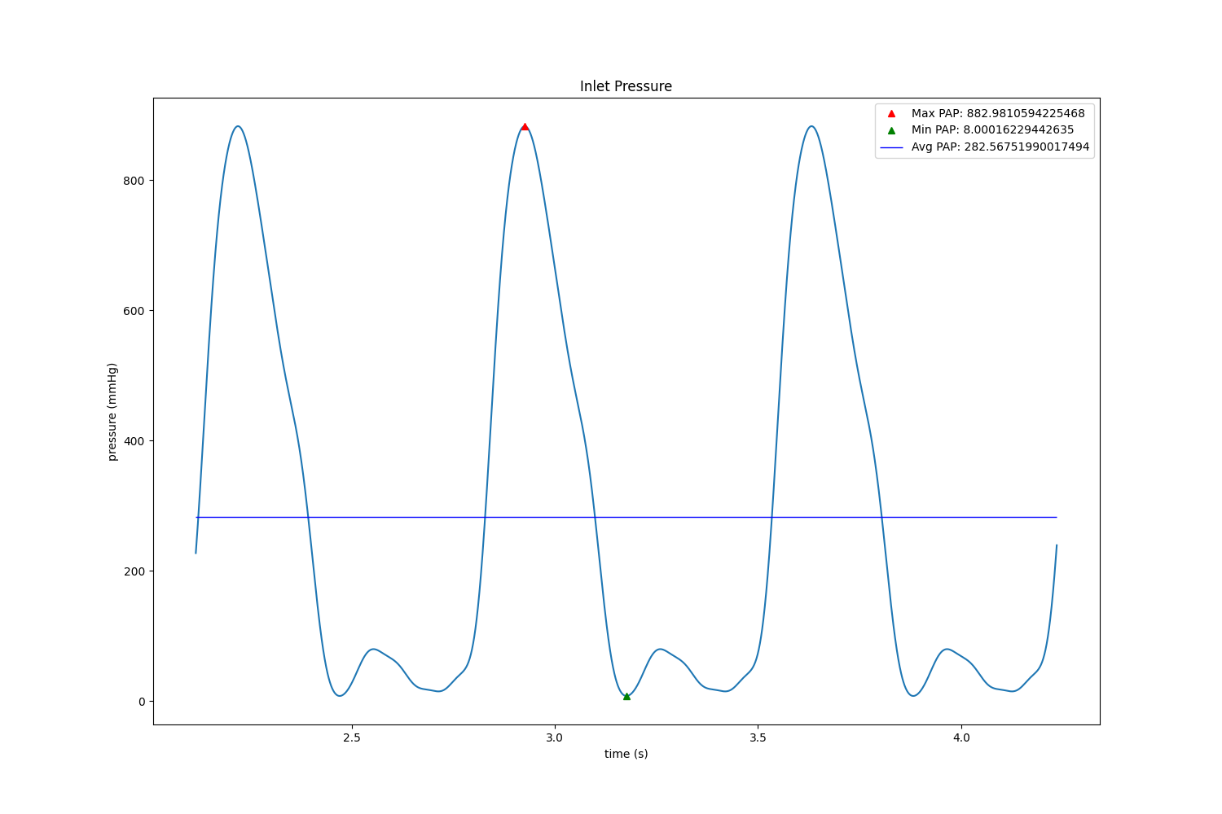

Using a Basic Test Model
No Modification
MPA * 1e-3
MPA * 1e-5
MPA * 100

Slide 14
Potential Solutions
Adaptive BC’s
Changing eh_r value for capacitance calculations (stenosis may cause a 1 magnitude change)
Change Something about stenosis coeff calculation b/c it is poor for pulmonary stenosis

Slide 15
Hypothesized Problem
https://github.com/SimVascular/svZeroDSolver/issues/40
Model example in link above is 0118_1000.
The stenosis is in the junctions and not in the actual vessel segment

Slide 16
Next Steps (Neural Network)
Construct NN capturing the changes in pressures and flows depending on the change in resistance
Sample from resistance space using Sobol Sampling
Compute Probabilities

