Slide 1
Research Update - 1/30/2023
John Lee

Slide 2
Current Work - Steps
Ensuring 0D Model is roughly similar/correlated to 3D model
Stenosis Detection to parametrize repair
Run ML scripts on diseased model
Quality/Correctness checks on ML portion.

Slide 3
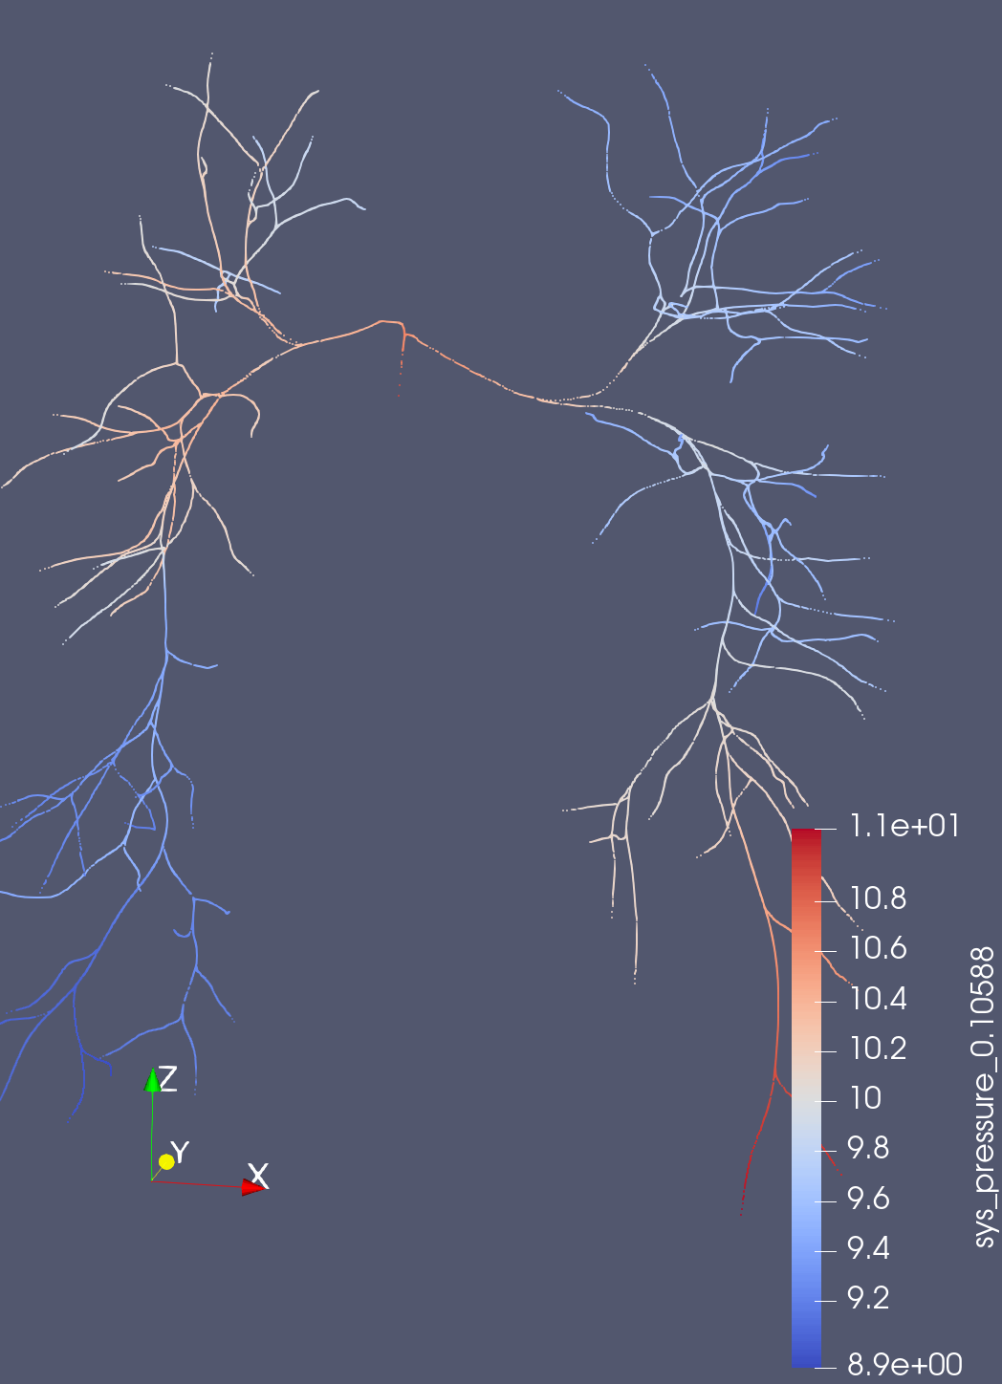
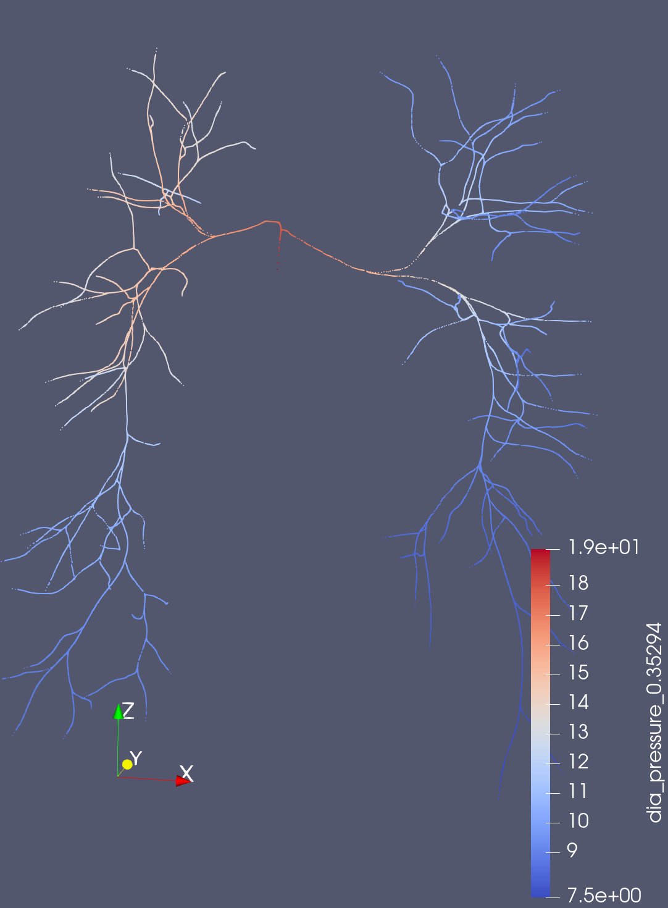
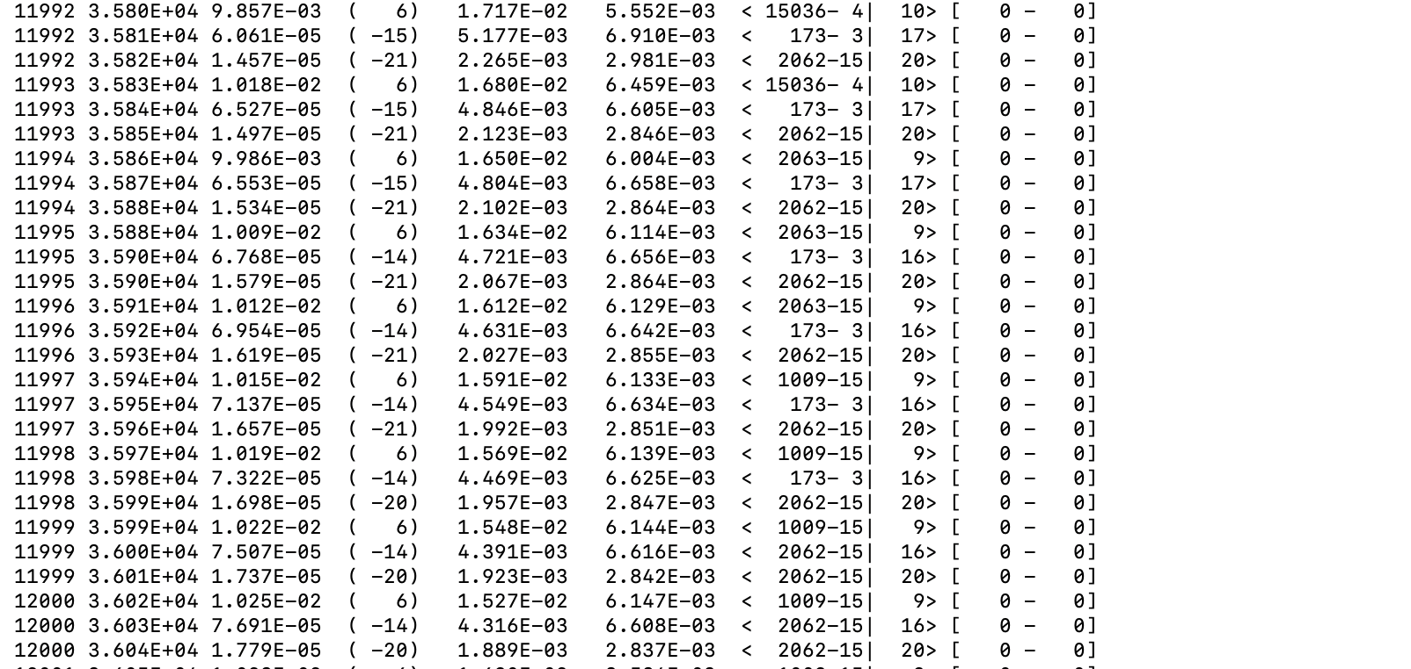
Current Work
But noticed new odd behavior/ distributions even in the healthy 3D models.
Systolic
Diastolic
Running 3D simulations of Ingrid’s models no longer explodes
The default parameters for 3D simulations are poor

Slide 4
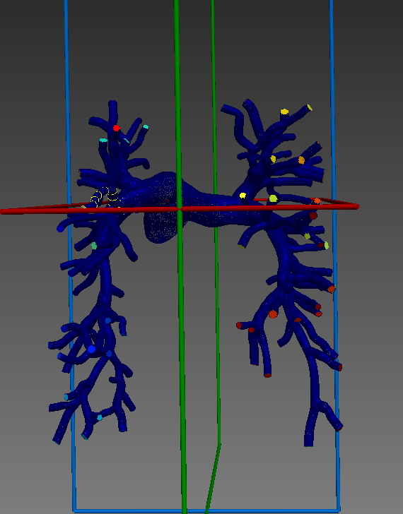
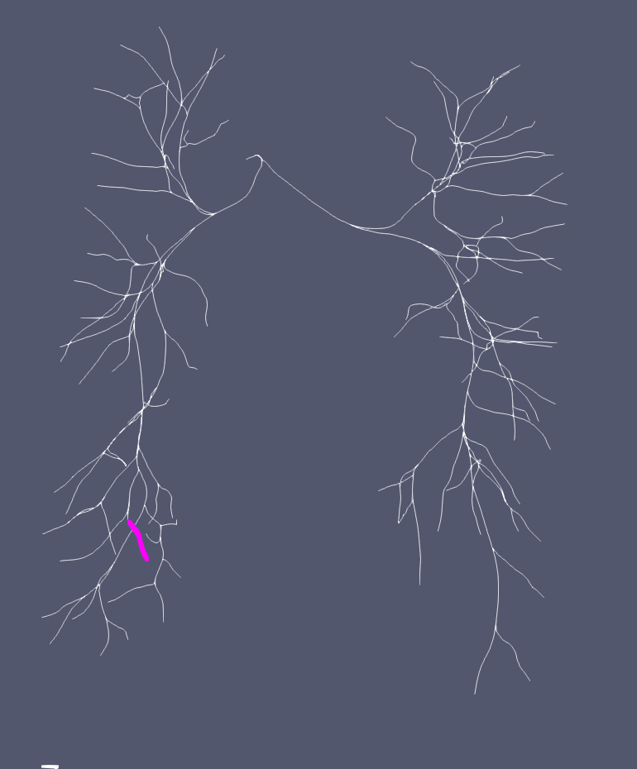
BC Mapping in 0D pipeline
- Branch 9 contains RCR_0, which should equal LPA_7 from an ordering perspective
- Ran using Simvascular ROM

Slide 5
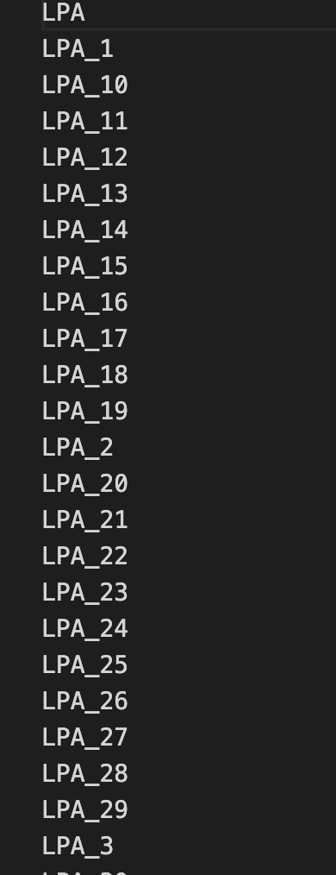
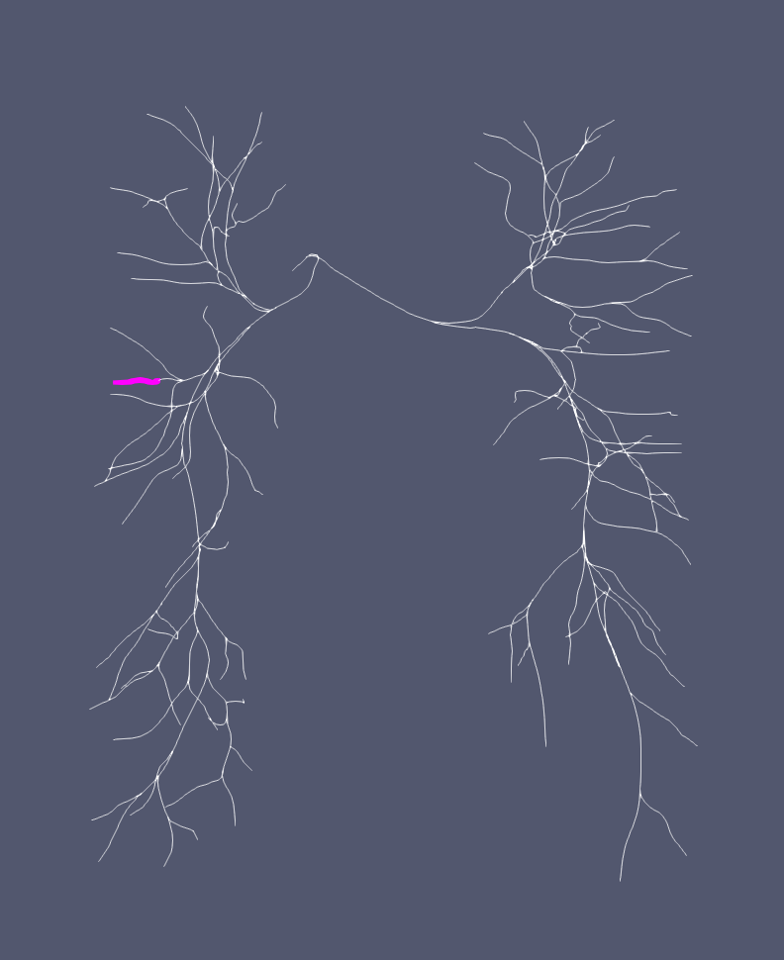
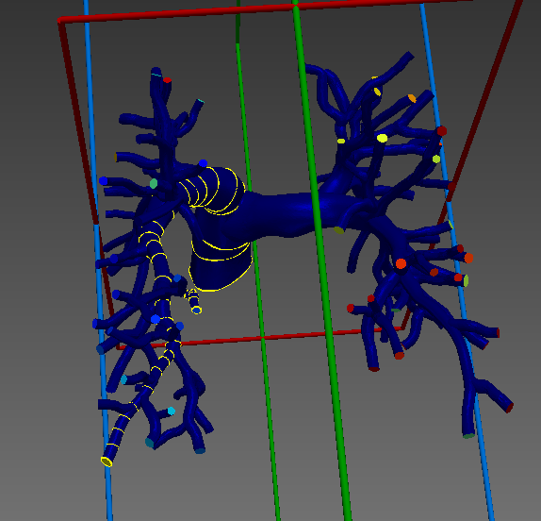
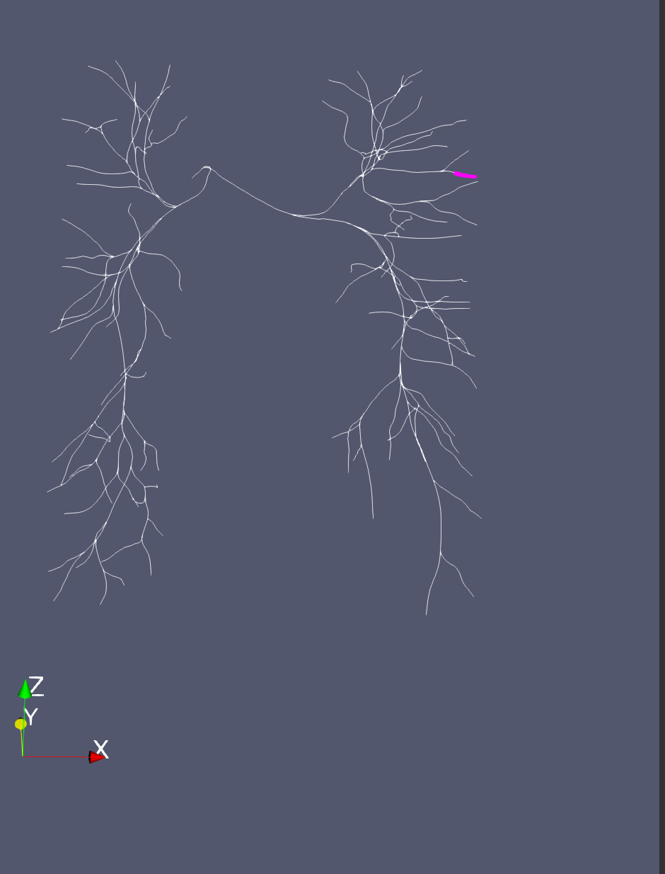
Branch 46, mapped to LPA_25, but it is clearly on the RPA.
- Branch 2^, Mapped to outlet LPA, but LPA should be at bottom
If I pass my own RCR file with ordering.

Slide 6

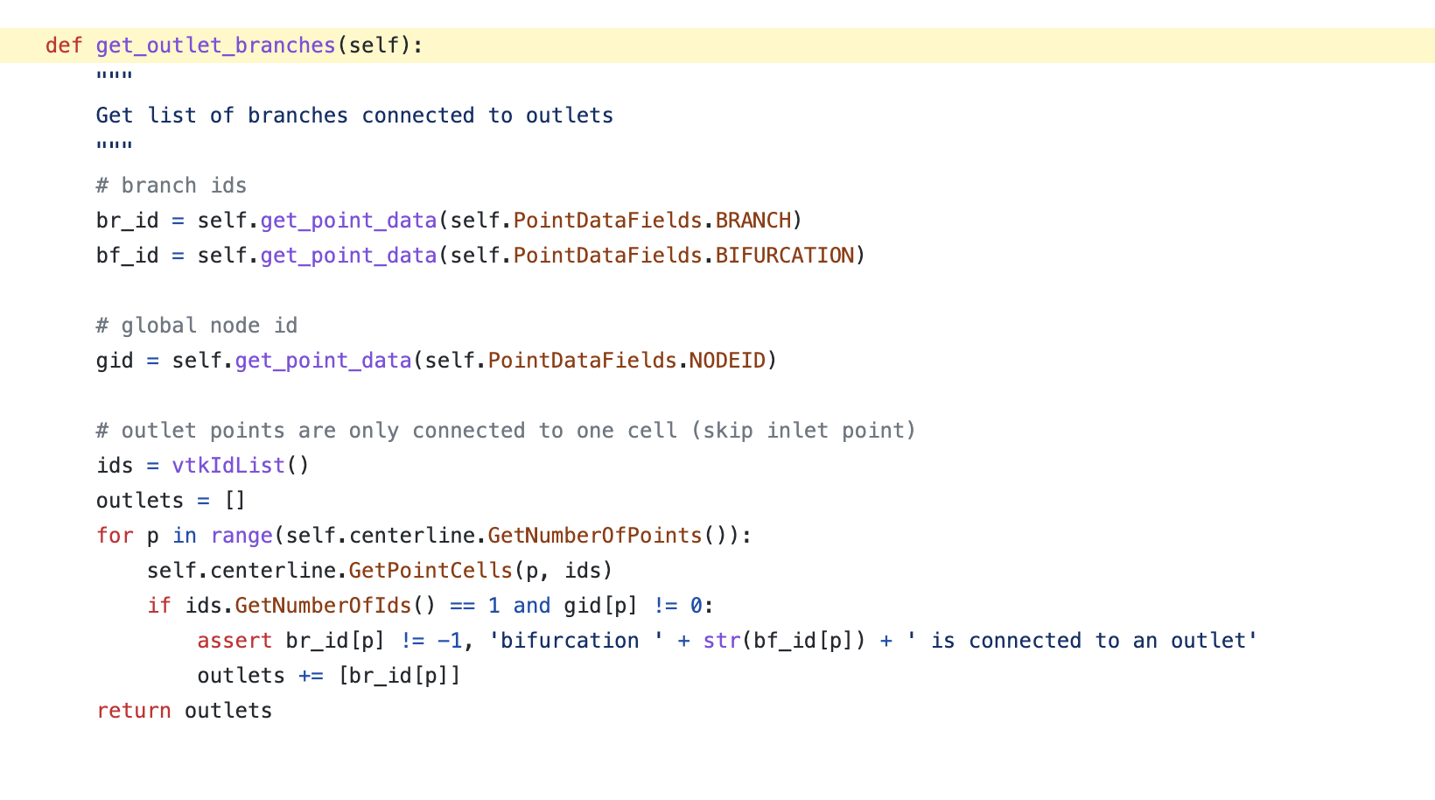
- The outlet branches order are selected in increasing order of point ID’s.
- Then each branch is mapped to the id of the last vessel segment in that branch

Slide 7
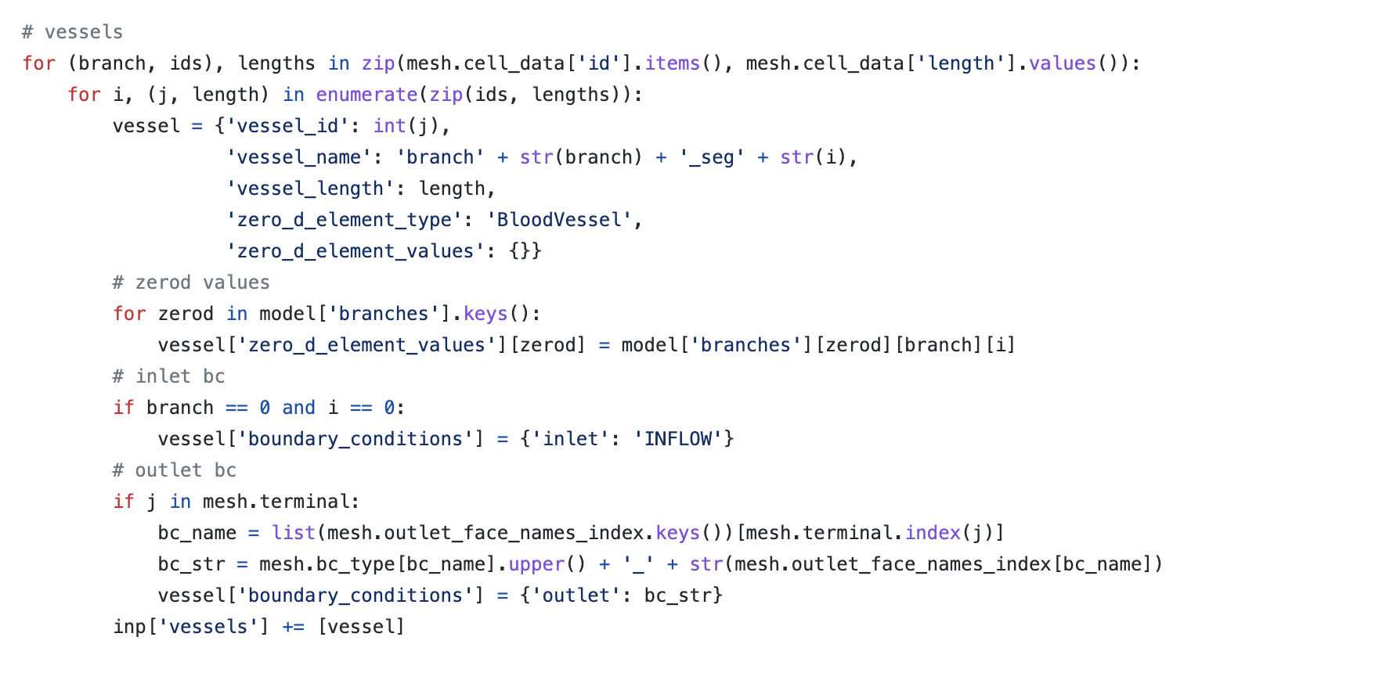
When mapping BC to particular vessels and branches, it checks if that particular j, or vesselID, is inside a mesh.terminal.
Then it gets matched with the particular name at the index of mesh.outlet_face_names_index.
Therefore, appropriate mapping depends on the order of mesh.outlet_face_names.

Slide 8
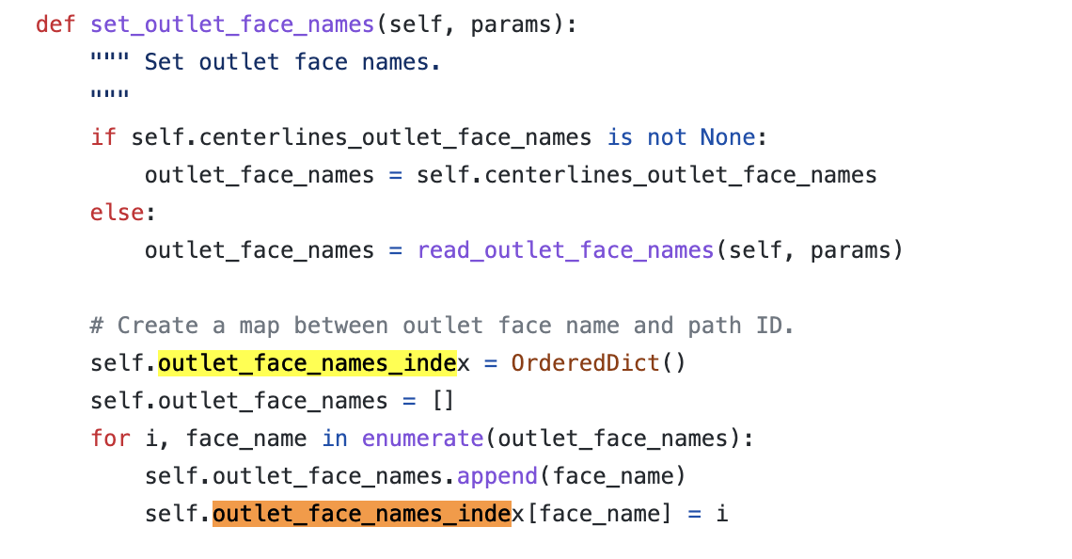
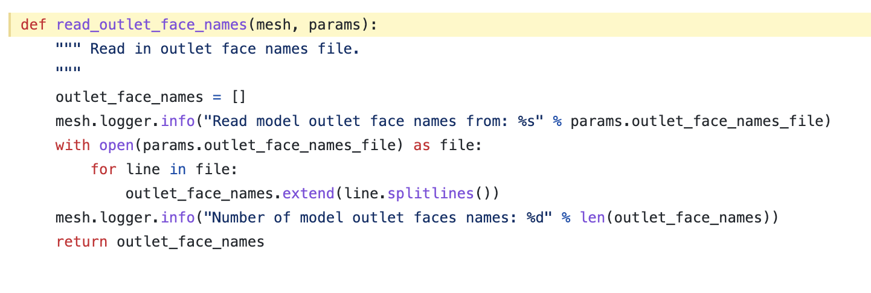
If I provide my own outlet_face_names.dat file, I have no guarantee that the order will match appropriately
Even when I used Simvascular’s build in method to double check, I don’t believe it matches up correctly
Essentially, the logic for associating the correct branches to the correct Face ID’s is not internal.

Slide 9
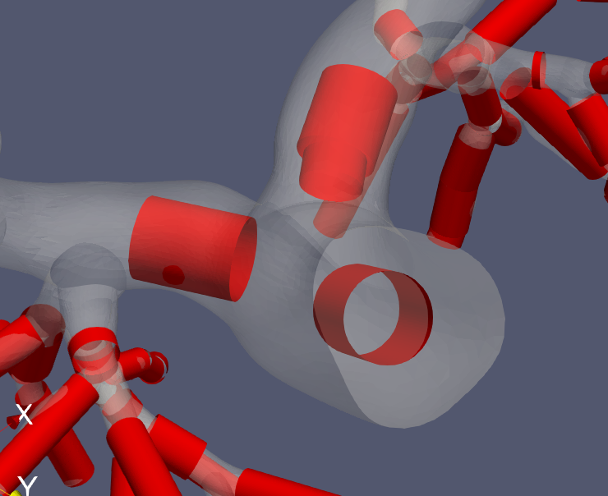
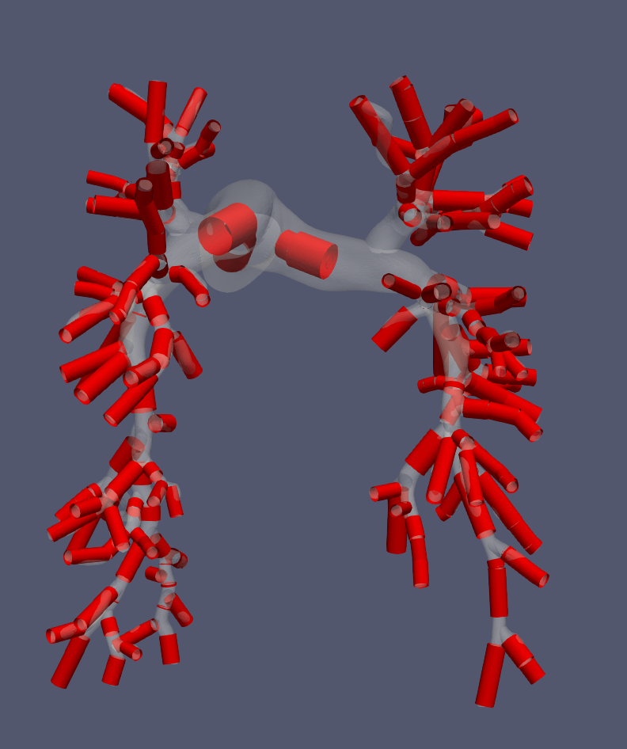
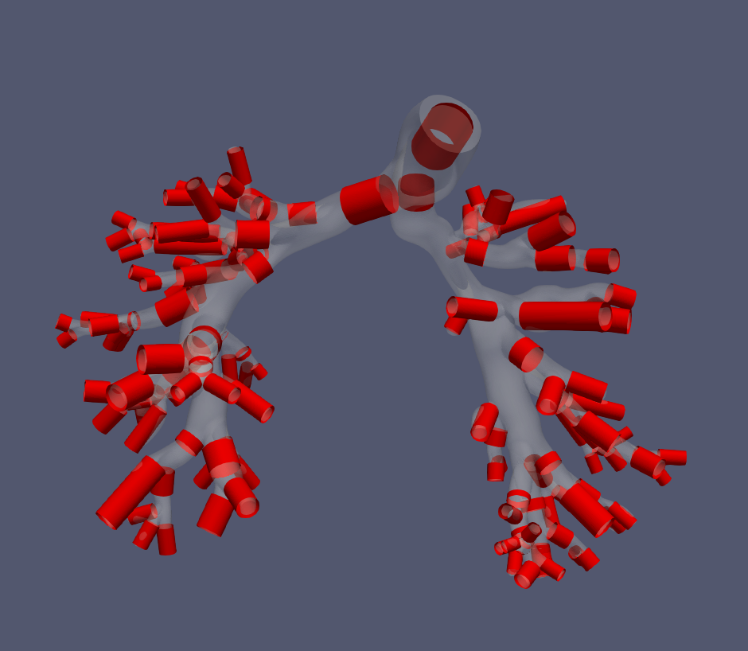
0D -> 3D model
Constructs an approximate 3D model from the 0D model
Does not factor in non-linear resistance, since it reverse engineers the radius from the Poiseuille resistance
It is a bit odd that the earlier segments severely overestimate the pressure
Curious how significant not capturing junctions is. The main stenosis is in the junction.
← Healthy Model
Diseased Model →

Slide 10
Sequential tuning
Natalia’s ML junctions

