Slide 1
Stenosis Surgical Guidance Tool
Update – 12/8/2022

Slide 2
Pipeline Overview
Manually Compare w/ 3D Simulation to ensure quality
Healthy: Generate Artificial Stenosis
Construct LPN models
Tune BC using Surrogate
Parametrize stenosis
Run LPN & train NN
Diseased: Detect Stenosis

Slide 3
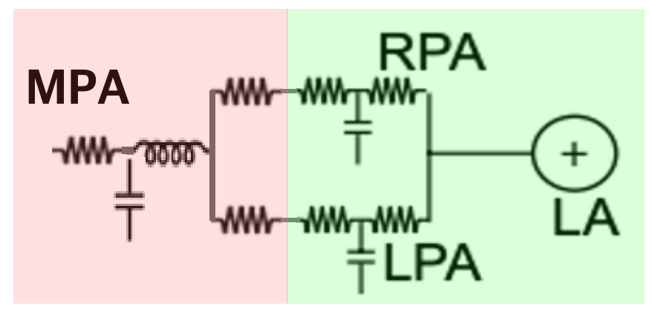
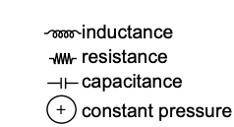
BC Tuning (Healthy Only) - Old
Yang et. al. 2019 Surrogate model (Modified)
Solver-determined RCL values.
RPA/LPA resistances computed using resistances in series and parallel
Tunable RCR boundary conditions for LPA and RPA, with constant capillary wedge pressure of 7 mmHg
Notes:
We take a modified surrogate tuning model used by Weiguang in 2019.
We use solver computed RCL values for the MPA, and represent the RPA/LPA trees by a resistance computed using resistances in series and parallel
For actual tunable parameters, we set RCR boundary conditions for the RPA and LPA respectfully with a target capillary wedge pressure of 7

Slide 4
Generic BC Tuning - New
Yang et. al. 2019 Surrogate model (Modified)
Targets
mPAP
sysPAP
diaPAP
Flow Split
Solver-determined RCL values.
RPA/LPA resistances computed differently (* Mentioned on next slide).
Tunable C/R boundary conditions – insufficient target values (4), causing optimization to be non-identifiable. We split R value into Rp:Rd using a 1:4 ratio (is this reasonable?).
Notes:
We take a modified surrogate tuning model used by Weiguang in 2019.
We use solver computed RCL values for the MPA, and represent the RPA/LPA trees by a resistance computed using resistances in series and parallel
For actual tunable parameters, we set RCR boundary conditions for the RPA and LPA respectfully with a target capillary wedge pressure of 7

Slide 5
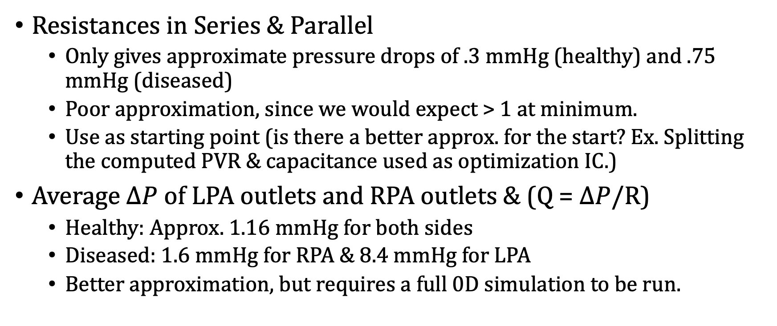
Difference in computing LPA & RPA R
Resistances in Series & Parallel
Only gives approximate pressure drops of .3 mmHg (healthy) and .75 mmHg (diseased)
Poor approximation, since we would expect > 1 at minimum.
Use as starting point (is there a better approx. for the start? Ex. Splitting the computed PVR & capacitance used as optimization IC.)
Average $∆P$ of LPA outlets and RPA outlets & (Q = $∆P$/R)
Healthy: Approx. 1.16 mmHg for both sides
Diseased: 1.6 mmHg for RPA & 8.4 mmHg for LPA
Better approximation, but requires a full 0D simulation to be run.

Slide 6
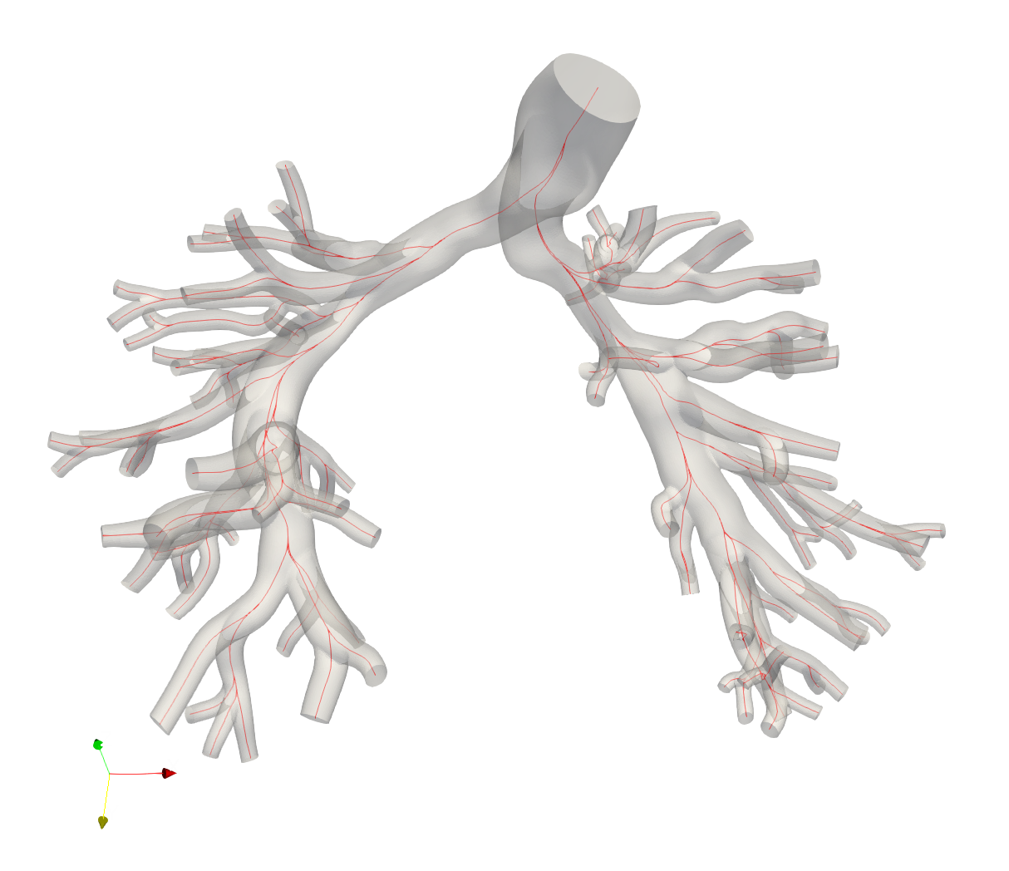
Diseased Model Bottleneck
Trying to use Ingrid’s AS1_SU0308 model
Some silly issues that would not occur in practice due to physiological measurements.
Solved Problems
Reconstructing a model from the XMT format. (issues with a branch not connected properly)
Adequate centerline generation for segmentation

Slide 7
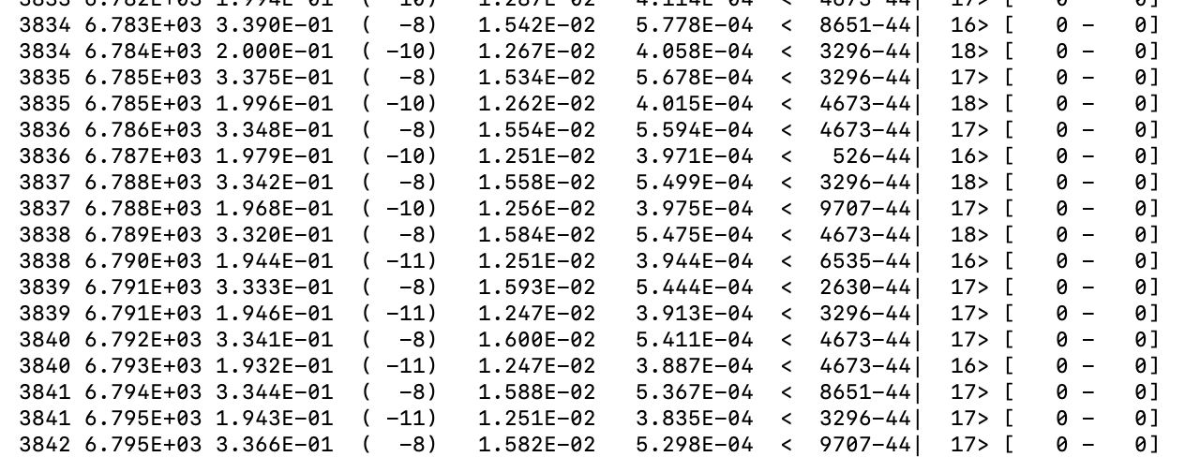
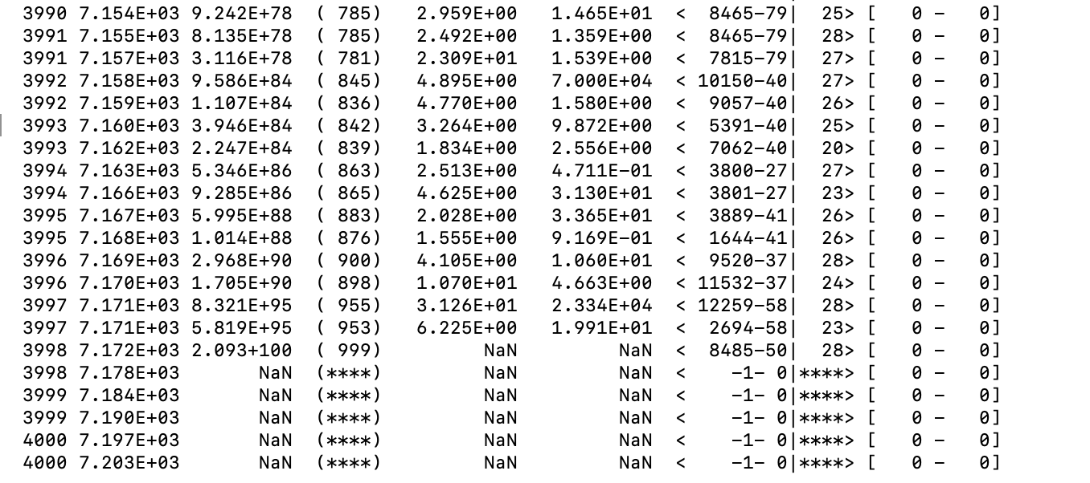
Main Problem – 3D simulation fails to stabilize

Slide 8
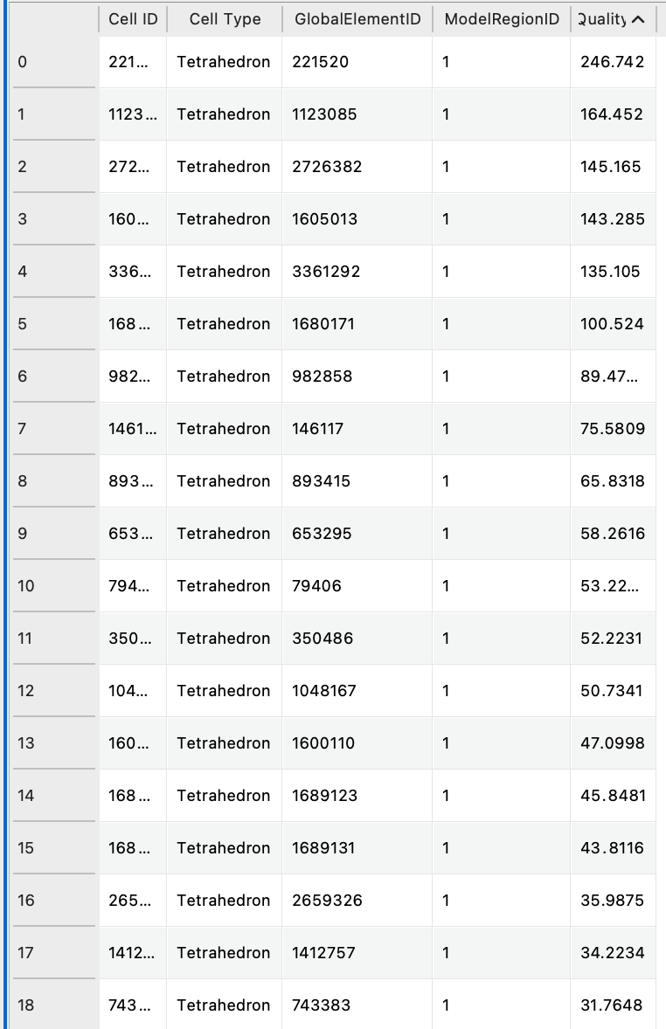
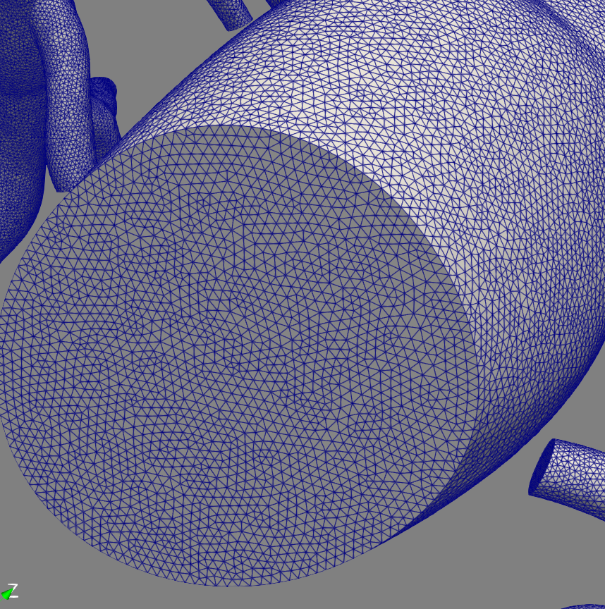
Mesh Quality
Refined & double checked, so this should not be an issue
Worst Qualities →

Slide 9
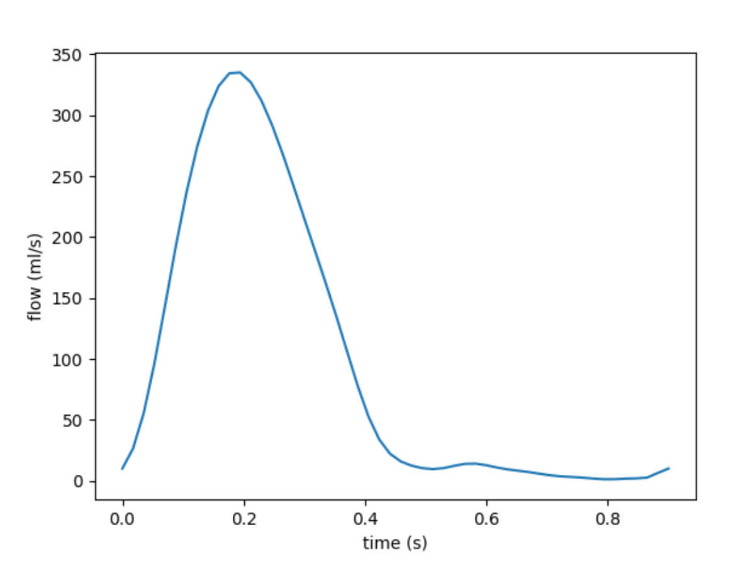
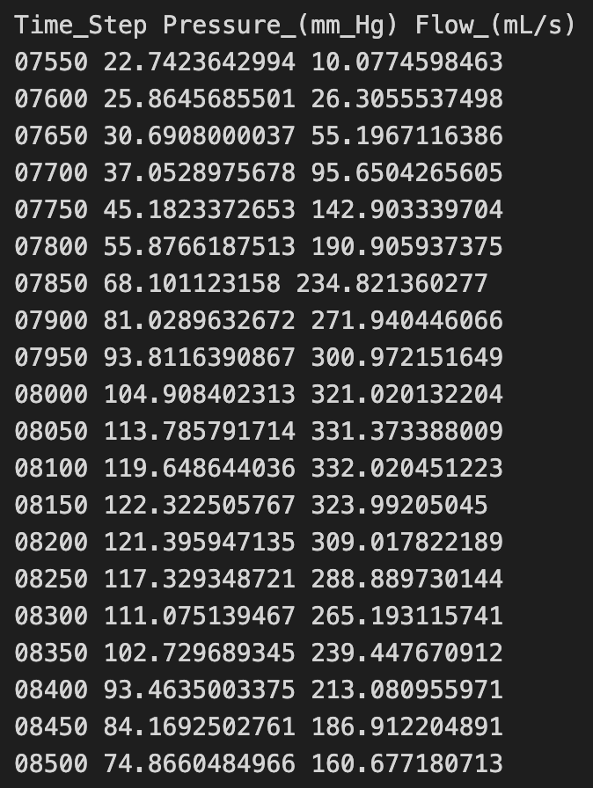
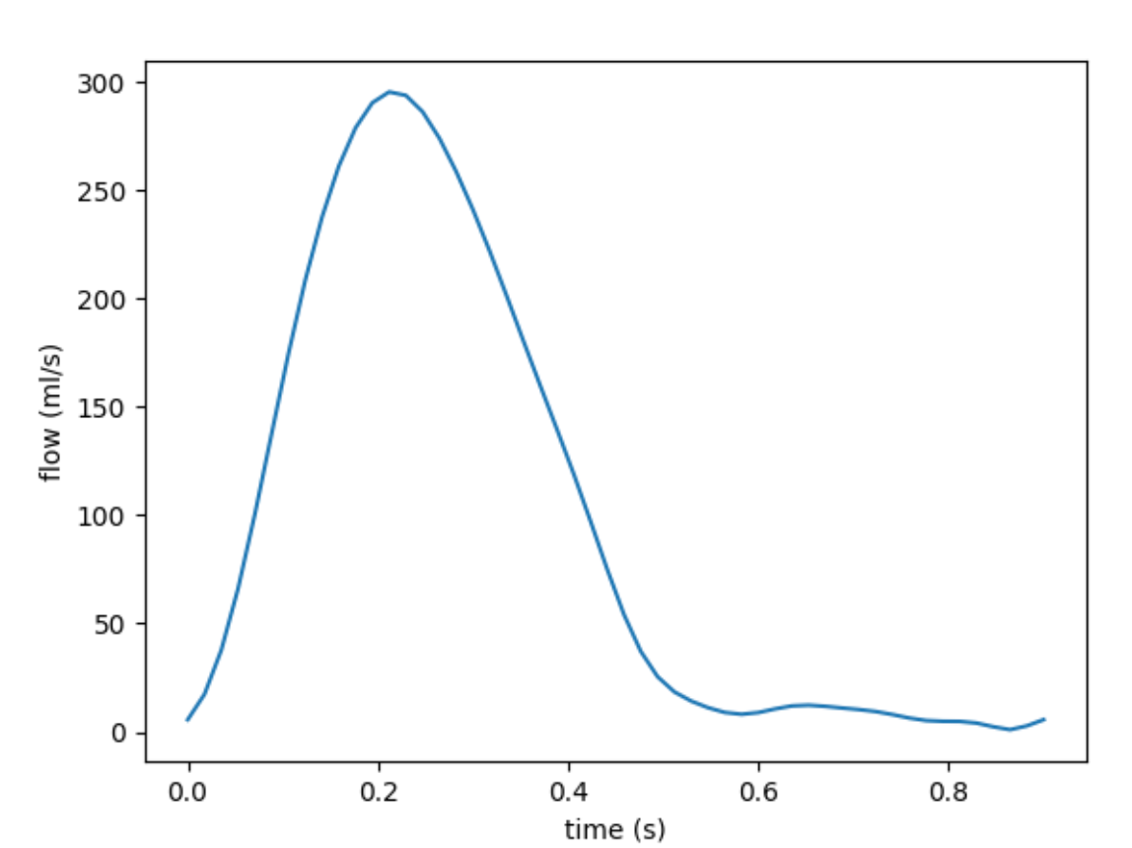
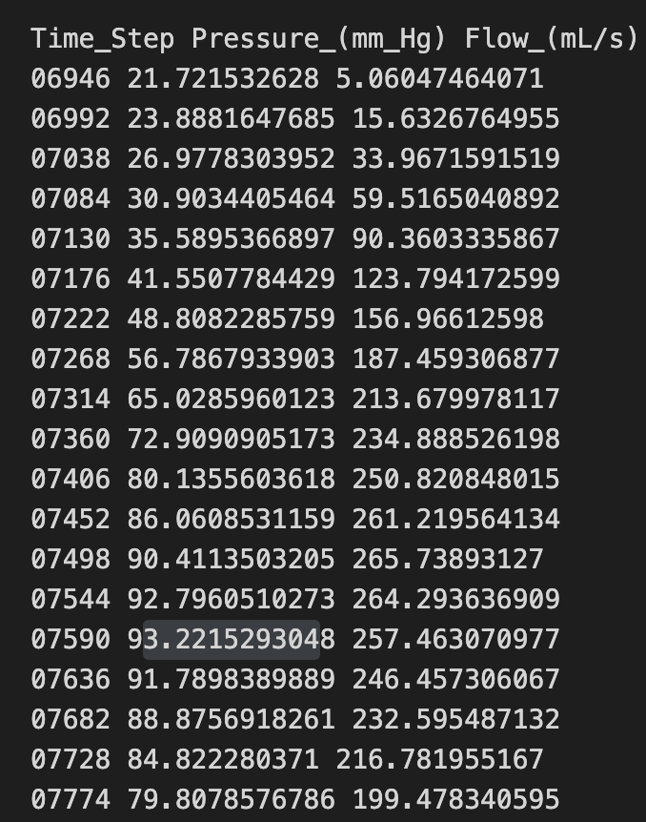
Inflow BC
Version 1: Matches CO (5.77), but not pressure targets (122 mmHg)
Ingrid’s models do not come with physiological inflows, so they were tuned
2 Versions, neither matching physiological values well.
CO = 5.83
Pressure: (90, 18, 42)
Tried scaling Version 2 to match, but problems in BC tuning
Version 2: Pressure targets (93 mmHg), but not CO (5.2 ml/s)
Scaled Plots ->

Slide 10
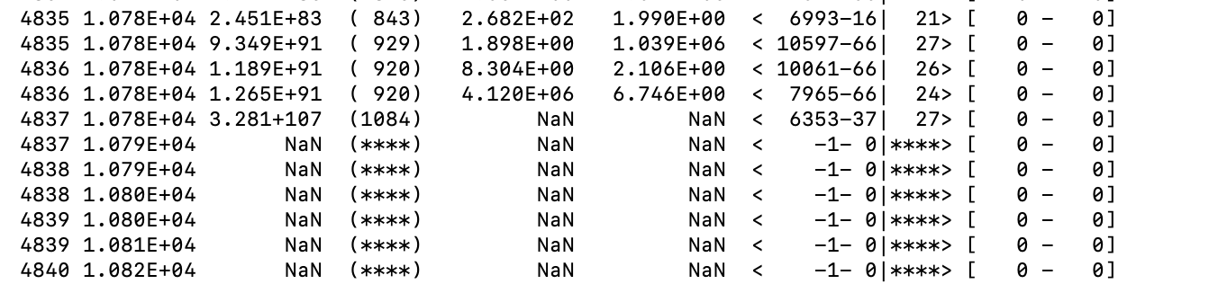
Outflow BC tuning
Version 2 inflow tunes to 0 capacitance, even when scaled to correct CO
Version 1 with different configurations:
No scaling to CO (minor difference anyways)
Tunes to capacitances of 1e-10, which causes RC constant to be extremely small, which could affect convergence
Tried replacing all capacitances with 1e-6 to test, but failed faster.
Small scaling to CO only
Tunes to 0 capacitance
Scaling & changing diaPAP to 20
Is it even possible to get < 20 minPAP if the PCWP = 20 mmHg?
Tunes to ~1e-6 or 1e-7 capacitance
Simulation runs for longer, but still fails.
Also values for log of residual change are worse.

Slide 11
Next Steps after Bottleneck
Comparing 3D and 0D models to ensure they are close or at least correlated.
Detecting/Parametrizing Stenosis in diseased model
Training model for diseased model (should not be problematic).

