Slide 1

uvudec: Open Source By Force
John n' Alex
RCOS
10/16/09

Slide 2

Project Goals
Architecture retargettable decompile
Geared towards embedded platforms (8051, BlackFin, ARM, etc)
Architectures can be defined through a config file or through a loadable module
Repurpose the Candela laser!

Slide 3
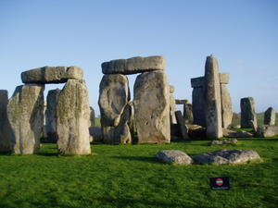
Milestones
1: Config file retargettable disassembler (DONE)
2: Static function analysis (in progress)
3: Basic assembly -> C
4: Advanced control flow analysis (ie for loops, more intelligent conditionals)
5: Add more processors and analysis features

Slide 4
Status as of last presentation
Tests currently implemented at 8051 (80C32)
Retargettable disassembler
Basic assembly analysis
Some R&D on function signature analysis

Slide 5

Static function analysis: brute force
Binary function comparison
Copyright issue: requires distributing binaries to other people for them to make same comparisons you are
Every possible variation of function is requires for successful analysis
May require statistical byte matching to get any reasonable results

Slide 6
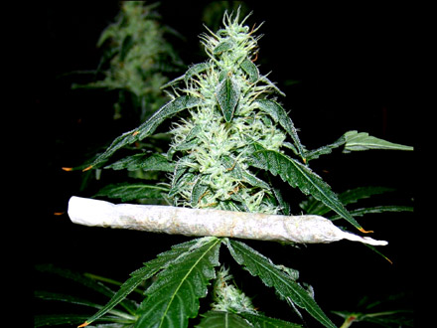
Static function analysis: hash
Supported analysis technique
Currently using libc MD5 implementation
Fast comparisons
Gets around copyright issues from distributing binaries you don't have right to

Slide 7
Static function analysis: relocatable objects
Convert to the form used in .o files before linking into executable
Literally making ELF .o files since it allows processing by bintools (ld and friends)
Supporting data will either go in config file or embedded in the object file
Resulting file could also be hashed

Slide 8
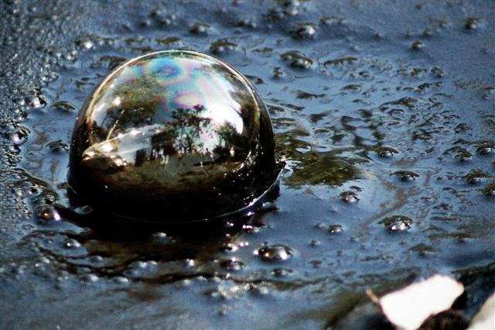
Distributing analysis files
Ideally would like to distribute as .tar.bz2 or similar archives so easy to manipulate and compressed
Archives will simply be collection of the binaries and supporting data used for analysis
Archives could also include processor support files

Slide 9
Generating analysis files
Template files can be generated from a given executable
Tools like ld and text editors can be used to shape them to more friendly forms (combine into CRT, add source code, etc)
Will add utilities to aid in analysis DB creation as they are needed

Slide 10
????

