Slide 1

uvudec: Open Source By Force
John n' Alex
RCOS
09/18/09

Slide 2

Project Goals
Architecture retargettable decompile
Geared towards em bedded platforms (8051, BlackFin, ARM, etc)
Architectures can be defined through a config file or through a loadable module
Repurpose the Candela laser!

Slide 3
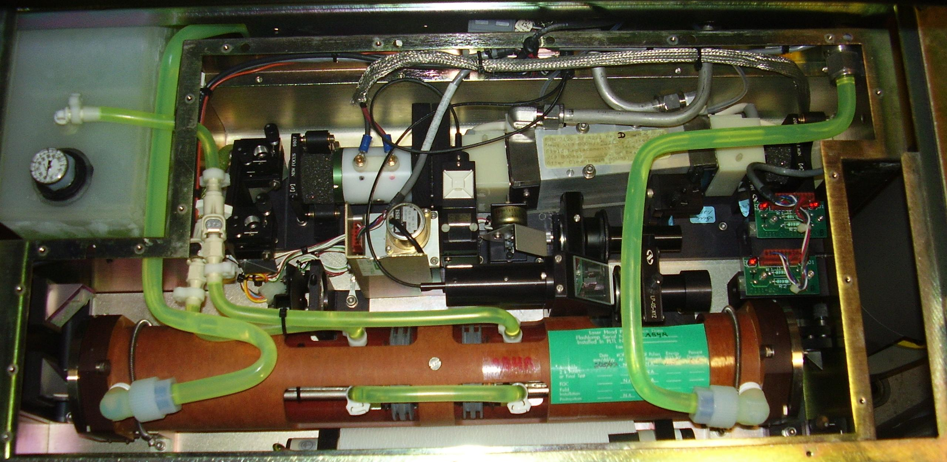
The sad laser

Slide 4

Why?
Interface proprietary applications
Make open source alternatives by studying commercial products
Virus analysis
Manual analysis is tedious, lengthy

Slide 5
Milestones
Retargettable disassembler
Assembly to logic engine
Logic engine to high level flow
High level flow to specific language
Support instruction prefixes and other advanced opcode concepts
Tune language (C) output to specific compilers
Function databases to aid static analysis

Slide 6

Related Projects
IDA + Hex Rays: commercial decompiler. Some $6,000 per license. Bad support for embedded
Alex's project from RCOS last year: not easily retargettable
.NET Reflector: .NET only
Assorted VB decompilers: VB only

Slide 7
Join us!
We would like a GUI programmer
People interested in low level programming, especially non-x86 experience
C++ and Python probably most relevant languages
The codebase is very large
I will liberate food from Sage for you

Slide 8

Questions?
  Can has source code?

