Slide 1

Universal Decompiler:
Open Source By Force
John McMaster
RCOS
10/22/10

Slide 2

Project Goals
Flexible target architecture
Geared towards embedded platforms (8051, BlackFin, ARM, etc)
Architectures can be defined through a config file or through a loadable module
Repurpose the Candela laser!
  Haven't for some time, but still on my mind

Slide 3

Semester Milestones
GOAL: user interface tools
1: disassembler/decompiler GUI
2: license scanner GUI
3: plugin and event systems

Slide 4

Last talk
Basic Qt disassembler GUI
  Somewhat ugly
  Performance issues
  Limited features
License scanner mockup GUI
Preparations for plugin support
Lots of bug fixes

Slide 5

Graphical user interface
Problem: QTextBrowser isn't sufficient
  Requires rendering all of the data ahead of time
  Performance issues
Goal: scalable, flexible rendering
Solution: use QAbstractScrollArea
Solution 1: subclass QTextBrowser
  Problematic, revision dependent?
Solution 2: use view onto QTextBrowser
  Harder, but “the right way”
Was directed to some example code, probably just need to review it some more

Slide 6
General enhancements
Object format class
Better addressing support
  Especially for printing a region of memory
Undecorated arguments
  Previous: uvpat2sig --input=file.pat --output=file.sig
  Now: uvpat2sig file.pat file.sig
Linking related enhancements

Slide 7
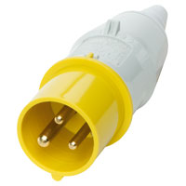
Plugin support
Plugin-able interfaces
  Architecture
  Object format
  Progress on FLIRT
    Generic architecture support, but special cases
Plugins
  uvdasm: configuration file based assembly
  uvdbfd: libbfd (binutils) objects, assembly
  uvdobjbin: binary object file loader
Moved all libbfd (binutils) code into plugin
  FLIRT plugin architecture related regression

Slide 8
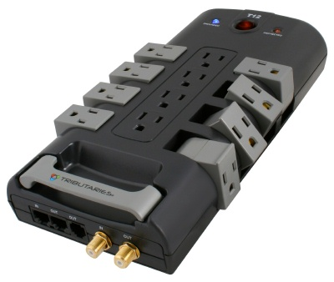
Plugin architecture
Plugin interfaces need two functions
canLoad(): assign score to ability
  ex: ELF loader preferred over bin obj loader
tryLoad(): force given data into loader
Loaders into abstract factory classes
Plugins convenience interfaces
  Doesn't currently work if can return multiple types

Slide 9
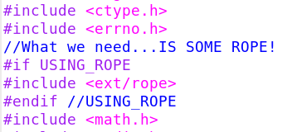
Include structure
Start: files prefixed with uvd_
  ex: uvd_plugin_factory.h
  Worked well for a small number of files
Problem: 270+ source files now
  Long names needed to describe uniquely
New format, ex: uvd/plugin/factory.h
  libxml2 does this and I like the format
“uvd.h” for everything (lazy/efficient users)

Slide 10

Library recognition (FLIRT)
Two lingering bugs from the summer
  libbfd functions with multiple names excluded
  What is a module vs a function?
The first was easy to fix
The second was more interesting and not necessarily a bug

Slide 11
FLIRT: Modules vs Functions
Exported symbols gave 1 module/function
  Windows DLLs
  ELF (Linux) .o files
...but then .a files didn't do this
Why? .a files contain .o files
FLIRT/FLAIR makes signatures for the .o files in .a files and indexes functions there
But there is a problem with this...

Slide 12
The problem with modules
Module signatures are basically
  32 leading bytes, checksum, symbol references
Say I statically link against math.a
  sqrt.o: sqrt @ 0x00
  trig.o: sin @ 0x00, cos @ 0x94
sqrt function recognized fine
What if I link in cos, but not sin?
  NONE of the leading bytes from sin are included
  The checksum won't match up either
  References would have been to earlier parts

Slide 13
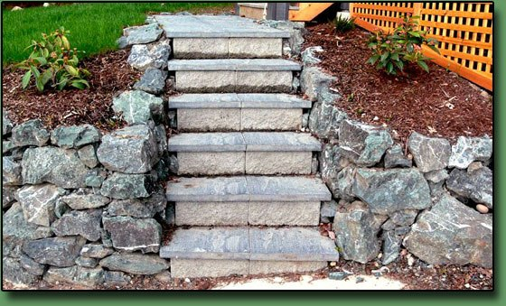
Next steps
Expand library recognition engine
Refine plugin architecture as needed
  Especially regarding FLIRT (.pat) generation
Improve my Qt skills

Slide 14
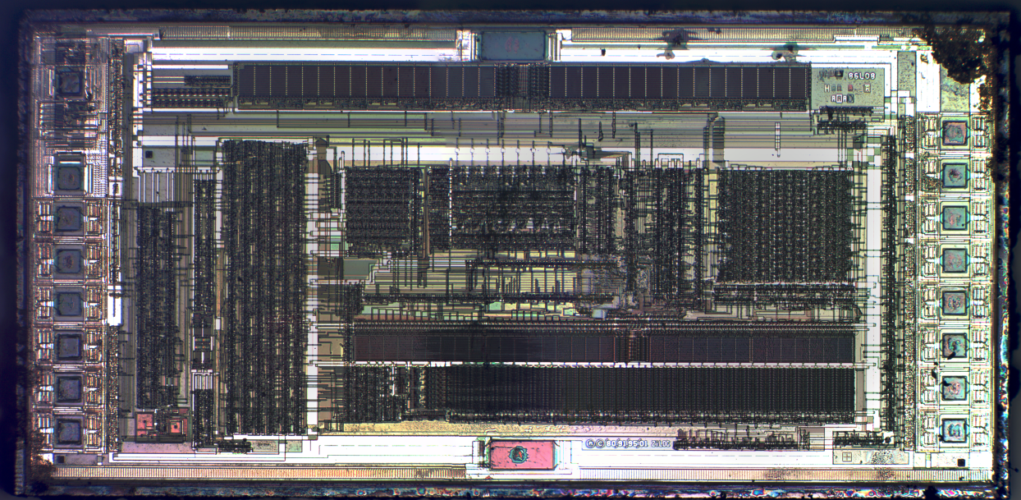
Questions????
Thanks to Sean O’Sullivan and RCOS!

