Slide 1

Universal Decompiler:
Open Source By Force
John McMaster
RCOS
10/17/10

Slide 2

Project Goals
Flexible target architecture
Geared towards embedded platforms (8051, BlackFin, ARM, etc)
Architectures can be defined through a config file or through a loadable module
Repurpose the Candela laser!
  Haven't for some time, but still on my mind

Slide 3
Last semester
Focus on Fast Library Identification and Recognition Technology (FLIRT) implementation
obj2pat: object file to .pat function signature
pat2sig: .pat file
Misc engine fixes

Slide 4
Summer progress
Rewrote BFD object to signature code
  Was previously based on hacked C code
Spent summer RE malicious software
  learned many new techniques
Learned basic Qt
Various bug fixes
Public signature archive
  http://github.com/JohnDMcMaster/uvsig

Slide 5

Semester Milestones
GOAL: user interface tools
1: disassembler/decompiler GUI
2: license scanner GUI
3: plugin and event systems

Slide 6
Graphical user interface
Easier to give hints through GUI then bash
Disassembly annotation environment
  Even if decompiling isn't possible
IDA had a disassembler GUI over a decade before a decompiler
GUIs will be developed in Qt
  Open source (LGPL)
  Well documented
  Feature rich: Qt Designer, many widgets

Slide 7
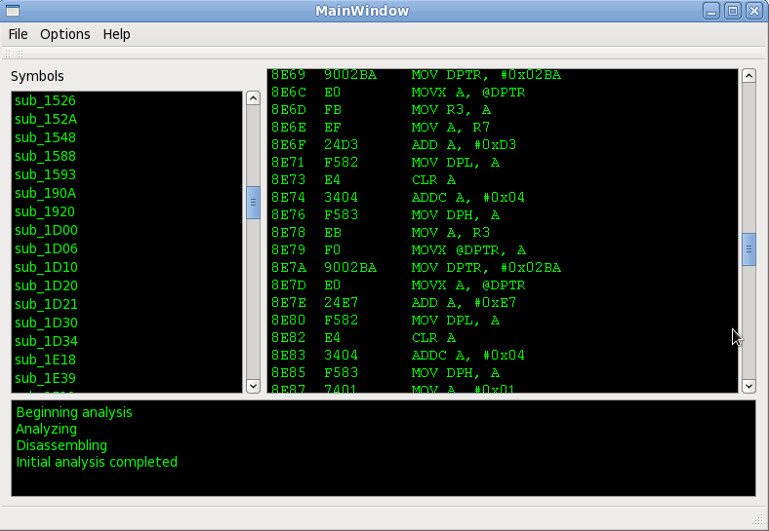
Initial sandbox

Slide 8
License scanner
Commercial software sometimes violates GPL and other licenses
Finds this code within closed source binaries
Proprietary companies/systems do this
  Black Duck Software
  OpenLogic
Build library signature database
  Even from people typically not interested in RE
I will not handle license violations
  Up to user what to do

Slide 9
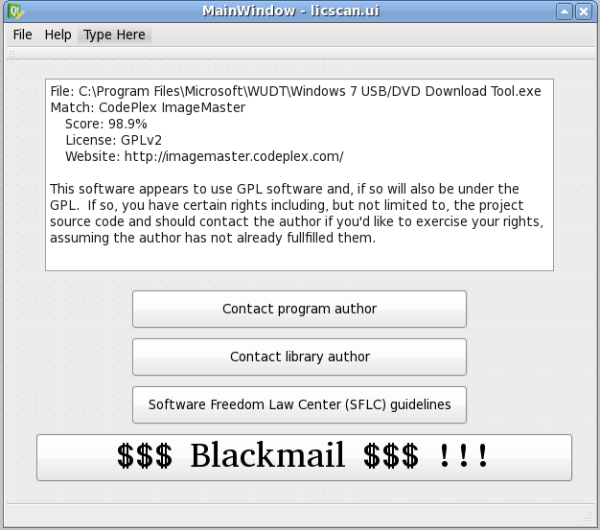
Mock UI

Slide 10
Preparing for the GUI
Initial algorithm will be simple and potentially misleading/inaccurate
  % of functions matched in a library
  % of code covered
  We may only use a small function subset
Make obj2pat, pat2sig match FLAIR output
Desirable if program could run on Windows
  Never tried before

Slide 11
Plugin support
Allows cleaner isolation of disassembly engines
Easier to integrate third party code
Requires callback/event system
Ability to use GPL'd software by isolating them to like licensed plugins

Slide 12
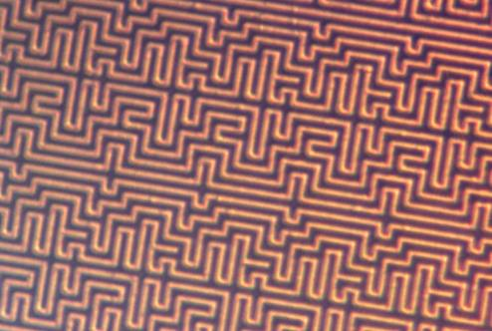
Questions????

