Slide 1

Universal Decompiler:
Open Source By Force
John McMaster
RCOS
2/??/10

Slide 2

Project Goals
Architecture retargettable decompile
Geared towards embedded platforms (8051, BlackFin, ARM, etc)
Architectures can be defined through a config file or through a loadable module
Repurpose the Candela laser!

Slide 3
FLAIR/FLIRT Background
"Fast Library Identification and Recognition Technology"
"FLAIR is a collection of tools for generating library function signatures which are later used by IDA to identify library functions in statically compiled binaries"
http://www.phreedom.org/research/reverse-challenge/analysis.html
Used as synonyms...FLIRT technology, FLAIR toolkit I guess

Slide 4
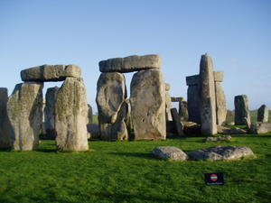
Semester Milestones
GOAL: FLIRT compatibility layer
1: elf2sig: ELF libraries/object files to
2: coff2sig: Windows PE analysis?
  The IDA tool has similar name...should rename?
3: auto2sig: automatically use right tool

Slide 5
Current progress and goals
Moved core code into a library
Improving command line process
  Need to keep same core arguments across multiple programs
  Want to use a property based approach at core with traditional --/- names for common args
Reworked build system with placeholder projects for each of the desired tools
Basic research on ASCII format files

Slide 6
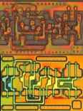
Questions?

