Slide 1
Gradle
蒋旦
2016/10/10

Slide 2
一、基本概念

Slide 3



起源
创世之初（1977），只有Make ====➔ GNU Make、BSD make、Microsoft nMake 等
Ant + Ivy（2000） Maven（2004） Gradle（2012）
Gradle follows the concept of convention over configuration

Slide 4
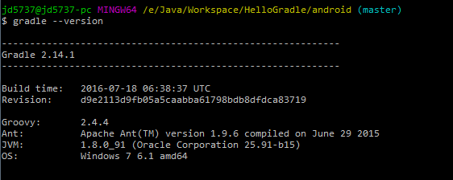
安装&配置
Gradle_home : D:\java\ast\androidstudio\gradle\gradle-2.14.1
Android_home: D:\java\ast\sdk
Java_home: D:\java\jdk8

Slide 5
最小配置
最简单的build.gradle
由3个部分组成：
buildscript { repositories { jcenter() } dependencies { classpath 'com.android.tools.build:gradle:2.1.3' } } apply plugin: 'com.android.application' android { compileSdkVersion 23 buildToolsVersion "23.1.0" }

Slide 6
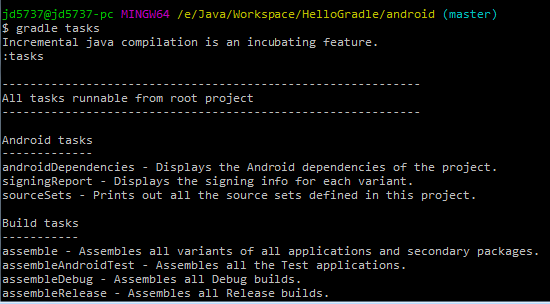
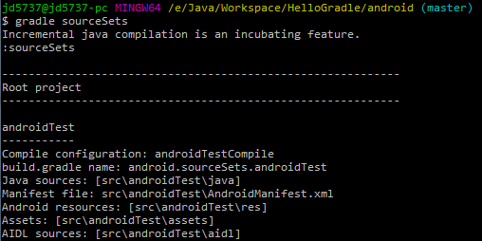
基本命令
gradle tasks
gradle sourcesets

Slide 7
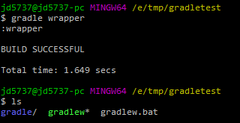
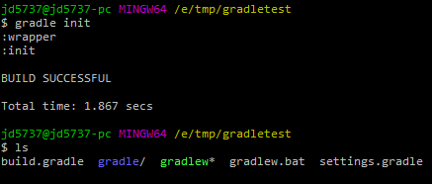
基本命令
gradle init：
提供build.gradle等模板
gradle wrapper：
自动安装并保证安装正确的版本

Slide 8
基本命令
Gradle assemble/assembleDebug/assembleRelease
Gradle lint/check
Gradle build = assemble + check + …
Gradle clean
Gradle installDebug/installDebugAndroidTest
Gradle uninstallDebug/uninstallAll
在Android5.0+上有问题，可以使用Adb install path/to/apk/*.apk

Slide 9
IDE 设置
File > project structure > project
Android plugin for gradle version：top-level build.Gradle
Gradle version：gradle/wrapper/gradle-wrapper.Properties
buildscript { ... dependencies { classpath 'com.android.tools.build:gradle:2.2.0' } }
distributionUrl = https\://services.gradle.org/distributions/gradle-2.10-all.zip

Slide 10
二、常用配置

Slide 11
常用配置
Manifest entries
Dependencies：libraries、repositories、projects
Build types
Build type + product flavor = build variant
BuildConfig
Signing configurations
ProGuard
Lint support、test、java language level …

Slide 12
1.Manifest Entries
defaultconfig {
applicationid "com.arcsoft.hellogradle.test"
minsdkversion 14
targetsdkversion 23
versioncode 1
versionname "1.0"
}

Slide 13
2. Dependencies
1.Libs directory：
2. Repositories：
3.Library projects：
dependencies { compile fileTree(dir: 'libs', include: ['*.jar']) }
repositories { jcenter() } dependencies { compile 'com.google.guava:guava:18.0' }
include ':app', ':libraries:lib1'
dependencies { compile project(':libraries:lib1') }

Slide 14
3. Build Types
AndroidTest
main
Debug
Release
debug_ant
test
testDebug
testRelease
testDebug_ant
android { buildTypes { debug { applicationIdSuffix ".debug" }
debug_ant {
initWith(buildTypes.debug)
applicationIdSuffix ".ant"
}
} }

Slide 15
4. Product Flavor
AndroidTest
AndroidTestFlavor_maven
main
Debug
Release
debug_ant
Flavor_maven
Flavor_mavenDebug
Flavor_mavenRelease
Flavor_mavenDebug_ant
android { .... productFlavors { flavor_maven { ... } } }
test
testDebug
testRelease
testDebug_ant
testFlavor_maven
testFlavor_mavenDebug
testFlavor_mavenRelease
testFlavor_mavenDebug_ant

Slide 16
5.BuildConfig
flavor_gradle {
applicationid "com.arcsoft.gradle"
buildconfigfield "int", "show_gradle", "1"
}
In MainActivity.java
if (BuildConfig.SHOW_GRADLE == 1) {
…
}
boolean DEBUG – if the build is debuggable
int VERSION_CODE
String VERSION_NAME
String APPLICATION_ID
String BUILD_TYPE – name of the build type, e.g. "release"
String FLAVOR – name of the flavor, e.g. “flavor_gradle"

Slide 17
References
https://docs.gradle.org/current/userguide/userguide
http://tools.android.com/tech-docs/new-build-system/user-guide
https://technologyconversations.com/2014/06/18/build-tools/
https://code.google.com/p/android/issues/detail?id=180674
https://developer.android.com/studio/releases/gradle-plugin.html#revisions
https://developer.android.com/studio/build/building-cmdline.html
http://google.github.io/android-gradle-dsl/current/

