Slide 1
Hotel Management System

Slide 2
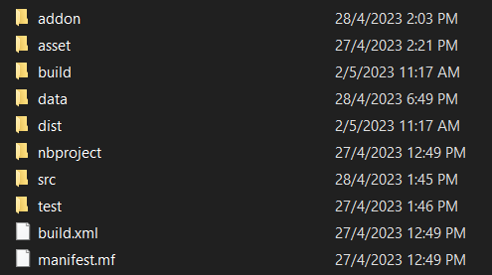
Directory Management
Contains External Library I Use
[Jcalendar]
Contains Images use in Authentication
Contains .txt file for database [authentication use only]
The rest are netbeans prebuilt
All the code locations

Slide 3
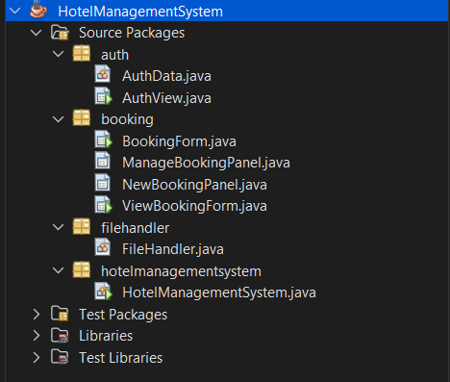
Directory Management
The Project name
Package auth
Login page for staff
Package booking
Booking management
Package filehandler
Handle reading textfile
Package hotelmanagementsystem
Main

Slide 4
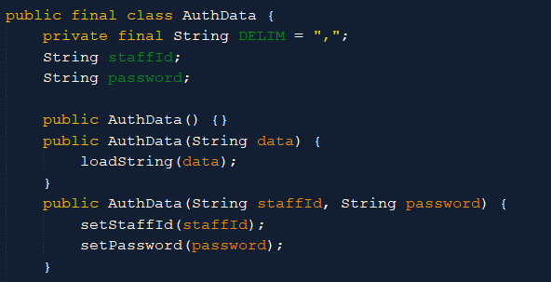
AuthData.java
Structure Authentication Data for easy save/load from/to database
Contains 1 constant & 2 data
DELIM:
file separator use for database to recognize the different data
!WARNING!
Make sure DELIM character not been using in other string as it would cause the program to malfunction
staffId:
Id to recognize staff
password:
For credential purposes

Slide 5
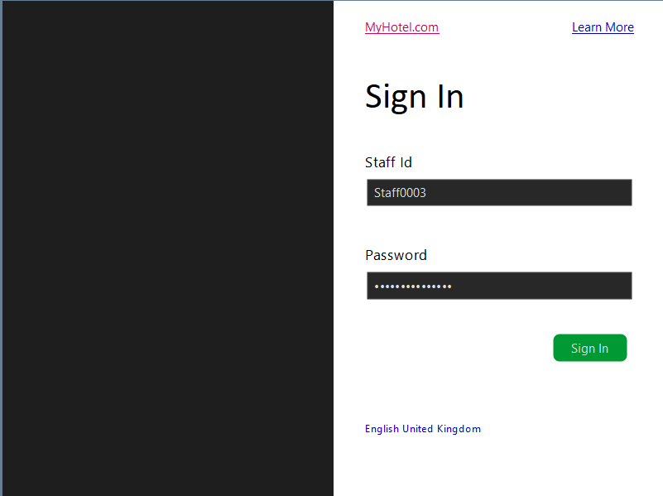
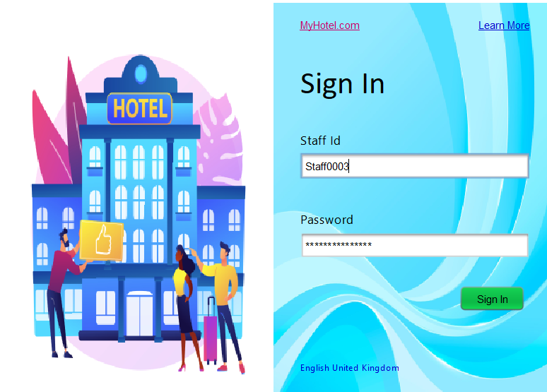
AuthView.java

Slide 6
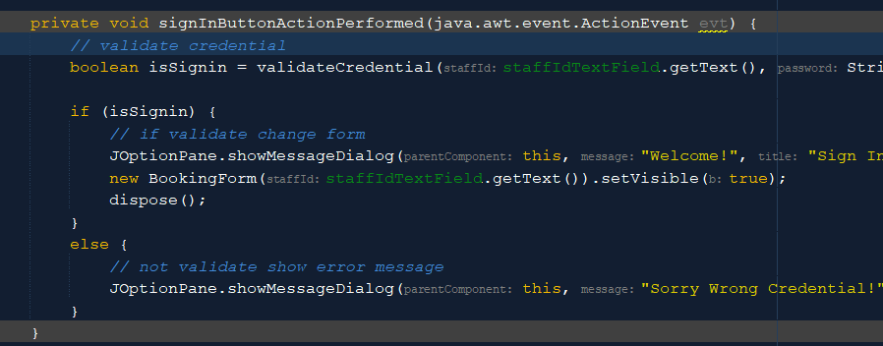
AuthView.java
staffId
To identify staff
password
For credential purposes
signin
For validation function to run

Slide 7
AuthView.java
validateCredential
Verify staff
Upon Success
Show message
Change Screen
-> Open new Screen
-> Close current Screen
Upon Failure
Show message

Slide 8
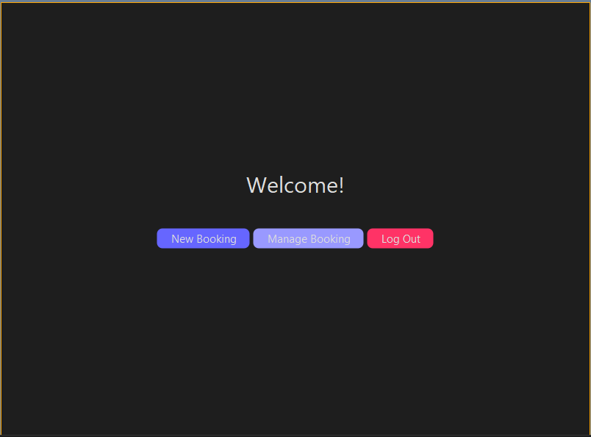
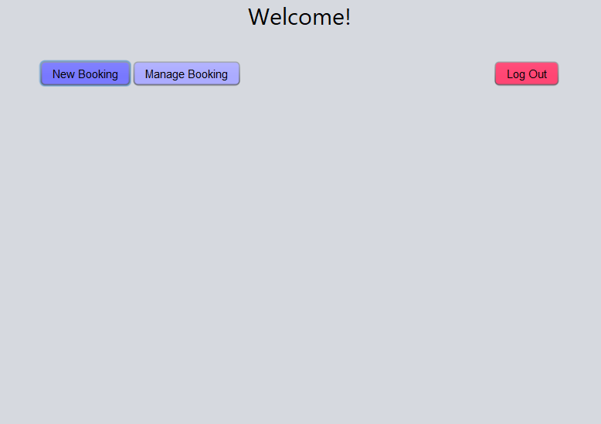

BookingForm.java
New Panel
Open new booking panel
Manage Panel
Open previous booking panel
Log Out
Back to Authentication

Slide 9
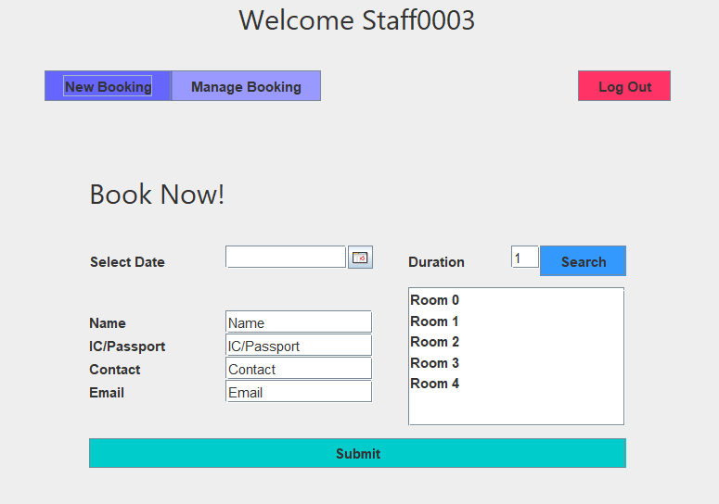
BookingForm.java
3 easy step
Remove previous panel
Add new panel
Refresh

Slide 10
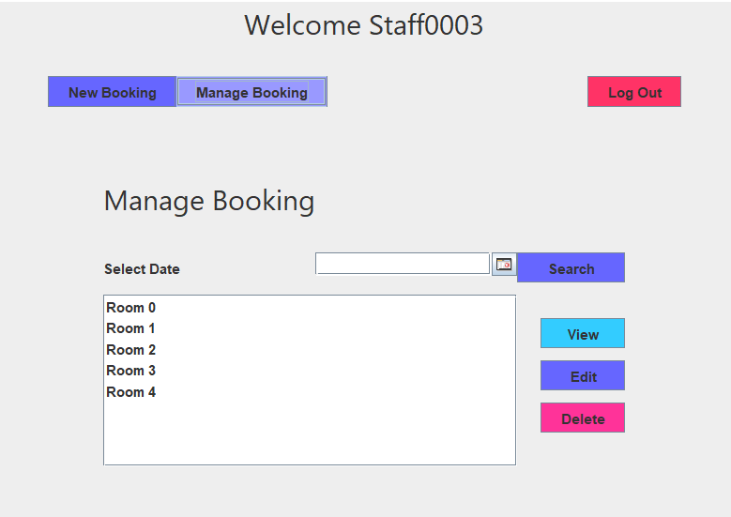
BookingForm.java
3 easy step
Remove previous panel
Add new panel
Refresh

Slide 11
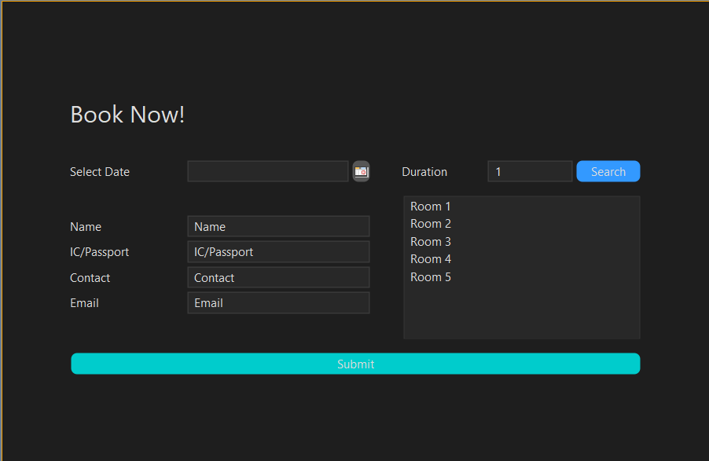
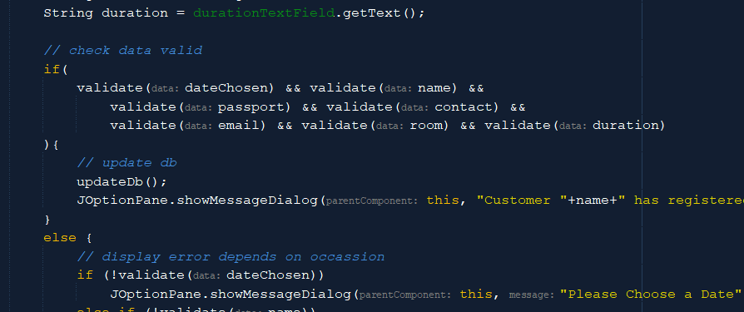
NewBookingPanel.java
Select Date & Duration
Select date to search
Submit
Customer Credential & Room of their choice
Select Customer Credential & Room of their choice

Slide 12
NewBookingPanel.java
Upon Failure
Show message
Upon Succeed
Update database
Show message
Submit

Slide 13
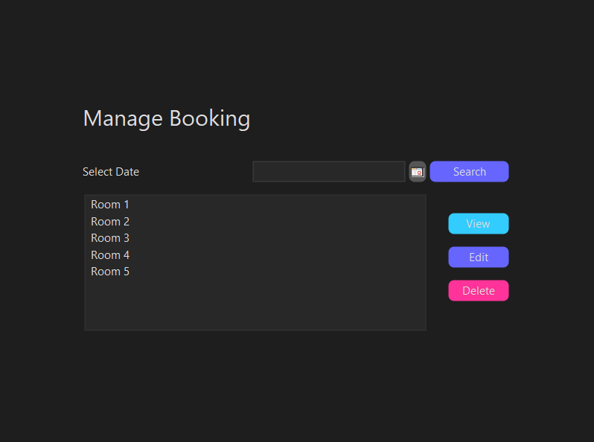
ManageBookingPanel.java
Select Date & Search
All option would be list down
Select Room & Manage
All option would be list down

Slide 14
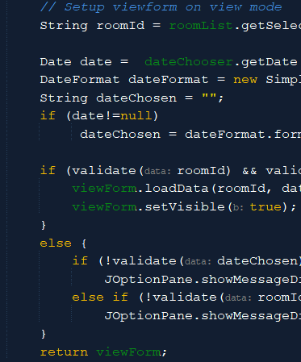
ManageBookingPanel.java
Upon Succeed
Change Screen to Details
Upon Failure
Show error

Slide 15
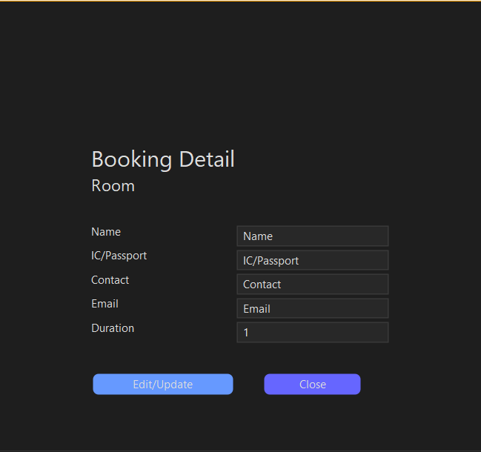
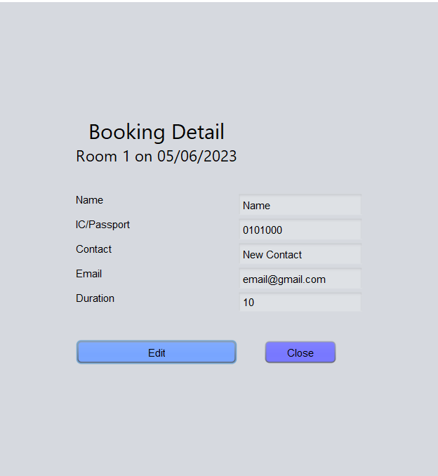
ViewBookingForm.java
Booking Details
All the details specified
Validation
Al data must be fill in
Close
Close the form
Toggle Button
Change from edit to view & vice versa

Slide 16
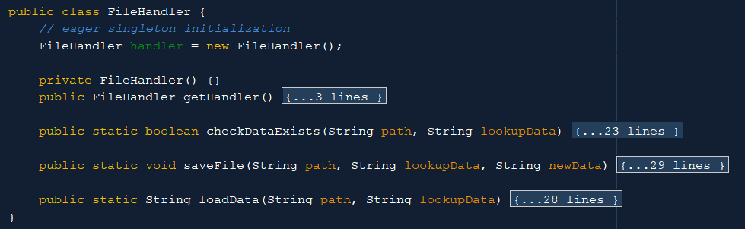
FileHandler.java
checkDataExists
Check data available in database
saveData
Update database from local
loadData
Update local from database

Slide 17
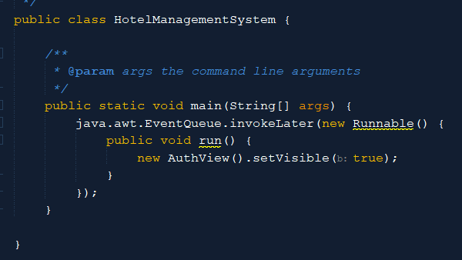
HotelManagementSystem.java
main
Start the program

Slide 18
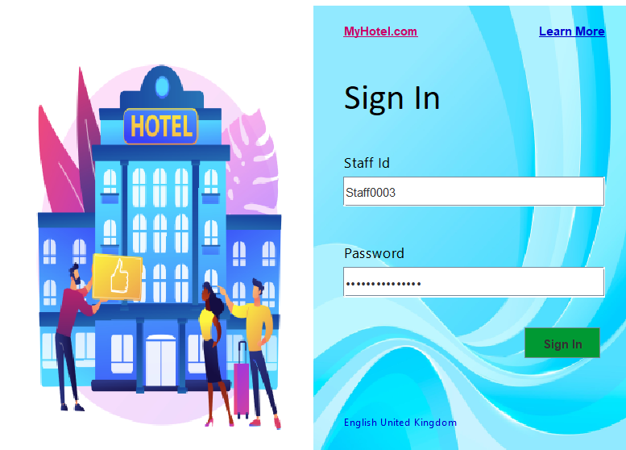
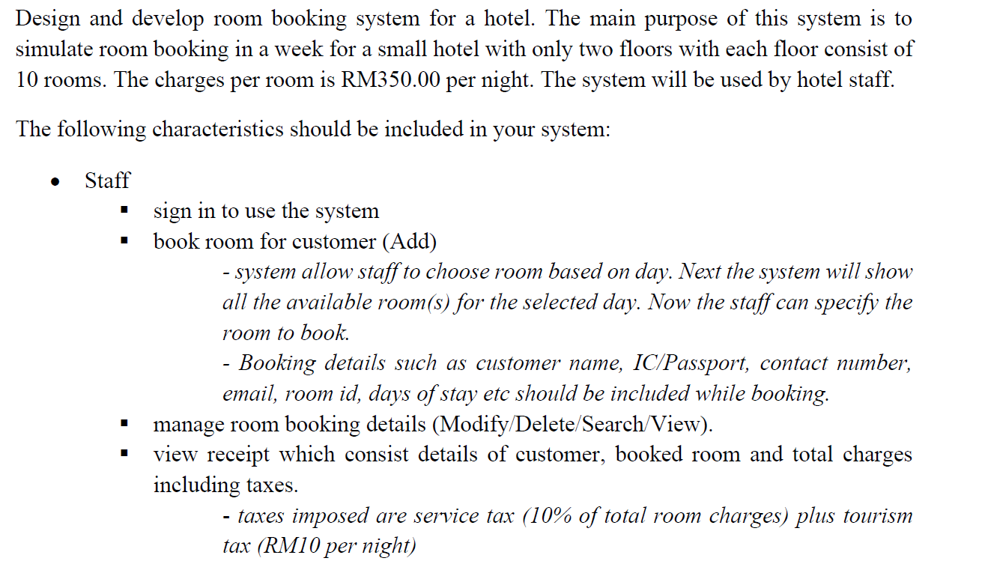

Slide 19
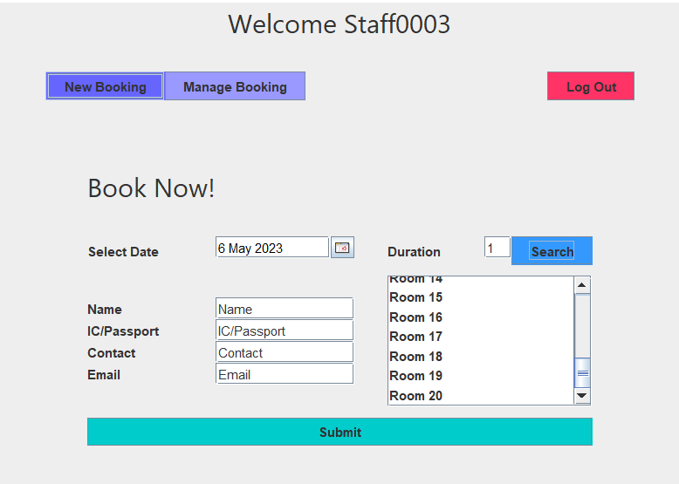

Slide 20
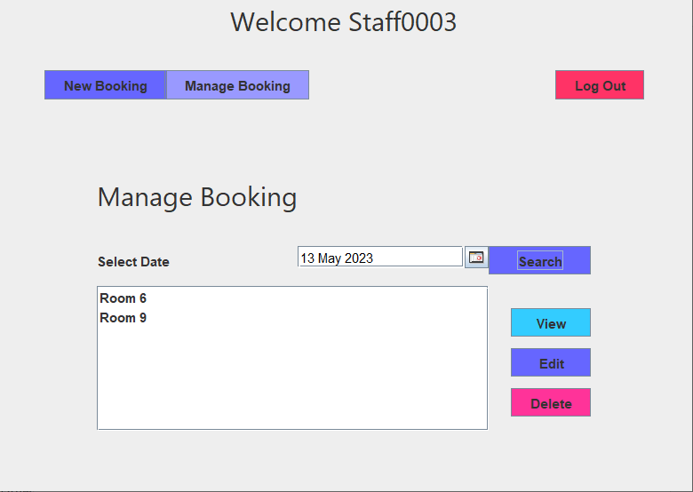
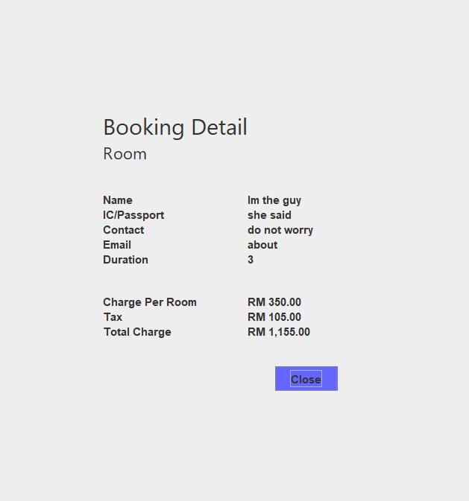
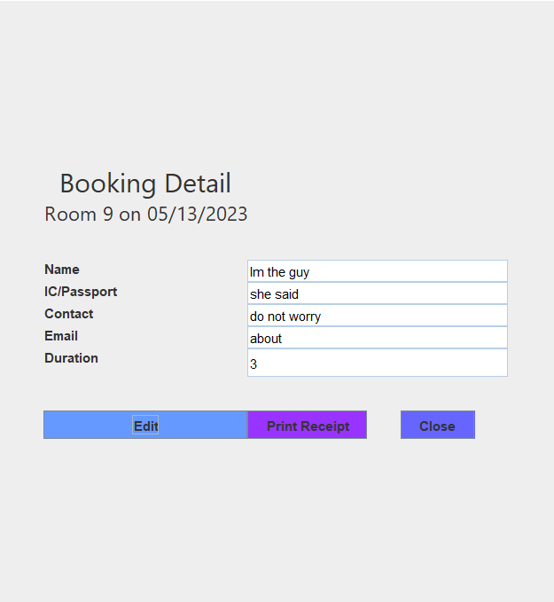

Slide 21
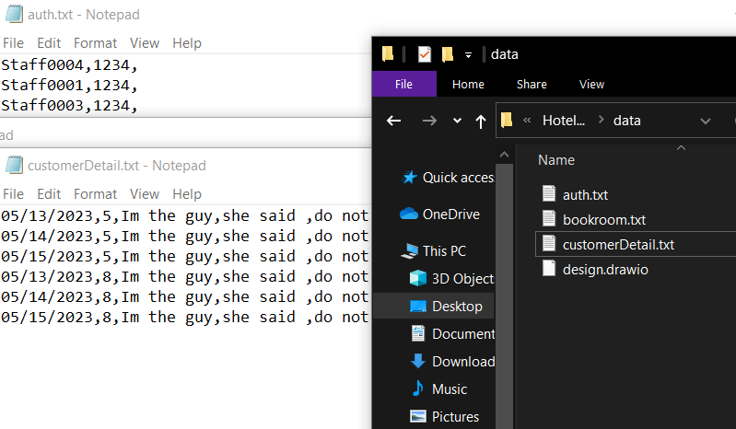
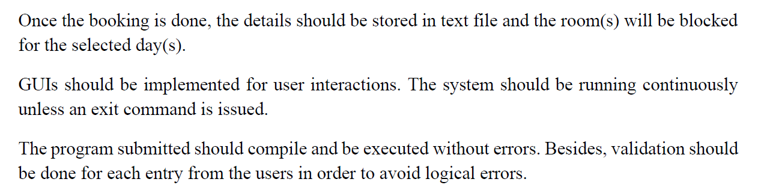
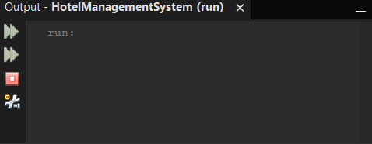

Slide 22
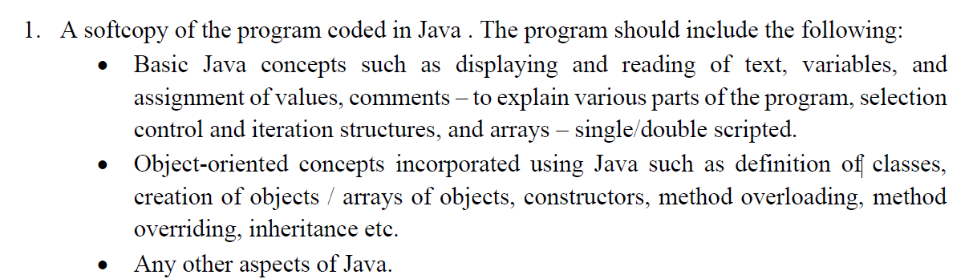
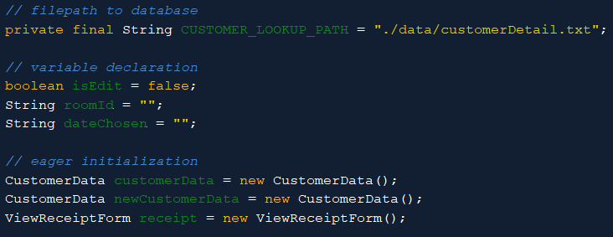
Text
String use for file path
Variable
Placeholder to hold values
Value
Literal that have meaning
Comment
For human understanding;
Compiler does not care

Slide 23
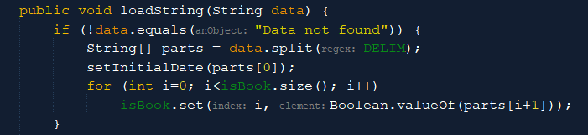
Selection Control
[if statement]
Logical comparison of data
Iteration structures
[for loop]
Go through a sequence
Array
Store multiple value in single variable

Slide 24
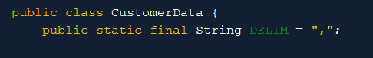

Class Definition
Tell the compiler that the object exists and functional
Creation of Object
Create an instance of Object [our class definition]

Slide 25
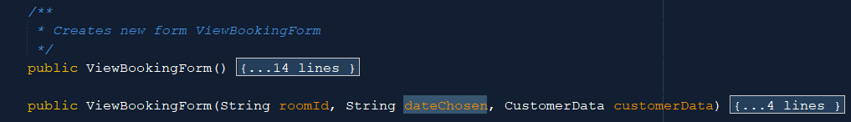
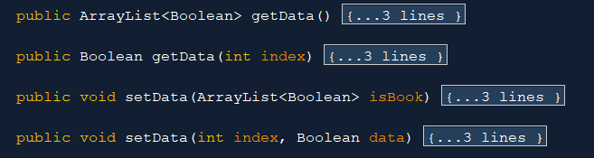

Constructor
Run Upon Class Creation
Constructor Overloading
Constructor Alternative depends on signature
Signature
Same name, different `return type`, `number of parameter`, `type of parameter` or `mixture of any`
Method Overloading
Method Alternative depends on signature
Method Overriding
Redefine the function purpose
Method Overriding
Normally: subclass differ from parent

Slide 26
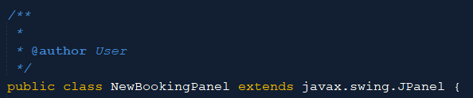

Inheritance
Allow a class to copy every parent attribute
Parse
Allow an object to become another object [Polymorphism]
Polymorphism
Allow an object to be in multiple form
Substring
String method to slice string

Slide 27
