Slide 1

Home Automation & Running Analysis Project
WATERFORD INSTITUTE OF TECHNOLOGY
INSTITIÚID TEICNEOLAÍOCHTA PHORT LÁIRGE
Department of COMPUTING & MATHEMATICS
Computer Systems & Networks
Autumn Semester 2020/2021
Project Graphics & Benchmarks
Student Name: | John Dennehy
Student Number: | 20091408
Programme of Study: | Higher Diploma in Science – Computer Science

Slide 2





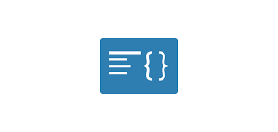


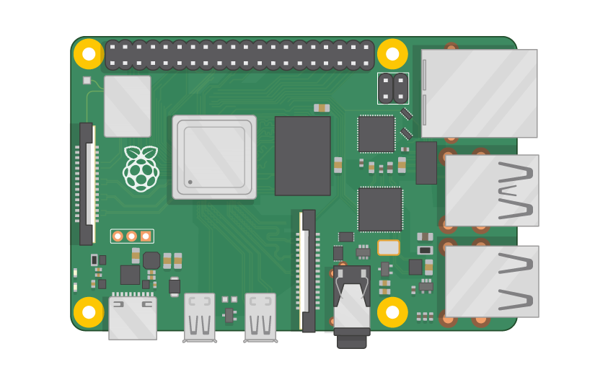





Automation of Light System – Pictorial Representation
Picamera used to obtain image data that is used in luminance analysis (YUV format to enable capture of luminance data. Once average luminance of photo is extracted, this is pushed to ThingSpeak
2 Reacts set on /currentLuminance channel.
If currentLuminance is less than 130 and isDusk equals 1 a React triggers a Thing HTTP with an IFTTT webhook that turns on Kasa Smart Wi-Fi Plug.
If currentLuminance is less than 130 and isDusk equals 0 a React triggers a Thing HTTP with an IFTTT webhook that sends me an email telling me to turn on the light (as it is dark in the room).
Mapbox API used to get coordinates for location (‘Drumcondra’ passed in call). Response longitude and latitude used in Sunrise Sunset API call for dusk time. If current time greater than dusk, ‘isDusk’ set to 1 (if not set to 0). Pushed to Thingspeak with average luminance
Lamp
Raspberry Pi Camera Module V2
/currentLuminance Channel
Geolocation API
API – Sunset Timestamp
TP-Link Kasa Smart Wi-Fi Plug
IFTTT Webhook
Gmail Email Client
Raspberry Pi 4
Paho MQTT Broker
Lamp
Paho MQTT broker used to push data to Thingspeak
IFTTT Webhook
/motionDetectedKitchen Channel
PIR Motion Sensor
Motion Sensor connected to Raspberry Pi via Breadboard and GPIO Pins. If motion detected in last 15 seconds, 1 pushed to Thingspeak (0 if no motion in last 15 seconds)
React set on /motionDetectedKitchen channel (if value is 1). Thing HTTP triggers IFTTT webhook that turns on Kasa Smart Wi-Fi Plug
TP-Link Kasa Smart Wi-Fi Plug
Notes
1. Mapbox Search API Documentation
2. Sunrise Sunset API Documentation
3. Camera Module Analysis Detail
4. ThingSpeak MQTT Documentation
5. IFTTT Webhook Documentation

Slide 3
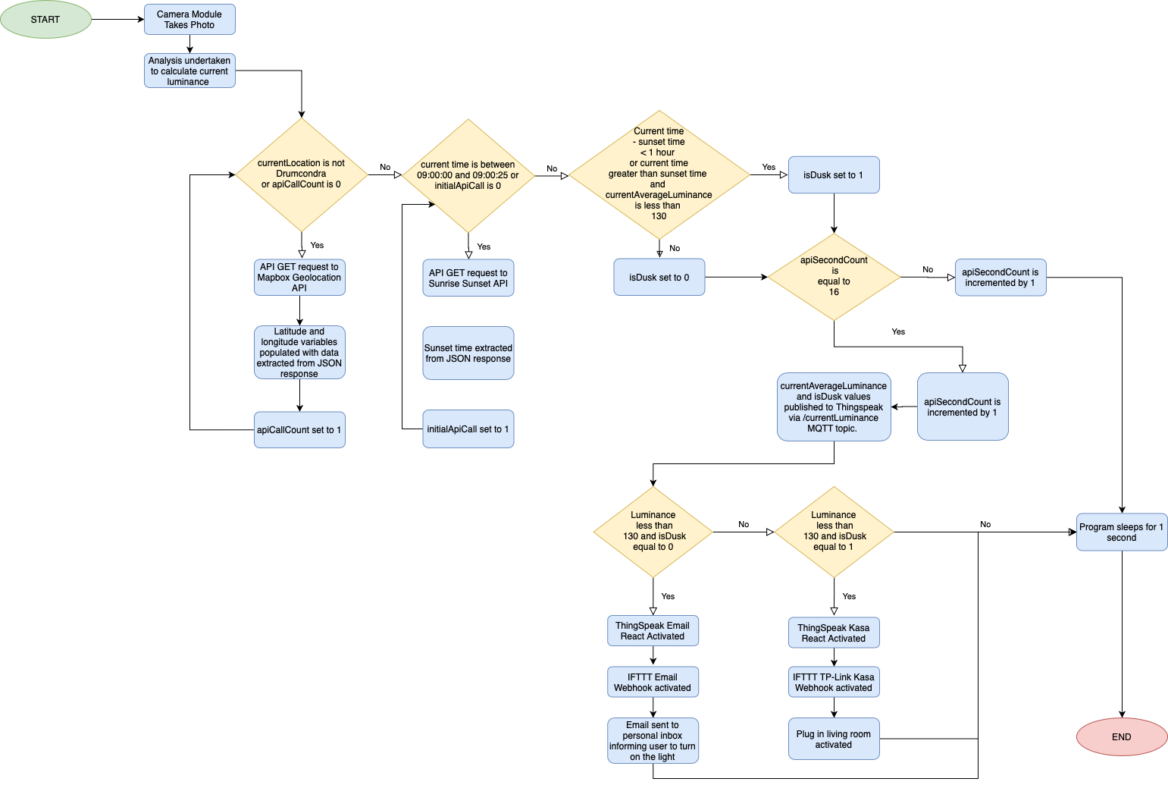
Automation of Light System – Informational Flow Diagram (/currentLuminance channel)

Slide 4
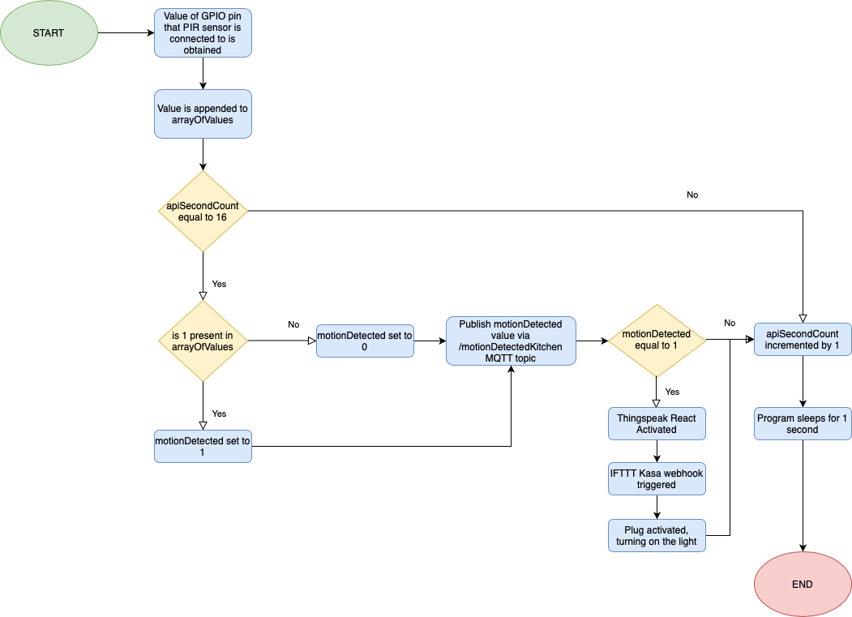
Automation of Light System – Informational Flow Diagram (/motionDetectedKitchen channel)

Slide 5


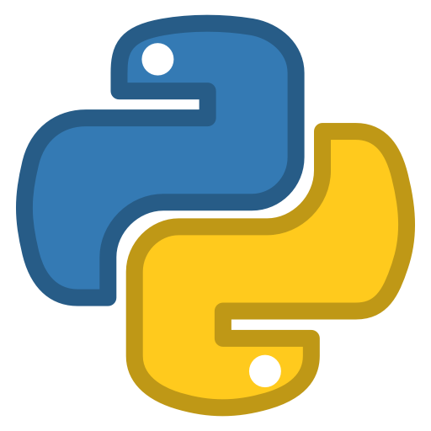
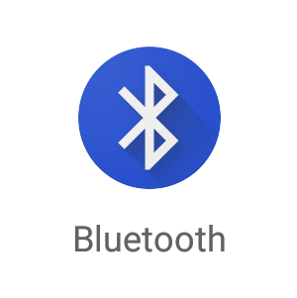
Control of Sonos Music Speakers – Pictorial Representation
Once a connection is established, the user is presented with a number of buttons on the phone screen (which each correspond to a different action for the Sonos speakers). When a button is clicked, the SoCo library is used to connect with the Sonos speaker and complete the relevant action (increase/decrease volume, set alarms, pause playback).
Blue Dot Phone Application used with bluedot python library to establish and initiate a Bluetooth connection between my OnePlus 5T and the Raspberry Pi
Sonos
Play One Speaker
Bluetooth
Protocol
Blue Dot
Python Library
Raspberry
Pi 4
SoCo
Python Library
Blue Dot
Android Application (on OnePlus 5T)
Sonos
Play One Speaker
Notes
1. Blue Dot Android Application
2. Blue Dot Library Documentation
3. SoCo Library Documentation

Slide 6
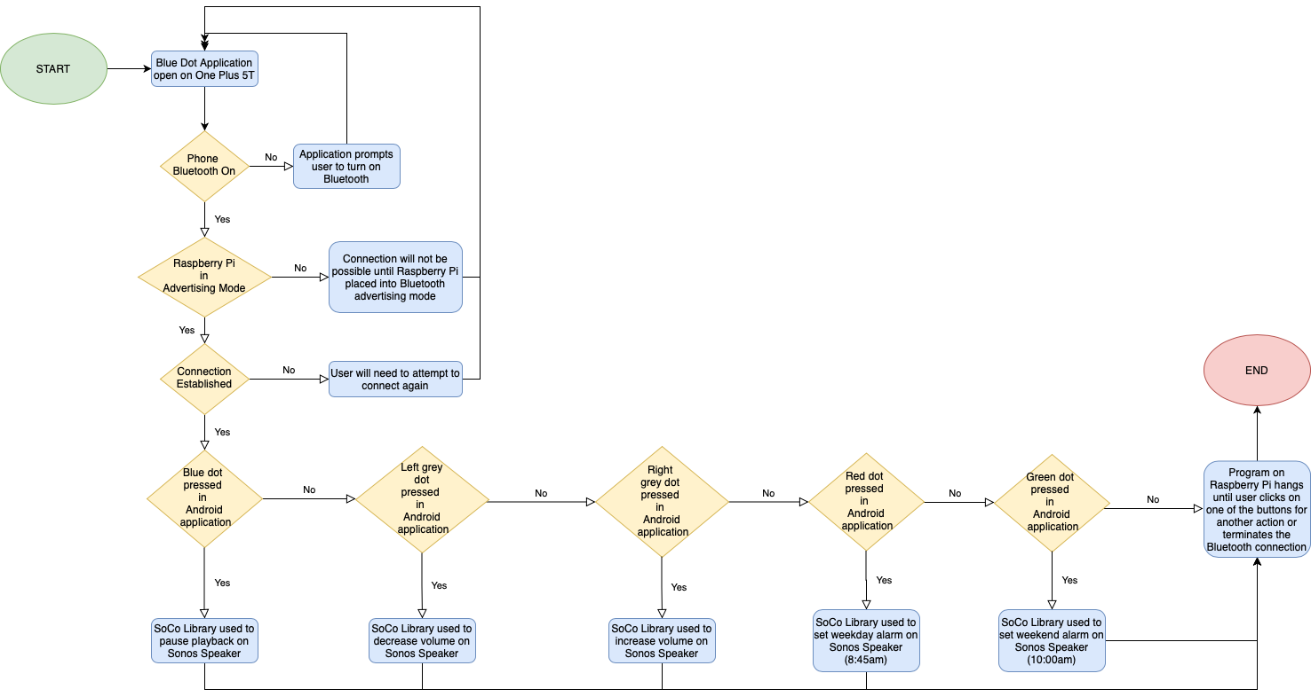
Control of Music Speakers – Informational Flow Diagram

Slide 7


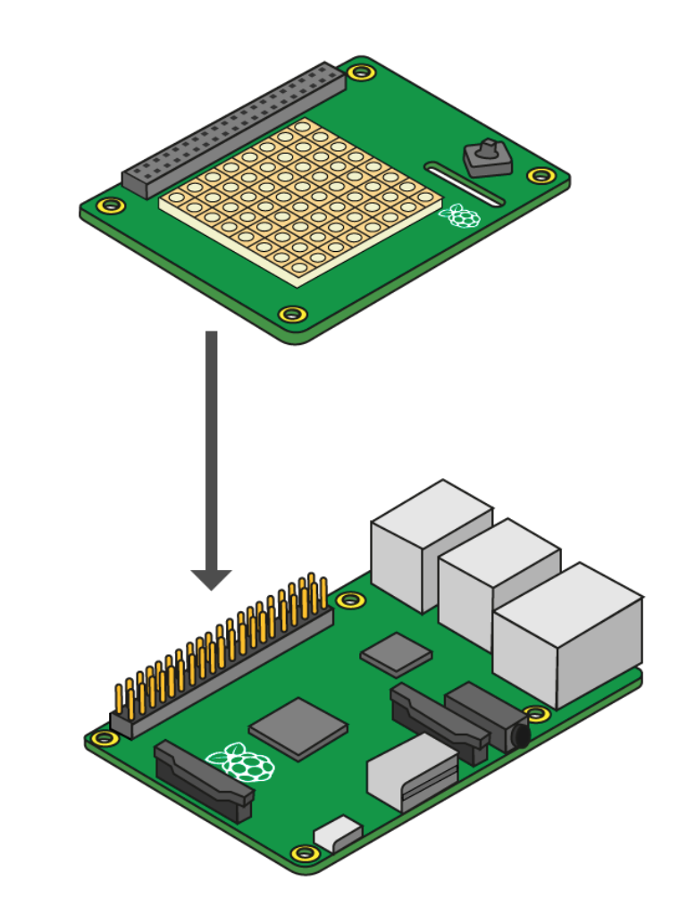






Study of Impact (if any) of Weather Conditions on Running Performance – Pictorial Representation
Strava API
Regular calls to the Strava API are made to determine if a new activity has been added in the previous 10 seconds (as API limit is 100 calls in a 15 minute period). If a new run activity has been detected, the activities are sorted by date (to ensure the latest activity is pushed). The new activity data is then pushed to Firebase.
Garmin smartwatch used to capture run activities. These are synced to my phone via Bluetooth which are then pushed by Garmin to the Cloud (via Wifi). Any new activities are then pushed to Strava.
Twilio API used to send SMS to my phone to let me know that a new activity has been uploaded (link to Glitch application is included in text message).
Garmin
Forerunner
645M
Smartwatch
OnePlus 5T
Google Maps API integrated on Glitch app to display GPS polyline from Strava API response (with markers added for start and end latitude and longitude coordinates
Bluetooth
Low
Energy
Raspberry
Pi 4
(with SenseHat attached)
FireBase
(Storage/DB)
Glitch
Application
PIR Motion Sensor
OpenWeather API
OpenWeather API used with the Sensehat to obtain weather data (A mini black hat hack3r was used to separate the hat from the Pi to ensure that weather readings are accurate). The weather data is pushed to Firebase at a 2 minute interval.
Glitch application connects to Firebase to provide real-time data updates. Latest activity is displayed and Chart.js is used to show key trends for run metrics over time with weather data also displayed on multiple charts (with last 30 entries displayed to ensure that weather data for last hour is shown).
Notes
1. Strava API Documentation
2. OpenWeather One Call API Documentation
3. Sense Hat API Documentation
4. FireBase Realtime Database Documentation
5. Glitch Application

Slide 8
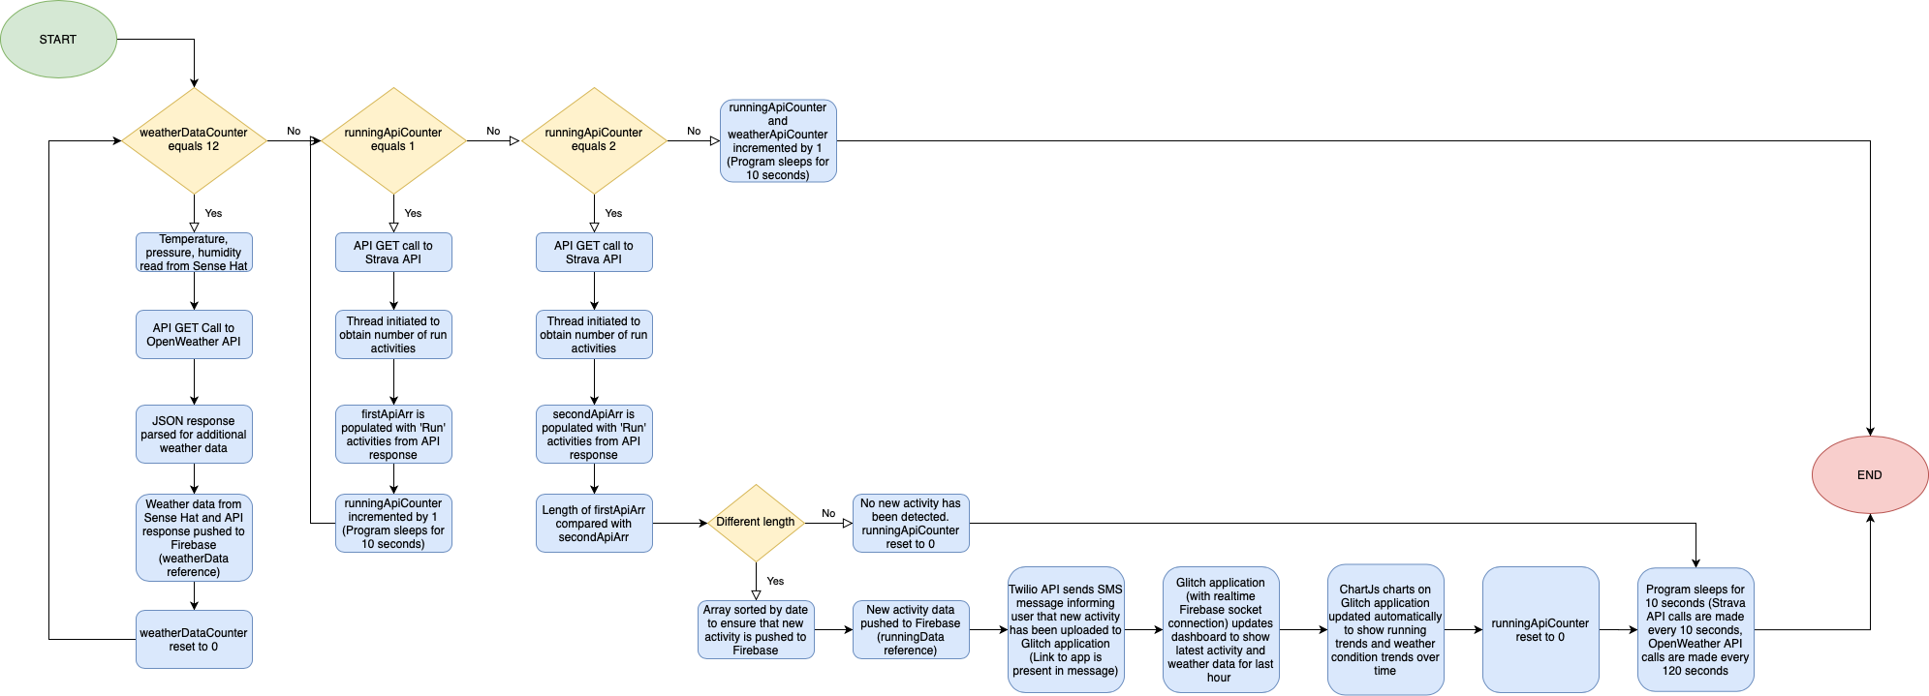
Study of Impact (if any) of Weather Conditions on Running Performance – Informational Flow Diagram

