Slide 1

Home Automation & Running Analysis Project
WATERFORD INSTITUTE OF TECHNOLOGY
INSTITIÚID TEICNEOLAÍOCHTA PHORT LÁIRGE
Department of COMPUTING & MATHEMATICS
Computer Systems & Networks
Autumn Semester 2020/2021
Project Graphics & Benchmarks
Student Name: | John Dennehy
Student Number: | 20091408
Programme of Study: | Higher Diploma in Science – Computer Science

Slide 2





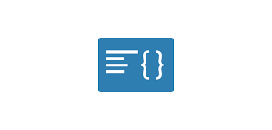


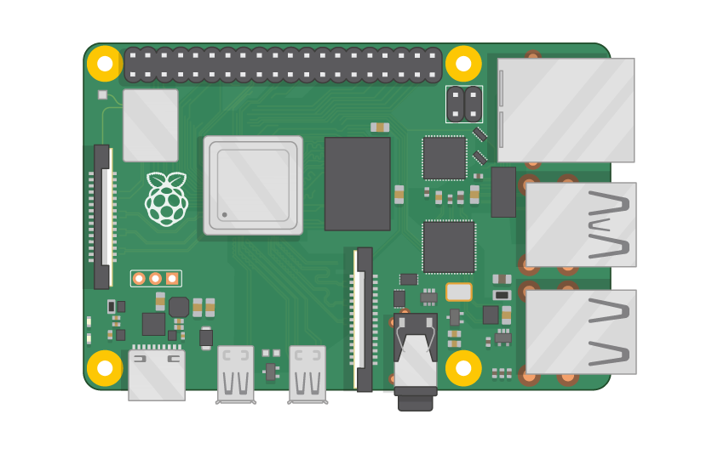





Automation of Light System – Pictorial Representation
Lamp
Raspberry Pi Camera Module V2
/currentLuminance Channel
Geolocation API
API – Sunset Timestamp
TP-Link Kasa Smart Wi-Fi Plug
IFTTT Webhook
Gmail Email Client
Raspberry Pi 4
HiveMq MQTT Broker
Lamp
IFTTT Webhook
/motionDetectedKitchen Channel
PIR Motion Sensor
TP-Link Kasa Smart Wi-Fi Plug
Notes
1. Mapbox Search API Documentation
2. Sunrise Sunset API Documentation
3. Camera Module Analysis Detail
4. ThingSpeak MQTT Documentation
5. IFTTT Webhook Documentation

Slide 3
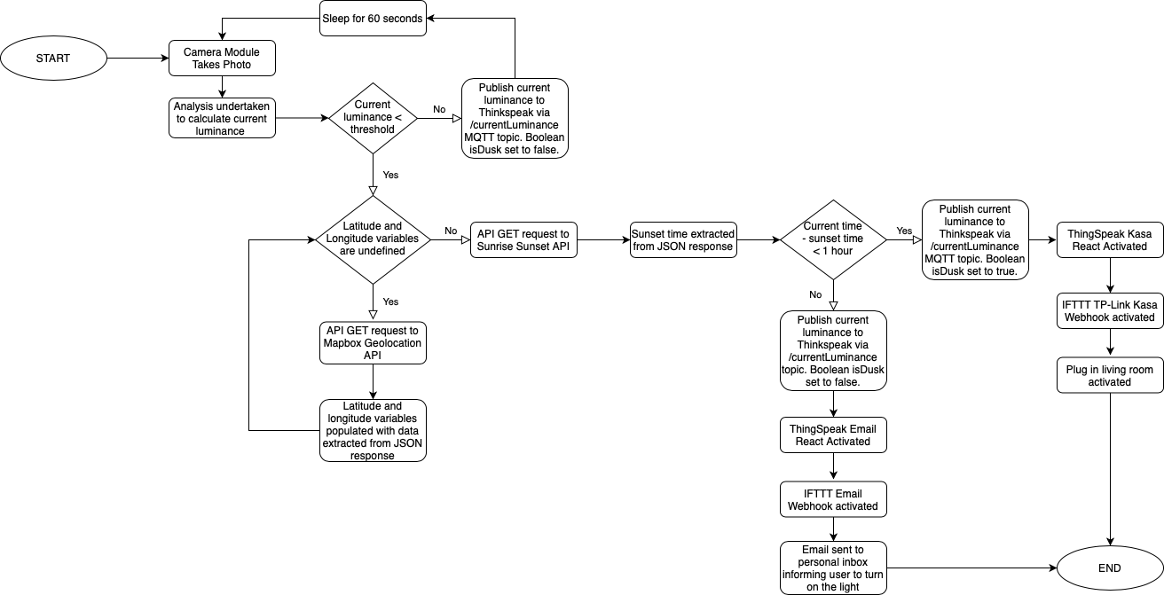
Automation of Light System – Informational Flow Diagram (Part 1)

Slide 4
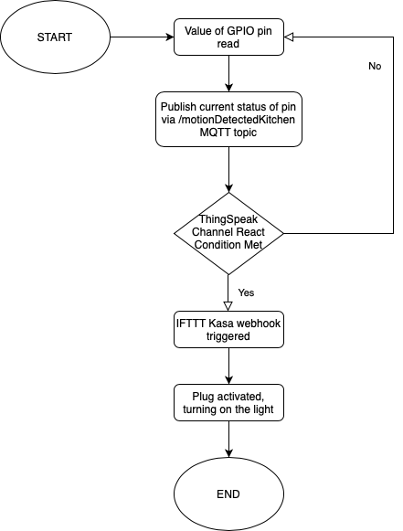
Automation of Light System – Informational Flow Diagram (Part 2)

Slide 5


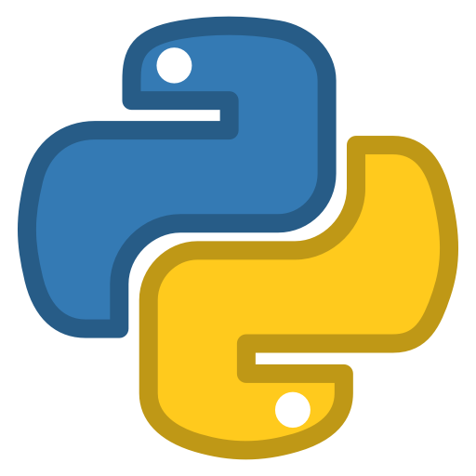

Control of Sonos Music Speakers – Pictorial Representation
Sonos
Play One Speaker
Bluetooth
Protocol
Blue Dot
Python Library
Raspberry
Pi 4
SoCo
Python Library
Blue Dot
Android Application (on OnePlus 5T)
Sonos
Play One Speaker
Notes
1. Blue Dot Android Application
2. Blue Dot Library Documentation
3. SoCo Library Documentation

Slide 6
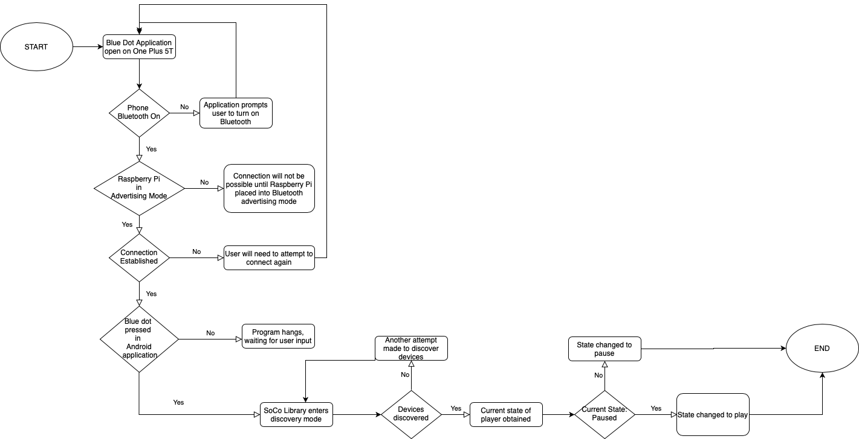
Control of Music Speakers – Informational Flow Diagram

Slide 7

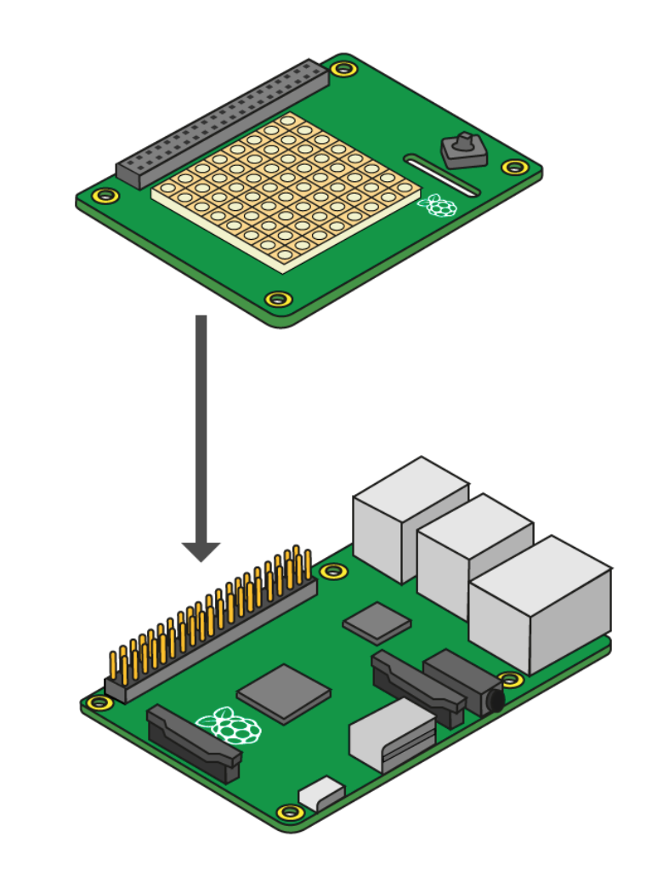

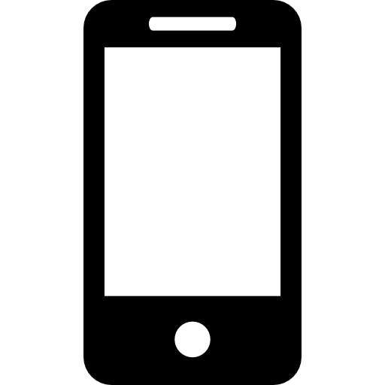



Study of Impact (if any) of Weather Conditions on Running Performance – Pictorial Representation
Strava API
Garmin
Forerunner
645M
Smartwatch
OnePlus 5T
Bluetooth
Low
Energy
Raspberry
Pi 4
(with SenseHat attached)
FireBase
(Storage/DB)
FireBase
Application
PIR Motion Sensor
OpenWeather API
Notes
1. Strava API Documentation
2. OpenWeather One Call API Documentation
3. Sense Hat API Documentation
4. FireBase Realtime Database Documentation
5. FireBase Hosting Documentation

Slide 8
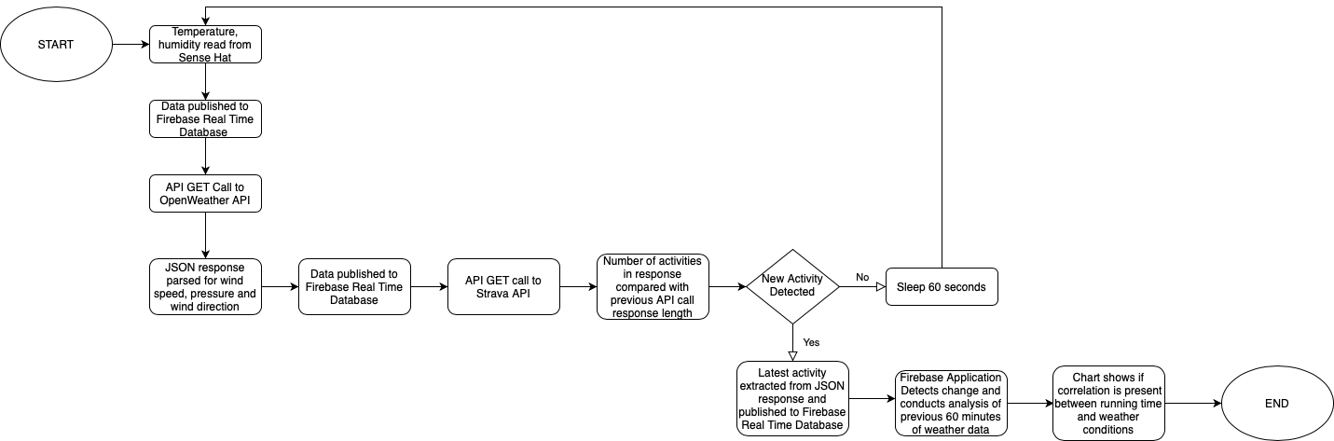
Study of Impact (if any) of Weather Conditions on Running Performance – Informational Flow Diagram

