Slide 1
Making Sense of Logs
One investigation, three perspectives
SereneDB challenge · National AI Hackathon 2026
SereneDB 26.10.1 · DeepSeek V4.1 Flash · Loghub BGL, 4,747,963 log lines
Making Sense of Logs · 1 / 12

Slide 2
The challenge and our approach
Our approach
Same logs, three questions
• SereneDB finds and counts the evidence on the full 4.7M-line log.
• An AI agent chooses typed, read-only tools; it never writes SQL.
• Every result becomes a numbered fact with its source log lines and the exact SQL.
• Three role views explain the same facts; switching roles never changes the evidence.
• The server checks every finding: no fact id, no finding; numbers not in the evidence are marked inferred.
• When the logs cannot answer (cost, customers, owners), the answer says so.
Engineer
What failed, when, and what came right before?
Team lead
What keeps coming back, and where?
Manager
What should we prioritise, and what can the logs not tell us?
Making Sense of Logs · 2 / 12

Slide 3
System diagram
Question
from the web UI, streamed back live
Planner
DeepSeek V4.1 Flash picks 2 to 6 tool calls
Typed tools
searchLogs · getContext · aggregate, zod-validated
SereneDB 26.10.1
4.7M rows, inverted index with BM25, SQL aggregation, read-only
Evidence check
drops uncited claims, flags unsupported numbers
Three role views
engineer, team lead, manager, from the same bundle
Priority score
visible formula over database counts
Evidence bundle
facts F1..Fn, source log lines, SQL and timings per query
The language model never sees the whole log and never writes SQL. Facts come only from SereneDB; the model explains them.
Making Sense of Logs · 3 / 12

Slide 4
Tool design
searchLogs
Full-text search with filters
Inputs: query, phrase, time range, label, level, component, midplane, node
SereneDB: Inverted index, BM25 ranking, ts_phrase; per-label breakdown
getContext
Timeline around one event
Inputs: seed line id, seconds before and after, same node or midplane
SereneDB: Time-window SQL: events per label and level, sample lines, per-second chart
aggregate
Recurrence, concentration, trend
Inputs: group by label, component, level, node, midplane, hour, day or week
SereneDB: GROUP BY with distinct nodes, active days, FATAL counts and true totals
Guardrails
• Arguments validated with zod and passed as SQL parameters; read-only queries, client-side time budget (SereneDB does not enforce statement_timeout).
• At most 6 tool calls in 3 rounds; the server, not the model, turns results into facts.
• Grouped counts use the index only to select rows, then group on the table (a GROUP BY directly on the index overcounted in our tests).
• If BM25 scoring fails, search falls back to exact matching and the UI says so.
Making Sense of Logs · 4 / 12

Slide 5
Data and performance
4,747,963
log lines, every line kept
348,460
alert lines in 41 categories
3.4 s
bulk load from Parquet
1 to 12 ms
per search or aggregation query
• Loghub BGL (Zenodo 8196385, md5 checked). Parser keeps all lines: 34,470 with an empty message, 306 without a node, 18 wrapped lines are flagged, not dropped.
• Times shown as printed in the log (US Pacific); the epoch field is UTC.
• Database work for one investigation: 45 to 241 ms. The language model takes about 25 to 35 s; streamed, the evidence appears after about 10 s and the first role view after about 17 s.
• Answers to repeated questions are cached, so evidence and numbers stay identical between runs.
• Measured on one laptop (Ryzen 7 7745HX, SereneDB in Docker), 2026-10-18.
Making Sense of Logs · 5 / 12

Slide 6
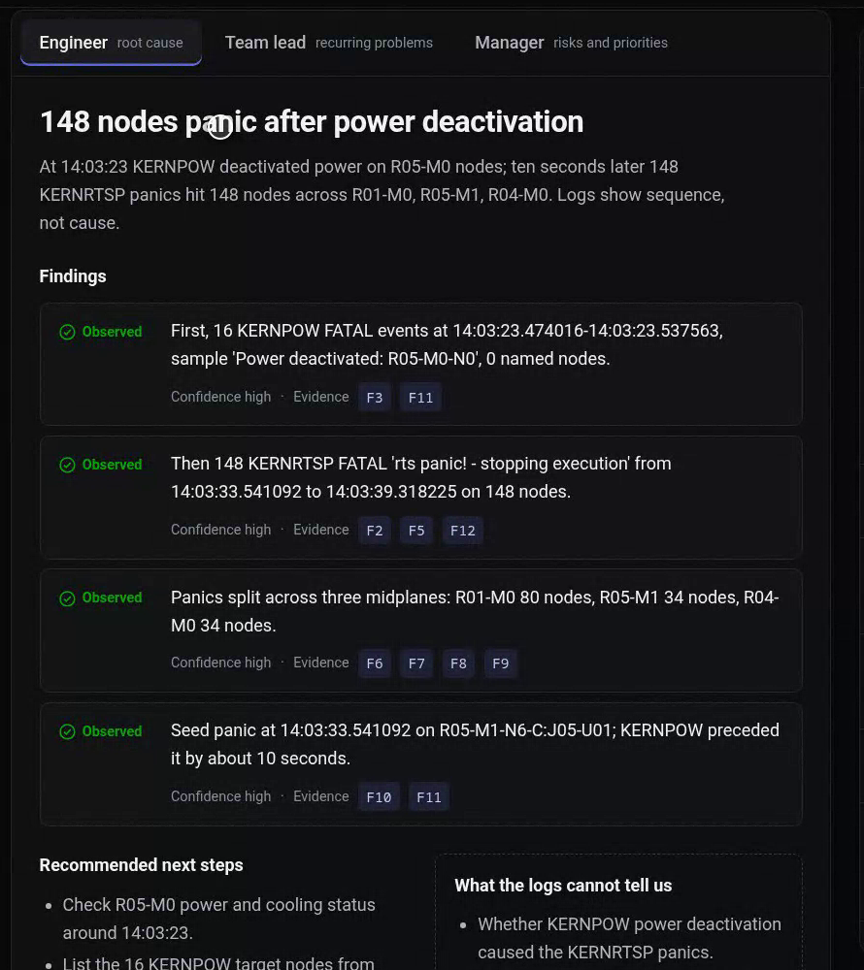
Findings for the engineer: the July 11 incident
• 14:03:23: 16 KERNPOW 'Power deactivated' events on midplane R05-M0.
• 14:03:33 to 14:03:39: 148 KERNRTSP 'rts panic! - stopping execution' events on 148 nodes.
• Spread: R01-M0 80 nodes, R04-M0 34, R05-M1 34.
• The agent states the logs show the order of events, not the cause.
• Next checks it recommends: R05-M0 power and cooling at 14:03:23; the job running on the panicked nodes.
Making Sense of Logs · 6 / 12

Slide 7
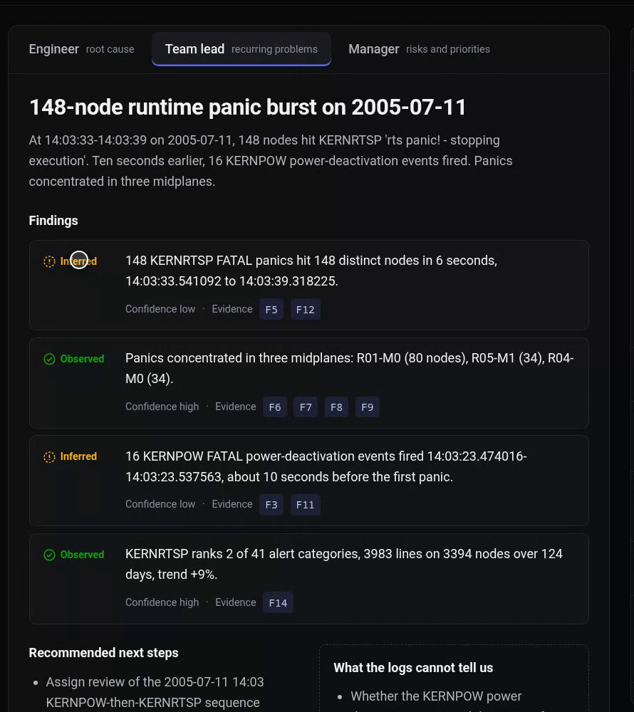
Findings for the team lead: what keeps coming back
• APPSEV: 49,651 alert lines on 1,024 nodes over 67 days, +216% in the last quarter.
• KERNRTSP: 3,983 lines on 3,394 nodes, recurring over 124 days, +9%.
• KERNSTOR: 63,491 lines on 22,529 nodes, but only on 5 days: bursts, not a steady problem.
• KERNDTLB: 152,734 lines, of which 152,182 come from one node on one day (2005-06-11).
• Same evidence as the engineer view; when the model writes a number that is not in the evidence (for example '6 seconds'), the claim is marked inferred.
Making Sense of Logs · 7 / 12

Slide 8
Findings for the manager: priorities from the logs
Alert category | Score | Events | Nodes | Active days | Trend
APPSEV | 79 | 49,651 | 1,024 | 67 | +216%
KERNRTSP | 79 | 3,983 | 3,394 | 124 | +9%
KERNSTOR | 78 | 63,491 | 22,529 | 5 | +100%
KERNDTLB | 72 | 152,734 | 541 | 11 | n/a
KERNTERM | 71 | 23,338 | 9,524 | 28 | -14%
What the manager hears
• Prioritise APPSEV and KERNRTSP first: widespread and rising.
• Treat KERNDTLB as a one-node spike, not a broad issue.
• The logs cannot show customer impact, cost or downtime; ask operations for those.
Score = 100 × (0.30 events + 0.25 nodes + 0.20 active days + 0.15 fatal share + 0.10 trend), each scaled against the largest category. All inputs are database counts; the trend compares the last quarter with the quarter before.
Asked 'did the panics cause data loss, and what did it cost?', the agent answers that the logs cannot tell, instead of inventing a figure.
Making Sense of Logs · 8 / 12

Slide 9
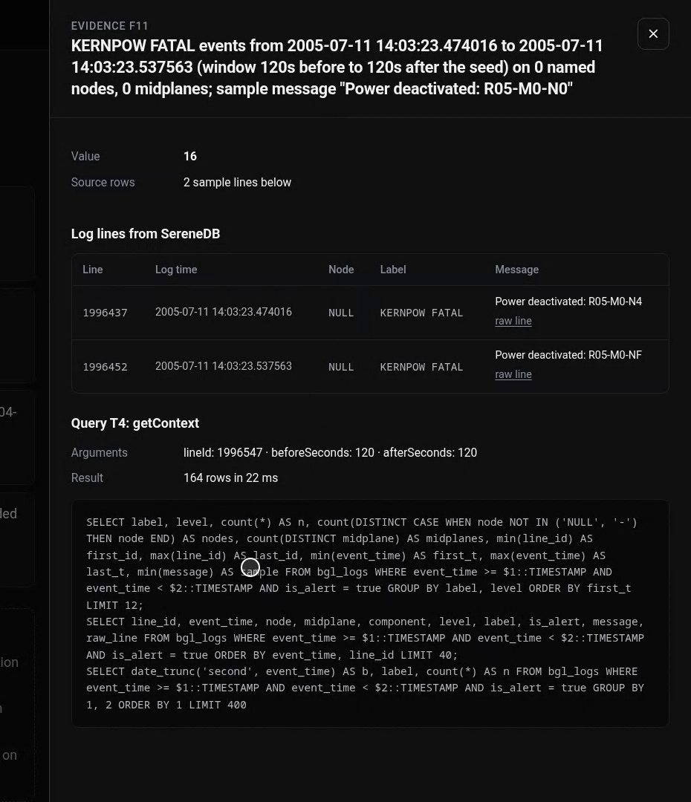
Query evidence: every claim links to rows and SQL
• Each finding cites fact ids (F1, F2, ...). A fact holds its value, the source log lines and the query that produced it.
• Example: the getContext query around the first panic returned 164 rows in 22 ms; the drawer shows the raw KERNPOW lines and the exact SQL.
• The trace lists every query the agent chose, with arguments, row counts and timings.
• Smoke test (9 checks) verifies: every finding cites an existing fact, every fact's rows are present, repeated questions give identical facts, unanswerable questions produce no cost or customer claim.
Making Sense of Logs · 9 / 12

Slide 10
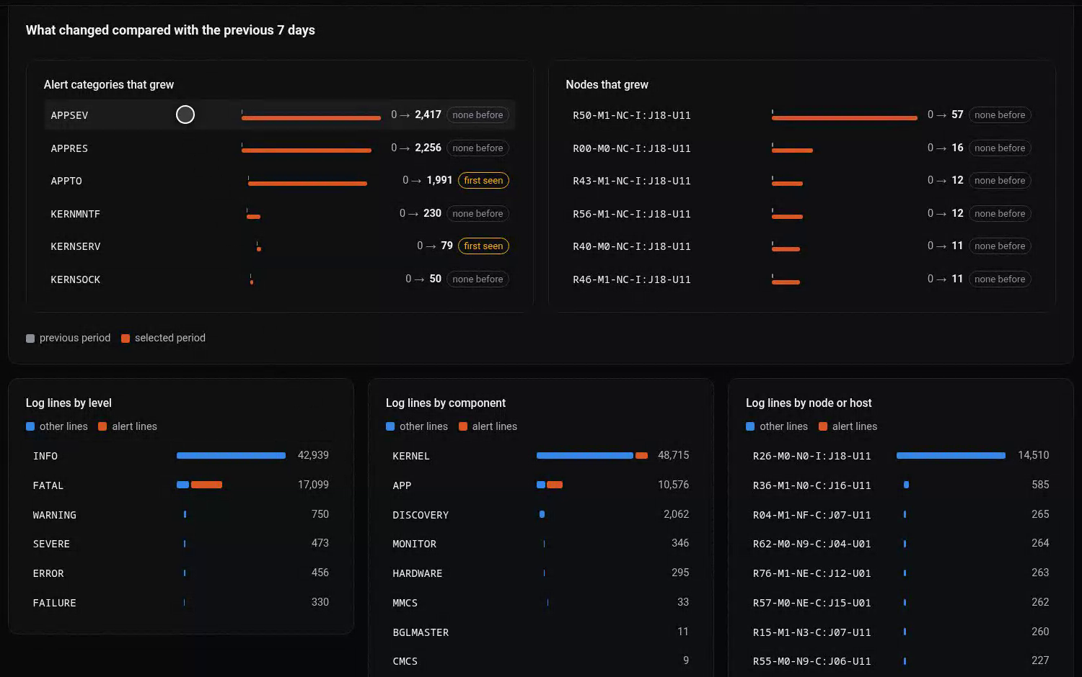
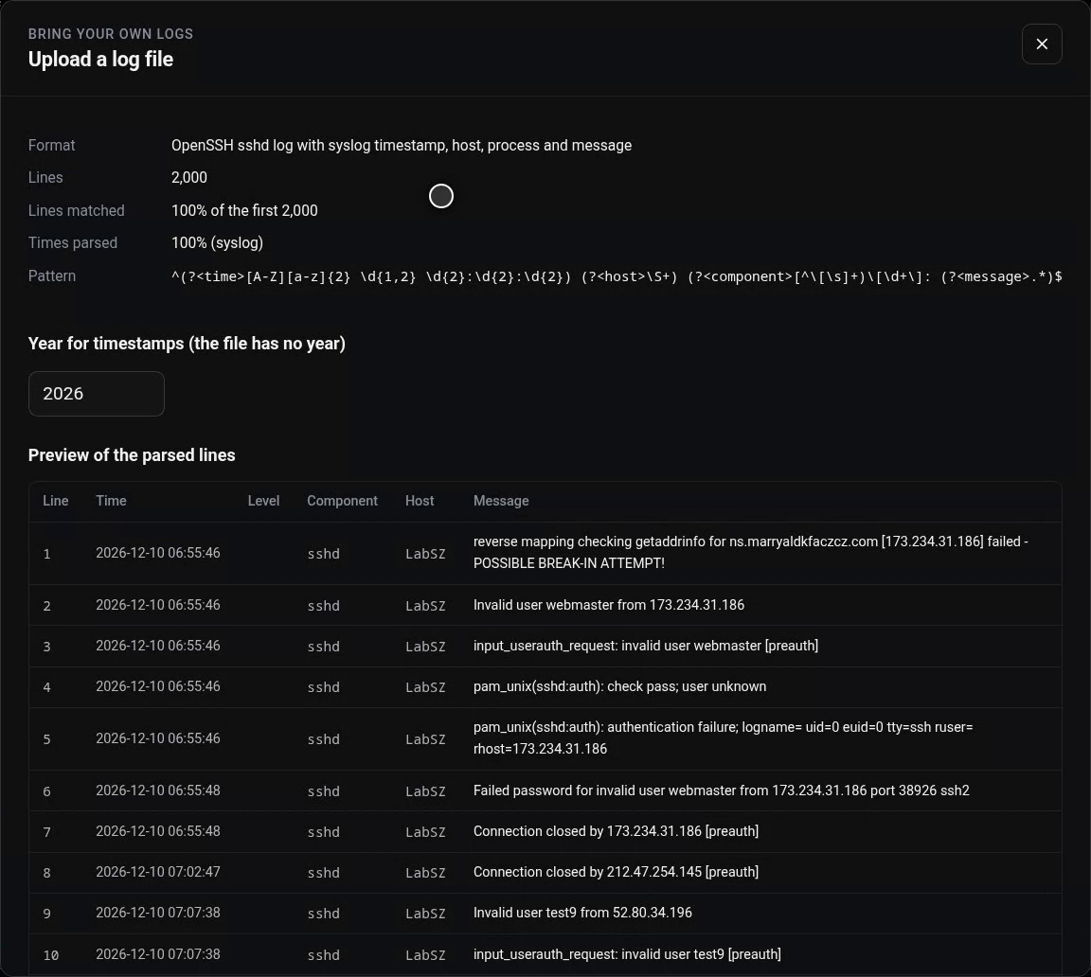
For non-experts and for any log file
• Key takeaways and KPI tiles computed by SQL rules, no AI numbers. Drag a period on the chart: compared with the previous equal period, with the categories and nodes that grew and patterns seen for the first time.
• Upload any line-based log: the model proposes a parser, the server tests it on 2,000 lines before loading. Six Loghub formats (HDFS, Linux, Apache, OpenSSH, Zookeeper, Spark): 100% of lines and timestamps parsed in 4 to 9 s.
Making Sense of Logs · 10 / 12

Slide 11
Recommendations
Engineer
Team lead
Manager
• Check R05-M0 power and cooling around 2005-07-11 14:03:23.
• Correlate the 148 panicked nodes with the job that was running.
• Inspect node R30-M0-N9-C:J16-U01, source of 152,182 KERNDTLB lines.
• Assign owners to APPSEV and KERNRTSP, the rising, widespread categories.
• Review the KERNSTOR bursts of 2005-06-13 and 2005-06-14.
• Track KERNRTSP recurrence (124 active days).
• Prioritise APPSEV and KERNRTSP, then KERNSTOR.
• Do not treat KERNDTLB volume as a fleet-wide problem.
• Get impact, cost and downtime from operations; the logs do not contain them.
Taken from the agent's three views of the same evidence; every item cites facts in the app.
Making Sense of Logs · 11 / 12

Slide 12
Limitations and what we would do next
• A new question takes about 25 to 35 s, almost all language model time; streaming shows evidence after about 10 s. Example questions are cached.
• Two fresh runs of the same question can choose different queries; cached answers are identical.
• BGL has no ownership, customer, cost or downtime data, so those are always reported as unknown.
• The priority weights and, for uploaded logs, the alert rule (WARNING or worse, or an error keyword) are our choices; syslog files need the year from the user.
• Uploaded samples and facts are sent to the model provider; the upload screen states this.
• Measured on one laptop with SereneDB 26.10.1 in Docker (amd64 image).
Next
Run several role writers in parallel on separate provider keys to cut waiting time.
Add the OpenStack logs mentioned for this challenge as a second built-in dataset.
Report the index GROUP BY overcount to SereneDB with our reproduction.
Making Sense of Logs · 12 / 12

